Slide 1


ECO624: Applied Production Analysis Project
Analysing the performance of management institutes across India with reference to NIRF RANKING methodology
OMKAR MOHANTY (20331)
PRATEEK MISHRA (20347)

Slide 2

Objectives
Analyse the efficiency of the top 50 management institutions across India by taking into account the methodology and framework adopted by the National Institutional Ranking Framework (NIRF) using various qualitative and quantitative parameters.
Critically examine institution-wise performance, an indicator of the utilization of public education expenditure.
Examine the effectiveness of the ranking methodology adopted by NIRF and suggest potential changes and improvements in the process.

Slide 3
Data Source and Variables
Data has been collected from the NIRF management institute rankings for the year 2020-21
INDICATORS | VARIABLES | SOURCE
Input Indicators | Student-Faculty Ratio | https://www.nirfindia.org/2023/ManagementRanking.html
 | Utilised Annual Capital Expenditure (CapEx) | https://www.nirfindia.org/2023/ManagementRanking.html
 | Utilised Annual Operational Expenditure (OpEx) | https://www.nirfindia.org/2023/ManagementRanking.html
Output Indicators | Median Placement Package | https://www.nirfindia.org/2023/ManagementRanking.html
 | Placement Percentage | https://www.nirfindia.org/2023/ManagementRanking.html

Slide 4
LITERATURE REVIEW
Shale et al. (1997):
Comparative analysis of British higher education institutions.
Introduced concepts of cost and outcome efficiency.
Utilized DEA to assess efficiency.
Identified a subset of six institutions with satisfactory performance.
Johnes (2006):
Conducted similar efficiency studies in the UK.
Munoz (2016):
Assessed research efficiency of Chilean universities using DEA.
Revealed limited efficiency in research among Chilean universities.
Highlighted variations in efficiency between traditional and private universities.
Li and Ng (2010):
Examined the effectiveness of Education Reforms in mid-1980s China.
Focused on the research performance of Chinese higher education institutions using DEA.
Found enhancements in research performance but overall inefficiency among institutions.

Slide 5
LITERATURE REVIEW
Türkan and Ozel (2017):
Analyzed the productivity of State Universities in Turkey using DEA.
Ranked universities based on efficiencies with a super-efficiency model.
Yang et al. (2018):
Evaluated the performance and development of Chinese research universities using a two-stage DEA model.
Suggested policies for enhancing universities’ performance.
RECENT STUDIES IN INDIA:
Thakur and Kumar (2019):
Evaluated the relative performance of Higher Education Institutions (HEIs) in India.
Proposed holistic efficiency measurement using dynamic data envelopment analysis (DDEA).
Bhaskar et al. (2023):
Conducted DEA analysis of undergraduate departments in a private engineering college in Bengaluru, India.
Found four out of twelve departments exhibited maximum efficiency.

Slide 6
MODEL OUTLINE
CCR Model
Inputs
Outputs
Super Efficiency
TE, SE, PTE
BCC Model
Isotonicity Test

Slide 7
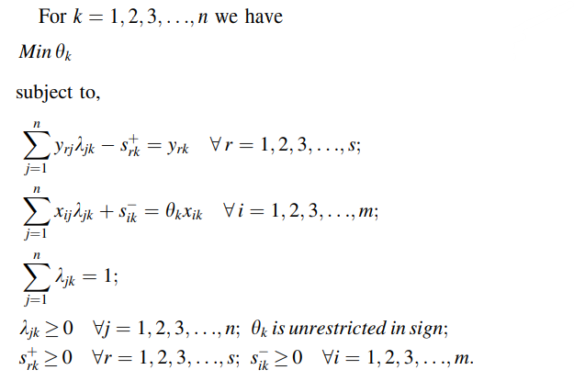
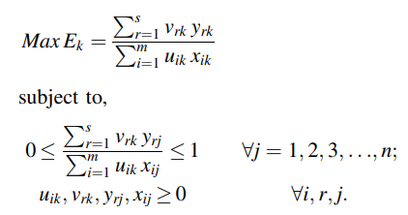
METHODOLOGY
Stage 1: CCR Model
Stage 2: BCC Model

Slide 8
RESULTS AND FINDINGS
INSTITUTE | TE | PTE | SE | RTS | SUP-EFF | NIRF RANK | OUR RANK
IIM-A | 0.583 | 0.982 | 0.594 | DRS | 0.58 | 1 | 46
IIM-B | 0.751 | 1 | 0.751 | DRS | 0.75 | 2 | 43
IIM-K | 0.552 | 0.996 | 0.554 | DRS | 0.55 | 3 | 49
IIM-C | 1 | 1 | 1 | CRS | 4.95 | 4 | 1
IIT-D | 1 | 1 | 1 | CRS | 3.01 | 5 | 6
IIM-L | 1 | 1 | 1 | CRS | 4.64 | 6 | 2
IIM-M | 1 | 1 | 1 | CRS | 4.27 | 7 | 3
IIM-I | 0.757 | 0.945 | 0.801 | DRS | 0.75 | 8 | 42
XLRI | 1 | 1 | 1 | CRS | 3.88 | 9 | 4
IIT-B | 0.87 | 0.87 | 1 | CRS | 0.87 | 10 | 31
IIM-Raipur | 0.954 | 0.996 | 0.958 | DRS | 0.95 | 11 | 26
IIM-Rohtak | 0.563 | 0.996 | 0.565 | DRS | 0.56 | 12 | 48
MDI | 1 | 1 | 1 | CRS | 2.98 | 13 | 7
IIT-KGP | 0.868 | 1 | 0.868 | DRS | 0.87 | 14 | 32

Slide 9
RESULTS AND FINDINGS
INSTITUTE | TE | PTE | SE | RTS | SUP-EFF | NIRF RANK | OUR RANK
IIT-M | 1 | 1 | 1 | CRS | 1.84 | 15 | 10
IIM-U | 1 | 1 | 1 | CRS | 2.62 | 16 | 8
SIBM | 0.994 | 1 | 0.994 | DRS | 0.99 | 17 | 21
IIT-R | 1 | 1 | 1 | CRS | 1.77 | 18 | 11
IIM-Kashipur | 0.93 | 0.982 | 0.947 | DRS | 0.93 | 19 | 27
SPJIMR | 0.86 | 1 | 0.86 | DRS | 0.86 | 20 | 33
NMIMS | 0.859 | 1 | 0.859 | DRS | 0.86 | 21 | 34
IIM-T | 0.886 | 0.985 | 0.9 | DRS | 0.89 | 22 | 28
IIT-K | 0.971 | 1 | 0.971 | DRS | 0.97 | 23 | 22
IIM-Ranchi | 1 | 1 | 1 | CRS | 2.05 | 24 | 9
Jamia | 1 | 1 | 1 | CRS | 1.62 | 25 | 14
IIM-S | 1 | 1 | 1 | CRS | 3.12 | 26 | 5
IIFT | 0.847 | 0.94 | 0.901 | DRS | 0.85 | 27 | 37
Amity-UP | 0.956 | 1 | 0.956 | DRS | 0.96 | 28 | 25

Slide 10
RESULTS AND FINDINGS
INSTITUTE | TE | PTE | SE | RTS | SUP-EFF | NIRF RANK | OUR RANK
IIM-V | 0.699 | 0.862 | 0.811 | DRS | 0.70 | 29 | 44
Amrita | 1 | 1 | 1 | CRS | 1.12 | 30 | 19
Great Lakes | 0.964 | 0.966 | 0.998 | IRS | 0.96 | 31 | 24
LPU | 0.429 | 0.472 | 0.907 | IRS | 0.43 | 32 | 50
GIM | 0.815 | 0.996 | 0.818 | DRS | 0.82 | 33 | 38
IMI | 1 | 1 | 1 | CRS | 1.73 | 34 | 12
NIT-T | 1 | 1 | 1 | CRS | 1.65 | 35 | 13
Chandigarh | 0.636 | 0.802 | 0.794 | DRS | 0.64 | 36 | 45
MICA | 1 | 1 | 1 | CRS | 1.24 | 37 | 18
IMT | 0.755 | 0.996 | 0.758 | DRS | 0.76 | 38 | 41
UPES | 0.848 | 1 | 0.848 | IRS | 0.85 | 39 | 35
ICFAI | 1 | 1 | 1 | CRS | 1.31 | 40 | 17
IIM-J | 0.791 | 1 | 0.791 | DRS | 0.79 | 41 | 40
Manipal | 0.881 | 0.989 | 0.89 | DRS | 0.88 | 42 | 29

Slide 11
RESULTS AND FINDINGS
INSTITUTE | TE | PTE | SE | RTS | SUP-EFF | NIRF RANK | OUR RANK
IIM-N | 0.802 | 0.9 | 0.892 | DRS | 0.80 | 43 | 39
IIT-ISM | 0.568 | 0.608 | 0.934 | DRS | 0.57 | 44 | 47
KJSIMSR | 0.964 | 0.972 | 0.992 | DRS | 0.96 | 45 | 23
XIMU | 1 | 1 | 1 | CRS | 1.49 | 46 | 15
JIM | 1 | 1 | 1 | CRS | 1.08 | 47 | 20
BIMT | 0.847 | 1 | 0.847 | DRS | 0.85 | 48 | 36
Thapar | 0.877 | 0.916 | 0.957 | DRS | 0.88 | 49 | 30
Anna Uni | 1 | 1 | 1 | CRS | 1.48 | 50 | 16
TE: Technical Efficiency
PTE: Pure Technical Efficiency
SE: Scale Efficiency
RTS: Returns To Scale
SUP-EFF: Super Efficiency
Average TE score = 0.96342
Average PTE score = 0.88154
Average SE score = 0.91432

Slide 12
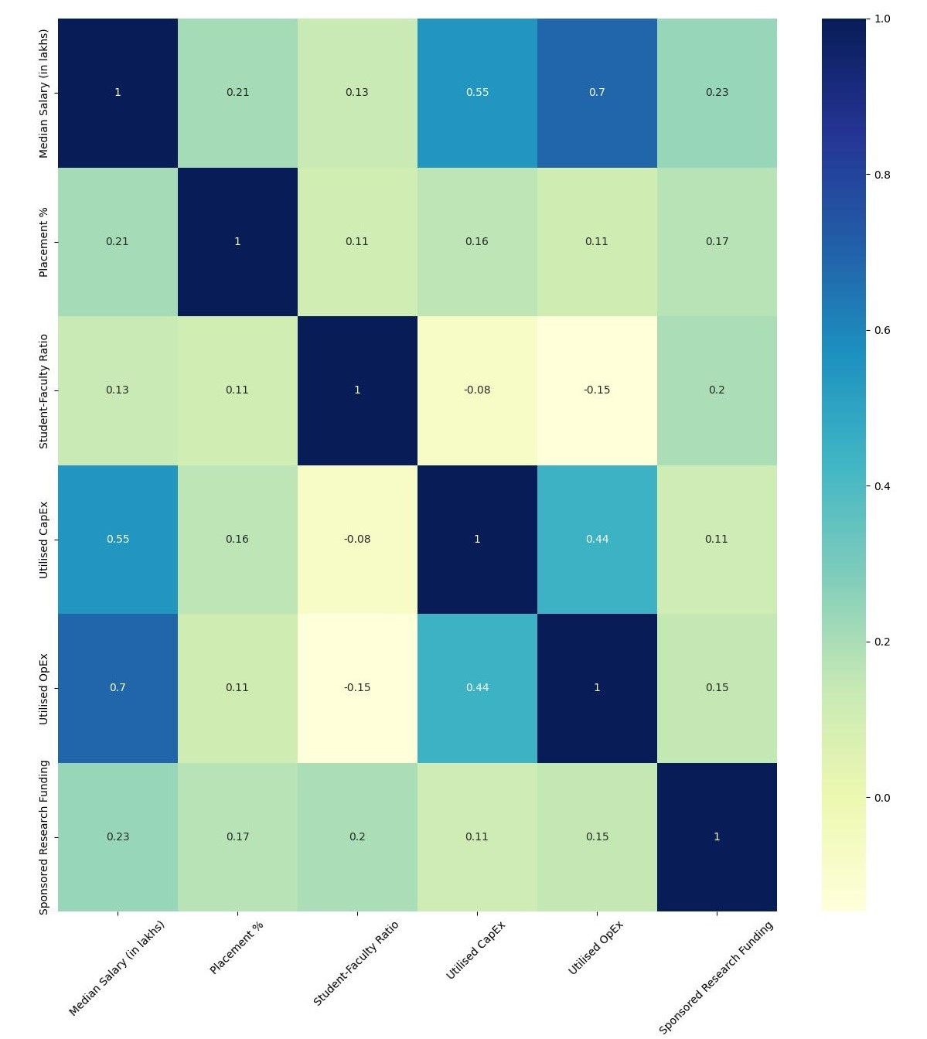
ISOTONICITY TEST
This test checks the correlation of every variable (both input and output variables) with each other in a matrix format.
The test is said to be passed if a positive correlation exists between every pair of variables.
Positive correlations also demonstrate very clearly that the researcher's choice of input and output variables at the beginning is appropriate.
As seen from this heatmap, there is a negative correlation between two pairs, both involving the Student-Faculty Ratio variable, thereby failing the test.

Slide 13
STAGE - 1 ANALYSIS
The TE scores of 20 institutes (DMUs) are 1. Hence, we consider our rankings based on the super efficiencies of the DMUs.
The positions of the top 5 institutes remain unchanged. Thereafter, significant changes can be observed.
Ranks in green indicate an upward movement, and red ones indicate a downward movement (WRT the actual NIRF ranks).
The current ranking process uses some variables that may not be relevant. They induce some biases, resulting in several Tier-1 institutes ranking below others despite performing better over the years.
Those institutes with TE scores above the threshold (average score) are observed to have comparatively better performance.

Slide 14
STAGE - 2 ANALYSIS
The PTE scores calculated under VRS, using the BCC model, help identify if the inefficiency in any institution is due to unfavorable size or inefficient use of resources.
For an SE score = 1, we can conclude that the institute is operating at an optimal scale size (acceptable ratio of resource allocation, such as OpEx, CapEx, Research Sponsorship, etc).
Those with SE < 1 have a slightly uneven resource distribution, either too much or too less. For example, compared to CapEx and OpEx, the research funding is extremely low.
Similar to Stage 1, the institutes with PTE and SE scores above the threshold (average score) have relatively better performance.
The Returns To Scale stats show that the number of institutes is almost balanced between CRS (21 DMUs) and DRS (26 DMUs). However, more institutes, especially in Tier-1, have a DRS, which raises ambiguity.

Slide 15
FINAL INSIGHTS
Most Tier-1 institutes, such as IIM-A, B and K, see a big fall in rankings based on super efficiency scores, while the lower-ranked ones take their place. This is unexpected and can be attributed to the incorrect method of variables (and their respective values) considered in the NIRF ranking system.
The Isotonicity Test results confirm the same. However, the test could have been passed had we considered the Faculty-Student Ratio instead of the reciprocal.
We observe that the allocation of CapEx, OpEx and Research Funding across all institutes was uneven, with some Tier-1 colleges receiving high inputs while others receiving very low funding.
If the colleges can be allocated funding based on some pre-assigned weights that are proportional to their student size and some related parameters, then the existing bias that is affecting the efficiency scores can be removed, leading to a more balanced distribution of the final outputs (Placement % and Median Package).

