Slide 1

IoT Based Smart Street Lighting System
Presented by :
Anand Kumar
2021072001
Btech IT 6th semester
Under Guidance of :
Dr. R.K. Diwedi
Asst. Professor
Dept. of ITCA,MMMUT

Slide 2
Table of Contents
Abstract
Introduction
Related Work
PROBLEM STATEMENTS
Proposed system
Result Analysis
Component used
Conclusion

Slide 3
Abstract
The main consideration in the present field technologies are Automation, Power consumption and cost effectiveness. Automation is intended to reduce man power with the help of intelligent systems.
Power saving is the main consideration forever as the source of the power are getting diminished due to various reasons. As we all know that energy consumption has been increasing day by day so, to overcome these consequences we are using IoT devices.
This project proposes a modal for modifying street light illumination by using sensors at minimum electrical energy consumption. When presence is detected, all surrounding street lights glow at their brightest mode, else they stay in the dim mode.
LED bulbs shall be implemented as they are better than conventional incandescent bulbs in every way. This shall reduce heat emissions, power consumption, maintenance and replacement costs and carbon dioxide emissions.

Slide 4
Introduction
The street lighting is one of the largest energy expenses for a cityThe present system is like the lights will be switched on in the evening before the sun sets and they are switched off the next day morning after there is sufficient light on the outside.
In sunny and rainy days, ON and OFF time differ discernibly which is one of the significant hindrances of the present street lights systems. Also the manual operation of the lighting system is completely eliminated.
Every day, streetlights are powered from sunset to sunrise at full strength, even when there is no one around. With this, the power will be wasted up to some extent.
The maintenance and replacement costs of conventional incandescent bulbs are immense. They consume a lot of electric power to function and their heat emissions are also quite high.
The main aim of the project is to provide an “IoT based Automatic Street Lightning System” powered with solar energy during night time.
A simple and effective solution to this would be dimming the lights during off peak hours. Whenever presence is detected, the lights around it will glow at the normal (bright) mode. This would save a lot of energy and also reduce cost of operation of the streetlights.
We can check the status of streetlight on internet using IOT (Internet of things) from anywhere in real time and solve the issues if happen during the processing

Slide 5
Related Work
S.Suganya et al have proposed about Street Light Glow on detecting vehicle movement using sensor is a system that utilizes the latest technology for sources of light as LED lamps. It is also used to control the switching of street light automatically according to the light intensity to develop flow based dynamic control statistics using infrared detection technology and maintain wireless communication among lamppost and control terminal using ZigBee Wireless protocol.
K.Santha et al have surveyed on Street Lighting System Based on Vehicle Movements. The system operates in the automatic mode which regulates the streetlight according to brightness and dimness algorithm and light intensity. It includes a time cut-out function and an automatic control pattern for conserving more electricity.
Proposed a ZigBee based Remote Control Automatic Street Light System. The system is designed with the help of ZigBee modules that helps in detecting the faulty lights and control the light. It also discusses about an intelligent system that takes automatic decisions for ON/OFF/DIMMING considering the vehicle movement. PIR motion sensor is used to detect movement of both living and non-living things.

Slide 6
PROBLEM STATEMENTS
Statement 1: Street lights are on in the presence of sun light.
Statement 2: Street lights are on in the absence of any vehicle and pedestrian.
Disadvantages of Classical Street Light:
Street lights remain always on when there is presence of light.
These street lights need a manual switching operation.
It also needs man power.
These street lights are unnecessarily glowing with its full intensity in the absence of any activities in the street.
High power consumption and waste of energy.
Advantages of the Proposed System:
Automatic Switching of Street lights.
Maintenance Cost Reduction.
Reduction in CO₂ emission.
Reduction of light pollution.
Energy Saving.
Reduction of manpower.

Slide 7
Proposed system
The present system employs power delivery via a single phase line to the streetlight. The proposed system involves five more components to regulate the power delivery. An Infra -Red Proximity Sensor at the base of the street light detects presence in a small area around the street light.
Arduino IDE: The Arduino Software (IDE) is an open source software and it makes easy to the code and upload it to the board. I t runs on the different plant from Windows, MAC OS, Linux.
LDR: A Light Dependent Resistor (LDR) or a photo resistor is a device whose resistivity is a function of the incident electromagnetic radiation. Hence, they are light sensitive devices.
IR Sensor: An infrared sensor is an electronic instrument that is used to sense certain characteristics of its surroundings by either emitting and/or detecting infrared radiation. It is also capable of measuring heat of an object and detecting motion.
The design basically includes three working modes:-
OFF mode: When there is enough natural light in the surrounding i.e. during the daytime, the entire system is switched off and the batteries are charging.
Active mode: When the natural light drops below a certain level the system automatically turns on and the motion sensors are powered.
ON mode: On the presence of pedestrians, the sensors turns on which in turn switches on the LED lights. These lights turns off after a period of time.

Slide 8
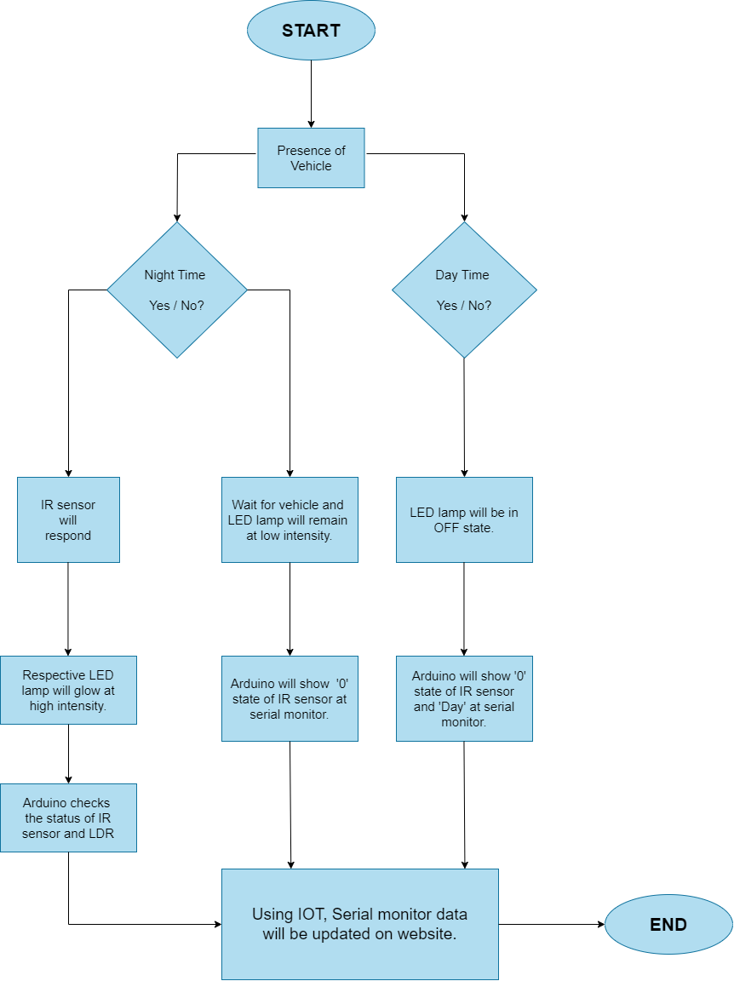
Flowchart

Slide 9
Component Used
Arduino IDE:
LDR Sensor
Microcontroller
PIC microcontroller Peripheral Interface Controller
Infrared sensor
PIR sensor
Optical sensor
Temperature sensor
Pressure sensor
Humidity sensor
Wi-Fi Module etc

Slide 10
Conclusion and Future work
Using this smart project, we can also estimate the speed of the vehicle, recognizing the number plate, recognizing the accidents took place on roads etc.
This Smart Street light project not only helps in rural areas but also beneficial in urban areas too. As we are moving towards more advancement we require more power so use of renewable resources is useful and advantageous. With this project, we can even add smart parking of vehicle and it is even useful for driverless cars.
With the advances in technology and good resource planning the cost of the project can be cut down and also with the use of good equipment the maintenance can also be reduced in terms of periodic checks. The LEDs have long life, emit cool light, donor have any toxic material and can be used for fast switching. For these reasons our project presents far more advantages which can over shadow the present limitations.
This project “IoT Based Smart Intelligent Lighting System for Smart City “ is a cost effective, practical, eco-friendly and the safest way to save energy and this system the light status information can be accessed from anytime and anywhere.
It clearly tackles the two problems that world is facing today, saving of energy and also disposal of incandescent lamps, very efficiently

Slide 11
Reference
[2].S. Suganya, R. Sinduja, T. Sowmiya& S. Senthilkumar, Street light glow on detecting vehicle movement using sensor
[3]. K.Santha Sheela,S.Padmadevi, Survey on Street Lighting System Based On Vehicle Movements
[4]. Srikanth M, Sudhakar K N,ZigBee Based Remote Control Automatic Street Light System
[5]. M.Abhishek, Syed ajram shah, K.Chetan, K,Arun Kumar, Design and implementation of traffic flow based street light control system with effective utilization of solar energy, International journal of Science Engineering and Advance Technology, IJSEAT, Vol 3, Issue 9, September -2015
[6]. C.Bhuvaneshwari, R.Rajeswari, C.Kalaiarasan, Analysis of Solar energy based street light with auto tracking system, International Journal of Advanced Research in Electrical, Electronics and Instrumentation Engineering, Vol 2, Issue 7, July 2013.

Slide 12
Thanks!

