Slide 1
KHANA DESTINATION
Name :
Branch :
Section :
Admission No. :
Guided By :
College :

Slide 2

ONLINE FOOD ORDER SYSTEM

Slide 3
CONTENTS
ABSTRACT
INTRODUCTION
OBECTIVE
PROBLEM STATEMENT
MODULES
TOOLS /TECHNOLOGY USED
METHODOLOGY
LITERATURE REVIEW
SCREENSHORTOF PROJECT
FUTURE SCOPE
THANK YOU

Slide 4
ABSTRACT
Online Food order system is a website designed primarily for use in the food delivery industry. The system will allow hotels and restaurants to increase scope of business by reducing the labor cost involved.
The system also allows quickly and easily manage an online menu which customers can browse and use to place orders with just few clicks.
Restaurant employees then use these orders through an easy to navigate graphical interface for efficient processing.

Slide 5
INTRODUCTION
Online food ordering platform is growing day by day. Start your own online business in food ordering system by using our Online Food Order System and earn more from the script.
Our Online Food order system allows restaurant to increase sales and expand business easily.
Our Online Food order system is helpful for those who try starting a new restaurant.
The main two features of our Food order system is SEO friendly and mobile responsive.

Slide 6
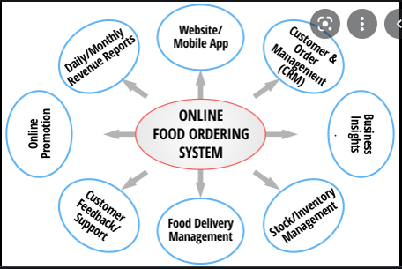

Slide 7
OBJECTIVE
The Main objective of OFOS is to create a system that allows customers to order food online.
The next important objective of OFOS is to make the process of ordering quick, easy and convenient.
Less time consuming hence increase the efficiency of the system.
Data Redundancy is avoided.
The System is User Friendly so that any person using it will not face any difficulties in operating it.

Slide 8
PROBLEM STATEMENT
The people have to be present condition takes food from hotel that means people had to compulsion of goes to hotel.
Now the moment the online food ordering could be called the response of the internet to the desire for delivery food.
It is a growing trend especially in unban area and on college campuses that allow people to order from restaurants featuring interactive menus by use of their internet connection.

Slide 9
MODULES
There are mainly two types of Users included in the system:
1. Admin
2. Customer

Slide 10
MODULES (Continued…)
1. Admin
Admin is the person who handles the food ordering system.
Login.
View reports on number of food delivery orders.
Assign the orders to particular staff.
Set the start and end times for special price orders (promotions) .
Change the food items and their prices.

Slide 11
MODULES (Continued…)
2. Customer Customer
Following are the various sub modules of the customer.
Login.
New Customer Registration.
View Menu items.
Place order.
Indicate time and location of delivery.
Rate the Services.

Slide 12
TOOLS /TECHNOLOGY USED
Server: Apache
Front-end: PHP
Back-end: My SQL
Platform: Windows 10 Pro

Slide 13
METHODOLOGY
Firstly , I am install my web server the server wamp server where I work on my project(online food ordering food system).
After that I learned about web development in which I explore my knowledge in some area like HTML,CSS,JAVASCRIPT and BOOTSTRAP.
The first step is customer entering the home page e food ordering system
Flow chart of online food ordering system.

Slide 14
Sign up/login
As manager and as a customer
Select item and placed the order
Arrival of Customers
Pay online /cash on delivery
Feedback

Slide 15
LITERATURE REVIEW
Zomato, Swiggy and other food delivering companies works in big cities not in small towns and rural area but my application provide services mainly in rural areas and small towns.
Zomato, Swiggy and other food giants companies works on only food order and deliver to home but i will link all the shops with Google Map, so that customers can easily reach at any shop.

Slide 16
Conclusion
So conclusion is that i want to provide all food related services at one place.....
Small town and rural area availabiliy.
If you want to find best restaurant in area we will help you.
Address, Price List of all food shops in area is listed here.
Google map navigation to every shop.

Slide 17
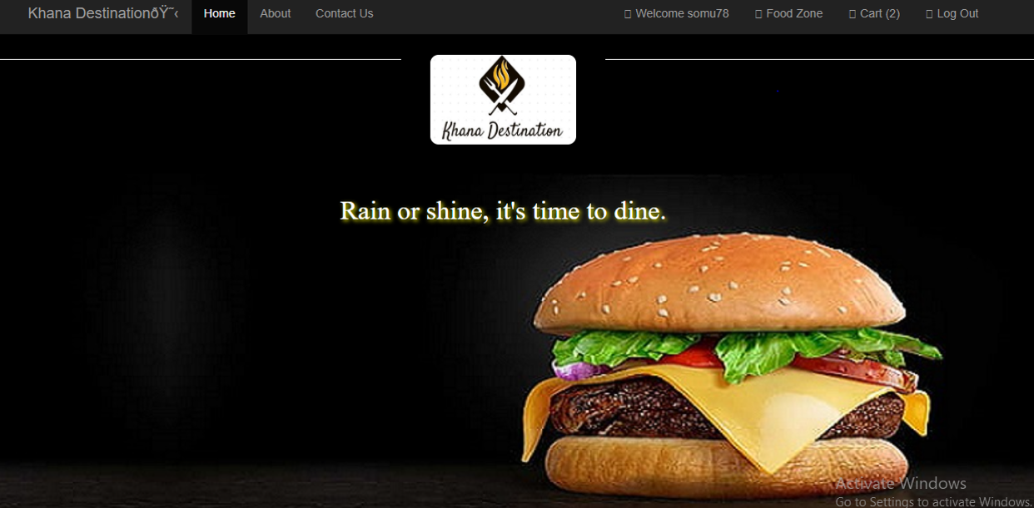
SCREENSHORT OF PROJECT
HOME PAGE

Slide 18
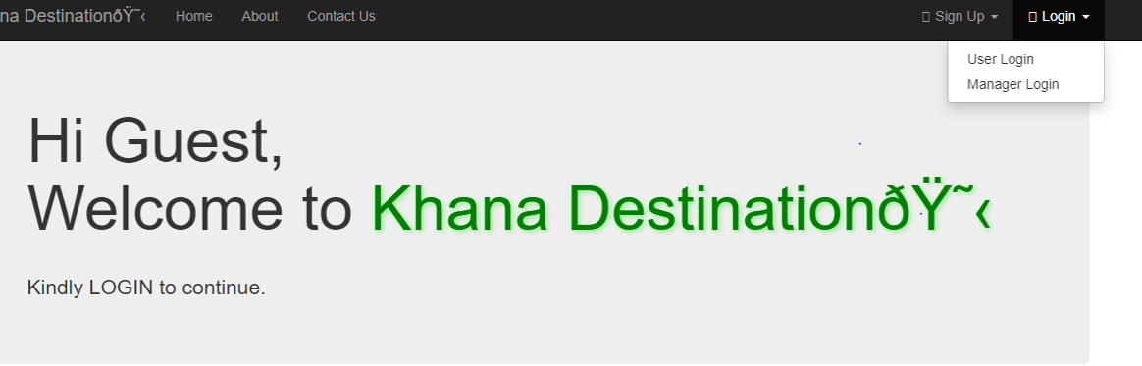
We can login as manager(admin) and as a customer

Slide 19
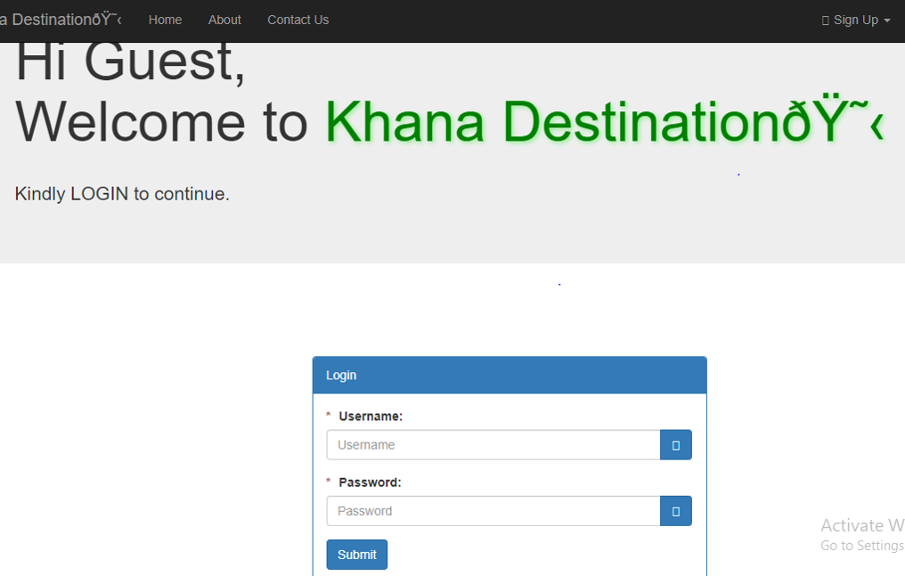
LOGIN PAGE
Sign up page

Slide 20
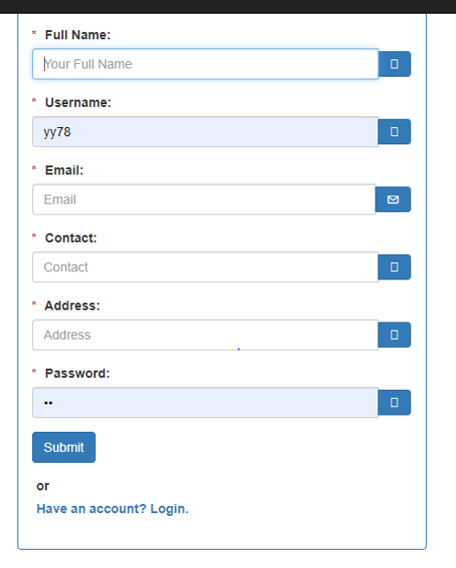
Create a new account

Slide 21
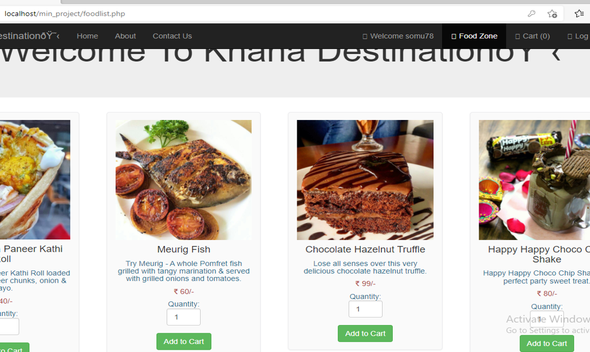
Select the item

Slide 22
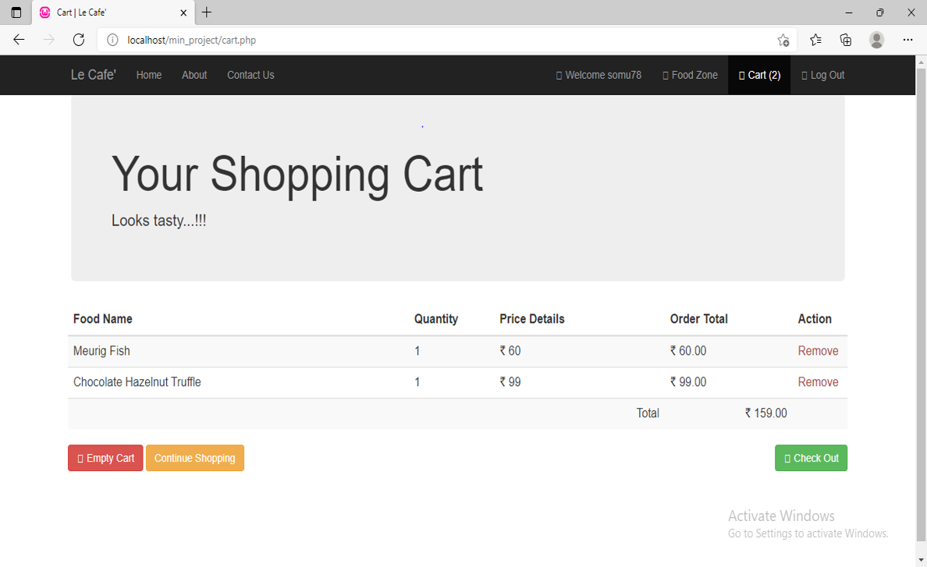
Shopping cart

Slide 23
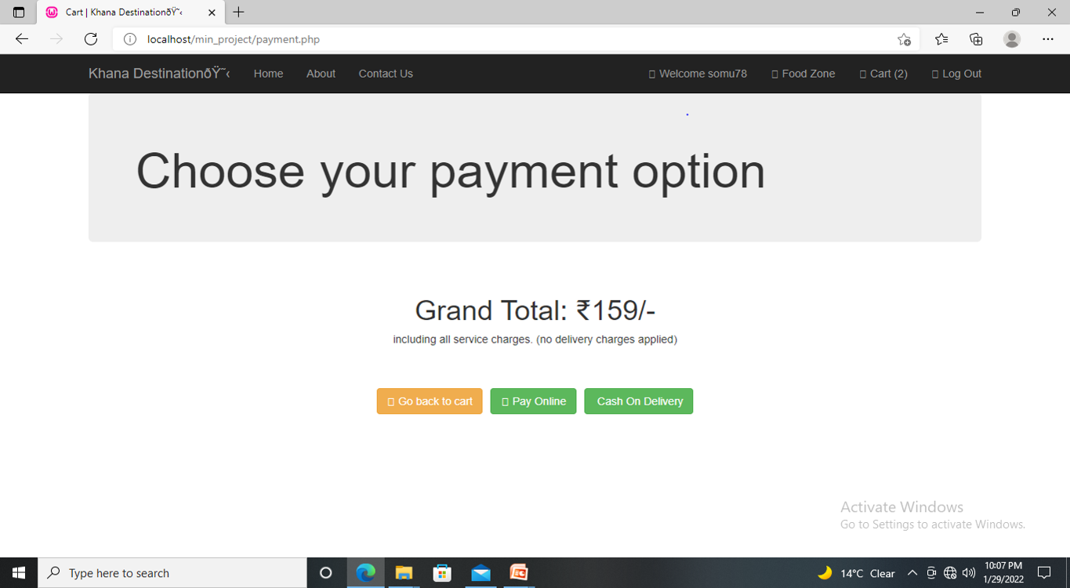
Grand total

Slide 24
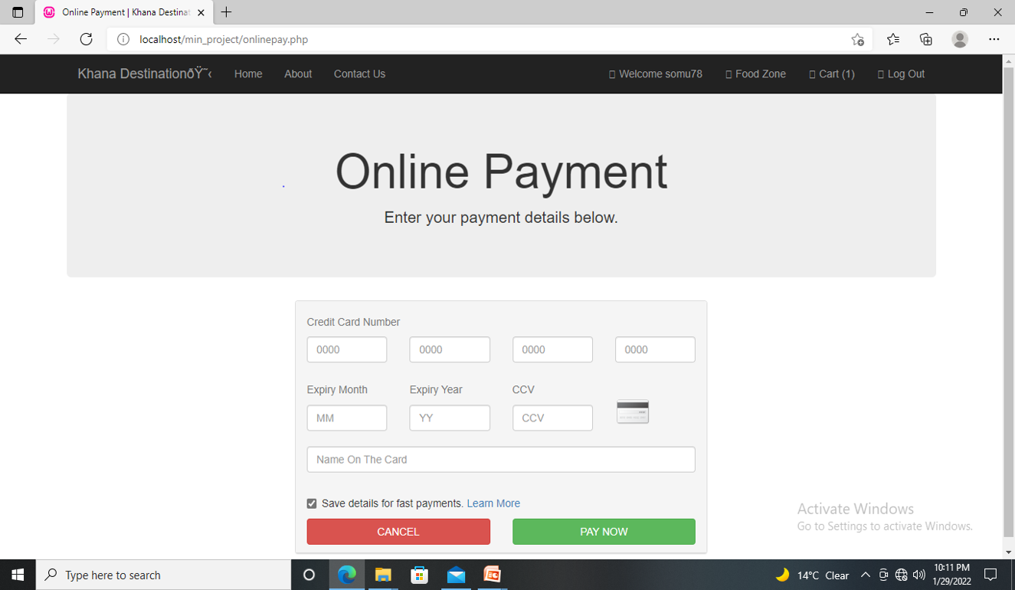
Payment

Slide 25
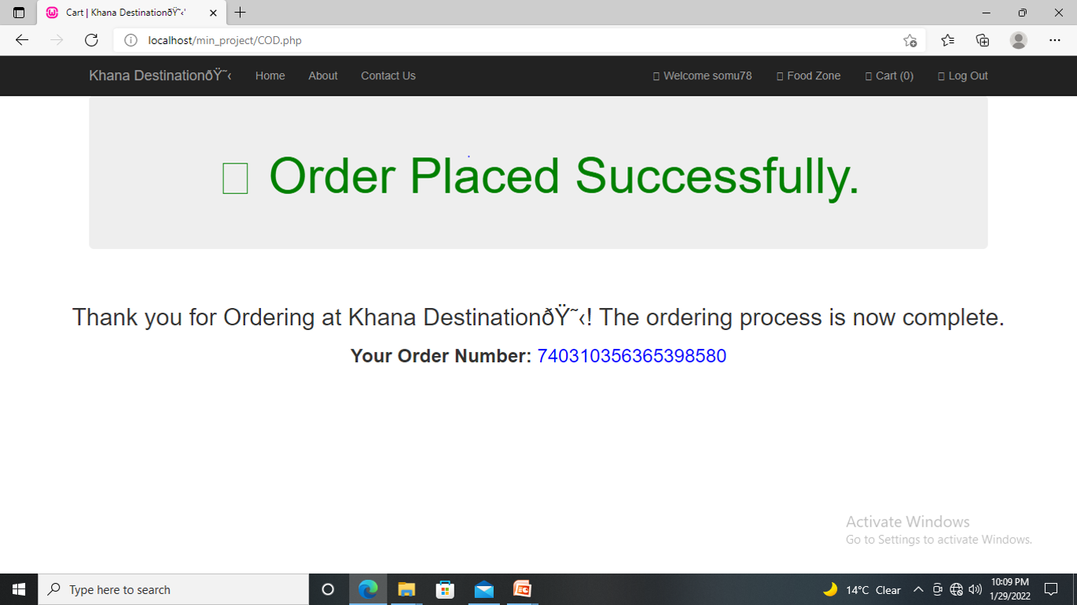
Order placed

Slide 26
THANKS YOU

