Slide 1

Basic Details of the Team and Problem Statement
Ministry/Organization Name/Student Innovation:
All India Council For Technical Education (AICTE)
PS Code: DR705
Problem Statement Title: Graphical Password Authentication
Team Name: Tech-know-brats
Team Leader Name: Khushi Sahay
Institute Code (AISHE): U-1056
Institute Name: Netaji Subhas University of Technology
Theme Name: Cyber Security

Slide 2
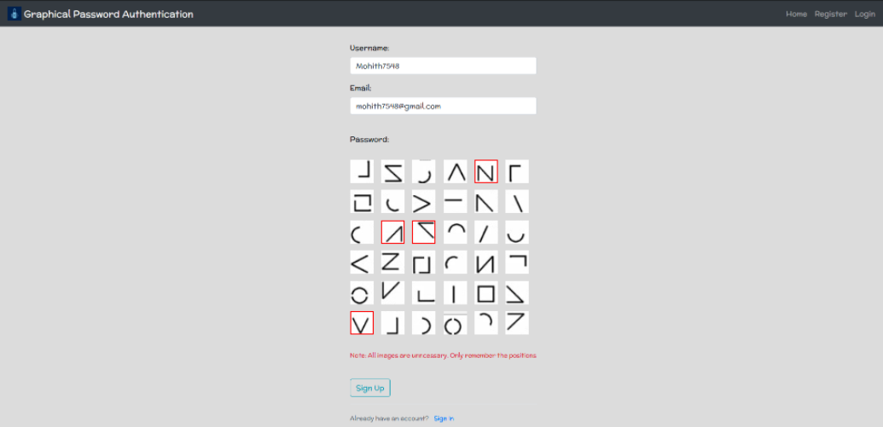
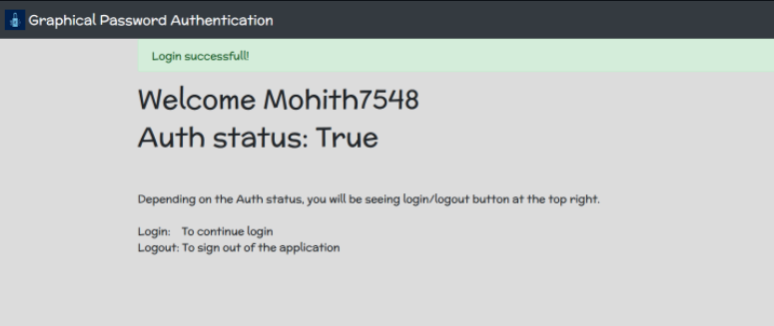
Idea/Approach Details
Describe your idea/Solution/Prototype here:
The prototype consists of several stages:
Signup page using graphical authentication
Login page
Password reset page.
Mail received with password reset link
Account blocked due to multiple login attempts
The user will select a pattern from a group of random images and will login through the same pattern.
All the images will be unnecessary and only the position of the pattern chosen will matter.
Describe your Technology stack here:
DJNGO
MongoDB

Slide 3
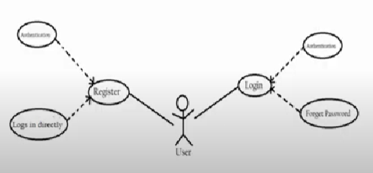
Idea/Approach Details
Describe your Use Cases here
Describe your Dependencies / Show stopper here
Login service
Net banking
Social media login
University management systems
Image dataset creation and annotation.
Encryption of datasets to prevent cyber attacks
Impossible to hack.
Password is based on positions of the image chosen.
Images changes everytime the user logins.
The user receives the email for multiple wrong login attempts with a link to reset the password.

Slide 4
Team Member Details
Team Leader Name: Khushi Sahay
Branch: Btech Stream (ECE, CSE etc): ECE Year (I,II,III,IV): II
Team Member 1 Name: Aryan Gupta
Branch: Btech Stream (ECE, CSE etc): ECE Year (I,II,III,IV): II
Team Member 2 Name: Prateek Mishra
Branch: Btech Stream (ECE, CSE etc): CSAI Year (I,II,III,IV): II
Team Member 3 Name: Shivam Singla
Branch: Btech Stream (ECE, CSE etc): CSAI Year (I,II,III,IV): II
Team Member 4 Name: Aditya Verma
Branch: Btech Stream (ECE, CSE etc): EE Year (I,II,III,IV): II
Team Member 5 Name: Nimish Bhatia
Branch: Btech Stream (ECE, CSE etc): CSAI Year (I,II,III,IV): II
Team Mentor 1 Name: Dr. Mohinder Pal Singh Bhatia
Category (Academic/Industry): Academic Expertise (AI/ML/Blockchain etc): Domain Experience (in years): 30
Team Mentor 2 Name: Manusheel Gupta
Category (Academic/Industry): Academic Expertise (AI/ML/Blockchain etc): Domain Experience (in years): 15

