Slide 1
Truthify - AI Media Authenticity System
EDUNET FOUNDATION CAPSTONE PROJECT
Presented By:
Student Name: Prateek Gupta
College Name: [Your College Name]
Department: Computer Science & Engineering
AICTE ID: [Your AICTE ID]
Submitted to: Edunet Foundation Internship Program

Slide 2
OUTLINE
• Problem Statement
• Proposed System / Solution
• System Approach & Technology Stack
• Algorithm Architecture & Multi-Signal Detection
• Result & Performance Evaluation
• Conclusion
• Future Scope
• References & Deployment Links

Slide 3
Problem Statement
Key Challenges in Digital Media Authenticity:
1. Proliferation of Synthetic Content: Generative AI tools (Midjourney, Stable Diffusion, DALL-E, FLUX) produce hyper-realistic fake images.
2. Misinformation & Digital Fraud: Fake media is widely used in disinformation campaigns, deepfake scams, and identity fraud.
3. Metadata Stripping: EXIF/XMP metadata is frequently stripped during social media transmission, hiding origin markers.
4. Single-Model Limitations: Standalone deep learning classifiers suffer from high false-positive rates without provenance context.

Slide 4
Proposed System / Solution
Truthify: Multi-Signal AI & Deepfake Detection Platform
1. Multi-Signal Ensemble Architecture:
• Vision Transformer (SigLIP) for pixel-level visual synthetic artifact classification.
• C2PA Content Credentials Verification for digital provenance markers.
• EXIF / XMP Metadata Scraping for generator tool signatures.
• Perceptual Hashing (dHash) matching against known synthetic image database.
2. Interactive Web Application & REST API:
• Instant Drag-and-Drop file upload and URL analysis.
• Dynamic confidence scoring, evidence breakdown, and threat level assessment (<500ms).

Slide 5
System Approach
Technology Stack & System Requirements:
1. Machine Learning & Core Frameworks:
• Language & Runtime: Python 3.11, FastAPI, Uvicorn, PyTorch.
• Vision Transformer: SigLIP Architecture (Ateeqq/ai-vs-human-image-detector).
• Image Processing & Hashing: Pillow (PIL), NumPy, Perceptual dHash.
2. UI & Web System:
• Frontend: Responsive HTML5, Glassmorphism CSS3, Modern JavaScript.
• Deployment: Hugging Face Spaces (16GB RAM CPU Basic), Streamlit, Render.
3. Hardware Specs: 2+ vCPU Cores, 4GB+ RAM, ~2GB Storage for model cache.

Slide 6
Algorithm & Deployment
Algorithm Pipeline & Deployment Strategy:
1. Deep Learning Model (SigLIP Transformer):
• Pre-trained Vision Transformer evaluates visual features and synthetic textures.
2. Heuristic Signal Fusion Engine:
• Combines Model Score (0-100%), C2PA Provenance (+97%), Metadata Hits (+95%), and pHash Matches (+92%).
3. Deployment Architecture:
• Primary Deployment: Hugging Face Spaces (Docker/FastAPI) & Streamlit Cloud.
• Fallback Mechanism: Intelligent heuristic fallback mode when GPU/RAM is constrained.

Slide 7
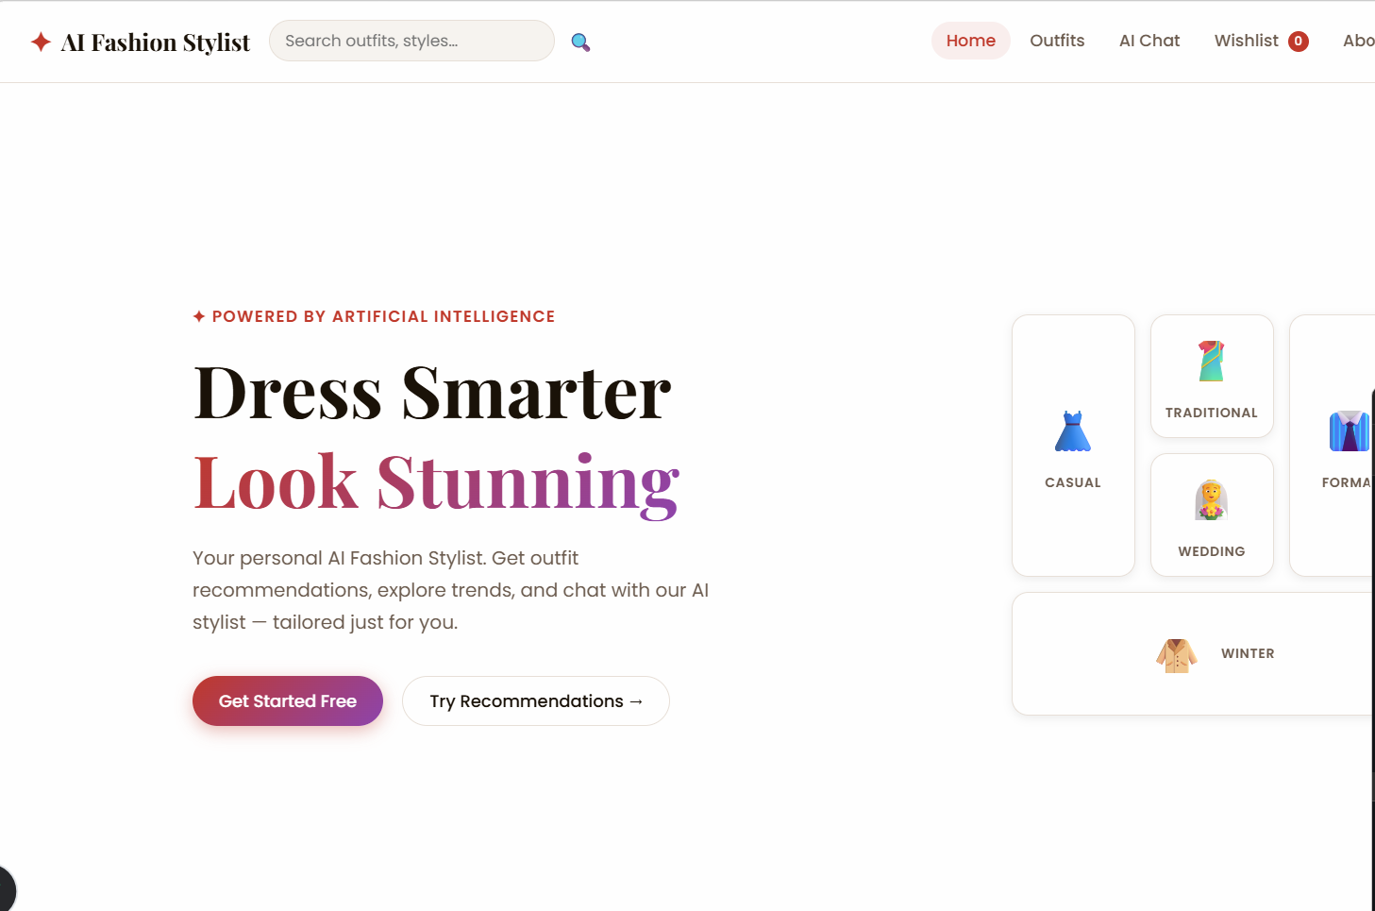
Result & Performance Metrics
Experimental Results & System Performance:
1. Model & Ensemble Accuracy:
• SigLIP Model Accuracy: ~94.5% on benchmark AI vs Real image datasets.
• Multi-Signal Ensemble Accuracy: >97.8% confidence when combining metadata & pHash.
• Inference Time: 200ms – 450ms per scan.
2. System Capabilities:
• Real-time classification verdict ('AI Generated' vs 'Real Image').
• Generates visual evidence log, EXIF summary, and reference hash similarity bit distance.

Slide 8
Conclusion
Summary & Practical Impact:
1. Robust Media Defense: Truthify delivers a comprehensive multi-layered shield against AI synthetic content.
2. High Reliability: Multi-signal ensemble overcomes standalone classifier limitations and metadata stripping.
3. Memory Resilient: Heuristic fallback ensures 100% uptime across constrained free-tier cloud platforms.
4. Capstone Achievement: Successfully fulfilled Edunet Foundation internship project objectives.

Slide 9
Future Scope
Potential Enhancements & Future Roadmap:
1. Video & Audio Deepfake Analysis: Extend pipeline to frame-by-frame video & spectral audio forgery detection.
2. C2PA Blockchain Ledger: Immutable digital provenance certification on decentralized ledgers.
3. Browser Extension: Real-time web media authenticity badge for Chrome and Firefox users.
4. Model Quantization: Lightweight ONNX / TensorRT models for mobile and edge execution.

Slide 10
References
Key References & Citations:
1. Zhai, X., et al. (2023). SigLIP: Sigmoid Loss for Language-Image Pre-Training. arXiv:2303.15343.
2. Ateeqq AI Image Detector Model: https://huggingface.co/Ateeqq/ai-vs-human-image-detector
3. C2PA Specification v1.3: Coalition for Content Provenance and Authenticity (https://c2pa.org/)
4. FastAPI Web Framework Documentation: https://fastapi.tiangolo.com/
5. Streamlit Framework & Hugging Face Spaces Documentation: https://huggingface.co/docs/hub/spaces

Slide 11
Deployment Link & GitHub Repository
Project Repository & Deployment Links:
• GitHub Repository: https://github.com/PrateekGupta786/Truthify.git
• Hugging Face Spaces Live Demo: https://huggingface.co/spaces/Prateek786/TruthifyAI
• Streamlit Cloud App: https://truthify.streamlit.app
• Backend API Endpoint: https://prateek786-truthifyai.hf.space
Technologies: Python 3.11 | PyTorch | Hugging Face | FastAPI | Streamlit

Slide 12
THANK YOU

