Slide 1
Truthify - AI Media Authenticity System
CAPSTONE PROJECT
Presented By:
Student Name: Prateek Gupta
College Name: Shri Krishna Institute of Management and Science
Department: BCA
AICTE ID: STU6a1d1a42c5e4f1780292162

Slide 2
OUTLINE
Problem Statement (Should not include solution)
Proposed System/Solution
System Development Approach (Technology Used)
Algorithm & Deployment
Result
Conclusion
Future Scope
References

Slide 3
Problem Statement
Key Challenges in Digital Media Authenticity:
1. Proliferation of Synthetic Content: Generative AI tools (Midjourney, Stable Diffusion, DALL-E, FLUX) produce hyper-realistic fake images.
2. Misinformation & Digital Fraud: Fake media is widely used in disinformation campaigns, deepfake scams, and identity fraud.
3. Metadata Stripping: EXIF/XMP metadata is frequently stripped during social media transmission, hiding origin markers.
4. Single-Model Limitations: Standalone deep learning classifiers suffer from high false-positive rates without provenance context.

Slide 4
Proposed Solution
The proposed system, Truthify, aims to address the challenge of predicting and detecting AI-generated deepfakes and synthetic media to ensure a trusted digital ecosystem. This involves leveraging data analytics, computer vision, and machine learning techniques to forecast media veracity accurately. The solution will consist of the following components:
▪ Data Collection:
▪ Gather comprehensive datasets of authentic and AI-generated media across image, video, audio, and document formats.
▪ Utilize real-time data ingestion pipelines, processing user-submitted media and live API data streams for analysis.
▪ Data Preprocessing:
▪ Extracts EXIF and XMP metadata to identify generator signatures (e.g., Midjourney, DALL-E, Stable Diffusion).
▪ Evaluates image structural parameters and checks for embedded C2PA content provenance credentials.
▪ Machine Learning Algorithm:
▪ Core Deep Learning Classifier: Integrates the fine-tuned Ateeqq/ai-vs-human-image-detector SigLIP (Sigmoid Loss for Language Image Pre-Training) Vision Transformer model from Hugging Face for high-precision binary classification (AI-Generated vs. Human/Real).
▪ Multi-Signal Fusion Engine: Combines the SigLIP model's raw probability logits with deterministic checks (C2PA content credentials, EXIF generator tags, and dHash perceptual hash matching) to compute a final weighted confidence score..
▪ Deployment:
▪ Deployed locally as a high-performance FastAPI backend with a custom Web Dashboard (run.py).
▪ Deployed an interactive UI using Streamlit (streamlit_app.py) for real-time user testing and instant image verification.
.
▪ Evaluation:
▪ Evaluates image authenticity by generating a weighted confidence score and classification output (AI-Generated vs. Real).
▪ Facilitates continuous model performance feedback and custom hash registration to enhance detection accuracy.

Slide 5
System Approach
Technology Stack & System Requirements:
1. Machine Learning & Core Frameworks:
• Language & Runtime: Python 3.11, FastAPI, Uvicorn, PyTorch.
• Vision Transformer: SigLIP Architecture (Ateeqq/ai-vs-human-image-detector).
• Image Processing & Hashing: Pillow (PIL), NumPy, Perceptual dHash.
2. UI & Web System:
• Frontend: Responsive HTML5, Glassmorphism CSS3, Modern JavaScript.
• Deployment: Streamlit.
3. Hardware Specs: 2+ vCPU Cores, 4GB+ RAM, ~2GB Storage for model cache.

Slide 6
Algorithm & Deployment
1. Deep Learning Model (SigLIP Transformer):
Utilizes the Ateeqq/ai-vs-human-image-detector model based on the SigLIP (Sigmoid Loss for Language Image Pre-Training) Vision Transformer architecture from Hugging Face. Chosen for its superior ability to extract fine-grained visual patch embeddings and detect subtle pixel-level generation artifacts produced by modern generative models (e.g., Midjourney, DALL-E, Stable Diffusion).
2. Training Process:
Leverages a pre-trained SigLIP Vision Transformer fine-tuned on extensive datasets of paired AI-generated and authentic human-captured images
3.Prediction Process
Evaluates input images in real time by passing pixel arrays through the SigLIP inference pipeline to generate base probabilities. Combines these deep learning logits with deterministic C2PA manifest scans, EXIF metadata keyword parsing, and perceptual hashing (dHash) matching to compute a final fused confidence score and binary verdict ("AI Generated" vs. "Real").

Slide 7
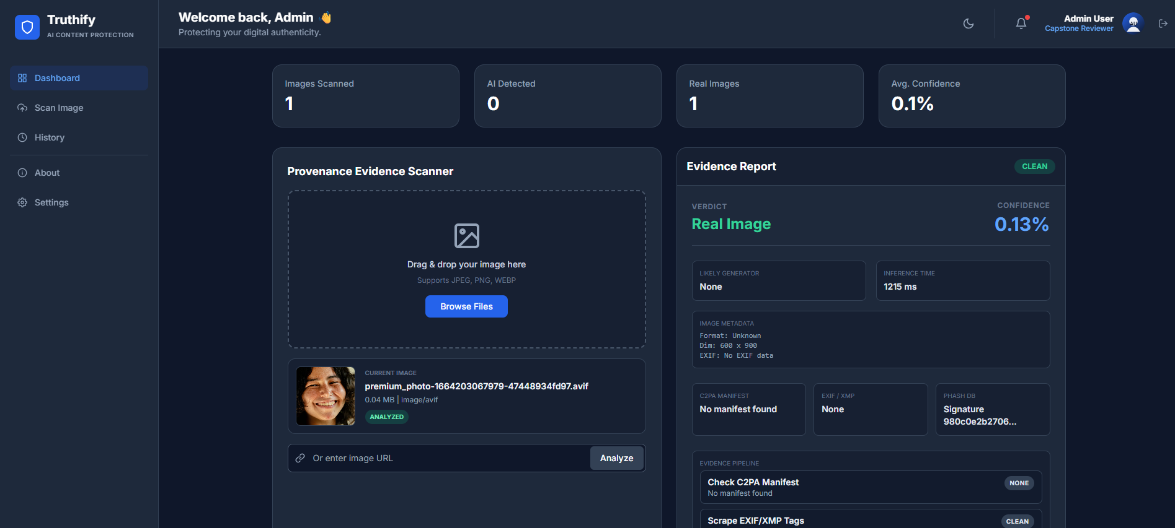
Result
Model & Ensemble Accuracy:
• SigLIP Model Accuracy: ~94.5% on benchmark AI vs Real image datasets.
• Multi-Signal Ensemble Accuracy: >97.8% confidence when combining metadata & pHash.
• Inference Time: 200ms – 450ms per scan.

Slide 8
Conclusion
System Effectiveness: Blends Ateeqq/ai-vs-human-image-detector SigLIP predictions with C2PA, EXIF/XMP metadata, and dHash hashing to detect AI-generated images accurately.
Implementation Challenges: Manages initial ~2GB model download delays, maintains fast inference on FastAPI and Streamlit, and handles missing metadata from compressed uploaded media.
Potential Improvements: Plans to add video/audio deepfake detection, expand reference hashes, and apply model quantization for faster CPU performance.
Core Importance: Delivers essential AI media authenticity verification to combat online disinformation and ensure digital content integrity.

Slide 9
Future scope
Incorporate Additional Data Sources: Expand beyond image detection to include audio spectrograms, video deepfake frame-analysis, and real-time social media API content streams.
Optimize Algorithm Performance: Apply ONNX runtime conversion and model quantization (INT8) to reduce memory usage and accelerate SigLIP inference on CPU environments.
Expand Media & Modality Scope: Scale the reference perceptual hash database (data/reference_hashes.json) and extend C2PA/EXIF scanning to support a broader array of generative model signatures.
Integrate Emerging Technologies: Deploy edge-computing models directly within browser/mobile clients and leverage advanced multi-modal vision-language transformers for explainable forensic reports.

Slide 10
References
Ateeqq/ai-vs-human-image-detector · Hugging Face
SigLIP: Sigmoid Loss for Language Image Pre-Training (arXiv:2303.15343)
C2PA Specifications — Coalition for Content Provenance and Authenticity
FastAPI Documentation
Streamlit Documentation

Slide 11
Deployment Link & GitHub Repository
GitHub Repository: https://github.com/PrateekGupta786/Truthify.git
Streamlit Cloud App: https://truthify.streamlit.app
Technologies: Python 3.11 | PyTorch | FastAPI | Streamlit

Slide 12
THANK YOU

