Slide 1

Observability into hybrid systems using Azure Monitor
Take this 2-minutes quiz! https://bitpro.azurewebsites.net

Slide 2





>_ Whoami
/in/prateekkumarsingh
@singhprateik
/prateekkumarsingh
leanpub.com/b/books

Slide 3
>_ Agenda
Monitoring Vs Observability
What is Azure Monitor?
Demo 1 - Monitoring on-prem containers in Azure Monitor
Demo 2 - Instrumenting a Web Application for end-to-end Observability
Thank you and Questions

Slide 4
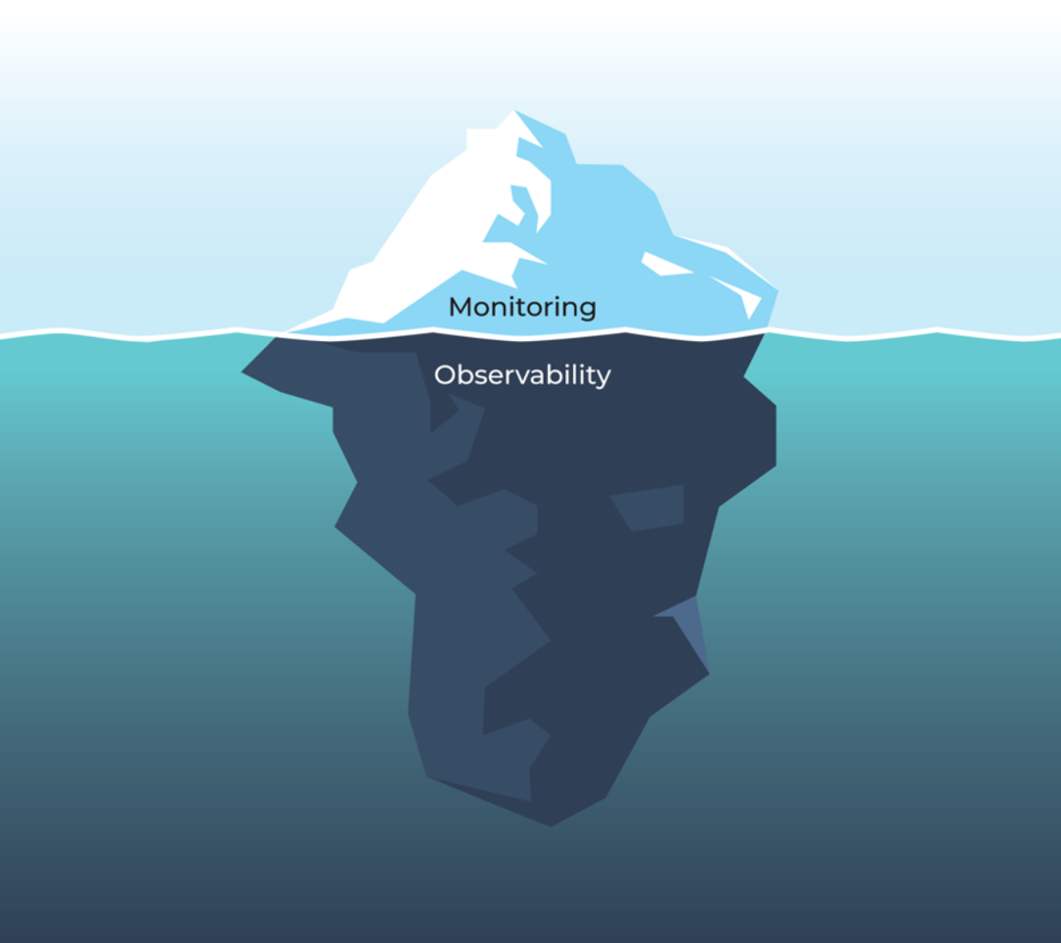
>_ Monitoring vs Observability
WHAT Happened?
Is this a KNOWN issue?
Is there a KNOWN fix?
IMPLEMENTATION PREDICTABLE
REACTIVE ALERTS & OUTAGE
Example: Your backend is down
WHY did it happen?
HOW can we make system more reliable?
IMAGINATION ROOT CAUSE PROACTIVE GAIN INSIGHTS INTO SYSTEMS
Example: You have a backend outage because a time triggered job has failed due to an invalid Database entry

Slide 5
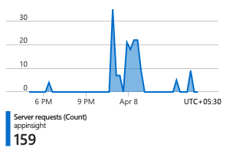
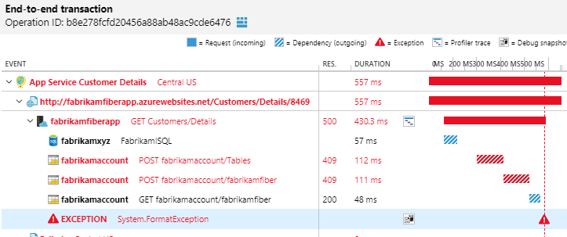
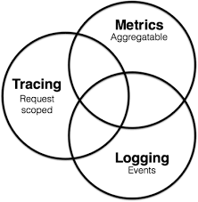
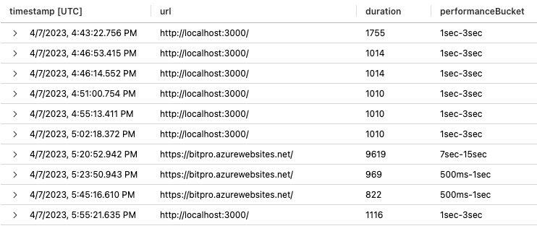
>_ What is Azure Monitor?
Azure Monitor is a comprehensive monitoring solution for hybrid IT Systems and applications
Single pane of glass for monitoring to:
Collect - Metrics, Logs, Traces (Pillars of monitoring)
Analyze - KQL queries, Visualization
Respond - Alerts, Actions, Auto-scaling
Collects and aggregates the data from every layer and component of your system into a common data platform
Azure Monitor achieves observability by correlating data from multiple pillars and aggregating data across the entire set of monitored resources
Use cases
Performance monitoring - IaaS, PaaS, APM
Capacity planning - Time series forecasting
Security monitoring - Powerful log analysis
Audits and compliance - Change analysis, Activity logs

Slide 6
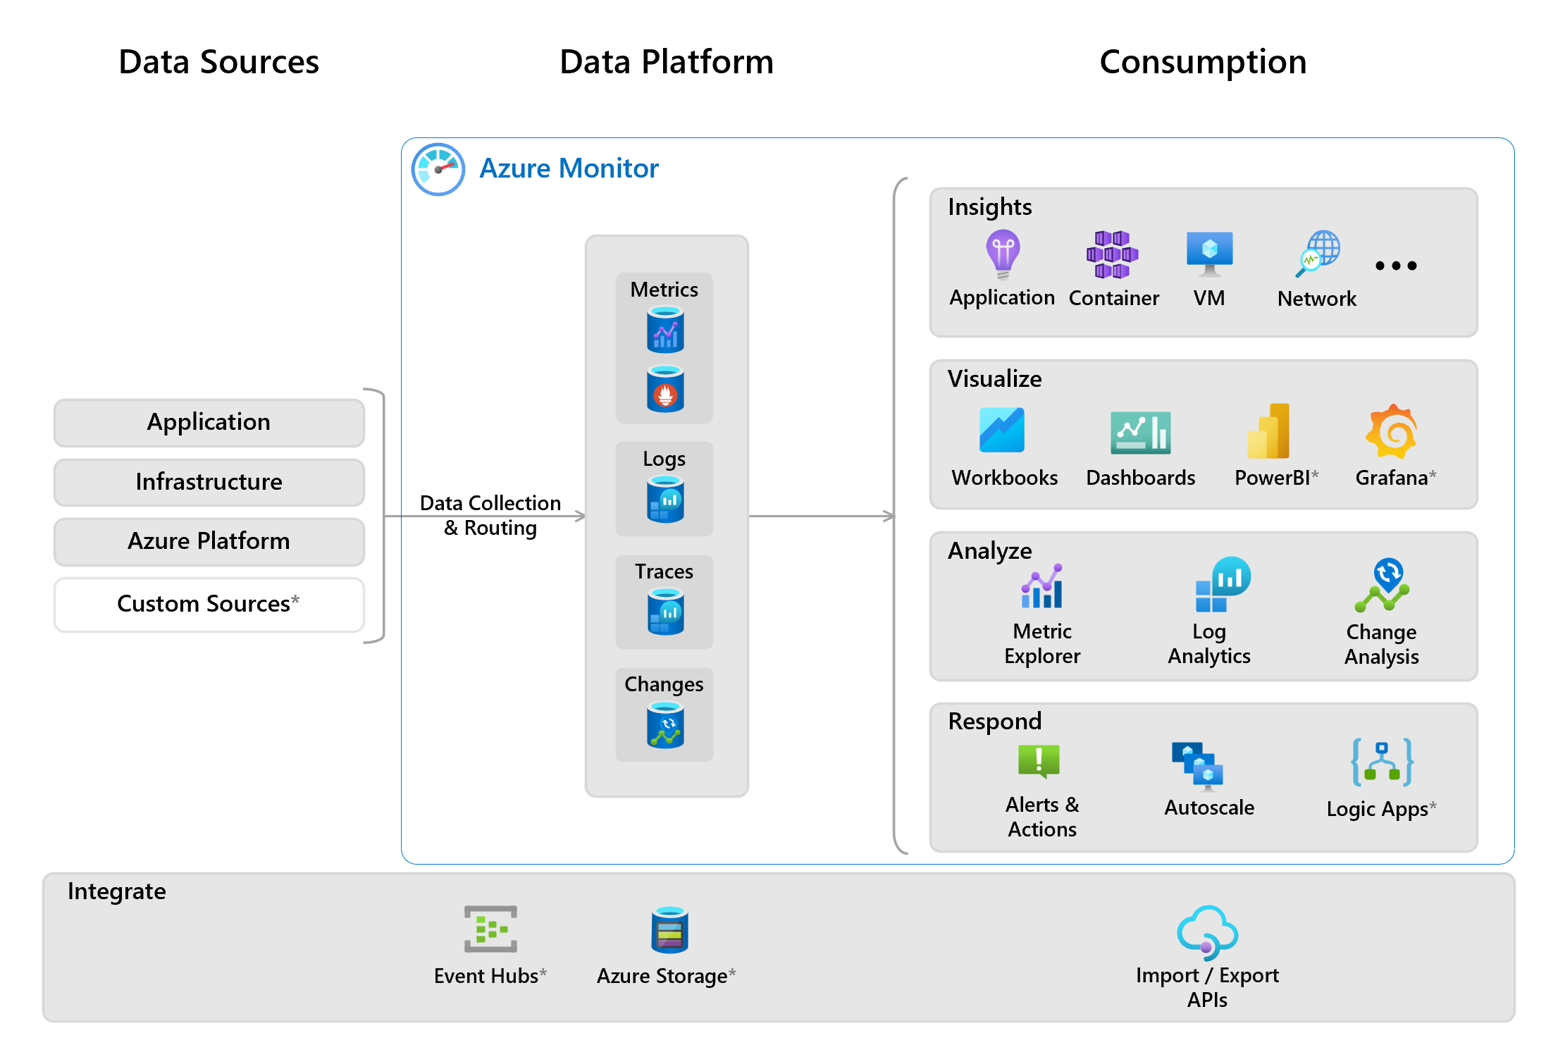

Slide 7
DEMO - 1
Monitoring on-premise container workload in Azure

Slide 8
DEMO - 2
Instrumenting a Web Application for end-to-end observability

Slide 9
Thank you!
Get the slide deck and code samples on: https://github.com/prateekkumarsingh/presentations

