Slide 1

Introduction to Data Analytics (CSE 2126) MINI PROJECT
ILPD: Indian Liver Patient Dataset
42 – Priyanka Pathak - 220962276
80 - Svadha Dey - 220962450

Slide 2
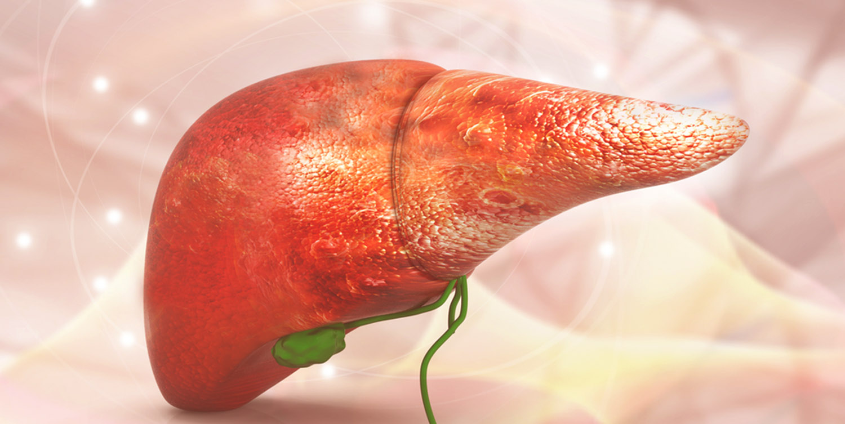
INTRODUCTION
Liver disease, including hepatitis, cirrhosis, and fatty liver disease, is a severe condition with potential fatal outcomes. The Indian Liver Patient Dataset (ILPD) comprises records of 583 patients, 416 with liver disease and 167 without. Each record includes 10 features like age, gender, and blood test results. Our project aims to develop a classification model using machine learning algorithms, including logistic regression, support vector machines, decision trees, and random forests. By comparing their performance, we seek to identify the most effective algorithm for accurately predicting liver disease.

Slide 3
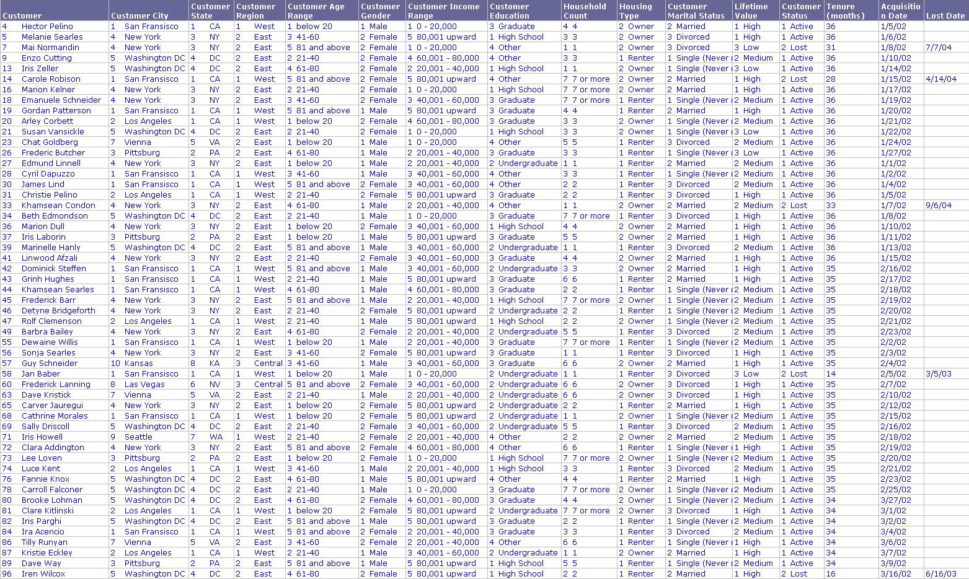
OBJECTIVE
Develop and compare machine learning models to enhance the accuracy of liver disease prediction using the ILPD dataset.
METHODOLOGY:
Data Preparation
Model Training
Model Evaluation
Prediction
Algorithm Comparison

Slide 4
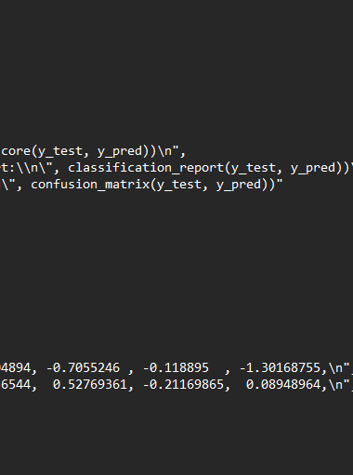
IMPORTING LIBRARIES
LOADING DATASET
EXPLORATORY DATA ANALYSIS
DATA CLEANING
DATA VISUALIZATION
DATA PREPROCESSING
FEATURE ENGINEERING
FEATURE SCALING
SPLITTING DARA
LOGISTIC REGRESSION MODEL
MODEL EVALUATION AND VISUALIZATION

Slide 5
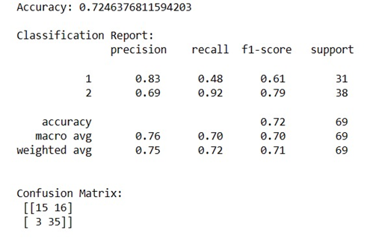
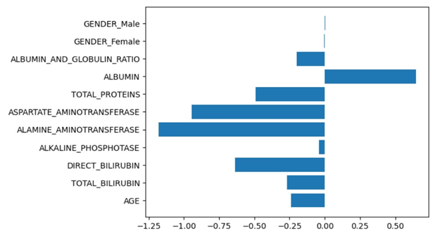
RESULTS

Slide 6
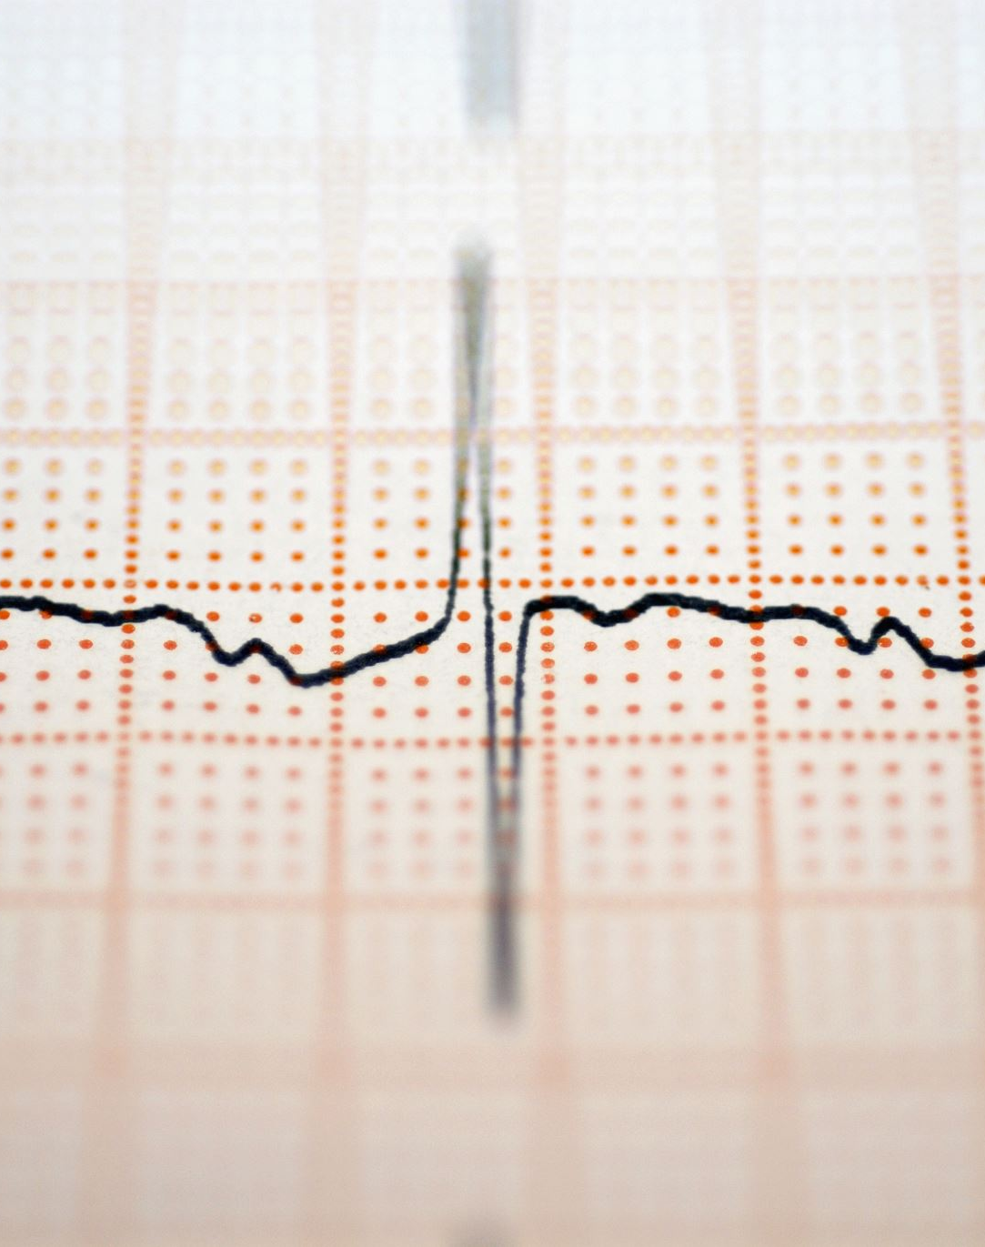
OVERALL PERFORMANCE: The model achieved 72.46% accuracy in classifying patients with or without liver disease, demonstrating commendable performance and effective generalization to unseen cases.
CLASS-SPECIFIC PERFORMANCE: The model excels at identifying patients without liver disease (precision: 0.69, recall: 0.92, F1: 0.79), but struggles with those having liver disease (precision: 0.83, recall: 0.48, F1: 0.62). This suggests potential overfitting to the majority class due to dataset imbalance.

Slide 7
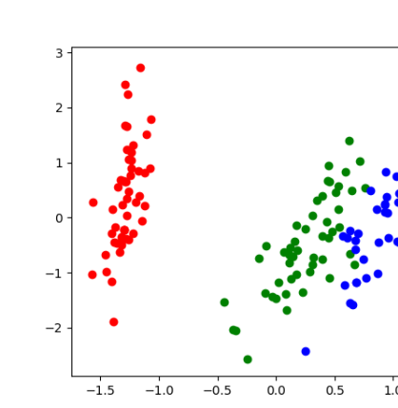
CONCLUSION
This project showcased the feasibility of using machine learning for liver disease prediction with an accuracy of 0.7246. While effective in identifying non-liver disease cases, improvements, such as data augmentation and ensemble learning, can enhance the model's robustness and accuracy for early detection.

