Slide 1
Splitwise++
Notes:
Improved Version on Splitwise. Using it for about a year now, and few things that I would change.

Slide 2
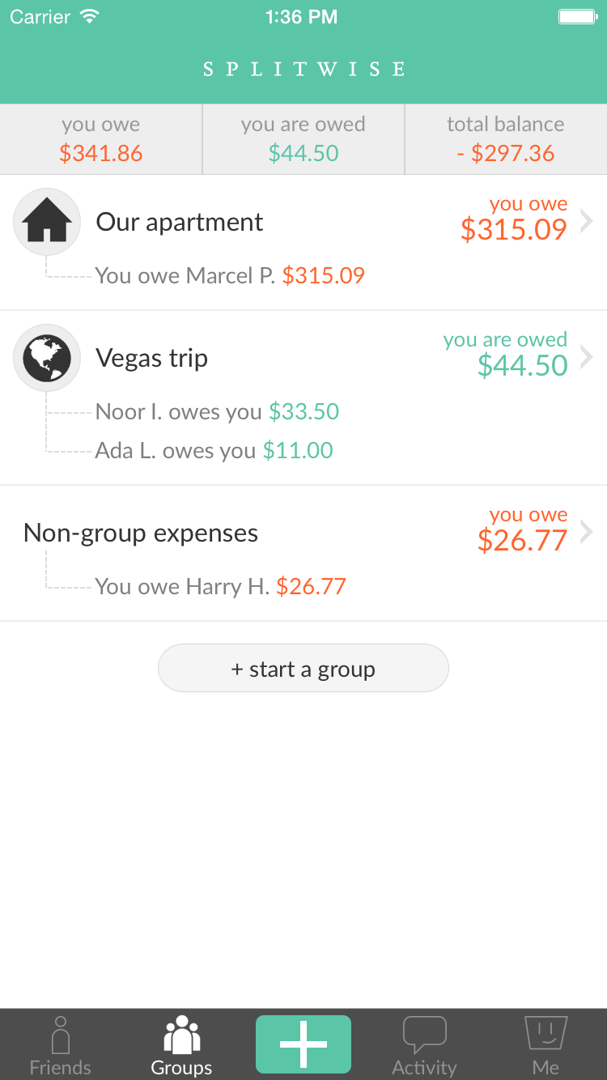
Motivation
Annoying problems with Splitwise:
The balance bug: The app has this weird bug, where it fails to calculate the correct balance in certain situations.
Participation Problems
No Concrete Record of Bills
Notes:
Balance Bug: Especially with group transactions. Costlier transactions will feel unsafe
Participation Problems: Assumes every person with whom the bill was shared with wants to share each item. No tailoring. This leads to having a different record/ bill for each item, and how that item is shared.
2 leads to 3, and we have record of bills, since most of the bills are now divided in to individual items.

Slide 3

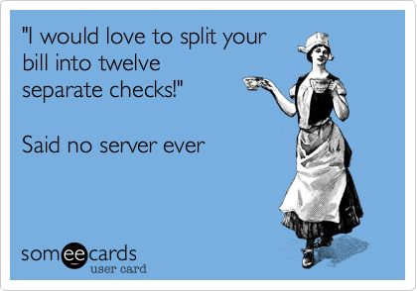
Significance
My App tries to fix the previously mentioned problems by:
Having a simpler database design.
Elimination of extraneous features/ tables.
Better Indexing.
Reduces Bugs.
An improved way of sharing a bill.
Users can choose the items they want to pay for.
Better explained in the demo.
Notes:
The significance is to add more flexibility to otherwise useful app.

Slide 4
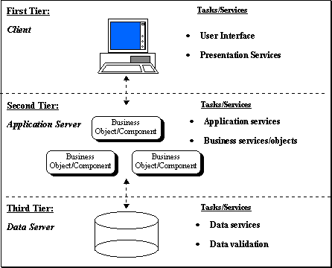
Architecture
The Application Follow a 3-Tier Client-Server Architecture.
MySQL forms the underlying DBMS.
The API(api.java) act like an Application Layer
The Swing Frontend from the User.
This essentially extends the architecture we had for Homework 3.
Notes:
This is all “pseudo”. Developed on 1 machine.

Slide 5

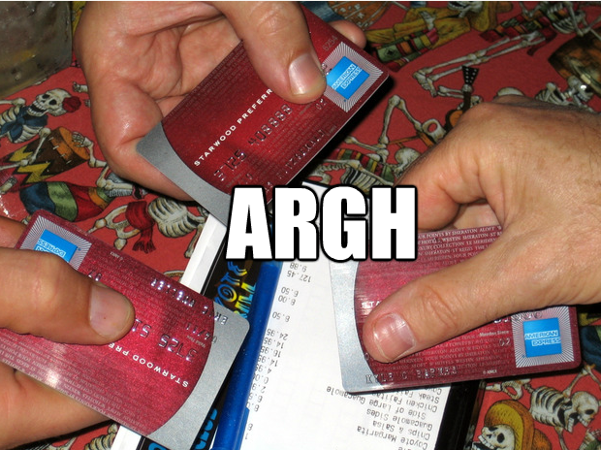
Use cases
This app is for:
Friends/ roommates
Ensure that every bill is split equally
Everyone gets paid.
People trying to maintain a budget
To keep track of the money they spent
What did they spend money on.
The app can also be used as a general record of all the bills that we generated by a user.
Notes:
2 and 3 are more of “you can also do this!”

Slide 6
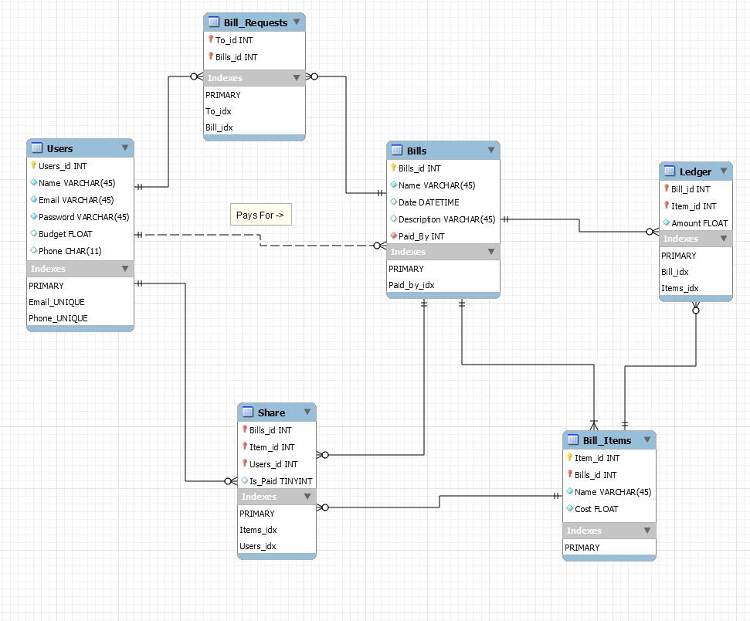
Conceptual Design
Notes:
Talk about fewer joins -> only joins required are amongst share, ledger and if required bills The entire app currently requires 3 joins.

Slide 7
YOU MADE IT TILL THE END!
Notes:
Move to demo!

