Slide 1
Developing a Route Optimisation Solution
Prateek Sharma
Under the guidance of Ramesh Melapu &

Slide 2
Objective
Developing a optimal routing solution for Spring-Cleaning by utilizing their resources and contraints

Slide 3
Domain Understanding
According to WHO medical adherence is the extent to which a person’s behavior(taking medication, following a diet or executing lifestyle changes)corresponds with agreed recommendations from a healthcare provider.
In US alone it is a 300 billion dollars problem because of poor adherence.

Slide 4
Stake holders
Stake holders and there advantages with this model
Customers : Time to time service.
Spring-Cleaning : Organized management of resources, healthy customers

Slide 5
Data understanding
Stops
Contains 189 stops, 6 depots
FROM_STOP_ID TO_STOP_ID TRAVEL_TIME | Stop ids Stop ids Time taken to travel from one depot/stop to other depot/stop
Parameters
Contain 6 ways of selecting number of vehicles

Slide 7
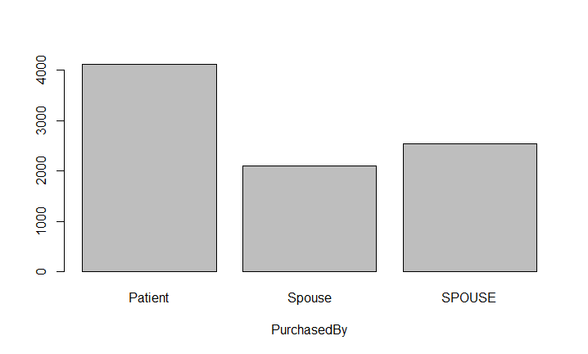
Summary plots
Barplot of PurchasedBY

Slide 8
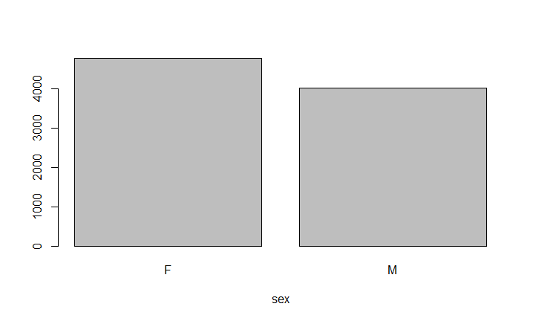
Barplot of Sex

Slide 9
Type of problem we are going to solve
The data given is Unsupervised data.
We have to make it Supervised by creating a target variable using the existing variables.
Then we have to do Classification on data to predict the patient will adhere or not.

Slide 10
Data preprocessing
Variable “date” is of type factor we have to convert it to type date.
Attribute “PurchasedBy” is having 3 levels where 2 levels are same(spouse and SPOUSE).
Attribute “Sex” for patientID 1004 has both male and female.
target variable has to be created.

Slide 11
Methods implemented
Decision trees
i)rpart
ii)C5.0
Random forests
Logistic regression

Slide 12
Evaluation Metrics on train & test:
 | Logistic Regression | Decision Tree |  | Random Forest
 |  | Rpart | C5.0
Train | Accuracy=63.3% Recall =69.9% | Accuracy=63.5% Recall=92.8% | Accuracy=71.1% Recall=74.7% | Accuracy=70.3% Recall =71.9%
Test | Accuracy=57.9% Recall=80.9% | Accuracy=56.3% Recall=95.8% | Accuracy=71.3% Recall=84.6% | Accuracy=70.9% Recall=80.7%

Slide 13
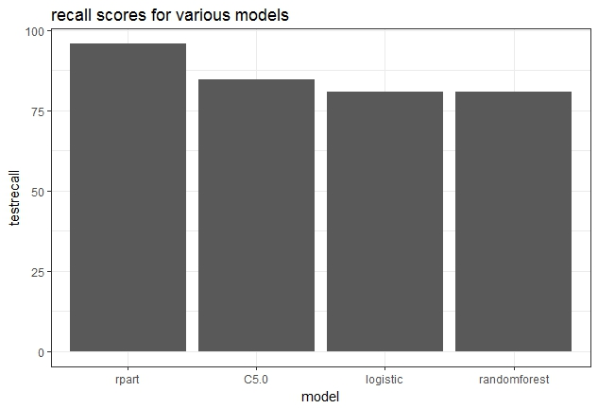
Here we can see that rpart is performing well

Slide 14
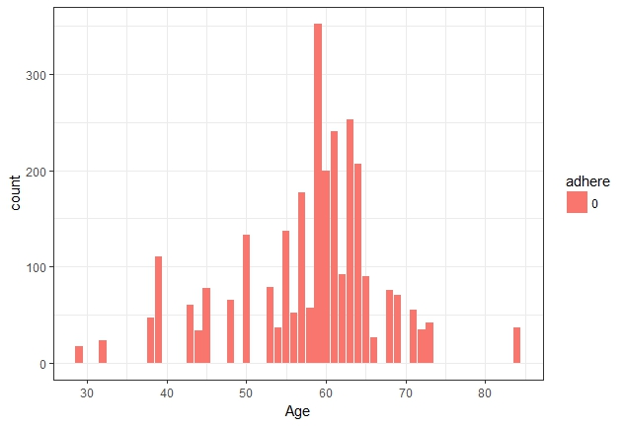
From this visualization we came to know that patients with age 60 to 64 tend to non-adhere
More when compared to remaining age groups

Slide 15
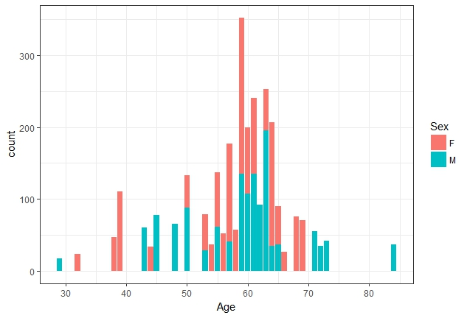
This visualization shows that what amount of patients tend to non-adhere depending on the age with respect to gender.

Slide 16
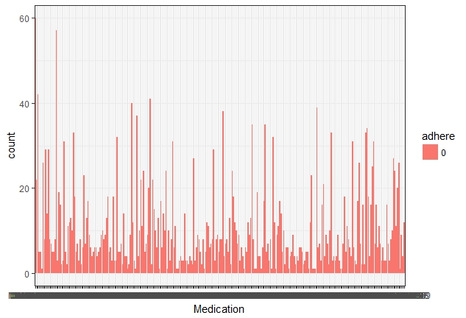
From this visualization we came to know that patients with Medication1 and Medication117 are becoming non adherent.

Slide 17
Steps for Improving accuracy
If the data had the real medication names unlike the masked data we can get more insights into the data as the threshold kept for the delay of refill can vary depending on the type of medication for example if the medication is for hypertension the delay should be 0 days but whereas for other medications some delay can be accepted.
If the amount of data and more features for model building we could have built better models with better accuracy and recall

Slide 18
Suggestions
Identifying the patients who are going to non-adhere and taking necessary action to bring them into adherence zone.
Educating the patients on effects of non-adherence.
Sms alerts and tele calls to keep reminding about the refill of medicines

