Slide 1


IEEE International Conference on Information, Implementation, and Innovation in Technology 2025
IEEE I2ITCON 2025
4th July 2025
FieldNet: A LoRa-Powered IoT Framework
for Agricultural Automation (2092)
Prateek Singh
Postgraduate Student, Electronics Engineering
Dr. D. Y. Patil Institute of Technology Pimpri, Pune, India
4th July, 2025

Slide 2
Motivation
Literature Survey
Methodology
Design
Hardware Implementation
Working Flow
Results
Conclusion
References
Challenges & Future Work
Notes:
(Blue)

Slide 3
🌱 Motivation
Need for real-time, reliable, and long-range agriculture monitoring
Traditional methods are manual, time-consuming, and less accurate
Existing wireless tech is either short-range, high-power, or expensive
LoRa offers a solution
⚡ Low power
📡 Long range
💰 Cost-effective

Slide 4
Motivation
Literature Survey
Methodology
Design
Hardware Implementation
Working Flow
Results
Conclusion
References
Challenges & Future Work
Notes:
(Blue)

Slide 5
📚 Literature Survey
1. LoRa-Based Smart Agriculture Monitoring and Automatic Irrigation System, Xiaoming Ding et al., 2024
Address inefficiencies in traditional agriculture, such as water waste and lack of real-time monitoring, by implementing a LoRa-based wireless system.
Developed a system with sensor nodes, gateways, and actuator nodes. Data is collected and transmitted via LoRa, visualised in real time using Blynk, and stored/analysed on ThingSpeak.
Key Findings
- Achieved reliable long-range communication (>6 km) with low power consumption.
- Enabled automated irrigation based on real-time sensor data and user commands.
2. Optimising Performances of LoRa-Based IoT Enabled Wireless Agriculture Science Direct, 2023
Optimise LoRa parameter settings for affordable, scalable monitoring on fruit and vegetable farms.
Experimented with LoRa configurations (spreading factor, bandwidth, transmission power) to maximise coverage and minimise energy use.
Key Findings
- Proper tuning of LoRa parameters can significantly extend battery life and coverage.
- Demonstrated the importance of balancing data rate and range for agricultural deployments.
3.An Efficient LoRa Smart Agriculture Platform Using WSNs JETIR, 2023
Build a LoRa-based smart agriculture management and monitoring system using wireless sensor networks (WSNs).
Created a private LoRa network interfaced with a gateway, collecting data from end nodes and transmitting it to the cloud for user applications.
Key Findings
- LoRa solves communication failure and energy-saving challenges in rural agricultural monitoring.
- Field tests confirmed satisfactory coverage and low power operation, even in dense environments.

Slide 6
Motivation
Literature Survey
Methodology
Design
Hardware Implementation
Working Flow
Results
Conclusion
References
Challenges & Future Work
Notes:
(Blue)

Slide 7
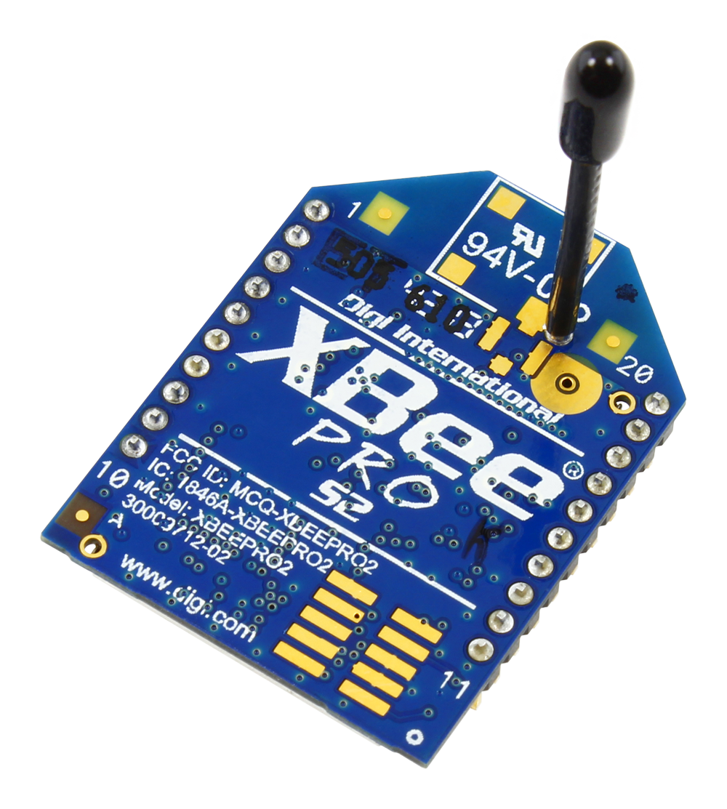
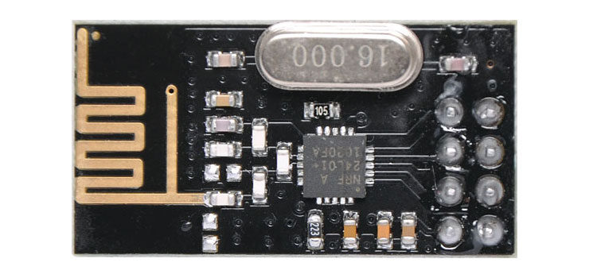
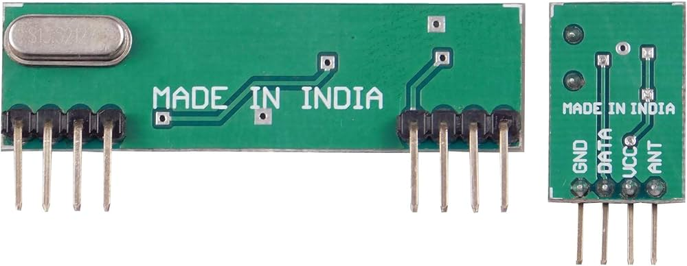
🛠️ Previous Method
RF zigbee Module
RF Module
RF NRF Module
Easy For RF-based Application.
Complete Radio Transmitter.
Transmit Range Up To 50m.
CMOS / TTL Input.
Power-down mode current: 4.2uA.
Operating Range: 1Km
Receive Mode Current(peak): 45mA
It uses 2.4GHz global open ISM band.
Integrated, Wire Antenna
15 general-purpose I/O lines
Industry-leading sleep current of sub 1 µA
Transmit Range Up To 1km.

Slide 8
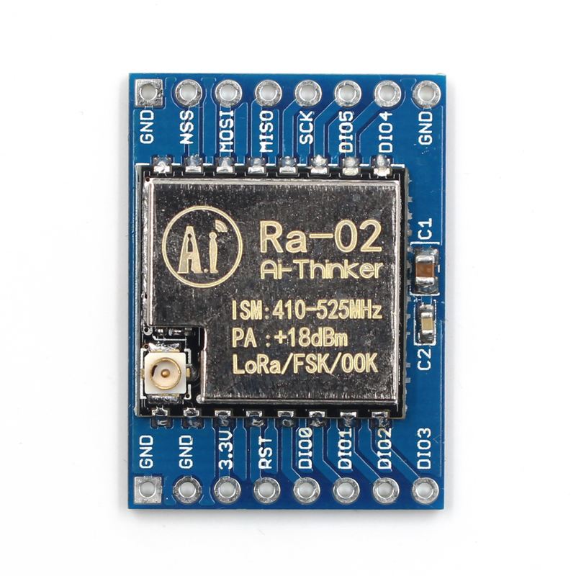
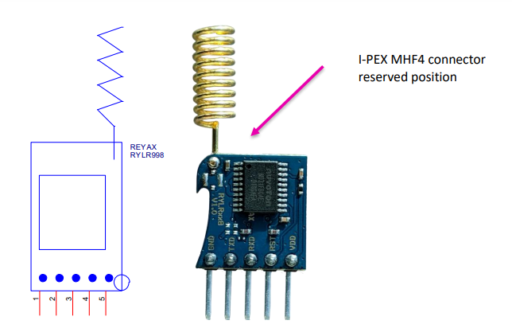
🧪 Design Method
📡 Long Range Transmits data reliably across several kilometers, covering large farms and remote fields
⚡ Low Power Consumption Sensors can operate for years (up to 15 years in some cases)
💰 Cost-Effective Lower setup and operational costs compared to cellular or other wireless solutions
🛡️ Robust and Reliable Strong signal penetration through obstacles resistance to interference, and secure, encrypted data transmission.
🔗 Easy Integration & Scalability
supports many sensor nodes
Frequency Bands 169 MHz, 433 MHz, 868 MHz and 915 MHz

Slide 9
Motivation
Literature Survey
Methodology
Design
Hardware Implementation
Working Flow
Results
Conclusion
References
Challenges & Future Work
Notes:
(Blue)

Slide 10
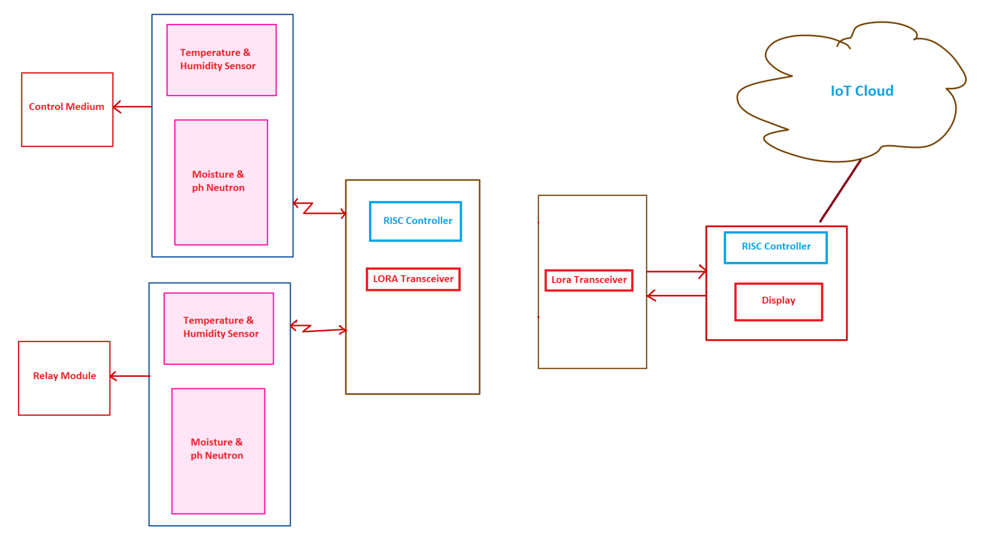
⚡ Block Diagram

Slide 11
🧠 RISC Microcontroller Central processing unit that collects sensor data and manages communication.
🌱 Soil Sensors (NPK, Moisture, Temperature) Measure key soil parameters to monitor nutrient levels and environmental conditions.
📡 LoRa Module (SX1278) Enables long-range, low-power wireless transmission of sensor data to the gateway.
🖥️ Local Displays (OLED) Show real-time sensor readings on-site for immediate monitoring.
☁️ Cloud/Server & User Interface Stores, visualizes, and analyzes data remotely
allows farmers to monitor and control irrigation via web or mobile apps.

Slide 12
Motivation
Literature Survey
Methodology
Design
Hardware Implementation
Working Flow
Results
Conclusion
References
Challenges & Future Work
Notes:
(Blue)

Slide 13
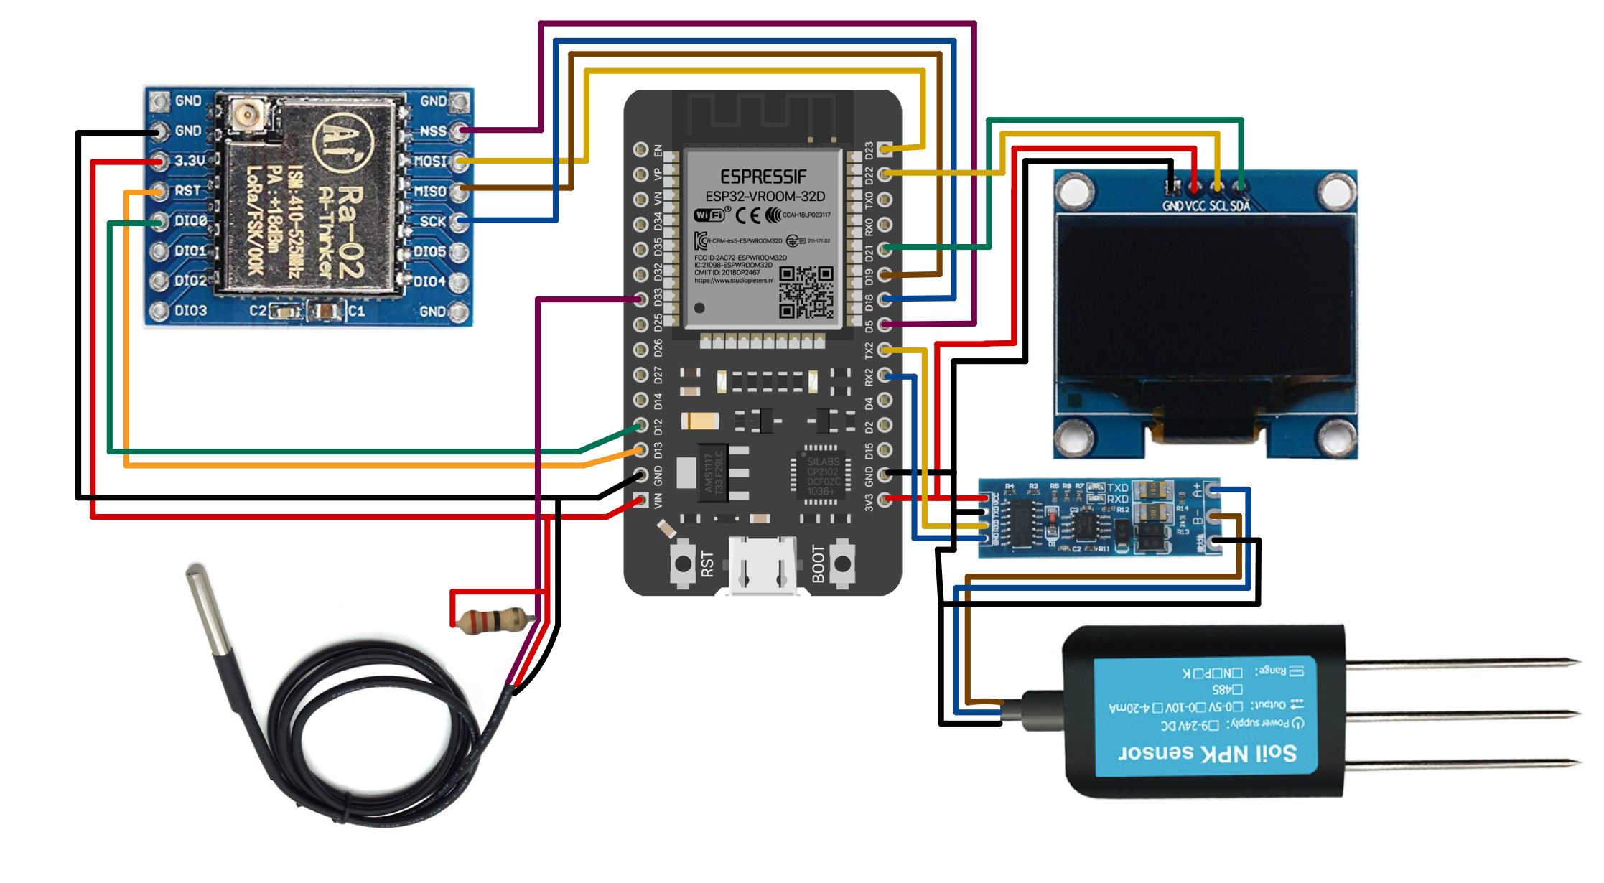
📤 Node_1

Slide 14
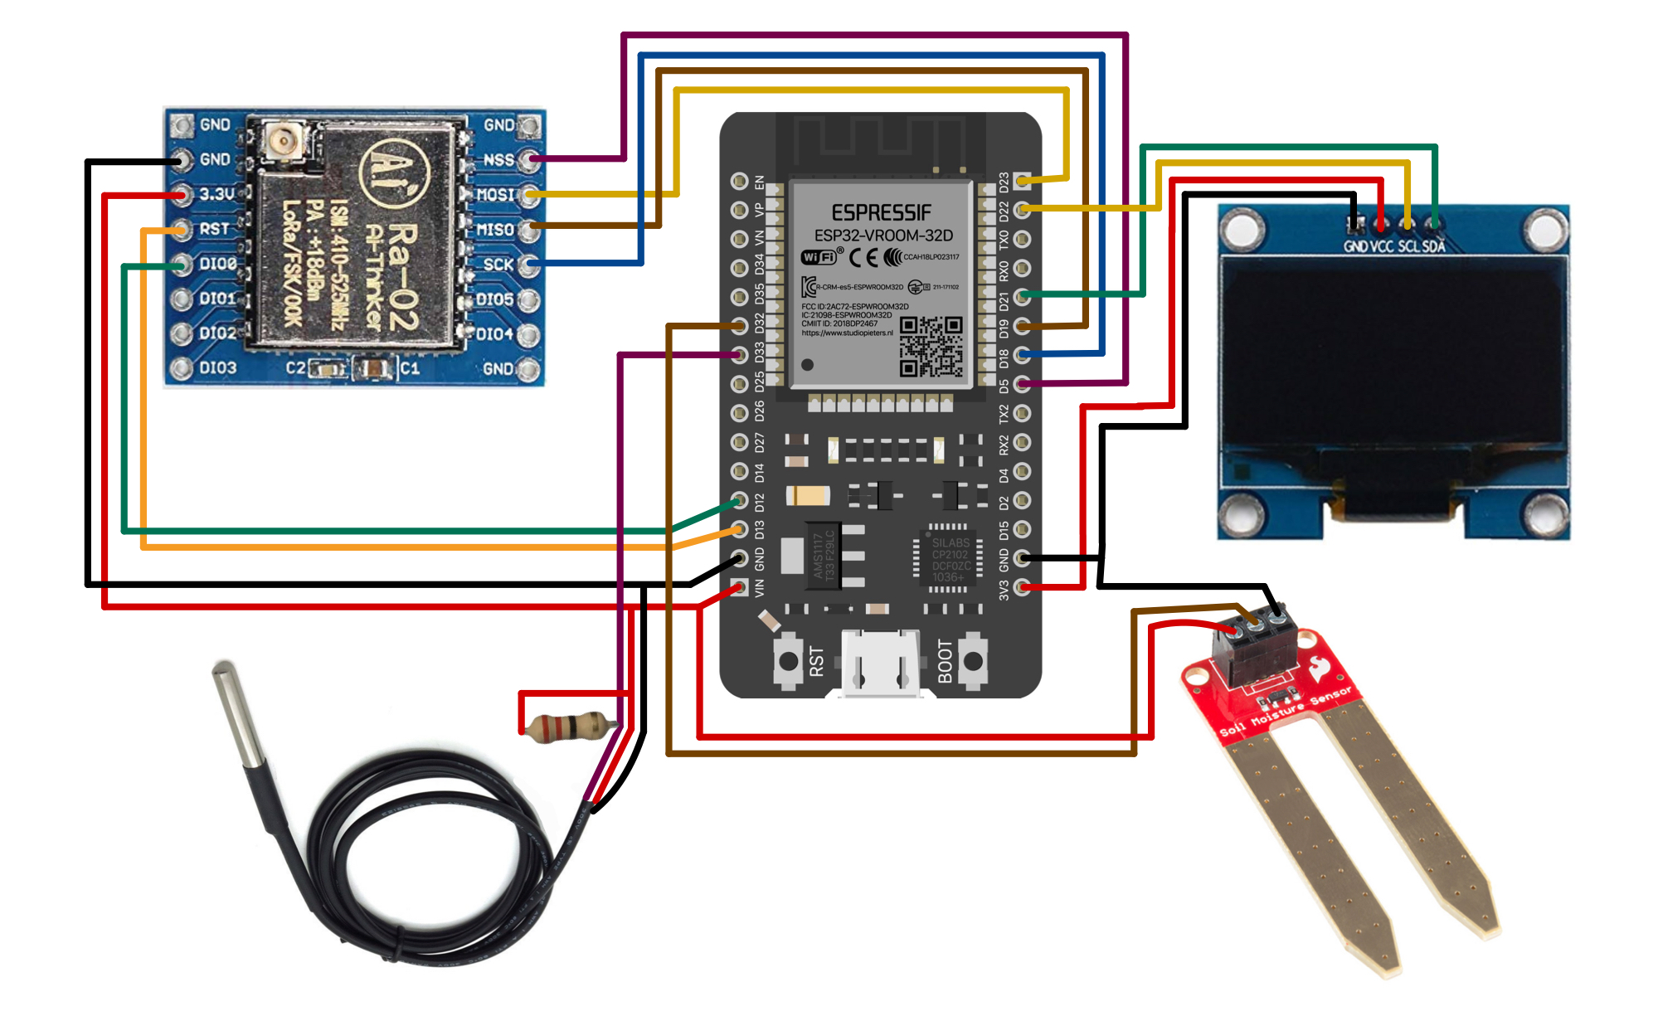
📤 Node_2

Slide 15
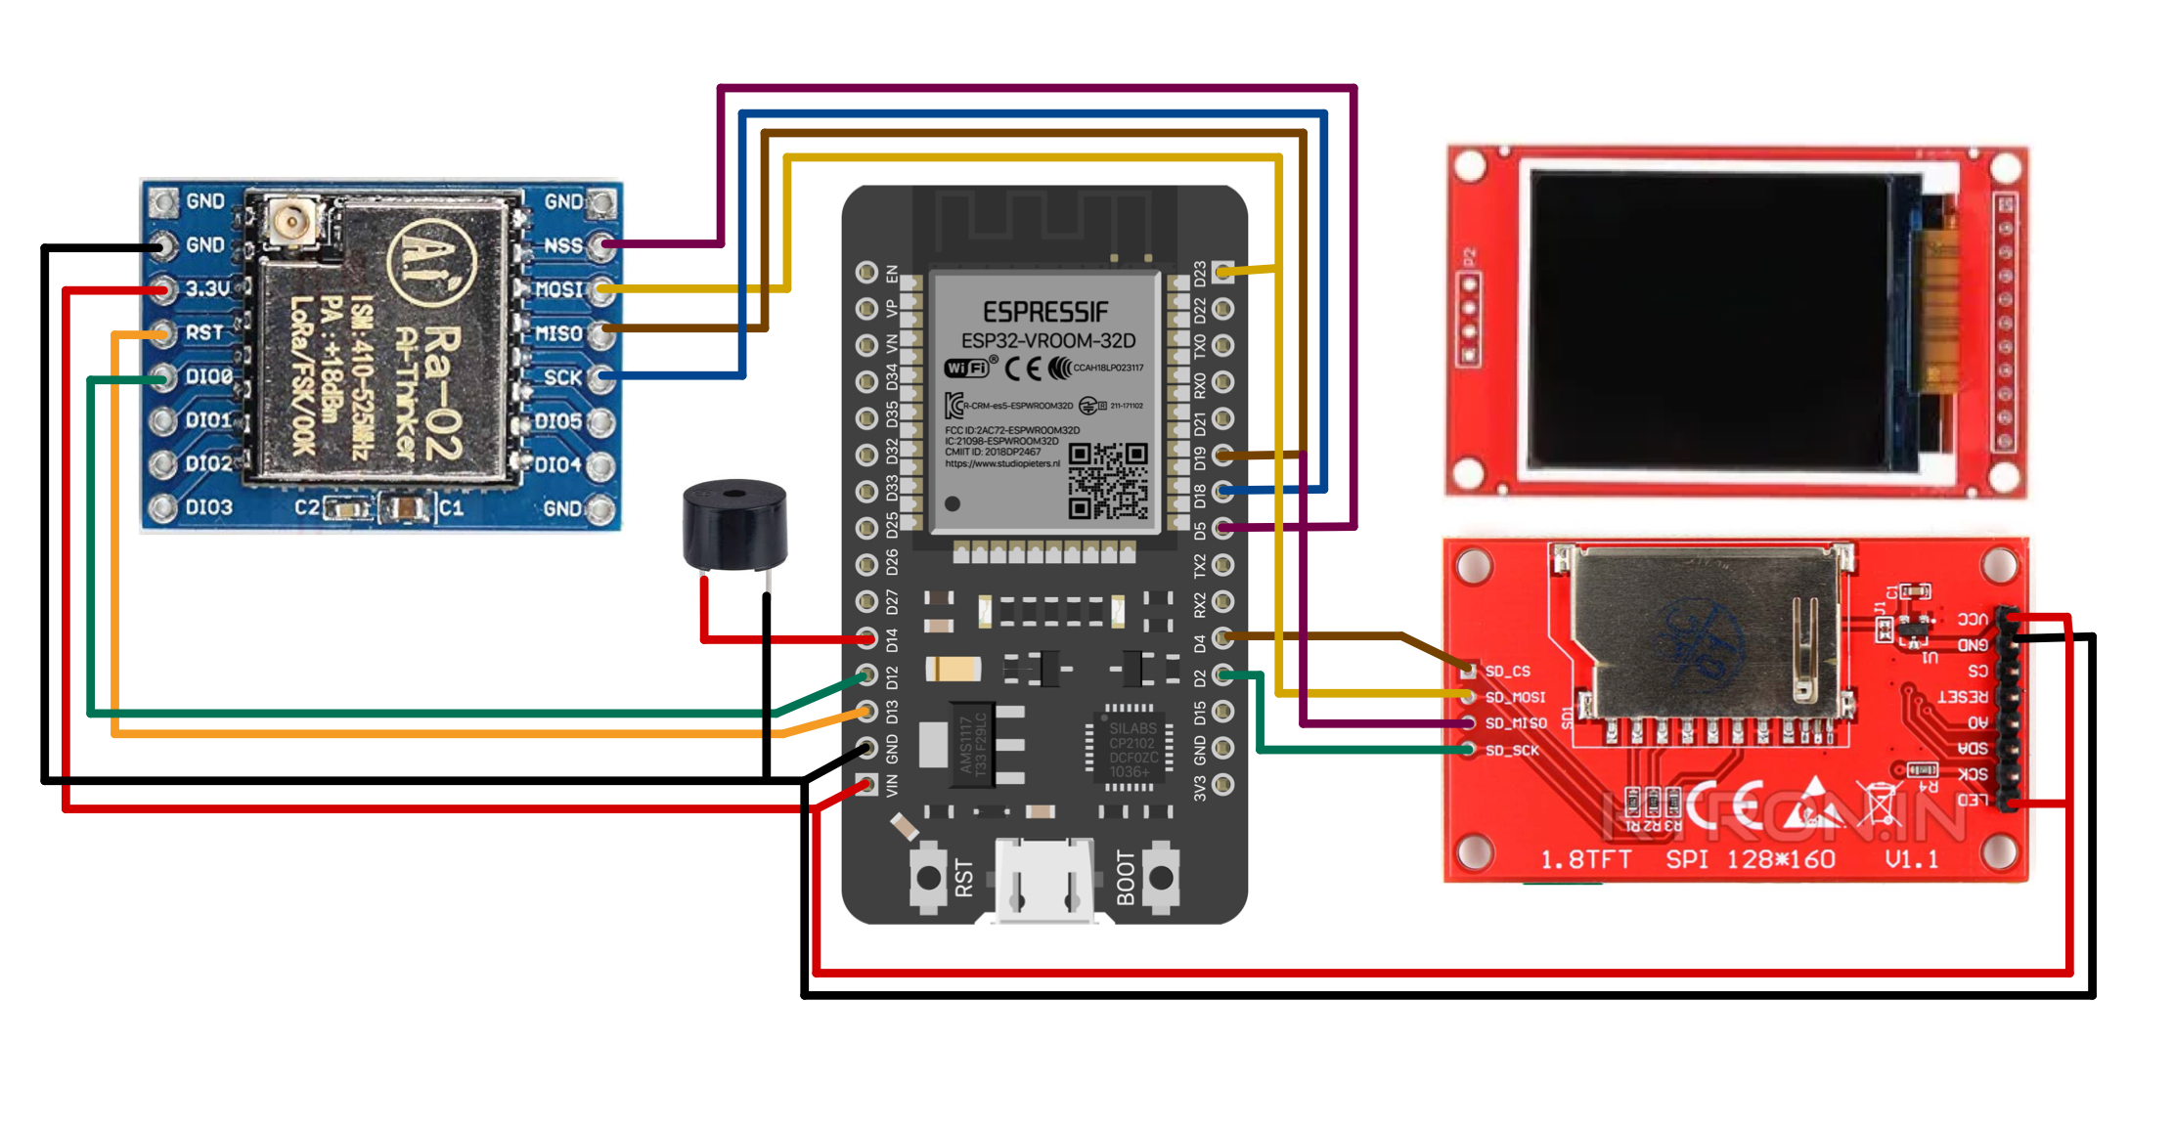
📥 Transceiver

Slide 16
Motivation
Literature Survey
Methodology
Design
Hardware Implementation
Working Flow
Results
Conclusion
References
Challenges & Future Work
Notes:
(Blue)

Slide 17
⏳ Working Flow
Transceiver
NODE
Sensors Date
↓
RISC Controller
↓
LoRa Transceiver
↓
Gateway (RISC Controller + Display)
↓
Firebase Database
↙ ↘
User App Command Listener
↓ ↓
User Sends Cmd Gateway Receives Cmd
↓ ↓
Firebase Database
↓ ↓
Gateway Reads Cmd
↓ ↓
Actuator (Relay/Control Medium)
Start
↓
Read Temperature & Humidity Sensor
↓
Read Moisture & pH Neutron Sensor
↓
Process Sensor Data in RISC Controller
↓
Send Data via LoRa Transceiver
↓
Wait for Control Command via LoRa
↓
Continue Monitoring Sensors
Activate Control Medium
↓
Repeat Cycle

Slide 18
Motivation
Literature Survey
Methodology
Design
Hardware Implementation
Working Flow
Results
Conclusion
References
Challenges & Future Work
Notes:
(Blue)

Slide 19
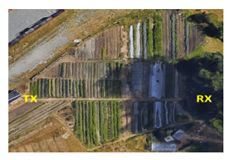
⚡ Results
You've set up a system on a one-acre farm. To monitor it, you've placed LoRa transmitters and receivers at opposite ends of the property.
The farm itself has been divided into a grid of squares, each measuring 45 feet by 45 feet. I took signal strength measurements (called RSSI) at 20 different points within these grids.
The typical signal strength you observed across these locations was -137 dBm.
Benefits
Increased Efficiency Reduced waste of water and nutrients.
Better Yields Healthier plants, optimized growth conditions.
Reduced Labor Automated monitoring and control.
Data-Driven Decisions Farmers gain actionable insights.

Slide 20
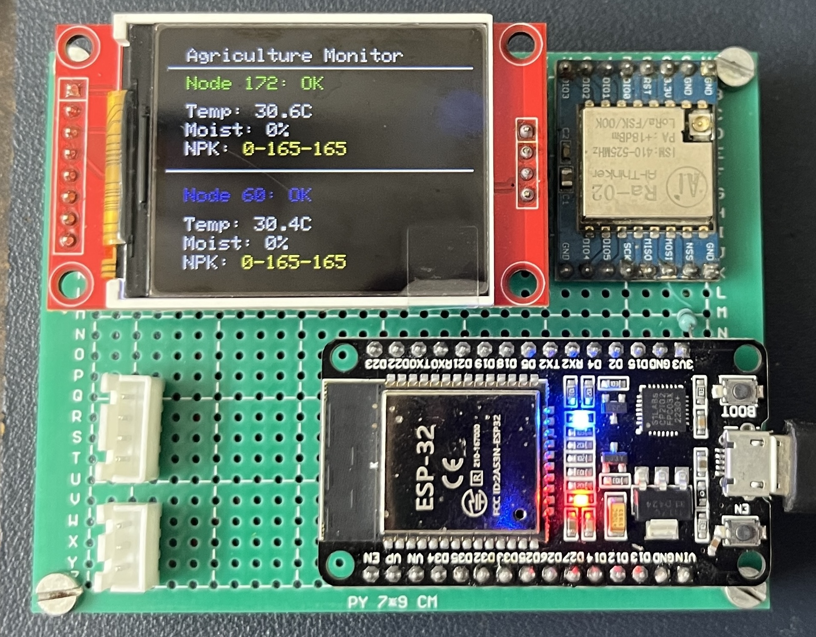
Transreceiver

Slide 21
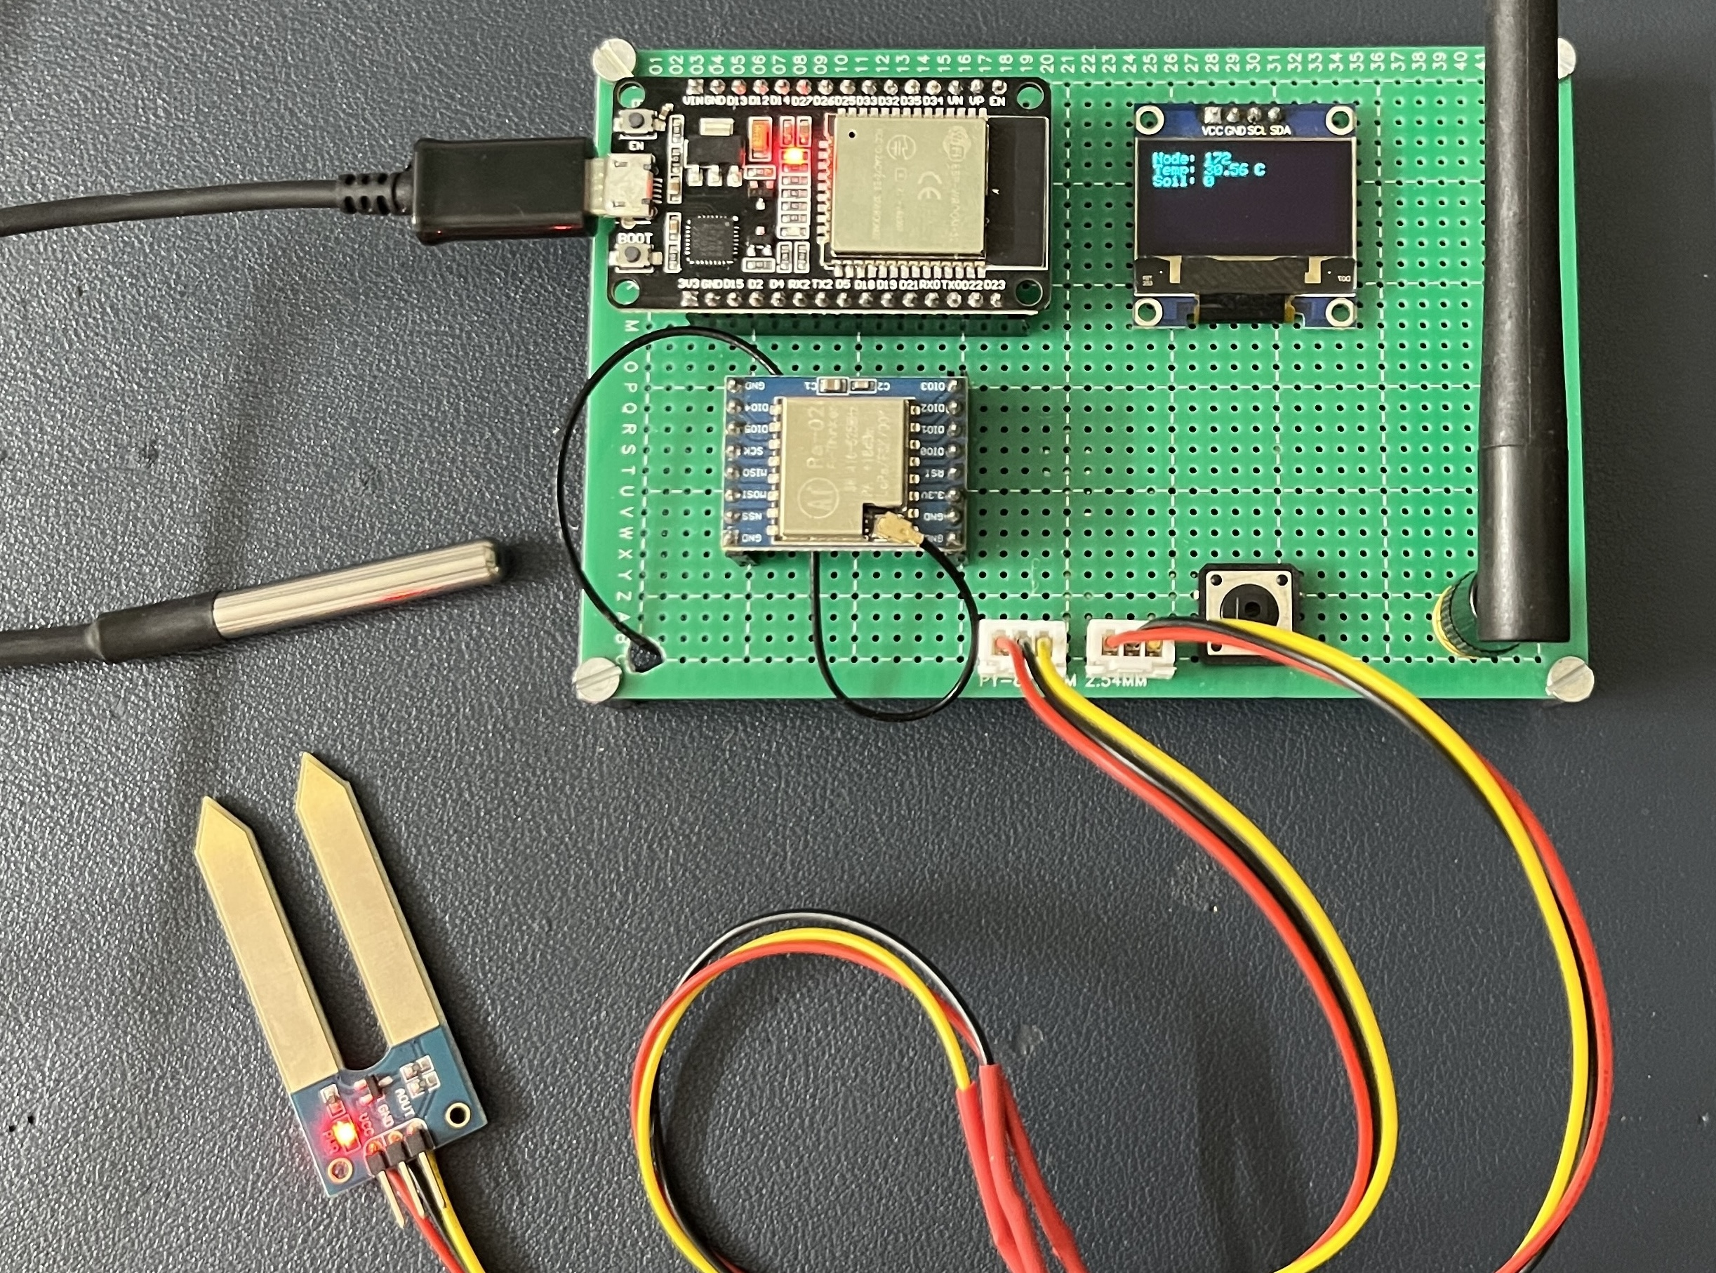
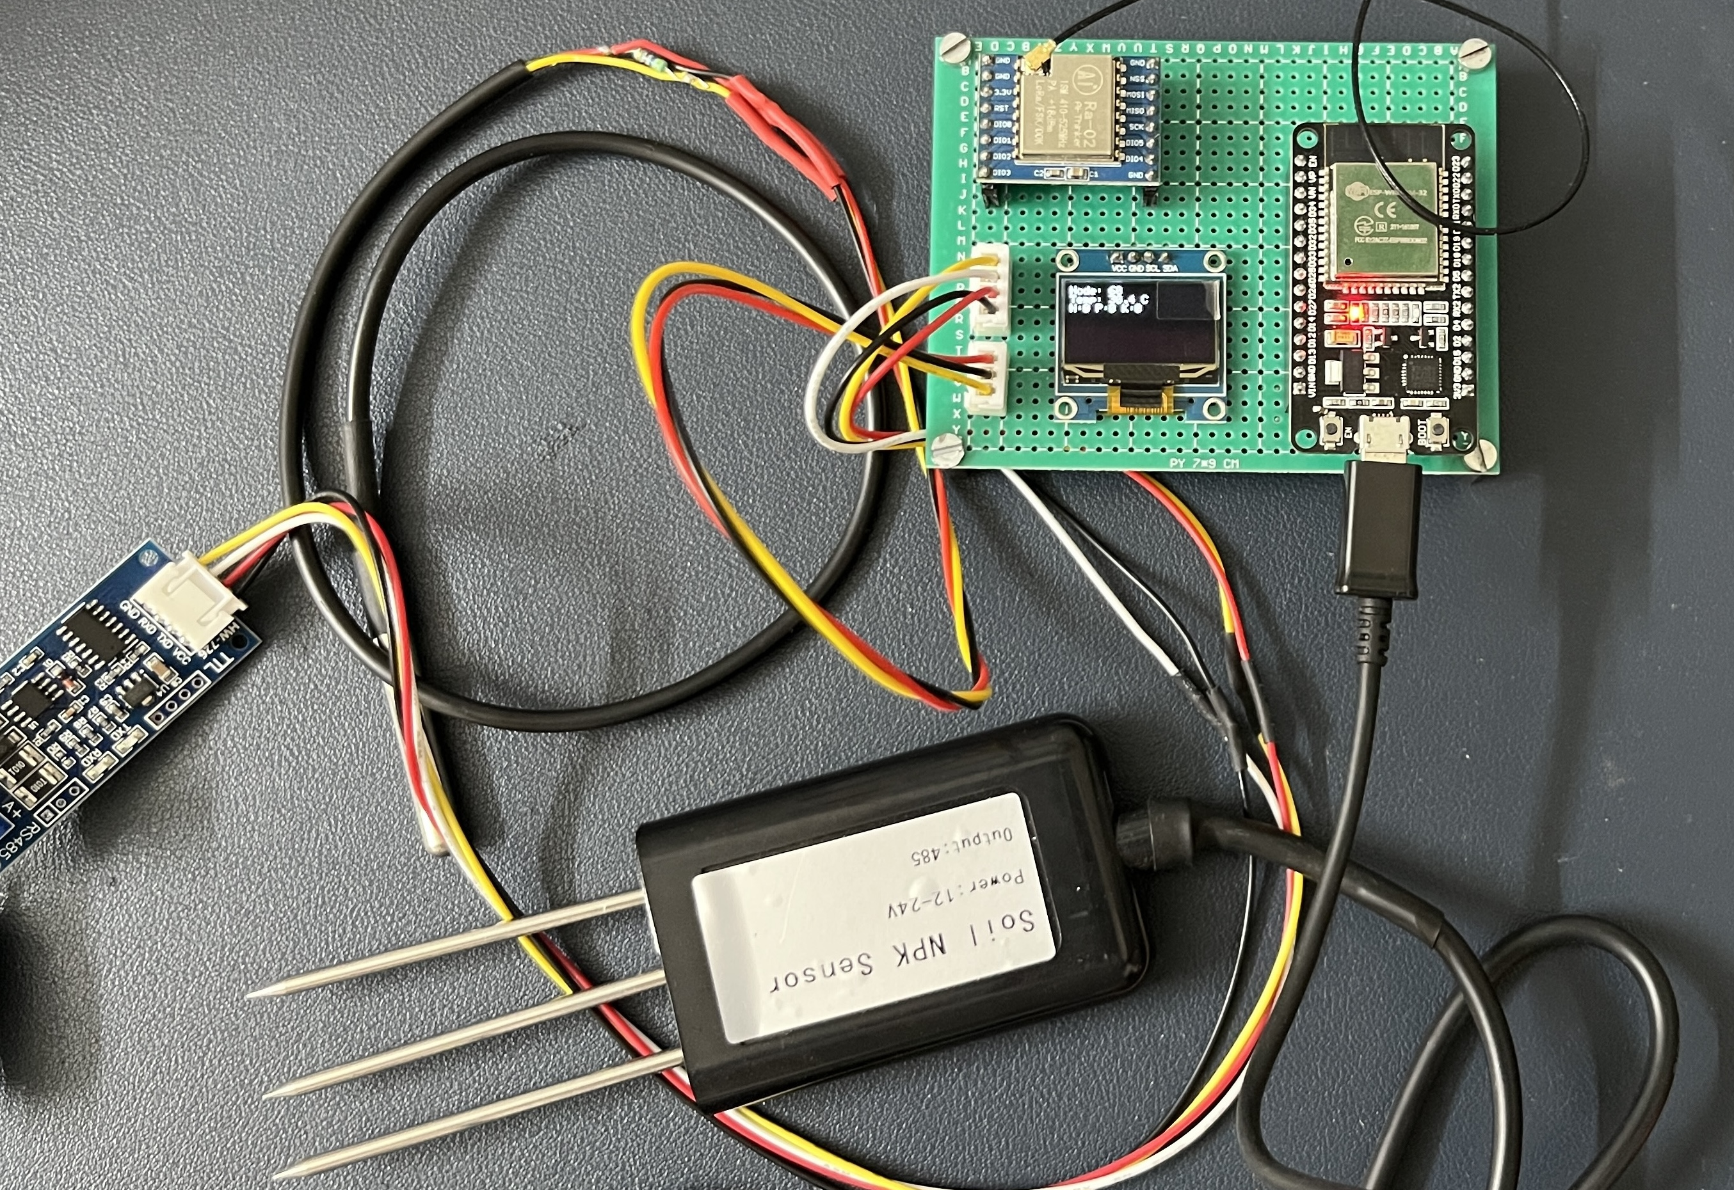
Node 1
Node 2

Slide 22
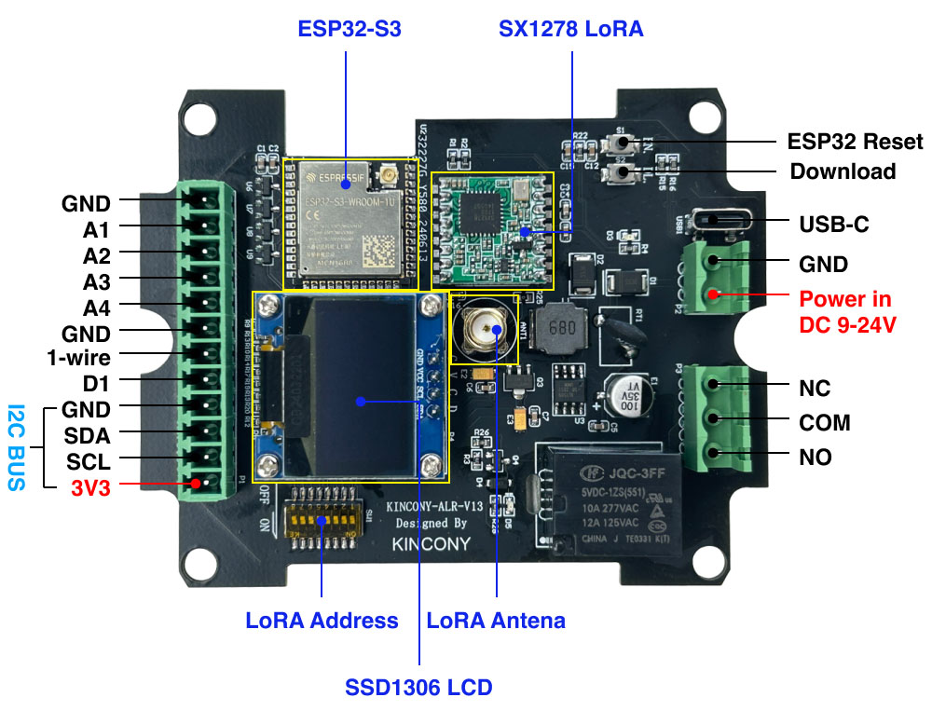
FieldNet

Slide 23
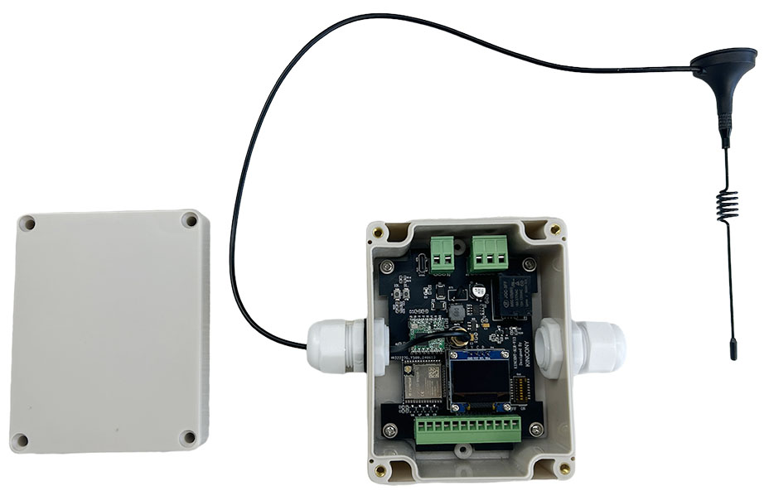
Hardware Resource
Power supply: DC9-24V USB-C: download firmware Buttons: ESP32 Reset and Download ESP32-S3-WROOM-1U N16R8 SX1278 LoRa module: Use by 433MHz Relay: MAX Load AC-250v 10A SSD1306 i2c OLED Display Analog Input: 4 channel dc 0-5v signal 1-wire: 1 channel Digital input: 1 channel
I2C bus: 1

Slide 24
Motivation
Literature Survey
Methodology
Design
Hardware Implementation
Working Flow
Results
Conclusion
References
Challenges & Future Work
Notes:
(Blue)

Slide 25
🚀 Conclusion
Our smart farm system is a game-changer! By continuously monitoring conditions, intelligently processing data, and communicating wirelessly via LoRa, we can precisely control various farm operations.
LoRa is the first wireless system that operates at km distances while consuming less than 10 µW
Inexpensive, flexible form factor connectivity solutions which can be integrated into everyday objects
Feasible for wide-area deployment whole-home coverage, precision agriculture, long-range medical implants, and more

Slide 26
Motivation
Literature Survey
Methodology
Design
Hardware Implementation
Working Flow
Results
Conclusion
References
Challenges & Future Work
Notes:
(Blue)

Slide 27
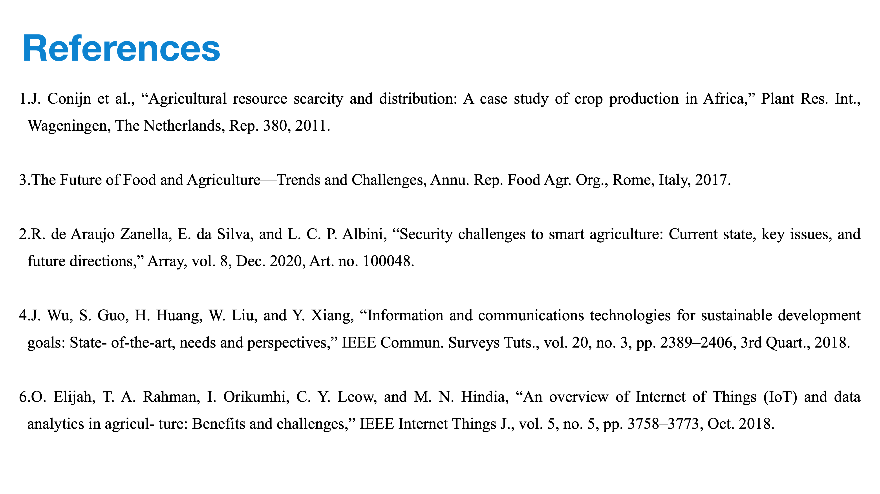

Slide 28
Thank You!!
Prateek Singh
Mobile No: +91 8830584864
Mail ID: prateeksingh4864@gmail.com
Github: https://github.com/PrateekSinghRajput/Post-Graduate-Project-Details-2025

