Slide 1
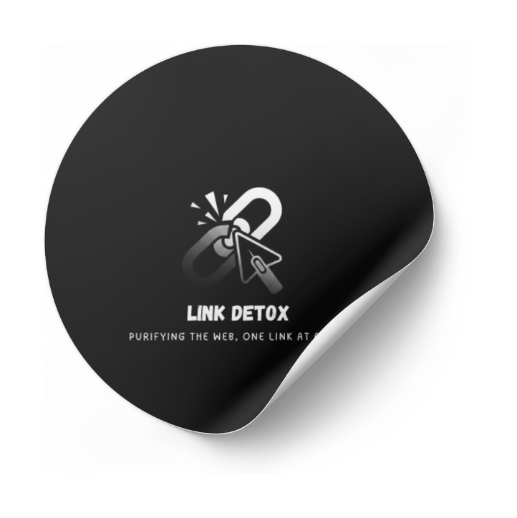

TEAM NAME:
CRTL+ALT+DEFEAT
Project:
LINK DETOX
DATA QUEST 2.0
THE ALL-IN-ONE PHISHING SHIELD & SECURITY PLATFORM
17/09/2025
1

Slide 2

The Problem
1
Over 3.4 billion phishing emails are sent daily.
2
A single malicious link can lead to data theft, financial loss, and malware infection.
Phishing is more than just a suspicious link.
3
Key Pain Points:
Hard to identify fakes
Existing tools are basic
Fear of clicking anything
For many users, especially the elderly or less tech-savvy, it's impossible to tell a safe link from a dangerous one
NEXT
2

Slide 3



The Solution
Introducing: Link Detox
Your Security Hub
A comprehensive platform that not only detects threats but empowers users and builds a community shield against phishing.
3
NEXT

Slide 4

Core Feature: Real Time URL Analysis
Instant, AI powered Analysis
Step 1
Step 2
Step 3
🔗https://www.freemoney.com
🔍AI Engine Scans the URL
🛡️Get a Clear, Simple Result
Our model instantly checks dozens of factors like domain age, SSL, keyword usage, and URL structure.
Safety Rating: ✅Safe, ⚠️ Suspicious, or❌ Phishing.
An example of a suspiscious link
Risk Score: A percentage from 0-100% to show confidence.
SSL Certificate Validity: whether a website has a valid and trusted SSL/TLS certificate.

Slide 5

Killer Feature: The Safe Preview
See Without the Risk: Safe Preview Mode
We render the website in a sandboxed environment with scripts disabled, so you can see what it is without getting infected.
Sandboxing is a security technique that executes suspicious websites in an isolated, controlled environment to observe their behavior without risking the security of the host system

Slide 6
The Community Shield (Crowdsourcing):
Here’s what happens when a user reports a suspicious URL.
1. User Reports a Threat:
2. Instant Automated Verification
When our AI is unsure, or a savvy user spots a brand-new threat, they can report it with a single click. This is the start of our community defense.
The report isn't just blindly accepted. Our backend instantly verifies the URL against leading security APIs and cross-references it with other user reports to confirm it's a genuine threat and filter out false positives.
3. Global Protection in Seconds
Once confirmed, the malicious URL is added to our global blocklist. Instantly, every other Link Detox user is protected from this new threat, whether they're on their browser or scanning a QR code on their phone.
NEXT

Slide 7

Your Shield, Everywhere
In Your Browser
On Your Phone
In Your Inbox
Analyzes links on web pages and warns you before you click them.
Exposes dangerous links hidden in QR codes.
Paste entire messages to find and neutralize all hidden threats at once.

Slide 8
Why we're fundamentally different from traditional URL checkers.
What Sets Us Apart?
Proactive Intelligence:
Standard checkers just give you a red or green light. We provide a full intelligence report. Our AI doesn't just identify threats; it explains the why with a risk score, lets you safely preview the site in a sandbox.
Dynamic, Community-Powered Defense:
Competitors rely on static, centrally-managed blacklists which are always a step behind new attacks. Link Detox uses crowdsourced intelligence. Every link reported by a user instantly updates our global database, protecting the entire community in real-time. Our defense gets smarter and faster with every single user.
More Than Just a Detector. It's a Security Hub.
Unified Security:
The biggest weakness of other tools is that you have to remember to go to their website. Our protection is ubiquitous. It's integrated directly into your browser, it's on your phone scanning QR codes, and it's analyzing the content of suspicious emails or chats you paste in. We protect you where the threats actually are.
NEXT

Slide 9
Thank You!
For more information, please reach out to us at for more info
Emails: prateek.vmathapati2025@vitstudent.ac.in
dhondi.saianush2025@vitstudent.ac.in
likhith.batchu2025@vitstudent.ac.in
anudeep.n2025@vitstudent.ac.in
venkata.madhira2025@vitstudent.ac.in
morthala.nikhilesh2025@vitstudent.ac.in

