Slide 1
Customer_retention_case_study

Slide 2
Different analysis to work on
df.dtypes
Gender of respondent
How old are you?
Which city do you shop online from? What is the Pin Code of where you shop online from?
Since How Long You are Shopping Online ?
How many times you have made an online purchase in the past year?

Slide 3
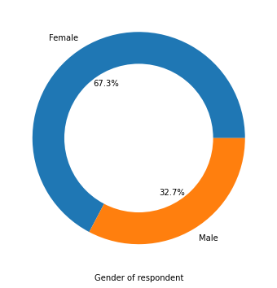
Gender of respondent

Slide 4
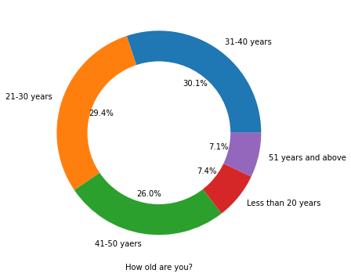
How old are you?

Slide 5
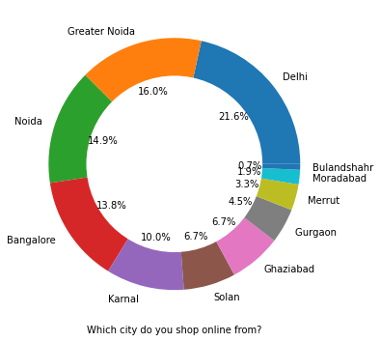
Which city do you shop online from?

Slide 6
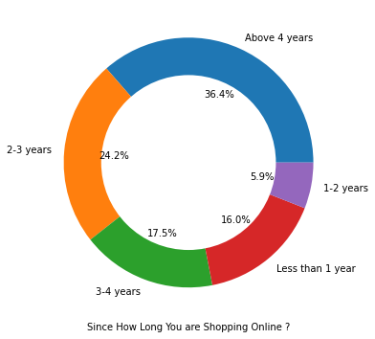
Since How Long You are Shopping Online ?

Slide 7
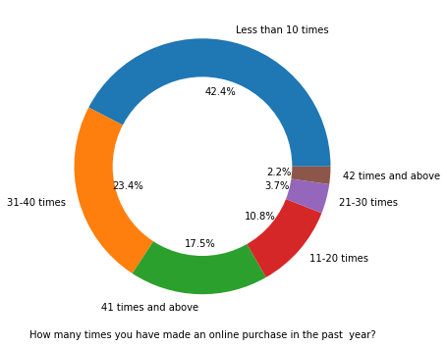
How many times you have made an online purchase in the past year?

Slide 8
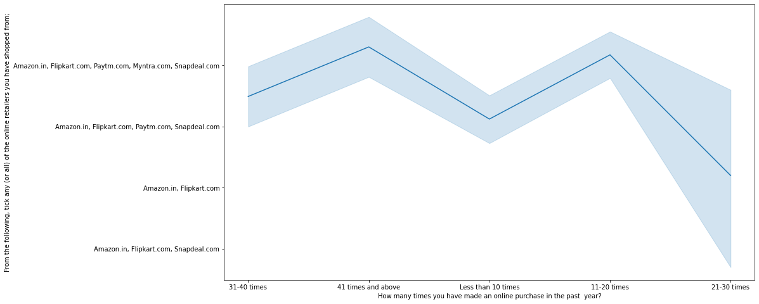
Relation of how many time shop in terms of different retailer

Slide 9
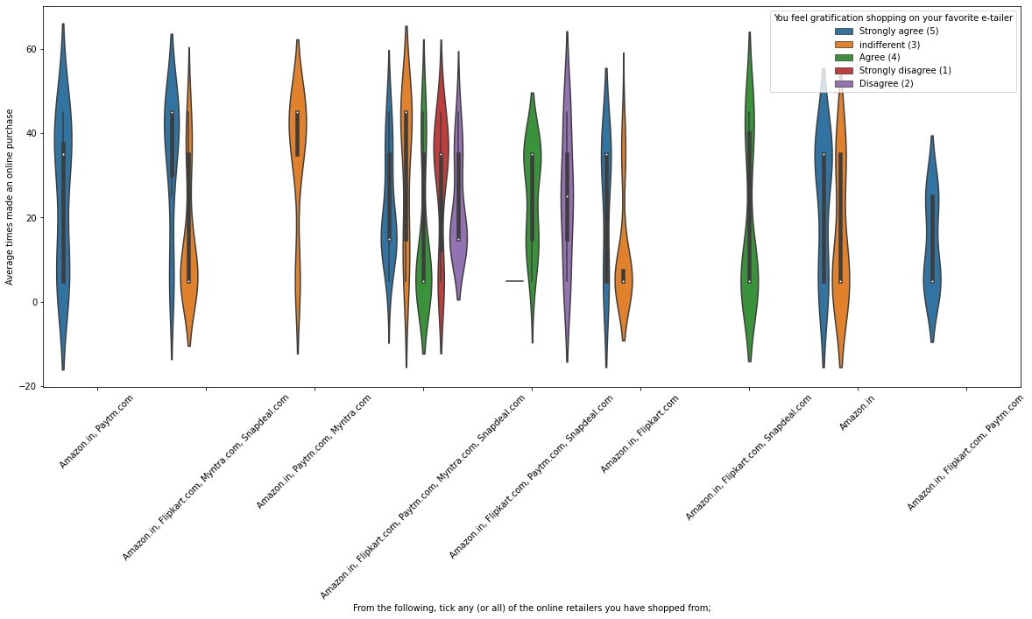
Relation of shopping with gratification in respect of different retailer

Slide 10
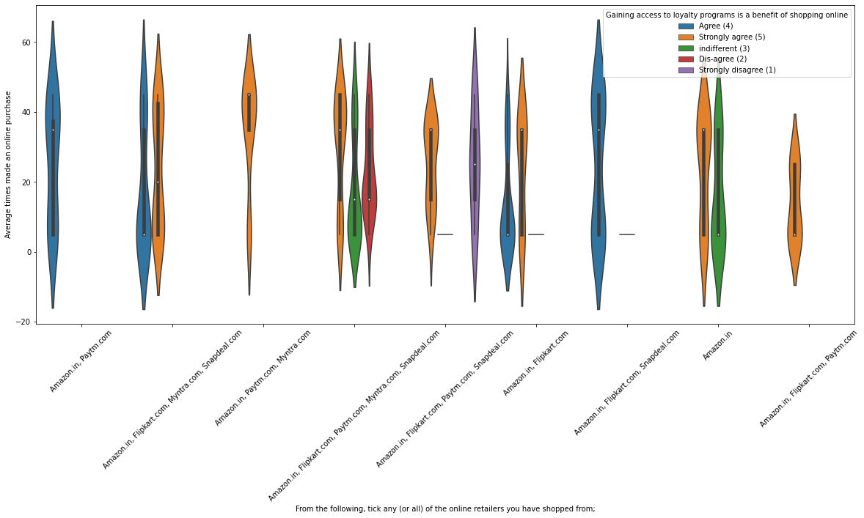
Gaining access to loyalty programs is a benefit of shopping online

Slide 11
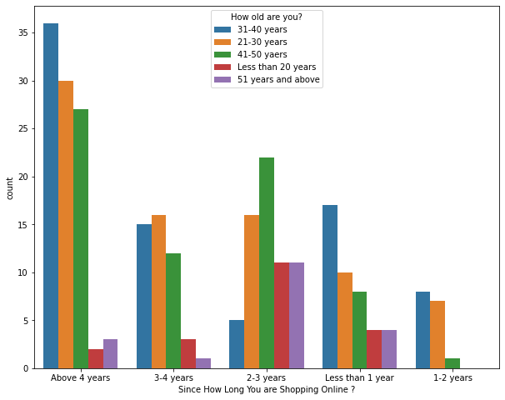
Relationship of age and no. of year shop

Slide 12
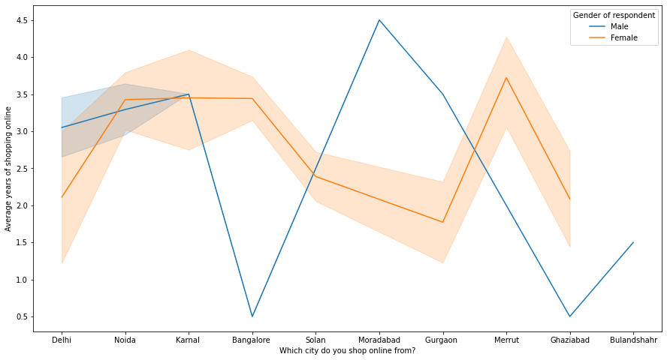
Relationship of gender, year of shopping and city.

Slide 13
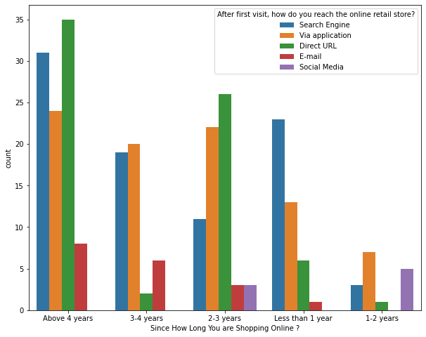
After first visit, how do you reach the online retail store

Slide 14
Performance based on:-
Easy to use website or application
Visual appealing web-page layout
Wild variety of product on offer
Complete, relevant description information of products
Fast loading website speed of website and application
Reliability of the website or application
Quickness to complete purchase
Availability of several payment options
Speedy order delivery
Privacy of customers’ information
Security of customer financial information
Perceived Trustworthiness
Presence of online assistance through multi-channel

Slide 15
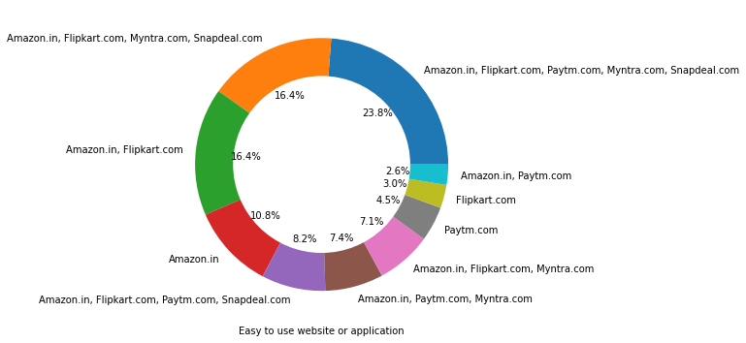
Easy to use website or application

Slide 16
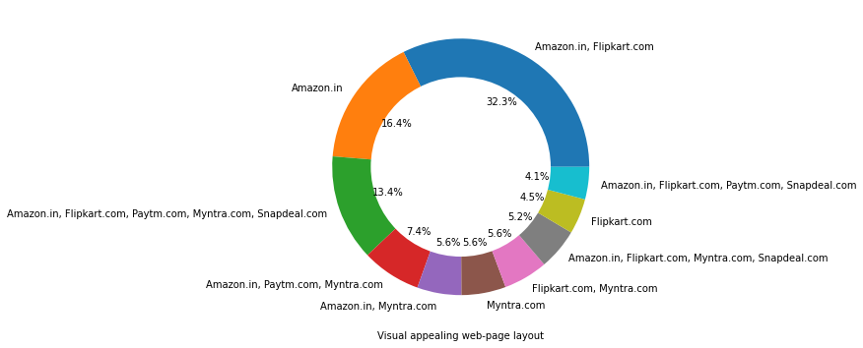
Visual appealing web-page layout

Slide 17
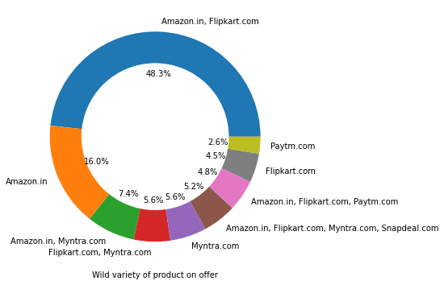
Wild variety of product on offer

Slide 18
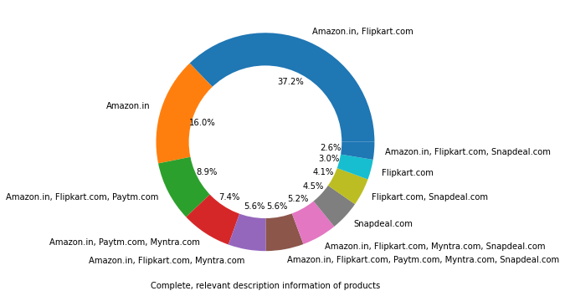
Complete, relevant description information of products

Slide 19
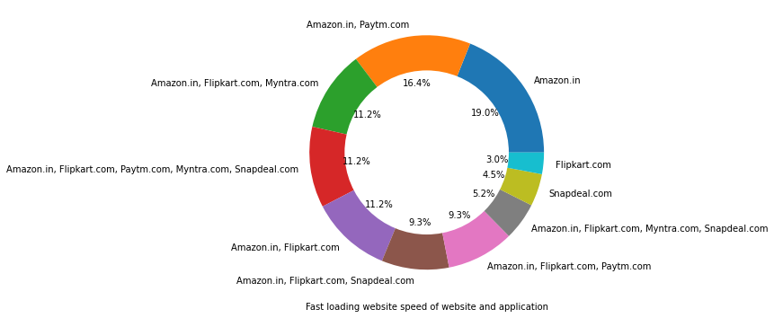
Fast loading website speed of website and application

Slide 20
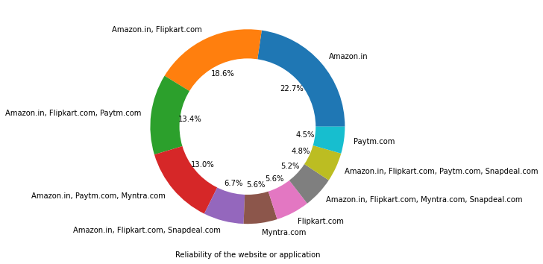
Reliability of the website or application

Slide 21
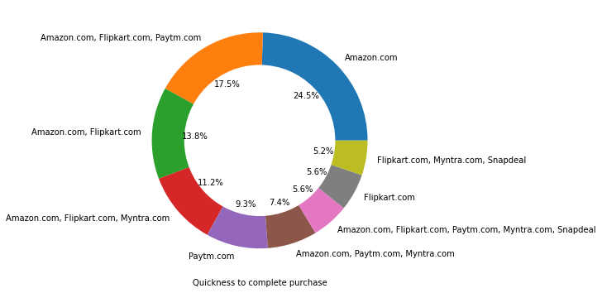
Quickness to complete purchase

Slide 22
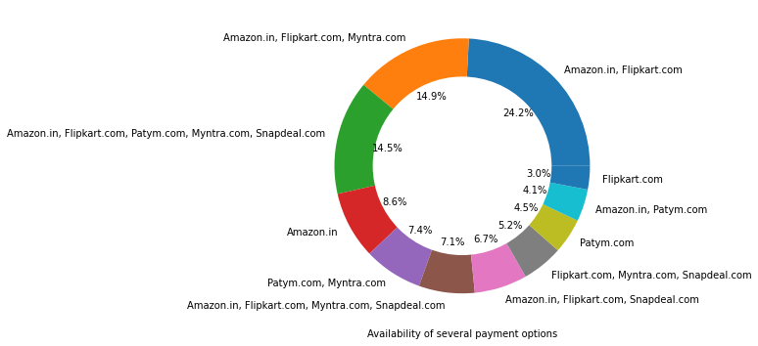
Availability of several payment options

Slide 23
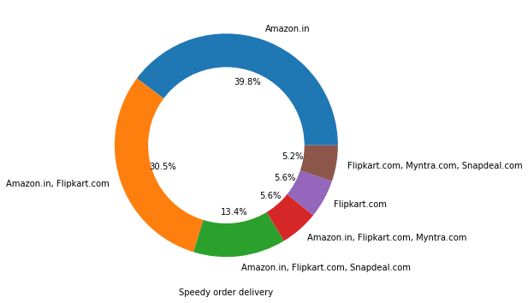
Speedy order delivery

Slide 24
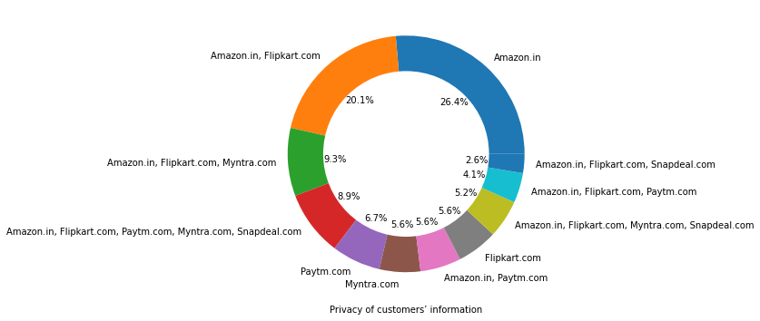
Privacy of customers’ information

Slide 25
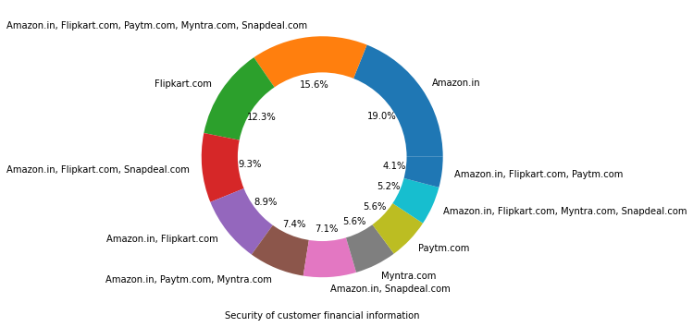
Security of customer financial information

Slide 26
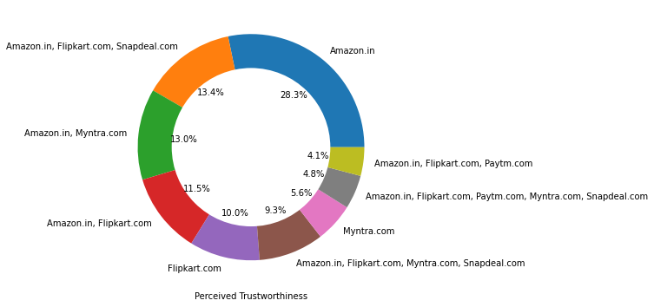
Perceived Trustworthiness

Slide 27
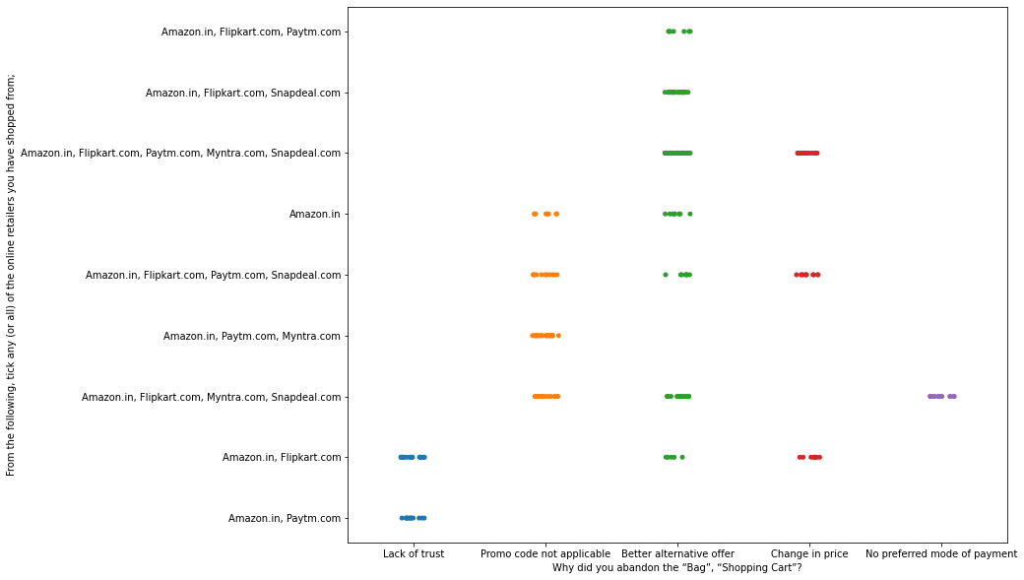
Relationship of not buying from different online retailer

Slide 28
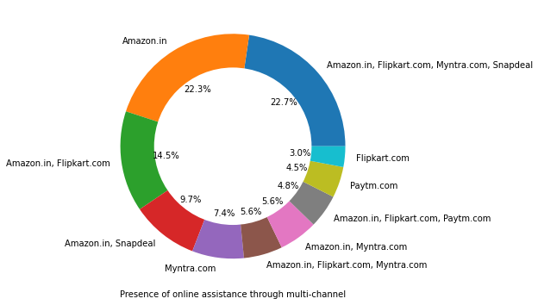
Presence of online assistance through multi-channel

Slide 29
Which of the Indian online retailer would you recommend to a friend?
Longer time to get logged in (promotion, sales period)
Longer time in displaying graphics and photos (promotion, sales period)
Late declaration of price (promotion, sales period)
Longer page loading time (promotion, sales period)
Limited mode of payment on most products (promotion, sales period)
Longer delivery period
Change in website/Application design
Frequent disruption when moving from one page to another

Slide 30
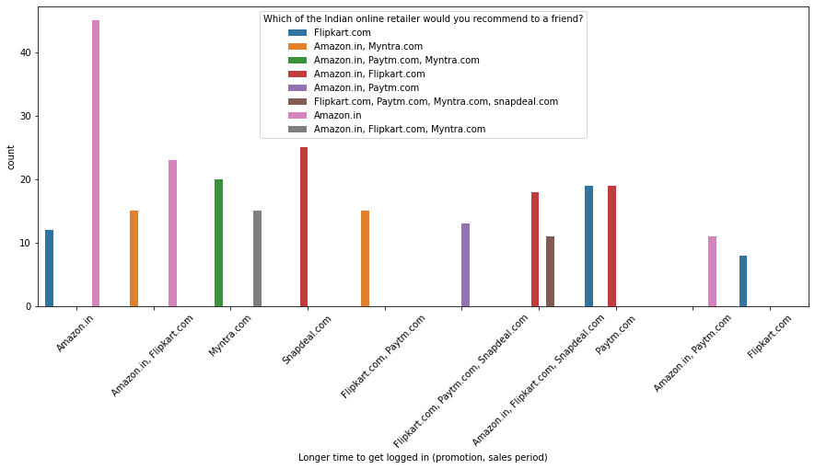
Longer time to get logged in (promotion, sales period)

Slide 31
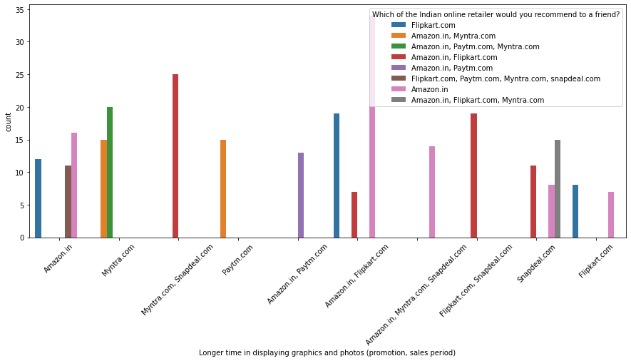
Longer time in displaying graphics and photos (promotion, sales period)

Slide 32
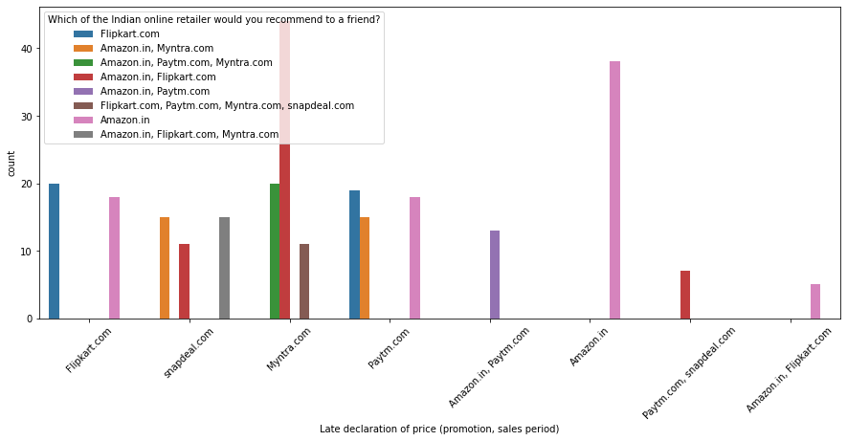
Late declaration of price (promotion, sales period)

Slide 33
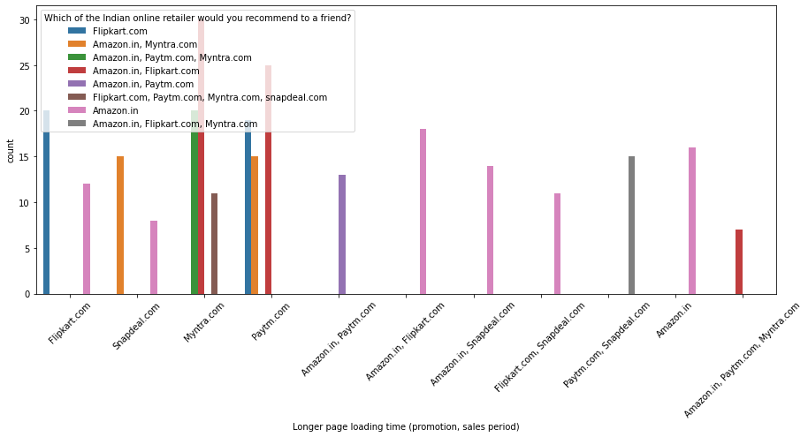
Longer page loading time (promotion, sales period)

Slide 34
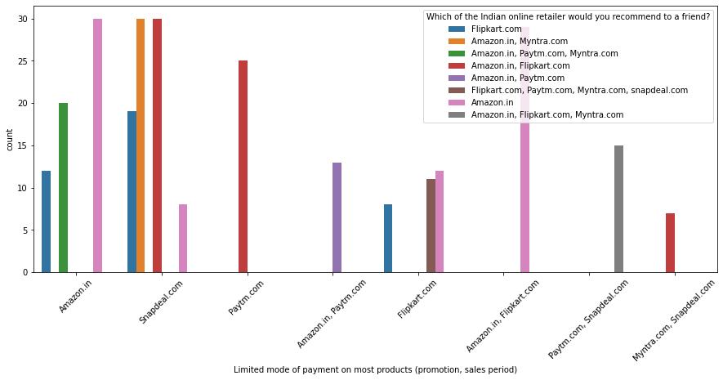
Limited mode of payment on most products (promotion, sales period)

Slide 35
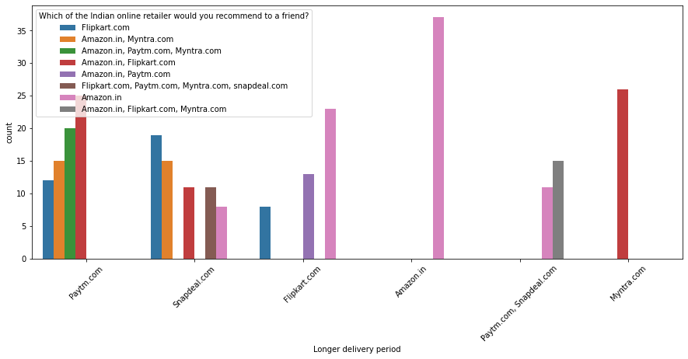
Longer delivery period

Slide 36
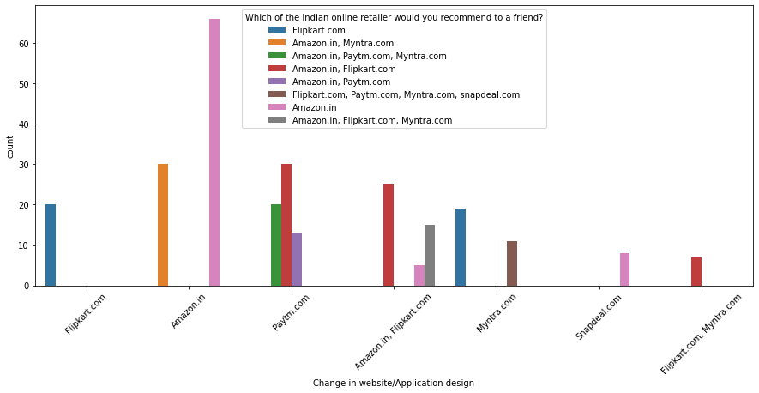
Change in website/Application design

Slide 37
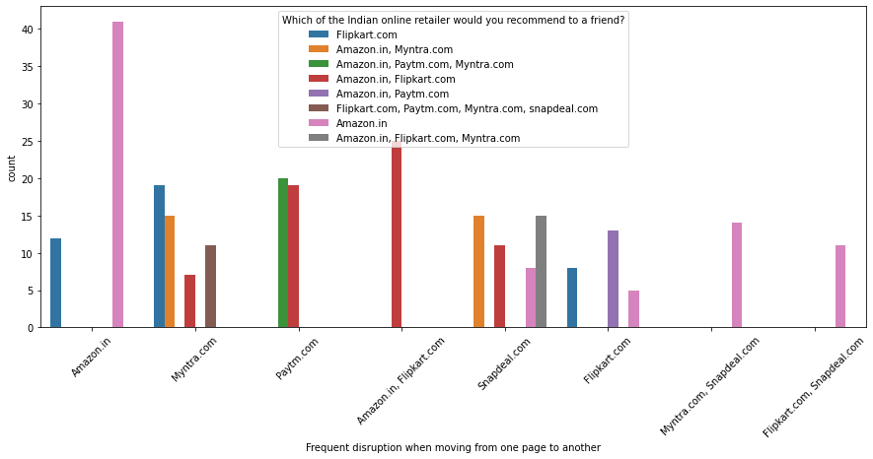
Frequent disruption when moving from one page to another

