Slide 1
Stock Market Trends

Slide 2
Objective:
Main objective of this projects is to provide an analytical report made in Power Bi so as to provide a detailed view on the time series projection of the different aspects via numbers for understanding the behavior of stocks in general for past 20 years
Benefits:
Helps us in understanding movement of stocks using visual representation of underlying patterns.
Gives us picture of total turnover for each of the company or for individual companies for any given year

Slide 3
Data Sharing Agreement :
Sample file name (ex ADANIPORTS.csv)
Number of Columns
Column names
Column data type

Slide 4
Architecture
Start
Fetching data from given local directory in Power BI desktop
Performing ETL process using Power Query Editor and M code for cleaning up the data
Use the calculated columns and measures created in Power BI in different visuals
Create required measures and calculated columns
Create the required pages, Save and publish it to required workspace in Power BI service
End

Slide 5
Results:
The measures and calculated columns created in the pbix file for this report will be used for different visuals depicting the fraudulent transactional cases across different visual depending on the most suitable that we want to represent.

Slide 6
Q & A:
Q1) What’s the source of data?
The data files for usage is provided by the client in multiple batches and each batch contain multiple files
Q 2) What was the type of data?
The data was the combination of numerical and Categorical values.
Q 3) What’s the complete flow you followed in this Project?
Refer slide 4th for better Understanding

Slide 7
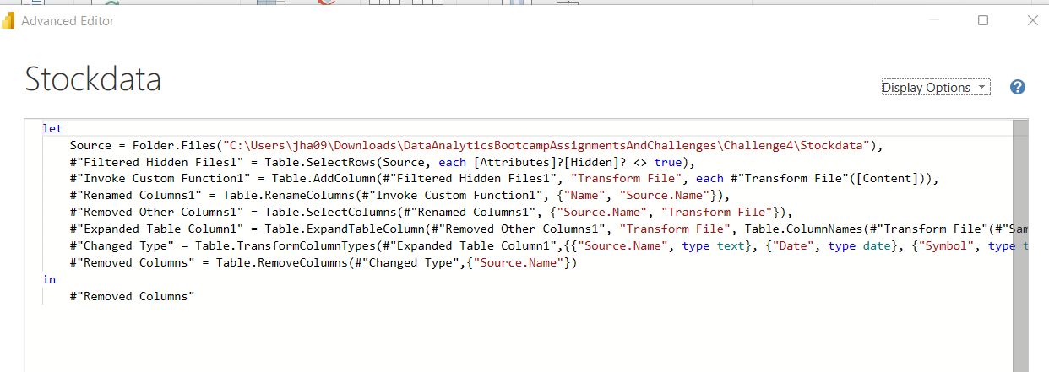
Q 4) What techniques were you using for data pre-processing?
Data cleaning was done using M code in Power Bi’s Query editor and is defined as following steps:

Slide 8
Thank you!

