Slide 1

Data Analysis
On
“NYC Taxi Fares Dataset”
By:
Murali Prateek Manthri

Slide 2

"From Data to Dollars" Optimizing Tip Strategies for Taxi Drivers

Slide 3

Executive Summary:
Overview of NYC Taxi Fare Dataset :-
Trip Data: Pickup/drop-off times, locations, distance, passenger count.
Fare Breakdown: Base fare, tips, tolls, surcharges (including congestion).
Payment Types: Cash, card
Predicting our outcome variable – “TIP” which is depended on various independent variables.
Creating bins – Categorizing peak times during the day to see their impact on our outcome variable- “Tip”.
Creating visuals to better understand the correlation between the variables within the data.
Establishing significant relations between individual variables and validating their impact.

Slide 4
THE REAL QUESTION IS:
Which key elements drive tipping behavior, and how can they be applied to boost both driver efficiency and customer satisfaction?

Slide 5
What are the primary drivers of higher TIPs ?
TIP
Passenger Count
Drop off Date & Time
Trip Distance
Fare amount
Pick up Date & Time
Congestion Surcharge

Slide 6
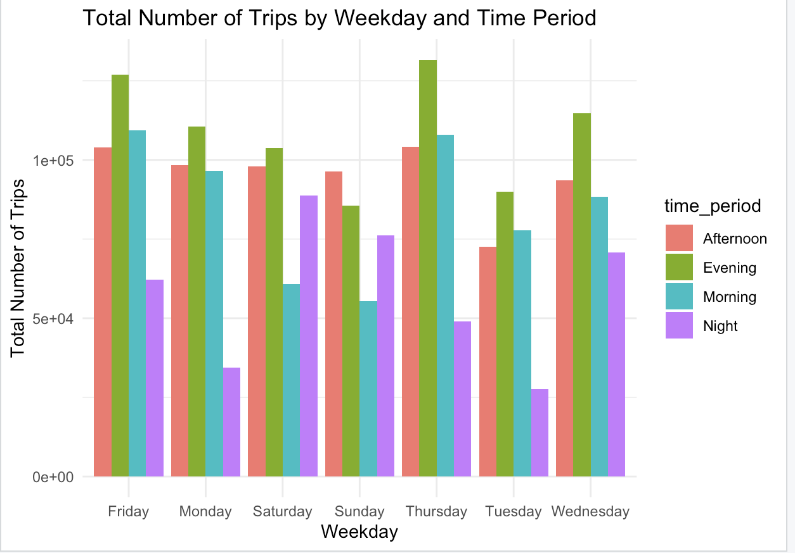
Data Visualization Of Tipping Behavior

Slide 7
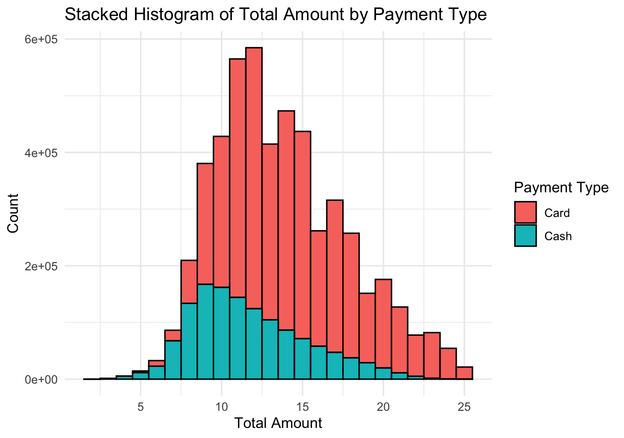
Data Visualization Of Tipping Behavior

Slide 8
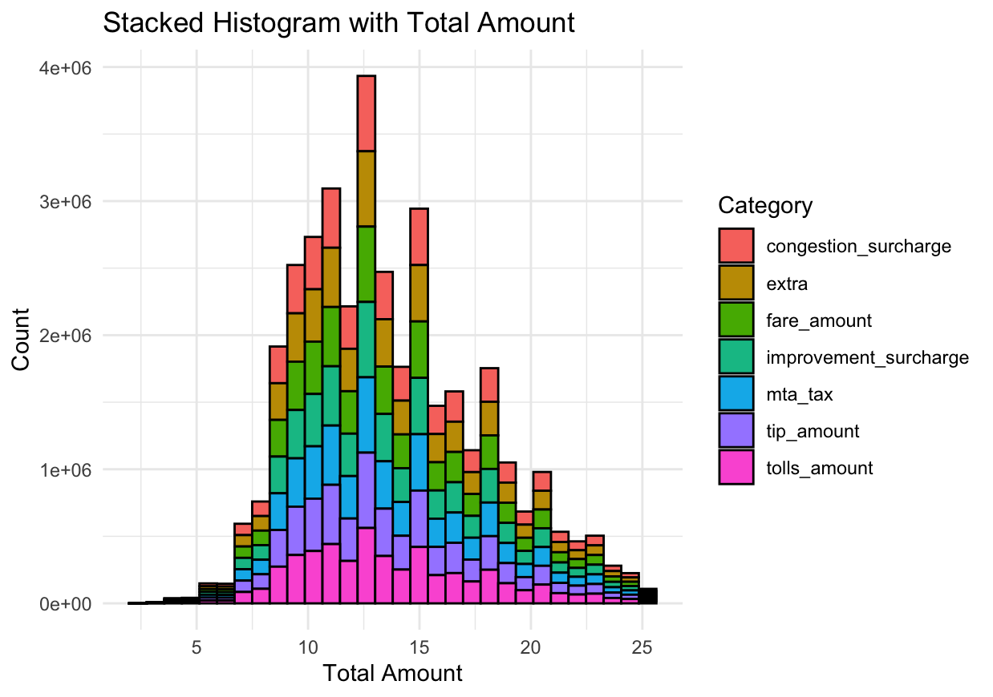
Data Visualization Of Tipping Behavior

Slide 9
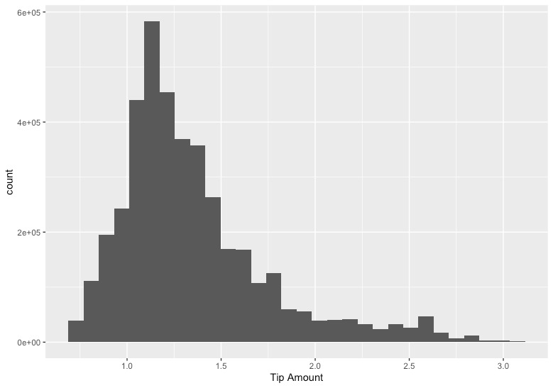
Data Visualization Of Tipping Behavior

Slide 10
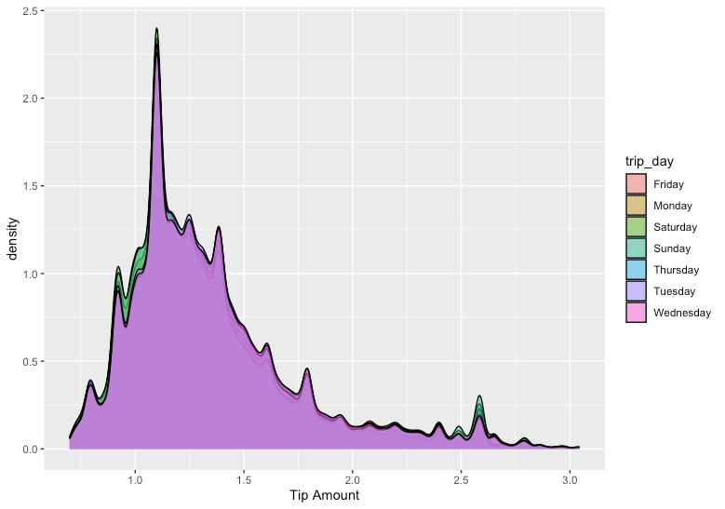
Data Visualization Of Tipping Behavior

Slide 11
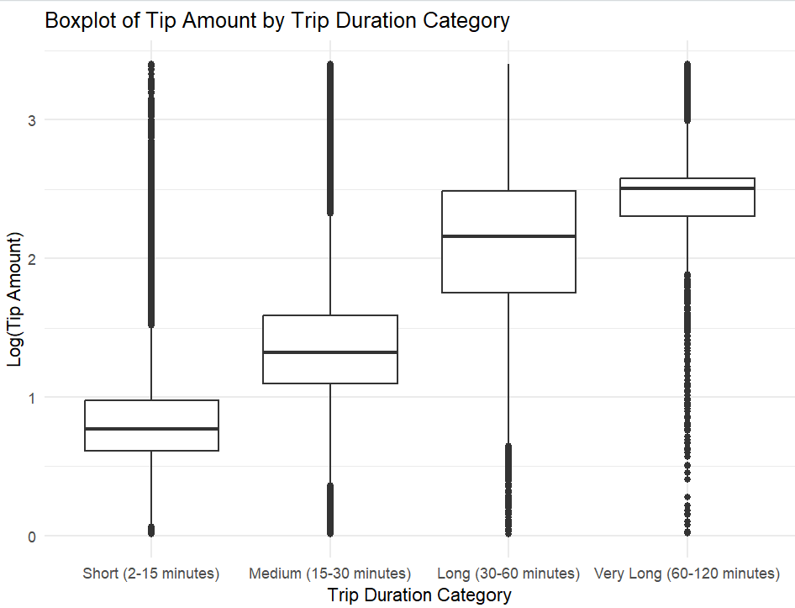
Data Visualization Of Tipping Behavior

Slide 12
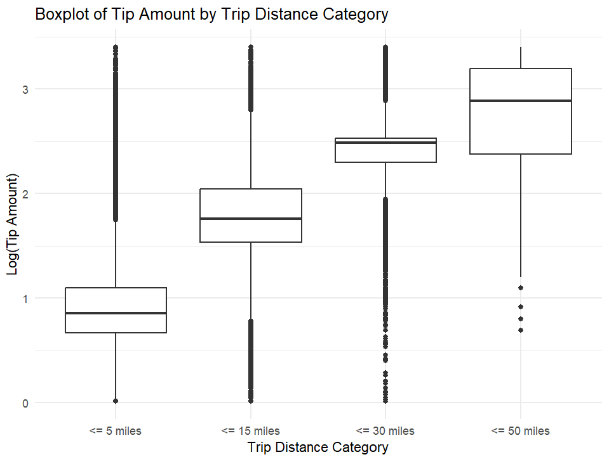
Data Visualization Of Tipping Behavior

Slide 13
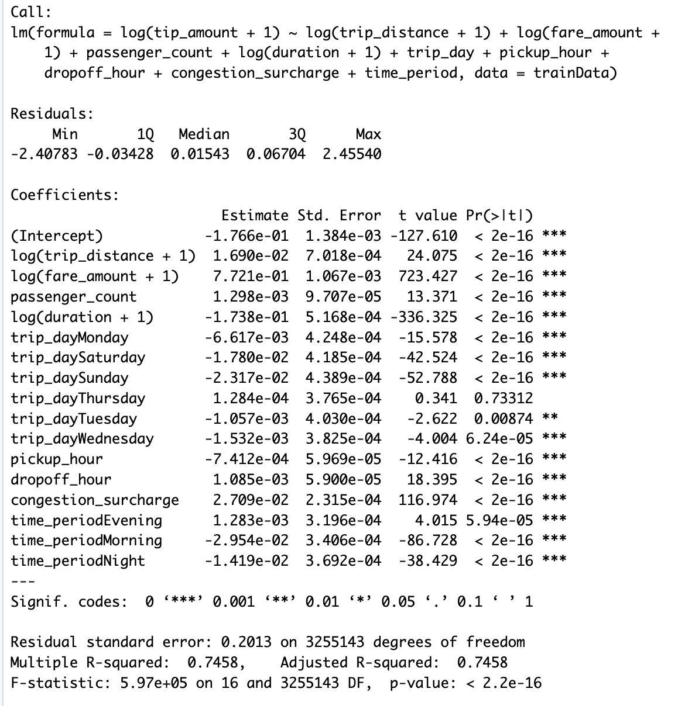
MODEL

Slide 14
“Driving Up the Tips”

Slide 15
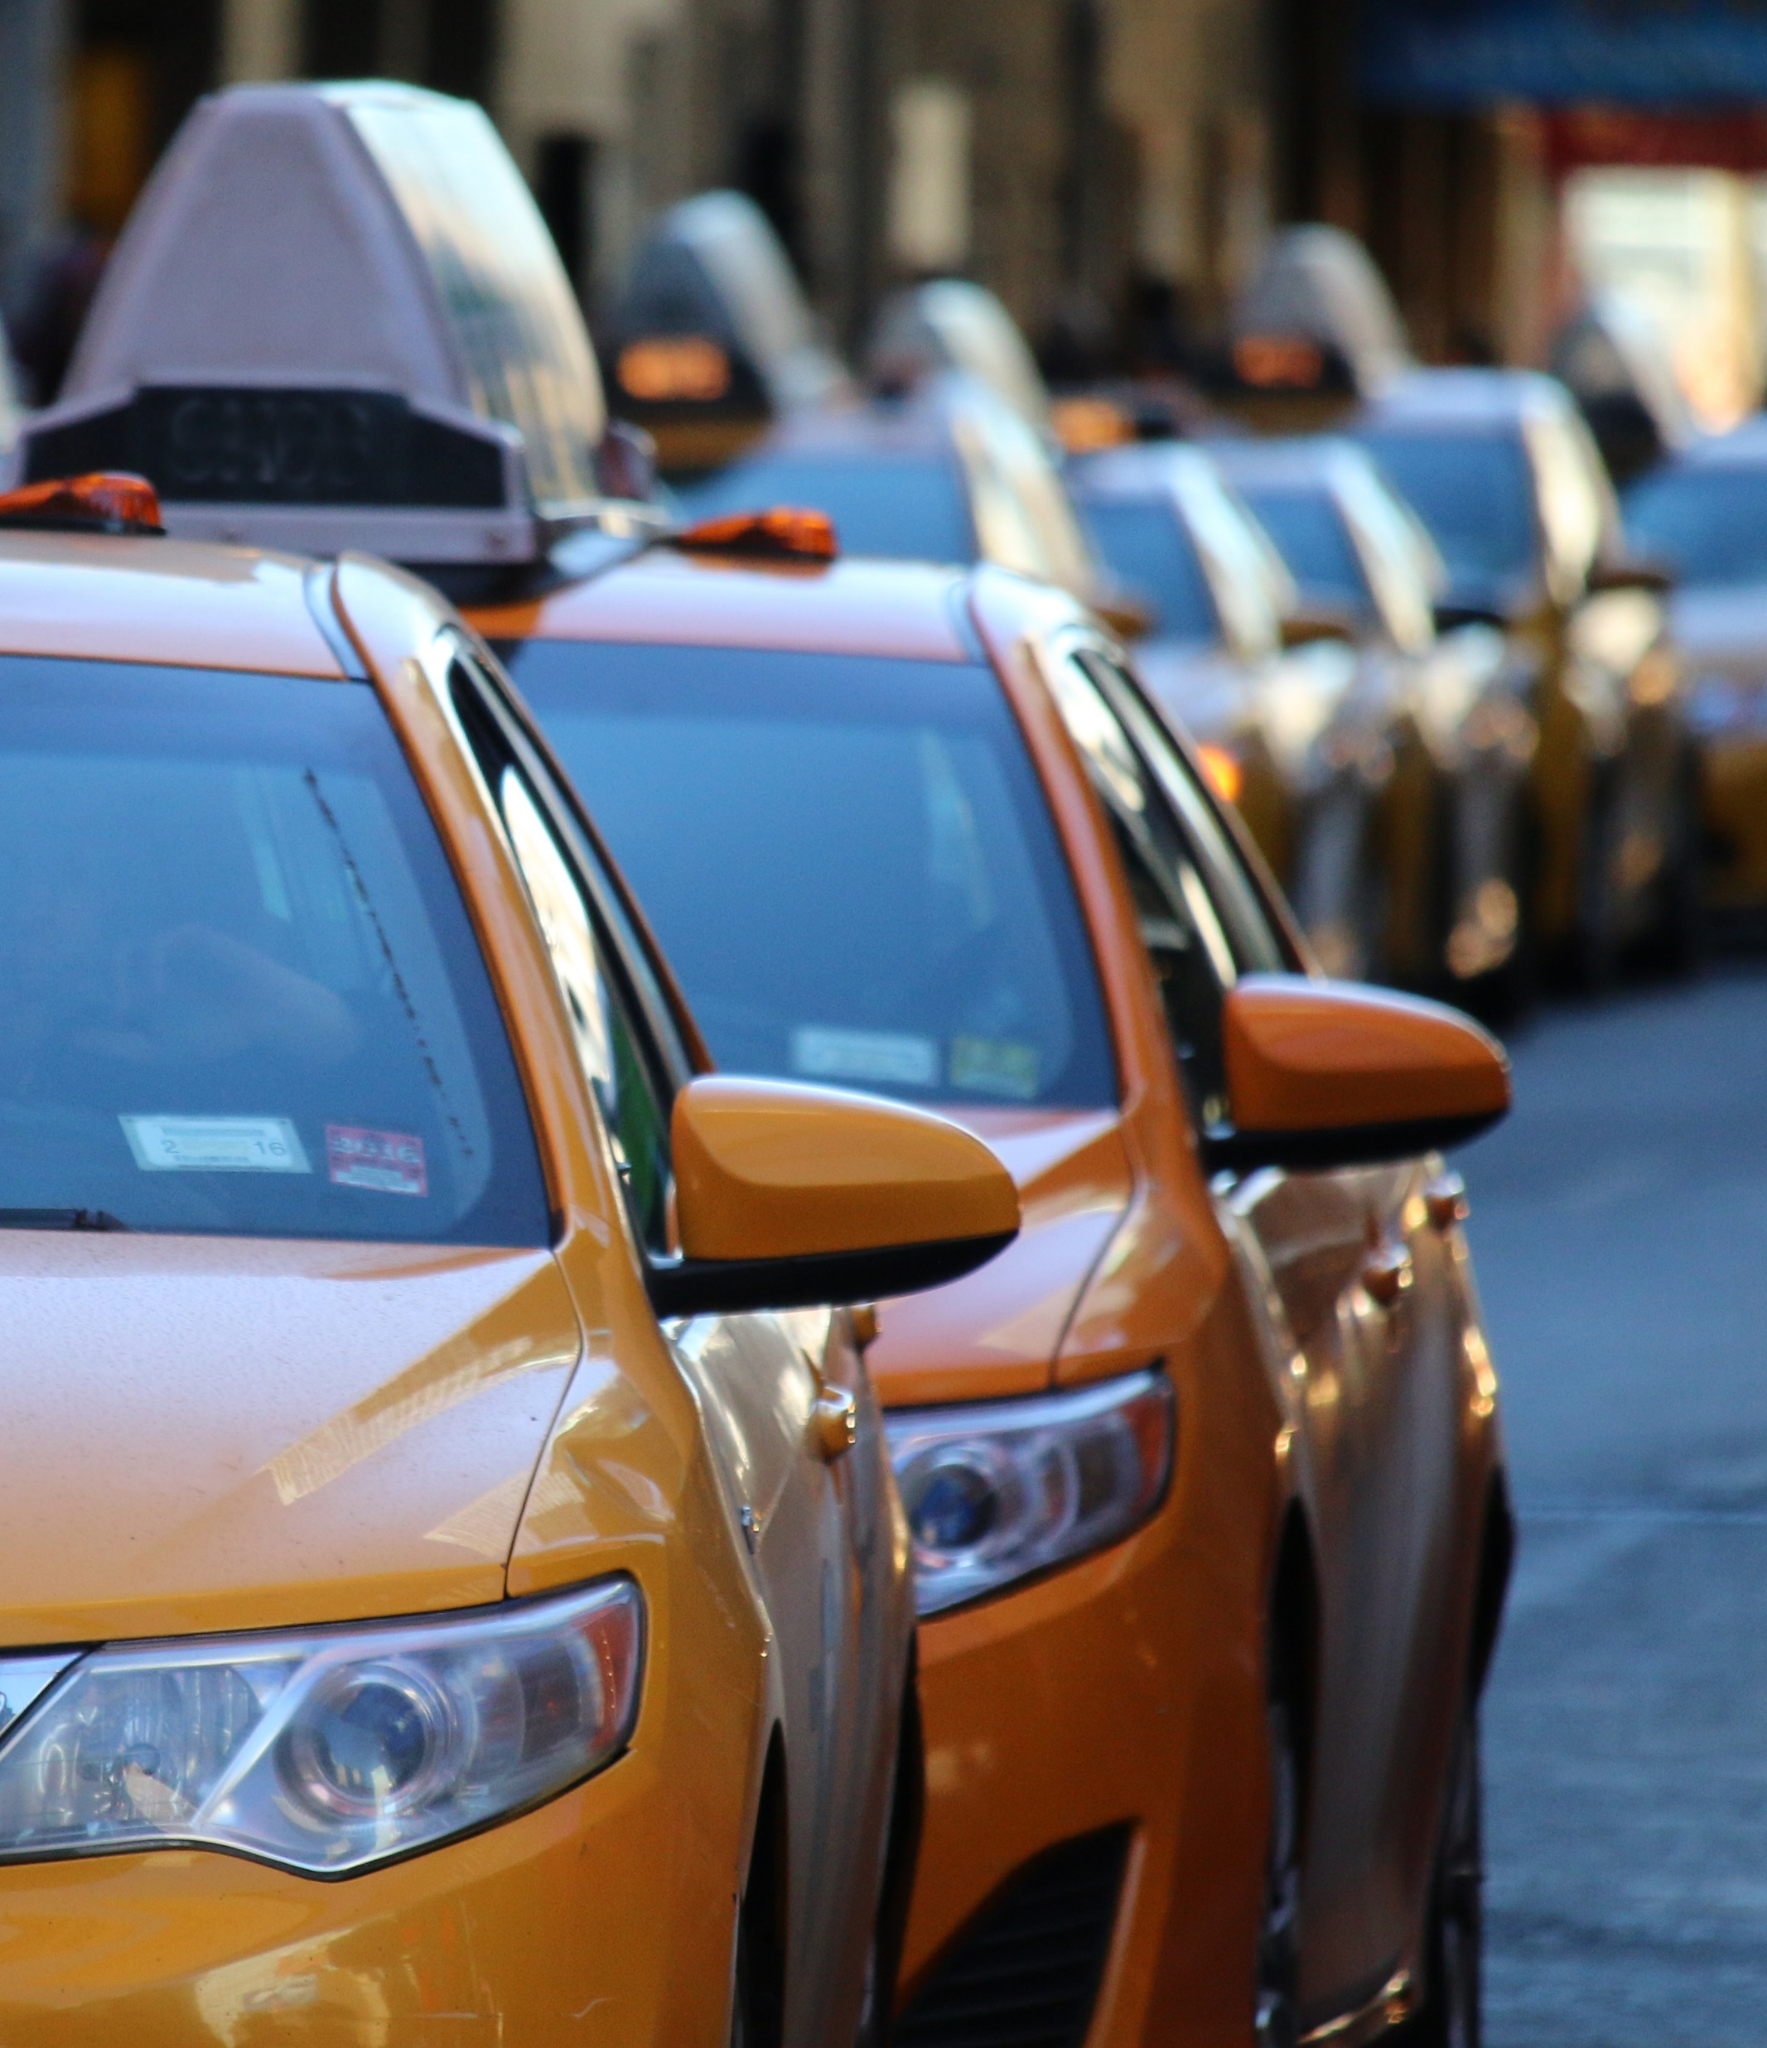
Conclusion:
There is a clear positive relationship between trip distance and tip amount; longer trips generally result in higher tips.
The number of outliers (very high tips) increases with the trip distance, suggesting that customers may tip generously for extended journeys.
Short trips have more clustered tips around lower values, possibly indicating standard tipping behavior for routine commutes.
There is a clear upward trend in median tip amounts as trip duration increases, suggesting that longer trips generally result in higher tips.
The variability in tip amounts also increases with trip duration, especially for trips longer than 30 minutes, indicating more diverse tipping behavior for extended rides.
The presence of many high outliers in the "Very Long" category suggests that customers are willing to tip generously for very long trips, even though the range of tip amounts is wide.

