Slide 1
Analysis of PGA Tour Statistics

Slide 2
Team members
ORATOR
INTERPRETER & ORATOR
CREATOR
DELIVERER
Darshan Gudivada
Prateeksha Mehta
Sri Sai Charan Donepudi
Hanoonah Sheikh

Slide 3
iNTRODUCTION
Scenario: Analysis of PGA Tour Statistics
Goal: Determine the best predictors of a player’s scoring average.
Focus: Top 125 players by earnings in 2008.
Method: Multiple Linear Regression models to analyze performance variables like driving distance, greens in regulation, and putts per round.

Slide 4
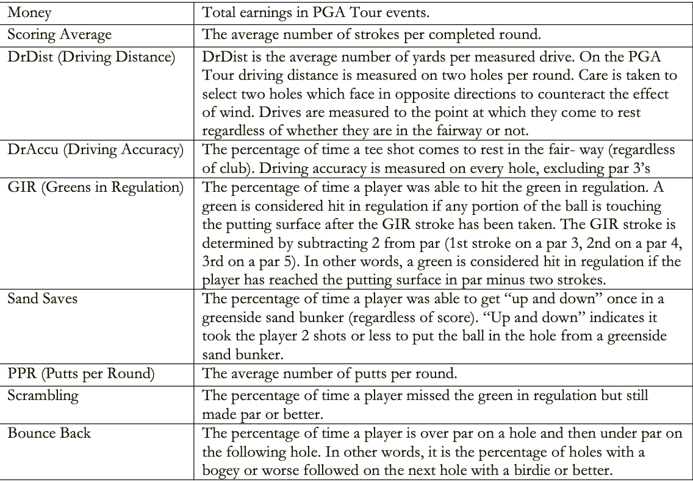
Variables in the dataset
Response Variable: Scoring Average
Explanatory Variables:
Continuous: Money, Bounce Back, PPR, GIR, DrDist, DrAccu, Scrambling, Sand Saves
Excluded: Rank and Player (not predictive)

Slide 5
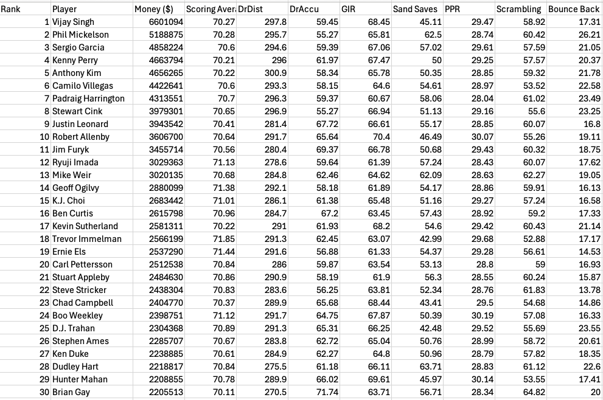
Glimpse of PGA Tour dataset

Slide 6

Exploratory Data Analysis (EDA)
Why EDA??
Distributions of individual variables.
Relationships between variables.
Identification of outliers and missing data.
Scatter Plots: Non-linear relationships observed.
Correlation Analysis: PPR and GIR showed high correlation (0.733).

Slide 7
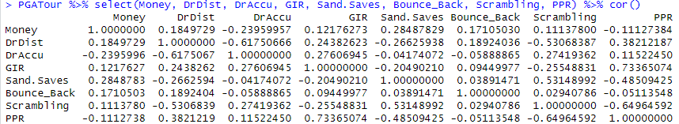

PPR and GIR are related to each other as the value of correlation is greater than 0.7
A chance of multicollinearity in our model

Slide 8
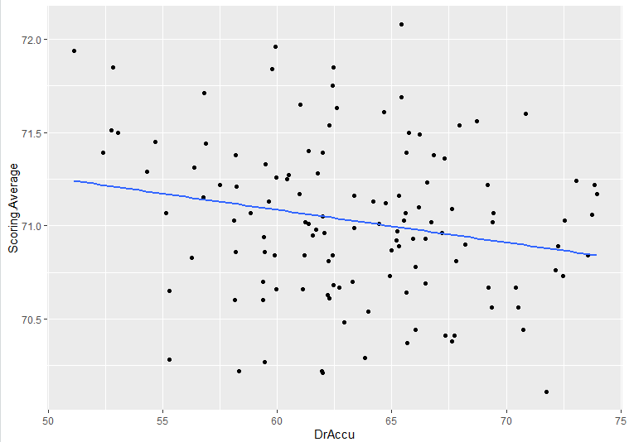
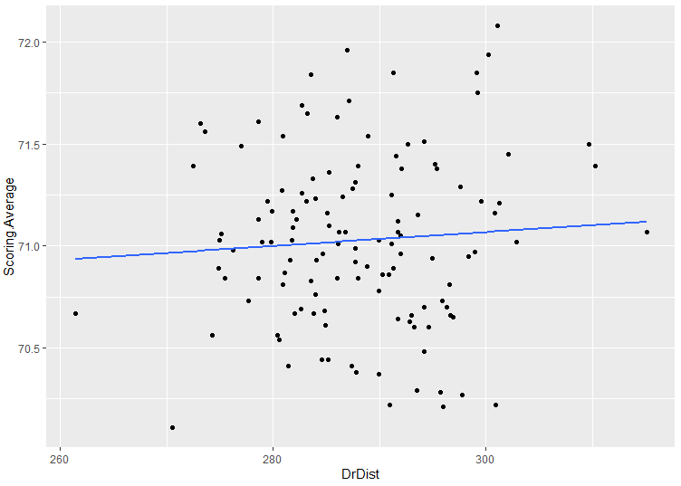
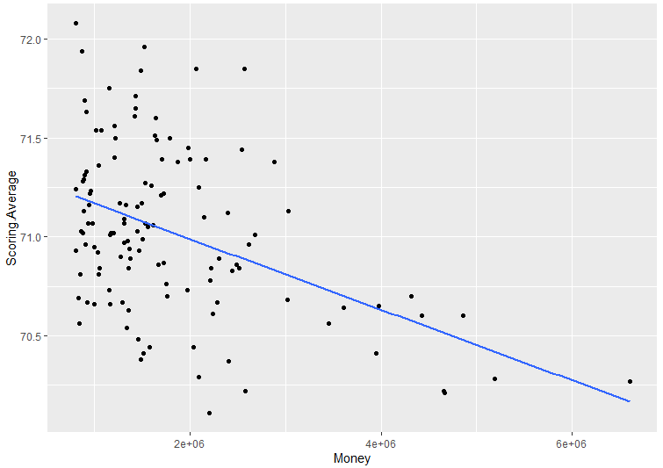
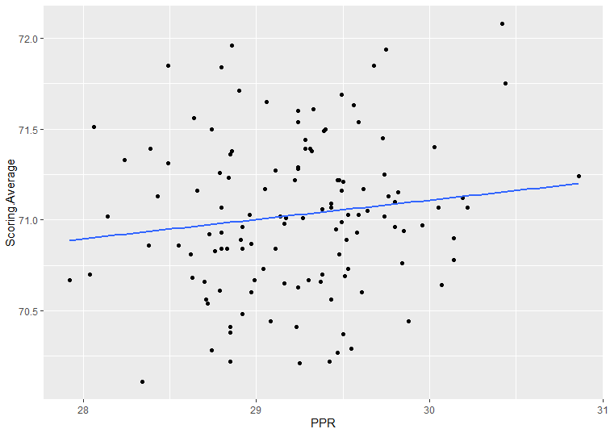
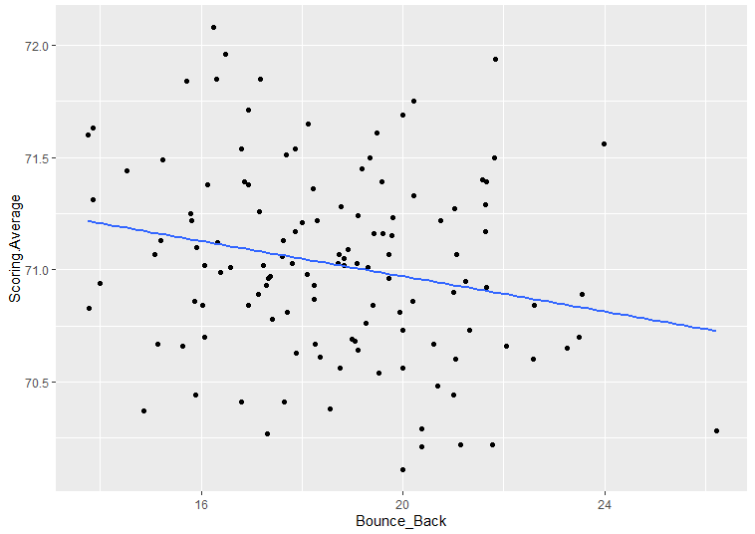
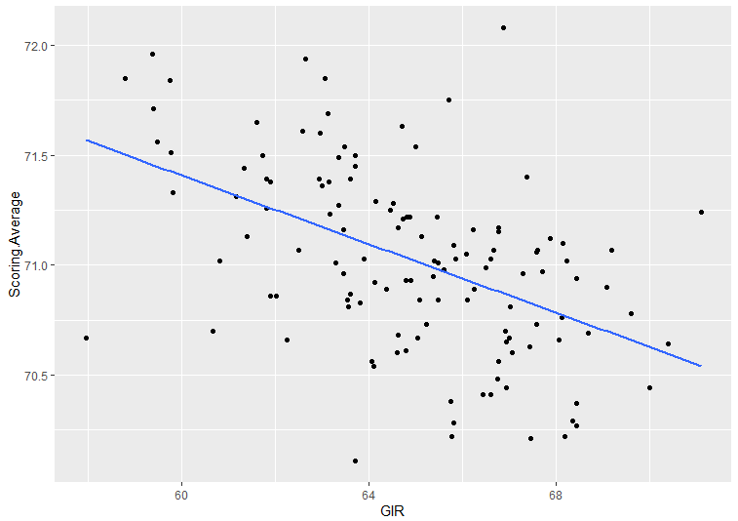
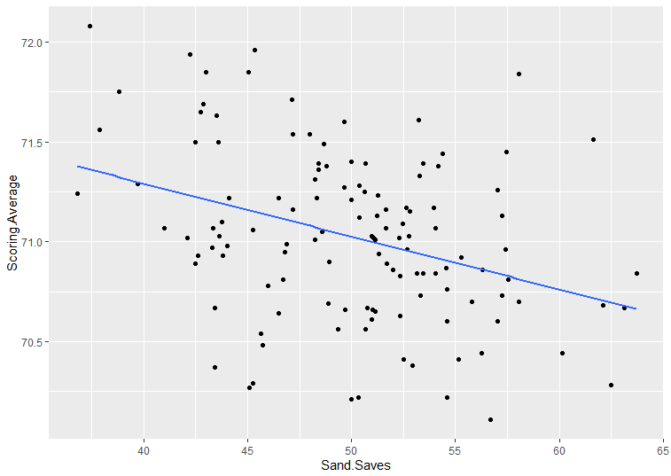
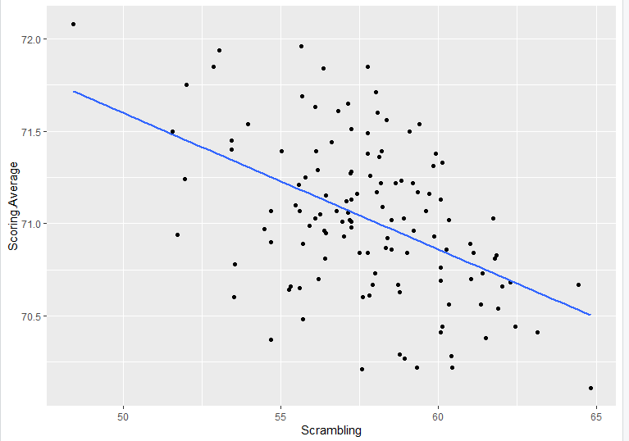
Scatter plot for data visualization

Slide 9

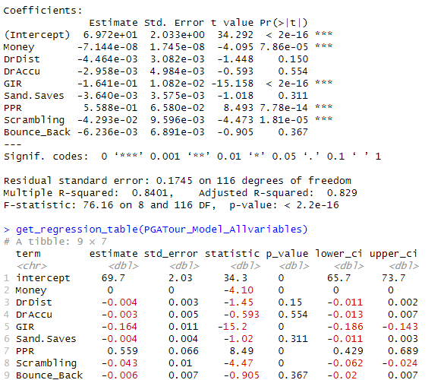
Initial Model
Multiple Linear Regression Model:
Considered all explanatory variables.
R-squared: 0.829
- Insignificant Variables whose p-values (>5%)
Sand Saves
DrDist
DrAccu
Bounce Back

Slide 10
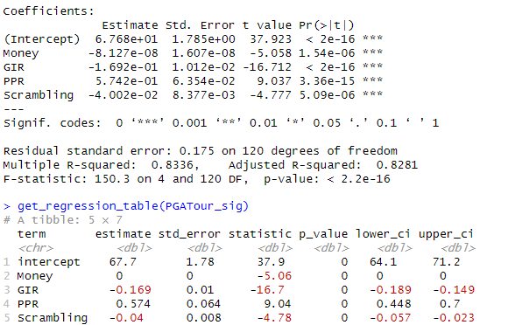
Regression Model with only Significant variables
Insights:
Adjusted R –square : 0.8281
This model is a good model as the variability is almost the same.

Slide 11
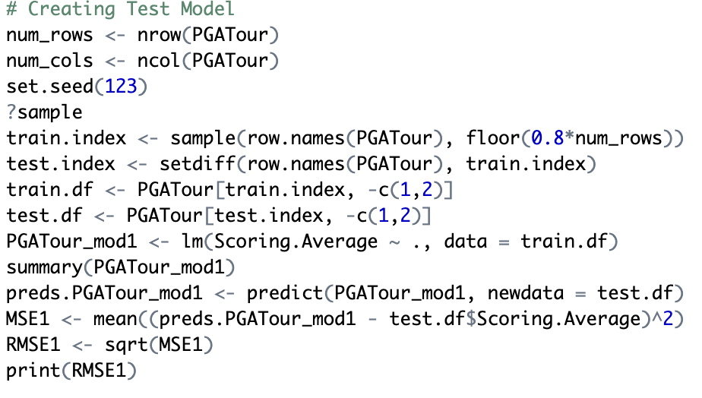
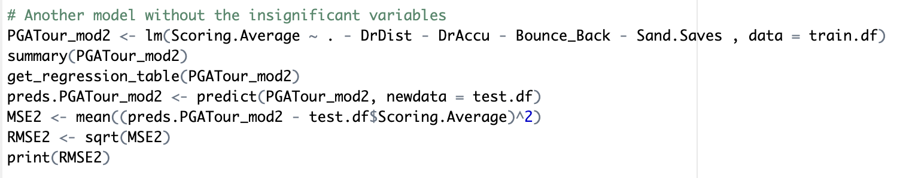
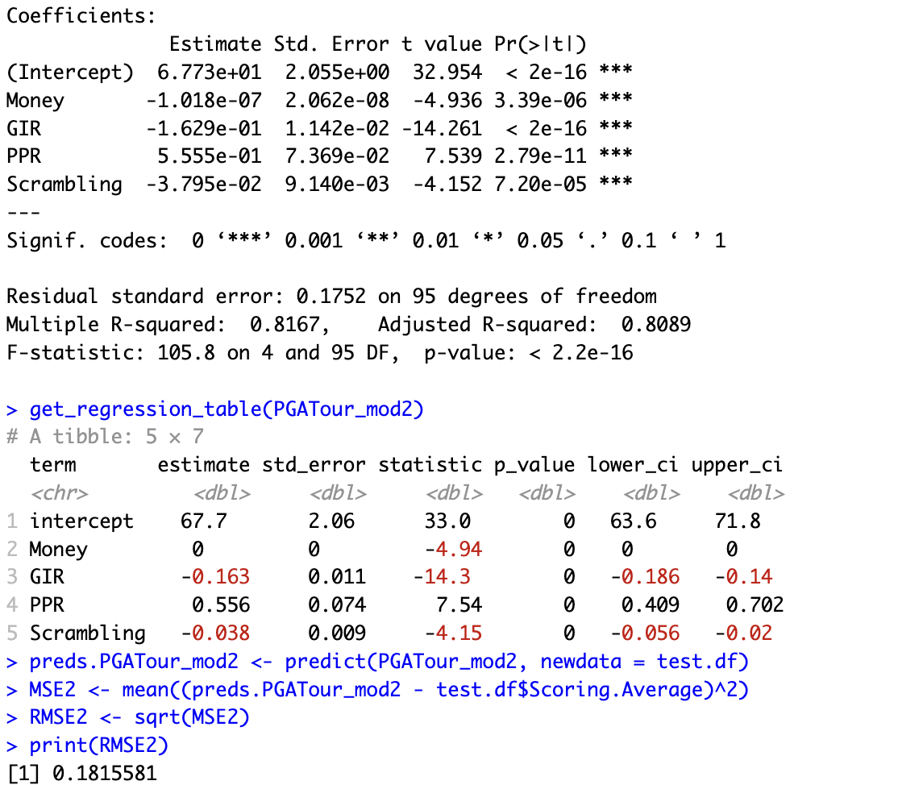
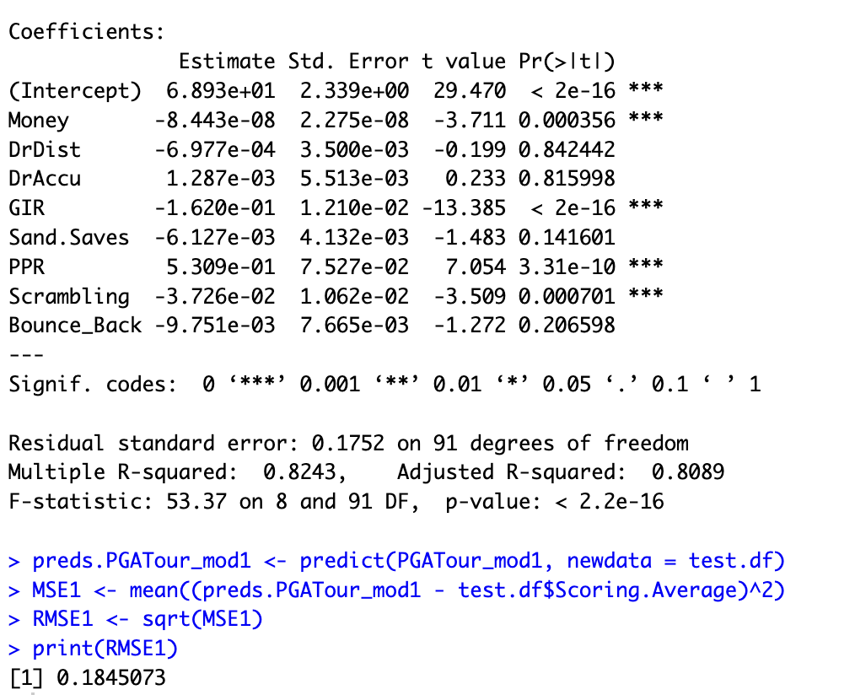
Model Validation
Model 1 (All variables): RMSE = 0.1845, R-squared = 0.8089.
Model 2 (Significant variables): RMSE = 0.1815, R-squared = 0.8089.

Slide 12


Which transformation will be our savior for improving our prediction accuracy??

Slide 13
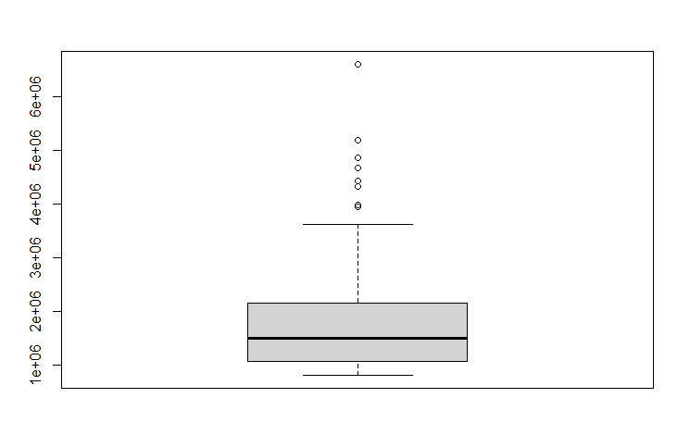
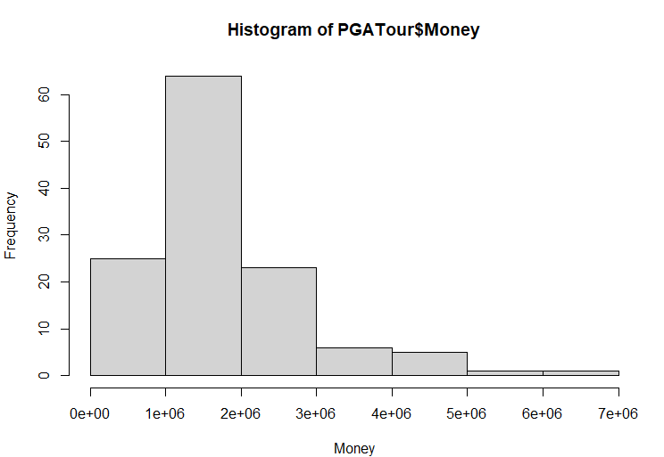
Why Log Transformation ??
Money

Slide 14
Transformation Techniques
Goal: Improve prediction accuracy.
Approach: Logarithmic Transformation:
Variables: Money (log transformation to reduce skewness and stabilize the variance).
Observation: Reduced RMSE to 0.175, R-squared = 0.8046.

Slide 15
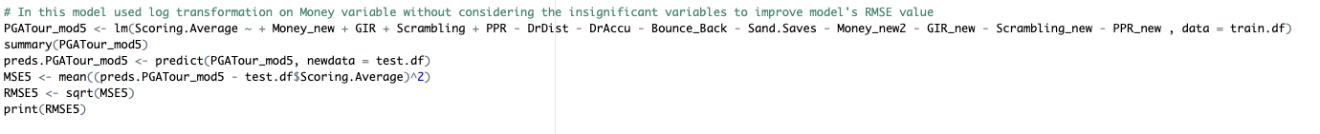
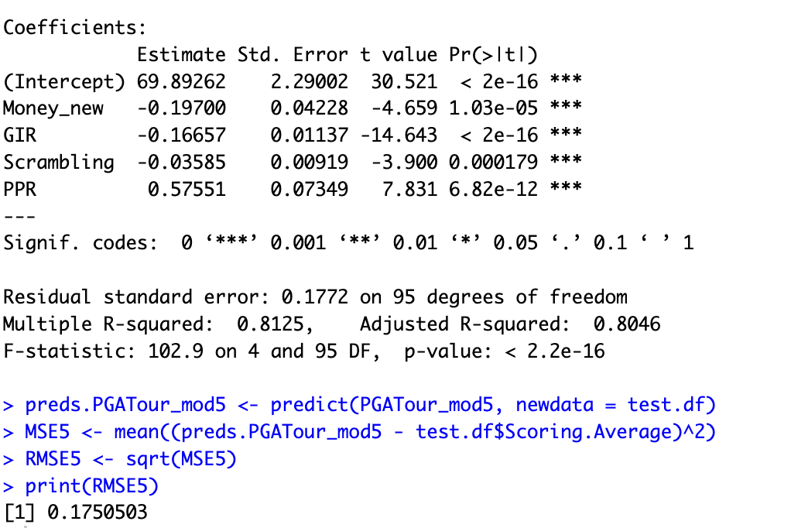
Log Transformation on Money variable with only significant variables
Insights:
RMSE value improved from the previous two models
R –squared slightly changed but still the model is good fit for prediction.
R-squared : 0.8046
RMSE : 0.17505

Slide 16
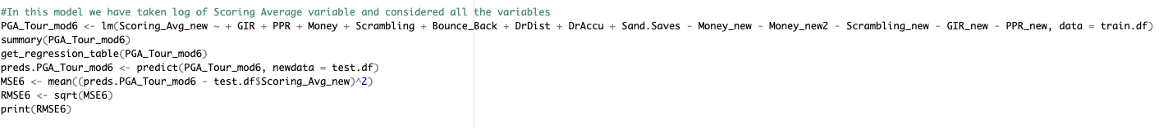
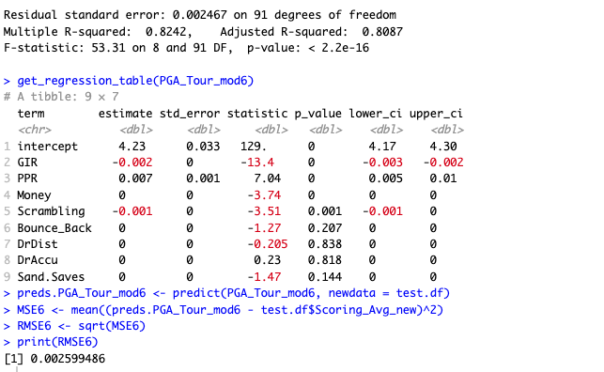
Log Transformation on Scoring Average variable with all variables
Insights:
RMSE value improved from the previous models
R –squared slightly changed but still the model is good fit for prediction.
R-squared : 0.8087
RMSE : 0.002599

Slide 17
R & D on Different Test Models
Model | R-square | RMSE
Mod 1 - All variables | 0.8089 | 0.1845
Mod 2 - Significant variables | 0.8089 | 0.1815
Mod 3 - Polynomial transformation on GIR, Money, PPR and Scrambling with all variables | 0.807 | 0.1855
Mod 4 - Polynomial transformation on GIR, Money, PPR and Scrambling | 0.8067 | 0.18602
Mod 5 - Log transformation on Money with all significant variables | 0.8046 | 0.17505
Mod 6 - Log transformation on Scoring Avg with all variables | 0.8087 | 0.002599
Mod 7 - Log transformation on Scoring Avg and Money with all variables | 0.8061 | 0.002542
Mod 8 - Log transformation on Scoring Avg and Money with only significant variables | 0.8044 | 0.002467

Slide 18
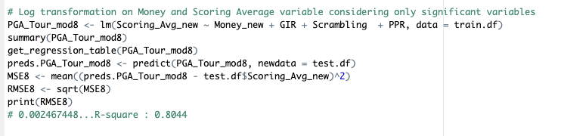
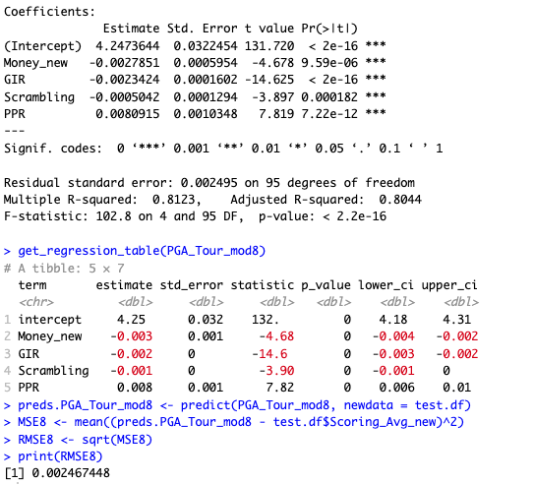
Enhanced Model
Insights:
Log transformation applied to both Scoring Average and Money.
RMSE value of this model is the best compared to the other models.
RMSE : 0.002467
R-squared : 0.8044

Slide 19
Estimated ReGression Equation
Final Equation: Regression formula for predicting Scoring Average.
log(Scoring.Average) = 4.25 - 0.002 log(Money) - 0.002 * GIR - 0.001 * Scrambling + 0.008 * PPR

Slide 20
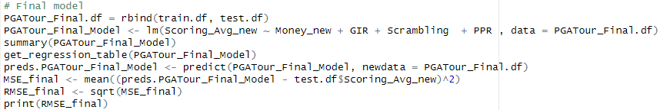
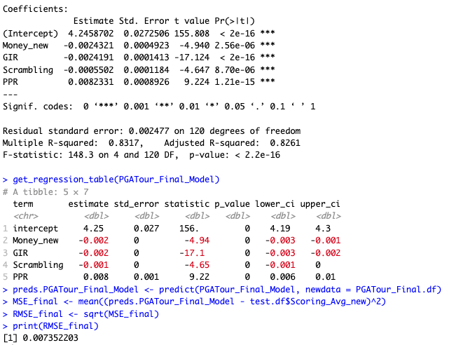
Final Model

Slide 21


Slide 22
THANK YOU

