Slide 1
GUILDLINES:
1) what is a kdevelop…
2)idea …
3)what problem does it solve…
4) intent behind to make it open source …
5) lincensing model…
6)popularity..
7)monetization..
8)IMPACT…

Slide 2

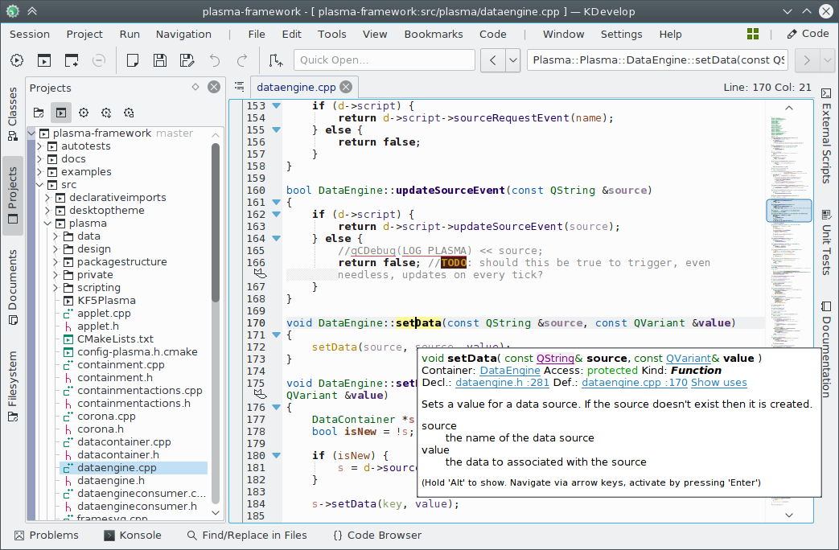
Kdevelop
KDevelop is a free and open-source integrated development environment for Unix-like computer operating systems and Microsoft Windows.

Slide 3

Idea (How was the project started)
AFAIK Sandy Meier founded it. Some people from his university helped him. Ralf Nolden has also been a member from the first days.
Although it's Sandy's story, I'm telling it now :-) Somewhen 1998 Sandy Meier started KDevelop and worked 8 weeks alone on this project. After 2 or 3 fellow students of him added some features, 0.1 was released on the Sept. 22. 1998. After 0.1 Ralf Nolden joined. 3 months later 0.2 was released. Then Pascal Kramer integrated the dialog editor and Jonas Nordin rewrote the C++ parser for the class browser. Release 0.3 came along. After that 0.4 was released but I don't know what was new in that version. After that 1.0beta1 was released. That was more or less the beginning. On the 4th May of 1999 www.KDevelop.org got online the first time!fays.

Slide 4
What problem dose it solve with Kdevelop software
KDevelop it's a perfect IDE for KDE users.
- support for most popular programming languages like PHP, Python, C, C++ and more...
Integration with most popular CVS (Convenience, Value, and Service) like Git, SVN and Mercurial.
better integration with KDE technology.
KDevelop increase the development productivity and quality of code.
Automatic code completion.

Slide 5
Intent to making it open source…
KDevelop is a free and “open-source” integrated development environment for Unix-like computer operating systems and Microsoft Windows.
Kdevelop is distribute as an “open source” software package.because user can modified added new Feature bugs fixes, help them to there admin..
Intent behind to make open source software because helping to student, university, to spend any money or less money complete there work properly
Give some opportunity to get a source code and make a new software develop and show your talent your mind and many more like that….
Be User Friendly—Be Developer Friendly..

Slide 6
License in kdevelop
KDevelop - A cross-platform IDE for C, C++, Python, QML/JavaScript and PHP. Our Philosophy. Free of Charge, Open Source. KDevelop is available free of charge and is licensed under the GNU GPL.

Slide 7
Kdevelop Popularity
Kdevelop is a one of the open source software and popular why he become a popular because many of think and feature are added….like
support for most popular programming languages like PHP, Python, C, C++ and more...
auto-completion, syntax highlight and debugger.
Integration in KDE, support for lots of languages, speed.
Simple to configure and have a nice GUI.
KDevelop is an extensible platform. Users can expand the software's functionalities through plug-ins.
Now he become a one of the popular software in market……

Slide 8
monetization
K develop earn money through the donation.people who like there software and give some money…..

Slide 9
impact
KDevelop 0.1 was released in 1998,with 1.0 following in late 1999.1.x and 2.x were developed over a period of four years from the original codebase. Bernd Gehrmann started a complete rewrite and announced KDevelop 3.x in March 2001.
And today many of them use there software and rebuild, fix it , patch it and new features added in this software…
But many of the people who not learne about kdevelop…

Slide 10
Thank you

