Slide 1
AI-Assisted Business Analytics Capstone
Small Online Retail Business | Sales Analytics + Generative AI

Slide 2
Business Scenario
Sales have slightly decreased.
Product performance differs.
Marketing campaigns have different results.
Customer retention needs improvement.
Goal: use data and AI tools to support business decisions.

Slide 3
Dataset & Sales Analysis
40 synthetic sales records
Fields: Product Name, Category, Month, Units Sold, Revenue, Region
Total Revenue: 41,140
Total Units Sold: 752
Top Product: Headphones
Top Category: Accessories

Slide 4
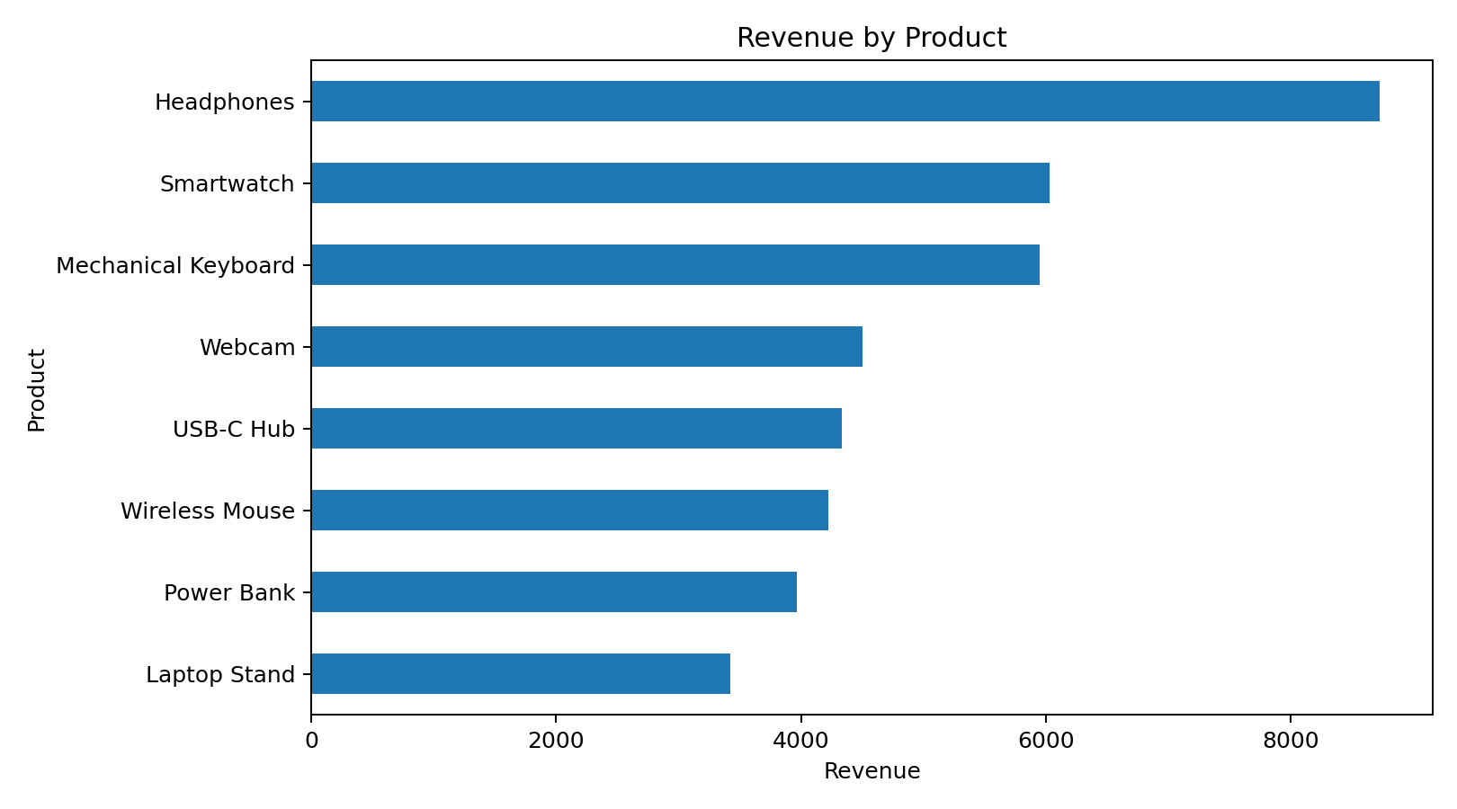
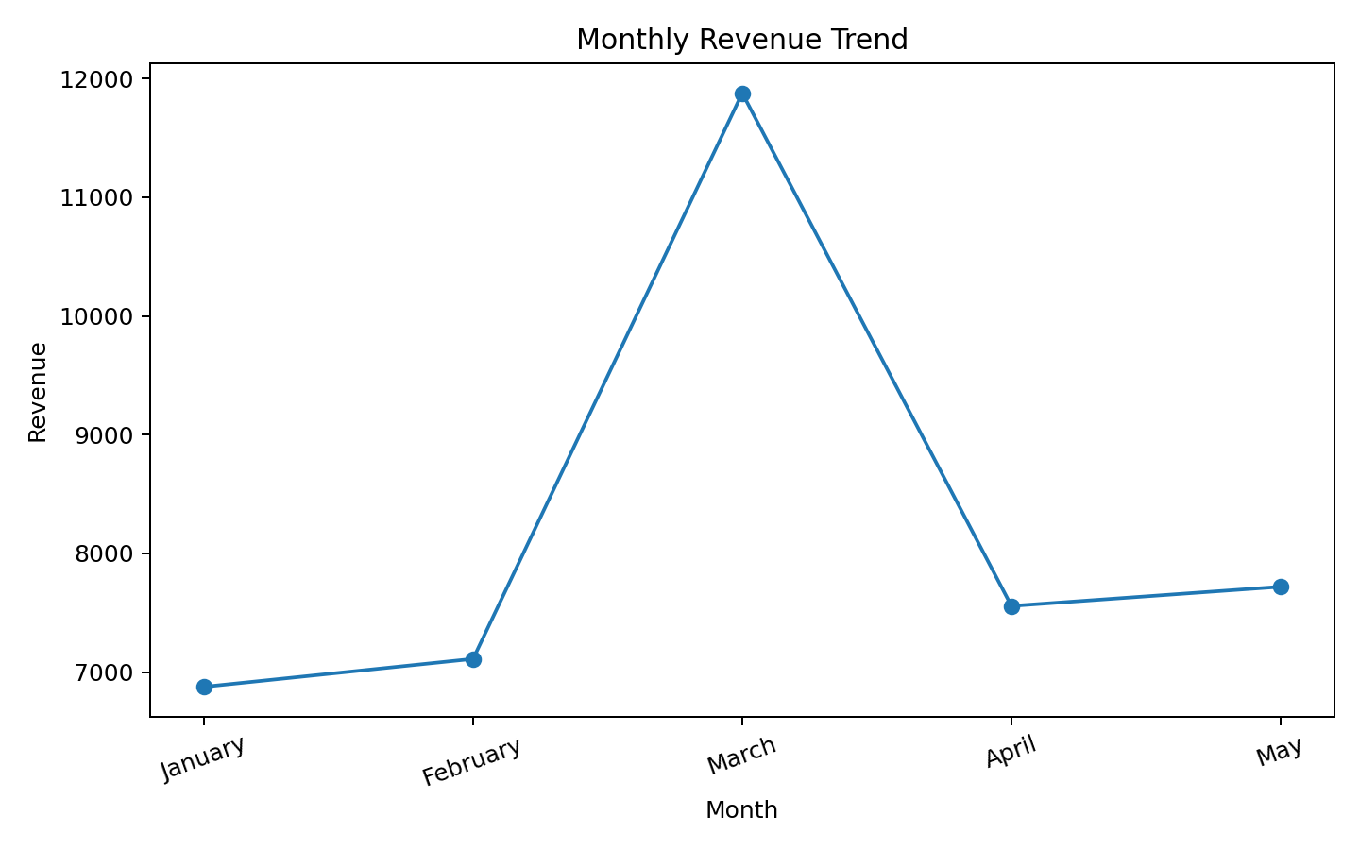
Charts & Findings

Slide 5
AI Prompt Examples
1. Sales Analysis — establishes the baseline
2. Product Performance — compares product contribution
3. Monthly Sales Trend — identifies timing patterns
4. Customer Feedback Analysis — structures qualitative feedback safely
5. Business Recommendation — turns evidence into actions

Slide 6
Prompt Engineering
Comparison 1: Basic “Analyze this sales data and tell me what performed best.” → Improved prompt specifies calculations, rankings, exact values, and evidence-based observations.
Comparison 2: Basic “Give me recommendations to increase sales.” → Improved prompt requires evidence, target area, business objective, and KPI.
Evaluation dimensions: Accuracy, Detail, Usefulness.

Slide 7
Responsible AI & Privacy
Complete-accuracy sales prediction is not reliable; forecasts require assumptions and uncertainty.
Human verification is required before using AI output for business decisions.
Sensitive data includes names, emails, phone numbers, addresses, and payment credentials.
Protect data through minimization, anonymization/pseudonymization, access controls, and approved handling processes.

Slide 8
Recommendations & Conclusion
Protect stock availability for high-contribution products.
Plan campaigns and inventory around strong sales periods.
Target regions differently and investigate weaker areas.
Use revenue and unit volume together when prioritizing products.
Track recurring KPIs such as monthly revenue, units sold, product share, and regional revenue.
Conclusion: AI can accelerate analysis and ideation, but outputs should remain evidence-based, privacy-aware, and human-verified.

