Slide 1
PG DAC project on GYM MAster
GROUP NO:- 01
DEVELOPED BY:-
Prathamesh Thorat (210943120110)
Tushar Jadhav (210943120113)
Rohit Gaikwad (210943120081)
Prasad Mhakale (210943120053)

Slide 2
Objective of GMS
Develop application that facilitates the data optimization and better administration.
Store the records of client’s & trainer’s with administrator having privileges to access, modify and delete any record.
To reduce the burden of keeping manual records and replace it with modern and reliable application yet easy to use.
To manage attendance of clients and trainers thus, contribute in making society healthier.

Slide 3
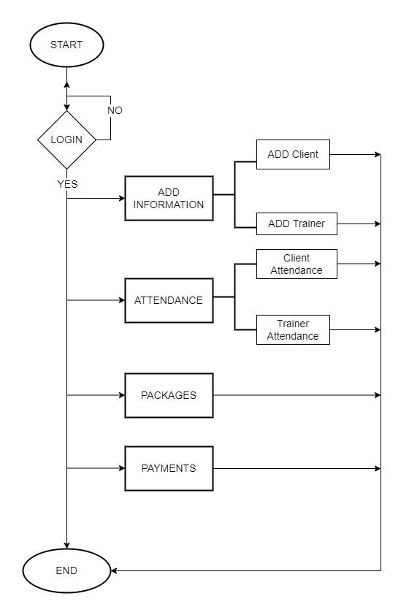
SYSTEM FLOW CHART

Slide 4
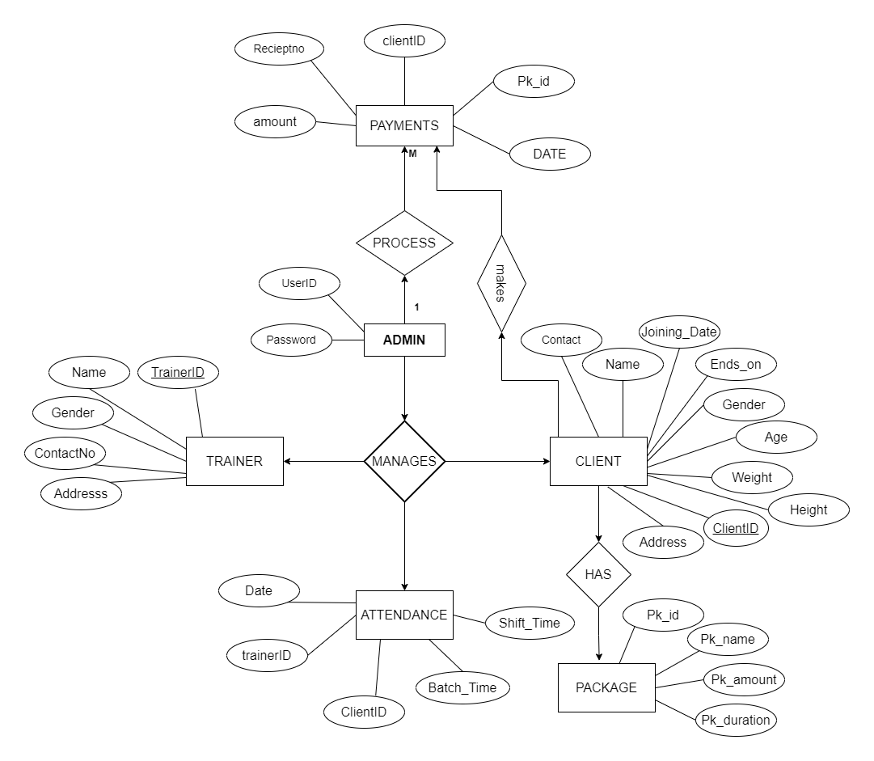
ENTITY RELATIONSHIP DIAGRAM

Slide 5

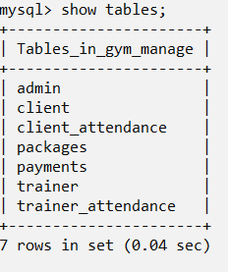
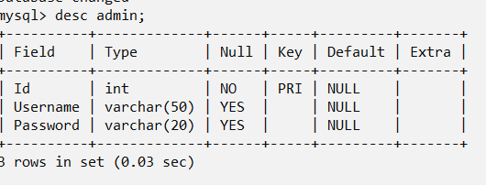
DATABASE TABLES

Slide 6
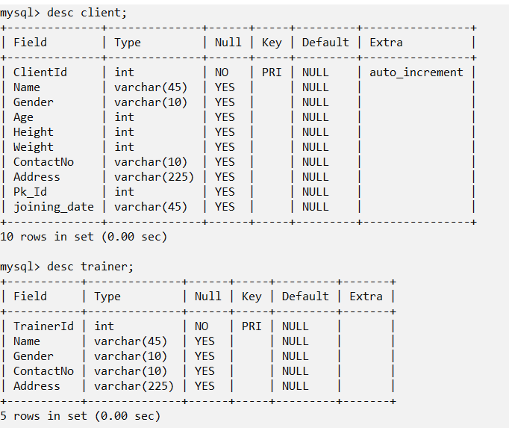
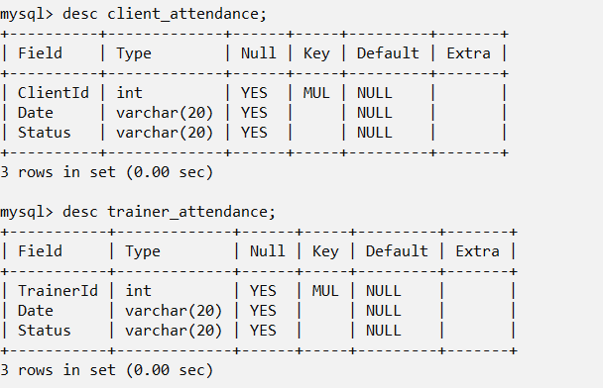
DATABASE TABLES

Slide 7
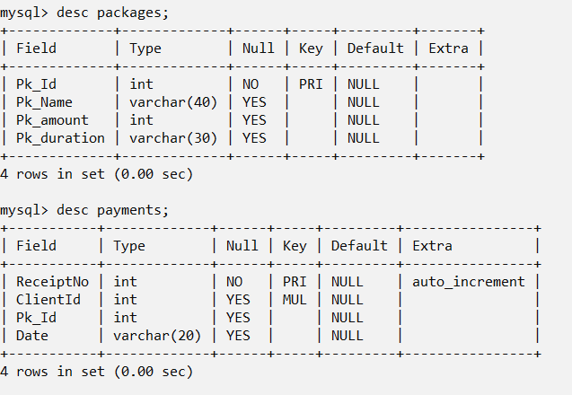
DATABASE TABLES

Slide 8
conclusion
The new computerized system was found to be much faster and reliable and user friendly then the existing system.
The system has been designed and developed step by step and tested successfully.
It eliminates the human error that are likely to creep in the kind of working in which a bulk quantity of data and calculations as to be processed.
The system results in quick retrieval of information that is very vital for the progress any organization.
Burden of manual work is reduced as whenever transaction takes place, there is a no need to record it in many places manually.

Slide 9
FUTURE SCOPE
This application has been developed in such a way that it can accept modifications and further changes.
The system is so flexible to allow any modification need for the further functioning of programs.
In Future many new features like nutrition and customized workout plan can be added.
There is scope to provide access of this application to client, with the introduction of features like promotions, events, fees payment etc.

Slide 10
THANKYOU

