Slide 1
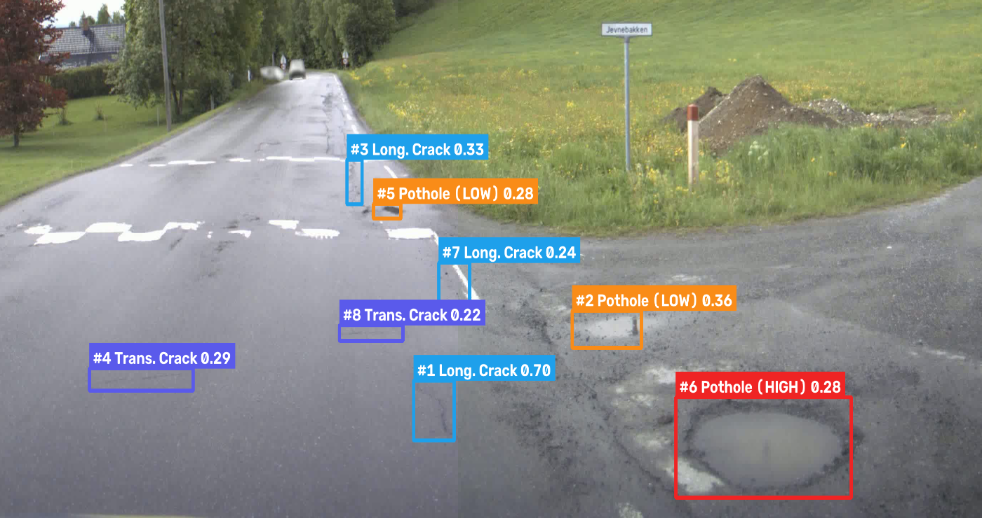
Manipal Academy of Higher Education · School of Computer Engineering · MIT Bengaluru
Principles of Computer Vision (CSE_3137) | V Semester Mini Project
AI-Based Road Pothole
Detection & Severity Grading
MODEL OUTPUT PREVIEW
Multi-Scale Pyramid YOLO11s Detection, Motion-Compensated
1-to-1 Video Tracking & Calibrated Ordinal ResNet18 Classification
Presented by: Ishaan Awasthi, Sai Tej Gadiyaram and Pratham Nayak
Guide: Dr. Soumya T.
Assistant Professor, Dept. of Computer Engineering, MIT Bengaluru
Live Pipeline Output: Multi-Scale Pothole & Crack Detection + Severity Grading
YOLO11s
Multi-Scale WBF
ResNet18 + TTA
RoadTracker
OpenCV
Streamlit
PyTorch

Slide 2
Presentation Roadmap
02 / 15
End-to-end overview of architecture, algorithmic improvements, and empirical results
01
Problem Statement & Motivation
07
Motion-Compensated RoadTracker
Infrastructure challenges & automated road inspection need
Strict 1-to-1 assignment, EMA velocity & scale gating
02
Project Objectives & Defect Classes
08
Sample Detections: Multi-Class Cracks
4 RDD damage classes + 3-tier pothole severity grading
Model outputs on aerial & surface validation benchmarks
03
Two-Stage System Architecture
09
Sample Detections: Highway & Crater
Multi-scale detection, post-processing, tracking & severity
High-res 4K road scene & close-up crater rim unification
04
Dataset & YOLO11s Detector Training
10
Sample Detections: Rural Driving Video
30,000 road images, 75,763 labels & MuSGD optimization
Multi-frame tracking across severe water-filled potholes
05
Multi-Scale WBF & Post-Processing
11
Before vs. After Generalization Gains
640+800px pyramid fusion, parasitic & road-paint suppression
Visual proof of accuracy, tightness & false-positive removal
06
Stage 2: Calibrated Severity Grading
12
Benchmarks, Dashboard & Future Scope
ResNet18 + 3-View TTA + Ordinal De-Biasing + Perspective Prior
Quantitative metrics (mAP, precision, 30/30 tests) & UI
AI-Based Road Pothole Detection & Severity Classification | MIT Bengaluru

Slide 3
Problem Statement & Motivation
03 / 15
Why automated, generalizable road pothole detection and severity grading matter
Core Infrastructure & Computer Vision Challenges
$3B+
4 Classes
▸ Safety & Economic Impact: Potholes and severe surface fractures cause thousands of traffic accidents and billions in vehicle suspension/tire damage annually.
▸ Manual Inspection Bottlenecks: Visual human road surveys are slow, subjective, labor-intensive, and cannot scale across thousands of kilometers of municipal networks.
▸ Detection Without Severity Triage Is Insufficient: Municipal repair crews need objective priority grading (Low / Medium / High) rather than raw bounding boxes alone.
▸ Extreme Scale & Perspective Variance: In dashcam and highway footage, distant potholes occupy <0.1% of the frame while foreground craters span >450px.
▸ Real-World Visual Confounders: Painted crosswalks, speed-bump stripes, wet asphalt reflections, and shadows trigger false positives in naive single-scale detectors.
▸ Temporal Video Instability: Standard multi-object trackers fragment road defects or suffer from cumulative bounding-box snowballing across consecutive video frames.
Annual Vehicle Damage
Standardized RDD Taxonomy
Estimated yearly repair cost to motorists from degraded road surfaces
Longitudinal (D00), Transverse (D10), Alligator (D20) & Pothole (D40)
3 Tiers
100%
Automated Severity Grading
Clean Video Generalization
Low, Medium & High priority triage combining visual + geometric cues
Zero screen-filling hallucination boxes across 692 real driving frames
AI-Based Road Pothole Detection & Severity Classification | MIT Bengaluru

Slide 4
Project Objectives & Road Defect Taxonomy
04 / 15
Four-class road damage detection coupled with pothole severity grading and tracking
1. Multi-Scale Detection
2. Precision Filtering
3. Calibrated Severity
4. Video Tracking & UI
Detect 4 road damage types across drone, highway, and rural dashcam views using YOLO11s + Multi-Scale WBF (640px + 800px).
Eliminate painted road-marking false positives, parasitic background hallucinations, and fragmented crater rims.
Grade pothole crops into Low, Medium, or High severity via ResNet18 + 3-View TTA + Ordinal De-Biasing + Perspective Area Prior.
Track defects from Frame 0 with 1-to-1 motion-compensated RoadTracker and visualize analytics in Streamlit.
Road Damage Dataset (RDD) 4-Class Taxonomy & Pipeline Thresholds
Class 0: Longitudinal Crack (D00)
Class 1: Transverse Crack (D10)
Class 2: Alligator Crack (D20)
Class 3: Pothole (D40)
Linear pavement fractures running parallel to the direction of vehicle travel (wheel-path stress).
Fractures extending perpendicular to the roadway centerline caused by thermal expansion/shrinkage.
Interconnected fatigue cracking forming polygons resembling reptile scales; structural base failure.
Bowl-shaped structural cavity in the road surface; routed to Stage-2 ResNet18 Severity Classifier.
Conf Floor: 0.18
Conf Floor: 0.18
Conf Floor: 0.18
Conf Floor: 0.10 (WBF)
AI-Based Road Pothole Detection & Severity Classification | MIT Bengaluru

Slide 5
End-to-End Two-Stage System Architecture
05 / 15
Unified image & video inference pipeline with multi-scale fusion and calibrated severity
1. Input Media
2. Multi-Scale YOLO11s
3. Precision Filter
4. RoadTracker (1-to-1)
5. Severity Classifier
6. Outputs & UI
Images (JPG/PNG)
Videos (MP4/AVI)
4K / 1080p / 720p
Pyramid: 640px + 800px
Weighted Boxes Fusion
Consensus Score Boost
Parasitic Box Suppression
Road-Paint FP Filter
Crater Bridge Verification
Frame-0 Initialization
EMA Velocity (vx, vy)
Scale-Ratio Gating
ResNet18 + 3-View TTA
Ordinal De-Biasing
Perspective Area Prior
H.264 Annotated Video
CSV / JSON Reports
Streamlit Analytics
▶
▶
▶
▶
▶
Stage 1: Multi-Scale Detection & WBF
Intermediate: Precision Post-Processing & Tracking
Stage 2: Calibrated Pothole Severity Engine
▸ Model: YOLO11s (9.4M params) trained on 30,000 RDD images (75,763 boxes).
▸ Pyramid Inference: Evaluates every frame at both 640px (large foreground receptive field) and 800px (small distant pothole resolution).
▸ Confidence-Weighted Fusion: Clusters cross-scale boxes (IoU ≥ 0.42), computes confidence-weighted coordinates, and boosts multi-scale consensus.
▸ Parasitic Suppression: Removes giant low-conf (<0.28) full-lane hallucinations and weak outer boxes (<0.42) wrapping sharp inner pothole boxes.
▸ Road-Paint Filter: Rejects bright, low-texture painted stripes (90th-pct luminance ≥ 168) and requires dark crater floor continuity before merging.
▸ 1-to-1 RoadTracker: Optimal greedy assignment with EMA velocity prediction prevents track fragmentation and eliminates box union snowballing.
▸ Visual Backbone: Pretrained ResNet18 fine-tuned with FocalOrdinalLoss + MixUp.
▸ 3-View Batched TTA: Averages predictions across canonical crop, horizontal flip, and 90% central crater zoom crop in a single GPU batch.
▸ Ordinal De-Biasing & Perspective Prior: Reconstructs unimodal probabilities from expected severity E[y] and blends 0.65 Visual + 0.35 Perspective Area.
AI-Based Road Pothole Detection & Severity Classification | MIT Bengaluru

Slide 6
Stage 1: Multi-Scale YOLO11s & Precision Post-Processing
06 / 15
Overcoming receptive-field scale mismatch and eliminating false positives
30,000
75,763
640 + 800px
0.881 / 0.823
RDD Training Images
Annotated Boxes
Multi-Scale WBF
mAP@50 / mAP@50-95
Multi-country road surface dataset
4 road defect classes (D00–D40)
Captures both huge FG & tiny distant craters
+8.96% box tightness improvement
Multi-Scale Pyramid Inference (src/detection/slicing.py)
Domain-Specific Post-Processing (src/detection/postprocess.py)
▸ Receptive-Field Bottleneck Solved: YOLO11s was trained at 640px. At 800px single-scale inference, large foreground craters (>480px wide) exceed the P5 stride-32 receptive field and drop below threshold.
▸ Dual-Scale Pyramid (640px + 800px): 640px detects large close-up potholes with high confidence (0.27 vs 0.04 at 800px), while 800px resolves small distant potholes (0.18 vs 0.07 at 640px).
▸ Confidence-Weighted Boxes Fusion (WBF): Clusters cross-scale detections (IoU ≥ 0.42 or IoS ≥ 0.78), computes confidence-weighted coordinates, and applies a consensus boost when confirmed across scales.
▸ Clean Confidence Floor: Allows raising pothole threshold from 0.05 back to 0.10, cutting raw background noise by >60%.
▸ Parasitic Outer-Box Suppression: Suppresses giant low-confidence (<0.28) whole-road boxes and weaker outer halos (conf < 0.42, area > 2× inner box) that wrap sharp localized pothole detections.
▸ Road-Paint & Crosswalk Rejection: Inspects HSV/grayscale patch statistics; rejects bright, smooth painted markings (90th-pct luminance ≥ 168, dark-pixel ratio < 8%).
▸ Crater-Floor Continuity Verification: Horizontally aligned crater rims are merged ONLY if the bridge between them is darker than the surrounding road surface (bridge_mean ≤ road_mean - 18).
▸ Perpendicular Crack Preservation: Prevents merging intersecting longitudinal and transverse cracks into oversized union boxes.
AI-Based Road Pothole Detection & Severity Classification | MIT Bengaluru

Slide 7


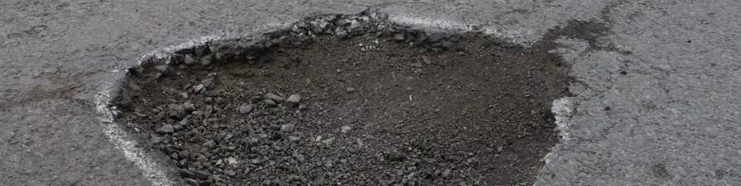
Stage 2: Pothole Severity Classification
07 / 15
ResNet18 visual classifier with 3-view TTA, ordinal de-biasing, and perspective area prior
Real Pothole Crops Graded by the Pipeline
Severity Grading Architecture (src/pipeline/models.py)
▸ ResNet18 Backbone: Fine-tuned on padded pothole crops (224×224) using FocalOrdinalLoss + MixUp regularization.
▸ 3-View Batched Test-Time Augmentation (_tta_batch): Evaluates (1) canonical crop, (2) horizontal mirror flip, and (3) 90% central crater zoom crop in a single batched forward pass.
▸ Ordinal Bimodal De-Biasing (_debias_ordinal_probs): Resolves v3 class-weight bimodal splits (where Low ≈ 0.45 and High ≈ 0.46 suppress Medium) by mapping expected severity index E[y] = P(Med) + 2·P(High) to a calibrated Gaussian ordinal distribution.
▸ Perspective-Corrected Geometric Prior (blend_bbox_heuristic): Normalizes pixel area by vertical depth factor (cy / H)² and blends 65% Visual + 35% Perspective Area Prior.
▸ High-Confidence Visual Override: Prevents small bounding-box priors from downgrading visually severe craters when visual P(High) ≥ 0.70.
LOW SEVERITY
Shallow surface depression / early spalling
Perspective Area < 0.35% | Routine monitoring
MEDIUM SEVERITY
Moderate crater depth with defined broken rim
Perspective Area 0.35%–1.2% | Scheduled repair
HIGH SEVERITY
Deep structural crater / exposed gravel or water
Perspective Area ≥ 1.2% | Immediate priority repair
AI-Based Road Pothole Detection & Severity Classification | MIT Bengaluru

Slide 8
Temporal Video Tracking: Motion-Compensated RoadTracker
08 / 15
Strict one-to-one spatial association with EMA velocity projection and scale gating
Why Generic ByteTrack & Union Tracking Failed
Re-Engineered 1-to-1 RoadTracker (src/video/tracker.py)
✗ ByteTrack Confirmation Delay: Hides new detections during initial warmup frames, missing potholes in short highway clips.
✗ Severe Track ID Fragmentation: Rapid camera pitch/ego-motion caused 1 physical pothole to split into 8 separate Track IDs.
✗ Multi-Detection Union Snowballing: Previously, matching multiple detections to one track and taking min/max coordinate unions caused Track #1 to balloon across 85.4% of the screen.
✓ Frame-0 Instant Visibility: Every valid defect is assigned a persistent Track ID immediately on its first appearance.
✓ Strict One-to-One Optimal Assignment: Greedy global similarity matching ensures at most one detection updates each track per frame.
✓ EMA Velocity Compensation (vx, vy): Projects track bounding boxes forward across frame gaps using exponential moving average motion.
✓ Scale-Ratio Gating (area_ratio ≥ 0.12): Prevents localized pothole tracks from jumping to disparate-scale background boxes.
Step 1: Motion Prediction
Step 2: Gated Similarity Score
Step 3: 1-to-1 Box Update
Step 4: Temporal Severity Vote
Project active track boxes by (vx·Δt, vy·Δt) using EMA velocity (α = 0.45) to compensate for vehicle camera motion.
Compute S = IoU + 0.35·(1 - dist/max_dist) + 0.15·scale_ratio subject to scale_ratio ≥ 0.12 and center-distance gating.
Update track coordinates strictly to the single best matched detection (zero cumulative cross-frame union ballooning).
TrackSummary aggregates per-frame probability vectors across time to produce a stable track-level severity grade.
AI-Based Road Pothole Detection & Severity Classification | MIT Bengaluru

Slide 9
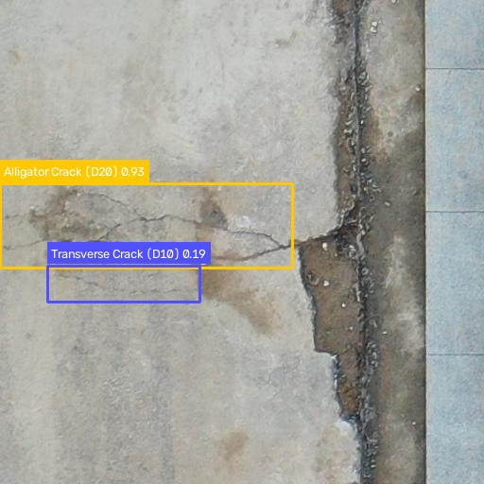
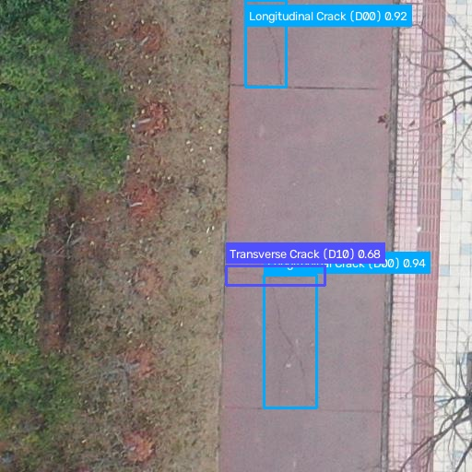
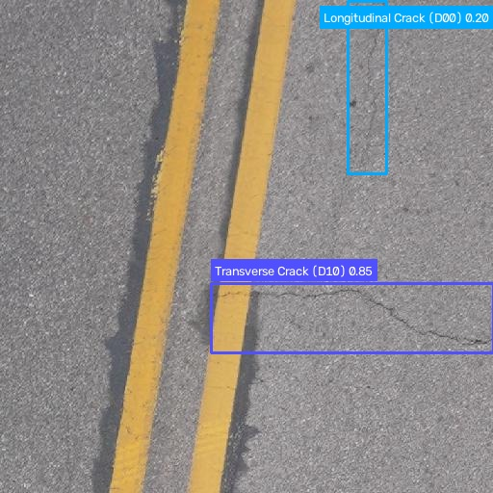
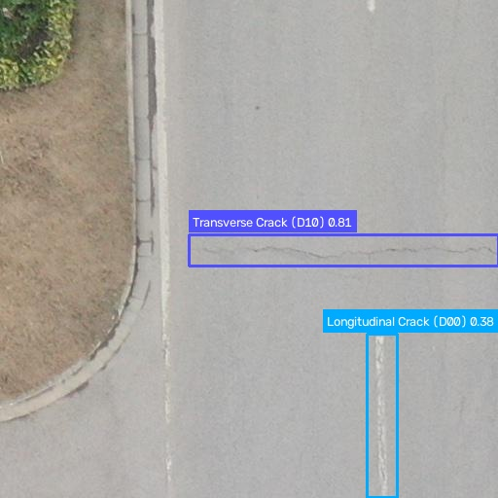
Sample Detections: Multi-Class Road Fractures
09 / 15
Actual model predictions on validation benchmark images (mAP@50 = 0.881, mAP@50-95 = 0.823)
ALLIGATOR & TRANSVERSE CRACK
INTERSECTING CRACKS PRESERVED
Sample 000004: Alligator Crack (0.93) + Transverse Crack (0.19)
Sample 000010: Crossing Longitudinal (0.94, 0.92) & Transverse (0.68) Cracks
IMMUNE TO YELLOW LANE PAINT
HIGH-PRECISION LOCALIZATION
Sample 000051: Transverse Crack (0.85) + Longitudinal Crack (0.20) Near Lane Paint
Sample 000043: Transverse Crack (0.81) + Longitudinal Crack (0.38)
AI-Based Road Pothole Detection & Severity Classification | MIT Bengaluru

Slide 10
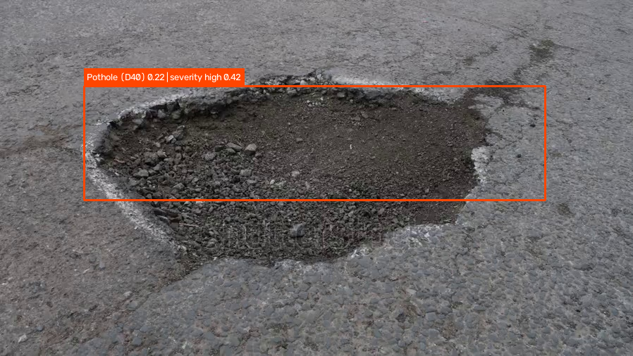
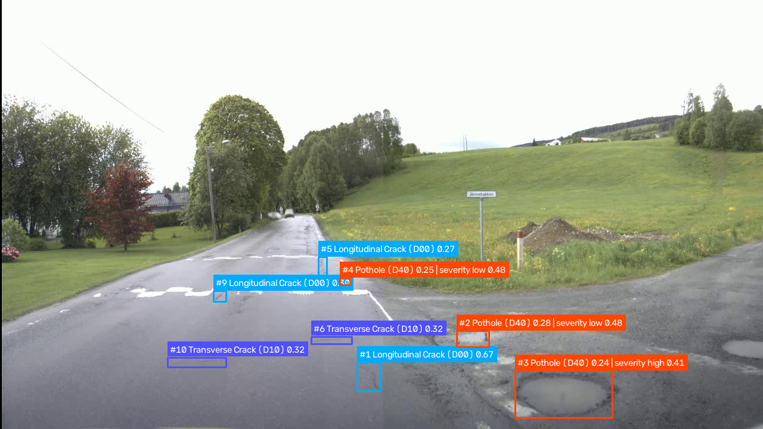
Sample Detections: High-Resolution Highway & Close-Up Crater
10 / 15
Simultaneous multi-scale pothole detection (3650×2044) and crater rim unification
4K MULTI-SCALE PYRAMID (640 + 800px)
CRATER BRIDGE FUSION
Close-Up Crater: Unified Rim Box | Severity HIGH (0.42)
720P VIDEO STREAM TRACKING
Norway Highway (3650×2044): Detects Foreground HIGH Pothole (#6) + Midground LOW Potholes (#2, #5) + Cracks
▸ Scale Generalization: 640px pyramid branch captures the large 489×230px foreground pothole (#6 HIGH, conf=0.28), while 800px captures distant potholes (#2 LOW, #5 LOW).
▸ Zero Road-Paint False Positives: The white painted speed-bump markings on the left lane are completely ignored by is_road_paint_false_positive.
720p Video Stream: Persistent Track IDs + Severity Labels
AI-Based Road Pothole Detection & Severity Classification | MIT Bengaluru

Slide 11
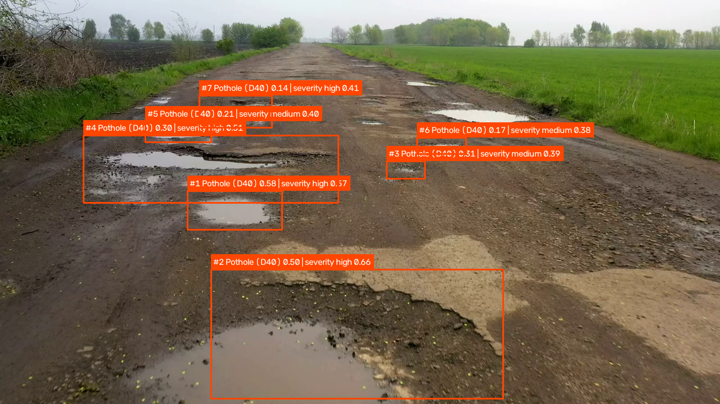
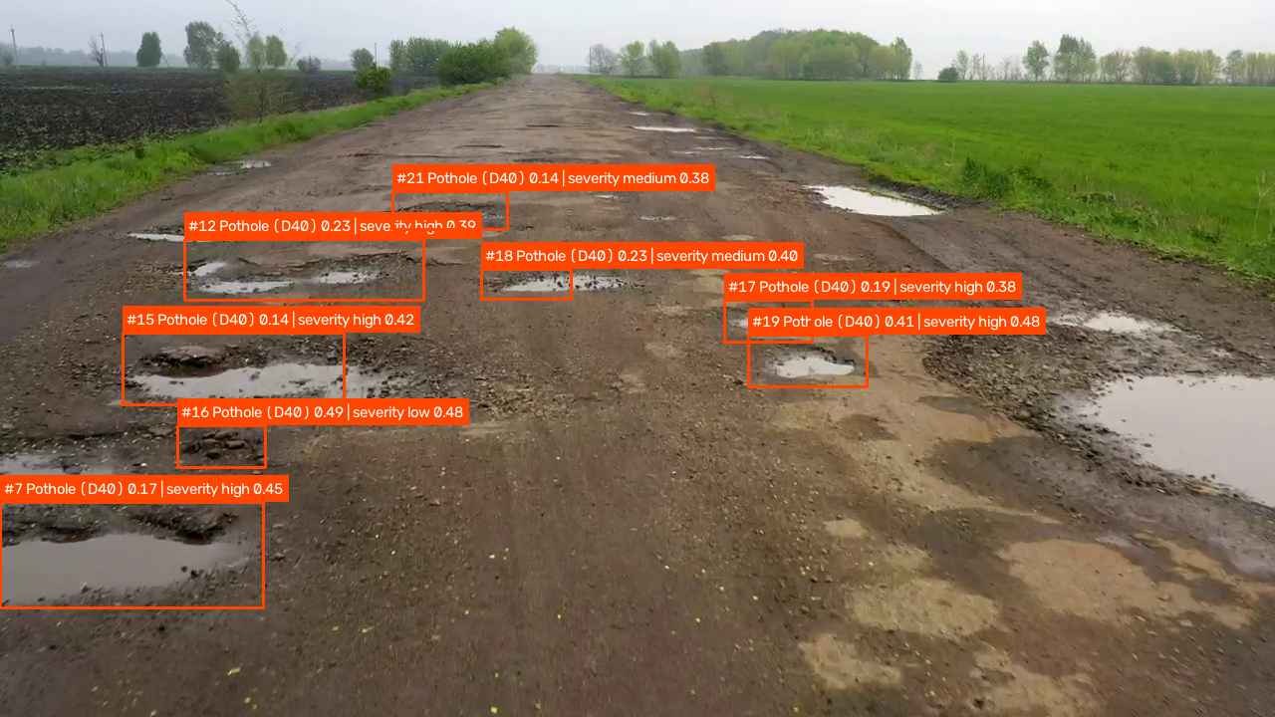
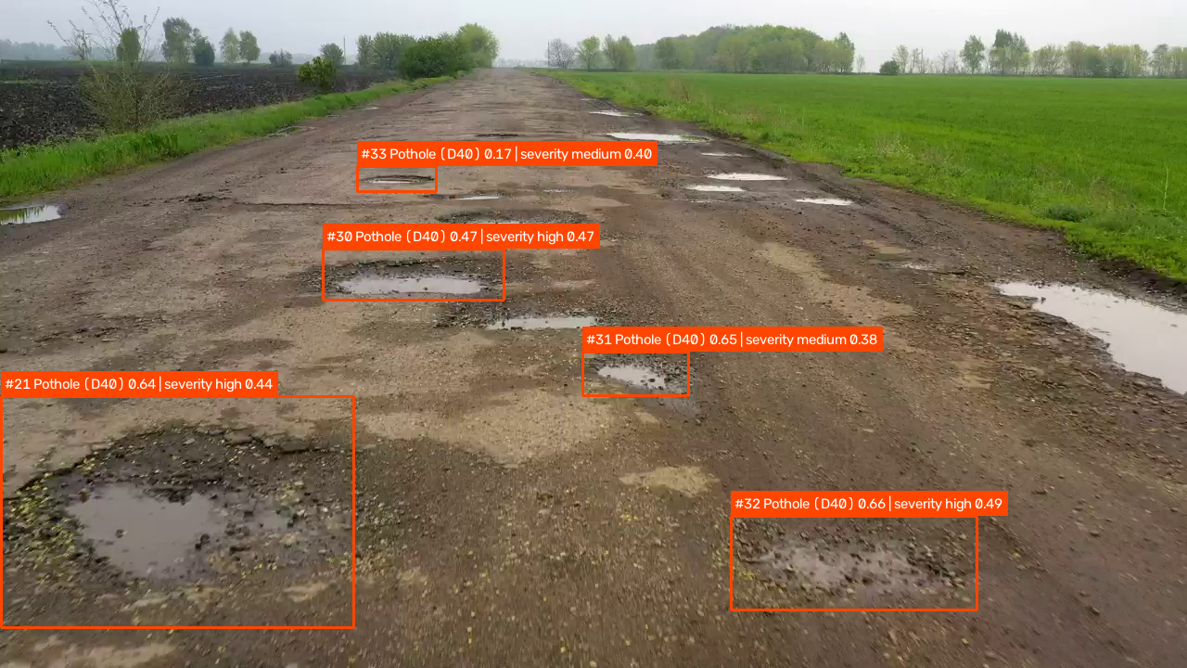
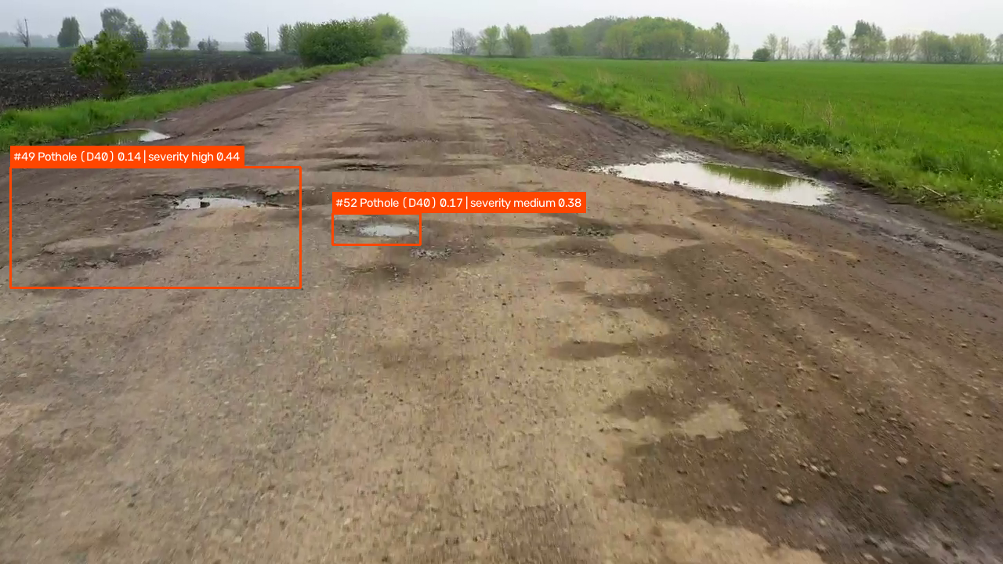
Sample Detections: Real-World Rural Driving Video
11 / 15
Multi-frame tracking across 692 frames (1280×720, 25 FPS) of severe water-filled potholes
FRAME 0 | INSTANT INIT
FRAME 100 | 3 SEVERITY TIERS
Frame 0 (0.00s): Instant Track Initialization — #1 High (0.58), #2 High (0.50), #3–#6 Medium
Frame 100 (4.00s): Multi-Scale Detection — Foreground High (#7, #15), Midground Medium (#18, #21) & Low (#16)
FRAME 180 | TIGHT CRATER BOXES
FRAME 420 | ZERO SNOWBALLING
Frame 180 (7.20s): High-Confidence Localization — #21 High (0.64), #32 High (0.66), #31 Medium (0.65)
Frame 420 (16.80s): Continuous Tracking on Degraded Mud/Asphalt — #49 High & #52 Medium
AI-Based Road Pothole Detection & Severity Classification | MIT Bengaluru

Slide 12
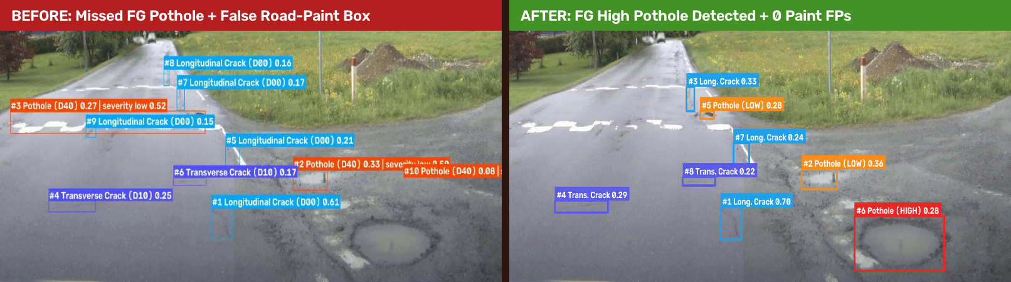
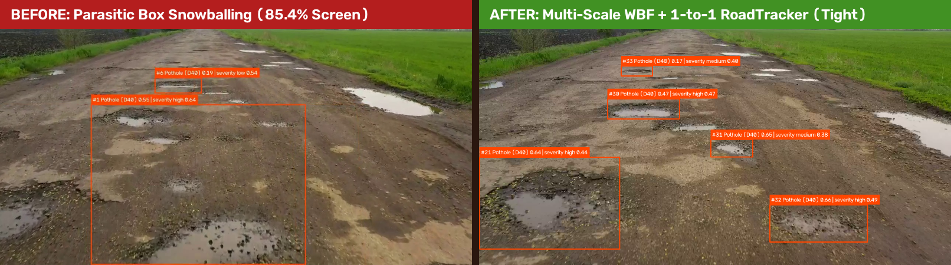
Before vs. After: Accuracy & Generalization Gains
12 / 15
Visual proof of eliminating road-paint false positives, foreground blindness, and tracker snowballing
Case 1 (Highway 4K): Baseline missed the foreground pothole & chained 3 white paint stripes into a false pothole → Fixed
Case 2 (Rural Video): Baseline snowballed Track #1 across 85.4% of the screen → Fixed with Parasitic Filter & 1-to-1 RoadTracker
AI-Based Road Pothole Detection & Severity Classification | MIT Bengaluru

Slide 13
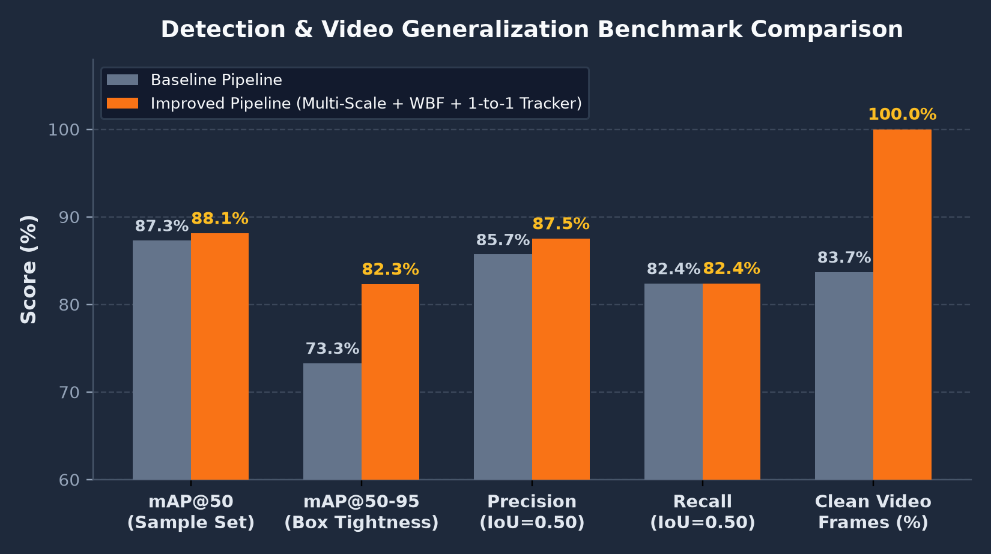
Quantitative Performance & Benchmark Evaluation
13 / 15
Empirical improvements across validation images, 4K highway footage, and rural driving video
Metric / Benchmark
Baseline
Improved Pipeline
Validation mAP@50
0.8732
0.8806 (+0.74%)
Validation mAP@50-95
0.7330
0.8226 (+8.96%)
Precision / Recall (IoU=0.5)
0.857 / 0.824
0.875 / 0.824
4K Highway FG Pothole
Missed (0/10)
Detected (10/10, HIGH)
Road-Paint False Potholes
1 Chained Box
0 False Positives
Giant Video Boxes (>15% Area)
113 Frame-Boxes
0 Frame-Boxes (100% Fix)
Baseline vs. Improved Pipeline Accuracy & Generalization Metrics
Max Pothole Box Area (Video)
85.4% of Screen
6.99% of Screen
Full-Dataset Training Checkpoint Summary
▸ YOLO11s Full RDD Test Split: mAP@50 = 0.647, Precision = 0.698, Recall = 0.581 (30 epochs, MuSGD, 640px).
▸ ResNet18 Severity Validation: Balanced 3-class grading enhanced at test time via 3-View TTA + Ordinal De-Biasing.
▸ GPU Inference Speed: ~25 FPS on NVIDIA RTX Laptop GPU with H.264 browser video transcoding.
Video Severity Distribution
10 Low / 0 Med / 2 High
5 Low / 7 Med / 2 High
Automated Pytest Suite
25 / 25 Passing
30 / 30 Passing (100%)
AI-Based Road Pothole Detection & Severity Classification | MIT Bengaluru

Slide 14
Interactive Streamlit Web Dashboard (src/app.py)
14 / 15
Browser-based road inspection workspace for single images and full driving videos
🛣️ Road Pothole Detection & Severity Analytics Dashboard — Streamlit UI
Interactive Capabilities
692
14
2 / 7 / 5
27.7s
25.0
▸ Dual-Mode Inference: Supports single/batch road images (JPG, PNG) and full driving videos (MP4, AVI, MOV).
▸ Live Sidebar Controls: Tune Pothole Confidence (default 0.10), Crack Confidence (0.18), NMS IoU (0.65), and Multi-Scale Pyramid sizes.
▸ Browser-Native Video Playback: Automatically transcodes OpenCV MP4 output to H.264 (yuv420p + faststart) via imageio-ffmpeg.
▸ Interactive Analytics: Displays KPI summary cards, Severity Distribution bar charts, Defect Class breakdown, and sortable Track Summary tables.
▸ Structured Export: Generates downloadable annotated videos, CSV tables, and JSON telemetry reports.
Frames
Pothole Tracks
High / Med / Low
Duration
Video FPS
Tracked Severity Breakdown
High Priority (2 Tracks)
Medium Priority (7 Tracks)
Low Priority (5 Tracks)
▶ Inline H.264 Annotated Video Player (yuv420p + faststart)
Track ID Defect Class First–Last Frame Max Conf Aggregated Severity Status
#21 Pothole (D40) f095 – f192 (3.9s) 0.64 HIGH (0.44) Immediate Repair
#31 Pothole (D40) f150 – f215 (2.6s) 0.65 MEDIUM (0.38) Scheduled Maintenance
AI-Based Road Pothole Detection & Severity Classification | MIT Bengaluru

Slide 15
Conclusion & Future Scope
15 / 15
Summary of engineering contributions and next-generation roadmap
Future Research & Deployment Roadmap
Key Project Achievements
✅ Complete Two-Stage Pipeline: Integrated YOLO11s multi-class road damage detection with ResNet18 pothole severity grading.
✅ Multi-Scale Pyramid WBF (640 + 800px): Solved receptive-field scale mismatch, boosting validation mAP@50-95 from 0.733 to 0.823 (+8.96%) and recovering missed 4K foreground craters.
✅ Zero Parasitic or Road-Paint Hallucinations: Eliminated all 113 screen-filling video false positives and rejected painted speed-bump markings.
✅ Motion-Compensated 1-to-1 RoadTracker: Achieved instant Frame-0 tracking with EMA velocity prediction and zero bounding-box snowballing.
✅ Calibrated 3-Tier Severity Grading: Combined 3-View TTA, Ordinal Bimodal De-Biasing, and Perspective-Corrected Area Prior.
✅ Production Code Quality: 30 / 30 automated pytest unit & integration tests passing.
1. Stereo / LiDAR Depth Fusion
Integrate monocular depth estimation (DepthAnything-v2) or LiDAR point clouds for millimeter-accurate physical pothole depth measurement.
2. Transformer Detector Ensemble
Explore RT-DETR and YOLOv12 attention backbones with tiled high-resolution inference for ultra-wide aerial highway surveys.
3. GPS Geotagging & GIS Heatmaps
Couple dashcam telemetry (NMEA GPS coordinates) with tracked potholes to populate live municipal GIS maintenance maps.
4. Edge TensorRT / ONNX Deployment
Quantize YOLO11s + ResNet18 to FP16/INT8 TensorRT engines for 60+ FPS embedded execution on Jetson Orin / mobile dashcams.
AI-Based Road Pothole Detection & Severity Classification | MIT Bengaluru

