Slide 1
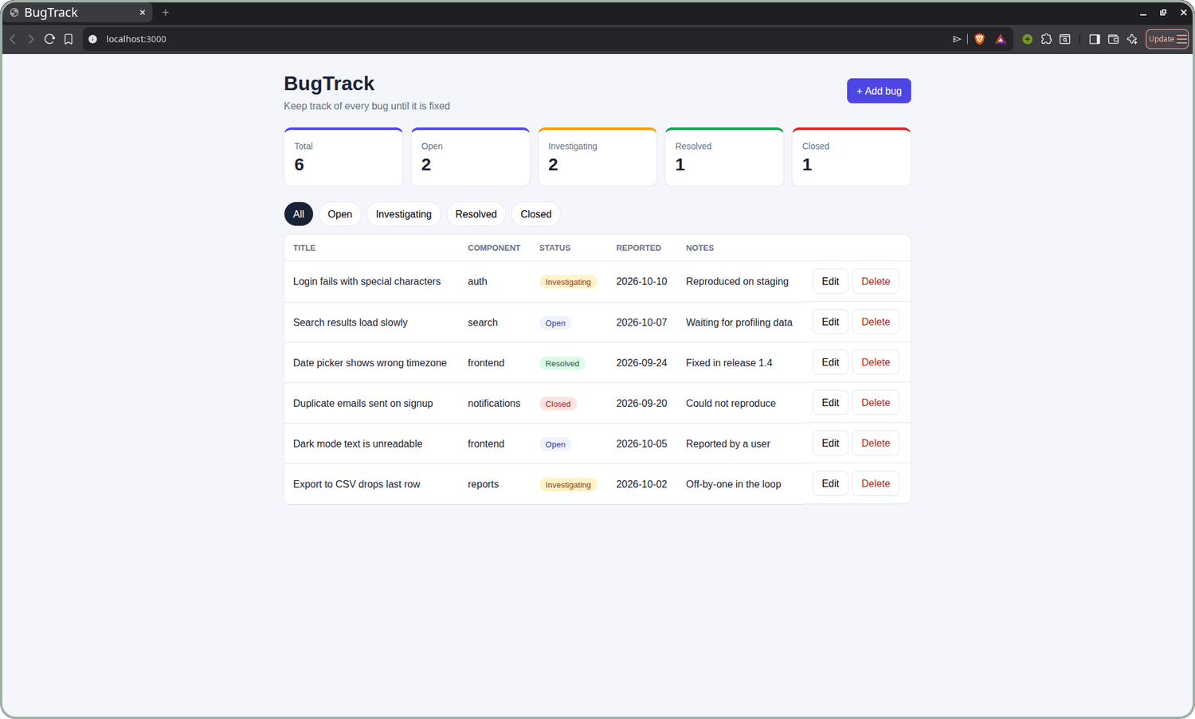
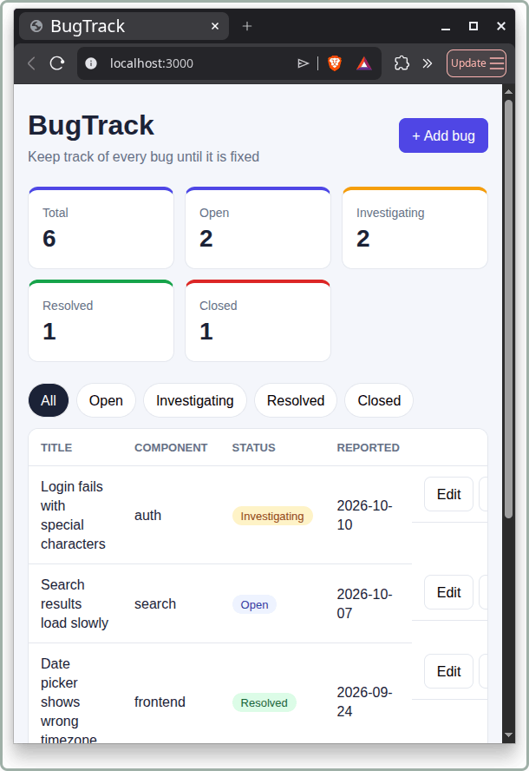
BugTrack
DEVOPS FINAL CAPSTONE
A bug tracker, taken from a laptop to a monitored Kubernetes cluster
Pratham Onkar Singh 24BCS10136
Notes:
Hello, I am Pratham. This is my DevOps capstone: BugTrack, a small app for tracking bugs until they are fixed. The app is simple on purpose. The real project is everything around it: tests, containers, CI/CD, security scanning, Terraform on AWS, Kubernetes with Helm, and monitoring.

Slide 2






What I built
OVERVIEW
BugTrack tracks a bug through open, investigating, resolved and closed. Every change travels the same path to a running, monitored cluster:
Code
GitHub Actions
GHCR
Terraform
Helm
Prometheus + Grafana
React, FastAPI, Postgres
test, build, scan
SHA-tagged images
AWS VPC and EKS
Kubernetes release
live metrics
Notes:
BugTrack tracks a bug through four statuses: open, investigating, resolved and closed. Every change I make follows the same path: code, a GitHub Actions pipeline that tests, builds and scans, SHA-tagged images in GHCR, Terraform for the AWS network and cluster, Helm to release on Kubernetes, and Prometheus with Grafana to watch it run.

Slide 3
The application
M1
6
REST endpoints under /api: list, create, get, update, delete, stats
3
operational endpoints: /health, /ready and /metrics
1
Alembic migration that creates the bugs table
Notes:
The backend is FastAPI with SQLAlchemy and an Alembic migration that creates the bugs table in PostgreSQL. It has create, read, update and delete endpoints plus a stats endpoint, and health, ready and metrics endpoints for Kubernetes and Prometheus. The React dashboard shows counts, status filters and an add and edit form, and it reflows to phone width, as you can see on the right.

Slide 4
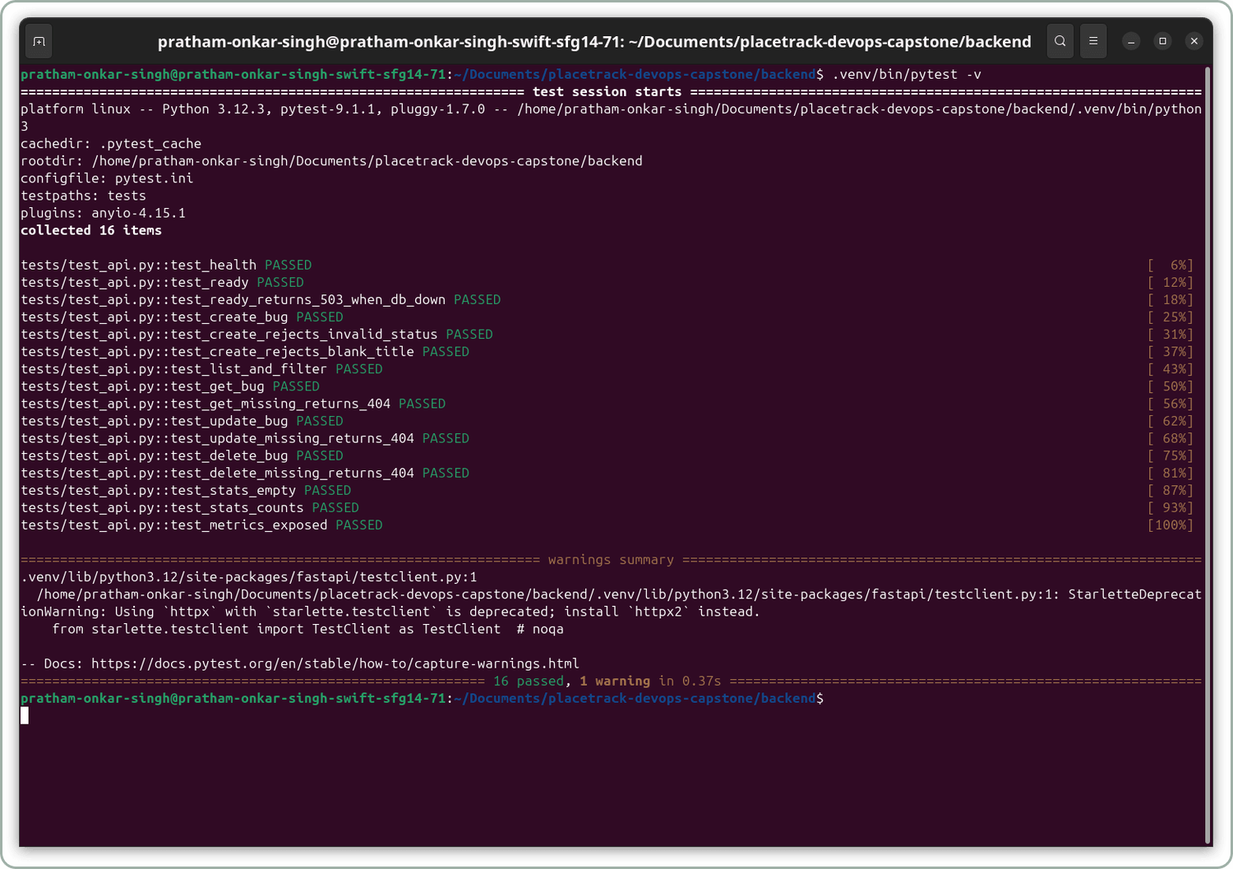
Tests
M2
16
tests, all passing
In-memory SQLite, not real Postgres
Create, list, get, update, delete, stats
Bad input: 422. Missing ids: 404
/ready returns 503 if the DB is down
/metrics is exposed
Notes:
I wrote 16 pytest tests. They cover every endpoint, bad input, missing ids, the metrics endpoint, and the case where the database is down and ready must return 503. The tests use an in-memory SQLite database through a dependency override, so they never touch the real Postgres. Settings are in pytest.ini.

Slide 5
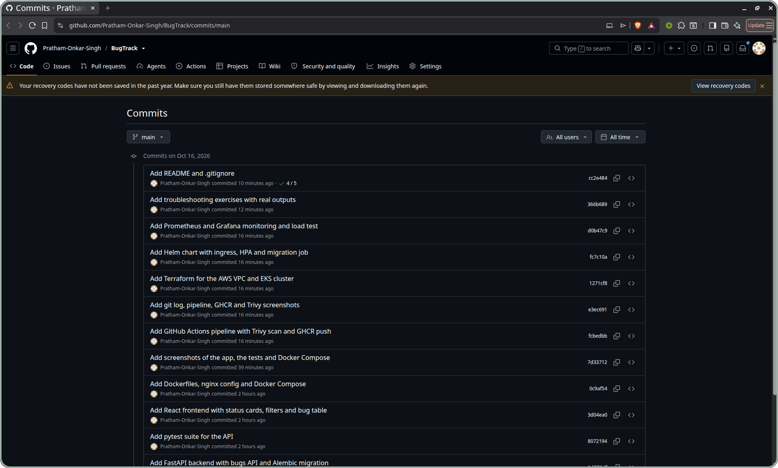
Git and GitHub
M3
10+
commits, each message says what it adds
.gitignore keeps .env, __pycache__, node_modules, .venv, Terraform state and tfvars out
Only .env.example is committed
No keys or passwords in the repo
Notes:
I work in small commits and write what each one adds in the message. The gitignore keeps env files, caches, node modules, the virtual environment and the Terraform state out of the repo. Only an example env file is committed, and there are no keys or passwords in the repository.

Slide 6
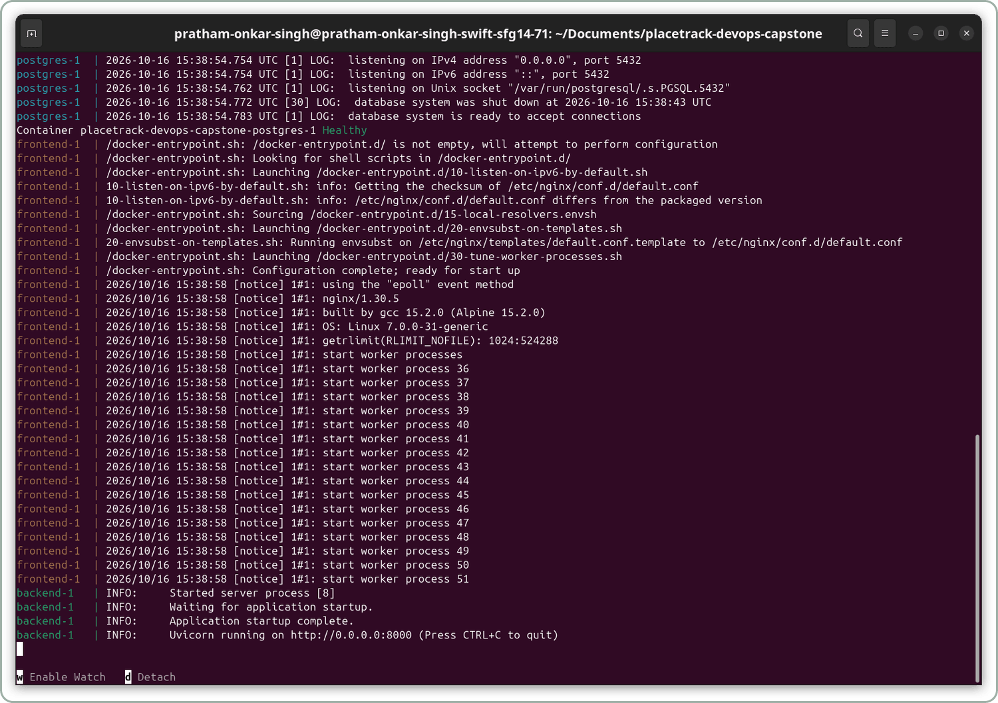


Docker
M4
Backend
python:3.12-slim, runs as user 10001
Frontend
Two stages: Node builds, nginx-unprivileged serves, user 101
docker compose up --build starts postgres, backend and frontend. The migration runs before the API.
Notes:
Both images run as a normal user, not root. The backend uses python 3.12 slim and runs as user 10001. The frontend has two stages: Node builds the React app and only the built files go into the nginx unprivileged image, which runs as user 101. With Docker Compose the whole stack starts with one command, and the migration runs before the API starts.

Slide 7

CI/CD pipeline
M5
1
2
3
4
5
6
test
frontend
image
Trivy
push
deploy
pytest fails the build
npm run build
build both images
HIGH and CRITICAL gate
GHCR, SHA tag
helm upgrade, opt-in
Runs on every push to main and on pull requests.
A failing test or a fixable HIGH or CRITICAL CVE stops the pipeline before anything is pushed.
Images are tagged with the commit SHA, never latest. Actions are pinned to commit SHAs; only the image job can write packages.
Notes:
My workflow runs on every push to main and on pull requests. Pytest and the frontend build run first. If both pass, the image job builds the backend and frontend images, scans each with Trivy, and on main pushes them to GHCR tagged with the commit SHA. A failing test or a fixable high or critical CVE stops the pipeline. The deploy job runs helm upgrade with the SHA on a self-hosted runner, and I switch it on with a repository variable.

Slide 8
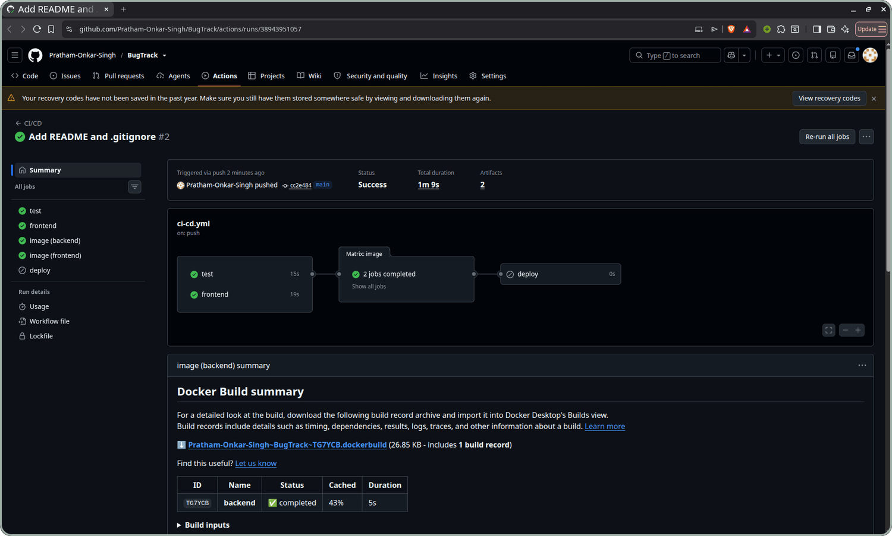
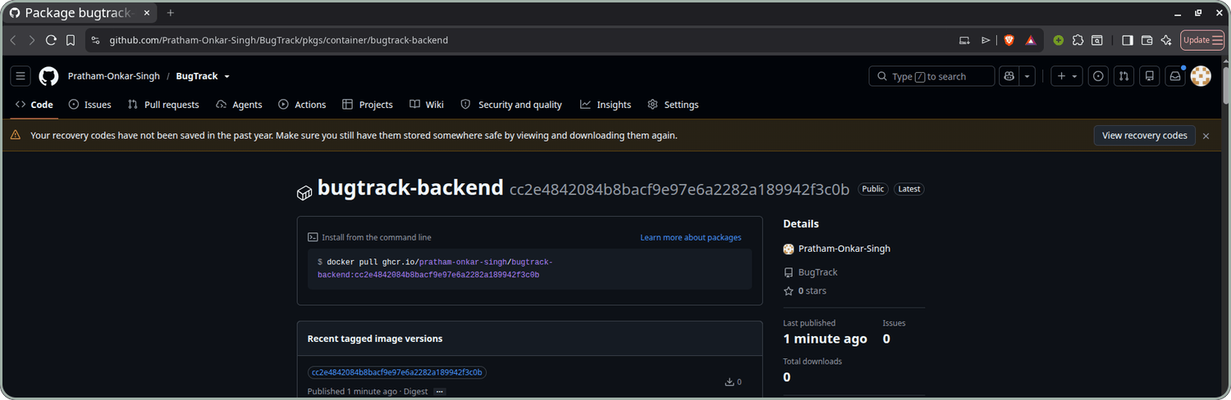
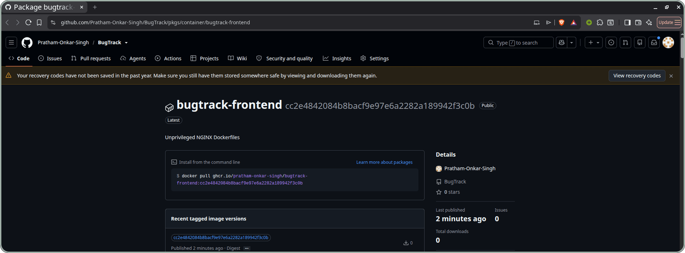
Pipeline run and GHCR
M5
Green run: test, frontend and both image builds passed.
Public in GHCR, tagged with the commit SHA.
Notes:
This is a passing run of the pipeline on my repository: tests, the frontend build, and both image builds with Trivy all passed. The deploy job shows as skipped because I have not switched it on. Both images are public in GHCR and carry the commit SHA as their tag.

Slide 9
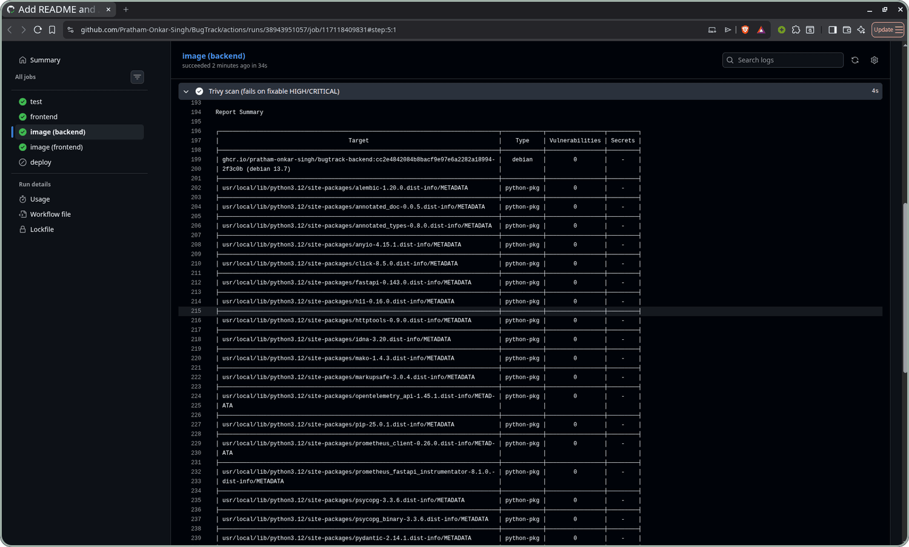
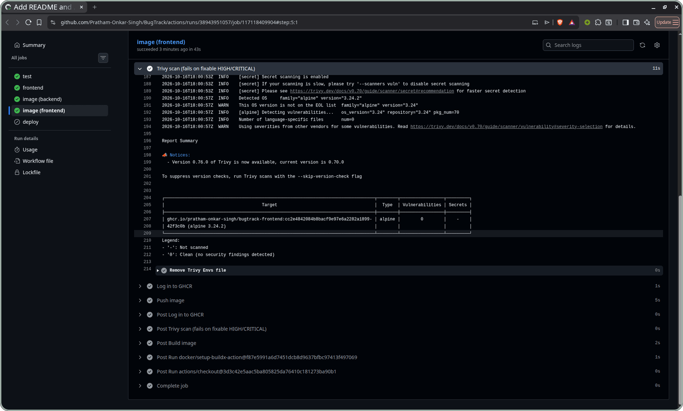
Security scan
M6
0
vulnerabilities in the backend image
0
vulnerabilities in the frontend image
Debian 13.7 and Python packages
Alpine 3.24.2
The gate: HIGH and CRITICAL, unfixed ignored, exit code 1. A bad image never reaches GHCR.
Notes:
Trivy scans both images in the pipeline. It checks the operating system packages of each image and, for the backend, the Python packages. Both scans came back with zero vulnerabilities, so the job passed and the images were pushed. The job is set to fail on a fixable high or critical finding, so a bad image never reaches GHCR. A clean scan only means nothing fixable was known that day, which is why it runs on every build.

Slide 10
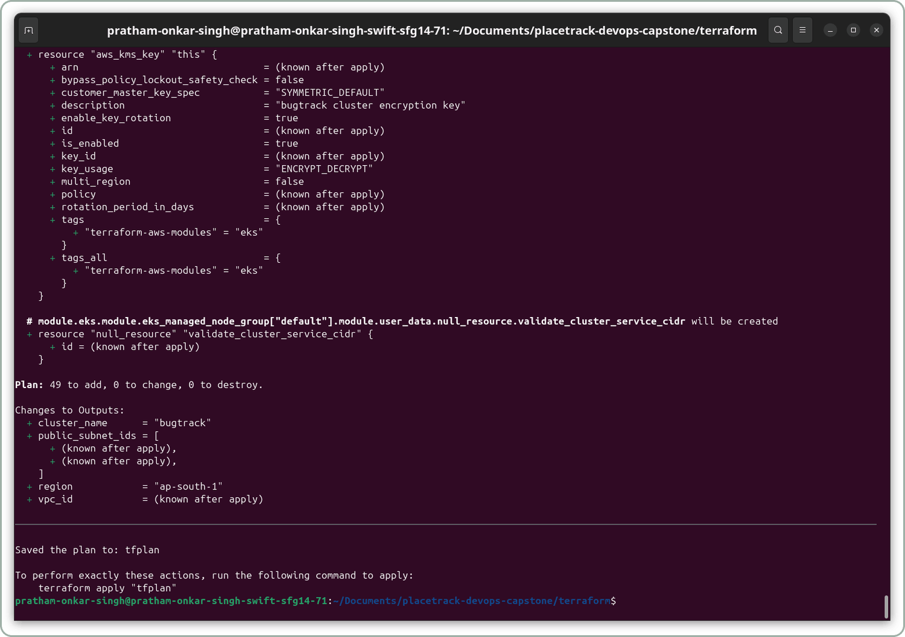



Terraform on AWS
M7
VPC 10.0.0.0/16 with two public subnets in ap-south-1a and ap-south-1b
EKS 1.35 managed node group, 2 x t3.small
Locked API only my IP can reach the cluster endpoint
49 resources planned, created and destroyed
Notes:
In the terraform folder I describe the AWS setup: a VPC with two public subnets in two availability zones, and an EKS 1.35 cluster with a managed node group of two t3.small nodes in ap-south-1. Only my IP can reach the cluster API, and that value lives in terraform.tfvars, which is not committed. The plan wanted to create 49 resources, apply created all of them, and destroy removed all of them.

Slide 11
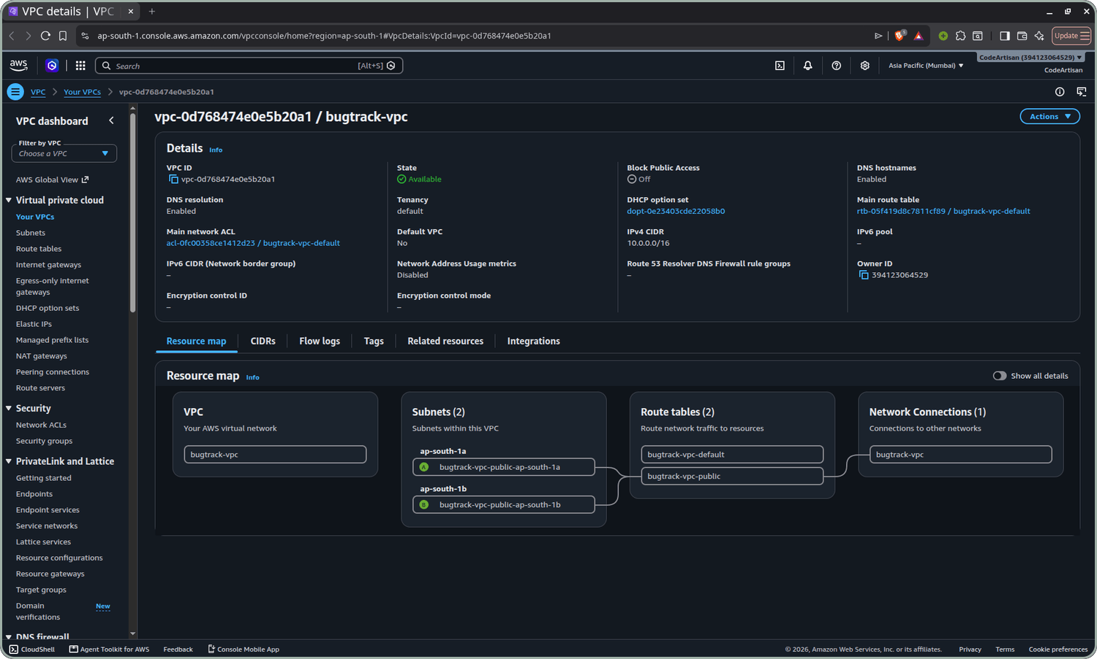
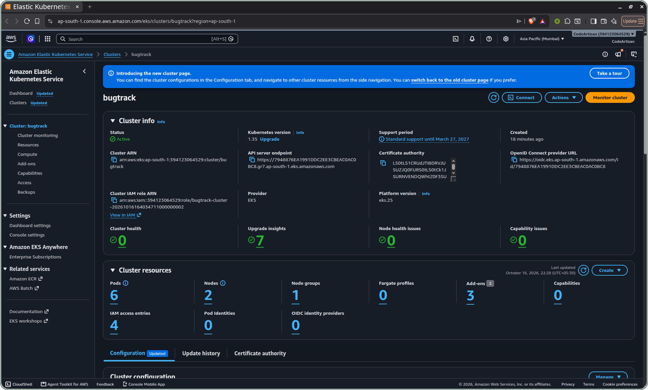
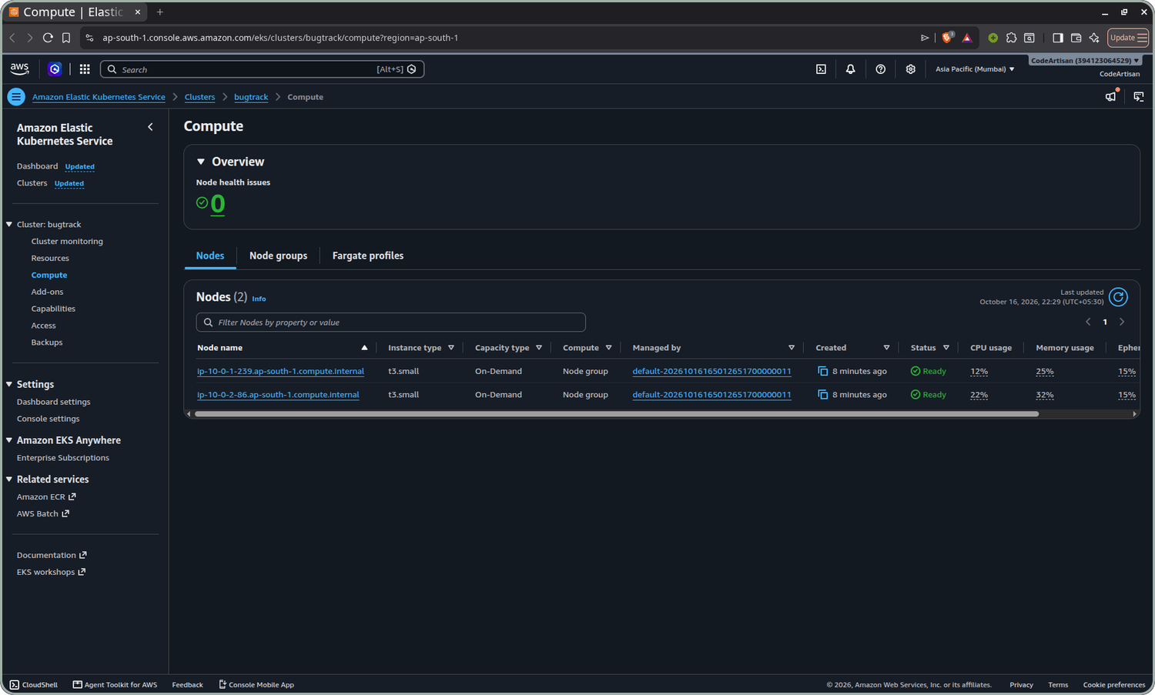
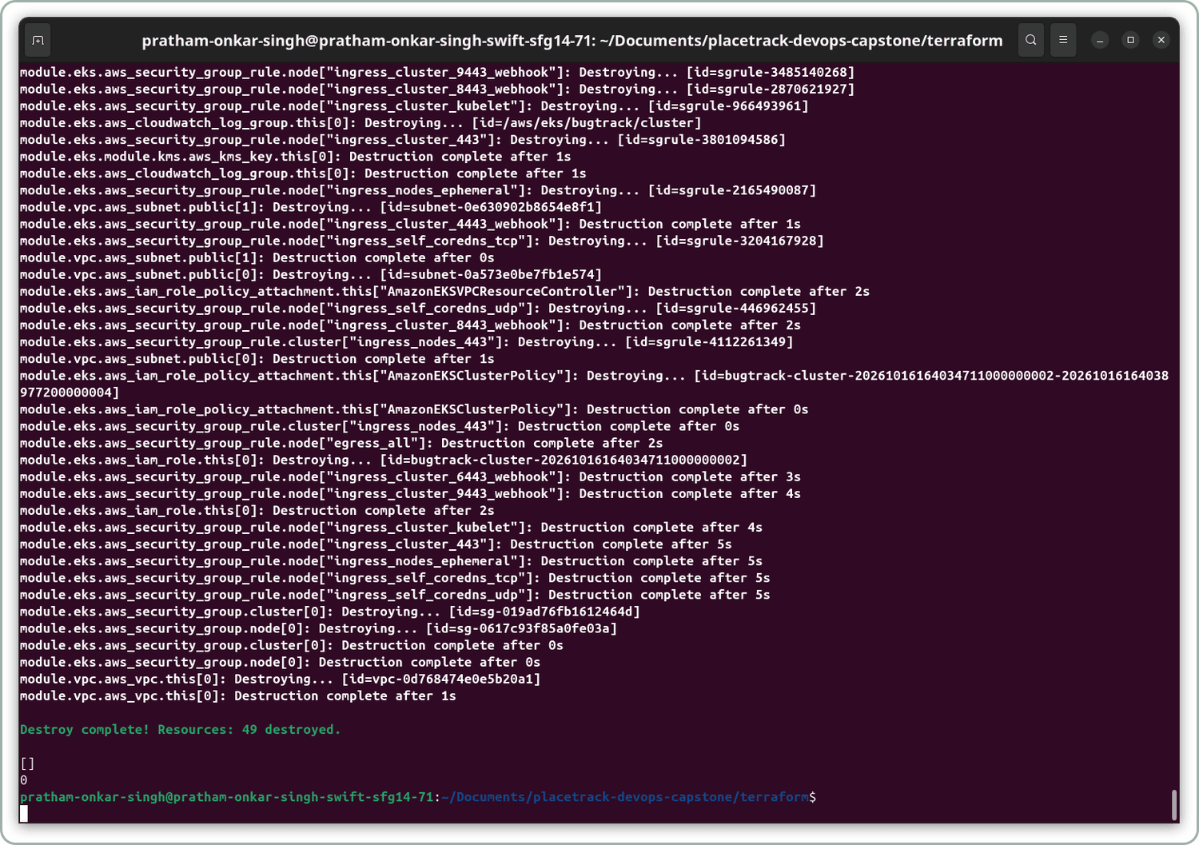
AWS Console
M7
VPC bugtrack-vpc, two subnets
EKS cluster, Active
2 nodes, Ready
49
resources removed by terraform destroy. Nothing is left to bill.
Notes:
After terraform apply I checked everything in the AWS Console: the VPC with its two subnets, the cluster in Active state, and the two nodes in Ready state. EKS bills by the hour, so right after the screenshots I ran terraform destroy. It removed all 49 resources, and I checked that no cluster or VPC was left.

Slide 12

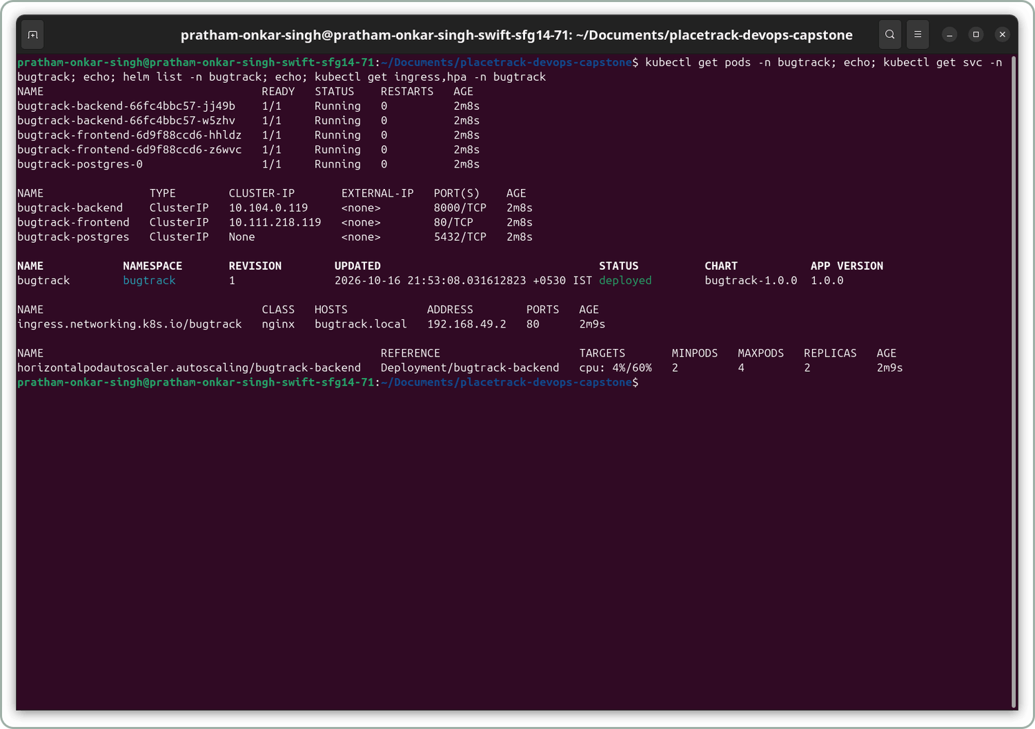





Kubernetes and Helm
M8
Backend: 2 replicas, ClusterIP service
Frontend: 2 replicas, ClusterIP service
Postgres: StatefulSet with a 1Gi volume
Migration: Job running alembic upgrade head
HPA: backend scales 2 to 4 pods at 60% CPU
Ingress: / to frontend, /api to backend
Notes:
I packed the app into a Helm chart. It creates the backend and frontend with two replicas each, ClusterIP services, Postgres, a Job that runs the migration, an HPA for the backend, and an Ingress that sends slash to the frontend and slash api to the backend. To keep the AWS bill low I ran the chart on a local cluster, using the images the pipeline pushed.

Slide 13
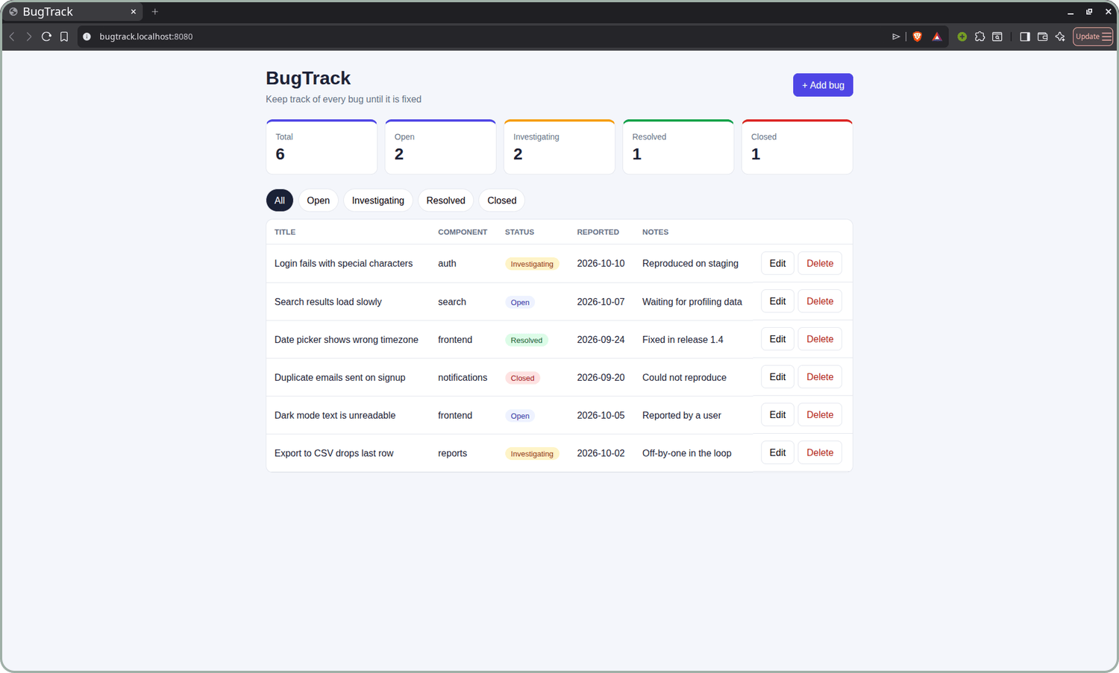
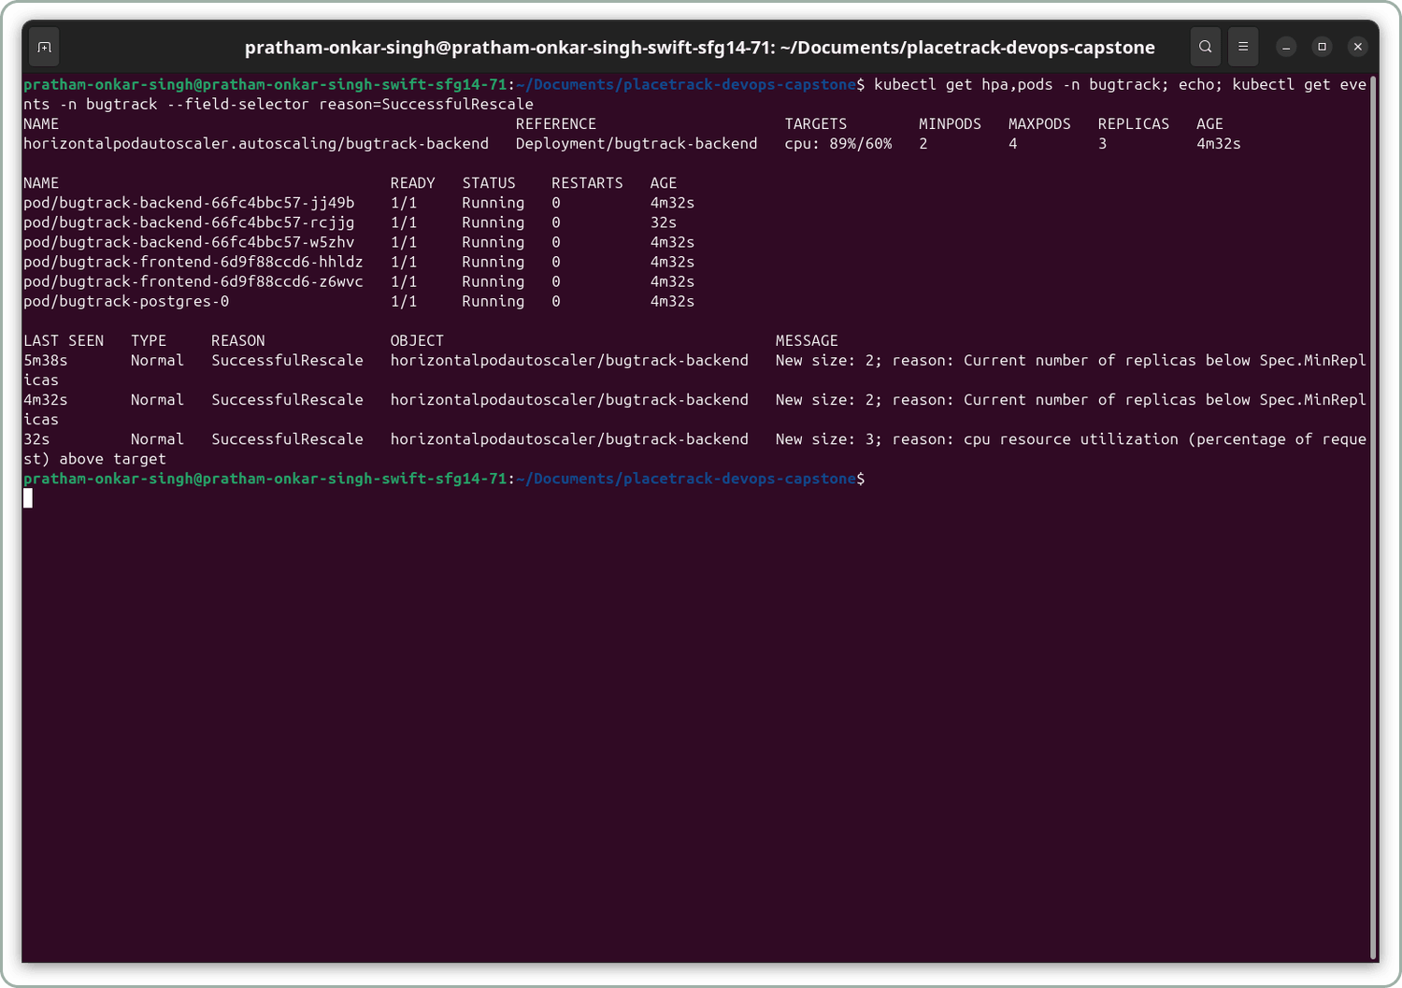
Ingress and autoscaling
M8
Scale out: the load test pushed CPU past the 60% target and the HPA added a third backend pod.
Served through the nginx Ingress: / to the frontend, /api to the backend.
Notes:
The app opens through the nginx Ingress: slash goes to the frontend and slash api to the backend, which talks to Postgres. When I ran the load test, CPU went above the 60 percent target and the HPA added a third backend pod.

Slide 14
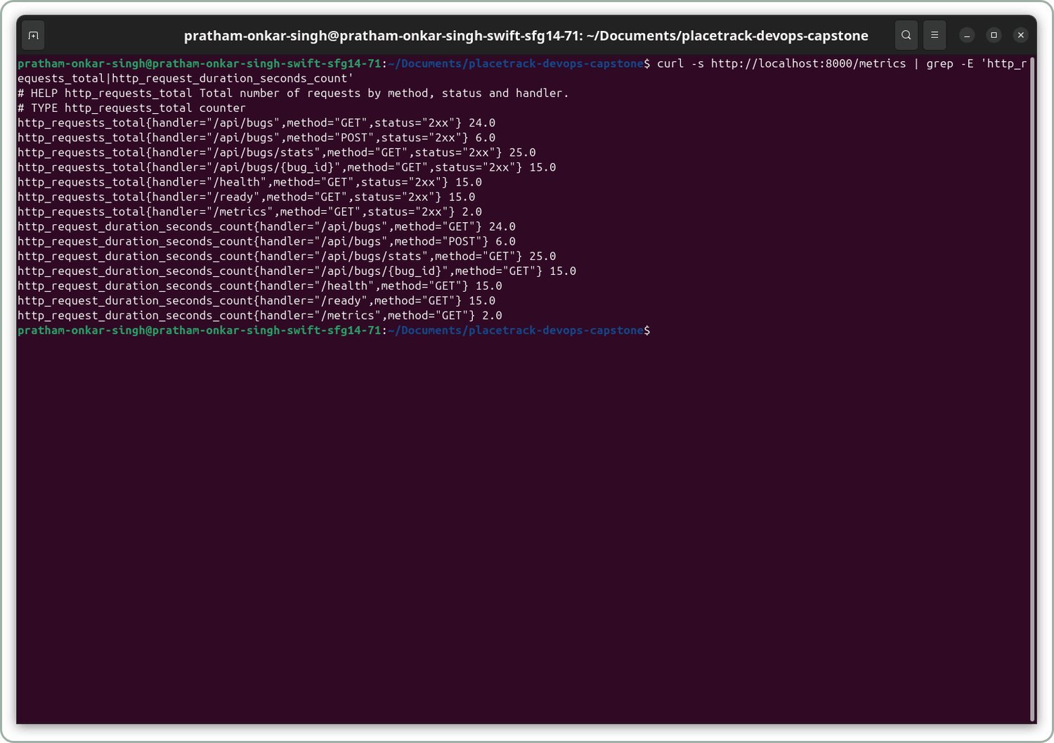
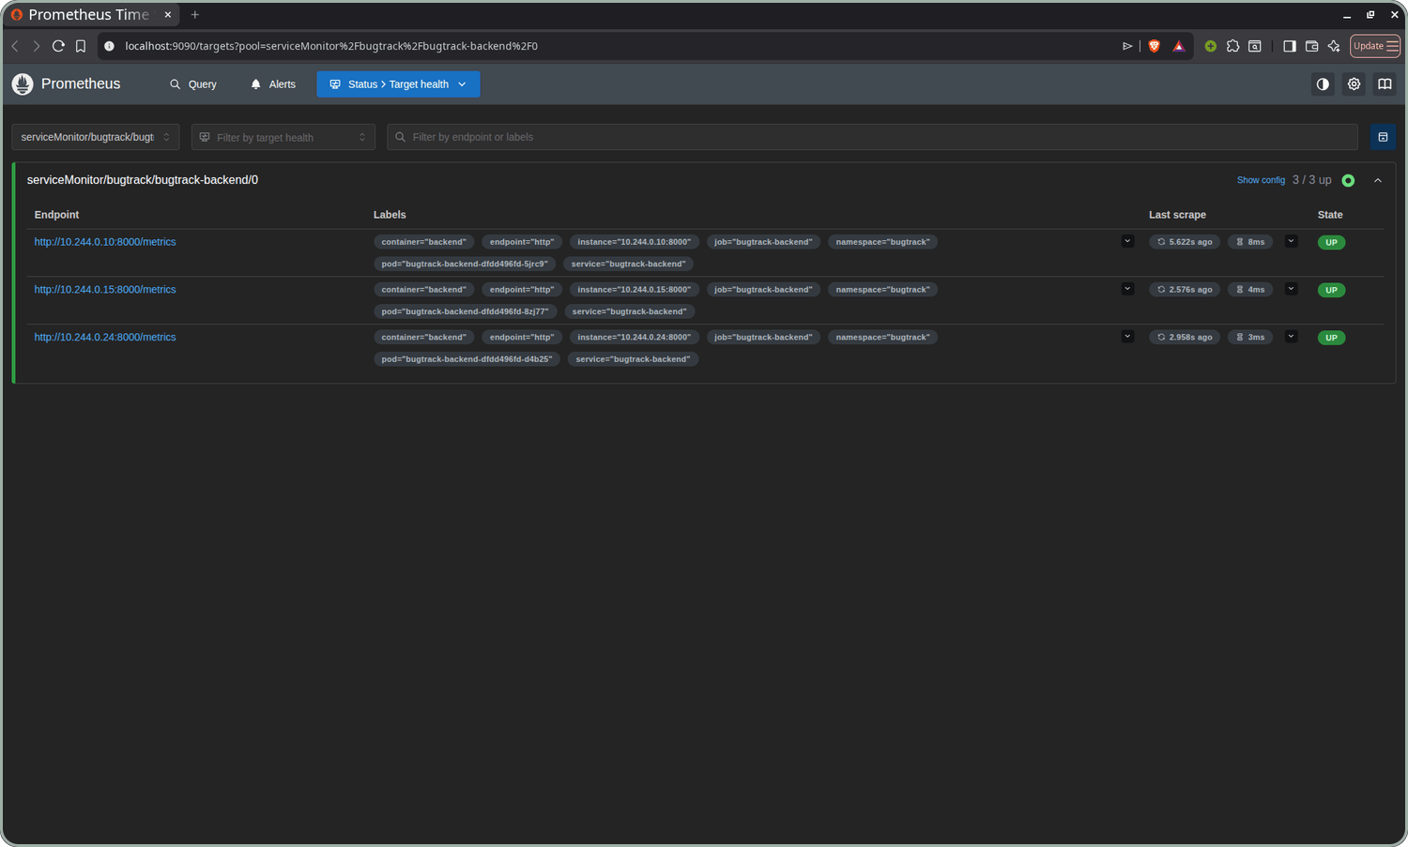
Metrics and targets
M9
/metrics: FastAPI exposes request counts and latency histograms.
Targets: the ServiceMonitor makes Prometheus scrape every backend pod, 3 of 3 UP.
Notes:
The backend exposes slash metrics with request counts and latency histograms. A ServiceMonitor in my chart tells Prometheus to scrape the backend pods, and the targets page shows all of them up.

Slide 15
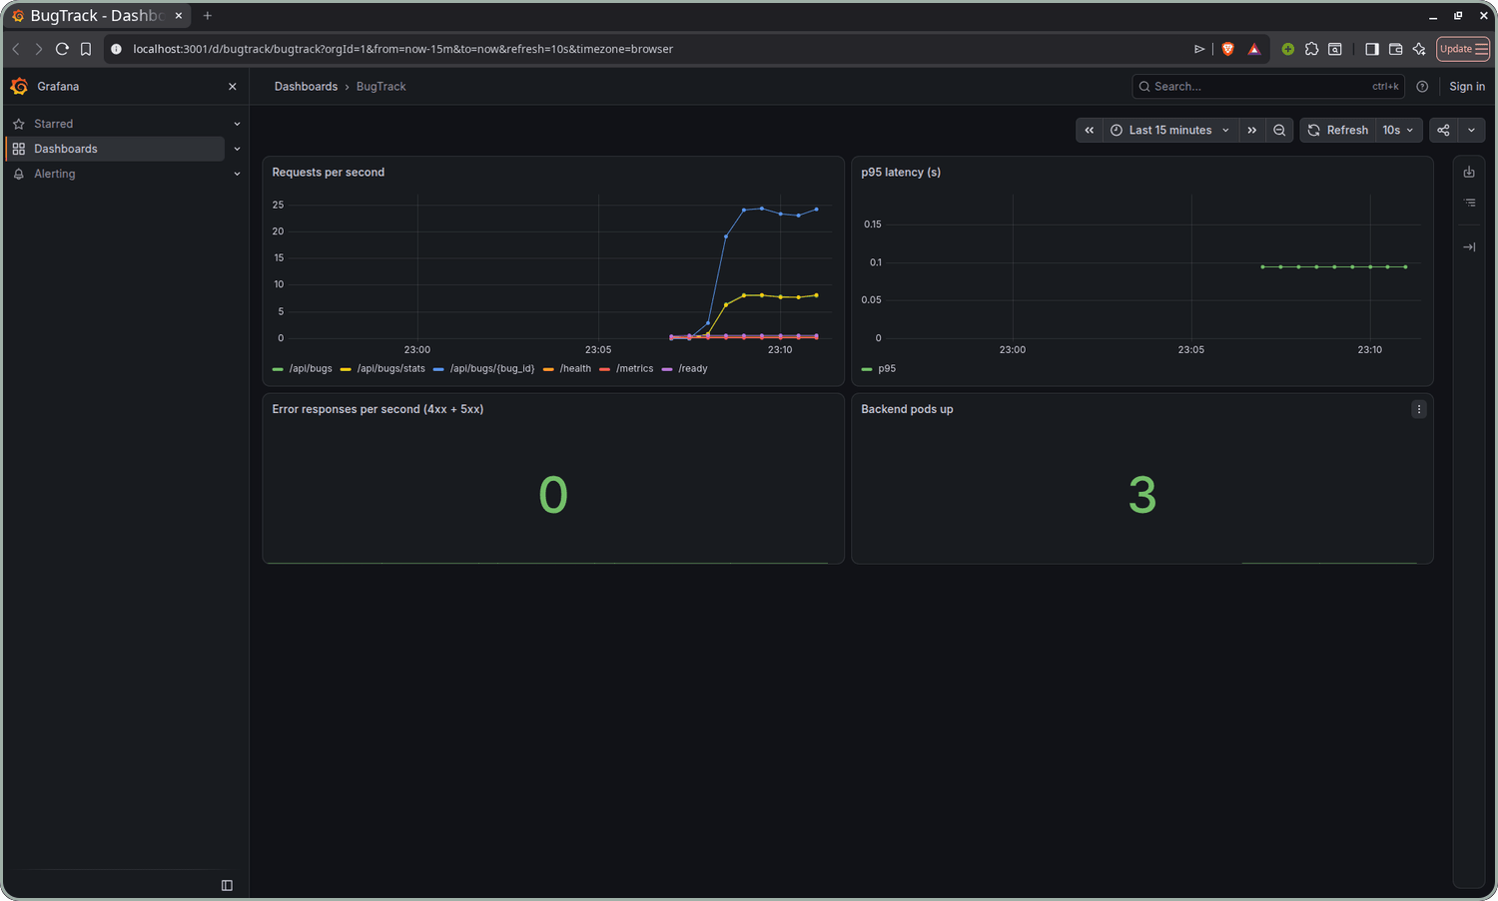
Grafana dashboard
M9
Requests per second, by route
p95 latency
Error responses (4xx and 5xx), 0 under load
Backend pods up, 3 after the HPA scaled out
Notes:
I made a small Grafana dashboard with four panels: requests per second by route, p95 latency, error responses, and the number of backend pods. The dashboard shows three pods because the HPA had just scaled out. The error panel stays at zero because the load test only asks for bugs that exist.

Slide 16
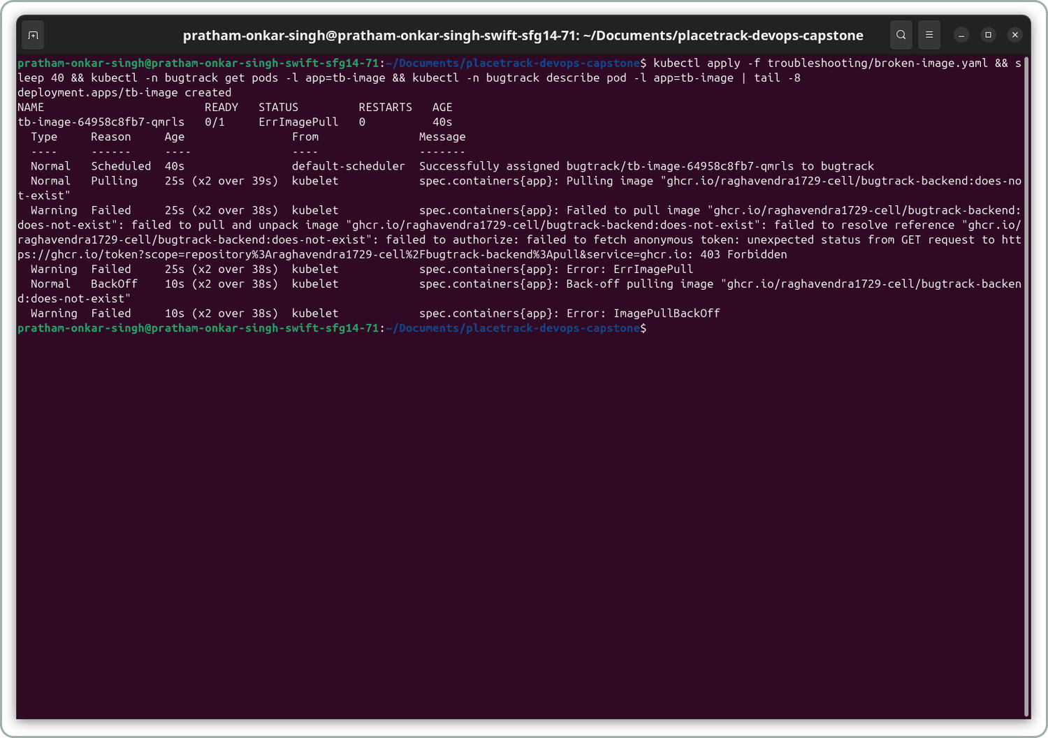
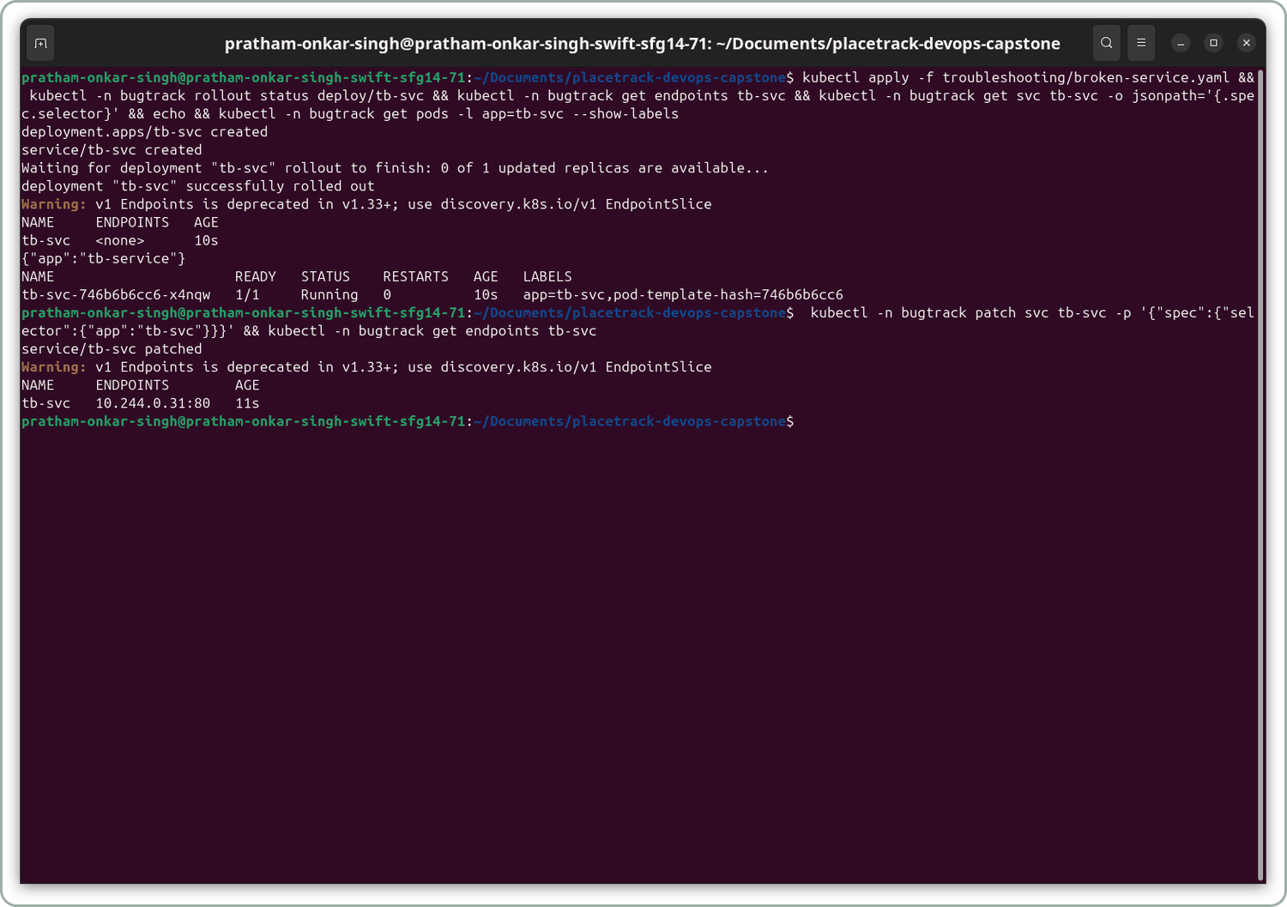
Troubleshooting
FIXES
Bad image tag
Symptom: ErrImagePull, then ImagePullBackOff
Cause: the tag does not exist; GHCR answers a missing tag with 403
Fix: kubectl set image to a tag that exists, new pod is 1/1 Running
Selector mismatch
Symptom: pod Running, but endpoints are <none>
Cause: Service selects app=tb-service, the pod is labelled app=tb-svc
Fix: patch the selector, the Pod IP appears under endpoints
Notes:
I broke two things on purpose to practise finding problems. First, a wrong image tag, which gives ErrImagePull and then ImagePullBackOff. Second, a Service whose selector does not match the pod labels, so it has no endpoints. For each one I followed the same steps: identify, investigate, root cause, fix, verify.

Slide 17
Live demo flow
DEMO
1
2
3
4
5
Edit a string
Push to main
Pipeline runs
Image in GHCR
Helm upgrade
frontend/src/App.jsx
git commit and push
tests, build, Trivy
tagged with the SHA
scripts/deploy.sh, then refresh
Commit a change, watch the pipeline run, see the deployment update.
Notes:
For the demo I change a visible string in the frontend, commit and push. GitHub Actions runs the tests, builds the images, scans them and pushes them to GHCR with the commit SHA. Then helm upgrade runs with that SHA, and when I refresh the browser the new text is live.

Slide 18
What I learned
1
A passing build is not a secure build. Trivy gates the push even when every test is green.
Thank you
2
nginx resolves the backend once, at start. It needs the full Service DNS name to avoid a 502.
BugTrack
3
Running is not Ready. Backend pods wait for Postgres because /ready checks the database.
github.com/Pratham-Onkar-Singh/BugTrack
4
Secrets are generated, never committed. The Postgres password Secret survives helm uninstall.
Notes:
Four things stayed with me. A build that passes can still be insecure, which is why Trivy gates the push. nginx looks up the backend name only once, so it needs the full service DNS name. A pod can be Running but not Ready until it reaches the database. And secrets are generated at deploy time and never committed. Thank you.

