Slide 1
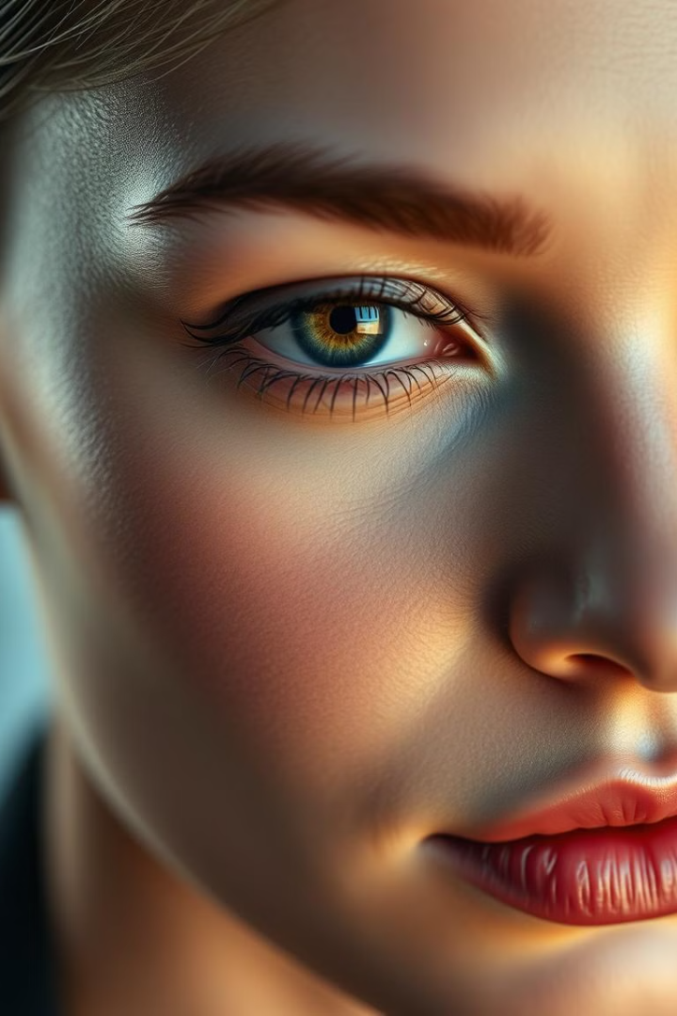
Facial Recognition
Welcome to this presentation on facial recognition with Python. We'll explore the science, technology, and ethical considerations behind this powerful field. This presentation will be a practical guide to understanding and building your own facial recognition systems using Python.

Slide 2
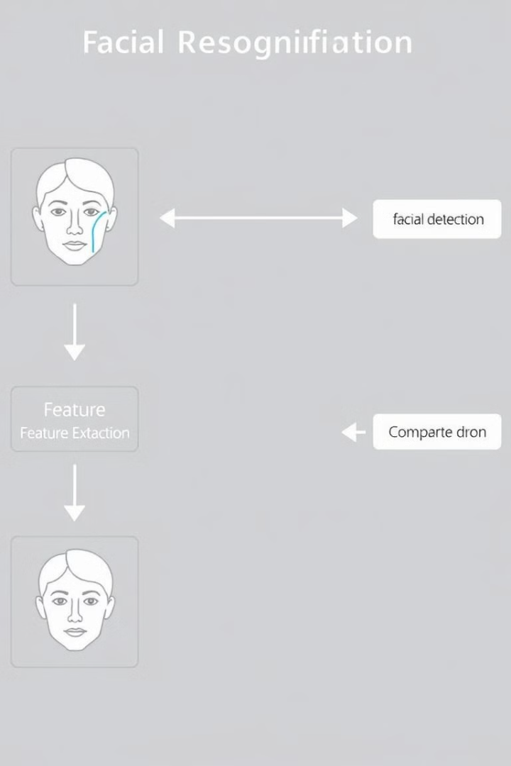
Building a Facial Recognition System
1
First, install the required Python libraries, such as OpenCV and Dlib.
2
Then, load a pre-trained facial recognition model or train your own model using a dataset of faces.
3
Finally, capture images or videos from a camera or file and process them through the facial recognition system to detect and identify faces.

Slide 3
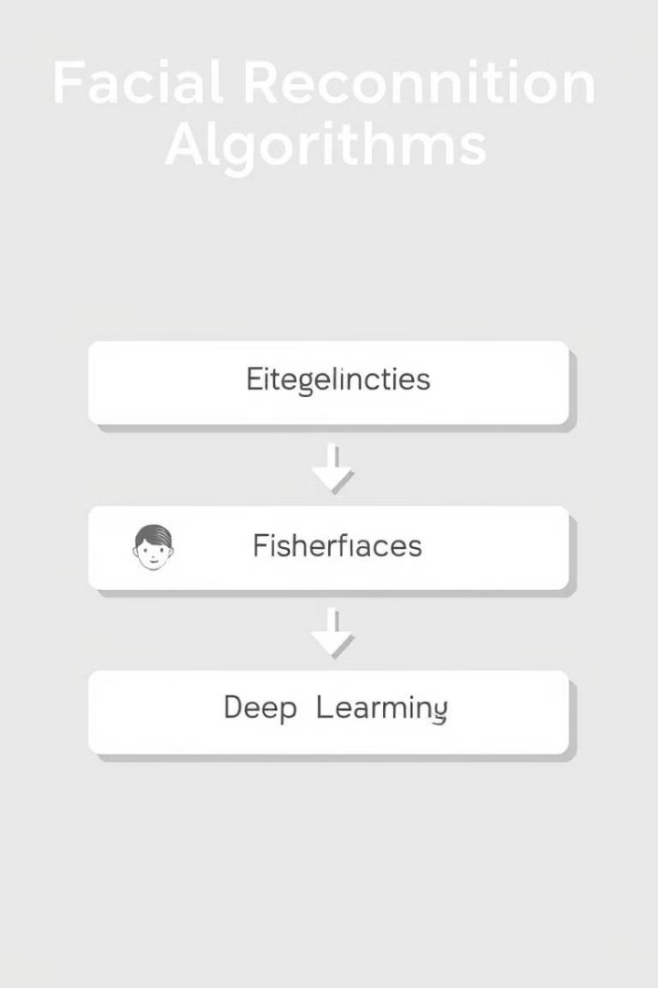



Facial Recognition Algorithms
Eigenfaces
This classic algorithm uses principal component analysis (PCA) to create a set of eigenfaces that represent the variability in facial features.
Deep Learning
Modern facial recognition systems rely heavily on deep learning, which involves training artificial neural networks on vast amounts of facial data.
FaceNet
This deep learning algorithm directly learns a mapping from face images to a compact embedding space. It is known for its high accuracy.

Slide 4
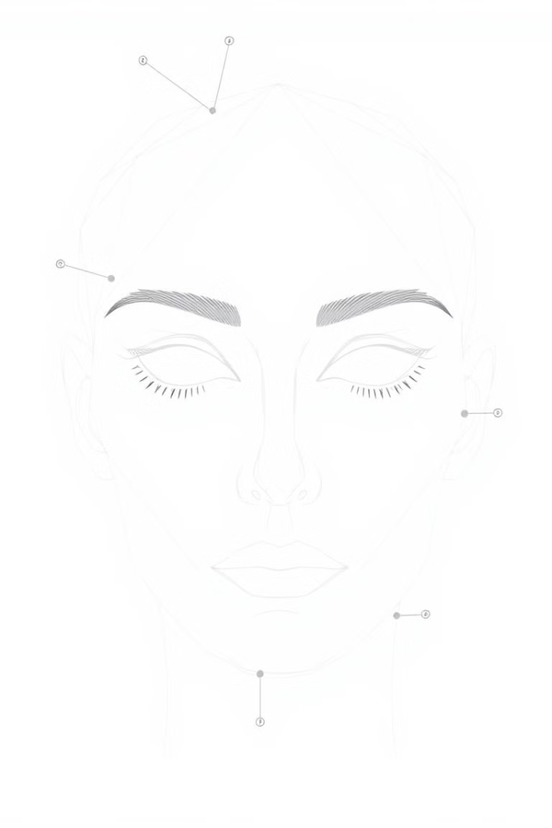
Facial Feature Extraction
Feature Extraction
Encoding
This is the process of extracting a numerical representation of a face that captures its unique characteristics.
The extracted features are then encoded into a compact vector of numbers, known as a facial embedding. This embedding represents the person's unique facial features.
Dimensionality Reduction
Often, dimensionality reduction techniques are used to reduce the number of features and make the encoding more efficient.

