Slide 1
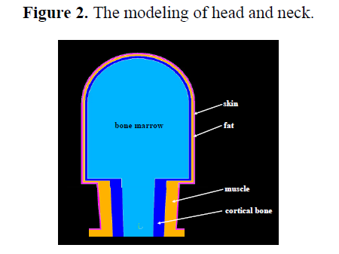
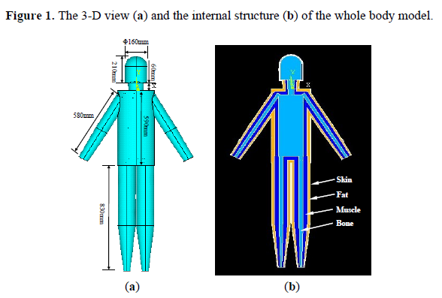
1. A Finite-Element Simulation of Galvanic Coupling Intra-Body Communication Based on the Whole Human Body
This paper shows a finite-element model of the entire human body to simulate galvanic coupling IBC. The simulation was performed in ANSYS software.
They developed a 3D FE model of the whole human body by showing parts like the head, torso, arms, and legs into cylinders and cones.

Slide 2
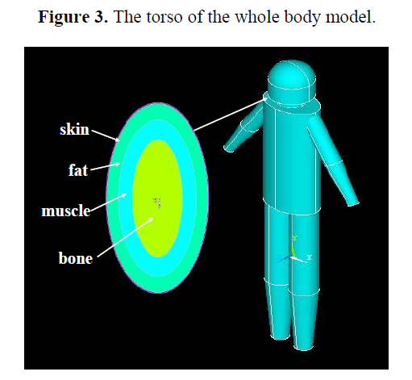
1. A Finite-Element Simulation of Galvanic Coupling Intra-Body Communication Based on the Whole Human Body
Some measurements included in the paper are:
The torso of the developed model was abstracted as an elliptic cylinder, which has a long-axis length of 265 mm, a short-axis length of 195 mm and a height of 590 mm.
The elliptic cylinder was also modeled by four layers (skin, fat, muscle and bone), while the thickness of these layers were set as 1.7 mm (skin), 22 mm (fat) and 27 mm (muscle).
Upper arms were modeled by the cylinders with a length of 32 mm, while the lower arms were modeled by the cones with a length of 26 mm.

Slide 3
1. A Finite-Element Simulation of Galvanic Coupling Intra-Body Communication Based on the Whole Human Body
Important observations/results: 1. The highest electrical potentials during signal transmission are concentrated around the transmitting electrode and decrease as the distance increases. These higher potentials are primarily located in the surface layers of the body, specifically the skin and fat.

Slide 4
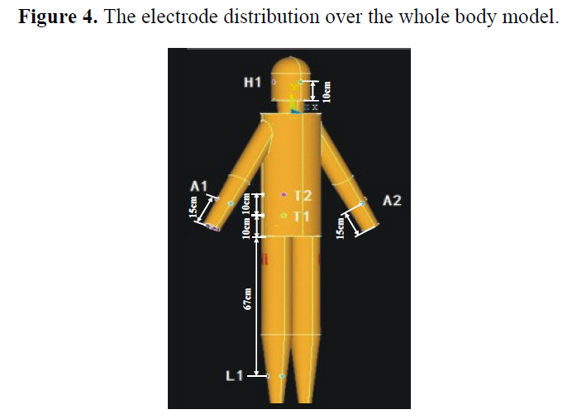
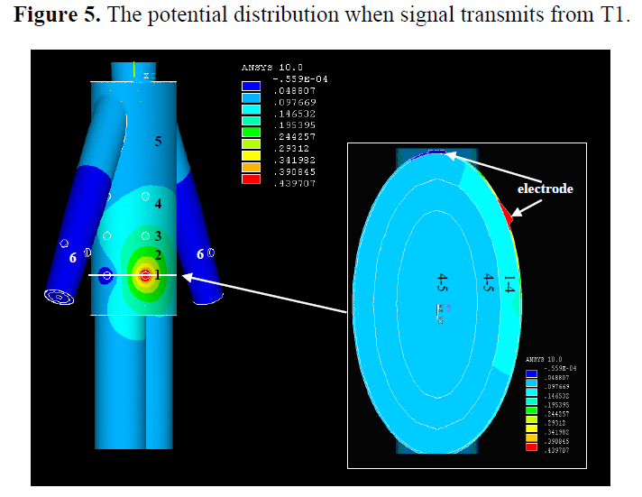
1. A Finite-Element Simulation of Galvanic Coupling Intra-Body Communication Based on the Whole Human Body

Slide 5
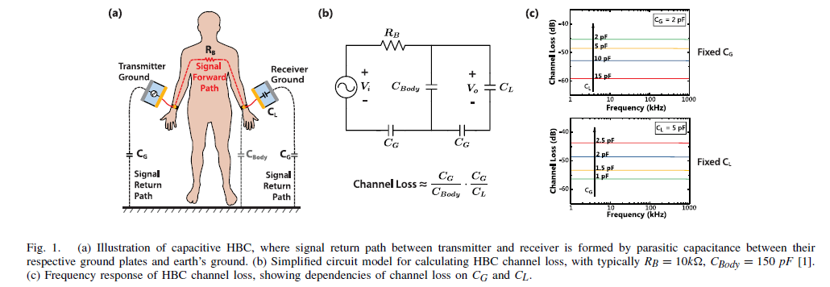
2. Understanding the Return Path Capacitance in Capacitive Human Body Communication
This paper analyzes the return path capacitance (CG​), a critical factor in Capacitive Human Body Communication (HBC) that influences channel performance.

Slide 6
3. Electric field intra-body communication in human body using wearable transceiver
Using a wearable transceiver in a real-life human setting was the main goal of this study to show that electric field intrabody communication can be used in real life.
Methods: A small, wearable transceiver was made, and tests were done on humans to measure the strength of the received signal in different body parts.
The results showed that a stable electric field signal could pass through the body and be picked up by a wearable device. This proved that body-worn communication systems could work in real life.
Reference:
K. Fujii, M. Takahashi, and K. Ito, “Electric field intra-body communication in human body using wearable transceiver,” IEEE Transactions on Antennas and Propagation, vol. 55, no. 7, pp. 2080–2087, 2007.

Slide 7
4. Electric field intrabody communication modeling with finite-element method
The goal of this paper was to use the Finite-Element Method (FEM), which works especially well with complex biological geometries, to create a strong and accurate numerical model for electric field intrabody communication.
Model Development: A detailed 3D model of the human body was made, including different types of tissue and the electrical properties (conductivity and permittivity) that go with them. This model made it possible to simulate the electric field distribution inside the body more accurately.
The FEM model that was made was an important analytical tool that helped researchers predict and understand how signals travel, how path loss works, and how different body tissues affect the communication channel without having to do a lot of physical testing.
Reference:
R. Xu, H. Zhu, and J. Yuan, “Electric field intrabody communication modeling with finite-element method,” IEEE Transactions on Biomedical Engineering, vol. 58, no. 3, pp. 705–712, 2010.

Slide 8
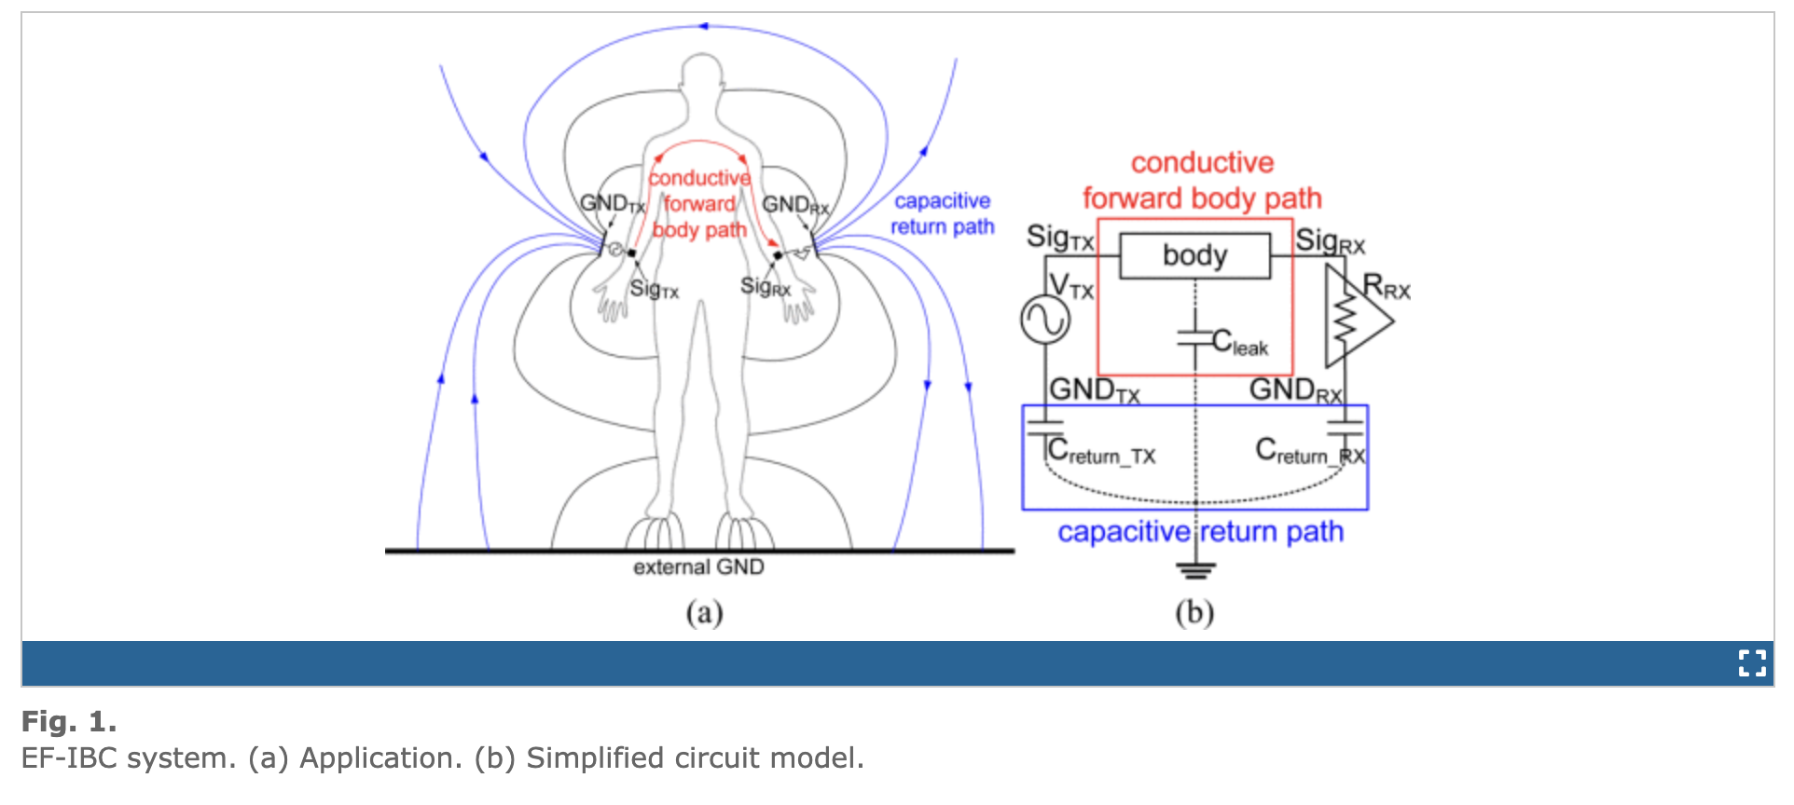
5. Electric field intrabody communication modeling with finite-element method

Slide 9
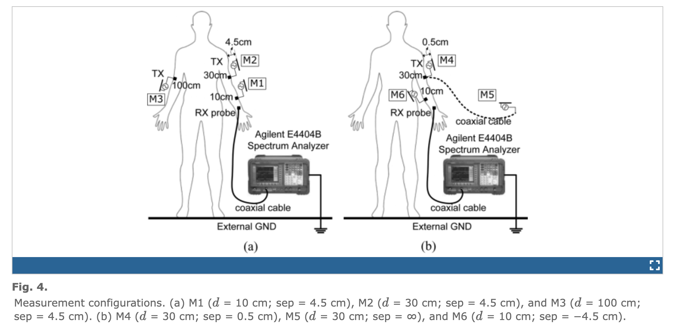
5. Electric field intrabody communication modeling with finite-element method

Slide 10
6. Characterization of human body forward path loss and variability effects in voltage-mode HBC
What is being looked into: The main goal of the study was to fully describe the forward path loss and the variability effects that are built into a voltage-mode HBC system. The signal moves through the body from the sender to the receiver. This is called the "forward path.“
Measurement: Experiments were done to find out how much the signal was weakened depending on how far apart the sending and receiving electrodes were on a person's body.
Variability Analysis: The study carefully looked at how changing things like body position, movement, and where the electrodes are placed can have a big effect on how stable and reliable the communication channel is.
Reference:
S. Maity, K. Moghe, and S. Sen, “Characterization of human body forward path loss and variability effects in voltage-mode HBC,” IEEE Microwave and Wireless Components Letters, vol. 28, no. 3, pp. 266–268, 2018.

Slide 11
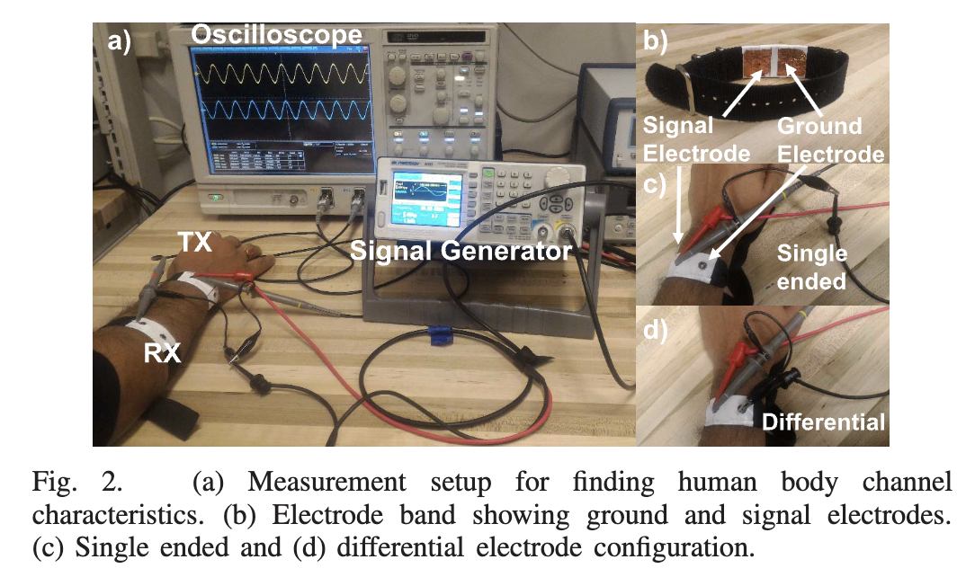
6. Characterization of human body forward path loss and variability effects in voltage-mode HBC

Slide 12
7. Toward understanding the return path capacitance in capacitive human body communication
This study looked at the return path capacitance from a different angle, which is an important but often overlooked part of the capacitive HBC communication circuit.
Key Findings: The research showed that the capacitance between the body and its surroundings is a key factor in determining how well the system works and how well the signals are sent.
In conclusion, this study helped us understand the capacitive HBC channel better by showing that both the forward and return paths are equally important. This made it easier to make more accurate system models and designs.
Reference:
M. N. Nath, S. Maity, and S. Sen, “Toward understanding the return path capacitance in capacitive human body communication,” IEEE Transactions on Circuits and Systems II: Express Briefs, vol. 66, no. 12, pp. 1878–1882, 2019.

Slide 13
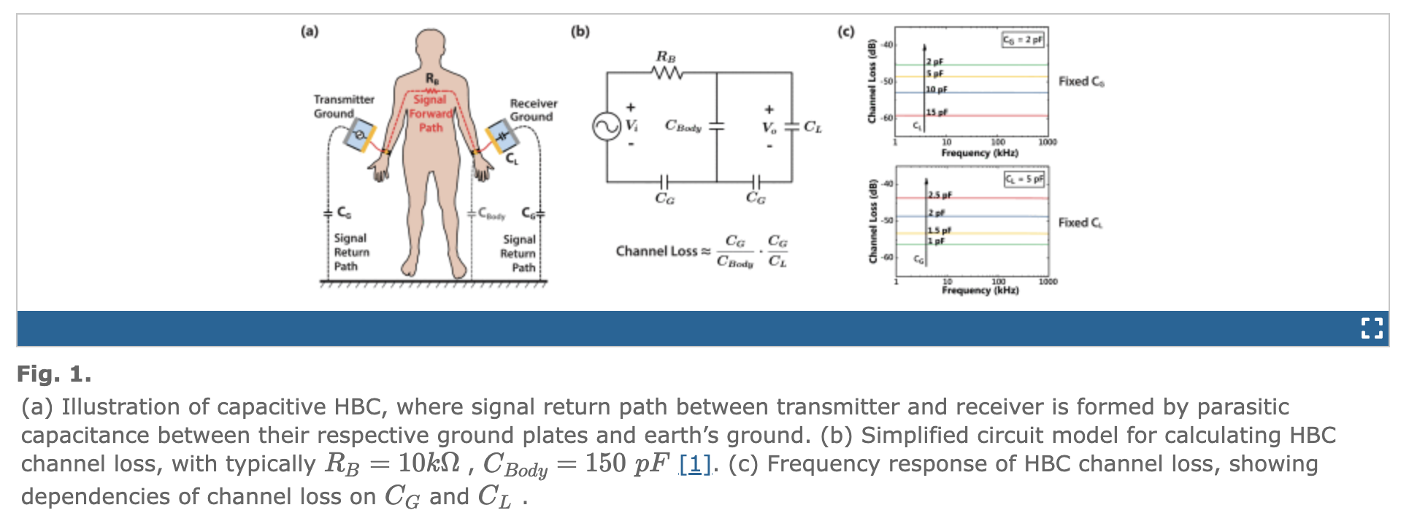
7. Toward understanding the return path capacitance in capacitive human body communication

Slide 14
8. Simplified human phantoms for intra-ward and intra-vehicle body area network modeling
Problem Statement: The computational expense and complexity associated with full-body FEM modeling were addressed in this paper by proposing a more computationally efficient alternative.
Proposed Method: To model communication within the body, the authors made simplified human phantoms. These phantoms, while anatomically less complex than a full model, accurately replicated the essential electrical properties of the human body.
Utility: These simplified models are particularly valuable for the rapid design and analysis of Body Area Networks (BANs) in constrained environments, such as a hospital ward or a vehicle, where a full anatomical model is not a prerequisite.
Reference:
B. Jacobsen and S. H. Isaacson, “Simplified human phantoms for intra-ward and intra-vehicle body area network modeling,” Conf. Proc. IEEE Int. Microwave Workshop Series on RF and Wireless Technologies for Biomedical and Healthcare Applications, 2013, pp. 1–4.

