Slide 1
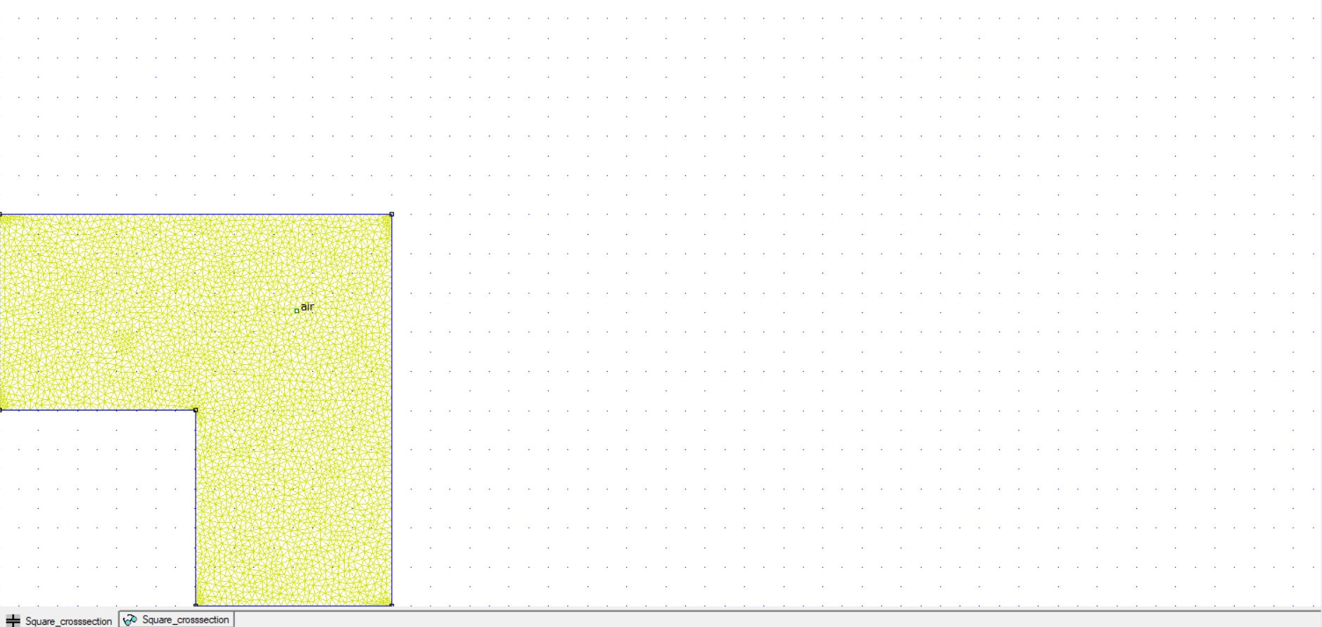
SQUARE CROSS-SECTION CAPACITOR IN FEMM
MODEL:

Slide 2
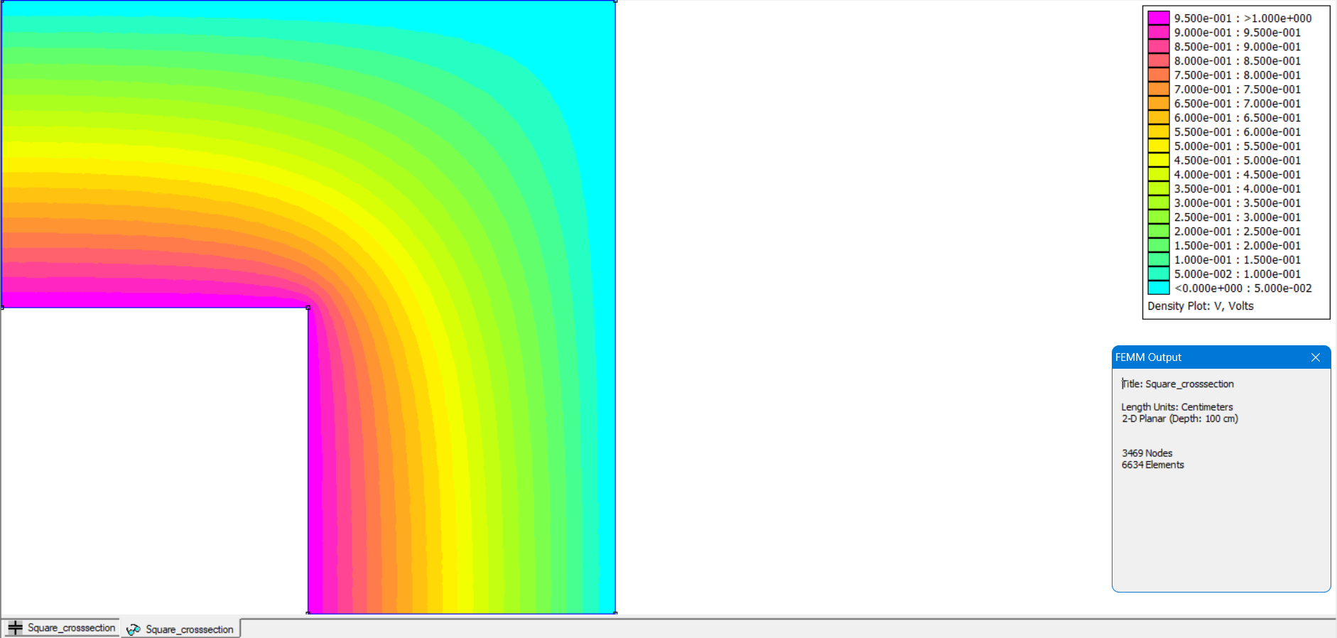
SQUARE CROSS-SECTION CAPACITOR IN FEMM
RESULTS:

Slide 3
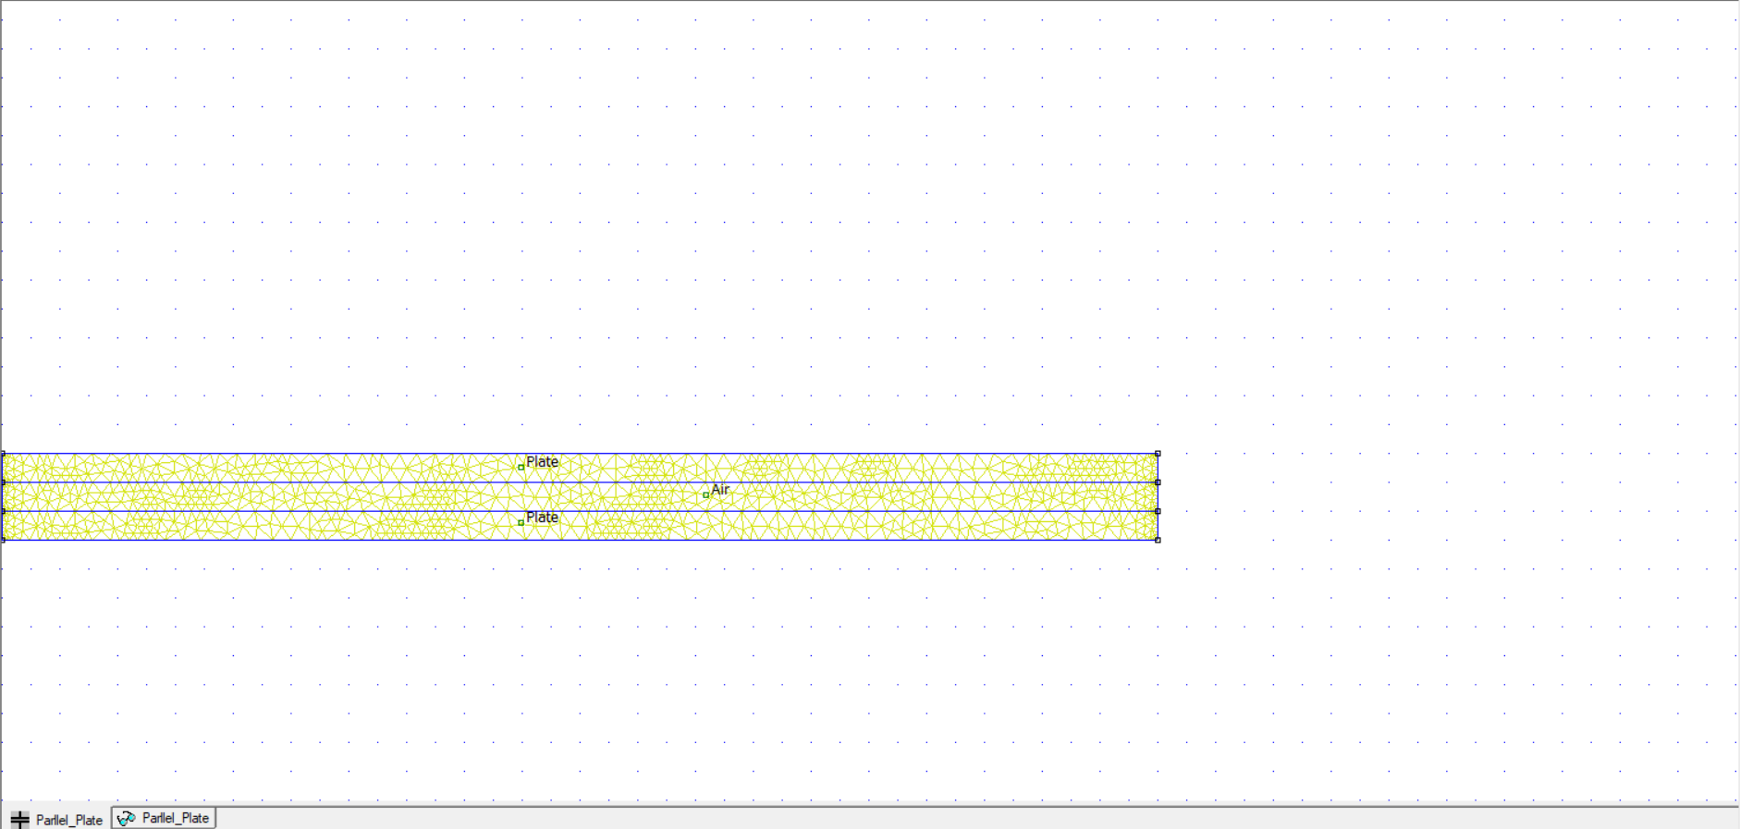
PARALLEL PLATE CAPACITOR IN FEMM
MODEL:

Slide 4
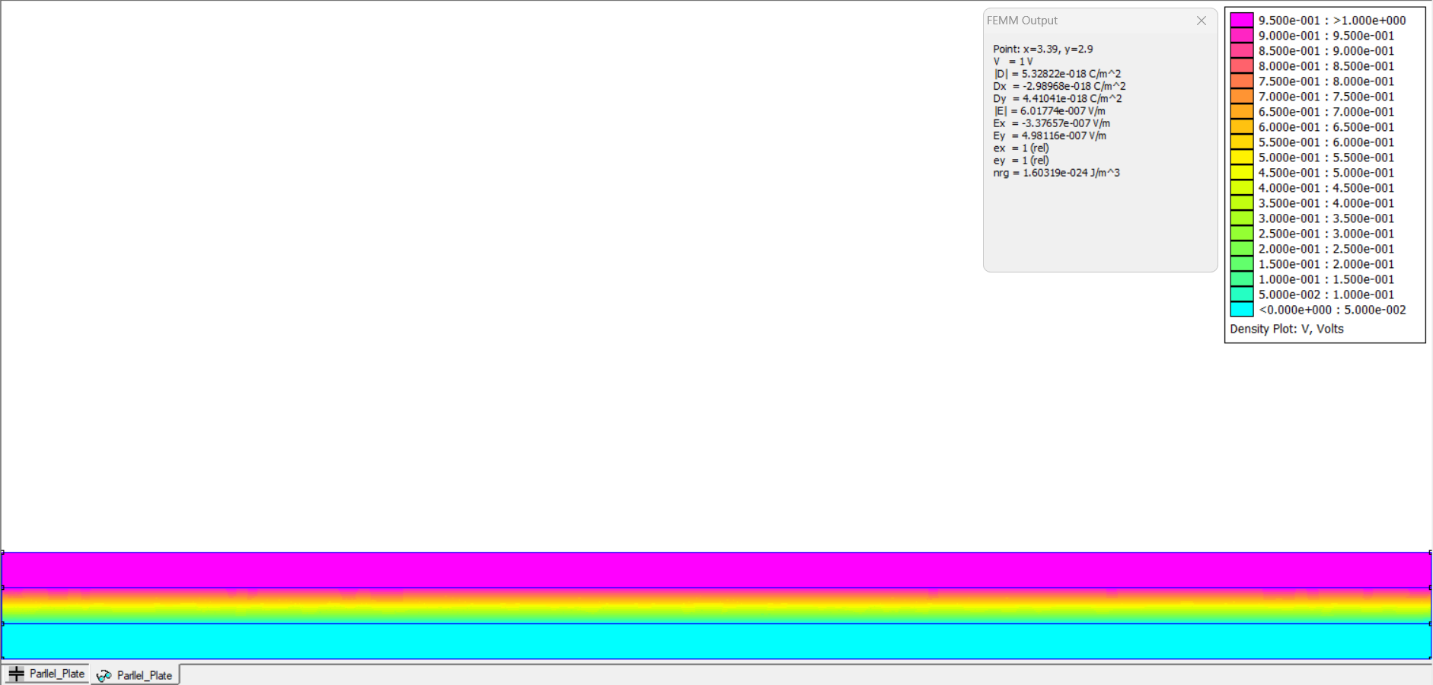
PARALLEL PLATE CAPACITOR IN FEMM
RESULTS:

