Slide 1


PREDICTING USER PURCHASE HISTORY
USING
DEEP LEARNING
-Pratham Yeshwante

Slide 2
OVERVIEW
Predict the next purchase based on user history
Enhance recommendation system for better user experience

Slide 3


STEPS
1.Study GenZDealZ.ai
2.Data Preparation
3.Model Development
4.Evaluation

Slide 4
UNDERSTANDING GENZDEALZ.AI
Platform Purpose:
Provide deals and recommendations from various e-commerce platforms like Amazon, Flipkart, Myntra, etc.
User Interactions:
Users browse and purchase deals
Recommendation system suggests deals based on purchase history

Slide 5
SIMULATED DATA
data =
[ {'user': 'user1', 'purchases': ['amazon', 'flipkart', 'myntra']},
{'user': 'user2', 'purchases': [ 'flipkart']},
{'user': 'user3', 'purchases': ['myntra', 'flipkart']}
]
Data Format: Each entry includes a user ID and a sequence of purchases

Slide 6

MODEL DEVELOPMENT
Framework: TensorFlow
Model Type: Recurrent Neural Network (RNN)
Architecture:
Input: Sequence of previous purchases
Output: Next predicted purchase
Layers: Embedding, LSTM, Dense, Dropout layer
Data Format: Each entry includes a user ID and a sequence of purchases

Slide 7

CODE SNIPPET
X_train, X_test, y_train, y_test = train_test_split(X, y, test_size=0.3, random_state=42)
embedding_size = 20
model = Sequential()
model.add(Embedding(input_dim=len(tokenizer.word_index) + 1, output_dim=embedding_size, input_length=max_sequence_len - 1))
model.add(SimpleRNN(100, return_sequences=True))
model.add(Dropout(0.3))
model.add(SimpleRNN(100))
model.add(Dropout(0.3))
model.add(Dense(len(tokenizer.word_index) + 1, activation='softmax'))
model.compile(loss='sparse_categorical_crossentropy', optimizer=tf.keras.optimizers.Adam(learning_rate=0.001), metrics=['accuracy'])
history = model.fit(X_train, y_train, epochs=100, batch_size=32, validation_data=(X_test, y_test))

Slide 8
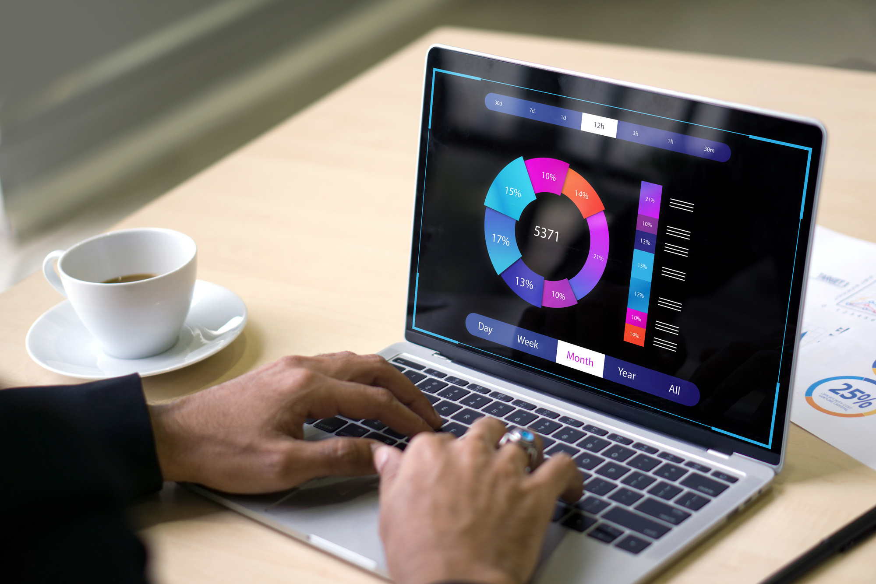
EVALUATION METRICS
Metrics:
Accuracy
Precision
Recall
Performance:
Train on 70% of data
Test on 30% of data

Slide 9
CHALLENGES AND SOLUTIONS
Challenges:
Limited Data: Simulated dataset may not fully capture real-world complexity
Sequence Length: Variable purchase sequences require padding
Solutions:
Data Augmentation: Simulate additional user data
Padding: Use pad_sequences to handle varying sequence lengths

Slide 10
INSIGHTS AND FUTURE
WORK
Future Work
Insights :
Model shows promising accuracy in predicting next purchase
Helps improve user engagement with personalized recommendations
Use real user data for training
Incorporate more features like user demographics, time of purchase , etc

Slide 11


OVERVIEW
Successfully developed a deep learning model to predict user purchases
Enhanced understanding of recommendation systems for e-commerce
THANKYOU!

