Slide 1
CSL 462: Computer Vision
Distracted Pedestrian Detection
Pratham Gupta (2015csb1024)
Rajat Sharma (2015csb1026)

Slide 2
Introduction
This Project works to prevent road accidents due to cell phone distraction. The proposed model detects people using cell phones while crossing the road using a CCTV camera installed at the traffic lights. On detecting a distracted pedestrian, an alarm can be rung to warn the person using the phone to pay attention to the road. The proposed model tries to estimate the pose of people crossing the road and use this data to detect pedestrians not paying attention to the road.

Slide 3
Prior Works in the Field
Prior work closest to our idea was proposed Akshay Rangesh, Eshed Ohn-Bar, Kevan Yuen and Mohan M. Trivedi in their research paper Pedestrians and their Phones - Detecting Phone-based Activities of Pedestrians for Autonomous Vehicles. The work employs a belief network to combine the results obtained from various sources such as pose clustering and HOG feature detection for segments depicting hands using a probabilistic approach.

Slide 4
Proposed Method
We apply a pipeline incorporating localizing humans, estimating the articulated human pose, assigning cluster based on the pose, extracting the images of both the hands and detecting the presence of phone in these cropped images, and weighing these factors to compute a final score which can then be thresholded, to detect pedestrians using their cell phones in a given image. We use YOLO Object Detection algorithm for the problem of localizing and detecting the humans and phone. For estimating the human pose, we use the Resnet 101 architecture and fully connected layer based neural networks.

Slide 5
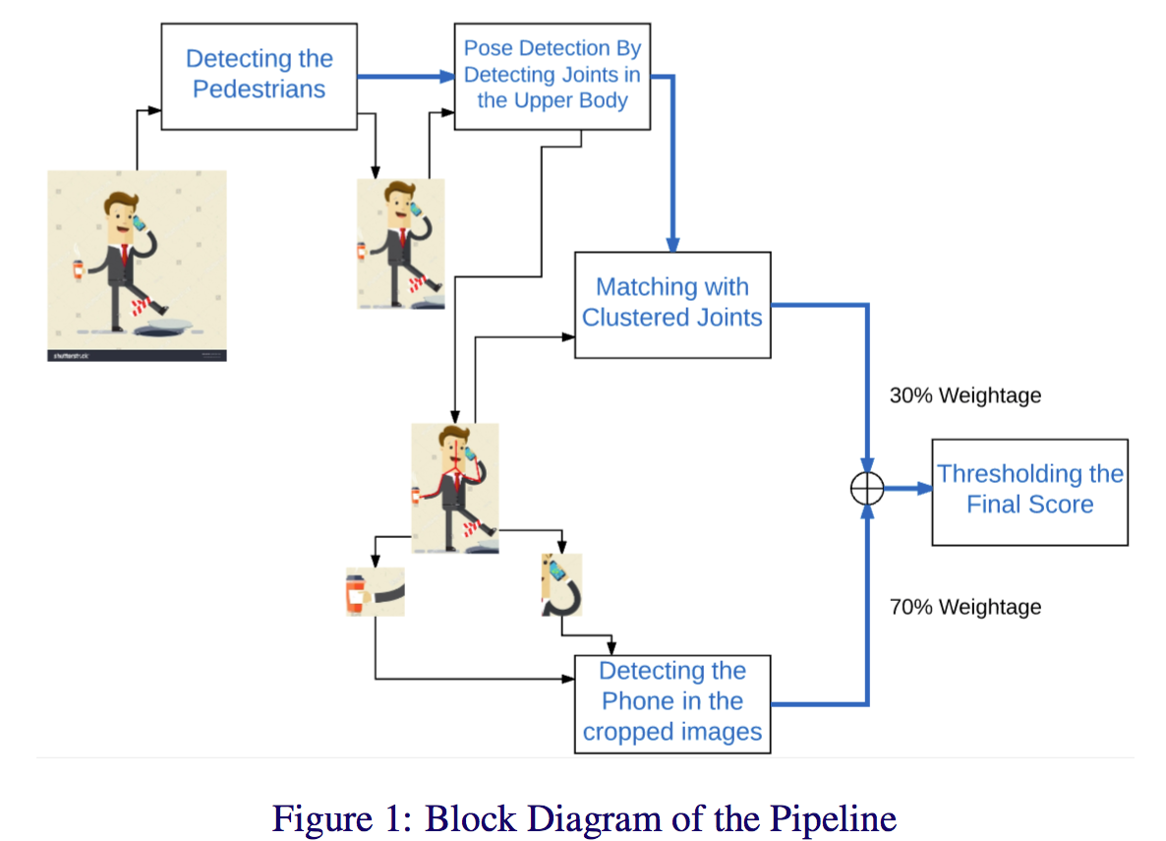
Pipeline Visualization

Slide 6
Results
The experimental results obtained suggest that a high enough accuracy, precision and recall were obtained using the proposed model.
The accuracy obtained was 70.89%.
The precision obtained was 77.77%.
The recall obtained was 72.92%.
The model takes about 15-20 seconds per image when run on a CPU. So, a very large speedup is expected from GPU usage and so, the system can be deployed for real-time application by sampling images at regular intervals from the video feed.

Slide 7
Conclusion & Possible Extension
Deaths due to cell phone distraction while walking accounted for 15% of the total traffic fatalities in 2014 and the number still continues to increase. We can conclude that use of our model in real time can work towards prevention of such accidents.
In order to improve the accuracy of our system we can use larger and better datasets for clustering and GPU implementation can allow real-time detection in videos.

Slide 8
THANK YOU

