Slide 1





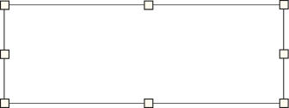
GROUP 43 |  | 27/03/2025
This presentation is optimized for whiteboard use
Frontend
NextJs
shadcn/ui
zod, recharts and tailwind
HUSH POLL
Backend
ExpressJs
GDPR Compliance
MongoDB Database
ANONYMOUS POLLING APPLICATION

Slide 2

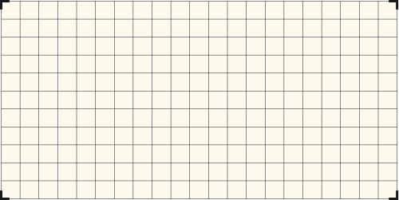





AGENDA
Introduction
Mind Map
Harsh Agrawal
Pratham Todi
Pratham Aggarwal
Idea Cluster
Diagram
Next Steps

Slide 3

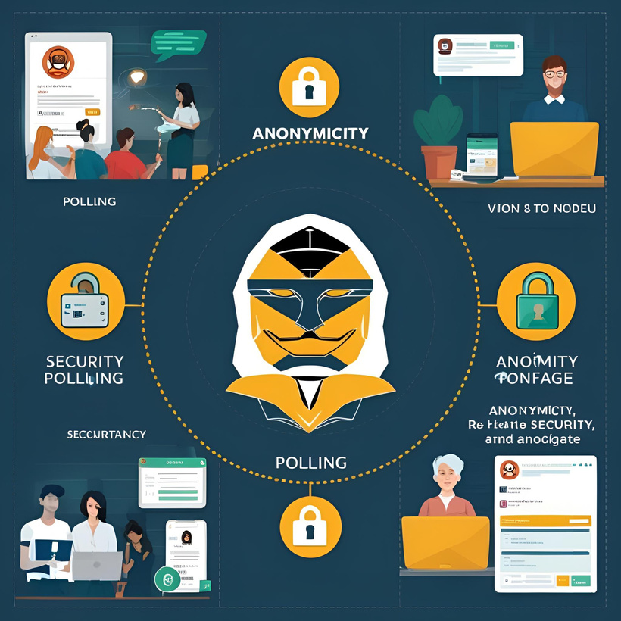


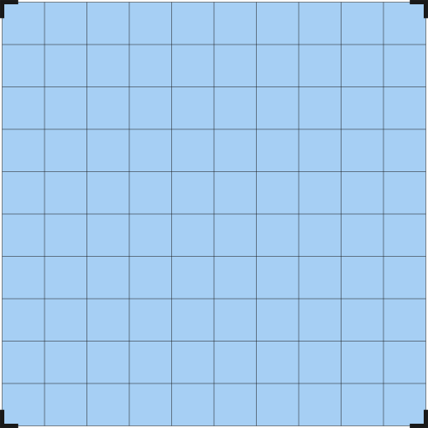
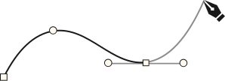
INTRODUCTION
Group 43
Anonymous, GDPR-compliant polling app with real-time analytics and cross-device support.
Built with Next.js, Node.js, and MongoDB, it features anti-duplication, admin moderation, and advanced user options.
HUSH POLL

Slide 4
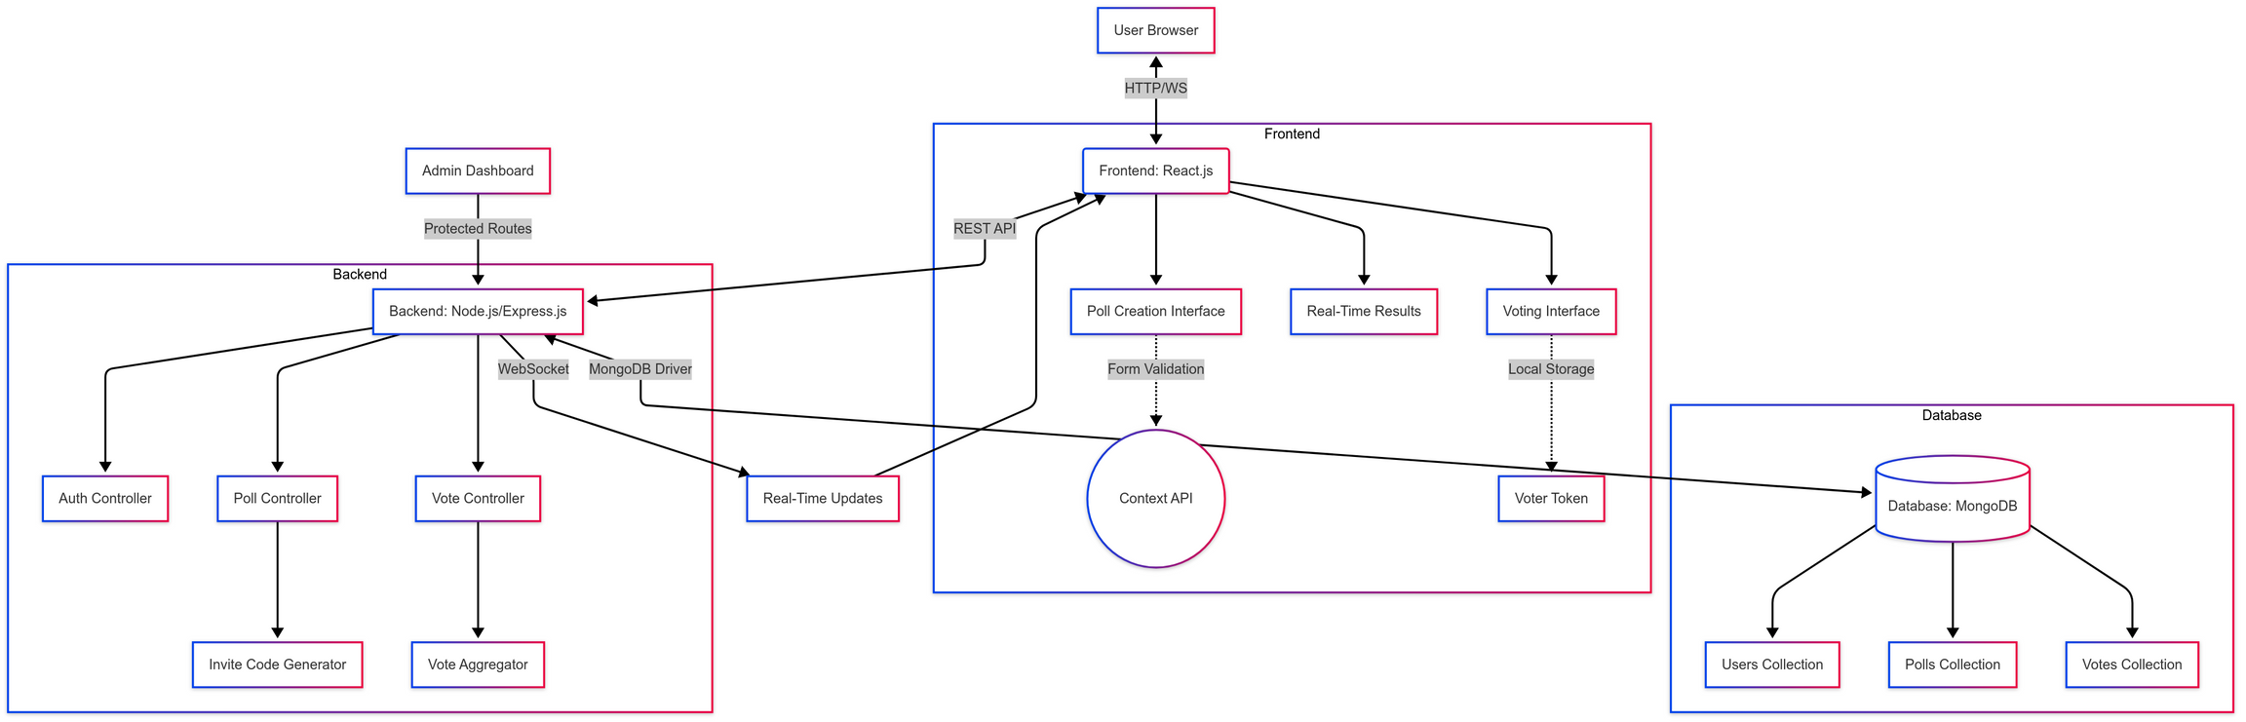
Back to Agenda Page
FLOW GRAPH

Slide 5
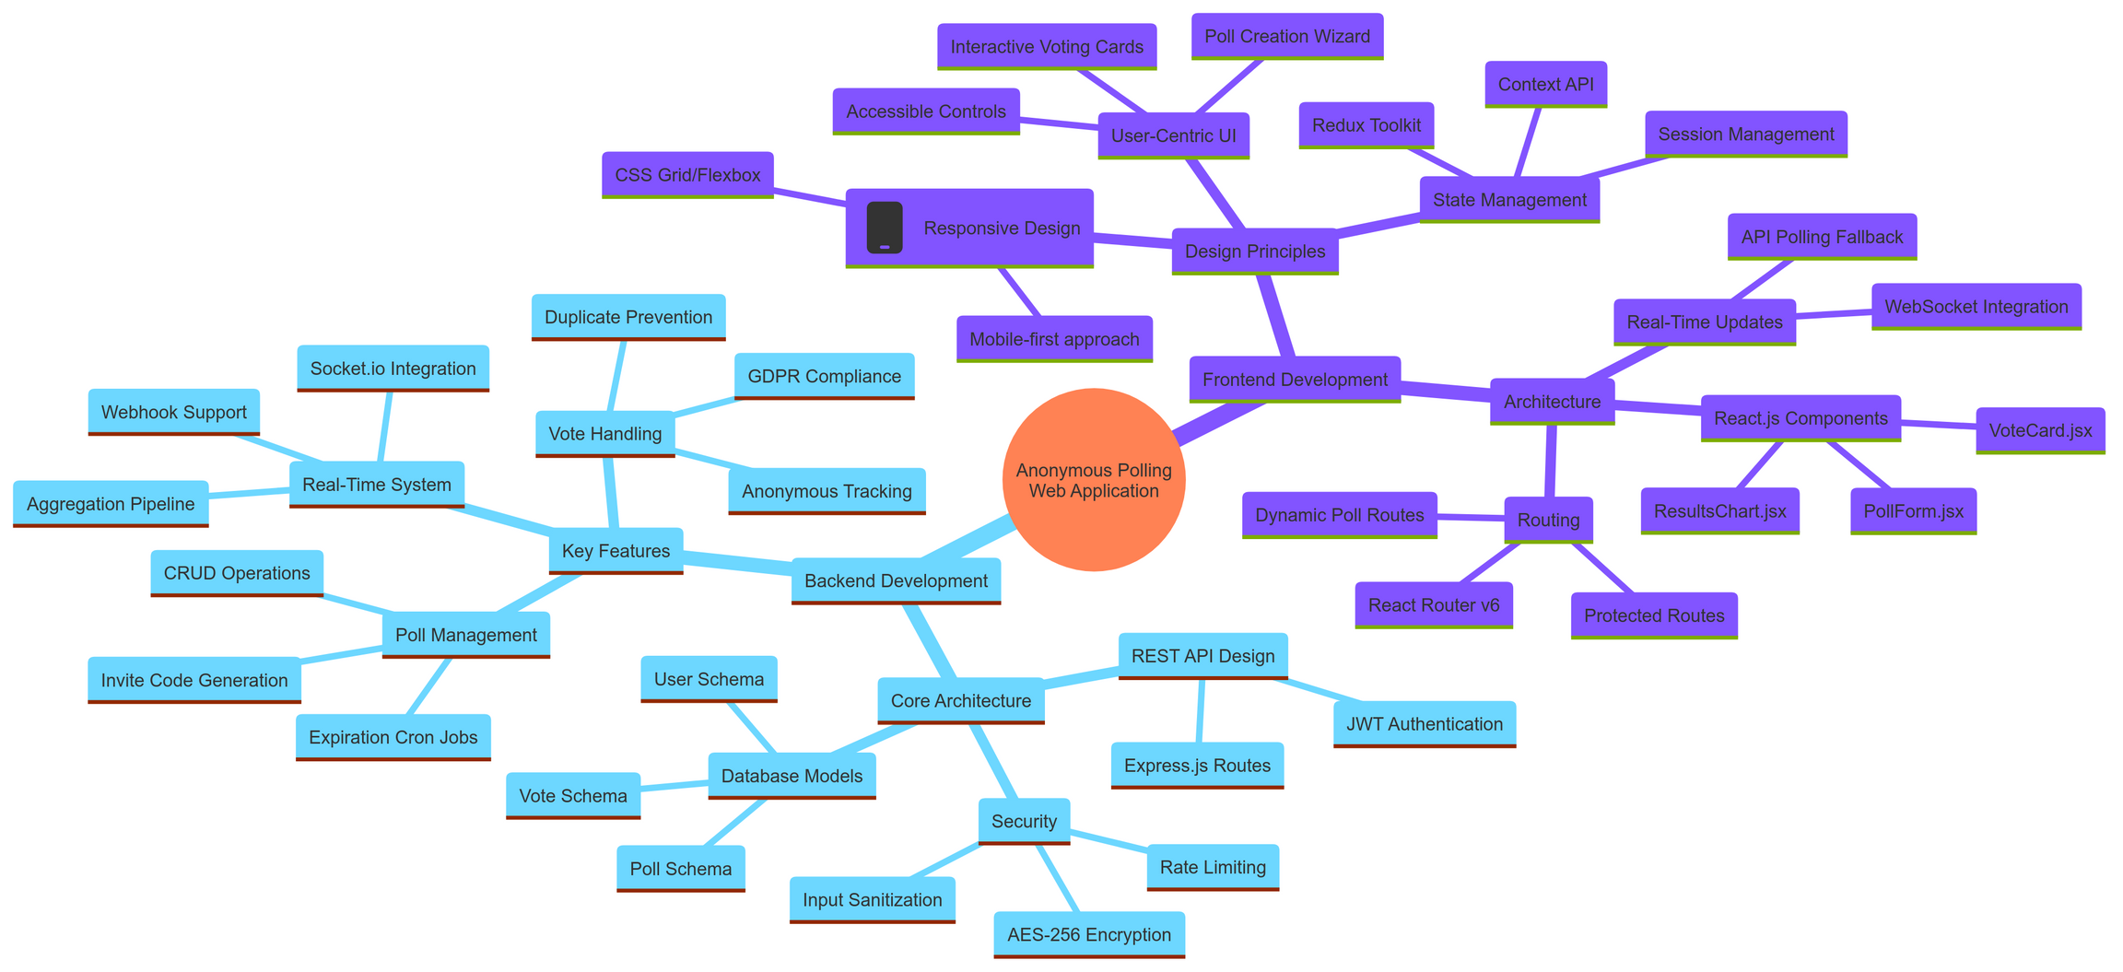
Modular Architecture with NextJs frontend + Node.js/Express backend with MongoDB handles poll creation, real-time voting via WebSocket, and result visualization.
Anonymous voting via hashed browser tokens. GDPR-compliant data handling with HTTPS encryption and rate-limited APIs.
Users create/share polls via UI; participants vote through links. Real-time charts update instantly via WebSocket connections.
1
2
3

Slide 6

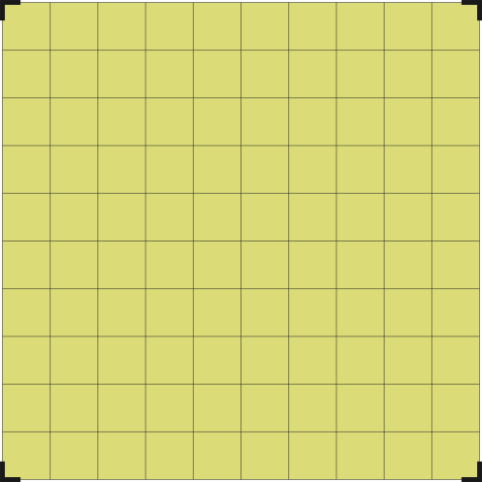
Back to Agenda Page
IDEA CLUSTER
Different Rest APIs and Requests made Between Client and Server with Adequate Middlewares for Effecient Logging, Error and Authentication Handling.
Controller functions and routes, mentioning different Features and Functionalities of the Anonymous Polling Application

Slide 7
Back to Agenda Page
H U S H P O L L | AUTH CONTROLLER | POLL CONTROLLER
H U S H P O L L
H U S H P O L L | VOTE CONTROLLER | ADMIN CONTROLLER
H U S H P O L L
ANONYMOUS POLLING WEB APPLICATION | ANONYMOUS POLLING WEB APPLICATION | ANONYMOUS POLLING WEB APPLICATION
JWT Authentication
Session Management
Poll CRUD Operations
Poll Retrieval
Poll Updates
POST /api/auth/login
POST /api/auth/signup
POST /api/polls
GET /api/polls/:id
PUT /api/polls/:id
Vote Submission
RealTime-Aggregation
WebSocket Stream
Moderation Dashboard
Content Removal
User Management
POST /api/polls/:id/vote
GET /api/polls/:id/results
WS /api/polls/:id/updates
GET /admin/polls
DELETE /admin/polls/:id
PATCH /admin/users/:id

Slide 8

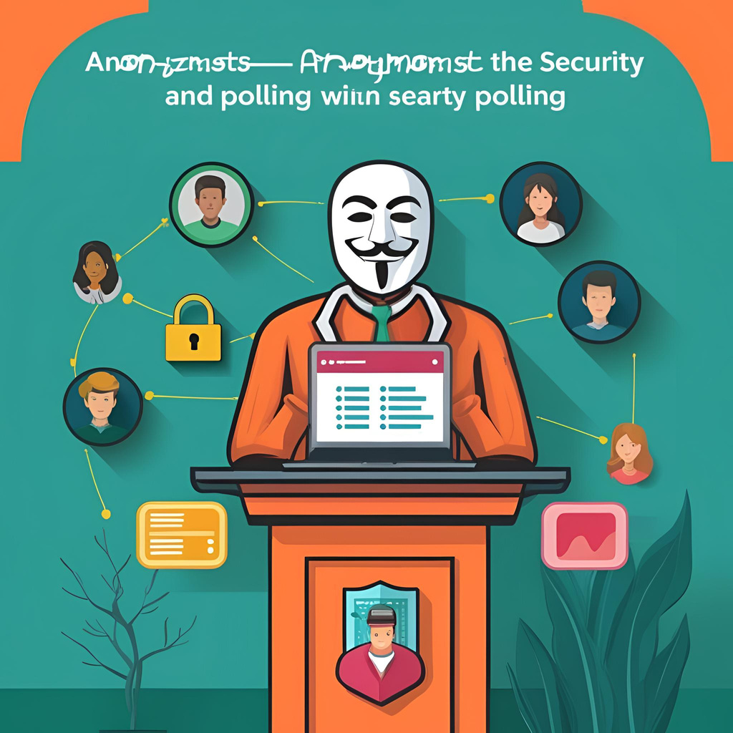
Back to Agenda Page
DIAGRAM
Empower authentic opinions with anonymous, real-time polling that captures collective insights without compromising privacy | Instantly deploy GDPR-compliant surveys across any device, backed by robust security and seamless user experiences.

Slide 9
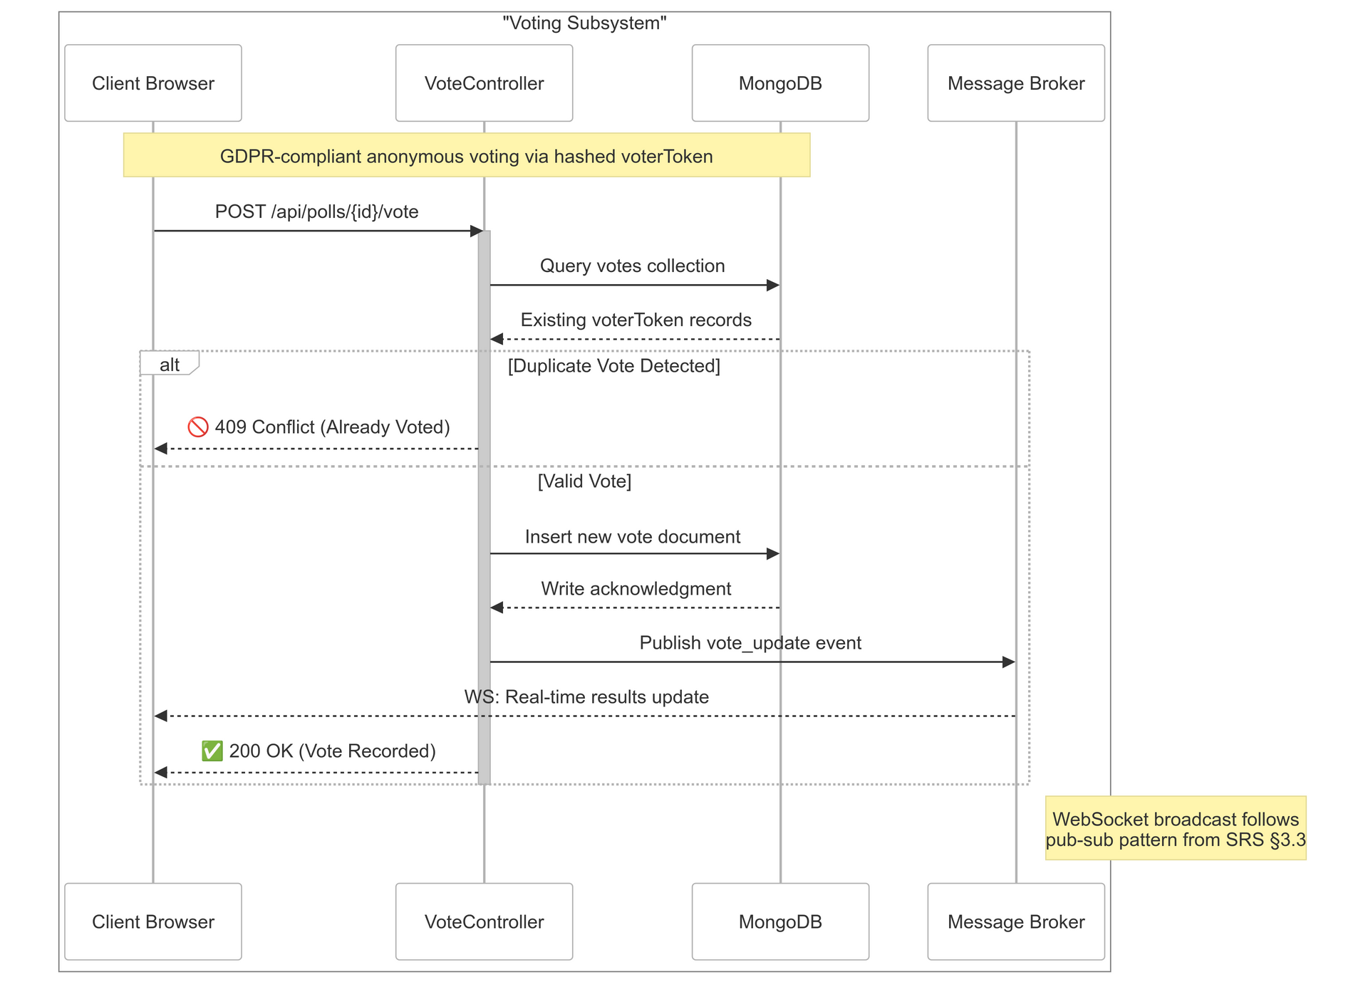
Back to Agenda Page
The GDPR-compliant voting process begins when a user submits a vote via /api/polls/{id}/vote. The system checks MongoDB for existing hashed voterToken to prevent duplicates. If detected, a 409 Conflict error is returned. Valid votes are stored in DB, triggering a WebSocket broadcast through a Message Broker using SRS §3.3's pub-sub pattern for real-time result updates. Clients receive success confirmation (200 OK) and instant UI refreshes. This flow ensures anonymous participation while maintaining vote integrity through token-based validation and encrypted data handling.

Slide 10

NEXT STEPS
NEXT STEPS | NEXT STEPS | NEXT STEPS
Main Idea | Action Item | Point Person
Complete the Integration of the Client with the Server | Communication, Connection and Business Logic | Pratham Aggarwal
Complete the Integration of the Client with the Server | Frontend Changes and Updates | Harsh Agrawal
Complete the Integration of the Client with the Server | Database and Architectural Design | Pratham Todi
Testing and Logging | Using Mocha and Winston for Testing and Error / Console Logs | Harsh Agrawal and Pratham Todi
Deployment | Deployment Scripts and Containerization | Pratham Aggarwal
1
2
3
Once you are done with the brainstorming phase, the next stage is identifying the action items.
The Final Project Implementations Will Be Uploaded to the GitHub for Version Control and Management.
Back to Agenda Page

Slide 11
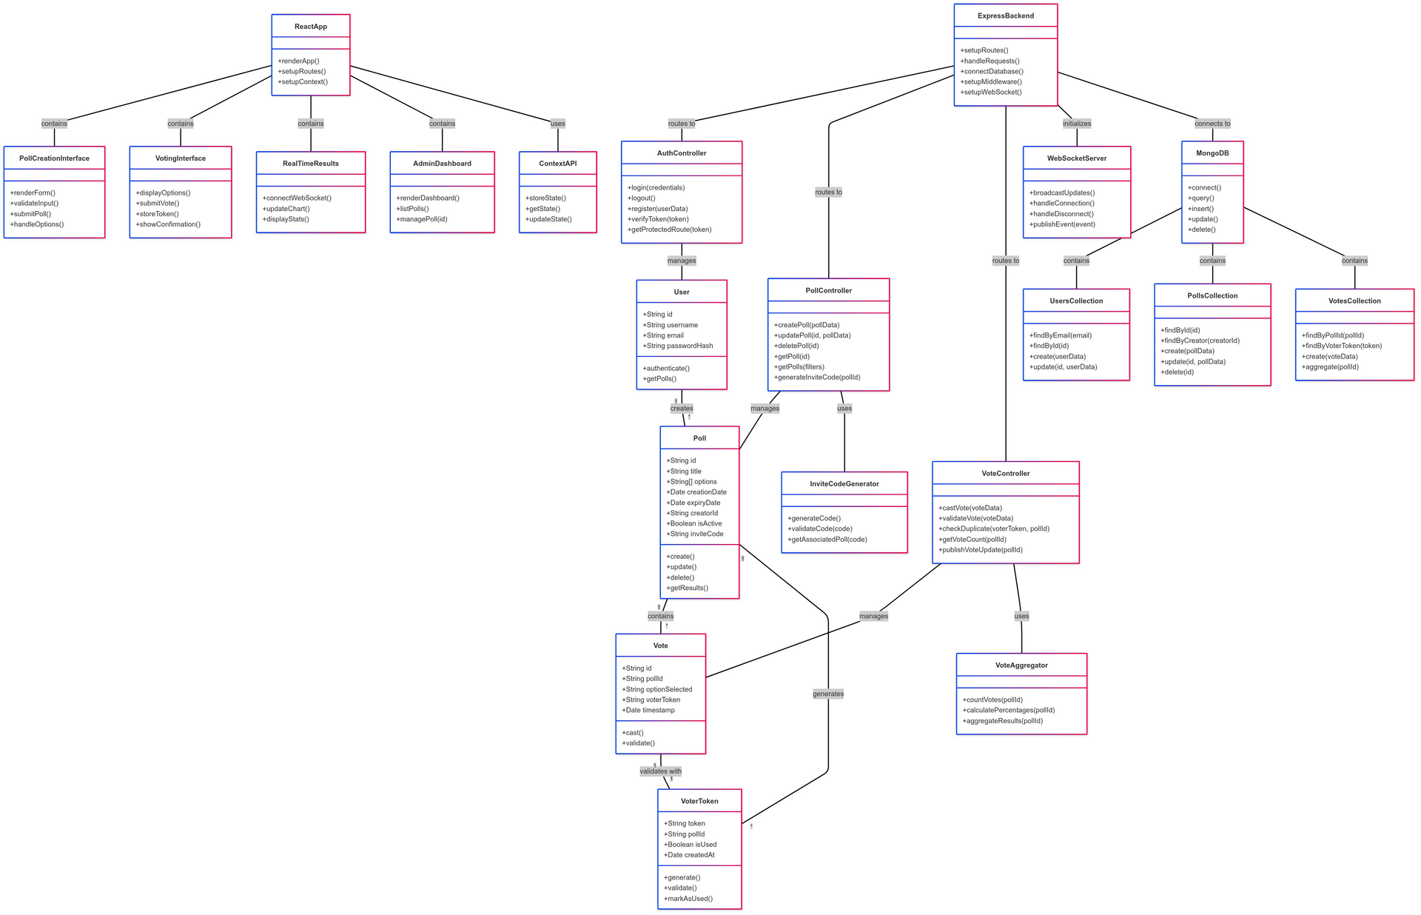
UML DIAGRAM
UML / Class Diagrams of the Hush Poll Application stating its Functionalities with Complete Extent

Slide 12
FUTURE ROADMAP
AI Powered Sentiment Analysis
M for mic drop
Advanced Data Visualization Options
Collaborative Tool Integrations
Any number from
0-9 for a timer
The Future That Out Application Holds. From Technical Aspects Like Containerizations to Institutional Aspects like Large-Traffic Handling.
Multiple-Language Support

Slide 13
Hush Poll represents a significant advancement in feedback collection technology. By prioritizing trust, privacy, and real-time insights. Hush Poll doesn't just collect data—it rebuilds the foundation of trust essential for collective decision-making in democratic societies, progressive organizations, and data-driven institutions.
CONCLUSION
THANK YOU
BY GROUP 43
Harsh Agrawal
Pratham Aggarwal
Pratham Todi

