Slide 1


SMART INDIA HACKATHON 2024
TITLE PAGE
Problem Statement ID – SIH25200
Problem Statement Title- Blockchain-Based Skill Credentialing System
Theme- Smart Education
PS Category- Software
Team ID- 83855
Team Name - _OmnitriX

Slide 2
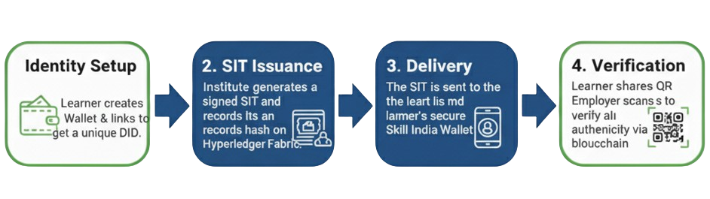
IDEA TITLE
_OmnitriX
Problem Addressed: Current vocational certificates in India face forgery, delays, and lack of interoperability, reducing trust and creating barriers for learners, employers, and institutions.
Solution:
A blockchain platform that issues and verifies Skill & Identity Tokens (SITs) securely, digitally, learner-owned credentials built using the concept of Soulbound Tokens (SBTs).
Tamper-proof & non-transferable digital credentials built on Soulbound Token (SBT) concepts.
Credentials bound to learners verified identities & Selective Disclosure.
Stored in learner’s digital wallet for lifelong access.
Permissioned Hyperledger Fabric blockchain ensures security, governance, and auditability.
Instant verification via QR code or REST API for employers and institutions.
Integrated & compliant with Aadhaar, DigiLocker, Skill India Portal.
Future-Ready Architecture: Scalable, supports millions of credentials, compatible with global standards.
Privacy by Design: Only hashes stored on-chain sensitive data kept off-chain for security and compliance.
Unique Value Proposition:
Learner-Owned Credentials: Learners truly control and own their skills record.
Non-Transferable SITs: Each credential is bound to the learner’s identity → eliminates fraud.
Instant Global Verification: Employers and institutions verify credentials in seconds.
Privacy by Design: Only hashes stored on-chain, sensitive data stays off-chain.
Scalable & Future-Ready: Supports millions of learners, compatible with global standards.

Slide 3
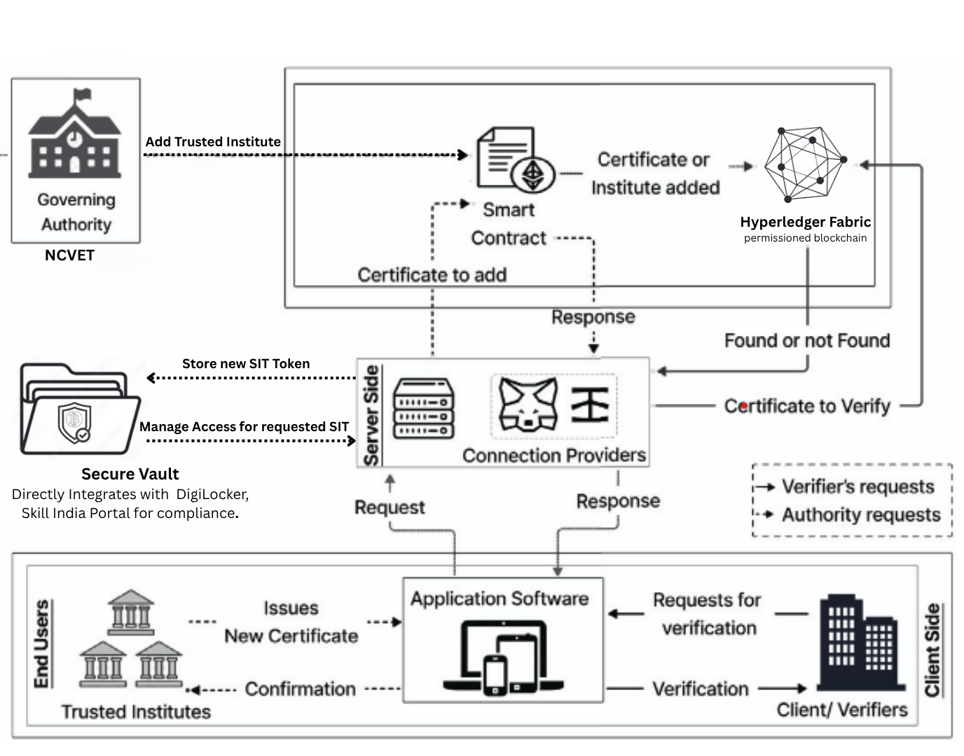

TECHNICAL APPROACH
_OmnitriX
System Architecture
Tech Stack

Slide 4
FEASIBILITY AND VIABILITY
_OmnitriX
FEASIBILITY
Technical: Utilizes mature, enterprise-grade technologies (Hyperledger Fabric, DID) proven for high-throughput, secure applications.
Operational: Intuitive for all users. Learners use a simple mobile wallet, and employers use a QR scanner. NCVET's governance provides a clear operational framework.
Economic: Drastically reduces administrative and verification costs (75% reduction). Low transaction costs after initial setup make it highly scalable and sustainable.
Potential challenges and risks:
Adoption: Onboarding thousands of institutes and millions of learners.
Integration: Ensuring seamless API connectivity with diverse government systems (Aadhaar, DigiLocker , Skill India Portal).
Connectivity: Ensuring verification works in low-internet areas.
Strategies for overcoming these challenges:
Phased Rollout: Provide clear onboarding guides and run awareness campaigns.
Robust APIs & Partnerships: Work directly with government bodies to ensure smooth integration.
Offline Verification: The wallet will have a feature for offline QR code verification using cached credentials.

Slide 5
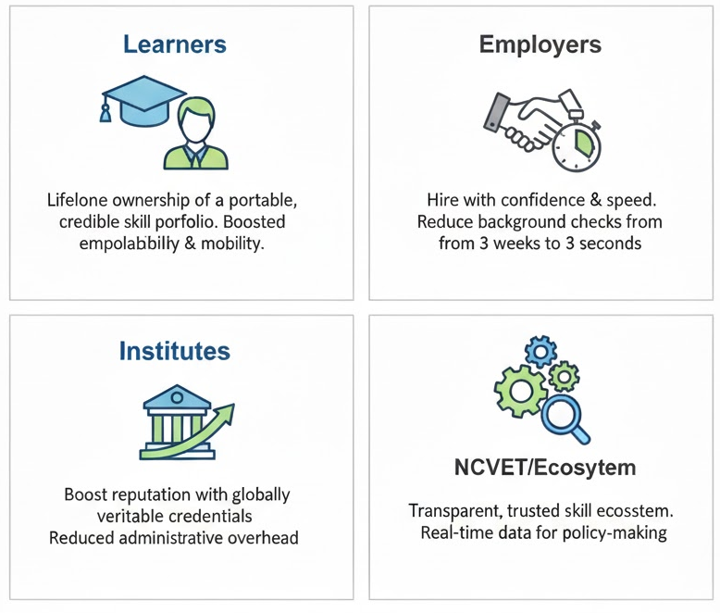
IMPACT AND BENEFITS
_OmnitriX
Benefits of the solution (social, economic, environmental, etc.):
Social Benefit: Increases trust and transparency in the national vocational education system. Empowers youth with control over their achievements.
Economic Benefit: Significant cost savings for businesses, reduces unemployment delays, and boosts the value of skilled labor.
Environmental Benefit: Reduces reliance on paper-based certificates and manual verification processes.

Slide 6
RESEARCH AND REFERENCES
_OmnitriX
References: [1] W3C Verifiable Credentials (VC): Global standard for digital credentials
[2] Decentralized Identifiers (DID): Foundation for self-sovereign identity (SSI).
[3] NCVET (National Council for Vocational Education and Training): Credential governance & policy.
[4] NSDC (National Skill Development Corporation): Skill development programs & reporting standards.
[5] Hyperledger Fabric Documentation: Enterprise-grade permissioned blockchain framework.
[6] Blockchain-Based Credential Models: Enhancing Verification With Soulbound Tokens.
[7] Blockchain Technology and Vocational Open Online Courses.
Details / Links of the reference and research work

