Slide 1


SMART INDIA HACKATHON 2024
TITLE PAGE
Problem Statement ID –
Problem Statement Title-
Theme-
PS Category- Software
Team ID-
Team Name (Registered on portal)

Slide 2
IDEA TITLE
_OmnitriX
Detailed explanation of the proposed solution:
We propose a blockchain-based network using Hyperledger Fabric governed by NCVET.
Every credential is issued as a Skill & Identity Token (SIT) - a type of Soulbound Token (SBT).
SITs are stored in a learner-controlled Skill India Wallet and linked to their Aadhaar-verified digital identity (DID).
Innovation and uniqueness of the solution:
First-of-its-kind use of Soulbound Tokens (SBTs) for national-level credentialing, preventing fraud at its source.
Deep Government Integration with Aadhaar, DigiLocker, and Skill India Portal for a unified, trusted ecosystem.
Learner-centric model based on Self-Sovereign Identity (SSI), putting the user in control.
How it addresses the problem:
Eliminates Fraud: SITs are non-transferable, making it impossible to sell or forge credentials.
Instant Verification: Employers verify credentials in seconds via a QR code scan, ending manual delays.
Empowers Learners: Learners get true ownership and control over their lifelong skill portfolio.
Creates Trust: The blockchain provides an immutable, single source of truth for all stakeholders.

Slide 3
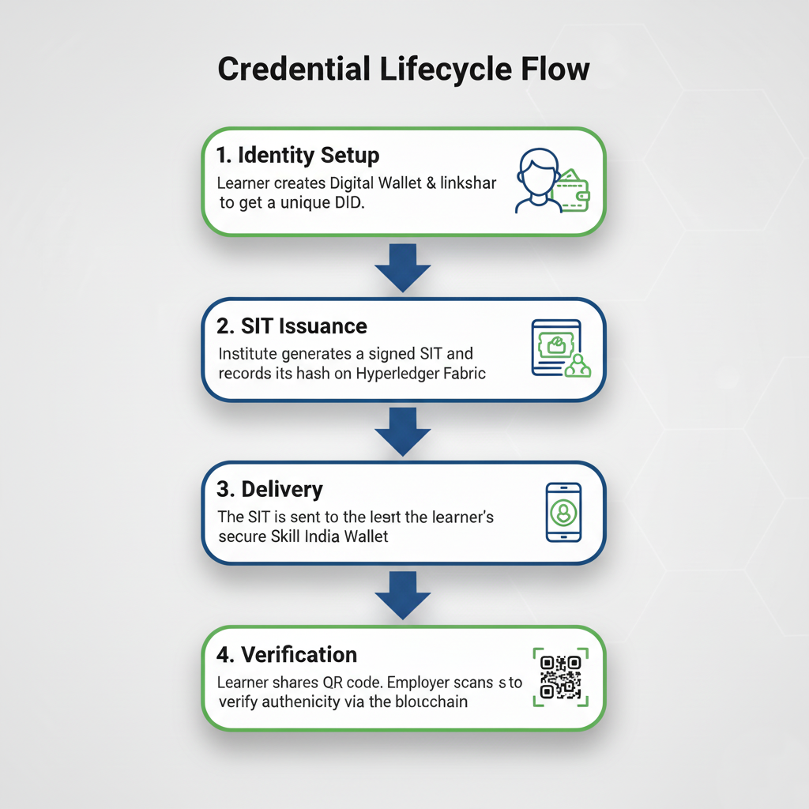

TECHNICAL APPROACH
_OmnitriX
Tech Stack

Slide 4
FEASIBILITY AND VIABILITY
_OmnitriX
FEASIBILITY
Technical: Utilizes mature, enterprise-grade technologies (Hyperledger Fabric, DID) proven for high-throughput, secure applications.
Operational: Intuitive for all users. Learners use a simple mobile wallet, and employers use a QR scanner. NCVET's governance provides a clear operational framework.
Economic: Drastically reduces administrative and verification costs (~80% reduction). Low transaction costs after initial setup make it highly scalable and sustainable.
Strategies for overcoming these challenges:
Phased Rollout: Pilot -> Scale -> National. Provide clear onboarding guides and run awareness campaigns.
Robust APIs & Partnerships: Work directly with government bodies to ensure smooth integration.
Offline Verification: The wallet will have a feature for offline QR code verification using cached credentials.
Potential challenges and risks:
Adoption: Onboarding thousands of institutes and millions of learners.
Integration: Ensuring seamless API connectivity with diverse government systems (Aadhaar, DigiLocker).
Connectivity: Ensuring verification works in low-internet areas.

Slide 5
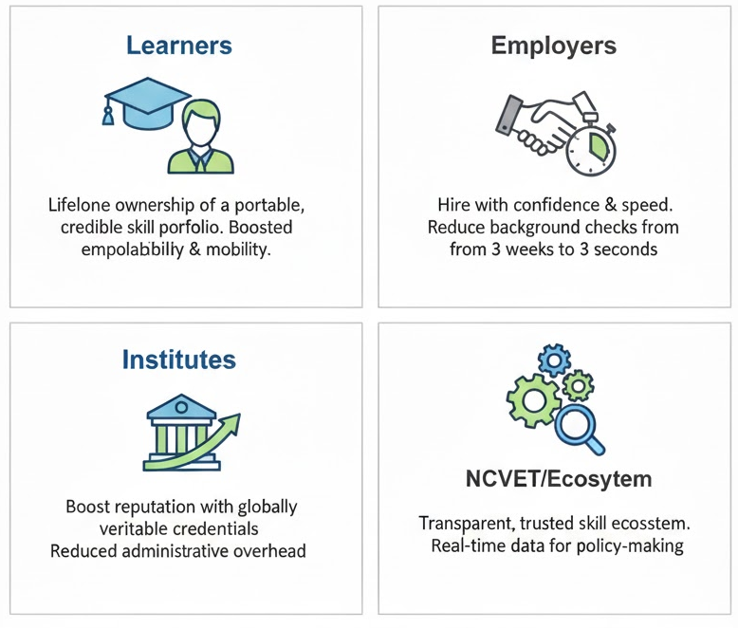
IMPACT AND BENEFITS
_OmnitriX
Benefits of the solution (social, economic, environmental, etc.):
Social Benefit: Increases trust and transparency in the national vocational education system. Empowers youth with control over their achievements.
Economic Benefit: Significant cost savings for businesses, reduces unemployment delays, and boosts the value of skilled labor.
Environmental Benefit: Reduces reliance on paper-based certificates and manual verification processes.

Slide 6
RESEARCH AND REFERENCES
_OmnitriX
References :
[1] https://www.pib.gov.in/PressReleseDetailm.aspx?PRID=1777711
[2] https://www.niti.gov.in/sites/default/files/2020-01/Blockchain_The_India_Strategy_Part_I.pdf
[3] https://blockchan.ge/blockchange-credentials.pdf
[4] https://inc42.com/infocus/blockchain-this-week/startup-india-unveils-blockchain-based-certificate-verification-system/
[5] https://entrackr.com/2018/02/india-blockchain-digital-degress/
[6] https://nishithdesai.com/default.aspx?id=4863
[7] https://blockchan.ge/blockchange-credentials.pdf
[8] https://www.lfdecentralizedtrust.org/blog/2023/02/16/benchmarking-hyperledger-fabric-2-5-performance

