Slide 1






Title:ERP for Student Management System
Sector: Education
Name of Institute:Government College Of Engineering And Research, Avasari
Name of Participants:
Prathamesh Sugriv Madane-BE E&TC-Management
Tushar Sunil Pawar-BE Computer-Marketing And Finance
Prathamesh Appasaheb Gursal-BE Computer-Technical

Slide 2
Total funding required:
Current Status: Bootstrapped. The project has been self-funded so far, and we are now actively seeking investment to roll out operations across Maharashtra.
Funding Breakdown: ₹83000
Cloud Hosting & Infrastructure: ₹15,000
Website Domain & SSL: ₹3,000
Third-Party APIs & Integrations: ₹15,000
Payment Gateway:15,000
5. Marketing & College Partnerships: ₹10,000
6. Testing & QA: ₹7,000
7. Marketing & Pilot Rollout: ₹10,000
8. Miscellaneous: ₹8,000
Do you need mentorship ?
Yes, We are seeking valuable guidance and mentorship in the areas of market strategy, scaling, partnership development, and effective rollout execution. Expert insights into revenue generation models, college partnership strategies, and technical architecture optimization will be highly valuable to ensure sustainable growth and smooth expansion across Maharashtra's educational institutions

Slide 3
Problem Statement & Social Need :
Faculty Time Drain: Manual administrative tasks consume 40% of faculty and staff time, severely impacting teaching quality and output.
Fragmented Operations: Institutions use disconnected paper and digital systems (post-admission), preventing unified management and real-time tracking of operations.
Inefficient Fee Collection: The fee collection process is characterized by long student queues and manual receipting, causing major accounting inefficiencies and bottlenecks.
Scattered Student Resources: Critical study materials are dispersed across various communication apps and emails, making resource access difficult and hindering student success.
Hostel & Mess Chaos: Paper-based room allocation, manual attendance logs, and offline meal tracking lead to operational chaos, poor security, and waste in student housing.
95% of educational institutions identify technology as primary facilitator but struggle with implementation
Only 20% of Indian colleges have fully integrated ERP systems - massive opportunity gap
Impact:
Administrative staff overload with paperwork and manual processes
Delayed results and fee processing affecting student satisfaction
Inefficient resource utilization across hostels, classrooms, and facilities
Social Need:

Slide 4
Solution :
Social Impact:
Reduces 40% manual workload, freeing staff for academics
Enhances student satisfaction & parent engagement
Saves time, cost & promotes eco-friendly paperless operations
Optimizes hostel, classroom & resource utilization
Strengthens institutional growth through data-driven insights
Admission & Enrollment: Online applications, document upload, digital admission, fee payment & student ID generation
Student Information System (SIS): Centralized student database with real-time updates & secure access for admin, faculty, and parents
Attendance Management: Biometric/RFID/Face/QR-based tracking, shortage alerts, leave requests & parent notifications
Hostel Management: Digital room allocation, RFID entry-exit logs, mess billing, visitor tracking & maintenance requests
Fee & Finance Management: Online payments (UPI/cards/net banking), receipts, installment tracking, scholarships & defaulter alerts
Learning Resource Hub: Centralized notes, assignments, previous papers, submissions & faculty–student interaction
Communication System: SMS/Email/App alerts for attendance, results, fees, circulars & announcements
Placement & Alumni: Job/internship postings, resume builder, alumni networking & success tracking

Slide 5
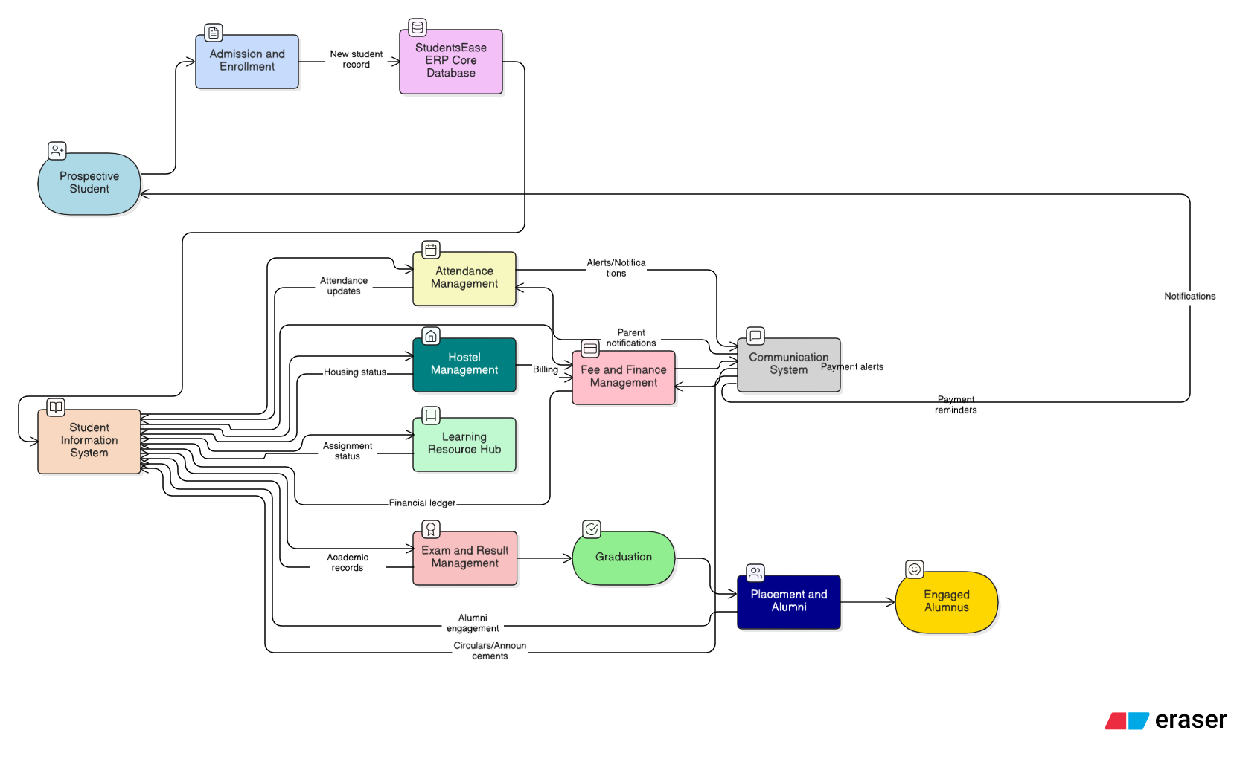
TECHNICAL APPROACH

Slide 6
Native AI + automation (built-in) vs add-on tools: intelligence is part of the core product.
Innovation Differentiation
Real-time dashboards: live KPIs (attendance, fees, performance) for instant decisions.
AI-powered capabilities: AI proctoring, predictive student-risk models, automated grading/analytics.
End-to-end lifecycle automation: admission → academics → hostel → exams → fees → alumni on one platform.
Unified campus workflows: integrated hostel, mess, visitor, maintenance and finance processes.
Learning Hub with offline sync: centralized resources, submissions, and offline access for low-connectivity users
Modular APIs & plug-ins: easy third-party integrations (payments, SIS, accounting, LMS).
Single source of truth vs fragmented systems: one unified database across departments.
Native AI + automation (built-in) vs add-on tools: intelligence is part of the core product.
Real-time, proactive insights vs periodic/batch reports.
Cloud-native SaaS: fast deployment, scalability, lower IT overhead
Higher operational efficiency: significant reduction in manual work and errors (staff time reclaimed).
Mobile-first + parent/student portals: strong UX for all stakeholders, better engagement.
Affordability & modularity: pay-for-needed modules → suits small colleges to large campuses.

Slide 7
Target Beneficiaries Market
Students:
Easy access to attendance, results, study materials & fee records
Real-time updates and transparent academic progress
Faculty:
Automated attendance, marks entry & result generation
Reduced paperwork and improved academic focus
Administrative Staff:
Streamlined admission, hostel, and fee processes
Reduced manual workload and faster operations
College Management:
Centralized data and real-time analytics for better decisions
Improved resource utilization and institutional efficiency
Government & Accreditation Bodies (Indirect):
Accurate digital records for audits, compliance & reporting
India’s EdTech ERP market projected to reach $1.5–2B by 2030 with rising digitization in education
Targeting colleges, universities, and technical institutes, especially in Tier-2 & Tier-3 cities
Existing systems are fragmented and manual, lacking unified lifecycle automation
Existing systems are fragmented and manual, lacking unified lifecycle automation
Growth driven by Digital India and NEP 2020 promoting paperless, data-driven campuses
High demand for AI-based analytics, online exams, and cashless fee systems

Slide 8
Business Model Sustainability
Revenue Streams: Tiered SaaS subscriptions (per-institution or per-student), implementation & onboarding fees, transaction fees on payments, paid add-on modules, customization & integration contracts, and paid support/training.
Pricing Strategy: Multi-tier pricing (Basic / Pro / Enterprise) + per-student-per-year or campus-seat licensing; usage-based billing for heavy services (AI proctoring, storage).
Recurring Services: Annual support & maintenance contracts, premium analytics reports, and SLA-backed uptime plans.
Unit Economics Focus: Target high gross margins (SaaS), optimize CAC vs LTV.
Go-to-Market: Direct sales to colleges, regional resellers for Tier-2/3, government tenders, and pilot-first approach for adoption.
Customer Acquisition Tactics: Free pilots, case studies, campus ambassadors, education conferences, and referral discounts.
Scalability Plan: Cloud-native multi-tenant architecture, microservices, horizontal scaling for proctoring and analytics, and robust APIs.
Financial: SaaS subscriptions, add-ons, and partnerships ensure recurring revenue.
Social: Affordable plans and offline access promote inclusivity.
Environmental: Paperless operations and green cloud hosting reduce carbon footprint.

Slide 9
Progress & Roadmap :
Current progress :
Status: Concept, module list and requirements done; wireframes & tech-stack selected; prototype is Under development.
Challenges & Strategies
Demo reliability: Use recorded fallback + pre-seeded demo data for live demo.
Real-time scalability: Cloud autoscale, caching, and event-driven streams.
AI reliability & bias: Simple explainable model + human review loop for flagged cases.
User adoption: Run short training, simple UI, and pilot champion to drive uptake.
Next Steps :
Phase 1 — Months 0–2: MVP & Live Demo
Deliver a polished MVP of 3 demo flows (Attendance via QR, Fee payment sandbox, Unified Dashboard) with backend APIs, seeded data and responsive UI — demo-ready.(ongoing)
Phase 2 — Months 3–4: Integrations & AI Prototype
Add payment gateway sandbox, hostel allocation mock, and a lightweight AI demo (attendance-risk alert + short proctoring prototype using 3rd-party or recorded session).
Phase 3 — Months 5–6: Polish, Pilot & Pitch
Polish UX, QA, deploy cloud demo.

Slide 10
References :
National Education Policy (NEP) 2020
PRAGYATA Guidelines for Digital Education (MHRD/MoE 2020)
National Digital Educational Architecture (NDEAR)
AICTE (All India Council for Technical Education) Guidelines
UGC (University Grants Commission) Digital Education Policy
Case Study: Deploying an Education ERP System (2025)
Enterprise Resource Planning in Higher Education: Implementation and Benefits

