Slide 1
MCA PROJECT VIVA
AeroFlow
Flight Disruption Recovery & Passenger Service Platform
CHARUSAT University | CMPICA
Pratham Sunilkumar Danawala — 25MCA046
Ajay Bhanushali — 25MCA029
Project guide: [Name to be added] | Academic year: [Year to be added]

Slide 2
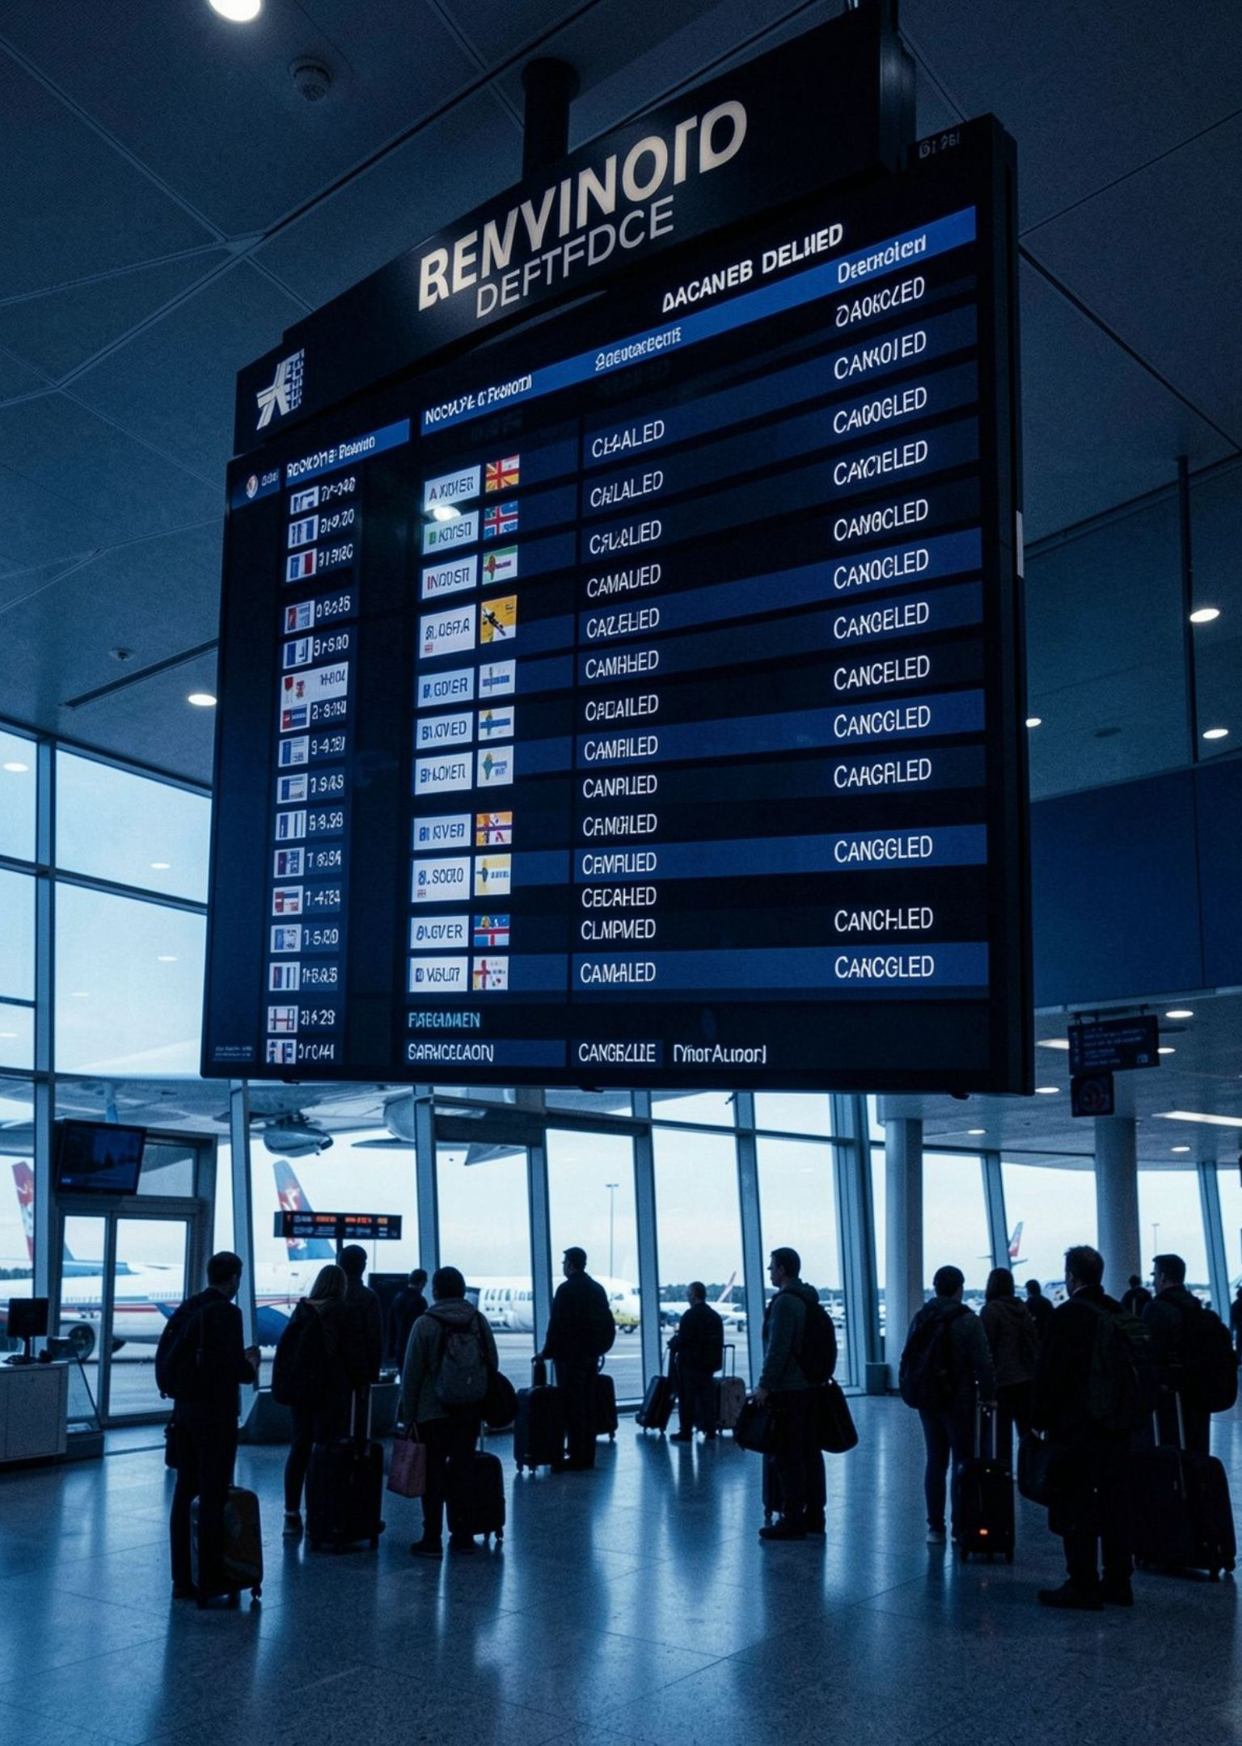
THE SERVICE PROBLEM
Flight disruption turns a simple journey into a service problem
AeroFlow is a web-based flight management and passenger service application.
Fragmented information
Delays, cancellations, and booking changes create fragmented passenger information and service needs.
One place to respond
The platform organizes flight information, bookings, and disruption-related workflows in one place.
Notes:
Frame disruption as a service problem rather than only an operational event. Explain that passengers need connected information and service actions when delays, cancellations, or booking changes occur.

Slide 3




PLATFORM SCOPE
AeroFlow centralizes the passenger journey from search to recovery
Flight and airport information
Passenger access
Support registration, login, flight search, and booking.
Centralize flight and airport information.
Recovery workflows
Passenger service outputs
Support cancellation, rescheduling, and disruption recovery.
Organize booking documents, QR codes, and relevant email notifications.
One web application connects the core passenger and disruption workflows.
Scope: a web application; limitations and unverified integrations remain clearly stated.
Notes:
Walk from the passenger’s first interaction through recovery. Emphasize that the scope includes search, booking, cancellation, rescheduling, documents, QR codes, and relevant email notifications, while limitations remain explicit.

Slide 4
TECHNICAL FOUNDATION
Python and Django connect the passenger interface to operational data
Technology stack
Architecture
Front end: HTML, CSS, JavaScript, and Django Template Language.
Back end: Python and Django.
Database: SQLite.
Supporting libraries: ReportLab, qrcode, Pillow
Passenger/Admin → Web Interface → Django Application → SQLite Database, with PDF and QR-code generation as supporting services.
Notes:
Explain how Python and Django connect the passenger interface to operational data. Walk through the listed front-end technologies, back end, database, supporting libraries, and the Passenger/Admin-to-SQLite architecture, including PDF and QR-code generation as supporting services.

Slide 5
IMPLEMENTED CAPABILITIES
Eight implemented modules organize flight and passenger services
01
02
03
04
User Authentication
Flight Management
Airport, Terminal and Gate Management
Passenger and Booking Management
05
06
07
08
Cancellation and Rescheduling
Boarding Pass and Booking Receipt
Voucher and Recovery Management
Email Notifications
Notes:
Present the eight modules as implemented capabilities. The numbering creates the reading order, while the two-row module map shows that flight operations and passenger services are organized within the same platform.

Slide 6
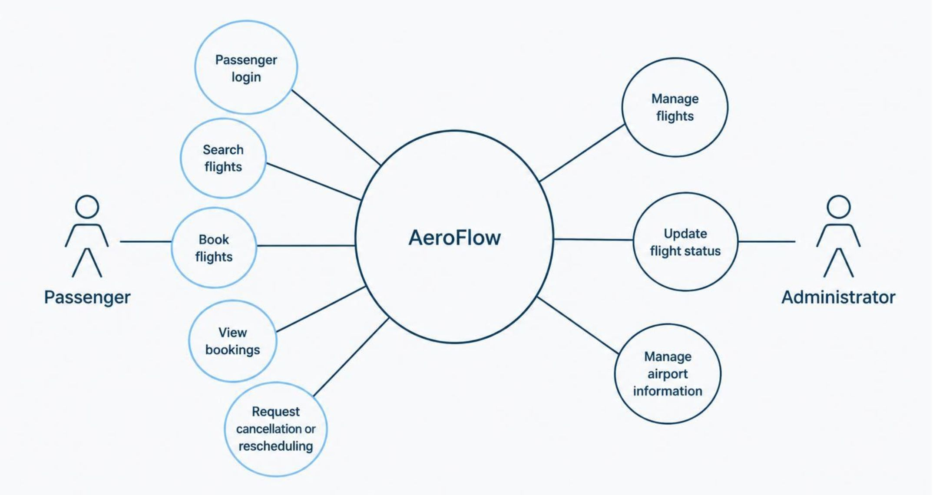
SYSTEM RESPONSIBILITIES
Passenger and administrator responsibilities meet inside AeroFlow
Notes:
Use the diagram to explain the system boundary. Passenger responsibilities are login, search, booking, viewing bookings, and requesting cancellation or rescheduling. Administrator responsibilities are managing flights, updating flight status, and managing airport information.

Slide 7
01
02
03
Login page
Passenger dashboard
Flight search
APPLICATION WALKTHROUGH
Application walkthrough: use real screens
04
05
Booking details
Admin flight management
Demonstrated functionality should be shown through the application screens.
Notes:
Explain that this slide is a presentation-ready structure for the walkthrough, not evidence by itself. Replace each placeholder with a real project screen when available, and keep the captions tied to demonstrated functionality.

Slide 8
BOOKING WORKFLOW
The booking workflow moves from validated input to confirmation
01
02
Login
Search Flight
03
04
Select Flight
Enter Passenger Details
05
06
Validate Details
Create Booking
Each step follows the next from passenger access to a confirmed booking.
07
Display Confirmation
Model diagram to be added from source code.
Notes:
Walk through the workflow in order. The important transition is from passenger input to validation, then booking creation and confirmation. A database relationship diagram is intentionally marked as a placeholder until the actual Django models and relationships are available.

Slide 9
QUALITY AND NEXT STEPS
Testing covers core behavior; integrations remain future work
Testing areas: functional, validation, integration, and system testing.
Testing area | Focus | Test result
Functional | Core behavior | Pass
Validation | Input handling | Pass
Integration | Connected behavior | Pass
System | Application flow | Pass
Future enhancements
Payment gateway integration
SMS notification service
WhatsApp integration
AI-based passenger assistant
Live flight-tracking API integration
Cloud deployment with Kubernetes
Passenger feedback and rating system
Notes:
Separate the testing areas from the results. Because actual project results were not provided, every result is visibly marked as “Results to be added.” Close by distinguishing future enhancements from implemented modules.

Slide 10
Thank You
Notes:
Summarize the project as a full-stack approach to disruption-aware passenger service. Reinforce the connection between workflows, Python, Django, SQLite, and the learning outcomes. End with Thank You and invite Questions & Answers.

