Slide 1
Name : Pratham Vinod Jain
Dataset Name : Electronic Store

Slide 2
Why ?Analysis
The electronic retail business is experiencing uneven sales performance across different regions, gender groups, and product categories, with a noticeable decline in sales over time. To Create a strong customer base and wide product variety, the company lacks clear visibility into which customer segments, products, and store locations are truly driving profitability. Additionally, underutilized regions and products may be limiting growth potential.
Therefore, a comprehensive data-driven analysis is required to:
Identify top-performing and underperforming products, stores, and customer segments.
Track sales trends over time to detect potential revenue drops.
Improve targeted marketing and inventory planning.
Enable strategic decisions for expanding into untapped markets and optimizing store performance.

Slide 3
How ? Analysis
Data Collection:
Dataset Downloaded From Kaggle.com and imported in MYSQL From .csv file and Loaded in Power Bi Desktop From MYSQL Database
Data Explanation:
The dataset appears to include:
  Product details (category, subcategory, brand)
  Sales performance (sales amount, units sold)
  Customer-related metrics
  Data is from July 2016 to September 2020(date, month, year)
Dataset Overview:
* Tables: 5 (e.g., Products, Sales, Calendar, Customers, Store)
  Rows: Calender (1714 rows),Customers (11036 rows), exchange_rates (11215 rows),products (2517 rows ),sales (62884 rows) , stores (66 rows).
  Key columns: Product Name, Sales Amount, Manufacturer, Continent, Date, etc.

Slide 4
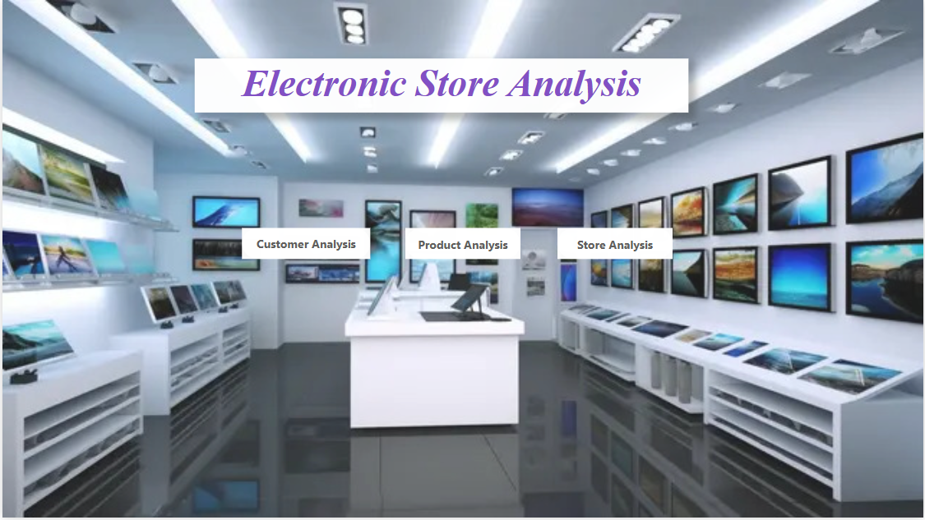
Home
Notes:
actionButton
No alt text provided
actionButton
No alt text provided
actionButton
No alt text provided
textbox
No alt text provided

Slide 5
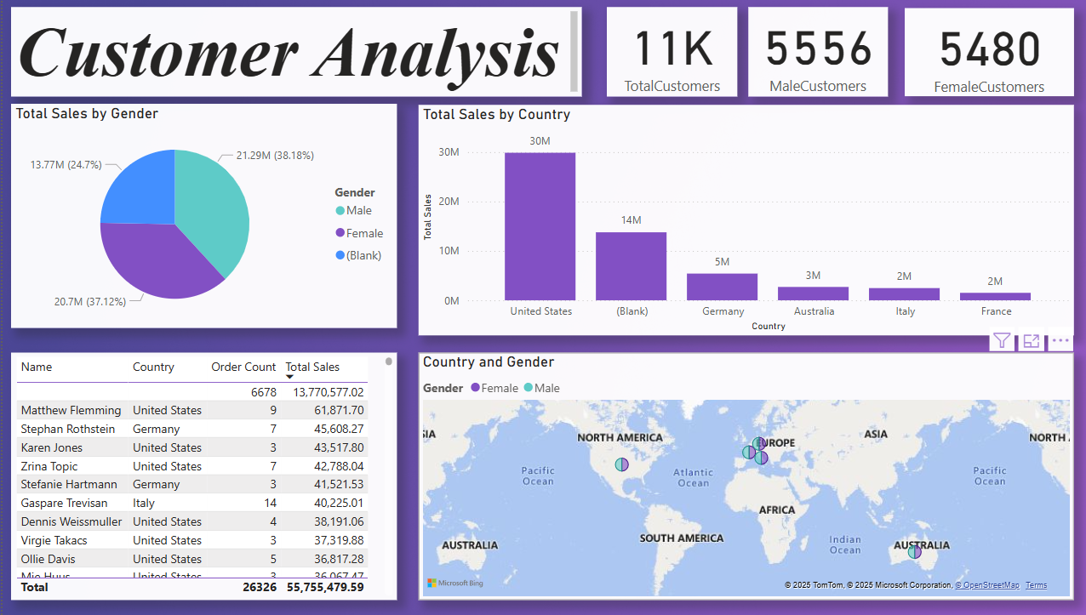
Customer Analysis
Notes:
textbox
No alt text provided
card
No alt text provided
card
No alt text provided
card
No alt text provided
tableEx
No alt text provided
clusteredColumnChart
No alt text provided
pieChart
No alt text provided
map
No alt text provided

Slide 6
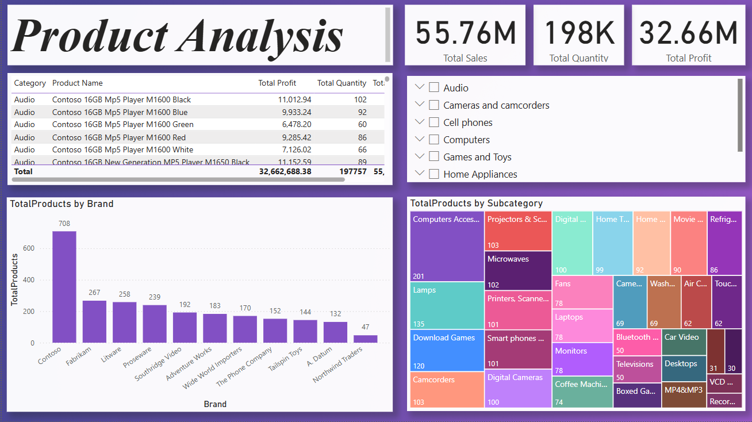
Product Analysis
Notes:
textbox
No alt text provided
tableEx
No alt text provided
card
No alt text provided
card
No alt text provided
card
No alt text provided
slicer
No alt text provided
clusteredColumnChart
No alt text provided
treemap
No alt text provided

Slide 7
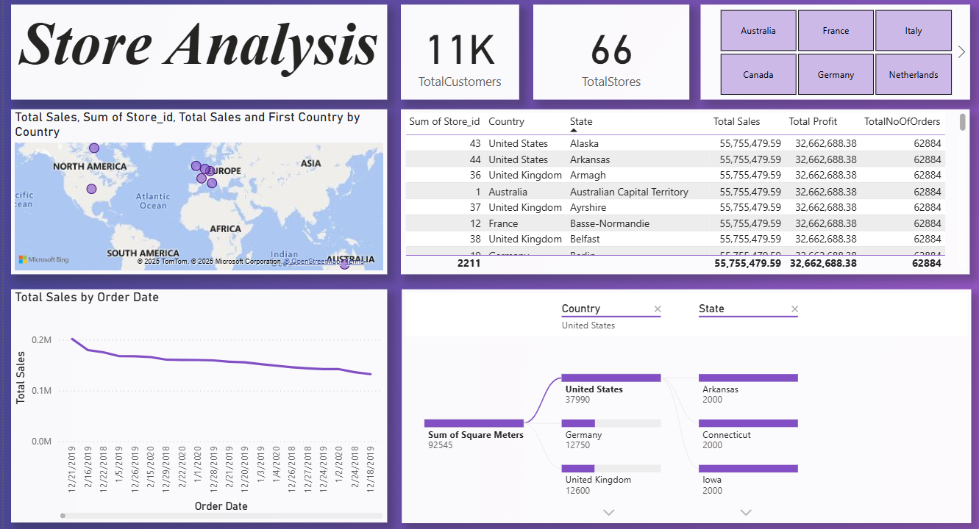
Store Analysis
Notes:
card
No alt text provided
textbox
No alt text provided
card
No alt text provided
slicer
No alt text provided
map
No alt text provided
tableEx
No alt text provided
lineChart
No alt text provided
multiRowCard
No alt text provided

Slide 8
CONCLUSION :
Most of the sales come from the United States, but other countries like Germany and Australia can grow more.
Both male and female customers are buying almost equally.
The Contoso brand and Audio products are the top performers.
Even though total sales are high, sales are slowly going down over time, which means we may need to change our sales or marketing plans.
Stores are mostly in a few countries, so there’s a good chance to open more stores in new places.
This report helps us understand what’s working well and what needs improvement, so we can make smarter business decisions.

