Slide 1

Flight Fare Intelligence
What drives domestic flight fares in India, and a dashboard that predicts them
Pratham Rangoonwala | Data Science Internship Project | October 2026
Notes:
Introduce the project: an end-to-end analysis of 445k Indian domestic fares, a prediction model, and a deployed Streamlit dashboard.

Slide 2



Project at a glance
445,366
0.953
₹2,386
4 tabs
flights, 9 airlines, 42 routes
R² on 89,074 held-out flights
mean absolute error per fare
live dashboard and fare predictor
Explore
Predict
Deploy
12 charts show how class, airline, route, stops, timing and booking window move fares.
A gradient-boosted model estimates the fare of any trip, within about ₹2,400 on average.
A filterable Streamlit app on Streamlit Cloud, with booking tips generated from the data.
Notes:
Headline numbers. All model figures are from the held-out test set in the notebook; all data figures were recomputed from Cleaned_dataset.csv.

Slide 3
Data and cleaning
What is in the data
Cleaning steps
445,366 flights after cleaning (452,088 raw rows)
7 cities, 9 airlines, 42 routes
Economy 56%, Business 28%, Premium Economy 16%; First has only 144 rows
Departures 16 Jan to 6 Mar 2023, 1 to 50 days before takeoff
1
Strip spaces and convert numeric columns
2
Drop missing values and 6,722 duplicate rows (1.5%)
3
Drop Date_of_journey and Flight_code
4
Convert stops to 0 / 1 / 2+ and add Route
Limitation: all prices were collected on a single day. Fare vs days-left patterns are real, but predictions are estimates, not live booking prices.
Notes:
Stress the single-day limitation early: it shapes how every later result should be read.

Slide 4
Class sets the price floor
1.6x
Premium Economy, ₹16,225 vs Economy
5.1x
Business, ₹51,632 vs Economy
6.0x
First, ₹60,731 (only 144 flights) vs Economy
Notes:
Class is also the strongest model feature. First class has just 144 flights, all Air India, so treat its average cautiously.

Slide 5
Last-minute flights cost more
Fare within 3 days vs 22+ days ahead
+49%
Economy: ₹13,461 vs ₹9,054
+89%
Premium Economy
+22%
Business
-1%
First: 144 flights, no signal
All prices were collected on one day, so days left is entangled with calendar date. Read it as a pattern, not a law.
Notes:
The jump shows up in the last three weeks and is steepest in the final week. Caveat: single-day collection means days-left and calendar date are tangled together.

Slide 6
Full-service airlines cost more
Premium carriers
Vistara (₹12,082) and Air India (₹11,276) average 38 to 47% more than Indigo (₹8,199).
Cheapest and steadiest
AkasaAir averages ₹3,570. AllianceAir has the steadiest fares: its middle 50% spans 31% of its median, vs 57% for Indigo.
Mixing classes misleads
Only Air India and Vistara sell Business or First, so all-class airline averages overstate their cost.
Notes:
Economy only, so classes are not mixed. Business and First exist only on Air India and Vistara, which is why the dashboard warns when several classes are selected.

Slide 7
Stops and timing move fares
+88%
1 stop vs non-stop (₹10,731 vs ₹5,723), but about 12.0 h vs 2.1 h in the air
+19%
6 AM to 12 PM departures vs before 6 AM (₹10,696 vs ₹9,004)
8%
gap between cheapest and costliest weekday (Tuesday ₹9,824, Sunday ₹10,640)
Non-stop flights are only 11.6% of all flights.
Notes:
Economy figures. Connecting flights are cheaper to avoid, not cheaper to take: they are roughly 12 hours in the air vs about 2 for non-stop. Day of week matters little.

Slide 8
Modelling approach
10 features
Encode
Boost
Ship
7 categorical, plus stops, duration, days left
OrdinalEncoder, native categorical splits
HistGradientBoosting on log(1 + fare)
joblib model, scikit-learn 1.8.0
Model (test set) | MAE (₹) | R²
Tuned Hist Gradient Boosting | 2,386 | 0.953
Random Forest | 2,357 | 0.948
Decision Tree | 2,587 | 0.938
Hist Gradient Boosting (untuned) | 3,120 | 0.929
Linear / Ridge regression | 4,711 | 0.862
Mean baseline | 16,724 | 0.000
Why gradient boosting
Highest R² and lowest RMSE, MAE within about 1% of Random Forest, roughly 3x faster to train (15 s vs 41 s) and a 5.8 MB file.
Split: 80/20 stratified by class, seed 42 (356,292 train, 89,074 test). Tuning: 3-fold randomized search on 100k training rows.
Notes:
Six models compared on the same 80/20 split. Random Forest has a slightly lower MAE, but tuned gradient boosting wins on R² and RMSE, trains about 3x faster and saves to a 5.8 MB file.

Slide 9
How accurate is the model?
0.953
₹2,386
7.4%
10.8%
R² on test set
mean absolute error
median error
mean % error
Where it struggles
Error is about 9 to 12% for Economy, Premium Economy and Business, but larger in rupees on Business (₹4,927 MAE vs ₹1,213 Economy)
Worst misses are cheap fares predicted far too high, up to about 5x
Notes:
Figures come straight from the executed notebook cells on the 89,074-flight test set. The app and the notebook conclusion text should quote these numbers.

Slide 10
What drives the fare
Class dominates
Shuffling it adds ₹14,722 of error, 5x the next feature.
Route counts twice
Source (₹1,719) and destination (₹1,555) together rival duration.
Booking window is mid-table
Days left (₹1,459) is on par with airline (₹1,671).
Timing is minor
Departure, arrival, stops and weekday are each under ₹600.
Notes:
Permutation importance: how much MAE rises when a feature is shuffled. Class dominates; route (source plus destination) and airline come next; timing slots and weekday barely matter.

Slide 11
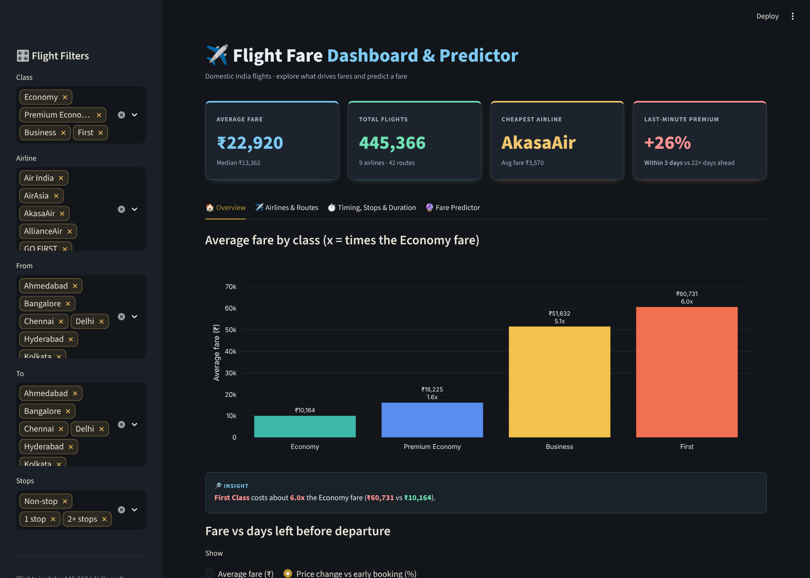



The dashboard
Overview
Class premium, days-left curve, fare distribution
Airlines & Routes
Airline gap, spread, route heatmap, top 10, class mix
Timing, Stops & Duration
Time of day, weekday, stops, duration vs fare
Fare Predictor
Trip inputs to fare, range and airline comparison
12 analysis charts and 2 predictor charts, one per row, mobile-friendly.
Notes:
Four tabs behind a shared sidebar (Class, Airline, From, To, Stops) and a hero KPI row. Dark theme, responsive down to phone width.

Slide 12
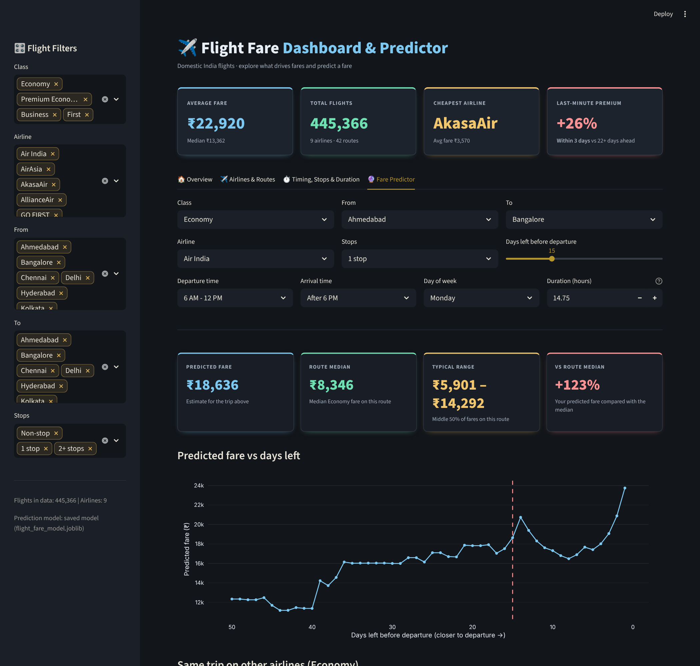
The fare predictor
Eight inputs: class, route, airline, stops, days left, times, weekday, duration
Duration auto-fills with the typical value for that airline, class, route and stops
Shows the predicted fare against the route median and typical range
Plots the fare across 1 to 50 days and the same trip on every airline
Warns when the combination is not in the data
Notes:
Everything updates instantly on any input change. The curve is jagged because the model learned from single-day data where days left and date are entangled; treat it as an estimate.

Slide 13
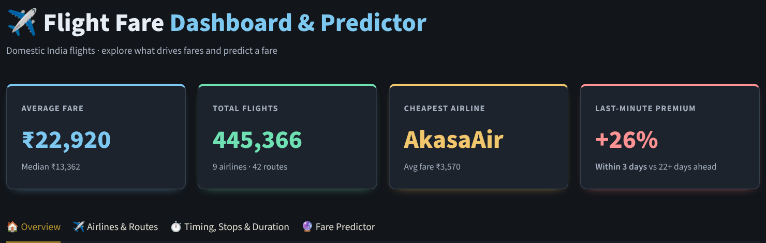
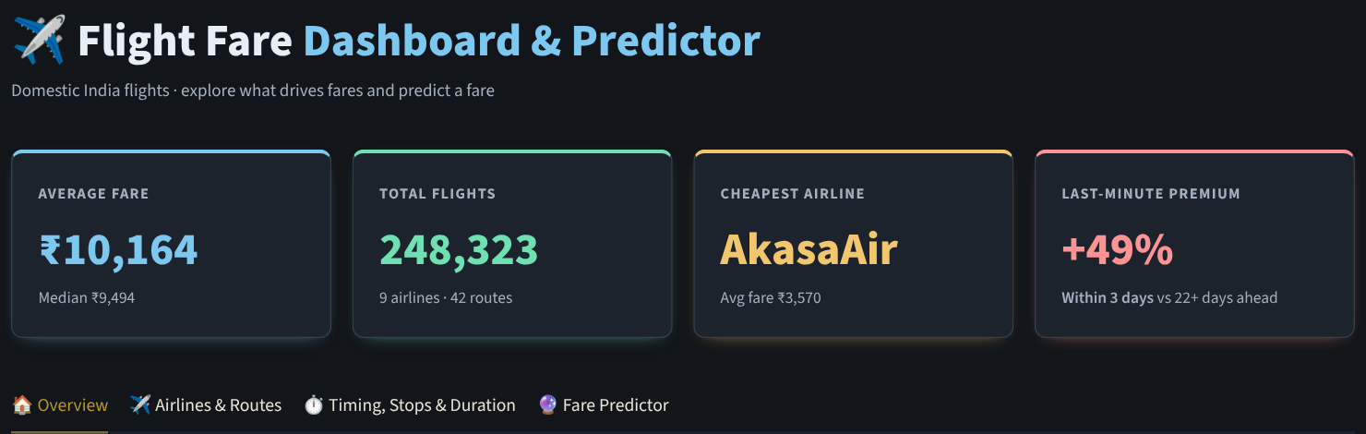
Filters change every number
All classes
₹22,920 to ₹10,164
average fare
445,366 to 248,323
flights
Class filter: Economy only
+26% to +49%
last-minute premium
Smart Booking Tips are the exception: they use the full dataset and stay fixed.
Notes:
Same page, one filter changed. The hero KPIs, tab KPIs and the insight boxes under the charts are all recomputed from the filtered data.

Slide 14




Engineering challenges solved
Memory limits
Model version mismatch
Copying 445k rows on every click ran out of memory. Fix: one cached copy, a 12-column filtered frame, a 50-row pre-binned histogram and sampled box and scatter plots.
The saved model failed with a scikit-learn _RemainderColsList error. Fix: re-saved it in Colab on the same version as the app, 1.8.0.
Deployment error
Debug visibility
Streamlit Cloud raised No module named '_loss'. Fix: pinned all seven packages in requirements.txt.
The sidebar shows whether the saved or the fallback model is serving. If loading fails, a matching pipeline trains itself.
Notes:
Four real problems hit on the way to deployment. Each has a concrete fix that is still in the repo.

Slide 15
Limitations and next steps
Limitations
Next steps
One-day price snapshot, so no true price-over-time signal
Only about 7 weeks of departures, no festivals or holidays
First class: 144 flights, all Air India
Random split, so scores may overstate accuracy on future flights
Collect fares across many days
Add holidays, fuel prices and seat availability
Quantile regression to predict fare ranges
Time-based validation; try XGBoost and LightGBM
Notes:
Be upfront: the model is a good estimator of the snapshot it was trained on, not a forecast of future prices.

Slide 16
Try it yourself
Live dashboard and full code, free to explore
App: flight-fare-intelligence.streamlit.app
Code: github.com/Pratham719/flight-fare-intelligence
Pratham Rangoonwala

