Slide 1
INTERNSHIP PROJECT REPORT · PRESENTATION
SaaS Subscription
Churn Prediction
Machine Learning and Interactive Analytics
Pratham Rangoonwala
Naviotech Solution Pvt. Ltd.
25/10/2026
Notes:
Introduce the project: an end-to-end churn analysis on a public SaaS dataset - cleaning, exploration, a classification model and a Streamlit dashboard. Everything in this deck is taken from the project notebooks and the app; where something could not be verified, the slide says so.

Slide 2
CONTEXT
Why churn, and what this project does
Objectives
Scope boundaries
▪ Clean and combine five SaaS tables into one row per account
▪ Describe how churn varies by plan, country, industry, tenure and behaviour
▪ Train and compare classifiers; choose model and threshold without touching the test set
▪ Present findings, results and a risk lookup in a six-tab Streamlit dashboard
▪ Synthetic dataset (Kaggle) - results describe this data only
▪ Associations, not causes - no causal claims
▪ No operational claims - no deployment, real-time scoring or alerts
▪ Validation ≠ test - metrics are always labelled by split
SaaS Subscription Churn Prediction | Pratham Rangoonwala
2
Notes:
Set expectations. The goal is analysis plus a working dashboard. Four boundaries apply to everything that follows: the data is synthetic, differences are associations, no operational deployment is claimed, and validation and test numbers are never mixed.

Slide 3
DATASET
RavenStack: five related tables, 500 accounts
accounts
subscriptions
feature_usage
support_tickets
churn_events
500 × 10
5,000 × 14
25,000 × 8
2,000 × 9
600 × 9
profile + churn_flag
MRR, plan, flags
usage, errors, beta
response, satisfaction
date, reason, refund
key: account_id
key: account_id
key: subscription_id
key: account_id
key: account_id
Target: churn_flag
Source and data quality
110 churned · 390 retained
▪ Kaggle: SaaS Subscription & Churn Analytics (River @ Rivalytics)
▪ Public descriptions call it synthetic
▪ No duplicate rows; missing values only in end_date, satisfaction_score and feedback_text
22.0% churn rate. The flag is used as supplied; how it was derived is not visible in the project code.
SaaS Subscription Churn Prediction | Pratham Rangoonwala
3
Notes:
Five tables joined on account_id (and subscription_id for feature usage). Missing values are mostly structural: open subscriptions have no end date; some tickets have no satisfaction score. One caveat: the churn_events table covers 352 accounts but only 110 are flagged as churned, which matters later. The 'synthetic' description comes from a public repository README; it has not been confirmed on the Kaggle listing itself.

Slide 4
SYSTEM DESIGN
From raw CSVs to an interactive dashboard
01 Cleaning
types, dates; 5 cleaned tables
account_data.csv
Kaggle data
500 × 33, one row per account
5 CSV tables
02 EDA
Streamlit app
segments; account_data.csv
6 tabs · Plotly charts · sidebar filters · risk lookup · CSV export
04 Classification
models/ + outputs/
split, select, threshold, test
model.pkl, threshold.pkl, importance, confusion matrix
Notebook 03 is an earlier iteration (80/20 split) superseded by notebook 04 - not used for any result in this deck.
SaaS Subscription Churn Prediction | Pratham Rangoonwala
4
Notes:
Walk left to right. Notebook 01 cleans, notebook 02 builds the account-level dataset used by the dashboard charts, notebook 04 trains and evaluates the model and saves artifacts. The app reads the dataset and the saved files. Notebook 03 was an earlier, leakier iteration and is excluded.

Slide 5
DATA PREPARATION
Features use only what was known before the prediction date
Prediction date per account
Retained → 2024-12-31 (end of the data)
Subscription, usage and ticket records are filtered to dates ≤ the prediction date before aggregation. Tenure is measured at that date.
Churned → first churn event − 30 days
Account profile
Subscription
Product usage
Support
plan tier, industry, country, seats, trial, tenure
avg MRR, upgrades, downgrades, auto-renew
usage, duration, errors, beta usage
tickets, resolution, response, satisfaction, escalations
19 features (31 after encoding). Excluded as leakage risks: churn_date, reason_code, refund_amount_usd, feedback_text.
SaaS Subscription Churn Prediction | Pratham Rangoonwala
5
Notes:
This is the leakage control. For retained accounts, features are built up to the end of the data. For churned accounts, features stop 30 days before their first churn event, so the model sees the period before leaving. Four columns that only exist after churn were excluded. One consequence, discussed on the limitations slide: churned accounts with no churn event get no prediction date and therefore missing features.

Slide 6
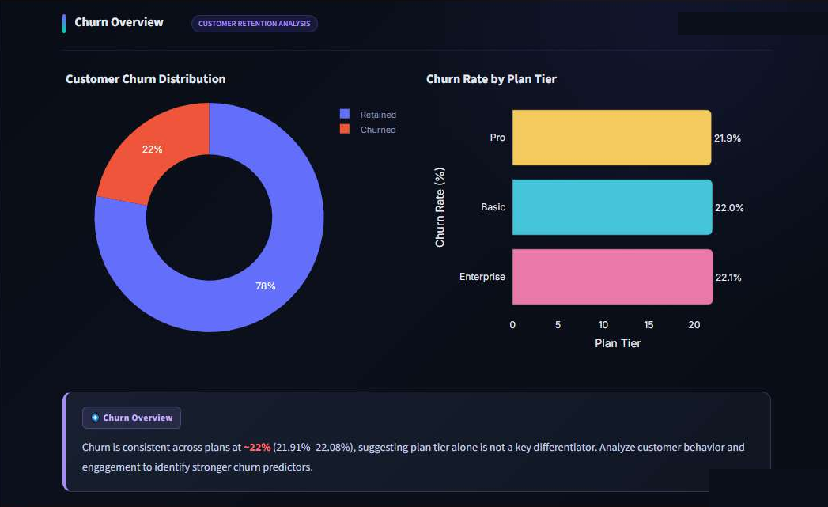
EXPLORATION
Churn is flat by plan; some segments stand out
~22%
31.0%
across all plan tiers (21.9–22.1%)
DevTools churn (35 of 113)
32%
25.8% vs 21.1%
Germany (8 of 25); US has most churned: 68
trial vs non-trial accounts
Event-referred accounts: 30.2% (29 of 96).
Tenure groups: 18.7% / 23.5% / 31.2% - but tenure is measured to the churn date for churned accounts, so this reflects how tenure is defined.
Screenshot: Churn Overview tab of the dashboard.
SaaS Subscription Churn Prediction | Pratham Rangoonwala
6
Notes:
Plan tier does not separate churners from retained customers - all three tiers sit near 22%. DevTools, Germany, event referrals and trial accounts show higher rates, but several groups are small (Germany is 25 accounts), and nothing is tested for significance. These are associations, not causes. Be careful with the tenure result: churned accounts are measured to their churn date, so tenure and churn are linked by construction.

Slide 7
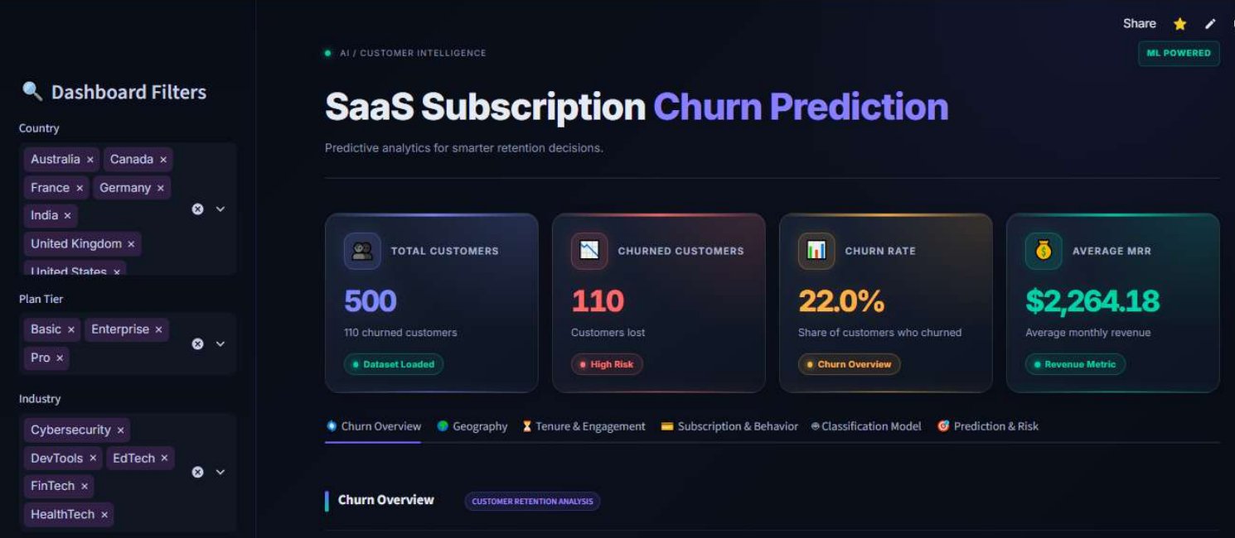
STREAMLIT DASHBOARD
One page, six tabs, sidebar filters
1 Churn Overview
2 Geography
3 Tenure & Engagement
4 Subscription & Behavior
5 Classification Model
6 Prediction & Risk
▪ Filters: Country, Plan Tier, Industry; four KPI cards: 500 customers, 110 churned, 22.0%, $2,264.18 average MRR
▪ Charts built with Plotly Express; custom dark theme (CSS)
▪ Insight boxes and recommendation cards are static text written in the app code
SaaS Subscription Churn Prediction | Pratham Rangoonwala
7
Notes:
This is the live app. The sidebar filters drive the exploratory charts. The insight boxes and recommendation cards are hard-coded text; their numbers were checked against the dataset, but they do not update when filters change.

Slide 8
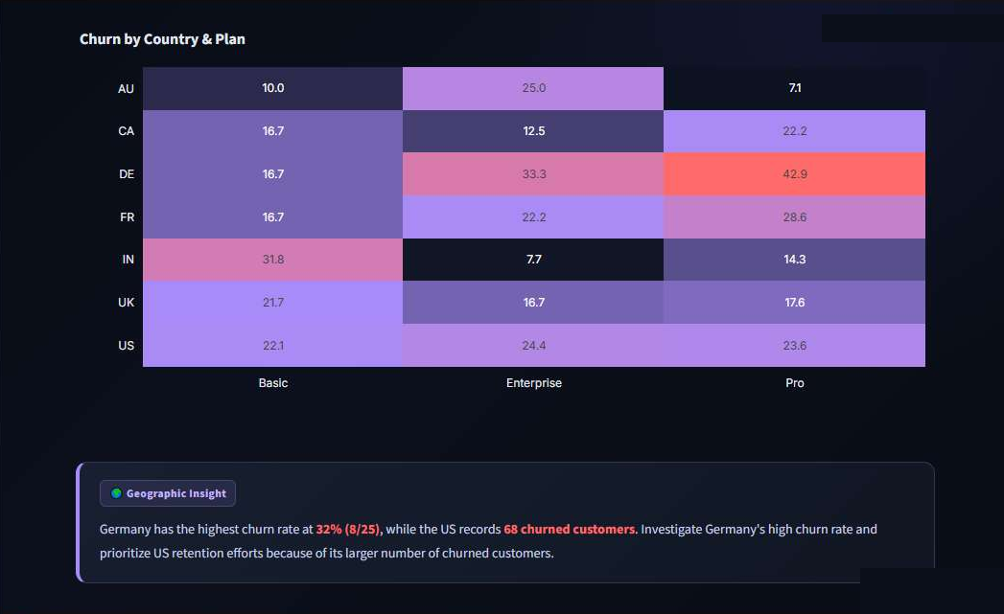
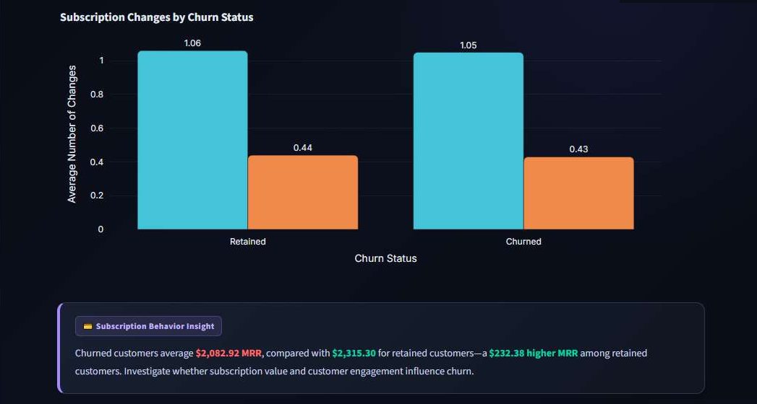
DASHBOARD VIEWS
Segment and behaviour charts
Subscription behaviour: upgrades 1.06 vs 1.05 and downgrades 0.44 vs 0.43 - nearly identical.
Average MRR: retained $2,315.30 vs churned $2,082.92.
Geography: churn rate by country and plan. Germany highest (32%); several cells rest on very few accounts.
SaaS Subscription Churn Prediction | Pratham Rangoonwala
8
Notes:
Two examples of the dashboard's charts, each ending in an insight box. Upgrade and downgrade counts barely differ between retained and churned accounts. MRR is about $232 higher for retained accounts, a descriptive difference only.

Slide 9
MODELLING
Select on validation, evaluate once on test
500 accounts
Stratified split
Pipeline
3 candidates
Selection
Final test
19 features
110 churned
train 300
validation 100
test 100
numeric: median impute
categorical: impute + one-hot
Logistic Regression
Random Forest
Gradient Boosting
validation set
GB chosen
threshold 0.40
scored once
n = 100
▪ Gradient Boosting: 150 trees, learning rate 0.05, depth 2, min leaf 5 (fixed settings; no tuning search recorded)
▪ Threshold scanned 0.20–0.70 in steps of 0.05; best validation F1 = 0.757 at 0.40 (0.45 ties)
▪ The model is fitted on the training split only
SaaS Subscription Churn Prediction | Pratham Rangoonwala
9
Notes:
The split is stratified, so each part has 22% churners. Preprocessing sits inside the pipeline so it is learned from training data only. Three models were compared on validation; Gradient Boosting won on every metric except ROC-AUC, where Random Forest was slightly higher (0.810 vs 0.805). The threshold was chosen on validation by best F1. Only then was the test set scored.

Slide 10
MODEL SELECTION
Validation results (n = 100, cutoff 0.50)
VALIDATION SET
Model | Accuracy | Precision | Recall | F1 | ROC-AUC
Logistic Regression | 0.710 | 0.370 | 0.455 | 0.408 | 0.686
Random Forest | 0.850 | 0.818 | 0.409 | 0.545 | 0.810
Gradient Boosting | 0.900 | 0.929 | 0.591 | 0.722 | 0.805
Why Gradient Boosting
Cross-check (not used to select)
Highest accuracy, precision, recall and F1 on validation; ROC-AUC close to Random Forest.
5-fold stratified CV on all 500 rows: accuracy 0.926, F1 0.810, ROC-AUC 0.916 at a 0.50 cutoff.
SaaS Subscription Churn Prediction | Pratham Rangoonwala
10
Notes:
These numbers are validation-set numbers at the default cutoff and are only for choosing between models. They are not the final performance. Cross-validation is a separate robustness check on all 500 rows and was not used for selection.

Slide 11
FINAL EVALUATION
Held-out TEST results (n = 100, threshold 0.40)
TEST SET
Accuracy
Precision
Recall
F1 score
ROC-AUC
0.900
0.800
0.727
0.762
0.876
 | Predicted retained | Predicted churned
Actual retained | 74 | 4
Actual churned | 6 | 16
How to read it
▪ 16 of 22 churners found; 6 missed
▪ 16 of 20 flagged accounts were real churners
▪ Only 22 churners: bootstrap 95% interval for recall ≈ 0.52–0.90 (supplementary)
Not comparable with the validation table: different accounts and a different threshold.
SaaS Subscription Churn Prediction | Pratham Rangoonwala
11
Notes:
These are the final numbers - the model was applied once to the held-out test set at the threshold picked on validation. The confusion matrix matches the metrics: precision 16/20, recall 16/22. The interval comes from my own bootstrap analysis done while documenting the project; it is not part of the notebooks. Do not compare these with the validation table - they use different accounts and a different threshold.

Slide 12
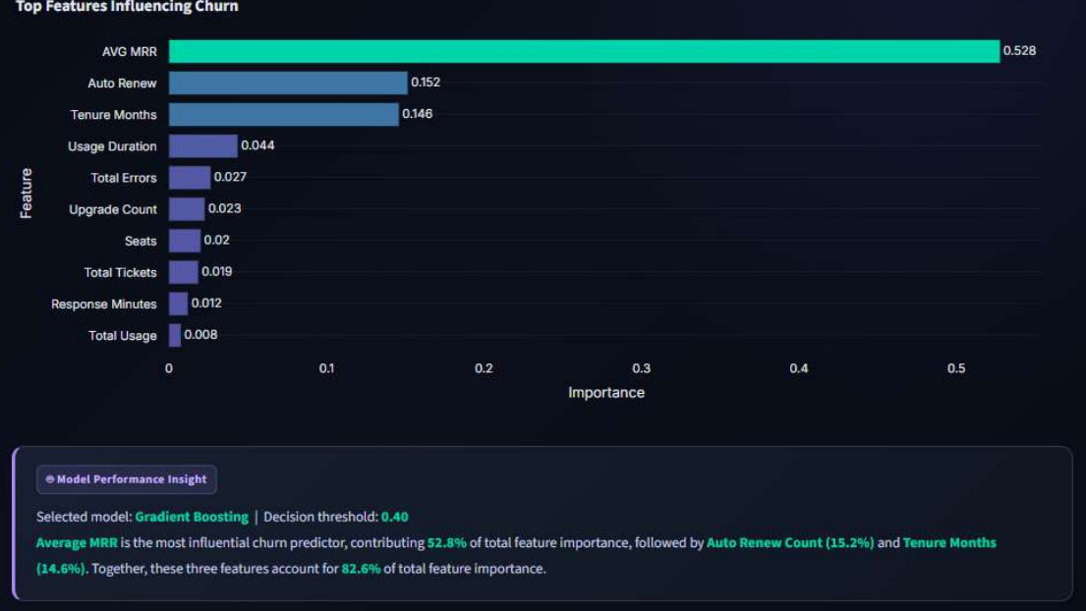
MODEL DRIVERS
What the Gradient Boosting model relies on
▪ Avg MRR 52.8%, Auto Renew 15.2%, Tenure 14.6% - together 82.6%
▪ Importance shows what the trees split on, not what causes churn
▪ Caution: avg MRR is missing for 62 of 110 churned accounts and 0 of 390 retained - part of its importance may reflect that pattern (next slides)
SaaS Subscription Churn Prediction | Pratham Rangoonwala
12
Notes:
Feature importance here is impurity-based, from the model fitted on the training split. It says which inputs the trees used, not that those inputs drive churn. Avg MRR dominates; the later limitations slide explains why part of that may be a data artefact.

Slide 13
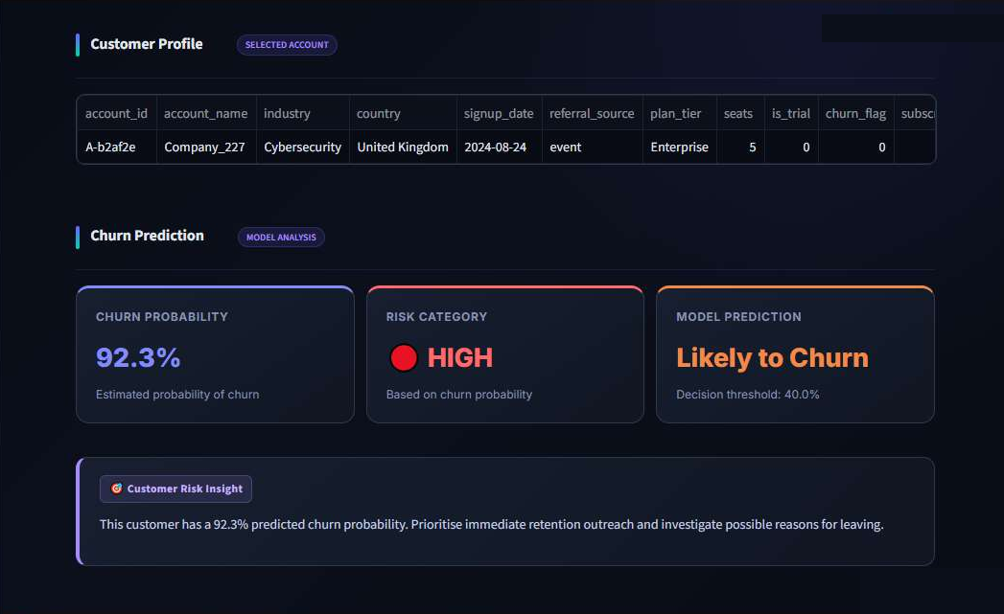
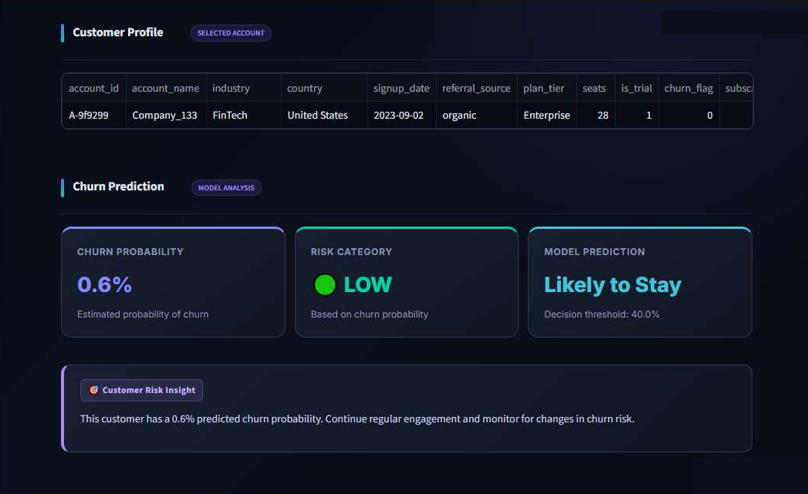
PREDICTION & RISK TAB
Per-account churn probability and risk band
HIGH
MEDIUM
LOW
Illustrative lookups only: the tab scores whole-history features from account_data.csv, which differ from the training windows, and ~60% of accounts were training rows.
probability ≥ 0.60
0.40 ≤ probability < 0.60
probability < 0.40
SaaS Subscription Churn Prediction | Pratham Rangoonwala
13
Notes:
The reader picks an account; the app shows probability, band and a message. This is a demonstration of how a score would be presented. It is not evidence of accuracy: the features fed here differ from those used in training, and most accounts were part of the training data.

Slide 14
LIMITATIONS
What the numbers do and do not show
Small test set
Missing features are informative
22 churners in 100 accounts. One account moves recall ~4.5 points; intervals are wide.
11 of 22 test churners have no avg MRR (no churn event → no prediction date). A rule 'avg MRR missing → churn' alone scores precision 1.0, recall 0.50. On the 89 test accounts with real values: AUC ≈ 0.76, recall ≈ 0.45.
Dashboard scoring mismatch
Data & app caveats
Prediction tab uses whole-history features; the model was trained on pre-prediction-date windows.
Synthetic data; churn_flag derivation not shown; model KPI cards, validation chart and insight text are hard-coded.
Reported test metrics are the project's own results; the supplementary figures come from a reproduction and diagnostics run while documenting it.
SaaS Subscription Churn Prediction | Pratham Rangoonwala
14
Notes:
Be upfront about this. Churned accounts that have no churn event get no prediction date, so their features are missing and get filled with medians. That pattern - missing avg MRR - never occurs for retained accounts, and the model can exploit it. Half of the test churners are of this type. I reproduced the notebook's pipeline from the cleaned CSVs (it matched the test metrics and confusion matrix exactly) and measured this. The headline test recall of 0.727 should be quoted with this caveat. Other limits: tiny test set, mismatch between dashboard features and training features, synthetic data.

Slide 15
SUMMARY
Conclusion and next steps
What was delivered
Suggested next steps (not yet done)
▪ End-to-end pipeline: five tables → account-level data → model → dashboard
▪ Plan tier is not associated with churn; DevTools, event referrals, trial accounts and Germany show higher rates
▪ Gradient Boosting, threshold 0.40: test accuracy 0.900, recall 0.727, ROC-AUC 0.876 (n = 100)
▪ Assign prediction dates without relying on the label; re-evaluate with and without missing indicators
▪ Score the dashboard with training-consistent features
▪ Repeated CV and confidence intervals
▪ Generate app figures from saved result files
▪ Validate on a real, non-synthetic dataset
SaaS Subscription Churn Prediction | Pratham Rangoonwala
15
Notes:
Close with the deliverable and the honest caveats. The next steps are suggestions only - none has been done. Thank the audience and invite questions.

