Slide 1
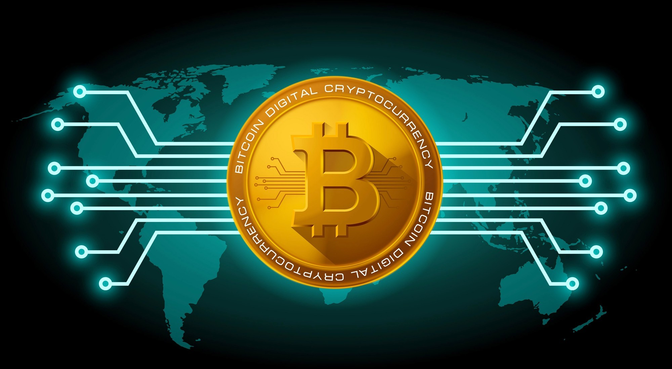

Slide 2
What is Bitcoin?
A type of cryptocurrency (digital currency) created in January 2009. It follows the ideas set out in a white paper by the mysterious Satoshi Nakamoto, whose true identity has yet to be verified.

Slide 3
What is Bitcoin?
Operated by a decentralized authority, unlike government-issued currencies.
Bitcoin offers the promise of lower transaction fees than traditional online payment mechanisms.
Not issued or backed by any banks or governments, nor are individual bitcoins valuable as a commodity.
●
●
Not physically available Not a legal tender

Slide 4
SIDE NOTE:
According to the official Bitcoin Foundation, the word "Bitcoin" is capitalized in the context of referring to the entity or concept, whereas "bitcoin" is written in the lower case when referring to a quantity of the currency (e.g. "I traded 20 bitcoin") or the units themselves. The plural form can be either "bitcoin" or "bitcoins."

Slide 5
Blockchain or Distributed Ledger Technology (DLT)
tracks ownership and allows for immediate and efficient transfers of Bitcoin.
makes Bitcoin completely transparent; it stores complete details by an address of every transaction that ever occurs.

Slide 6
Mathematical encryption
Public keys
comparable to a bank account number
serves as the address which is published to the world and to which others may send bitcoins.
Private keys
comparable to an ATM PIN
meant to be a guarded secret, and only used to authorize Bitcoin transmissions.

Slide 7
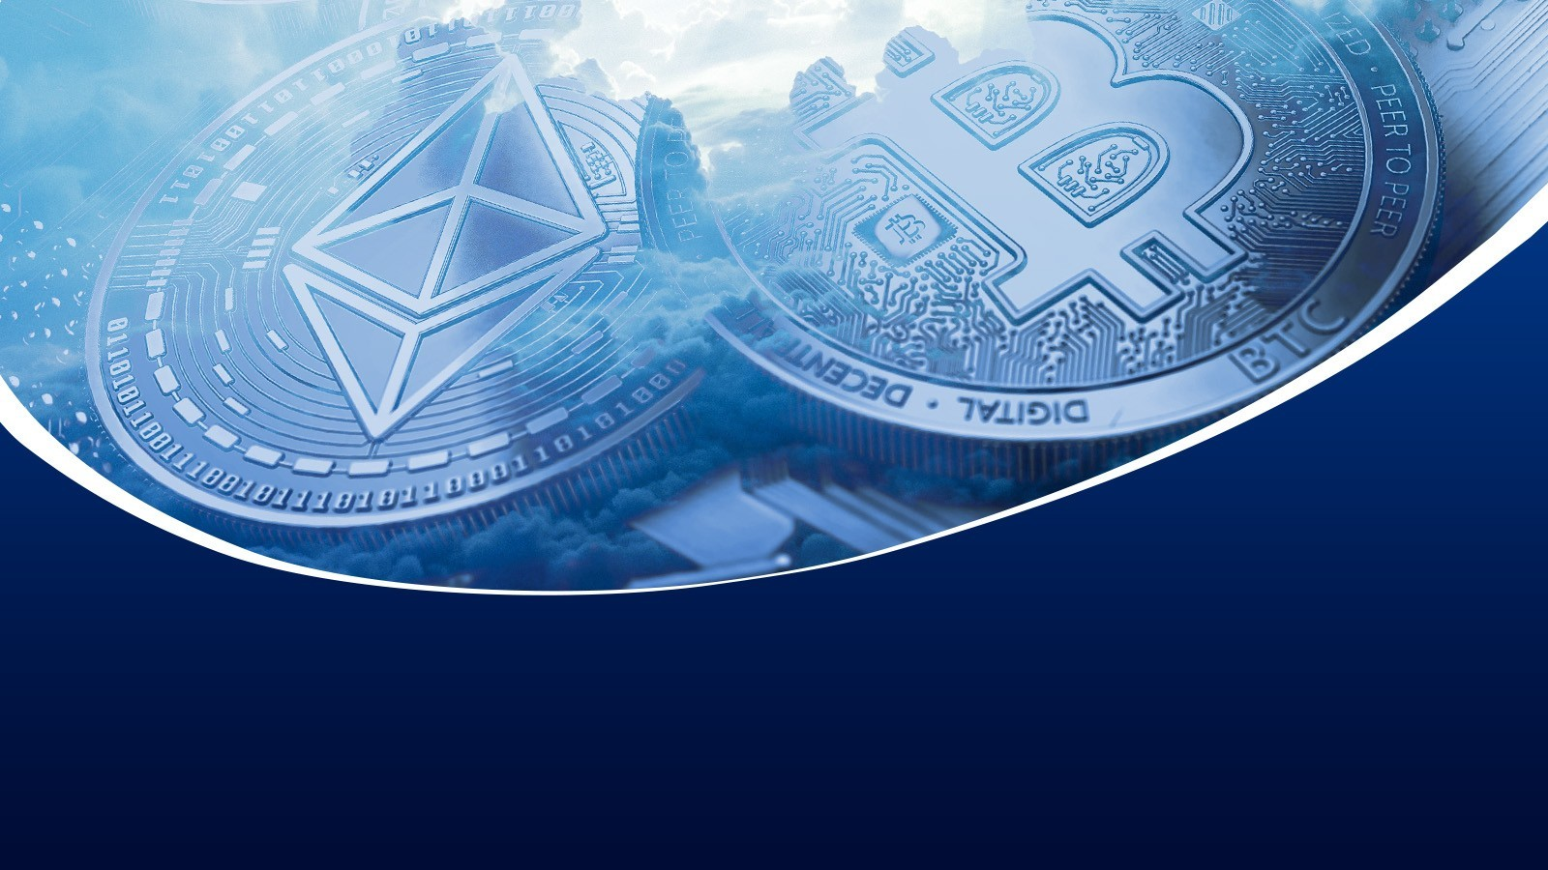
How does Bitcoin
work?

Slide 8

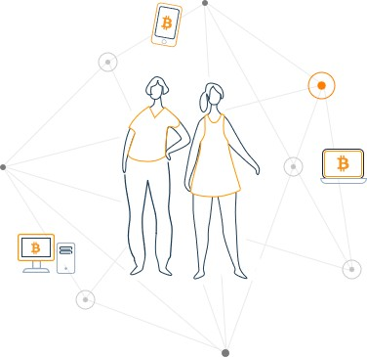
The basics for a
Slide Title
As a _{n}ne_{e}w _{w}use_{u}r,_{s}y_{e}ou_{r}can get started with Bitcoin without understanding the technical details. Once you've installed a Bitcoin wallet on your computer or mobile phone, it will generate your first Bitcoin address and you can create more whenever you need one.

Slide 9
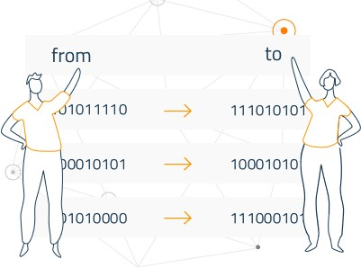
Balances - Block
The block chain is a shared public ledger on
which_{c}t_{h}he_{a}en_{i}t_{n}ire Bitcoin network relies. All confirmed transactions are included in the block chain. It allows Bitcoin wallets to
calculate their spendable balance so that new transactions can be verified thereby ensuring they're actually owned by the spender.

Slide 10
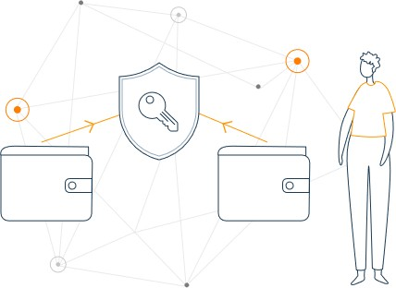
Transactions - private
A transaction is a transfer of value between
keys
Bitcoin wallets that gets included in the block
chain. Bitcoin wallets keep a secret piece of data called a private key or seed, which is used to sign transactions, providing a mathematical proof
that they have come from the owner of the wallet.

Slide 11
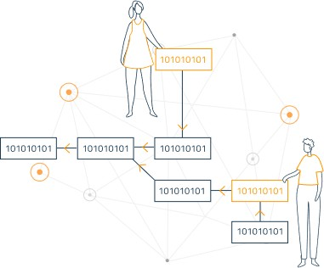
Processing -
Mining
Mining is a distributed consensus system that is used
to confirm pending transactions by including them in
the block chain. It enforces a chronological order in the block chain, protects the neutrality of the network, and allows different computers to agree on the state of the system. Mining also creates the equivalent of a competitive lottery that prevents any individual from easily adding new blocks consecutively to the block chain

Slide 12
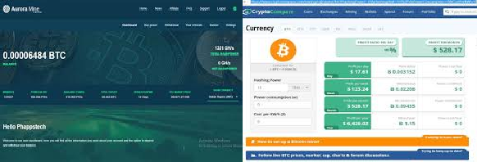
Slide Title
Product B
Feature 1
Feature 2
Feature 3
•
•
•

Slide 13
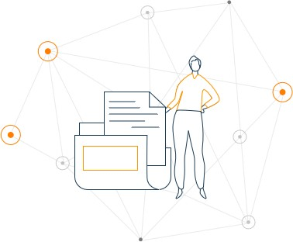
Going down the Rabbit Hole
This is just a short summary of Bitcoin.

Slide 14
How to get a Bitcoin Wallet?
1.Install 2.Sign-up 3.Log-in
4.Buy Bitcoins 5.Mine
6.Pay

Slide 15
BITCOIN: HOW IT BEGAN?
AUGUST 18, 2008
JANUARY 8, 2009
– The first version of Bitcoin software
– The domain name bitcoin.org is registered
JANUARY 9,
2009 – Block
1 is mined, and bitcoin
mining commences in
earnest.
JANUARY 3, 2009 –
“Genesis
Block” of bitcoin
OCTOBER 31,
2008 –
Satoshi Nakamoto

Slide 16
History and Timeline of
1998-2009 PBriet-cboiitncoin Years
B-money Bit Gold
2007 Legendary Mr. Satoshi Nakamoto
Began formulating

Slide 17
History and Timeline of
2008 Mr. Nakam_{B}ot_{it}o_{coin}
Aug. 18 SourceForge.com
Oct.31 Bitcoin-A Peer-to-Peer eCash System
2009 Bitcoin Begins
Jan. 9 First Transaction between Satoshi and Hal Finney
Jan. 12 US$ 1 = 1, 309.03 BTC
Oct. | 12 | #bitcoin-dev | hits freenode
Dec. | 16 | Version 0.2 | is released

Slide 18
History and Timeline of
2010 Bitcoin i_{B}s_{it}V_{c}al_{o}ue_{in}d
Feb. 6 Currency exchange is born
May 10 Swap 10, 000 BTC for 2 pizzas
July | 7 | Version 0.3
July | 17 | MtGox is Establish
Aug. | 15 | Exploit generates 184 | B | BTC
Dec. | 7 | Bitcoin for Nokia N900

Slide 19
History and Timeline of
2011 Rival of_{Bi}C_{t}r_{c}y_{o}pt_{i}o_{n}currencies Emerge
Namecoin and Litcoin
Feb. 14 Vehicle offered for bitcoins
July 7 Major breach at MtGox
June 12 Great Bubble
June 13 Largest Bitcoin Theft

Slide 20
History and Timeline of
2012 Bitcoin_{B}ic_{i}a_{tc}H_{o}ac_{in}ked
Dec. 6 Bitcoin Central
licensed as a bank
2013 Bitcoin Price Crashes
Nov. 29 Bitcoin Black Friday
Dec. 5 China's Central Bank bans BTC Transactions

Slide 21
History and Timeline of
2014 Scams BanitdcoThineft
Jan. MtGox disappears
2016 Euthereum and ICOs.
Ether a cryptocurrency that facilitates blockchain-based smart contract and apps
Initial Coin Offerings (ICOs)

Slide 22
History and Timeline of
2017 Bitco^{B}i^{it}n^{co}re^{in}aches
$10,000 and continues to grow

Slide 23



Why is Satoshi Nakamoto Anonymous?

Slide 24
The Suspects
Oct 10, 2011– Michael Clear
- Vili Lehdonvirta
Oct 11, 2011 - Neal King, Vladimir Oksman and Charles Bry
May, 2013
Gavin Andresen
Jed McCaleb
Shinichi Mochizuki

Slide 25
The Suspects
Dec, 2013 - Nick Szabo
March, 2014 – Satoshi Nakamoto

Slide 26
What proof is needed to identify Satoshi Nakamoto?
1.) Registration of bitcoin.org
2.) Emails and forums used by Satoshi Nakamoto
3.) ownership of some earliest mined bitcoins

Slide 27
INVESTING IN BITCOINS
Internal Revenue Service – IRS
is a U.S. government agency responsible for the collection of taxes and enforcement of tax laws
March 2014
- all virtual currencies, including bitcoins, would be taxed
as property rather than currency.

Slide 28
THINGS TO KNOW BEFORE INVESTING IN BITCOIN
Why Invest in Bitcoin?
•
•
•
Bitcoins are scarce and useful.
21 million Bitcoin Bitcoin provides sound and
predictable monetary policy that can be verified by anyone.

Slide 29
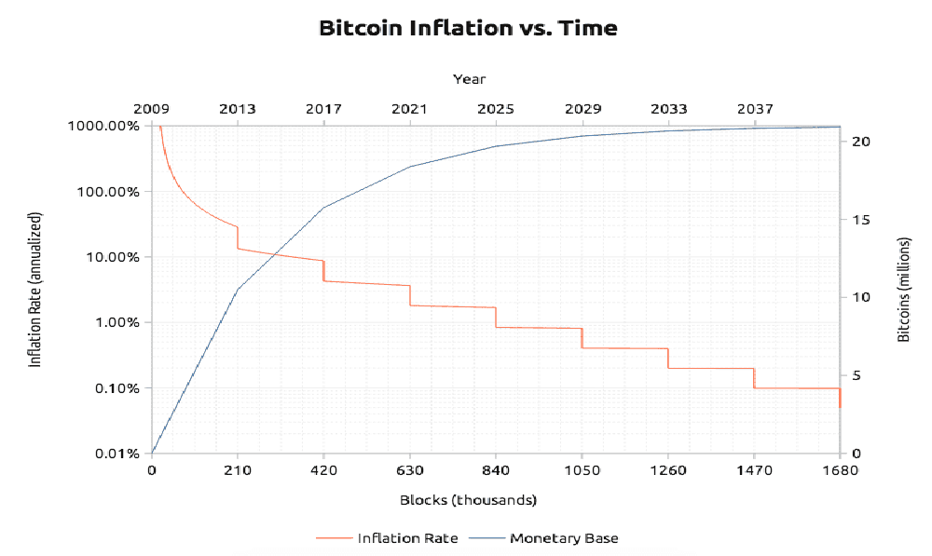

Slide 30
When is the right time to
•
•
buy?
nothing is for sure.
Use tools like Bitcoin
Wisdom or Cryptowatch to analyze charts and understand Bitcoin’s price history. Bitcoin is global and not affected by any single country’s financial situation or stability.
global scale and not just about what’s happening in a single country.
•
•

Slide 31
How to Invest in Bitcoins and
The difficuWltyheofrebutyoingBubiytcoins depends on your country. Developed countries have more options and more liquidity.
•
•
Coinbase is the world’s largest bitcoin broker and available in the United States, UK, Canada, Singapore, and most of Europe.
You can use our exchange finder to find a place to buy bitcoins in your country
•

Slide 32
How to Secure Bitcoins?
•
Ledger Nano S – Ledger is a Bitcoin security company that offers a wide range of secure Bitcoin storage devices. We currently see the Ledger Nano S as Ledger’s most secure wallet. Read more about the Ledger Nano or buy one.
TREZOR – TREZOR is a hardware wallet that was built to secure bitcoins. It generates your Bitcoin private keys offline. Read more about TREZOR or buy one.
•

Slide 33
Should you Invest in Bitcoin Mining?
Bitcoin miners are no longer a profitable
investment for new Bitcoin users.

Slide 34
PROS
•
•
Greater liquidity as compared to its peer Full acceptance and popularity among the people
Virtual transactions easier than regular currencies
Lower transaction fees
Privacy and anonymity in relative to traditional currencies
No dependency on creators or political agents
Scarcity makes it more precious
•
•
•
•
•

Slide 35
CONS
Delayed transactions
Dark marketplaces are working towards the damage
Susceptible to price swings
No recovery once the private key is lost, its lost forever
Maybe replaced by potential cryptocurrencies

Slide 36
How to Secure Bitcoins?
•
Ledger Nano S – Ledger is a Bitcoin security company that offers a wide range of secure Bitcoin storage devices. We currently see the Ledger Nano S as Ledger’s most secure wallet. Read more about the Ledger Nano or buy one.
TREZOR – TREZOR is a hardware wallet that was built to secure bitcoins. It generates your Bitcoin private keys offline. Read more about TREZOR or buy one.
•

Slide 37
How to Invest in Bitcoins?
Part I: Buying and Selling BTC

Slide 38
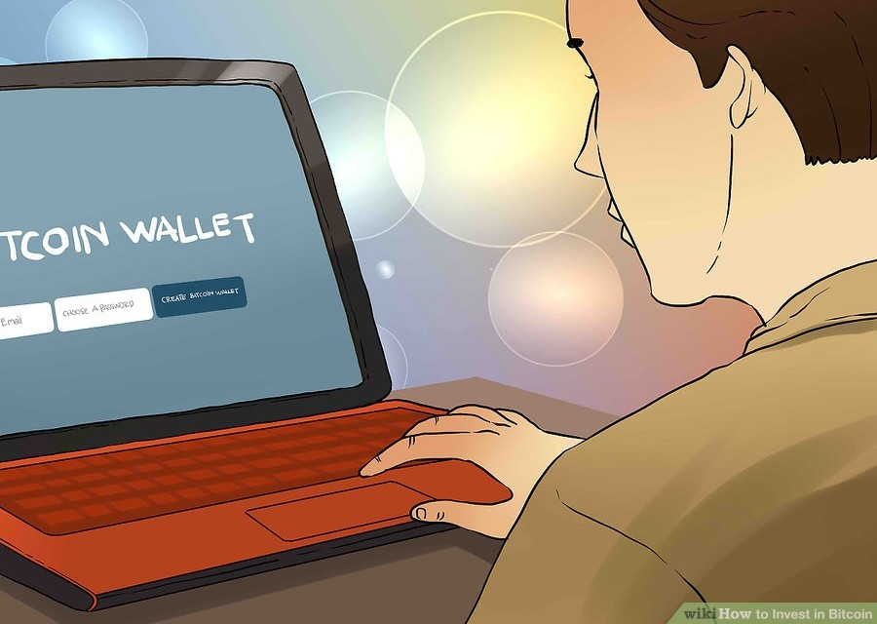
1.Create a Bitcoin wallet.

Slide 39
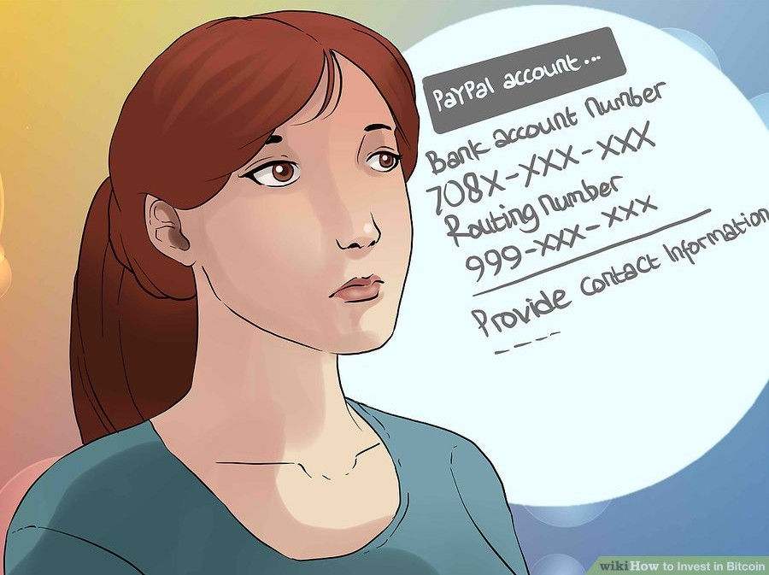
2. Link your bank account to your wallet

Slide 40
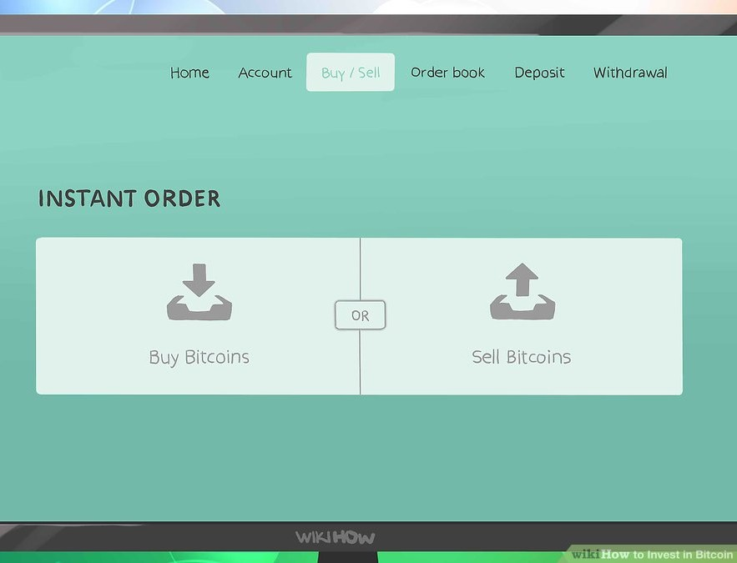
3. Buy BTC with money from your bank account.

Slide 41
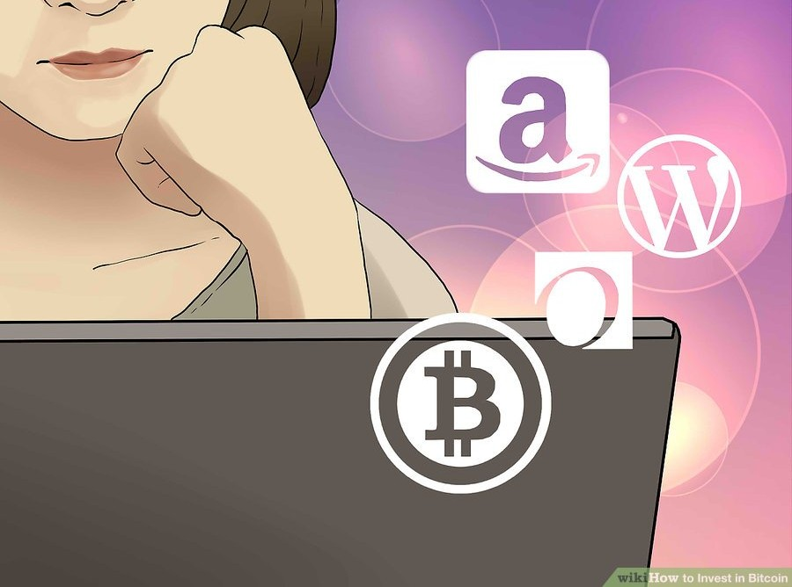
4. Use your Bitcoin to buy from retailers that accept it
Amazon
Wordpress
Overstock.com
Bitcoin.travel
Victoria's Secret
Subway
Zappos
Whole Foods

Slide 42
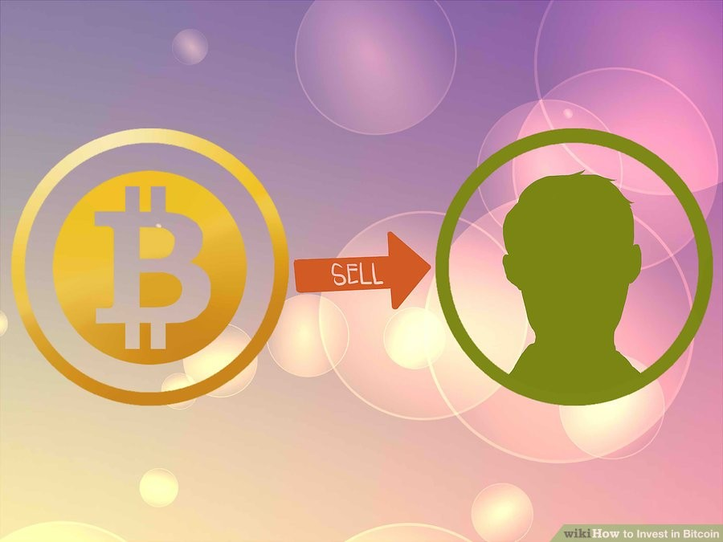
5. Sell your Bitcoin to another user.

Slide 43
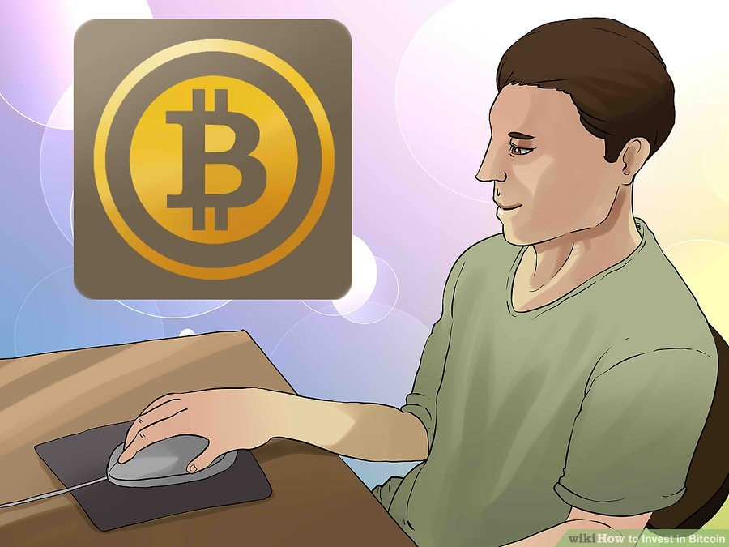
6. | Alternatively, | sell | your | Bitcoin
on | an exchange.

Slide 44
How to Invest in Bitcoins?
PART II: USING ALTERNATE OPTIONS

Slide 45
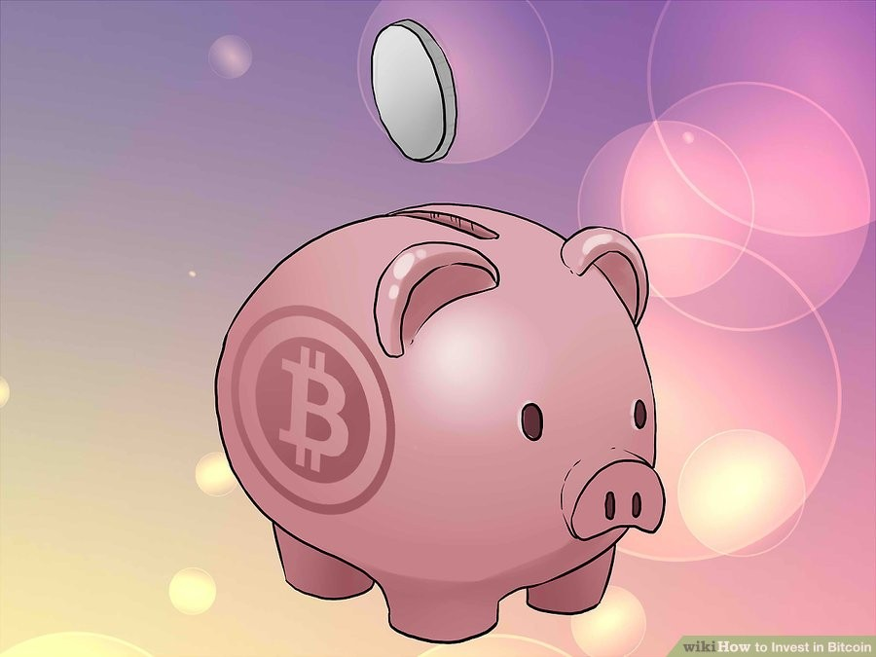
1. Consider setting up a regular purchase scheme

Slide 46
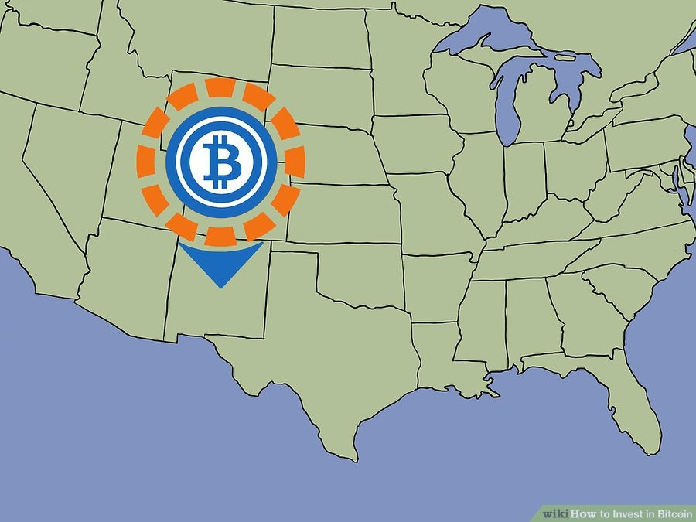
2. Consider buying Bitcoin locally.

Slide 47
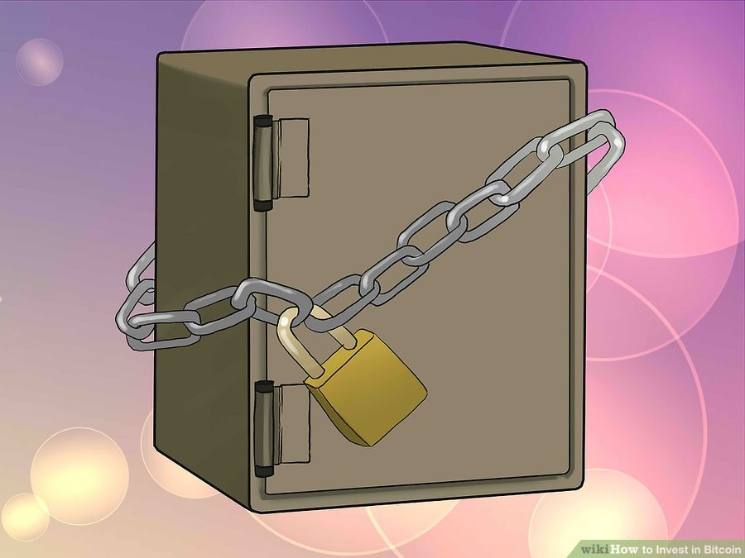
3. Consider buying into a Bitcoin investing company.

Slide 48
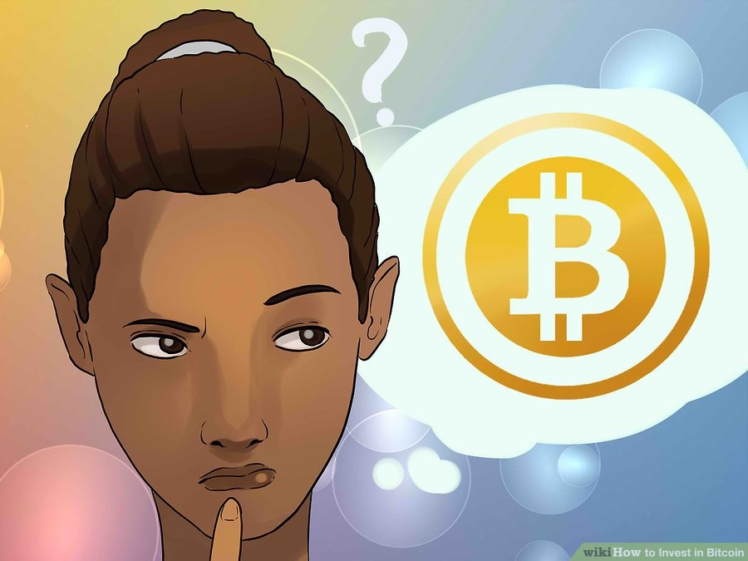
4. Consider "mining" Bitcoin.

Slide 49
How to Invest in Bitcoins?
PART III: MAKING MONEY ON YOUR INVESTMENT

Slide 50
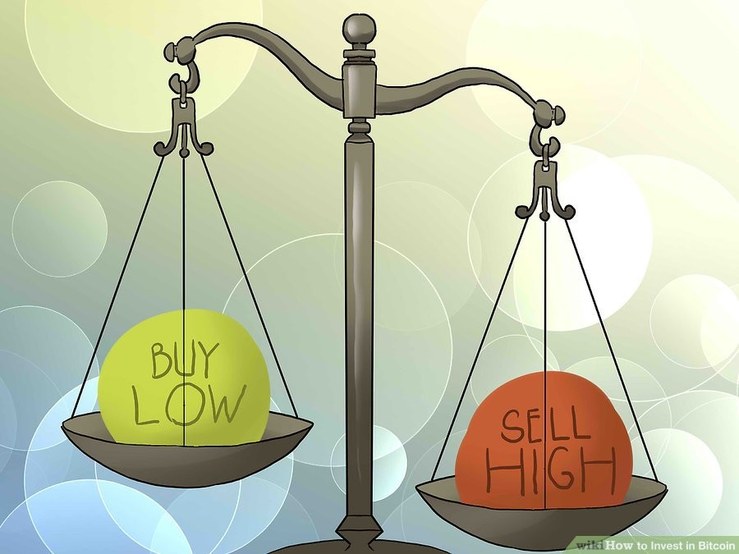
1. Buy low, sell high.

Slide 51
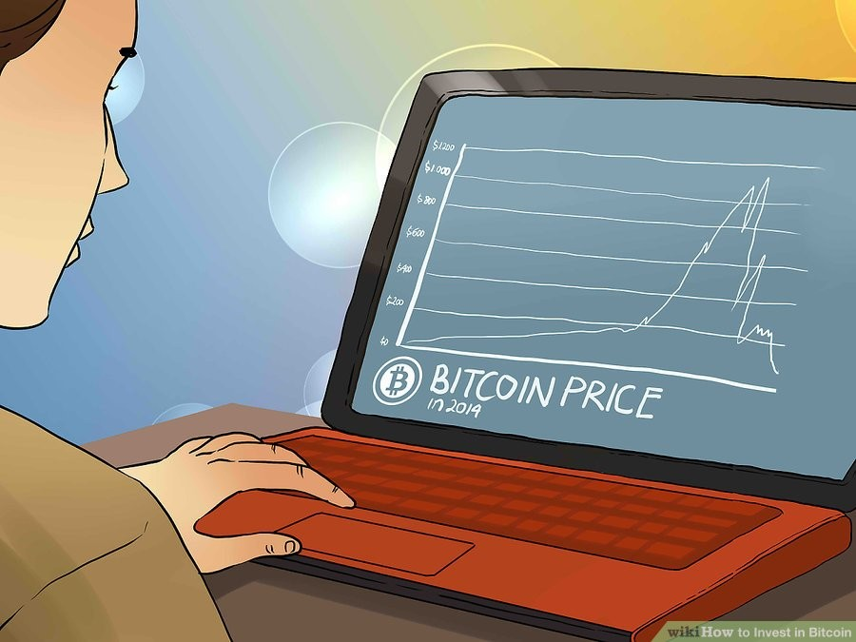
2. Stay up-to-date on Bitcoin market trends.

Slide 52
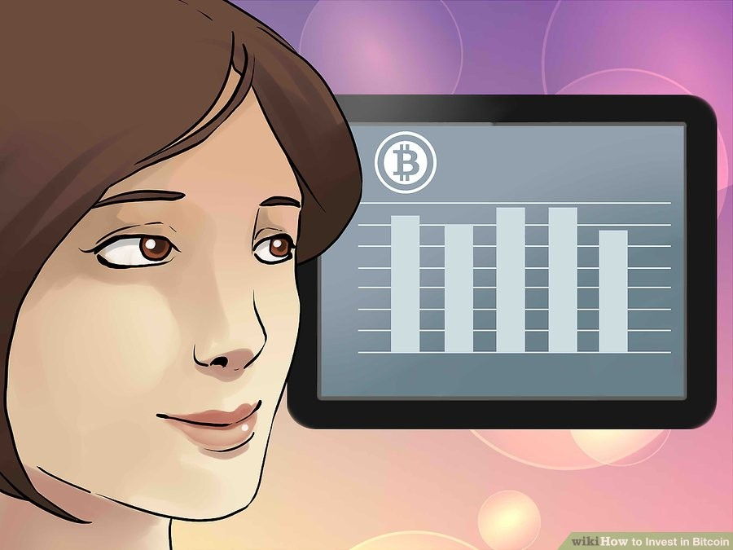
3. Use Bitcoin wealth to purchase more stable investments

Slide 53
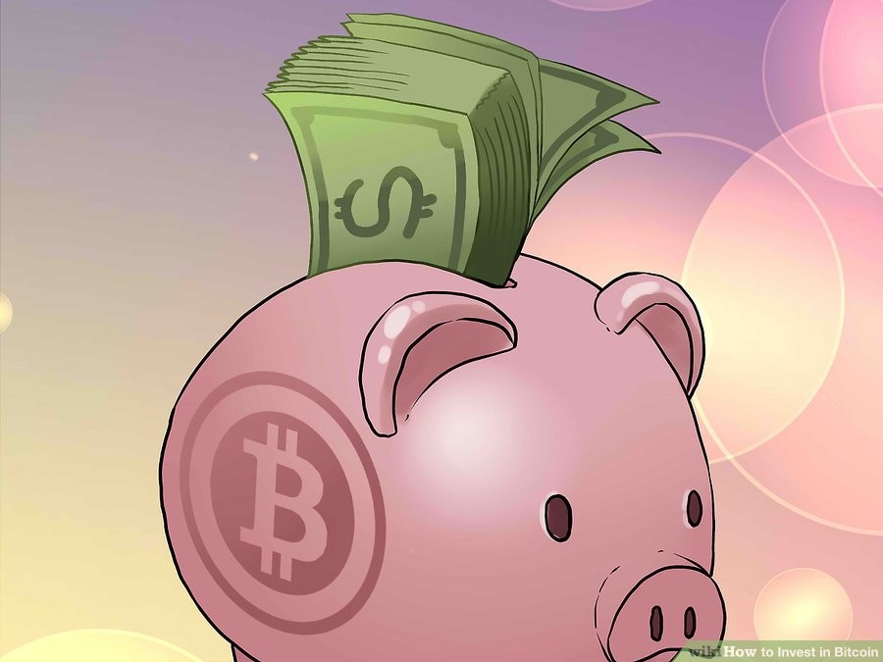
4. Never put more money into Bitcoin than you can afford to lose

Slide 54
Final Thoughts!!!
It’s important to understand how Bitcoin works before investing any money.

Slide 55
Ways to Earn Bitcoins
RECEIVING AS PAYMENT
Can be accepted as a means of payment for products sold or services provided
“ Bitcoin Accepted Here”

Slide 56
Ways to Earn Bitcoins
WORKING FOR THEM
Those who are self-employed can get paid for a job in bitcoins Websites / Job Boards which are
dedicated to digital currency
Work for Bitcoin
Coinality
Jobs 4 Bitcoins & BitGigs

Slide 57
Ways to Earn Bitcoins
GAMBLING
it’s possible to play at casino that cater to bitcoin aficionados
e.g. online lotteries, jackpots, spread betting, and other games

Slide 58
Ways to Earn Bitcoins
INTEREST PAYMENTS
Lending of bitcoin and being repaid by the same currency
3 FORMS
Direct lending to someone you
know
Pairing borrowers and lenders
Lending bitcoins in a virtual
bank

Slide 59
Risk of Investing in Bitcoin
Security Risk
- Bitcoin exchanges are entirely digital and, as with any virtual system, are at risk from hackers, malware and operational glitches.

Slide 60
Risk of Investing in Bitcoin
Fraud risk
- While Bitcoin uses private key encryption to verify owners and register transactions, fraudsters and scammers may attempt to sell false bitcoins.

Slide 61
Risk of Investing in Bitcoin
Fraud risk
- While Bitcoin uses private key encryption to verify owners and register transactions, fraudsters and scammers may attempt to sell false bitcoins.

Slide 62
Risk of Investing in Bitcoin
Tax risk
- As bitcoin is ineligible to be included in any tax-advantaged retirement accounts, there are no good, legal options to shield investments from taxation.

Slide 63
Risk of Investing in Bitcoin
Regulatory Risk
- Bitcoins are a rival to government currency and may be used for black market transactions, money laundering, illegal activities or tax evasion.

Slide 64
Risk of Investing in Bitcoin
Insurance Risk
- Bitcoin exchanges and Bitcoin accounts are not insured by any type of federal or government program.

Slide 65
Risk of Investing in Bitcoin
Market Risk
- Like with any investment, Bitcoin values can fluctuate. Indeed, the value of the currency has seen wild swings in price over its short existence.

