Slide 1

Group No 2
Ethereum- A next generation
Blockchain

Slide 2
Where It all started
What is Block chain?
Digital messages (transactions) bundled into: ...
Blocks.
Blocks linked in a chain to form chronicle.

Slide 3
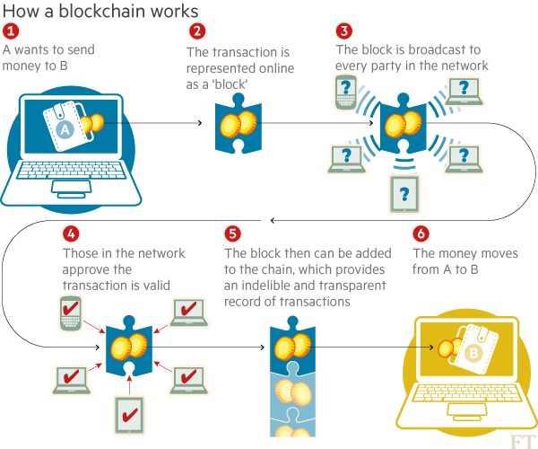
How it works???

Slide 4
What is Ethereum?
Ethereum is the largest decentralized software platform that allows you to build smart contracts and decentralized applications without any downtime and without any third party interference.
It forms a decentralized and Peer-to-Peer network where all the applications run on a public ledger.
•
•

Slide 5
The concep
•
It is a Block Chain….. With a few tiny additions
▪
▪
A built-in programming language Two types of accounts
User accounts (controlled by private keys)
Contracts (controlled by code)
Anyone can create an application with any rules by defining it as a contract
▪

Slide 6
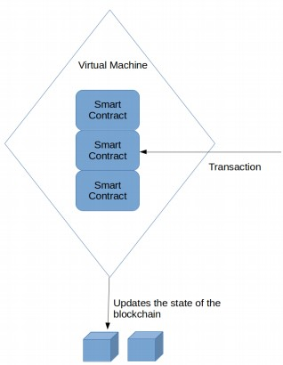
Ethereum Node
In Simple terms……
Internet is to communication as
Ethereum is to agreements

Slide 7
Bitcoin vs Ethereum
How is Ethereum different from Bitcoin ?
More general, not just a currency each node has a virtual machine forming a planetary scale computer the virtual machines run "smart contracts" users can call functions on the contract = TRANSACTIONS

Slide 8


Slide 9
Block Chain 2.0- Ethereum
•
Blockchain with expressive programming language
– Programming language makes it ideal for smart contracts
•
Why?
Most public blockchains are cryptocurrencies
Can only transfer coins between users
Smart contracts enable much more applications

Slide 10
How Ethereum Works?
•
Two types of account:
Normal account like in Bitcoin
has balance and address
Smart Contract account
like an object: containing (i) code, and (ii) private storage (key-value storage)
Code can
–
–
–
Send ETH to other accounts Read/write storage
Call (ie. start execution in) other contracts

Slide 11
Transaction in Ethereum
•
Normal transactions like Bitcoin transactions
– Send tokens between accounts
•
Transactions to contracts
–
–
like function calls to objects
specify which object you are talking to, which function, and what data (if possible)
•
Transactions to create contracts

Slide 12
Transaction in Ethereum
•
•
•
•
•
•
•
nonce (anti-replay-attack)
to (destination address)
value (amount of ETH to send)
data (readable by contract code) gasprice (amount of ether per unit gas) startgas (maximum gas consumable) v, r, s (ECDSA signature values)

Slide 13
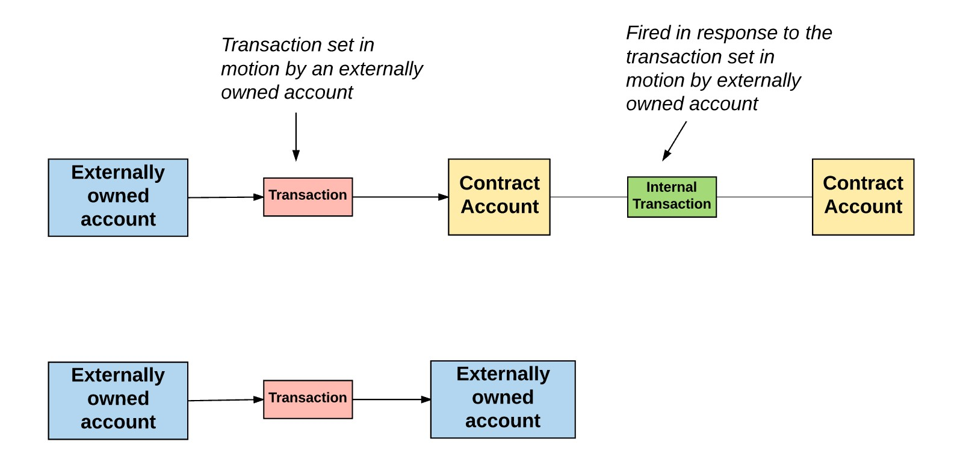
Transaction in Ethereum

Slide 14
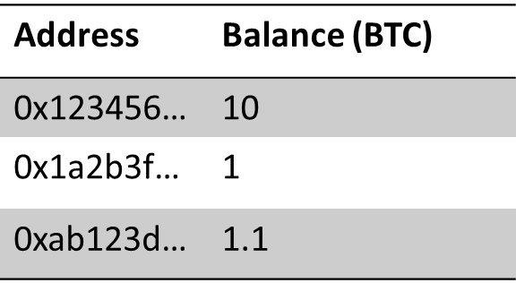
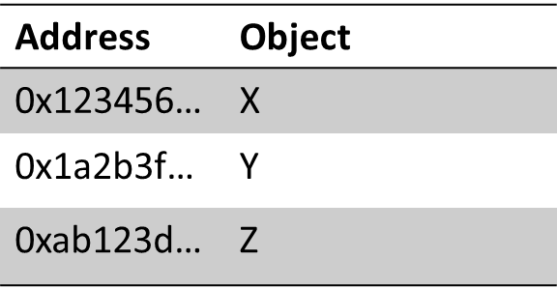
Block chain State
•
Bitcoin’s state consists of key value mapping addresses to account balance
•
Ethereum’s state consists of key value mapping addresses to account objects
Blockchain != Blockchain state

Slide 15
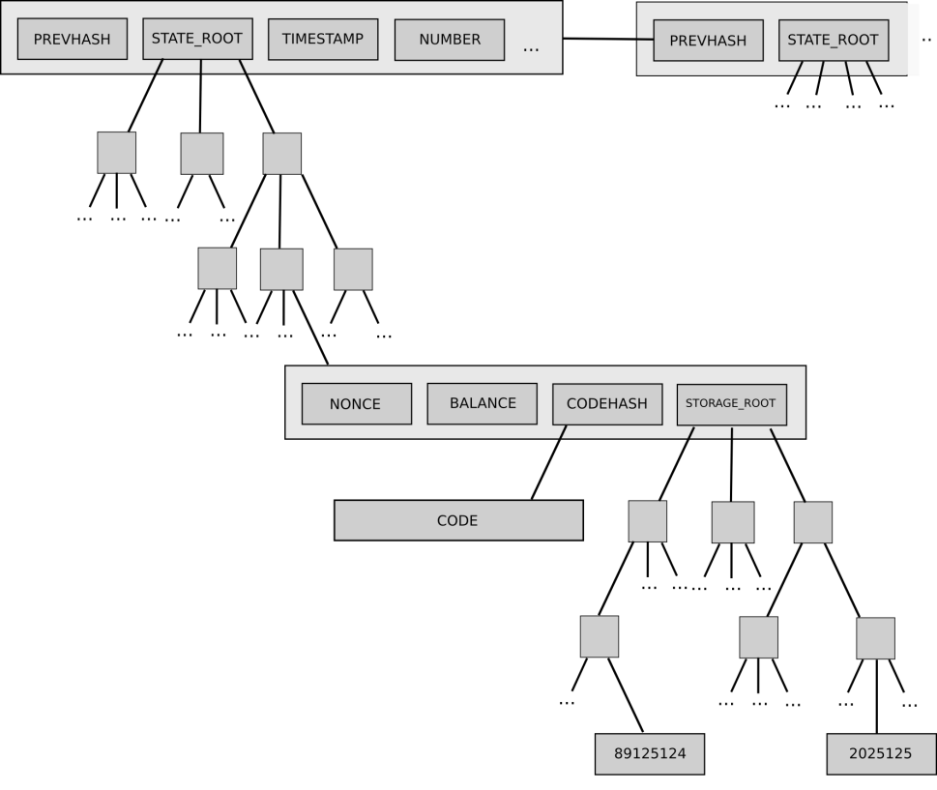
Account Object
•
Every account object contains 4 pieces of data:
–
–
–
Nonce Balance
Code hash (code = empty string for
normal accounts) Storage trie root
–

Slide 16
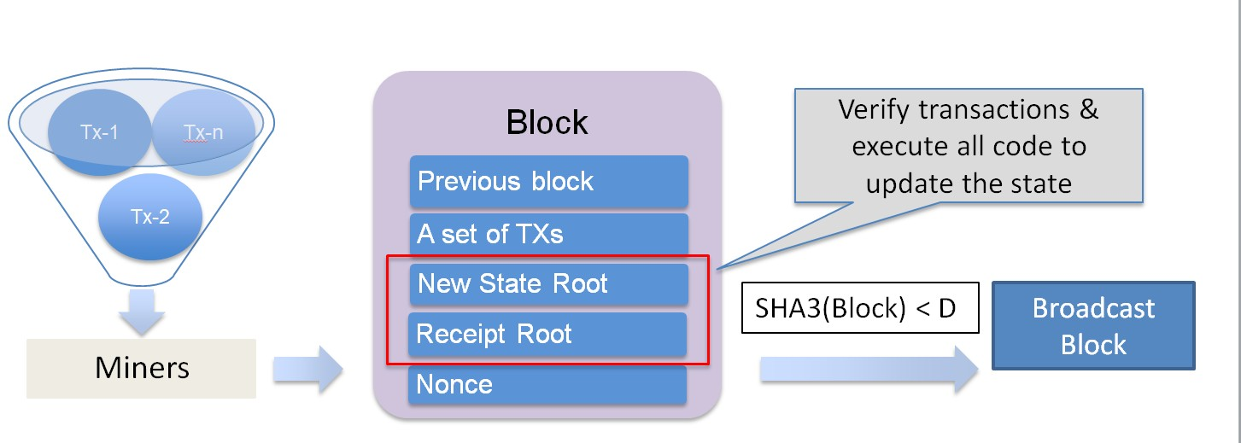
Block Mining

Slide 17
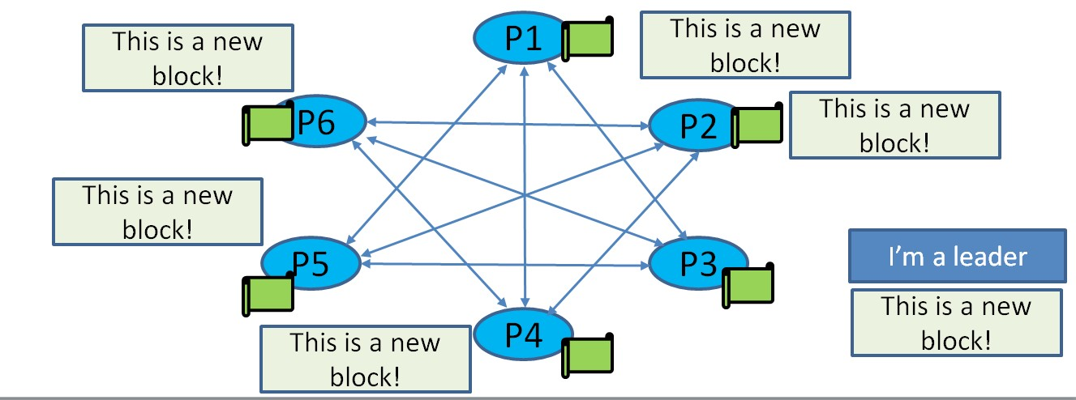
Code execution
•
Every (full) node on the blockchain processes every transaction and stores the entire state

Slide 18
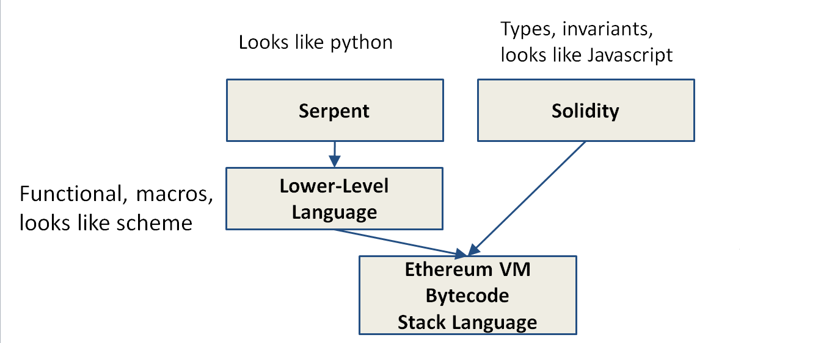
Ethereum Languages

Slide 19
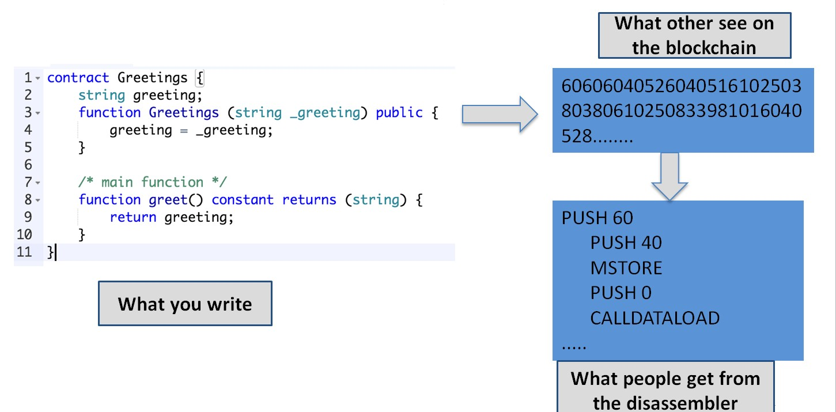
Example

Slide 20
DoS Attack Vector
•
Halting problem
–
–
Cannot tell whether or not a program will run infinitely A malicious miner can DoS attack full nodes by including lots of computation in their txs
Full nodes attacked when verifying the block
int i = 1;
while (i++ > 0) { donothing();
}

Slide 21
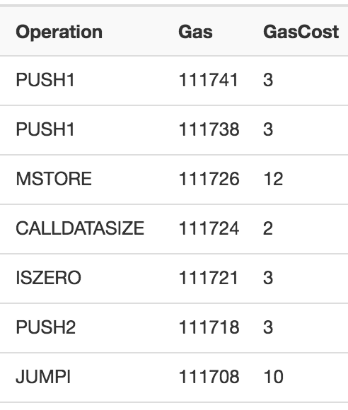
Solution???
•
GAS - Charge fee per computational step (“gas”)
– Special gas fees for operations that take up
storage

Slide 22
Sender has to pay for the gas
•
•
gasprice: amount of ether per unit gas
startgas: maximum gas consumable
– If startgas is less than needed
Out of gas exception, revert the state as if the TX has never happened
Sender still pays all the gas
•
•
•
TX fee = gasprice * consumedgas
Gas limit: similar to block size limit in Bitcoin
– Total gas spent by all transactions in a block < Gas Limit

Slide 23
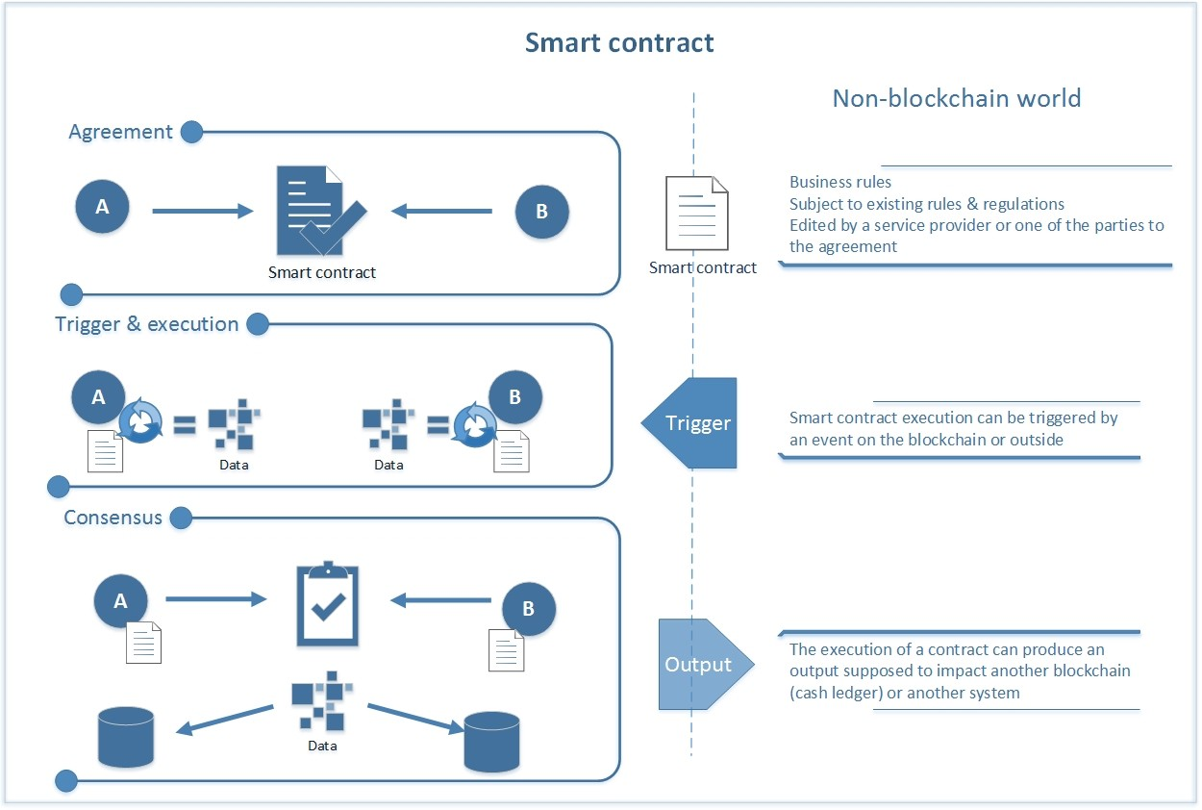
Smart Contracts

Slide 24
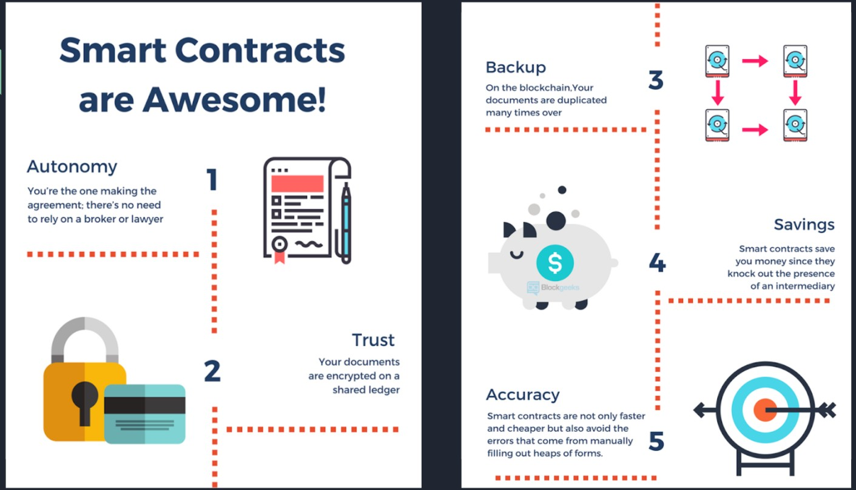
Why Smart Contracts?

Slide 25
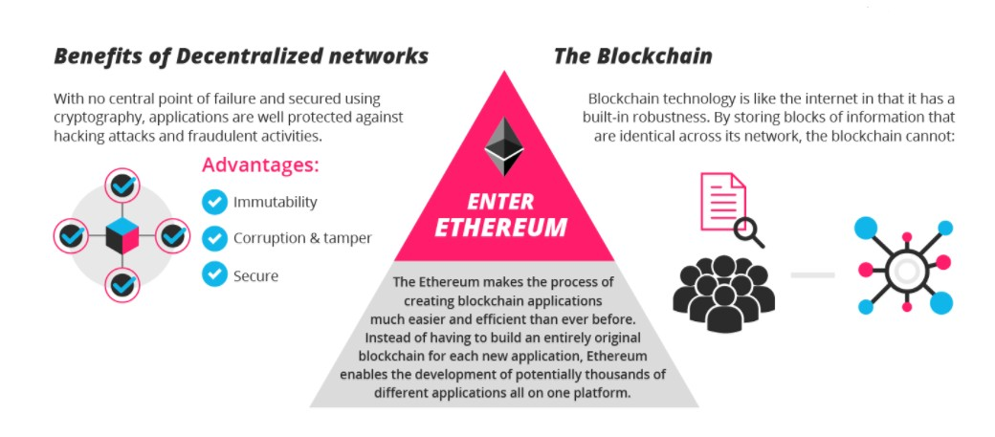
Decentralized applications

Slide 26
Ether- The fuel for Ethereum
•
Ether is the digital token used by Ethereum. It is also used to pay transaction fees and other computational services on the Ethereum Network.
Ether is also used as a cryptocurrency and is traded on various exchanges just like bitcoin.
It is the second most popular cryptocurrency in the world and has a market capitalization of 950 million USD.
The price of Ether token is also volatile just like other cryptocurrencies and it keeps fluctuating every minute.
•
•
•

Slide 27

Ether wallet
•
Ether wallet is a virtual wallet, basically a mobile or web application that lets you store your ether tokens.
An Ether Wallet also provides several other facilities like sending your ethers to another wallet address or receiving ethers from outside sources.
You can also keep a track of all your transactions. Many wallet providers have also released web browser extensions of their respective wallets and some are going to release a hardware version as well which will be a USB stick that you can plug into any computer.
•
•
•

Slide 28

Ethereum Virtual Machine
•
Ethereum Virtual Machine is a computer software which runs at an abstraction layer straight above the underlying hardware.
Ethereum uses a Turing Complete Virtual Machine for running and compiling the codes.
For this reason, Ethereum Virtual Machine is also called
•
•
Turing Complete Virtual Machine
•
The term “Turing Complete” flaunts that this software is
adroit enough to run any code defined by the developer or user.

Slide 29
Solidity,The Language Behind Ethereum
•
Solidity is one of the two main programming languages that are specifically designed to target the Ethereum Virtual Machine or EVM.
The other one is Serpent. All the Ethereum based applications and Smart Contracts are written in Solidity. Solidity was initially proposed in August 2014 by Dr. Gavin
Wood and it was later developed by the Ethereum project's Solidity team, lead by Dr. Christian Reitweissner.
•
•

Slide 30
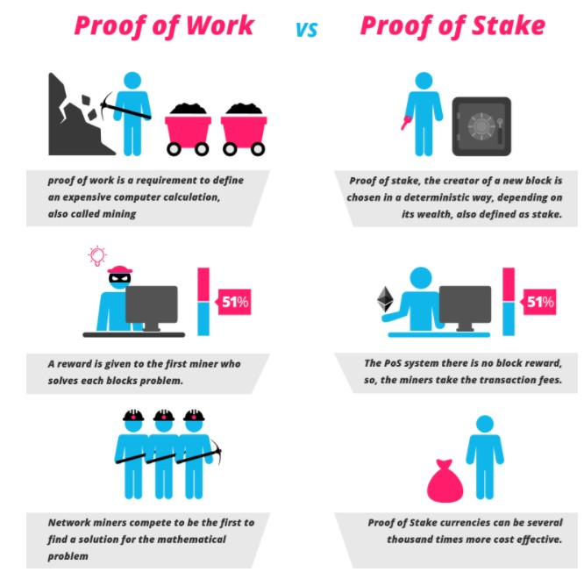
Proof of work vs Proof of Stake
•
Proof of work is a protocol that has the main goal of deterring cyber-attacks such as a distributed denial-of-service attack (DDoS) which has the purpose of exhausting the resources of a computer system by sending multiple fake requests.
It allows trustless and distributed consensus.
•

Slide 31
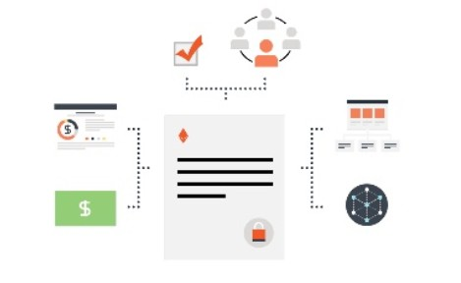
What ethereum can be used for?
•
•
Ethereum is VERSATILE. Contracts can be used to build
currencies, financial derivatives,
voting systems, decentralized organizations, data feeds, title registries and thousands of other applications.

Slide 32
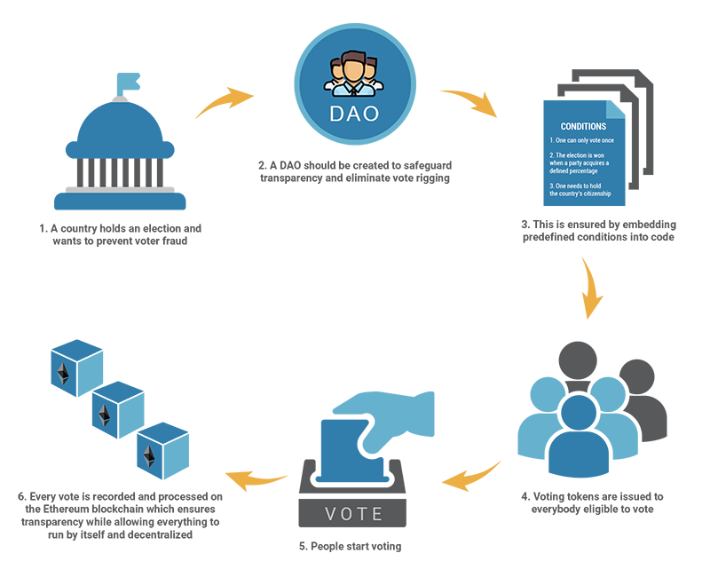
Decentralised Autonomous
Organisation

Slide 33
Advantages of Ethereum
•
•
•
Allowing for a turing complete language on the blockchain No need for 3rd parties services
Ethereum acts as a platform for other products and Services, allowing for a robust ecosystem to grow around the system.
Companies getting involved with improving Ethereum beyond the foundation.
•

Slide 34
Problems/challenges
Privacy
Ethereum blockchain guarantees correctness and availability, not privacy for smart contracts
Everything on the Ethereum blockchain is public
Cannot execute on private data (e.g. death will remains secret until the owner dies)
Transactions are traceable
•
•

Slide 35
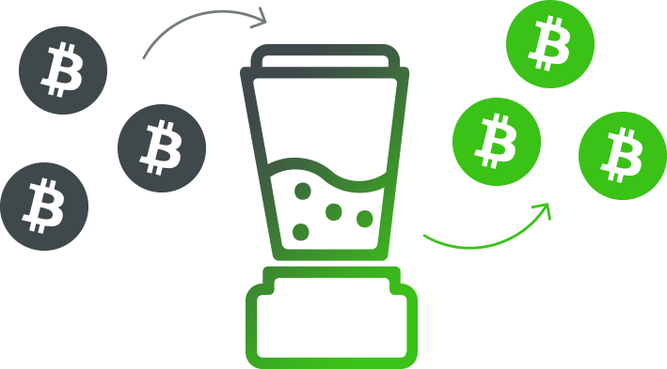
Privacy solution
•
•
•
Privacy-Preserving Smart Contracts
Execute confidential, fair, multiparty protocols
Zero cash over ethereum, Ring Signature on ethereum
Mixing coins with others

Slide 36
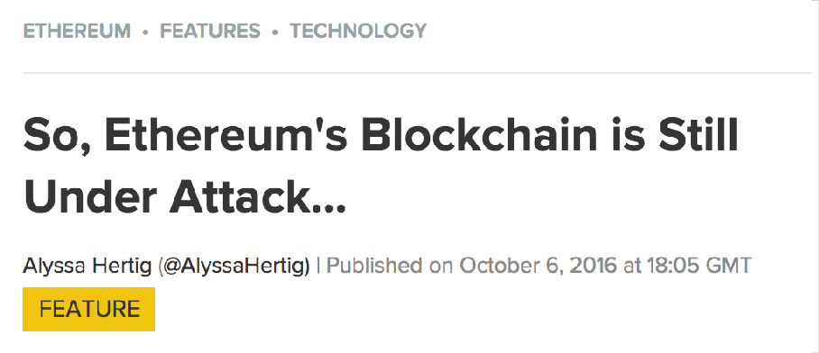

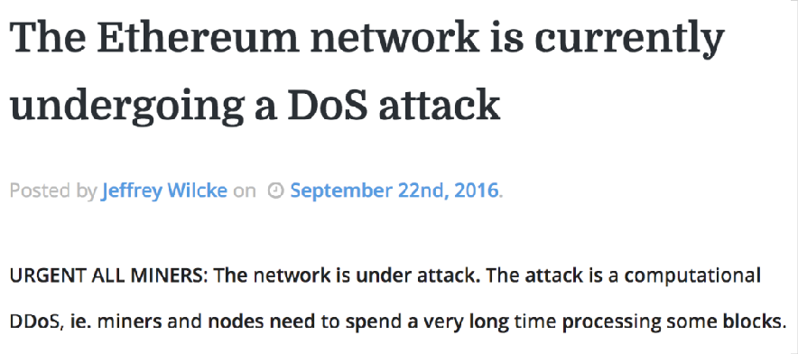



Scalability
Resources on blockchain are expensive
–
–
Full nodes perform the same on-chain computations Full nodes store the same data
•
Gas-limit is relatively small
–
–
Can’t run an OS on blockchain Can’t increase gas-limit: DoS vector

Slide 37
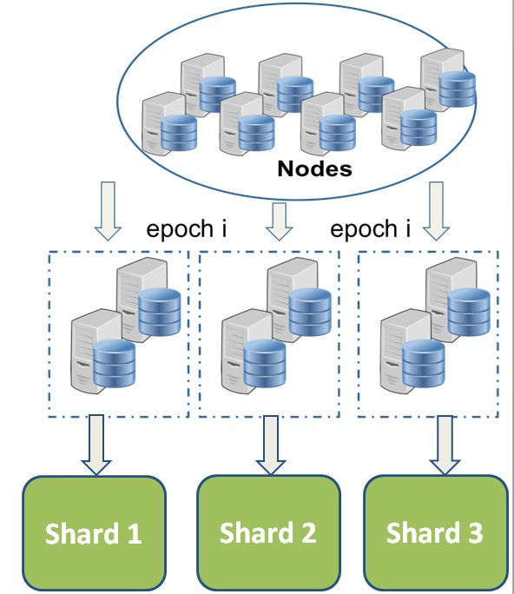
Scalability Solution 1: Sharding
Divide the network into sub-networks
each stores and manages a fraction of the block chain (a shard)
Allow scaling up as the network grows
There is a catch
May affect usability or performance
May not be compatible with all existing applications

Slide 38
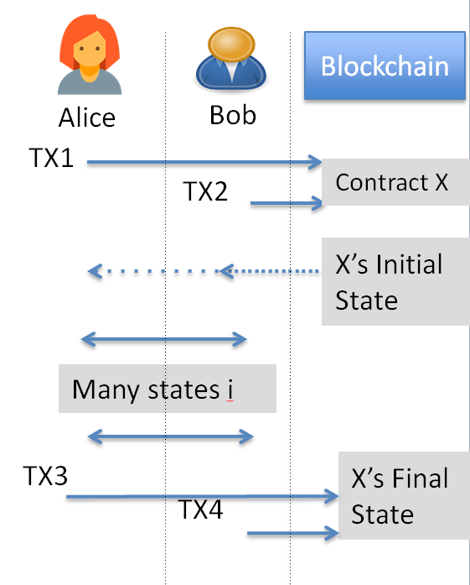
Scalability Solution 2: State
Channel
•
Similar to payment channel (e.g. lightning network) but for states
Scaling by using off-chain transactions
Can update the state multiple times
Only settlement transactions are on- chain
•
Challenges
Cannot create state channel for all applications
Still early research, more work needed

Slide 39

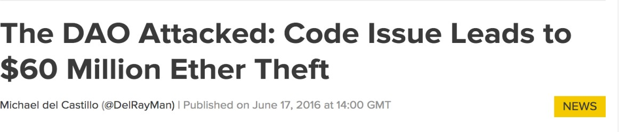
Security Flaws
•
Due to abstraction of semantic
–
–
Transaction ordering dependence Reentrancy Bug
Which exploited the DAO Obscure VM rules
•
Maximum stack depth is 1024: not many devs know
Inconsistent Exception Handling in EVM

Slide 40
Solutions to Resolve Security
Flaws
•
Create developer tools
–
–
–
Smart contract analyzer based on symbolic exec: Oyente Testing and deployment framework: Truffle
Formal verification for smart contracts: eth-isabelle , why3
•
•
•
Design better semantic [CCS’16] Educate users
Idea
– Create security certificates for smart contracts?

Slide 41

Conclusion
Ethereum is a fascinating research area at the intersection of multiple fields: cryptography and distributed systems, programming languages and formal verification, economics and game theory, human-computer interaction, finance and law.
The promise of smart contracts is not limited to making existing processes more efficient by putting parts of their logic onto a very inefficient, yet very secure decentralized network.
This new way of handling value without a trusted third party opens up whole new classes of previously impossible use cases.
•
•

Slide 42

