Slide 1
Smart Contracts
Slide 1

Slide 2
Outlines
•
•
•
•
What is a Smart Contract? Advantage of Smart Contracts Applications of Smart Contracts Other Use Cases and Characteristics
Slide 2

Slide 3
What is a Smart Contract?
A smart contract is a computer protocol intended to digitally facilitate, verify, or enforce the negotiation or performance of a contract.
▪
▪
What Nick Szabo proposed in 1994:
▪
A smart contract is a computerized transaction protocol that executes the terms of a contract.
▪
IBM:
▪
Smart contracts are lines of code that are stored on a blockchain and automatically execute when predetermined terms and conditions are met.
Chaincodes
▪
Slide 3

Slide 4
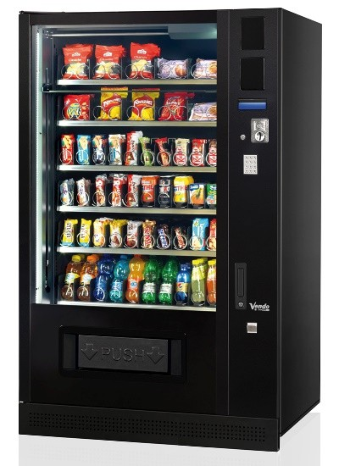


What is a Smart Contract?
▪
Characteristics of smart contracts
▪
Simply computer programs that acts as agreements where the terms of the agreement can be programmed with the ability to self-execute.
▪
A primitive ancestor of smart contracts
▪
Vending machine: Coins in and soda out.
▪
More sophisticated ones
Slide 4

Slide 5
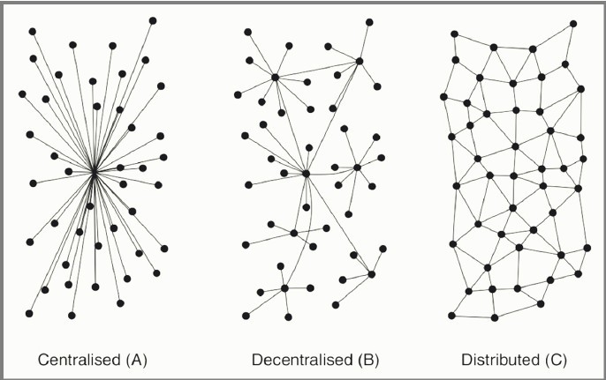
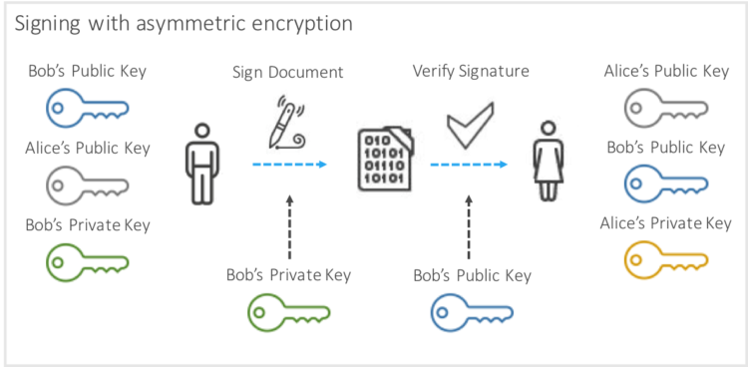
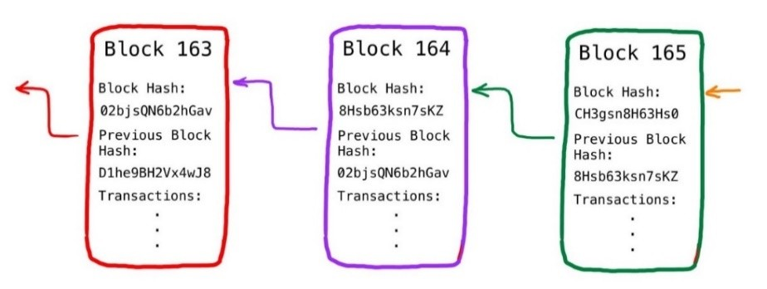
Significance of Smart Contracts on Blockchain
A distributed, append-only ledger of provably signed, sequentially linked, and cryptographically secured transactions that’s replicated across a network of computer nodes, with ongoing updates determined by a software-driven consensus.
Smart contract on blockchain:
Immutability (irreversible)
Security
Can be more transparent
Slide 5

Slide 6

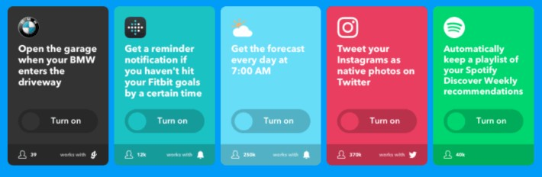
An Example of a Kind-of-Smart Contract
Slide 6

Slide 7
Advantages of Smart Contract
Characteristics of smart contracts on blockchain:
Immutability (irreversible)
Security (in the sense that the blockchain does not fail easily)
Transparency
•
Compared to traditional contracts:
•
•
High certainty of contract terms
Can be more transparent (subject to debate)
•
Additional benefits over other digital contracts:
•
•
Contracts can be immutable and irreversible Can be more transparent
Slide 7

Slide 8
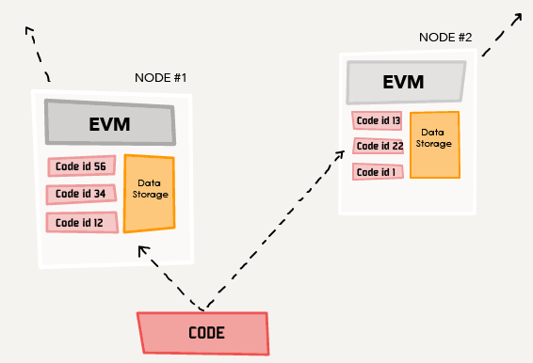
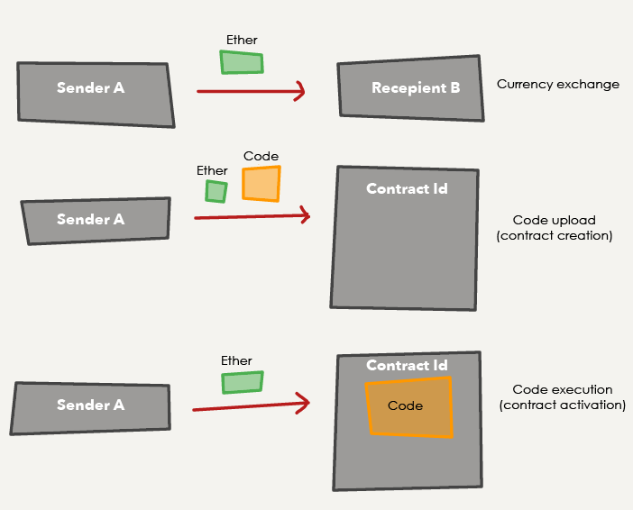
How Do Smart Contracts Work?
•
Ethereum
Send the application to the system, the code and associated data is replicated around the network.
Once stored, the Ethereum Blockchain assigns a unique address to reference the uploaded code.
Execute the code by calling the program at that address.
Ethereum has three types of transactions:
Transfer of Ether
Creating a smart contract
Transaction with a smart contract (activate a smart contract)

Slide 9
Outlines
•
•
•
•
What is a Smart Contract? Advantage of Smart Contracts Applications of Smart Contracts Other Use Cases and Characteristics

Slide 10
Use Case of Smart Contracts
Current use cases
Banking and financial service contracts
Money transfer; flight delay insurance; securities trading, clearing and settlement
Prediction markets Replacing escrow services
Token sales: Initial Coin Offering, Securities Token Offering
•
•
•

Slide 11
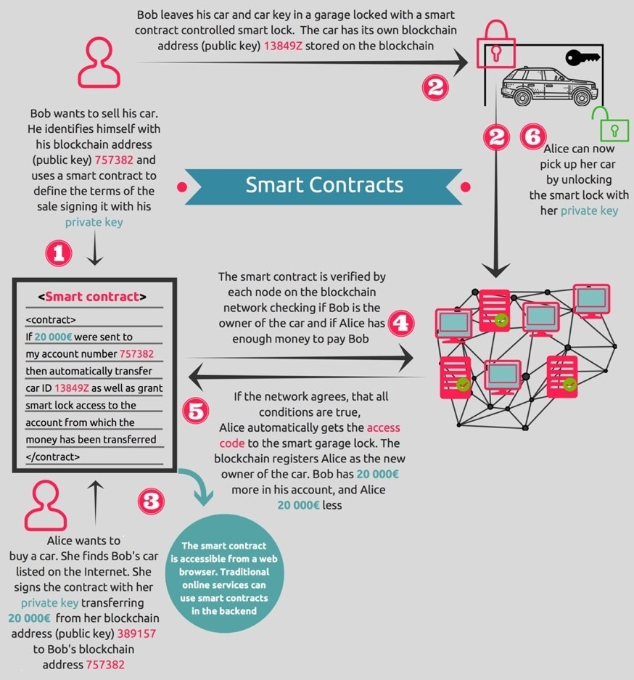
Use Case
“Future” use case
Transfer of assets registered on blockchain
Tangible assets (land, house, vehicles) Copyrighted contents
(music, etc)
•
•

