Slide 1
POLAR CODES
Your paragraph text
PRESENTED BY GROUP 1

Slide 2
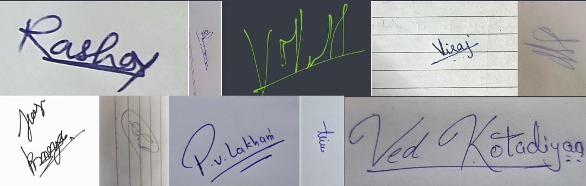
HONOUR CODE
We declare that the work presented is our own work.
We have not copied the work someone else has done.
Concepts, understanding and insights are our own
Wherever we have relied on existing work which is not our own,we have provided proper reference citation.
We know that violation of this pledge can carry grave conseqeunce
Group Members
VED KOTADIYA → 202301001
BHUMSAR BORO → 202301002
KARTIK VYAS → 202301003
ARYAN PATEL → 202301005
JAY RATHOD → 202301006
TIRTH KHENI → 202301007
VIRAJ MEHTA → 202301008
PRATHAM LAKHANI → 2020301009
VARSHIL PATEL → 202301010
RASHA PARMAR → 202301012
SMIT PARMAR → 202301013

Slide 3
Introduction
Polar Codes were discovered by Erdal Arikan in 2008
They are the first error correcting code with explicit construction that achieve Shannon Channel Capacity meaning that they have maximal rate of reliable communication over a memoryless channel.
Polar Codes are built upon innovative concept of Channel Polarization and they also feature low complexity decoding and are also used in modern systems like 5G communication.

Slide 4
YoChannel Polarizationtext
Channel Polarization is a process of splitting a channel into good and bad channels repeatedly and after recursively doing this process we obtain channels which are either extremely good or extremely bad .
Then we choose the most reliable channels to transmit our message.

Slide 5

Martingales
Martingale is a special kind of random process
where the expected future value equals the current value.
It basically shows how something evolves over time.
Formally a sequence {Xt} is called martingale if

Slide 6



Martingales and Polar Code
Here is a random variable taking values +1 and -1 uniformly.
is a probability like value which represents how good the channel is.

Slide 7
Martingales and Polar Code
If e takes value +1 then by solving the equation we see that the value of w increases and when it takes value -1 then by solving the equation we see that it reduces.
But on average you stay where you were before.
That’s what a Martingale is and it helps in showing Polarization in a way that as ‘t’ tends to infinity the path stabilizes that is the value of ‘w’ at inifinity stabilizes at either ‘0’ or ‘1’.
t
t+1

Slide 8
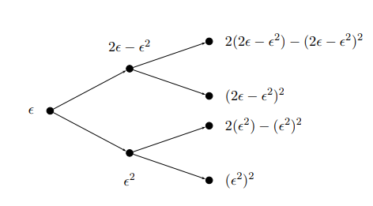
Martingales and Polar Code
That is what the essence of channel polarization is, that we split a channel in such a way that we get good and bad channels out of it.
Below is a figure representing Channel Polarization in case of Martingales
image source
EE376A Information Theory Lecture 9: Polar Codes Stanford University

Slide 9
Bhattacharya Parameter
Bhattacharya Parameter method is a method proposed by Arikan for measuring the channel reliability of BEC Channel.
It measures how noisy the channel is and then arranges in the order of reliability.

Slide 10

How does Bhattacharya Parameter measure noise?
Here W(y/x) is known as channel transition probability. It means the probability that channel outputs y given that the input was x.
image source-->https://ieeexplore.ieee.org/document/9271700

Slide 11
How does Bhattacharya Parameter measure noise?
Now what happens that we are doing the summation of the transition probabilities (W(y/0)*W(y/1)) so if this product is large than both 0 and 1 can produce this output with a large probability so the channel confusability which means the noise is more in the channel.
So we can generalize it and tell that when Z(W) tends to 1 it means more noise and when it tends to 0 it means less noise.
And we know more noise reduces the reliability of channel hence the channel having more noise is less reliable and vice versa.
And so we can order the channels in the order of their reliability and select K most reliable channel from those.

Slide 12
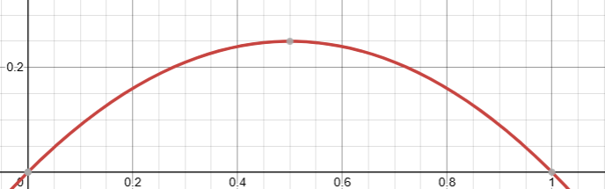
How does Bhattacharya Parameter measure noise?
Image source-->desmos

Slide 13

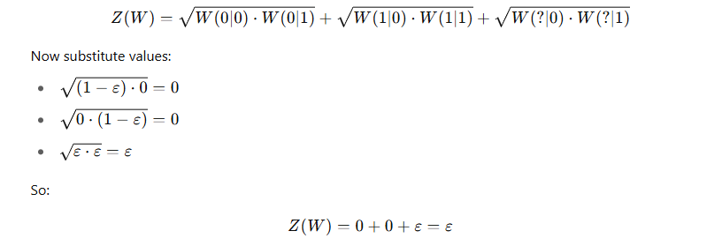
Calculation of Bhattacharya Parameter under certain Erasure Proabability
The forumula to calulate Bhattacharya Parameter is
And Z(W) is the erasure(e) for Bhattacharya Parameter.

Slide 14
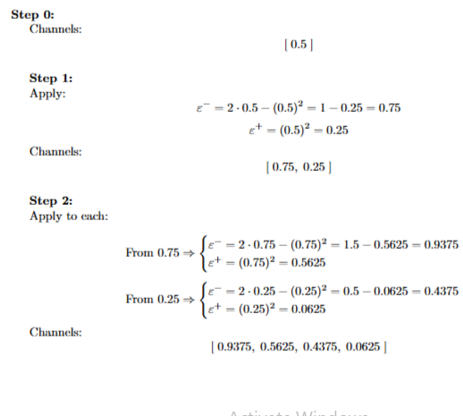
Calculation of Bhattacharya Parameter under certain Erasure Proabability

Slide 15
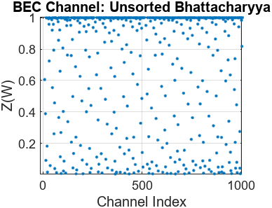
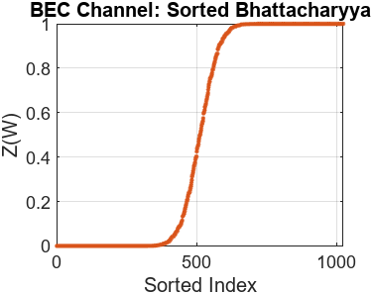
Bhattacharya parameters for BEC
Code length is 1024

Slide 16
Reliability Sequence
Reliability seqeunce is the channels placed in their order of their reliability of transmitting information from lowest to highest.
It can be found out by the channel polarization method discussed before.
Lets take for example (16,8) polar code which means there are 8 message bits and total number of bits are 16.
For N=16 the standard reliability sequence is [1 2 3 5 9 4 6 10 7 11 13 8 12 14 15 16]
And we have to trasmit 8 message bits so what we will do is we will take 8 most reliable channels that are [7 11 13 8 12 14 15 16]

Slide 17
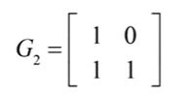

Encoding
To get encoded message we multiply the message bits with generator matrix.
The following is the generator matrix and the encoded message
image source-->NPTEL video lecture

Slide 18
Encoding
To get encoded message we multiply the message bits with generator matrix.
The following is the generator matrix and the encoded message
image source-->NPTEL video lecture

Slide 19
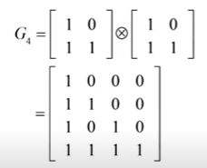
Encoding
Similarly to get more bits encoded we take Kronecker product of G2.
image source-->NPTEL video lecture

Slide 20

Encoded sequence example for (8,4) Polar Code
We have N=8 and K=4 so we want to transfer 4 message bits and the reliability seqeuence is [1,2,3,5,4,6,7,8].
And let’s say we have message bits as u=[m1,m2,m3,m4].
Then first N-K bits will be frozen and the message will be
[0 0 0 m1 0 m2 m3 m4]
And then as we have 8 message bits we multiply message with G8 generator matrix and then we get encoded message.

Slide 21
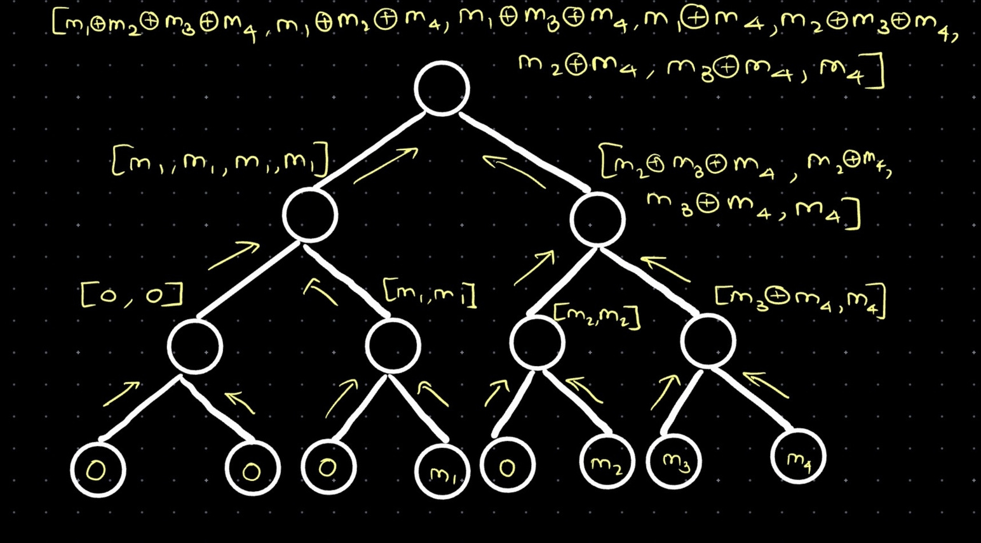
Encoded sequence example for (8,4) Polar Code

Slide 22
Decoding in Polar Codes
Polar codes can be decoded using different strategies based on complexity and performance needs.
The two most widely used techniques are:
Successive Cancellation (SC) Decoding
Successive Cancellation List (SCL) Decoding
These methods differ in how they handle uncertainty and decision-making during the decoding process.

Slide 23
Role of Frozen and Information Bits
In polar codes, channel polarization creates some good (reliable) and some bad (unreliable) bit channels.
Frozen bits are fixed (usually set to 0) and placed in bad channels — these are known to both encoder and decoder.
Information bits are placed in the good channels — these are the bits we aim to recover.
During decoding, SC skips processing frozen bits and focuses only on decoding the information bits using channel observations and already-decoded bits.

Slide 24
Introduction to SC Decoder
What is Successive Cancellation Decoder?
A sequential decoder used in polar codes.
It decodes bits one-by-one, in a fixed order.
Each decoded bit assists the next — e.g., u₁ helps decode u₂, u₁ and u₂ help decode u₃, and so on.
The process continues through the full codeword.

Slide 25
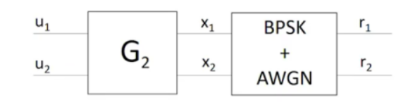
Transmission Process
During the transmission process, the encoder encodes the message by multiplying the message bits (u1,u2) with the generator matrix G2​, resulting in the codeword X=[x1 x2].

Slide 26
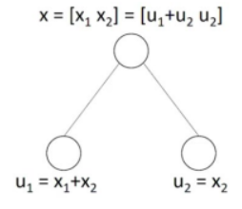
Decoding Process
Since, G2 being an invertible matrix, we can conclude that
U1 = X1 + X2
U2 = X2
Knowing that r1 and r2 are beliefs for x1 and x2, a function known as minsum f(r1,r2) is used to get the soft belief for u1.
f(𝑟1, 𝑟2) = 𝑠𝑔𝑛 (𝑟1)∗ 𝑠𝑔𝑛 (𝑟2) ∗ 𝑚𝑖𝑛( |𝑟1| , |𝑟2|)
If f(r1,r2) >= 0 then =0 and if f(r1,r2) < 0 then = 1.

Slide 27
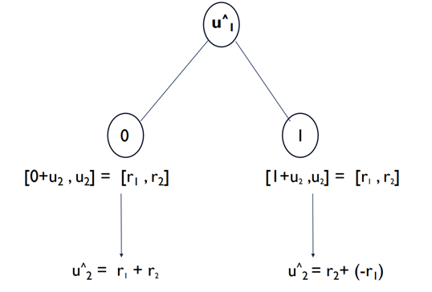
Decoding Process
Once the estimated value of u1​ is decoded, it is assumed to be correct and is then used further in decoding value of u2.
We define a function g(r1,r2,u1) to calculate beliefs for u2 :
g(r1,r2,u1) = r2 + (1-2u1)r1
i.e. If u₁ = 0 then u₂ will be r₁ + r₂ and if u₁ = 1 then u₂ = r₂ - r₁.

Slide 28
Decoding Process
Decoding is performed by traversing a binary tree structure using the following three steps:
Step 0: Start at the root node.
Step 1:Begin by moving to the left child of the current node recursively, until a leaf node is reached. At the leaf, we use the minsum function to decode the bit, which passed back up to the parent node.
Step 2:Once a node receives a belief from its left child, it proceeds to its right child. Here, we use the g function i.e. g (r1,r2,u1), which combines the left child's belief with the decoded value of the left bit, to compute the belief for the right child.
Step 3: After receiving a belief from the right child, the node now has the beliefs for both its left and right children. These are then passed upward to its parent node as [u1+u2 u2] and this process continues until the entire message is decoded.

Slide 29
Introduction to SCL Decoder
What is SCL (Successive Cancellation List) Decoding?
Improved version of SC decoding
Instead of one path, it keeps a list of possible decoding paths
Each time a bit is decoded, it splits into two possibilities:
→ one assuming bit = 0, the other assuming bit = 1

Slide 30
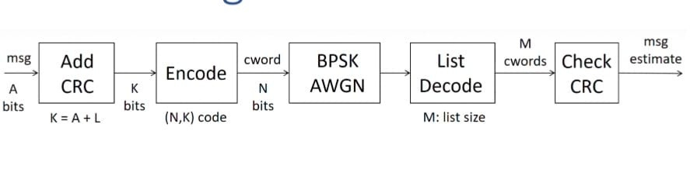
List Decoding
Above figure shows complete block diagram of complete transmission through the encoder to list decoding.
• In List decoding we use concept of path metric and decision metric for making efficient decoded message sequence (i.e. having list error among all).
• Decision metric (DM) is calculated at each leaf node when we make decision for that let us define function L which is named Belief function.

Slide 31
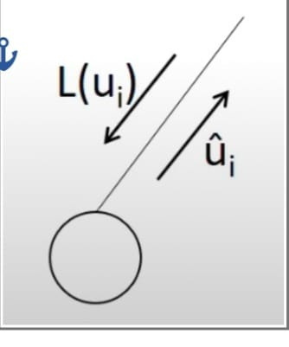
Introduction to SCL Decoder
·So, if L(ui) >= 0: ûi = 0 has DMi=0, ûi=1 has DMi=|L(ui)|,
if L(ui) < 0: ûi = 1 has DMi=0, ûi=0 has DMi=|L(ui)|.
·Also, DM will be assigned even if ‘i’ is frozen, there will be only one decision and that is ûi=0.
·Path metric (PM) is calculated using sum of decision metrics on a path of choices, here path refers to candidate codeword.
·Path metric also can be called as belief of the path.

Slide 32
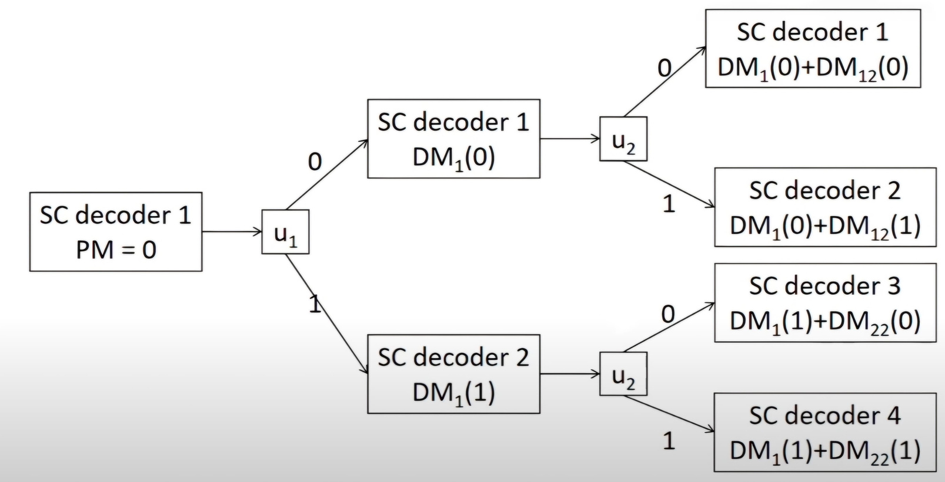
How SCL Decoding Works
·We will continue this process until the depth of tree becomes log(N).
·But the size of this decoder is 4 so after u2, for u3 we will sort all present SC decoders (8 in this case) with respect to PM values of each decoder, and select least 4 decoders from sorted sequence.
·After that we will continue with 4 surviving decoders.
·Decoded codewords are 4 surviving paths at the end.

Slide 33
SC vs SCL Decoder – Summary Table
Feature | SC Decoder | SCL Decoder
Speed | Fast | Slower (due to multiple paths)
Accuracy | Good | Better (especially with CRC)
Complexity | Low | Higher (depends on list size L)
Used in | Basic polar coding | 5G NR, modern systems

Slide 34
Frozen Bits and CRC in SCL
Frozen bits are still used like in SC
To improve accuracy, CRC (Cyclic Redundancy Check) is used:
Helps pick the correct path among the surviving ones
Reduces the chance of selecting a wrong path with high score

Slide 35
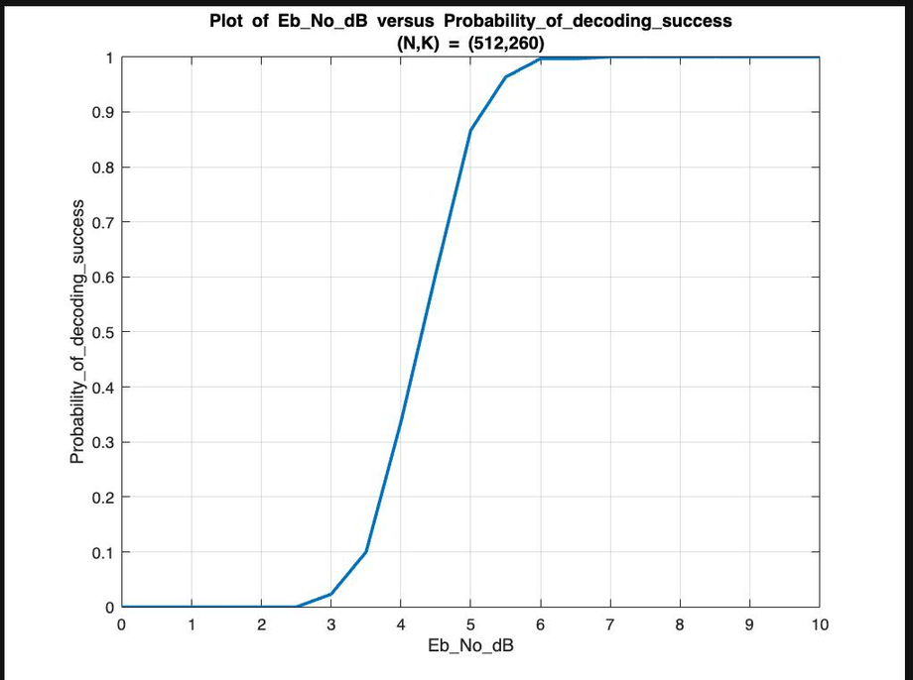
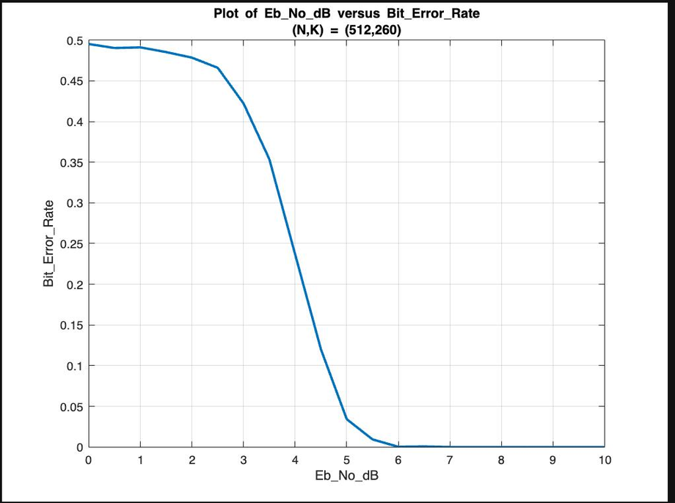
Implementation and Results
of Successive Cancellation

Slide 36
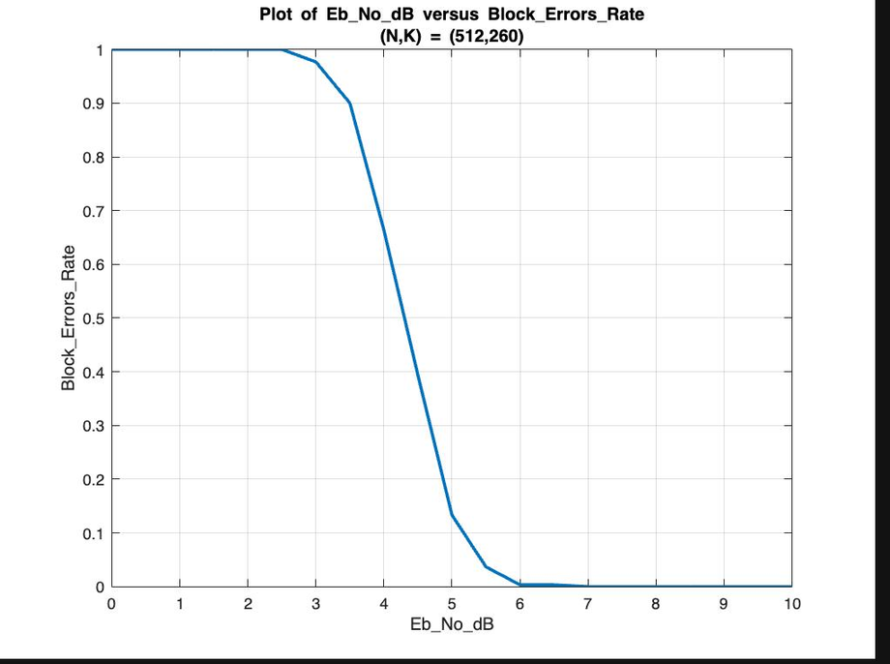
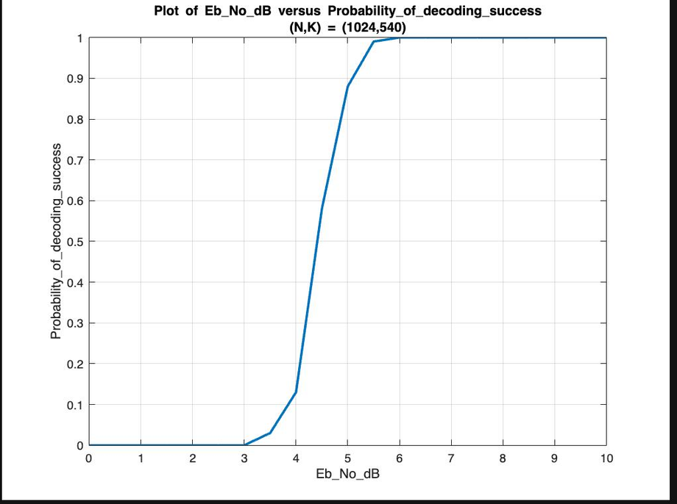
Implementation and Results
of Successive Cancellation

Slide 37
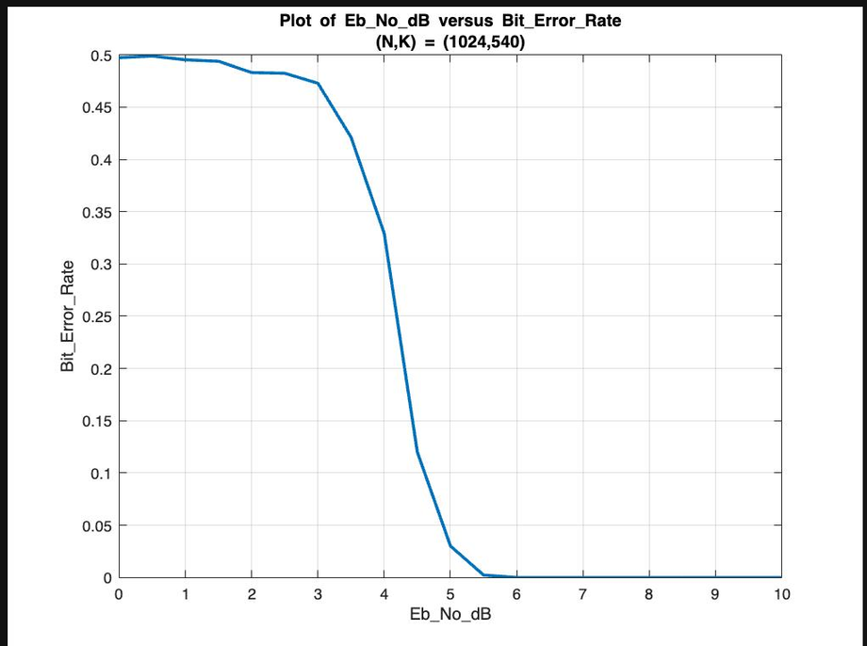
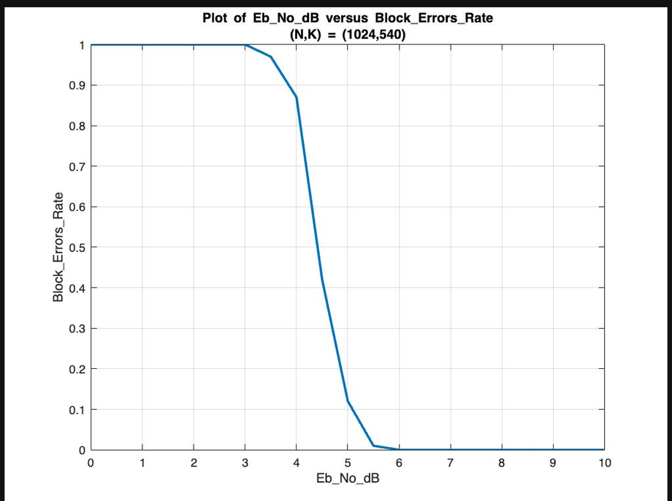
Implementation and Results
of Successive Cancellation

Slide 38
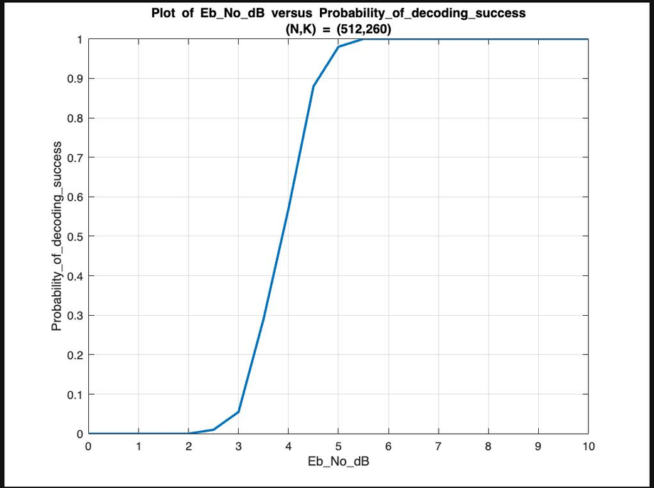
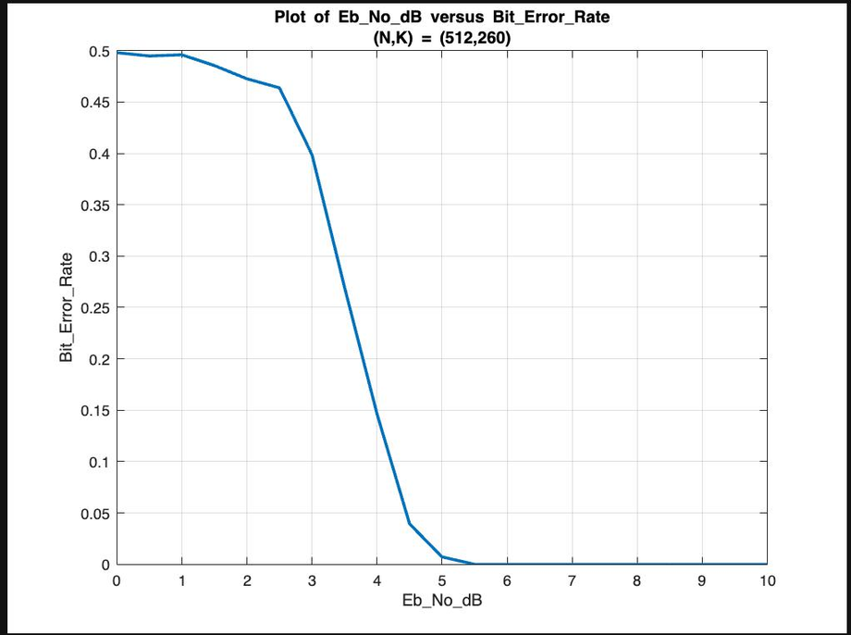
Implementation and Results
of Successive Cancellation List

Slide 39
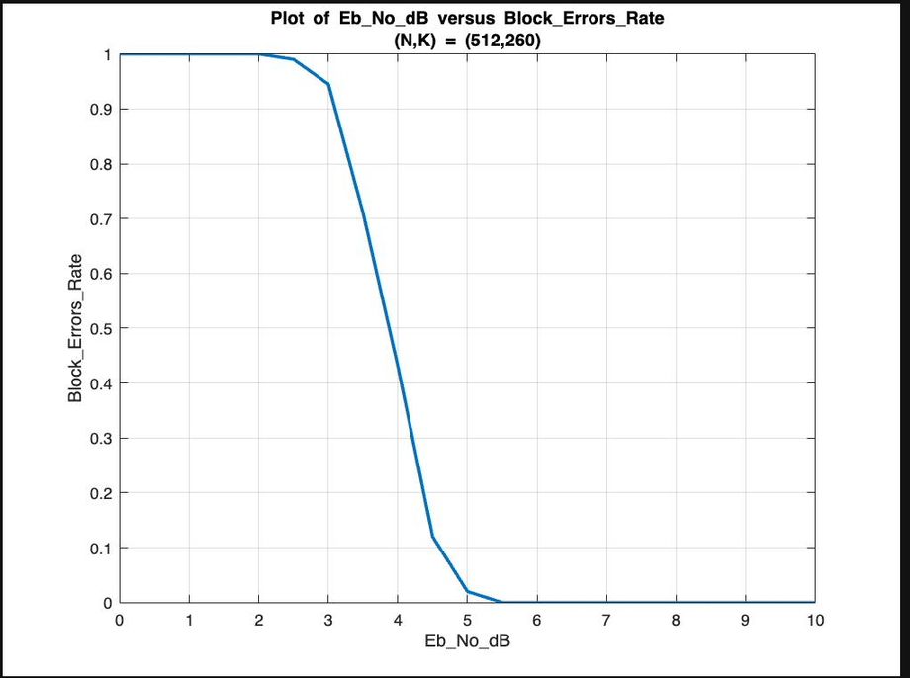
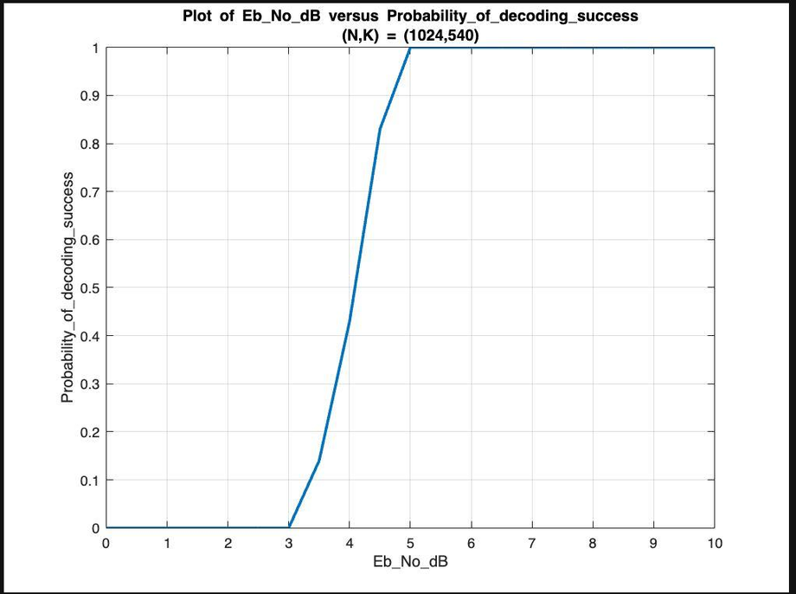
Implementation and Results
of Successive Cancellation List

Slide 40
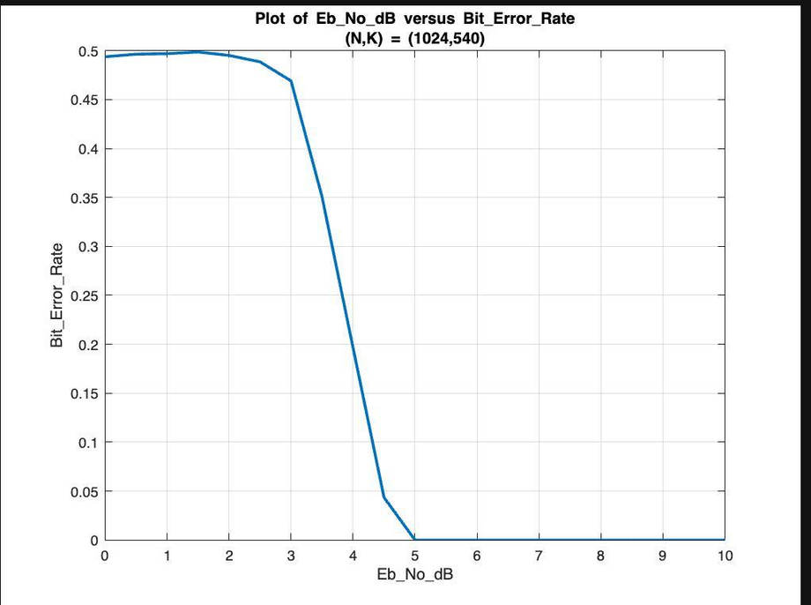
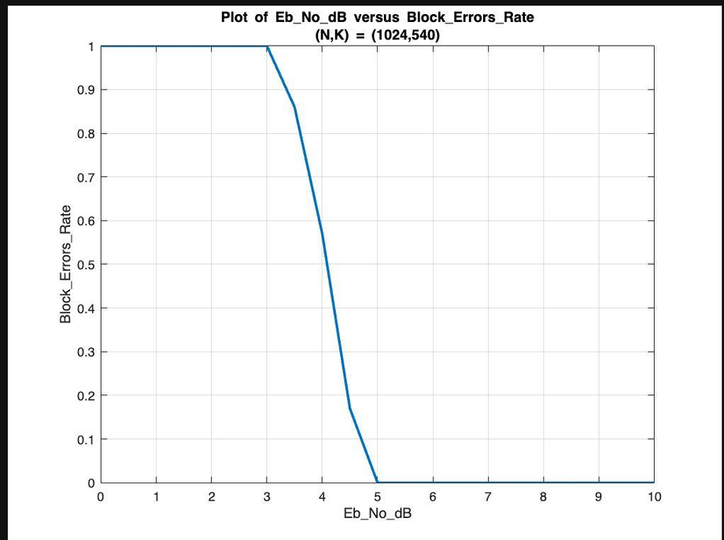
Implementation and Results
of Successive Cancellation List

Slide 41
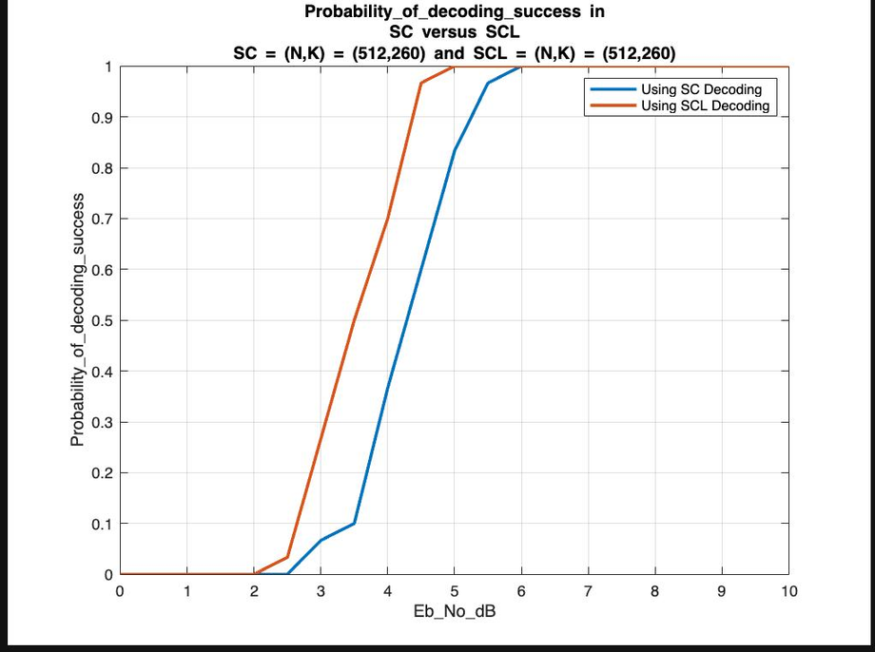
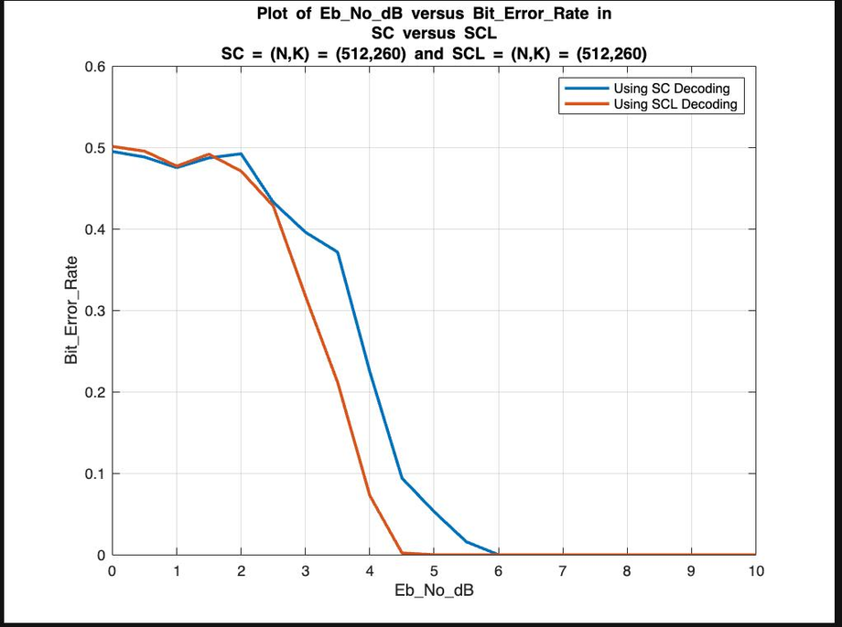
Implementation and Results
Comparison of SC v/s SCL

Slide 42
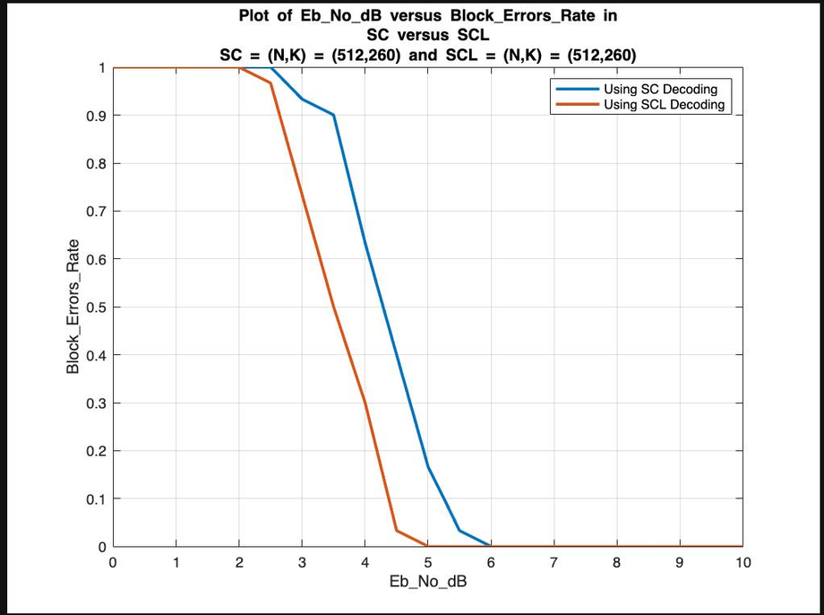
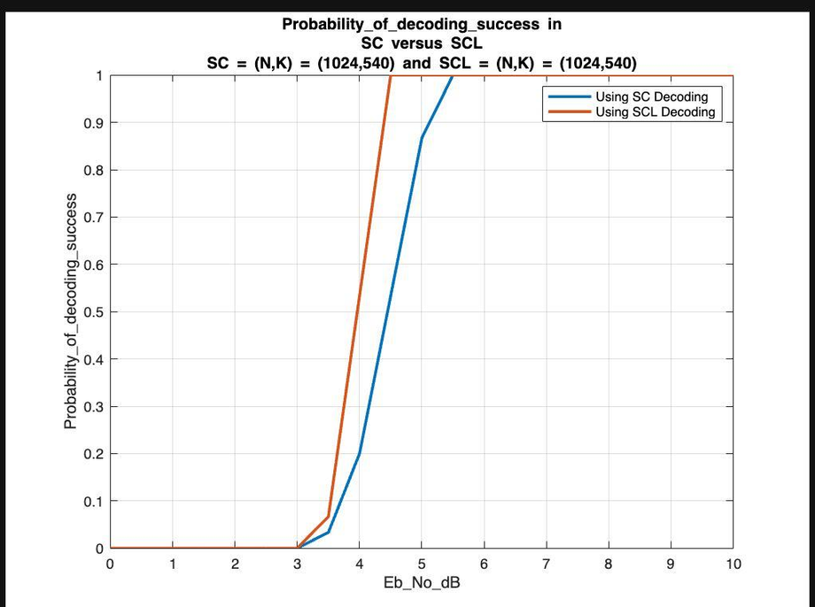
Implementation and Results
Comparison of SC v/s SCL

Slide 43
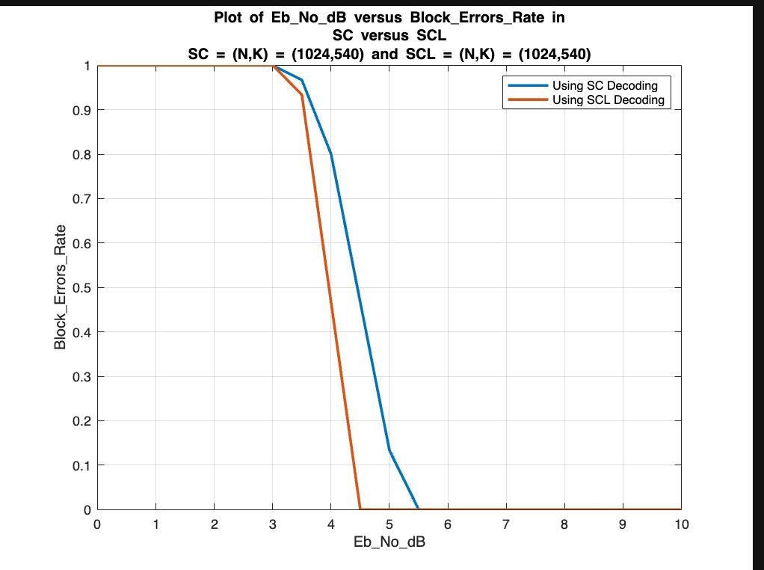
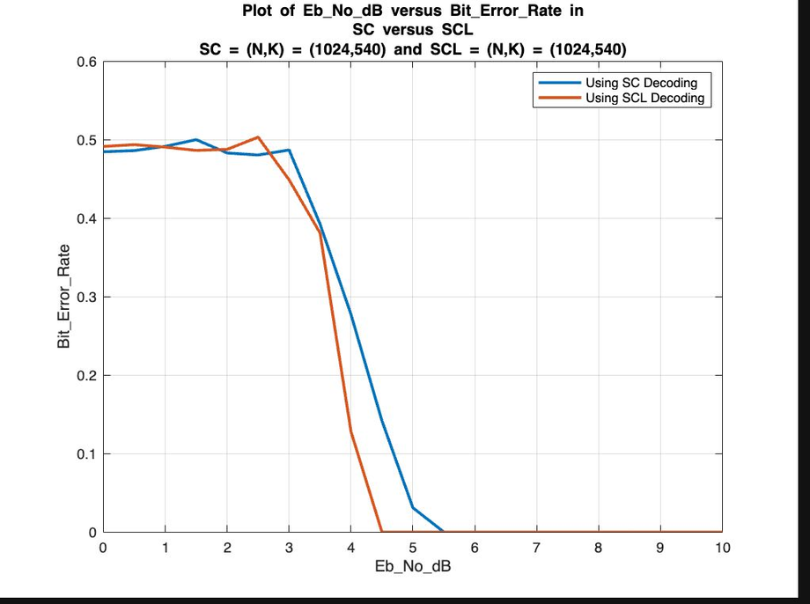
Implementation and Results
Comparison of SC v/s SCL

Slide 44
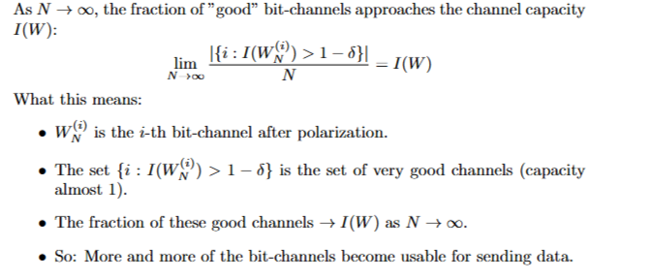
Do Polar Codes achieve Shannon’s Channel Capacity for large values of N ??

Slide 45
Summary of the Project
1.Channel Polarisation
Channel polarization is the foundational principle behind Polar Codes, transforming N identical channels into a set of synthetic bit-channels that exhibit extreme reliability differences:
Reliable channels: Near perfect(capacity-approaching) for information bits.
Unreliable channels:Useless(frozen).
Works as:
A)Recursive Splitting & Combining:
Uses Arikan’s G kernel to recursively combine channels creating a binary tree of dependencies.
Splits into two types of channels: one improved, one degraded.
B)Polarization Effect:
As N goes infinity, a fraction of channel capacity becomes perfect, while the rest become useless.
C)Reliability estimation:
Bhattacharya parameters(for BEC).
High-reliability channels carry data; low-reliability ones are frozen.
Applications: 5G control channel, Ultra reliable low-latency communication(URLLC).

Slide 46
Summary of the Project
2.Polar encoder
The polar encoder transforms input bits into a codeword by exploiting channel polarization. It uses a recursive Kronecker-based structure to generate a transform matrix Gn.
Frozen & Information Bits: Only the most reliable bit-channels( selected via Bhattacharyya parameters or monte carlo density evolution) carry information bits, while the rest are frozen.
Encoding: The codeword is computed as x = u.Gn(non-systematic) or via systematic methods for better performance.
Efficiency: The structure enables fast encoding[O(nlog(n))] using easier operations.
Polar codes achieve channel capacity by concentrating data on near-perfect bit. channels, making them ideal for 5G and beyond.

Slide 47
Summary of the Project
3.Polar Decoders:
Polar codes rely on two key decoding strategies to recover transmitted data efficiently:
A.Successive Cancellation(SC) Decoding:
Recursively estimates bits one-by-one, using prior decisions in a tree-like structure.
Complexity is low [O(nlog(n))], but has error propogation.
There is one drawback that is for short-to-moderate block lengths due to sequential decision.
B. Successive Cancellation List(SCL) Decoding:
Maintains multiple candidate paths(L most likely) to reduce error risk.
Near ML decoding when L is greater than or equal to 8.
It also uses a CRC checksum to select the correct path, significantly improving accuracy(used in 5G control channels).
Applications:Storage systems(NAND Flash, DNA Storage).

Slide 48
THANK
YOU

