Slide 1
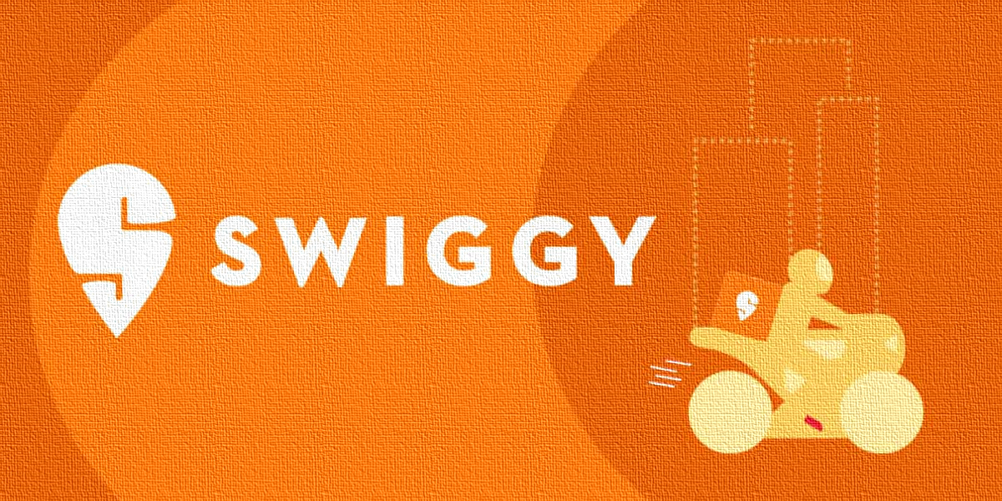
Swiggy Sales Performance Analysis (Jan–Aug 2025)
Identifying Growth Opportunities Through Data Analytics

Slide 2
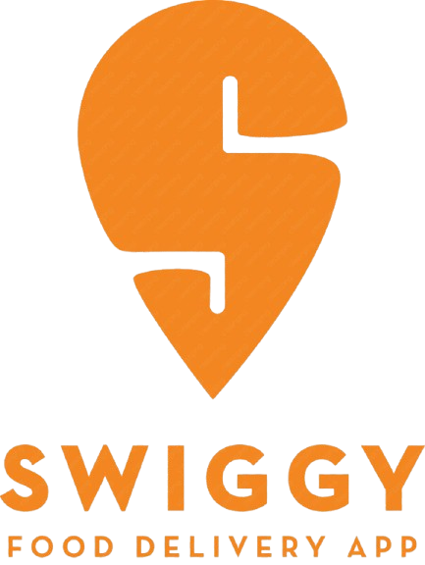





How Did Swiggy Perform Overall ?
Swiggy processed approximately 197K orders and generated ₹53 Million in revenue during the eight-month analysis period .
An average customer rating of 4.34 suggests a generally positive customer experience, while the average dish price was approximately ₹268

Slide 3
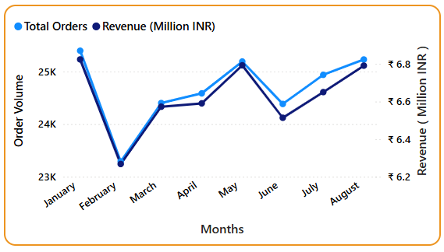
Order Volume Peaks in January , May and August
Orders peaked in January, May and August.
Revenue closely followed order trends.
February, March and June recorded relatively lower activity and were investigated further .

Slide 4
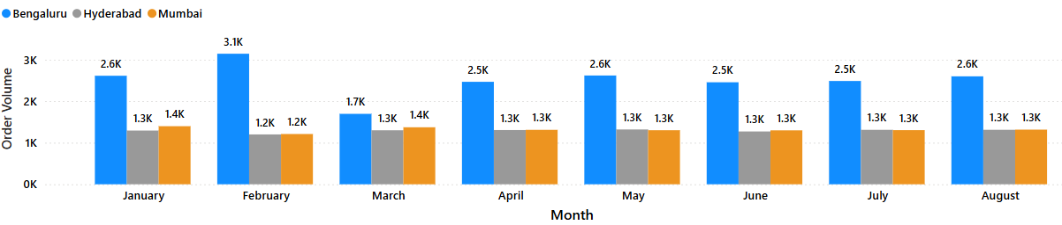
Why Did Order Volume Decline in February, March and June?
• The decline in order volume was relatively small rather than a significant business downturn.
• February's lower orders are largely explained by having fewer calendar days.
• March's decline was primarily associated with reduced order volume from Bengaluru.
• June experienced weaker weekend demand during Weeks 25–26.

Slide 5
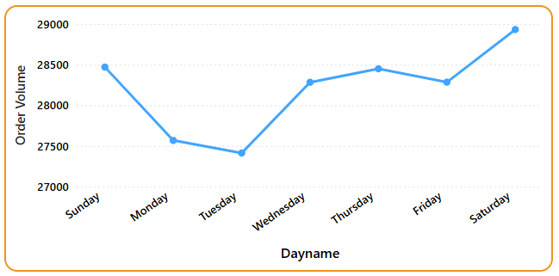
Customer Demand Peaks Between Thursday and Sunday
Customer demand increases steadily from Thursday and reaches its highest levels on Saturday and Sunday, indicating a clear weekend ordering pattern.
This creates opportunities for targeted weekend marketing and promotional campaigns.

Slide 6
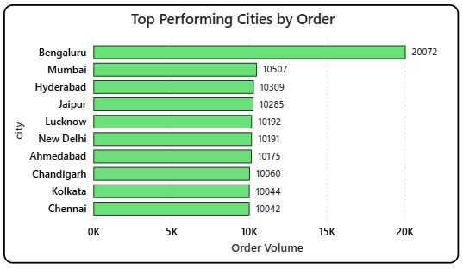
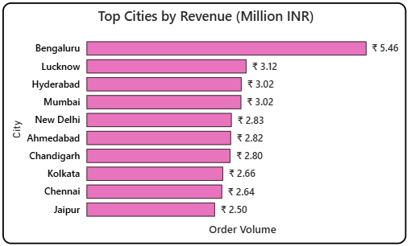
v
Bengaluru Leads Order Volume While Lucknow Outperforms on Revenue
Bengaluru, Mumbai and Hyderabad generate the highest order volumes.
While Bengaluru also leads in revenue, Lucknow ranks 2nd in revenue despite having only the 5th highest order volume.
Jaipur ranks 4th in order volume but falls to 10th in revenue, indicating lower revenue generated per order. We have investigated these cases further .

Slide 7
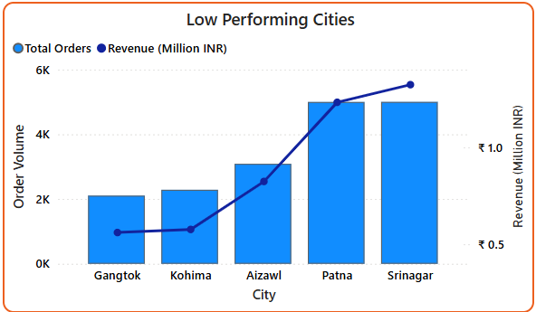
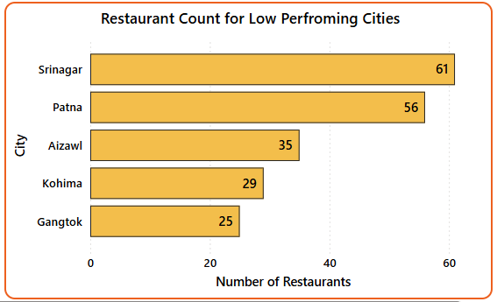

v
Expansion Opportunity in Gangtok , Kohima, Aizawl
Cities with low order volume and low revenue - Gangtok , Kohima, Aizawl .
All three cities have a relatively small restaurant network (25–35 restaurants) and limited delivery coverage (7–11 locations), which is likely associated with lower order volumes and revenue.
Expanding restaurant partnerships and delivery coverage could improve market penetration in these cities.

Slide 8
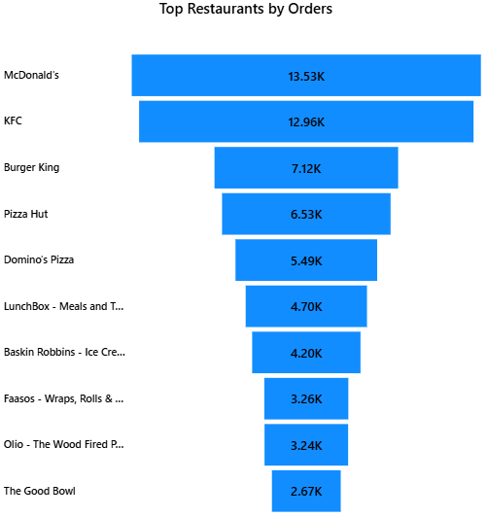
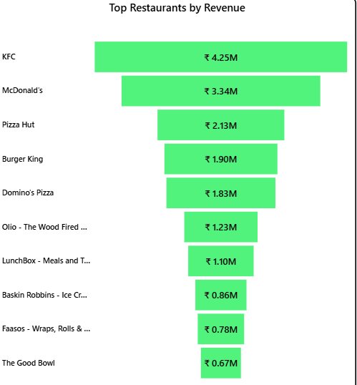
v
What drives successful restaurant chains?
Top-performing restaurant chains appear to benefit from strong demand across multiple high-performing categories such as Burgers, Desserts, and Beverages, Pizza which is likely associated with their higher overall order volume and revenue.

Slide 9
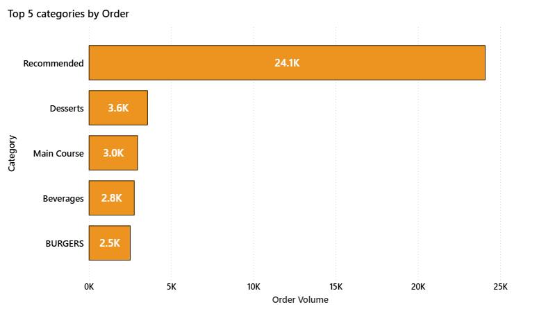
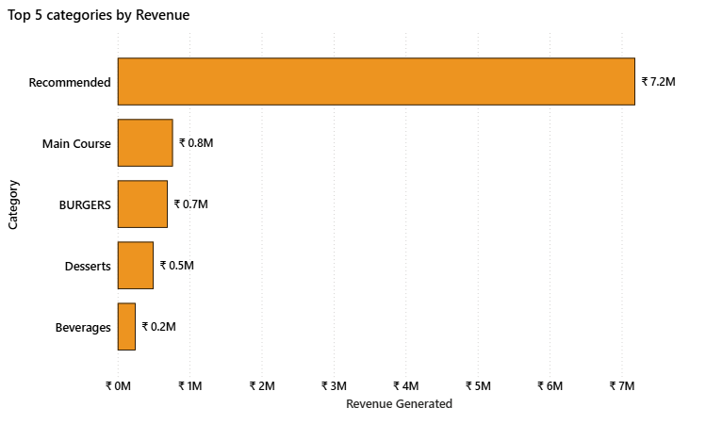
v
Recommended, Main Course, Burgers, Deserts , Beverages are top categories
Recommended, Main course , Burgers, Deserts, Beverages are giving high total revenue.
Recommended , Desserts , Main Course , Beverages , Burgers are having top order count.

Slide 10
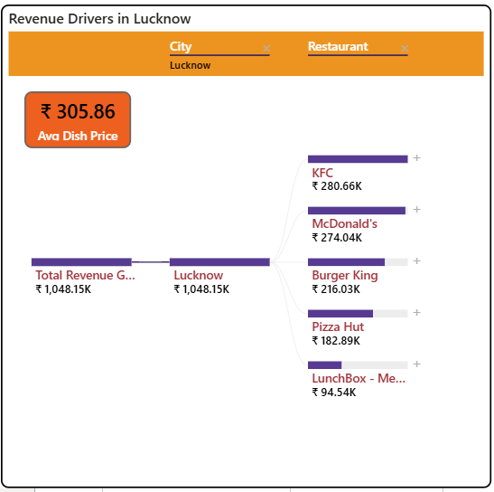
v
Why Does Lucknow Generate Higher Revenue Than Mumbai and Hyderabad?
Lucknow has one of the highest average dish prices among the top cities.
A significant share of orders comes from premium quick-service chains such as KFC, McDonald's, Burger King and Pizza Hut.
This combination is likely associated with higher revenue generation despite lower order volume.

Slide 11
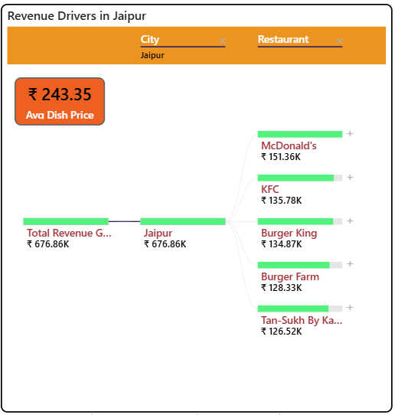
v
Why Jaipur generates low revenue despite of high order count ?
Jaipur's average dish price (₹243) is lower than other leading cities, reducing revenue generated per order.
A large share of orders comes from local restaurants such as Burger Farm and Tan-Sukh By Kanha, which have lower average menu prices than premium chains.
Introducing premium meal bundles or higher-value menu options at high-volume restaurants could increase average order value while maintaining demand.

Slide 12
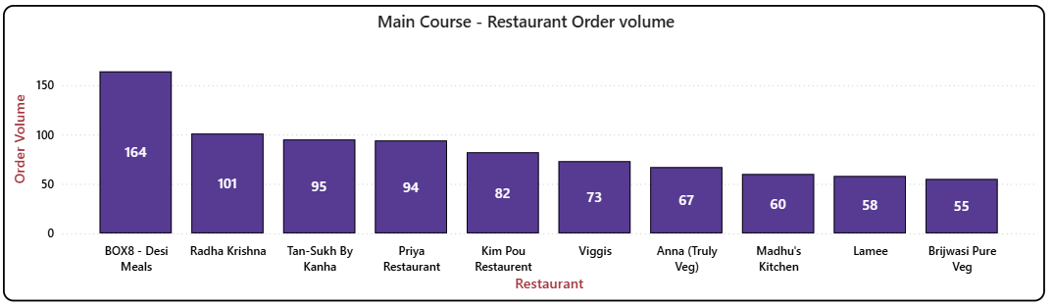
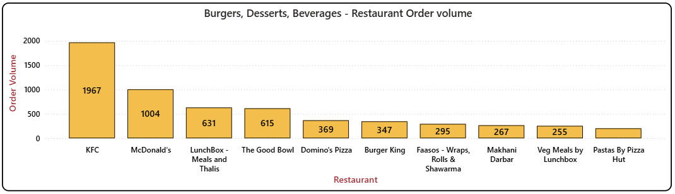
v
Main Course Demand Is Distributed Across Many Restaurants
Unlike categories such as Burgers or Desserts, where demand is concentrated among a few major restaurant chains, Main Course orders are distributed across a wider range of restaurants.
This broader distribution reduces the likelihood of any single restaurant dominating overall order volume or revenue.

Slide 13
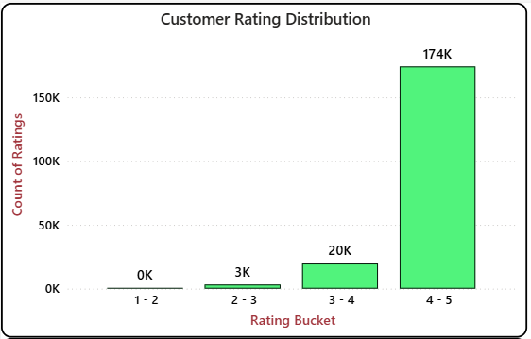
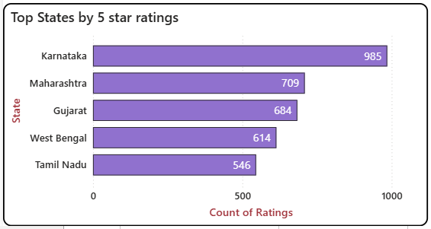

v
Customer Ratings Indicate Strong Overall Service Quality
4.40 is the rating which has received the highest rating count , nearly 43.3 % of total orders, indicating a consistently positive customer experience
Only 1.7% of orders received ratings below 3, suggesting relatively few poor customer experiences.
One interesting exception was Gujarat, which recorded unusually high 5-star ratings despite not being among the top-order states. This was investigated further.

Slide 14
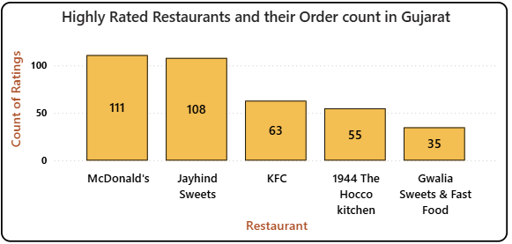
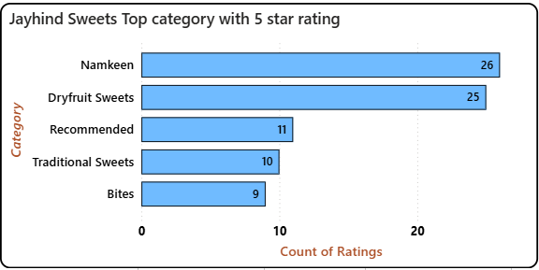


v
Why Does Gujarat Receive More 5-Star Ratings?
Gujarat records a disproportionately high number of 5-star ratings despite relatively lower order volume.
Within Gujarat, Jayhind Sweets stands out with approximately 19.5% of its orders receiving a 5-star rating.
Namkeen and Dry fruit Sweets combine high demand with consistently high customer ratings, making them strong candidates for promotional campaigns.
Swiggy could test increased visibility for these products through featured placements or recommendations and monitor the impact on order volume.

Slide 15

v
Strategic Recommendations: Marketing & Expansion
Marketing & Expansion
1) Targeted weekend campaigns for marketing.
2) Investigate why premium restaurant chains perform exceptionally well in Lucknow. If operational or promotional differences are identified, replicate successful practices in Mumbai and Hyderabad. Also evaluate partnerships with high-performing local restaurants such as Shiv Sagar Veg Restaurant and Bikanervala.
3) Partner with restaurants in low-coverage cities like Gangtok , Kohima, Aizawl to increase the revenue and order volume

Slide 16
v
Strategic Recommendations: Revenue Growth & Customer Experience
Increase Revenue
In Jaipur, introduce premium meal bundles, combo offers, or higher-value menu items at high-order local restaurants such as Burger Farm and Tan-Sukh By Kanha to increase the average revenue generated per order while maintaining existing order volume.
Restaurants specializing in Main Course items could explore expanding into complementary high-demand categories such as Desserts or Beverages to increase average order value. Similarly, Swiggy could recommend add-on items from these categories during checkout to encourage cross-category purchases.
Customer Experience
Jayhind Sweets - Namkeen and Dryfruit Sweets consistently receive both high order volume and a relatively high proportion of 5-star ratings. Swiggy could consider increasing the visibility of these products within Gujarat through featured placements or recommendation sections and monitor whether this leads to higher order volume and revenue.

Slide 17
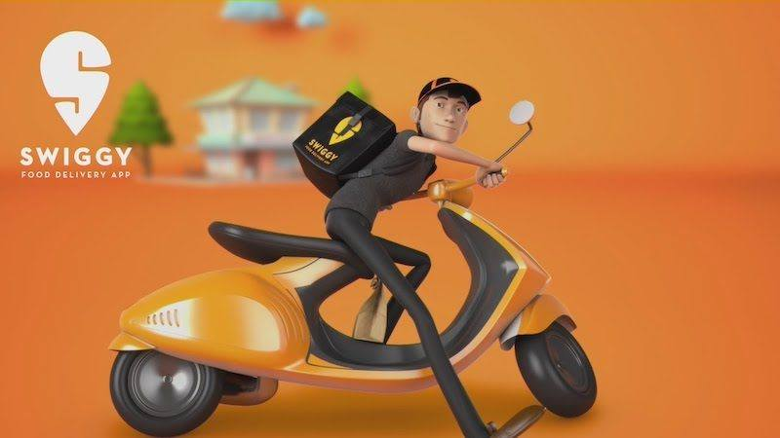
v
THANK YOU !!
Questions and Discussions
Prathamesh Patil
Data Analytics Portfolio Project

Slide 18

v
APPENDIX

Slide 19
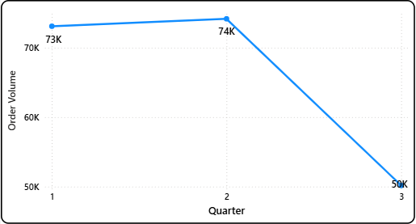
v
Quarterly Trends
Quarterly trend for Order volume and revenue is same :
Q2 (April -May-June) is top performing,
Q1 (Jan-Feb-March) is second highest ,
Q3 (July-Aug) is the 3rd Highest as it contained two months data only.

Slide 20
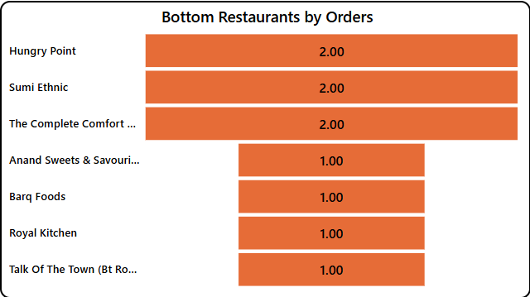
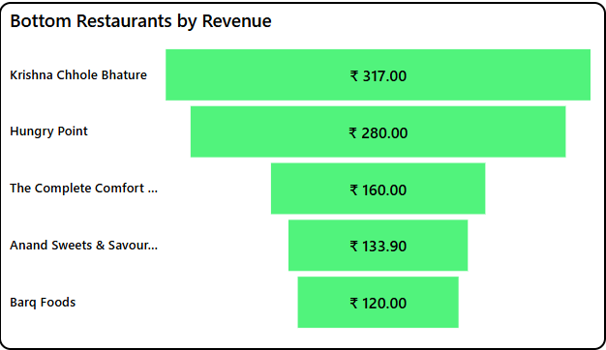
v
Low performing Restaurants
Barq Foods, Anand Sweets & Savouries , The Complete Comfort Zone , Hungry Point are restaurants with low revenue . They have 1-2 orders only in whole span of 8 months

Slide 21
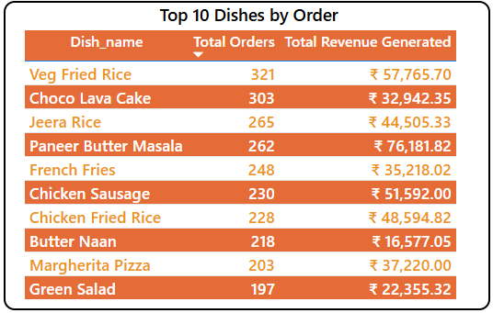
v
Most Ordered Dishes
Choco Lava Cake, Veg Fried Rice, Paneer Butter Masala, Jeera Rice are highly ordered dishes

Slide 22
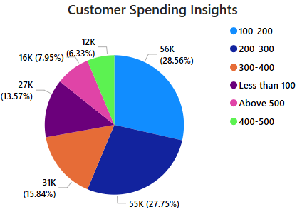
v
Customer Spending Insights
We can see order are mostly coming from price bucket between 100-400 price bucket.
Comparatively few orders are seen in 'under 100’, ’400-500’ and '500 + category'

