Slide 1

ML Results Presentation
Analysis & Prediction of Global COVID-19 Excess Mortality
A Machine Learning Approach Using the WHO Dataset
Pratham Agrawal
PRN: 22070521078
Sem: VII C
Under the guidance of
Dr. Piyush Chauhan
Symbiosis Institute of Technology, Nagpur Campus

Slide 2

Project Agenda
Agenda of this project:
Project Workflow: Our step-by-step pipeline.
Introduction: Project Objectives & The Data
Data Preprocessing: Cleaning & Feature Engineering
Exploratory Data Analysis (EDA): Getting Key Insights
Machine Learning Implementation using multiple models:
Task 1: Regression
Task 2: Classification
Task 3: Applying Neural Networks
Task 4: Clustering
Model Evaluation: Identifying the Best Models
Final Application: The "Future Risk Predictor" Dashboard
Conclusion

Slide 3
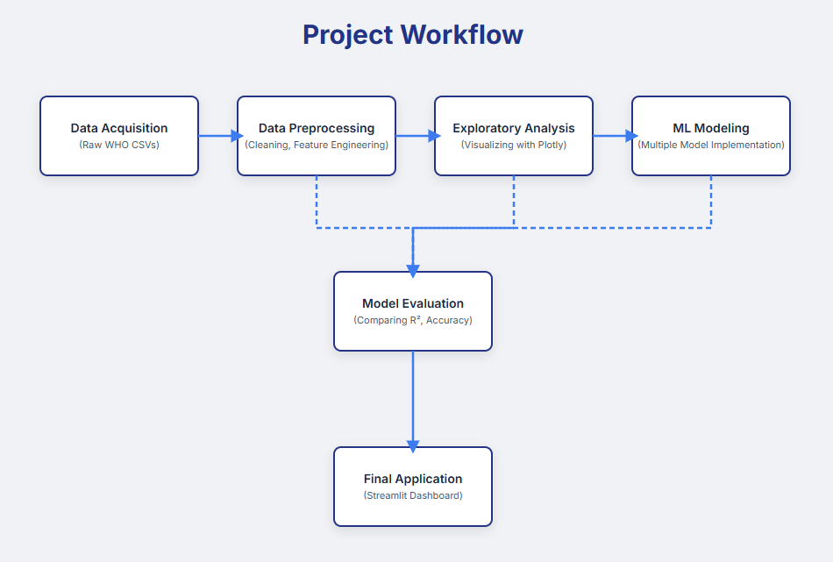
Project Workflow
Project Pipeline
Figure 1: Our Project Pipeline

Slide 4

Introduction & Project Objectives
What is "Excess Death"?
Definition: "Excess Death" is the most comprehensive measure of the pandemic's true impact. It's the number of deaths from all causes that are above what we would normally expect to see.
Formula: Excess Deaths = Total Deaths - Expected Deaths
Why it Matters: It captures not only the confirmed COVID-19 deaths but also the indirect effects, such as deaths from overwhelmed healthcare systems.
Project Objectives
Analyze global excess death patterns across countries, years, and demographics.
Build & Evaluate machine learning models to predict future outcomes.
Develop an interactive dashboard to make these insights accessible.

Slide 5
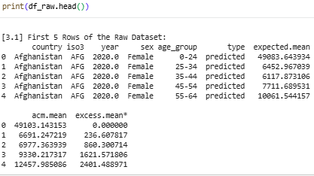
The Dataset
The WHO Excess Deaths Dataset
Source: World Health Organization (WHO)
Scope: Covers data from 2020-2021 for 194 countries.
Key Features:
country: The country of observation.
year: 2020 or 2021.
sex: Male or Female.
age_group: e.g., '0-24', '65-74', '>85'.
expectedmean: The baseline number of deaths normally expected.
acmmean: The actual all-cause mortality (ACM) recorded.
excessmean: Our primary target variable (ACM - Expected).
Figure 2: Raw Data Structure
Authentic Dataset Link: https://www.who.int/data/sets/global-excess-deaths-associated-with-covid-19-modelled-estimates

Slide 6
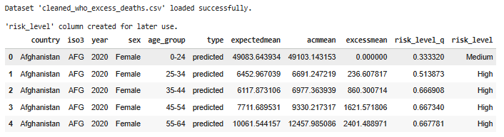
Data Preprocessing & Feature Engineering
Preparing the Data for Machine Learning
Data Cleaning:
Standard procedures were applied, including checking for null values and ensuring correct data types for analysis.
Feature Engineering: Creating "Risk Level"
This was the most critical step for our classification task.
The excessmean (a number) was converted into a category.
We used quantiles to divide the data into three equal groups, creating a new target variable: Low Risk, Medium Risk, High Risk.
This allowed us to train models to predict a number and assess a risk level.
Figure 3: Data Structure after cleaning and feature engineering.

Slide 7
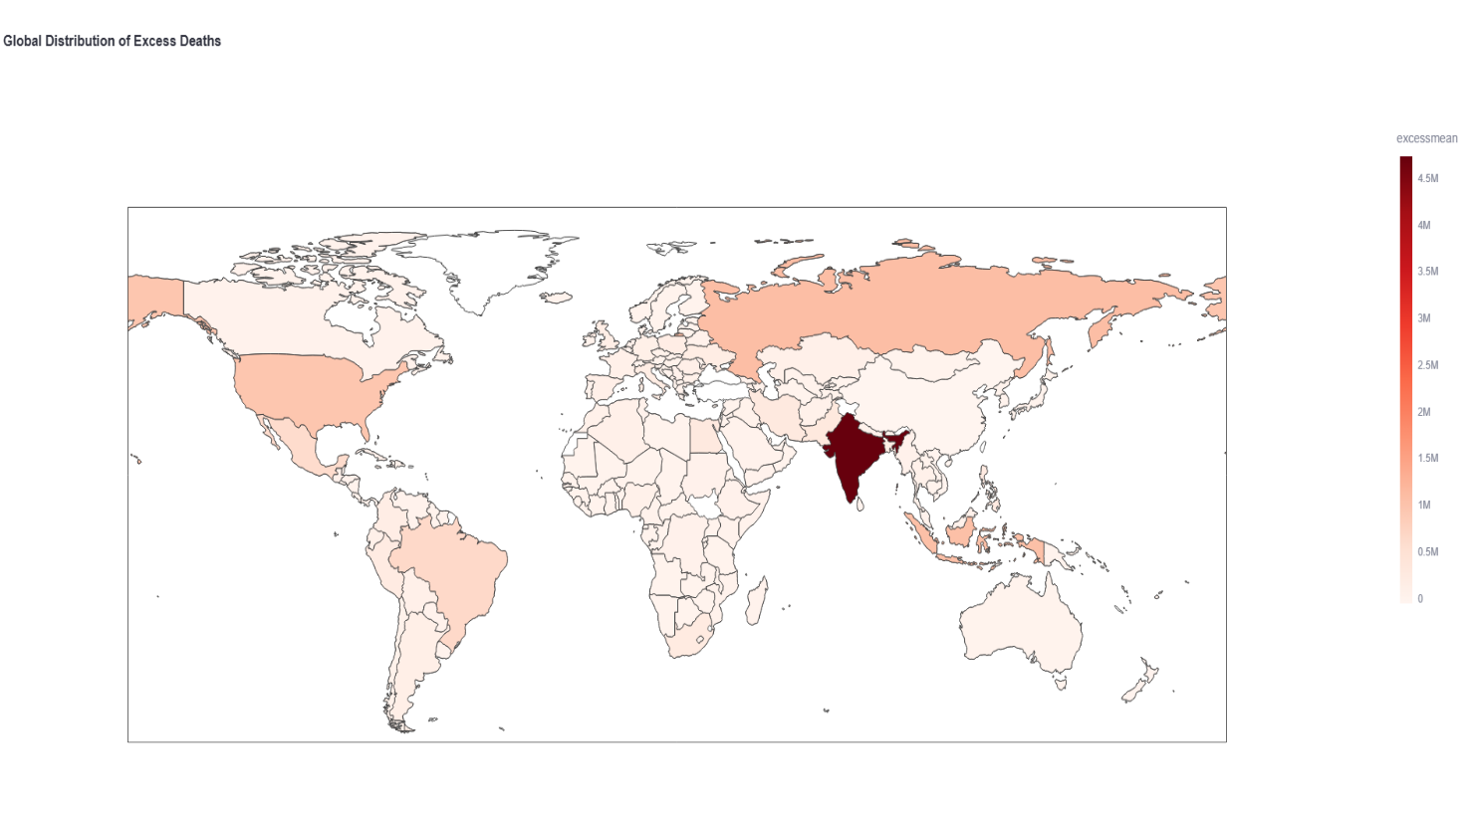
Exploratory Data Analysis (EDA)
Finding the Key Patterns in the Data
Before we could build any models, we first had to understand the data. Our Exploratory Data Analysis focused on three key questions: Where was the impact greatest, and who was most affected?
EDA Result 1: The Global View
Our first finding was the sheer scale: over 15 million excess deaths globally in 2020 and 2021.
The impact was heavily concentrated. Countries like India, Russia, the United States, and Brazil showed the highest cumulative excess mortality.
Other regions, like Australia and parts of East Asia, had mortality rates at or even below expected levels.
China refused to share internal data during pandemic period.
Figure 4: Global Distribution of Excess Deaths.

Slide 8
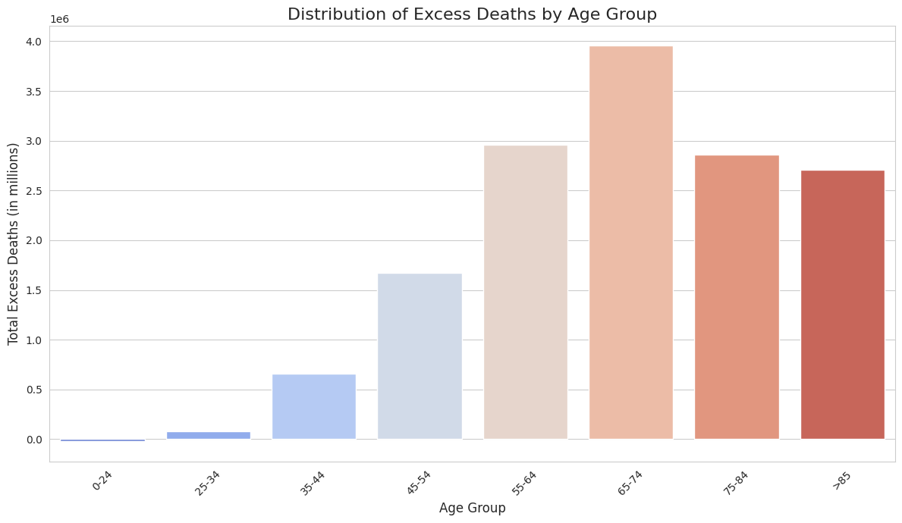
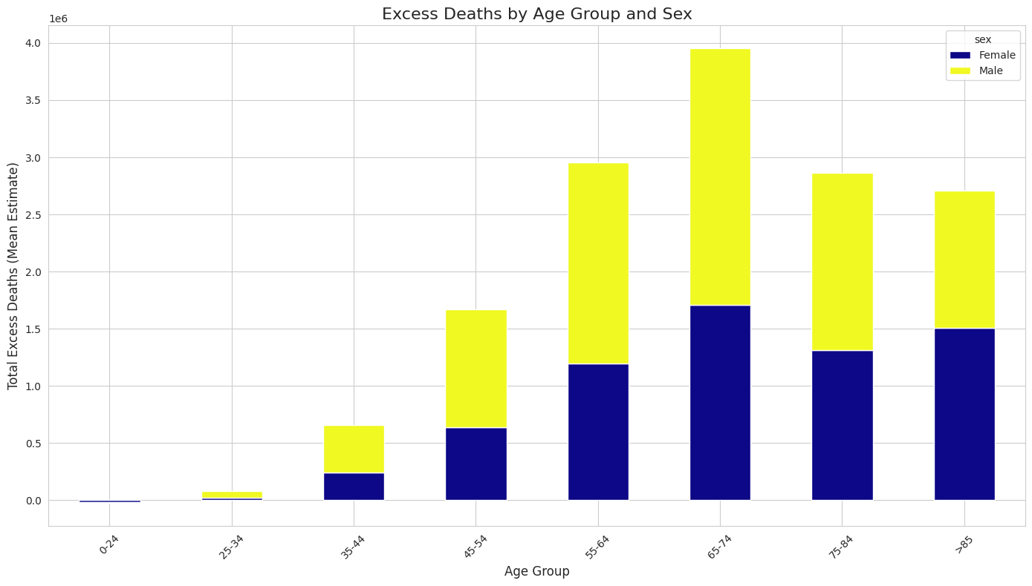
Exploratory Data Analysis (EDA)
EDA Result 2: Risk Dramatically Increases with Age
The data confirms that age is the single most significant risk factor.
The vast majority of excess deaths occurred in older populations.
The '65-74', '75-84', and '>85' age groups consistently accounted for the largest share of mortality across almost all countries.
Figure 5: Global Distribution of Excess Deaths by Age Group.
Figure 6: Global Distribution of Excess Deaths by Age Group and Sex.

Slide 9
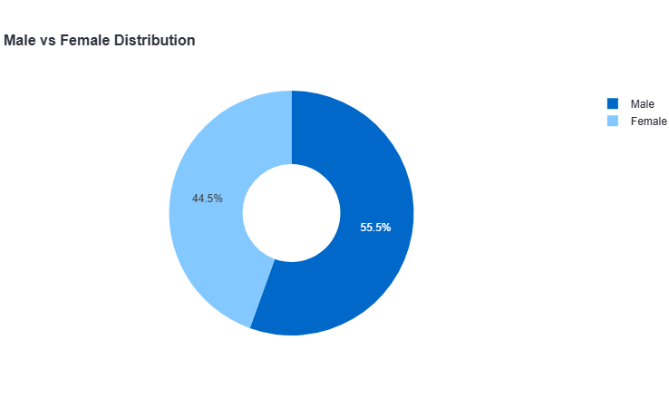
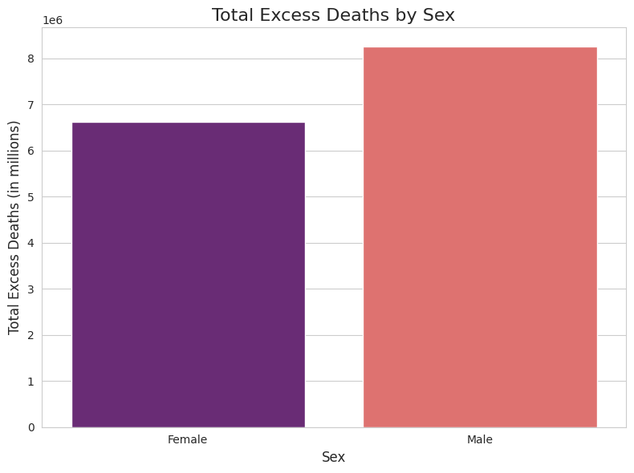
Exploratory Data Analysis (EDA)
EDA Result 3: A Significant & Global Gender Gap
Our analysis also revealed a clear disparity by sex.
Globally, excess mortality was substantially higher for Males than for Females.
This pattern was not isolated; it held true across most countries and age groups, pointing to a systemic difference in risk.
Figure 7: Male vs Female Excess Deaths Distribution.
Figure 8: Total Excess Deaths by Sex.

Slide 10
Machine Learning Implementation - Regression
ML Task 1: Regression (Predicting How Many Deaths)
Objective: To accurately forecast the exact number of excess deaths for a given demographic (Country, Year, Sex, Age).
Models Tested: We evaluated a range of models, including Linear Regression, Decision Tree, XGBoost, and Gradient Boosting.
Result: The Gradient Boosting Regressor was the clear winner.
Performance: It achieved an R-squared of 87%, meaning it could explain 87% of the variance in the data, and had the lowest overall error.
Sr No. | Model | R-squared (R²) | Mean Absolute Error (MAE) | Mean Squared Error (MSE) | Root Mean Squared Error (RMSE)
0 | Gradient Boosting Regressor | 0.871831 | 1993.1554 | 6.20E+07 | 7875.273
1 | XGBoost Regressor | 0.869614 | 1533.6747 | 6.31E+07 | 7943.0986
2 | Decision Tree Regressor | 0.859785 | 1407.9818 | 6.78E+07 | 8237.0433
3 | Random Forest Regressor | 0.8199 | 1426.4392 | 8.71E+07 | 9335.3524
4 | Multiple Linear Regression | 0.461381 | 3318.1011 | 2.61E+08 | 16144.158
5 | Lasso Regression | 0.461193 | 3299.8713 | 2.61E+08 | 16146.962
6 | Ridge Regression | 0.45124 | 3314.1516 | 2.66E+08 | 16295.415
7 | MLP Regressor (Neural Network) | 0.349018 | 2187.9241 | 3.15E+08 | 17748.383
8 | Simple Linear Regression | 0.005451 | 4078.9761 | 4.81E+08 | 21937.52
9 | K-Neighbors Regressor | -0.002659 | 3841.2617 | 4.85E+08 | 22026.783
Table 1: Evaluation metrics of all regression models applied.

Slide 11
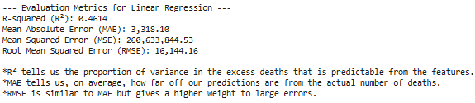
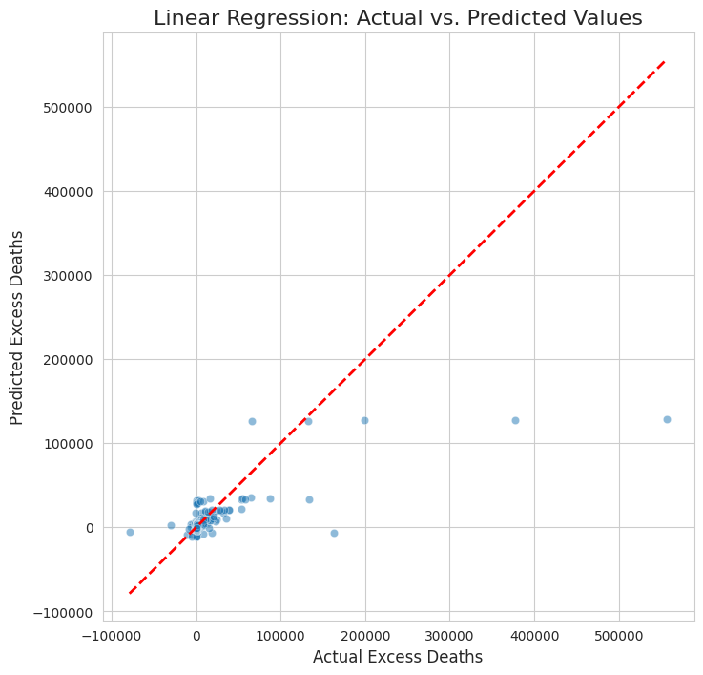
Regression Model : Linear Regression
Regression Model 1: Linear Regression
Purpose: To establish a simple, "baseline" performance.
How it Works: Assumes a linear relationship between features (like age, sex) and the number of deaths.
Result: The model was too simple for this complex data. It had a low R-squared and high error, proving that a more advanced model was necessary.
Figure 9: Evaluation metrics of Linear regression model .

Slide 12

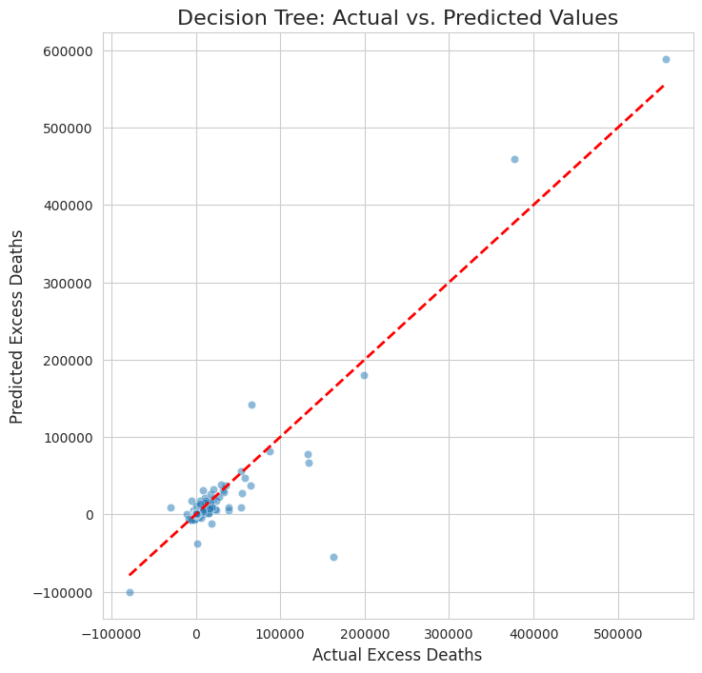
Regression Model : Decision Tree Regressor
Regression Model 2: Decision Tree Regressor
Purpose: To capture non-linear relationships that the linear model missed.
How it Works: Creates a "flowchart" of if/then rules based on the data.
Result: A significant improvement over Linear Regression, with an R-squared of ~86%. This confirmed that the data's patterns were non-linear. However, single decision trees can be prone to overfitting.
Figure 10: Evaluation metrics of Decision Tree regression model.

Slide 13

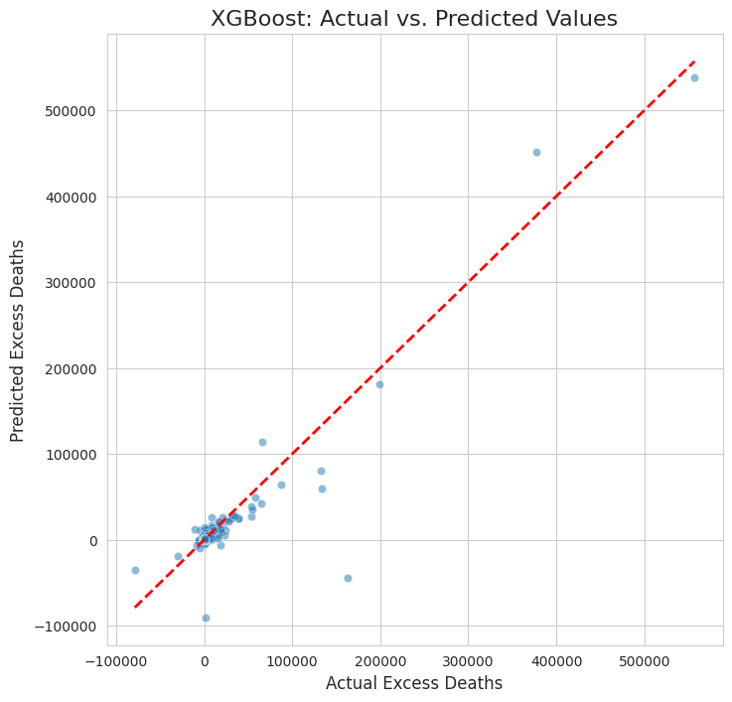
Regression Model : XGBoost Regressor
Regression Model 3: XGBoost Regressor
Purpose: To use a powerful, industry-standard "ensemble" model.
How it Works: An advanced form of Gradient Boosting, known for its high performance and speed. It builds many trees sequentially, with each new tree correcting the errors of the previous one.
Result: Excellent performance, achieving an R-squared of ~87% and a low Mean Absolute Error. This was a top contender.
Figure 11: Evaluation metrics of XGBoost Regression model.

Slide 14

Regression Model : Gradient Boosting Regressor
Regression Model 4: Gradient Boosting Regressor
Purpose: To compare against another top-tier ensemble method.
How it Works: Similar to XGBoost, it builds trees sequentially to correct errors. We used Scikit-learn implementation.
Result: This model also achieved an R-squared of ~87% and had the lowest overall Root Mean Squared Error (RMSE). It was slightly more robust in our tests than the XGBoost model.
Figure 12: Evaluation metrics of Gradient Boosting regression model.
These are some of our regression models applied.

Slide 15
Machine Learning Implementation - Classification
ML Task 2: Classification (What is the Risk Level?)
Objective: To classify a demographic's risk as 'Low', 'Medium', or 'High' (using our engineered feature).
Models Tested: We tested Logistic Regression, K-Neighbors, Support Vector Classifier (SVC), and an MLP Classifier (Neural Network).
Result: The MLP Classifier provided the best performance.
Performance: It achieved a 91% Accuracy in correctly classifying the risk level for a given demographic.
Sr no. | Model | Accuracy | Precision (Weighted) | Recall (Weighted) | F1-score (Weighted)
0 | MLP Classifier (Neural Network) | 0.909823 | 0.909289 | 0.909823 | 0.909335
1 | Support Vector Classifier (SVC) | 0.877617 | 0.877677 | 0.877617 | 0.877214
2 | Logistic Regression | 0.876812 | 0.876086 | 0.876812 | 0.876234
3 | Random Forest Classifier | 0.747987 | 0.756164 | 0.747987 | 0.749279
4 | K-Neighbors Classifier | 0.63124 | 0.64154 | 0.63124 | 0.633098
Table 2: Evaluation metrics of all classification models applied.

Slide 16
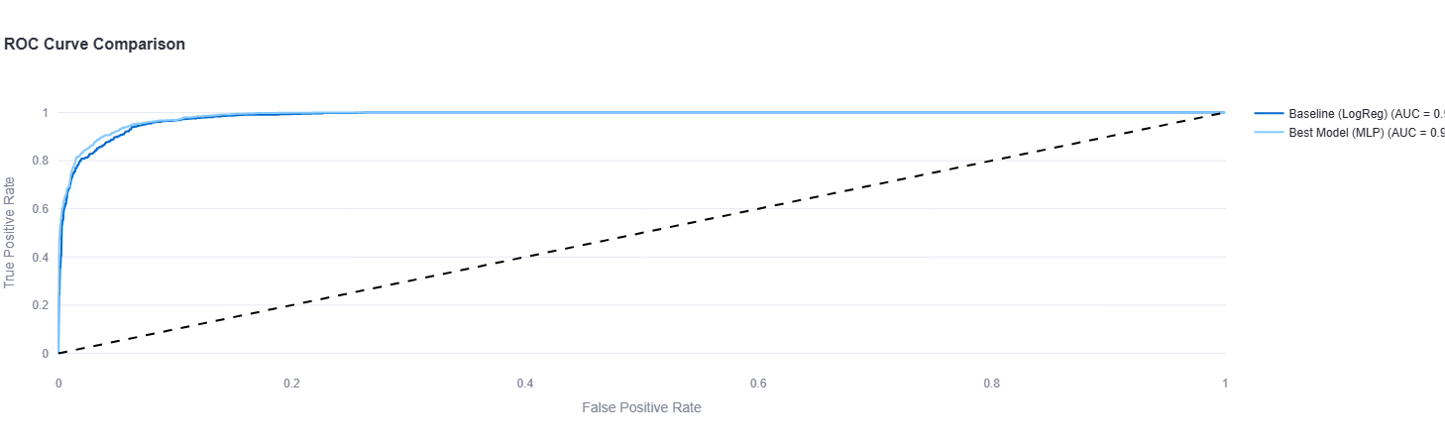
Machine Learning Implementation - Classification
Confirming Our Classifier's Performance (ROC Curve)
To be certain of our model, we analyzed its ROC Curve.
This graph shows the model's ability to distinguish between classes.
The Area Under the Curve (AUC) was excellent (close to 1.0) for all three classes (Low, Medium, High).
Finding: This confirms the MLP Classifier is highly robust and not just "guessing." It is very effective at separating high-risk groups from low-risk groups.
Figure 13: ROC Curve: Best (MLP) vs. Baseline (LogReg).

Slide 17

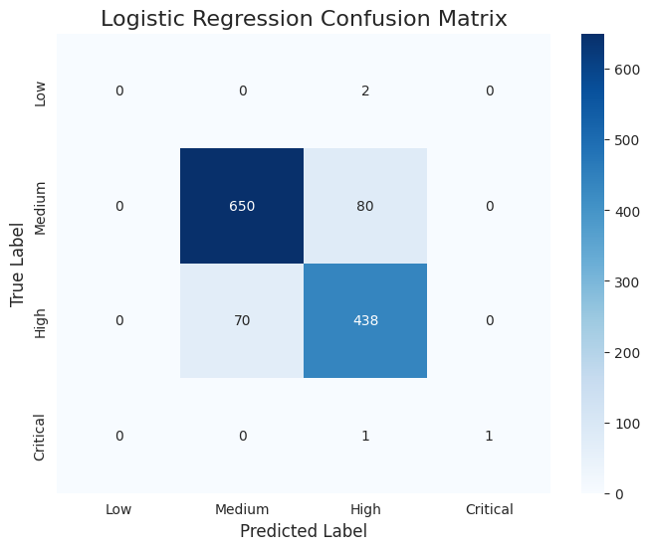
Classification Model : Logistic Regression
Classification Model 1: Logistic Regression
Purpose: To establish a simple, "baseline" performance for classification.
How it Works: A linear model that's used to predict a categorical outcome (Low, Medium, or High).
Result: Performed surprisingly well, with an 87.6% accuracy. This showed that the classes we engineered were distinct, but we believed we could improve this score with more complex models.
Figure 14: Evaluation metrics of Logistic regression model.

Slide 18
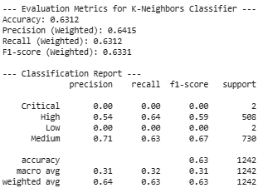
Classification Model : K-Neighbours Classifier
Classification Model 2: K-Neighbours Classifier
Purpose: To test a non-linear, instance-based approach.
How it Works: Classifies a new data point based on the "votes" of its nearest neighbors in the training data.
Result: Poor performance, with only 63.1% accuracy. This model struggled to find a clear pattern, likely due to the high-dimensional nature of our data.
Figure 15: Evaluation metrics of K-Neighbour Classifier model.

Slide 19
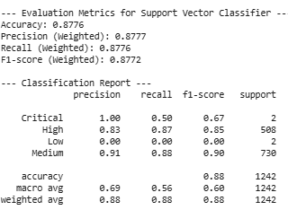
Classification Model : Support Vector Classifier (SVC)
Classification Model 3: Support Vector Classifier (SVC)
Purpose: To use a powerful model known for finding optimal decision boundaries.
How it Works: Finds the "hyperplane" that best separates the data points into their respective classes (Low, Medium, High).
Result: Good performance, achieving 87.7% accuracy—a slight improvement over our Logistic Regression baseline.
Figure 16: Evaluation metrics of Support Vector Classifier model.

Slide 20
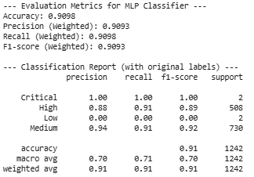
Classification Model : MLP Classifier
Classification Model 4: MLP Classifier (Neural Network)
Purpose: To apply a deep learning approach to see if it could capture the most complex patterns.
How it Works: A "Multi-layer Perceptron" is a type of artificial neural network. It passes the data through several layers of "neurons" to learn very intricate relationships.
Result: This was the best-performing model by a clear margin, achieving an accuracy of 91%.
Figure 17: Evaluation metrics of all regression models applied.
These are some of our classification models applied.

Slide 21
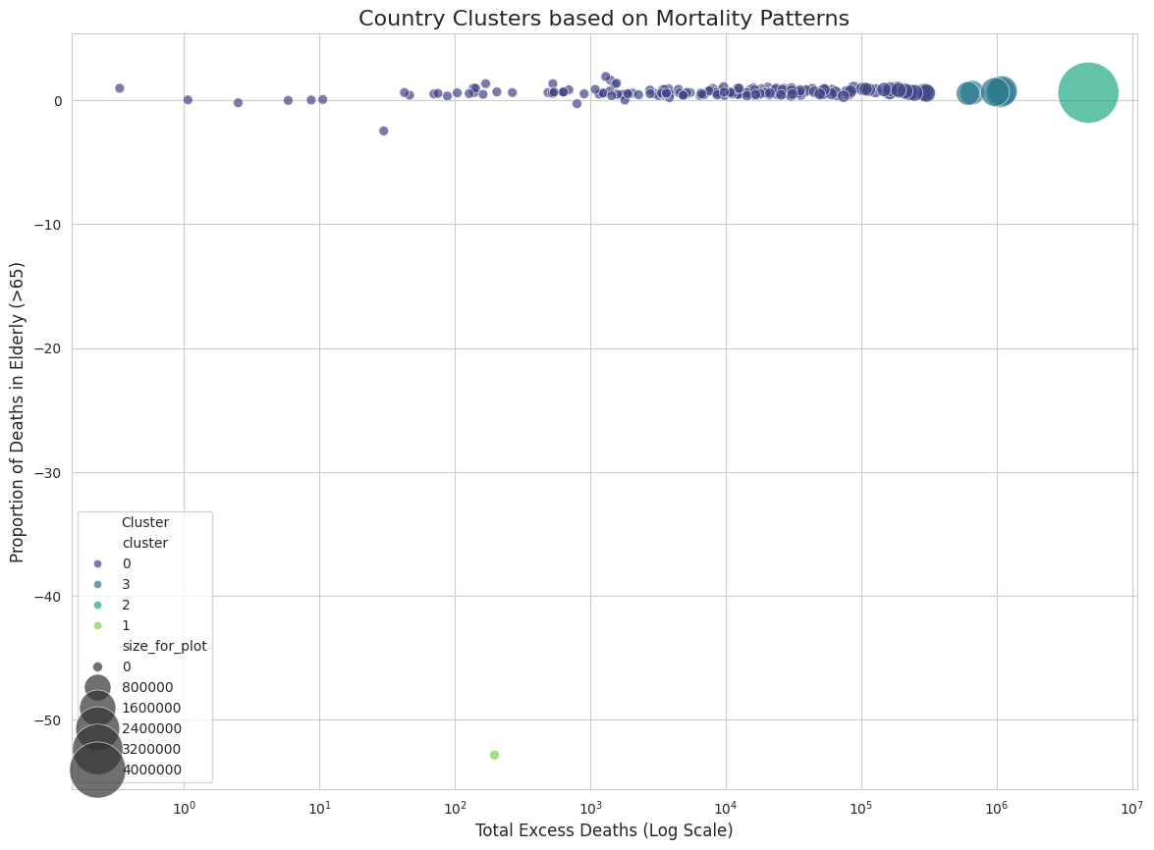
Machine Learning Implementation - Clustering
ML Task 3: Clustering (Discovering Hidden Profiles)
Objective: To use an unsupervised model (K-Means) to find non-obvious groupings of countries.
Method: We clustered countries based on their total excess deaths and the proportion of deaths in the elderly (65+).
Finding: The model revealed distinct profiles. For example:
Cluster 0: High total deaths AND high elderly mortality (e.g., USA, Brazil).
Cluster 1: Low total deaths AND low elderly mortality (e.g., Australia, New Zealand).
Cluster 2: Low total deaths BUT high elderly mortality (e.g., Japan, South Korea).
This provides a new way to analyze and compare national outcomes.
Figure 18: Country Clustering based on Mortality Patterns.

Slide 22
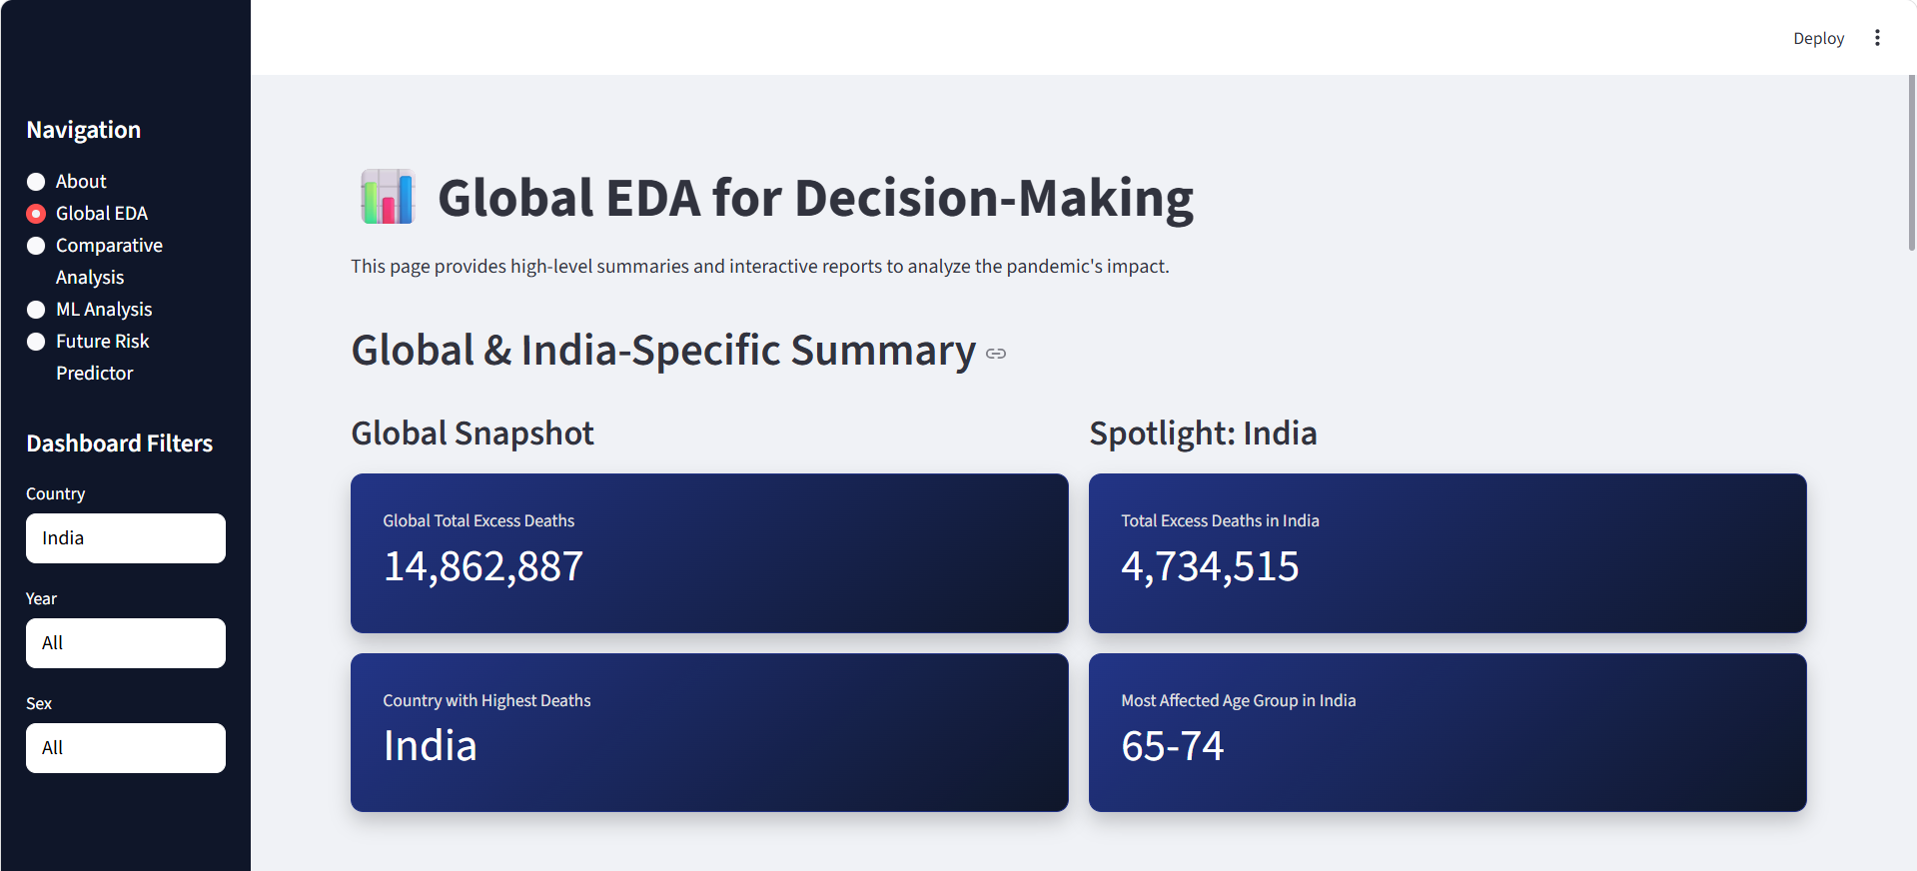
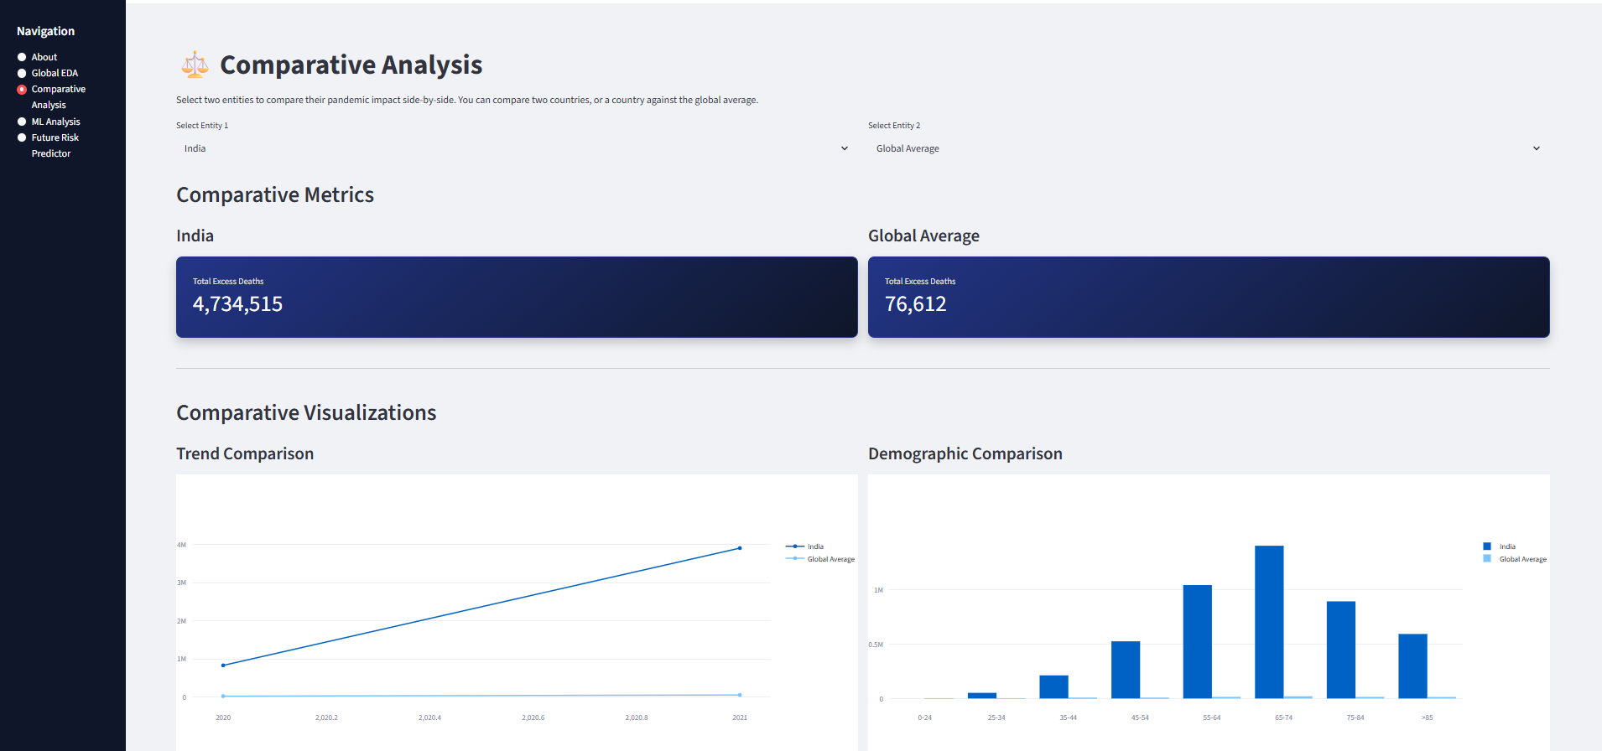
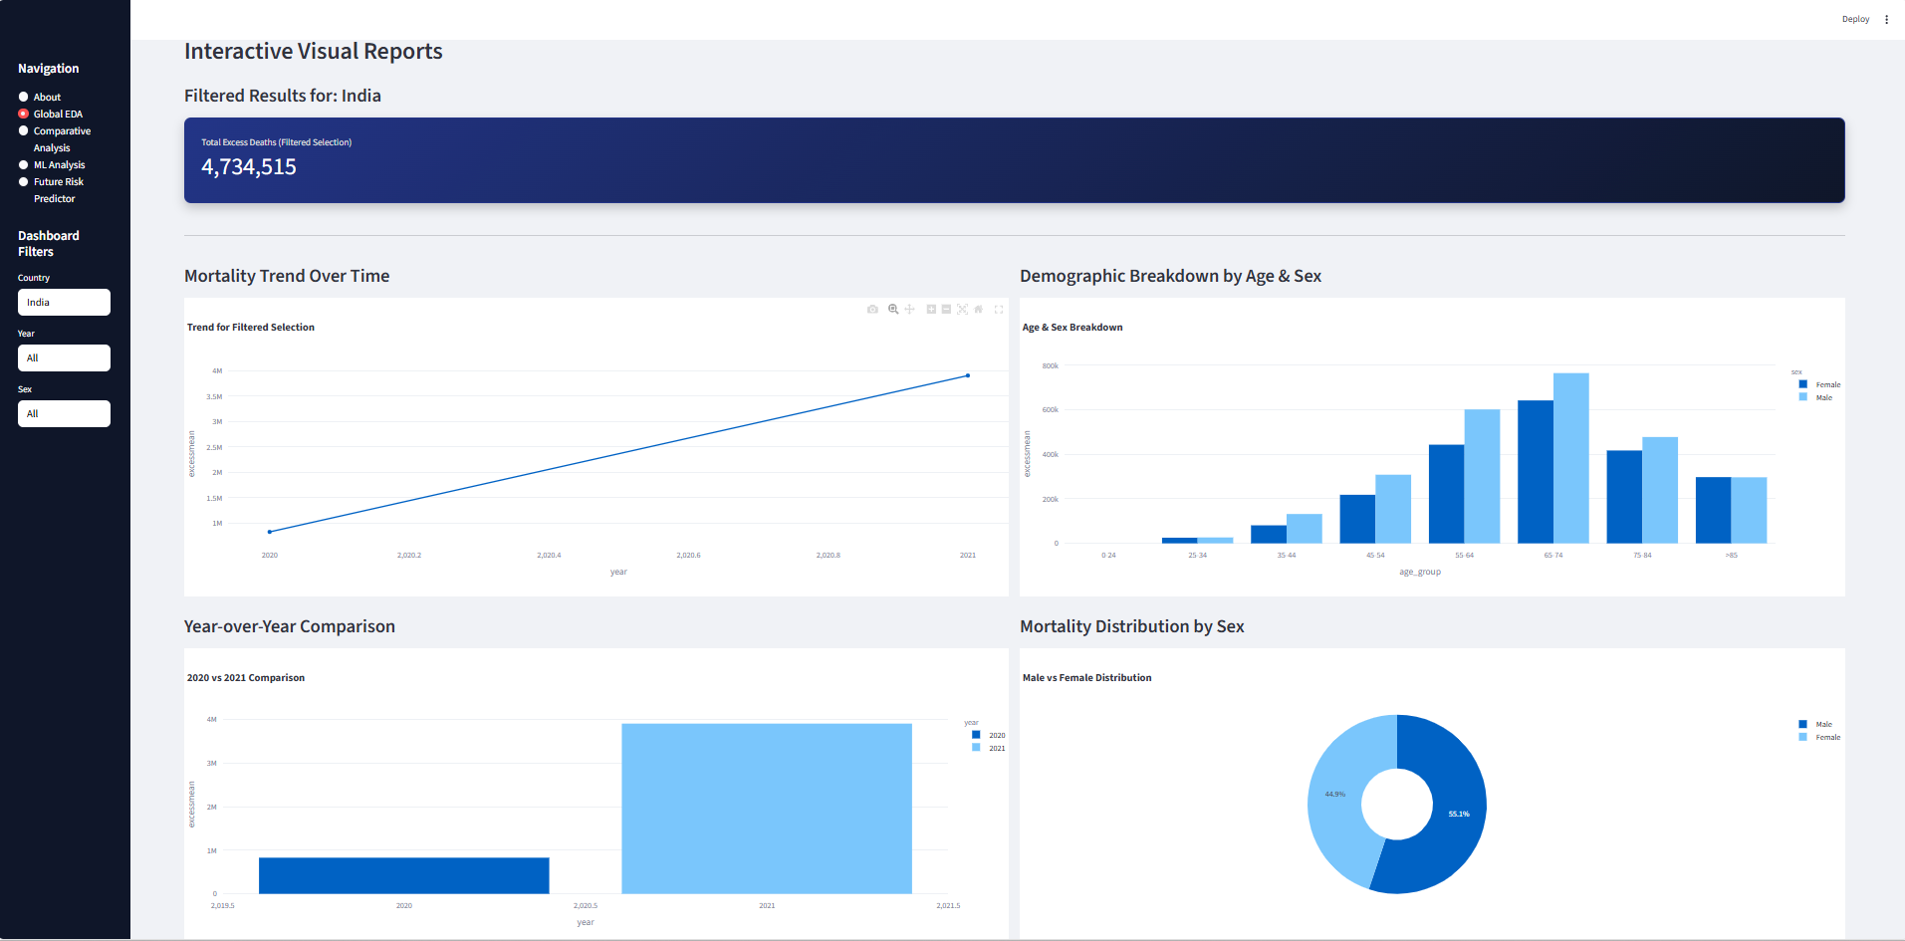
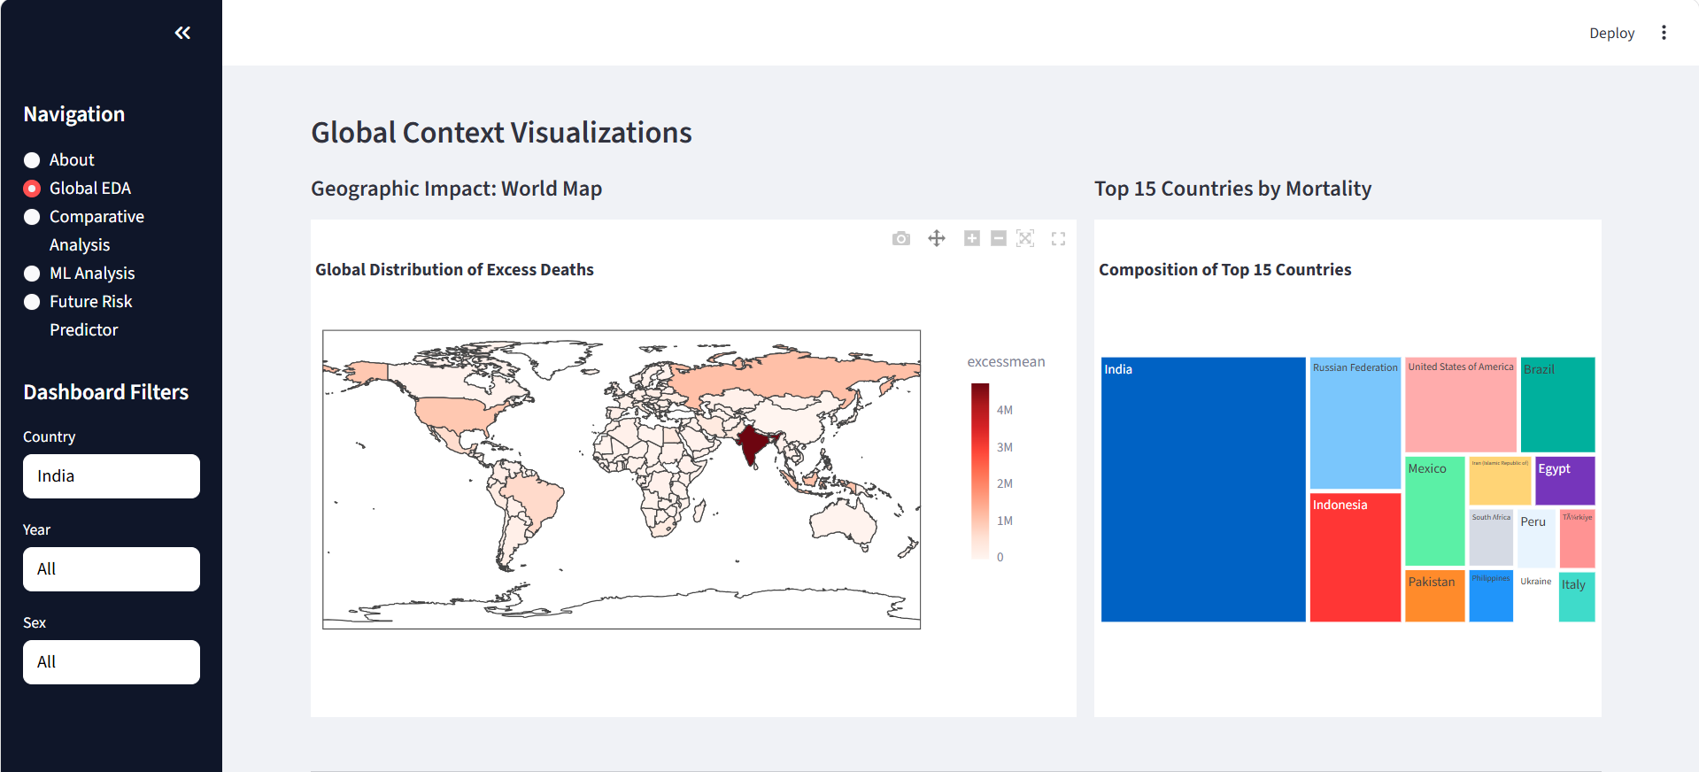
Final Application
Final Application: The "Future Risk Predictor" Dashboard
The final and most important result of our project was not just the models themselves, but making them usable. We integrated our best-performing models into a single, interactive Streamlit Dashboard.

Slide 23
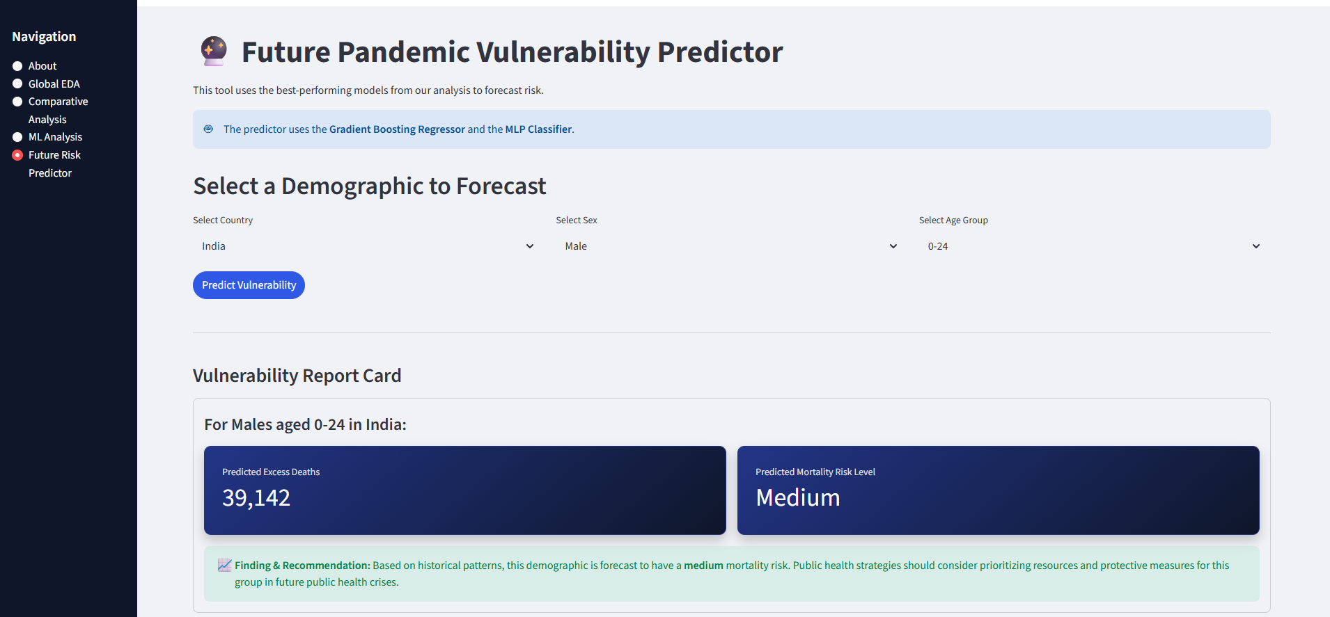
Application: The "Future Risk Predictor"
Dashboard Feature: The Future Risk Predictor
This tool is the final output of our project. It allows any user to get an instant prediction based on our models.
How it Works: It combines our two best-performing models:
The Gradient Boosting Regressor runs to predict the specific number of excess deaths.
The MLP Classifier runs to assess the overall risk level ('Low', 'Medium', or 'High').
The user simply selects the inputs from the dropdown menus.
Deployed Dashboard Link: https://pratham-covidexcessdeathsdashboard.streamlit.app/

Slide 24
Key Takeaways and Future Work
Project Conclusion & Key Takeaways
Takeaway 1 (EDA): Excess mortality was not uniform. Our analysis confirmed that the impact was concentrated in specific countries (like India, USA) and demographic groups (overwhelmingly older, male populations).
Takeaway 2 (ML Models): No single model is best for all tasks.
Gradient Boosting was best for the precision task of regression.
MLP Classifier (Neural Net) was best for the nuanced task of classification.
Takeaway 3 (Application): The true value is achieved when models are made accessible. Our Streamlit dashboard successfully translates complex predictions into a simple, usable tool for analysis and decision-making.
Future Work
Integrate New Features: Add economic data (like GDP, healthcare spending per capita) or comorbidity data (like diabetes or smoking rates) to see if we can build even more accurate predictive models.
Time-Series Forecasting: Use models like ARIMA or LSTM to forecast excess death trends into the future, rather than just for a specific demographic.

Slide 25

Appendix
Project GitHub Link: https://github.com/PrathamAgrawal51/Pratham_Agrawal_22070521078_ML_CA1
Deployed Dashboard Link: https://pratham-covidexcessdeathsdashboard.streamlit.app/
Authentic Dataset Link: https://www.who.int/data/sets/global-excess-deaths-associated-with-covid-19-modelled-estimates
Pratham Agrawal
PRN: 22070521078
Sem: VII C

Slide 26
Thank You
Pratham Agrawal
PRN: 22070521078
Sem: VII C

