Slide 1
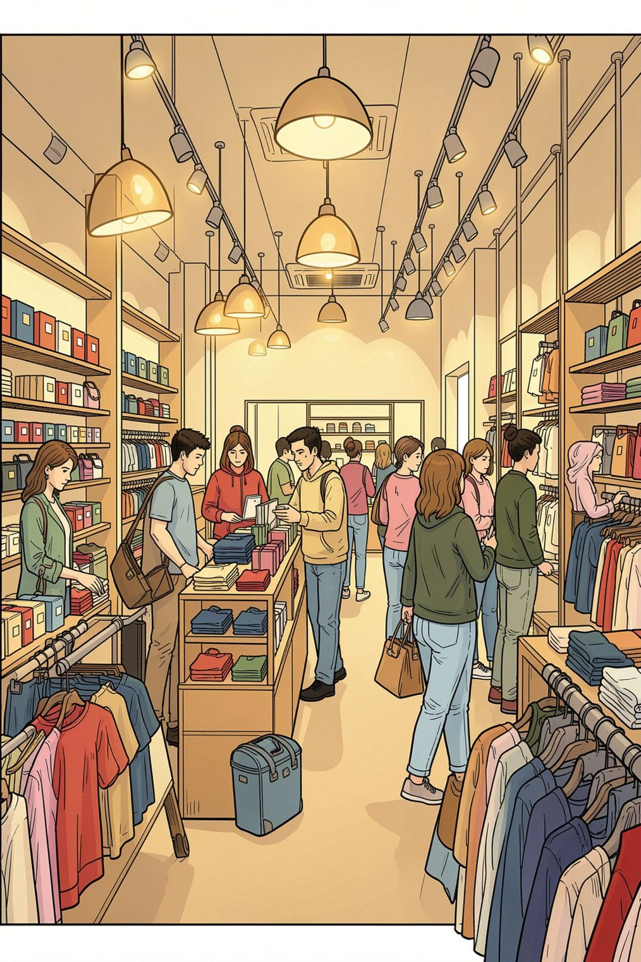
Customer Shopping Behavior Analysis
A data-driven exploration of 3,900 transactions — uncovering spending patterns, customer segments, and product preferences to guide strategic business decisions.

Slide 2
Project at a Glance
3,900
18
Transactions
Data Columns
Purchase records analyzed across all product categories
Demographics, purchase details, and behavioral signals
37
3
Missing Values
Tools Used
Imputed in Review Rating using category medians
Python, PostgreSQL, and Power BI
The dataset spans customer demographics, product attributes, and behavioral signals — enabling a 360° view of shopping patterns.

Slide 3

Data Preparation in Python
01
Load & Explore
Imported data via pandas; used df.info() and .describe() for initial structure review.
02
Clean & Impute
Handled null values; imputed missing Review Ratings using category-level medians.
03
Engineer Features
Created age_group bins and purchase_frequency_days; dropped redundant promo_code_used.
04
Load to Database
Connected to PostgreSQL and loaded the cleaned DataFrame for SQL-based analysis.

Slide 4
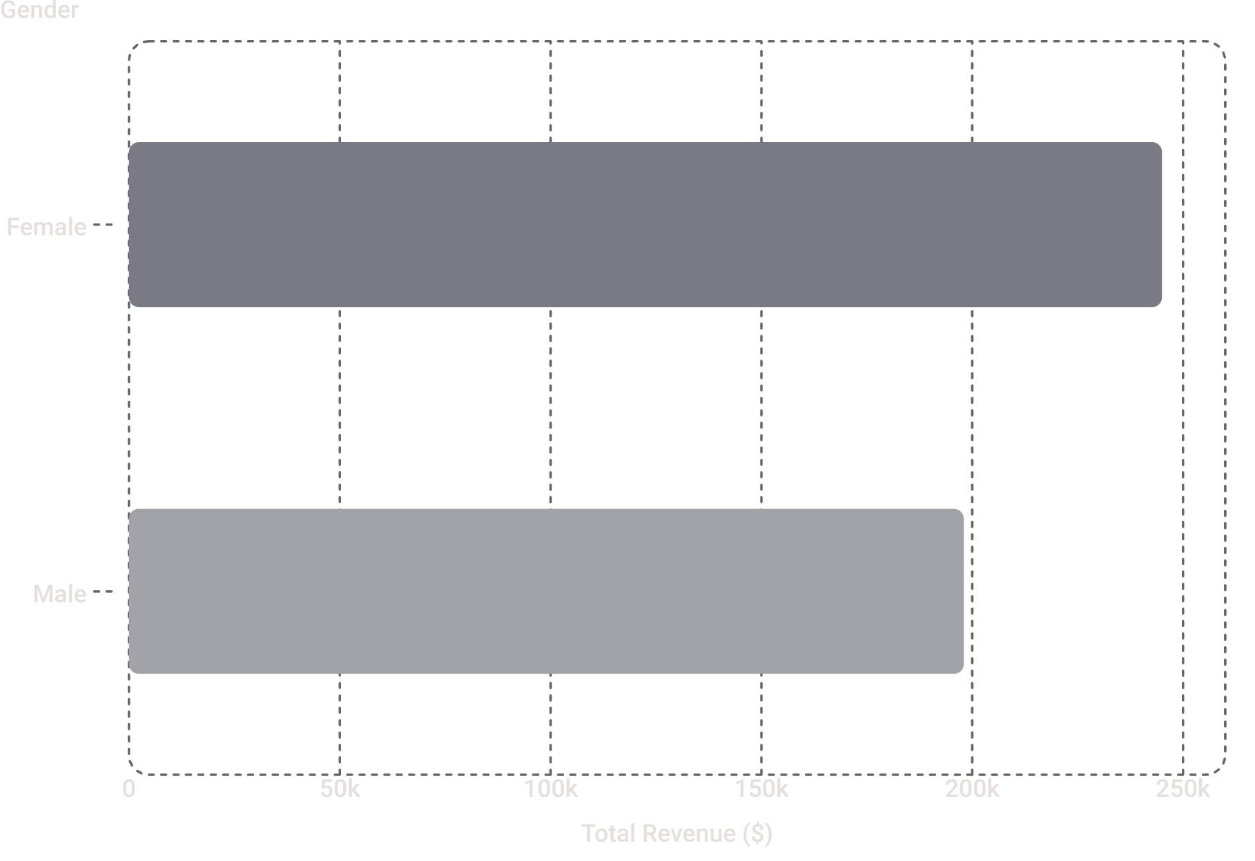

Revenue by Gender
Female Customers Lead Revenue
Female shoppers generated approximately 55% of total revenue, outpacing male customers by a meaningful margin. This signals a key demographic for targeted promotions and loyalty initiatives.
Consider gender-specific campaigns and product bundles to further capitalize on this segment.

Slide 5
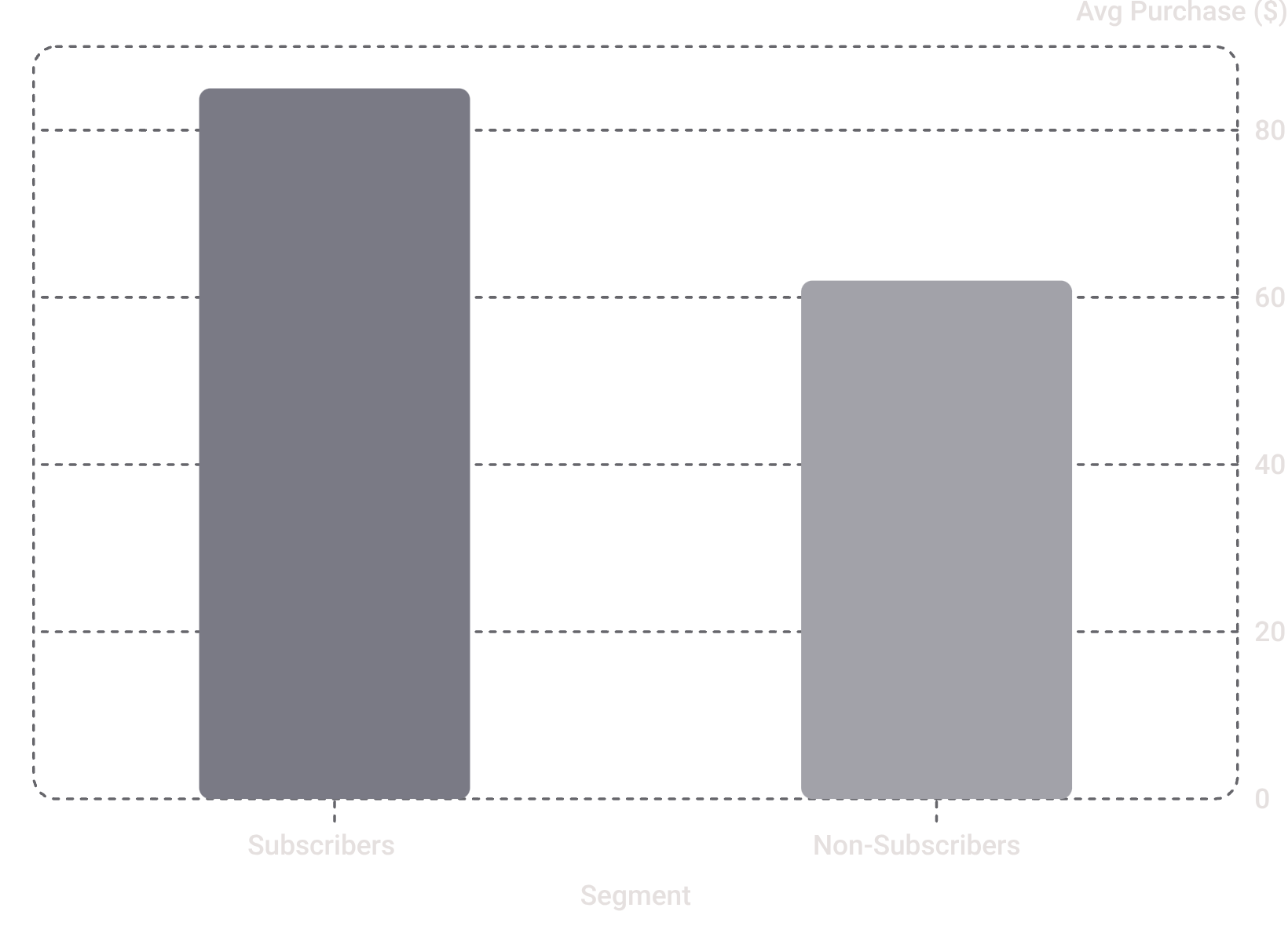
Subscribers vs. Non-Subscribers
Subscribers Spend More
Subscribers average $85 per transaction versus $62 for non-subscribers — a 37% premium. They also contribute disproportionately to total revenue, making subscription conversion a high-leverage growth lever.
Higher average order value
Greater purchase frequency
Stronger brand engagement

Slide 6
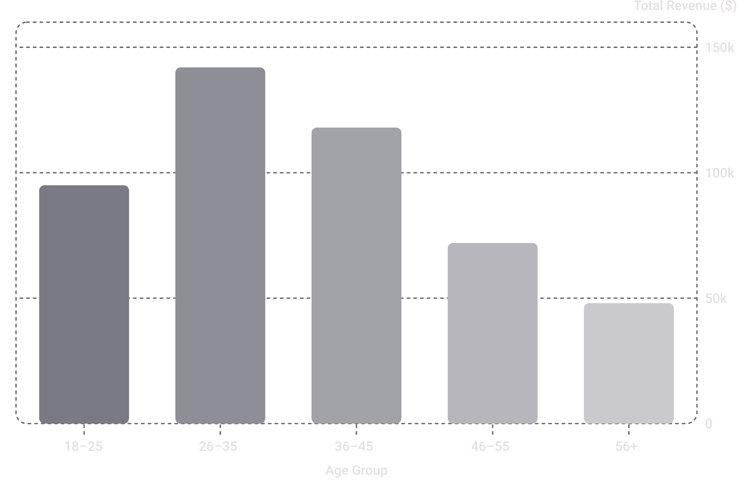
Revenue by Age Group
26–35 Is the Power Segment
The 26–35 age group drives the highest revenue contribution, followed closely by 36–45. Together, these two cohorts account for the majority of total spend.
Marketing budgets should prioritize these segments, while younger groups (18–25) represent a strong growth pipeline.

Slide 7
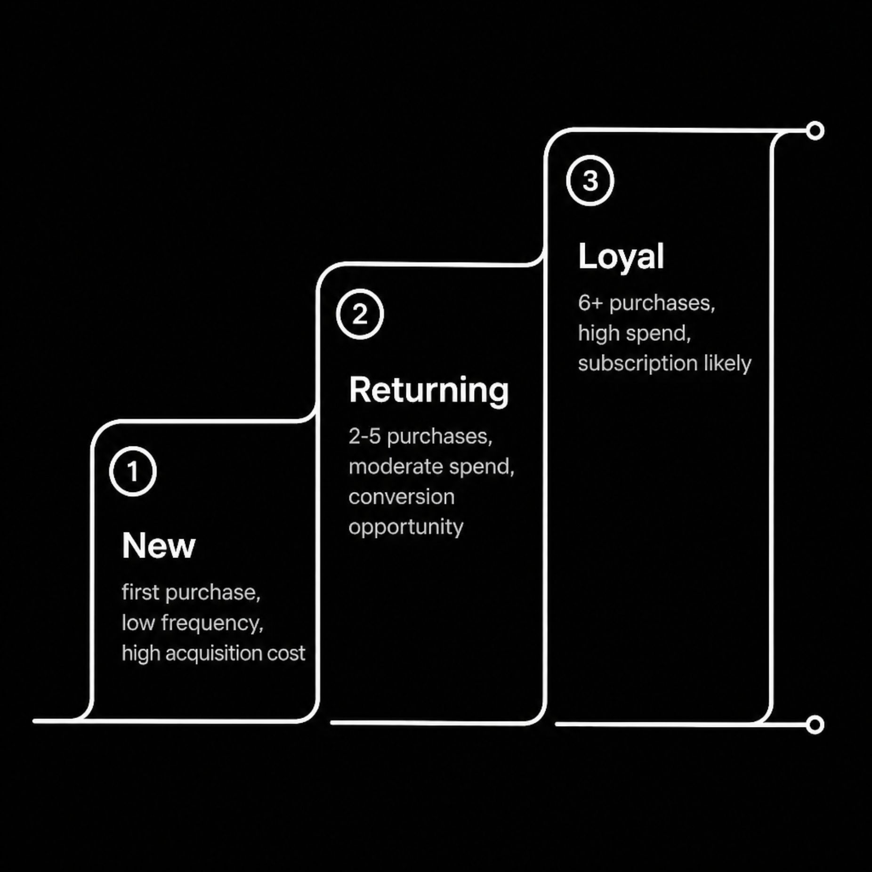

Customer Segmentation
Customers were classified into three behavioral segments based on purchase history, enabling tailored engagement strategies.
New
Returning
Loyal
First-time buyers — focus on onboarding and first-purchase incentives.
Repeat purchasers — nudge toward subscription with exclusive offers.
High-frequency buyers — reward with VIP perks and early access.

Slide 8

Shipping & Discount Insights
Express Shipping Premium
High-Spending Discount Users
Express shipping customers spend significantly more per order than Standard shipping users — suggesting urgency correlates with higher basket size.
A subset of discount users still exceed average purchase amounts, indicating price sensitivity without sacrificing spend — a prime upsell target.
Discount-Dependent Products
Five products showed the highest share of discounted purchases, signaling potential margin risk and over-reliance on promotions.

Slide 9
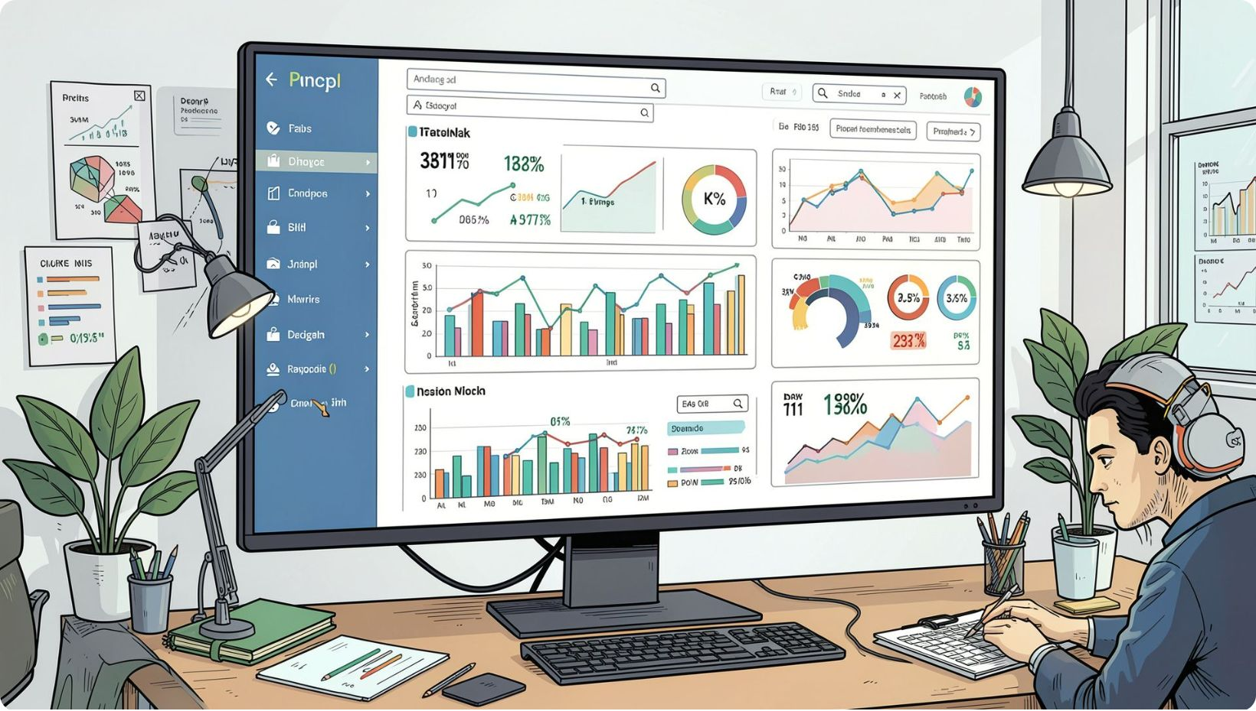
Power BI Dashboard
Visual Storytelling for Decision-Makers
An interactive Power BI dashboard was built to surface key findings at a glance — enabling stakeholders to explore revenue trends, segment performance, and product metrics without relying on raw data exports.
Revenue breakdowns by gender, age, and subscription
Product-level ratings and purchase volumes
Customer segment distribution and trends
Shipping and discount impact analysis

Slide 10





Business Recommendations
Boost Subscriptions
Loyalty Programs
Review Discount Policy
Promote exclusive subscriber benefits to convert high-frequency buyers and lift average order value.
Reward Returning customers to accelerate their progression into the Loyal segment.
Audit discount-dependent products to balance sales lift against margin erosion.
Targeted Marketing
Product Positioning
Concentrate spend on 26–35 and 36–45 age groups, plus express-shipping users with higher baskets.
Feature top-rated and best-selling products prominently in campaigns and homepage placements.

