Slide 1

AtliQ Technologies HR Analytics
Workforce presence, remote work, and sick leave trends — April 1 to June 30, 2022
POWER BI DASHBOARD REPORT

Slide 2
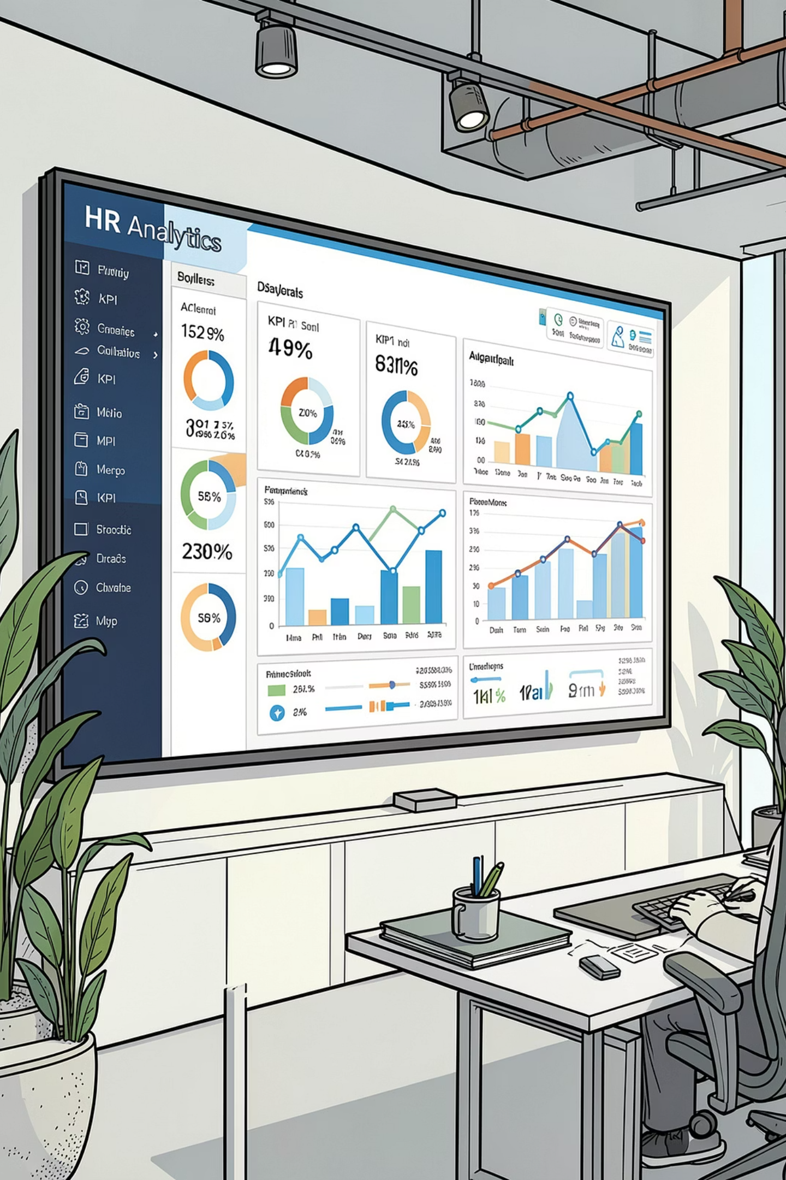
Executive KPI Summary
1,525
Present Days
Total logged by workforce
94.0%
Attendance
Stable workforce availability baseline
9.1%
WFH Rate
~1 in 10 days completed remotely
0.4%
Sick Leave
Controlled unplanned absence baseline

Slide 3
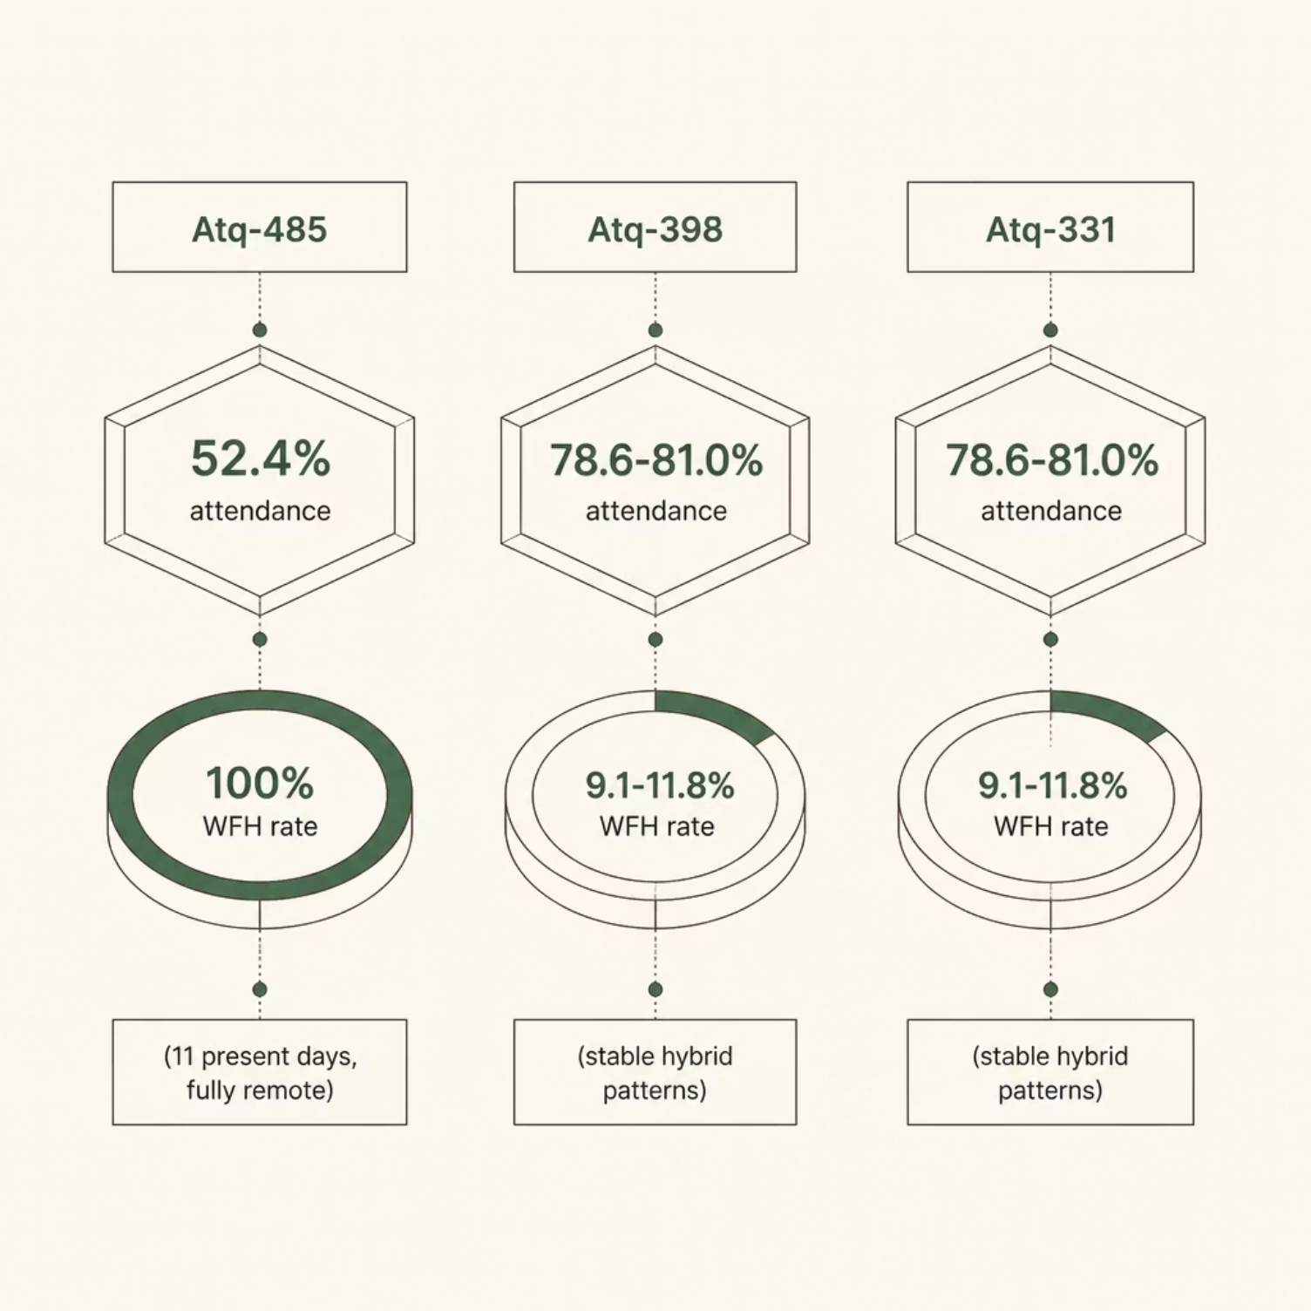

Outlier Employee Tracking
Key Findings
Atq-485 — Only 52.4% attendance across 11 days; 100% WFH whenever active
Atq-398 & Atq-331 — Stable hybrid: 78.6–81.0% attendance, 9.1–11.8% remote
Dashboard isolates individual behavioral variations for HR action

Slide 4
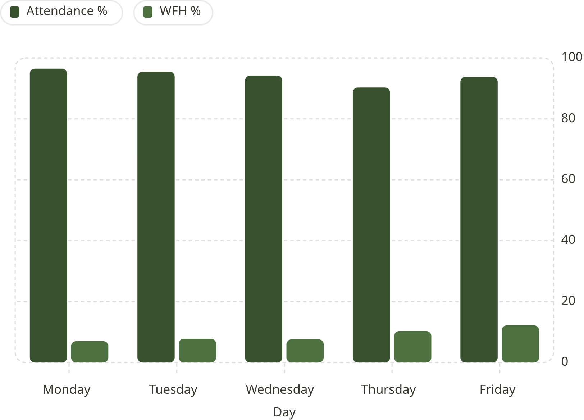
Day-of-Week Patterns
Weekly Insights
Monday — Highest presence (96.5%), lowest WFH (7.0%)
Thursday — Lowest presence (90.3%), highest SL (1.30%)
Friday — Highest WFH (12.2%), zero sick leave

Slide 5
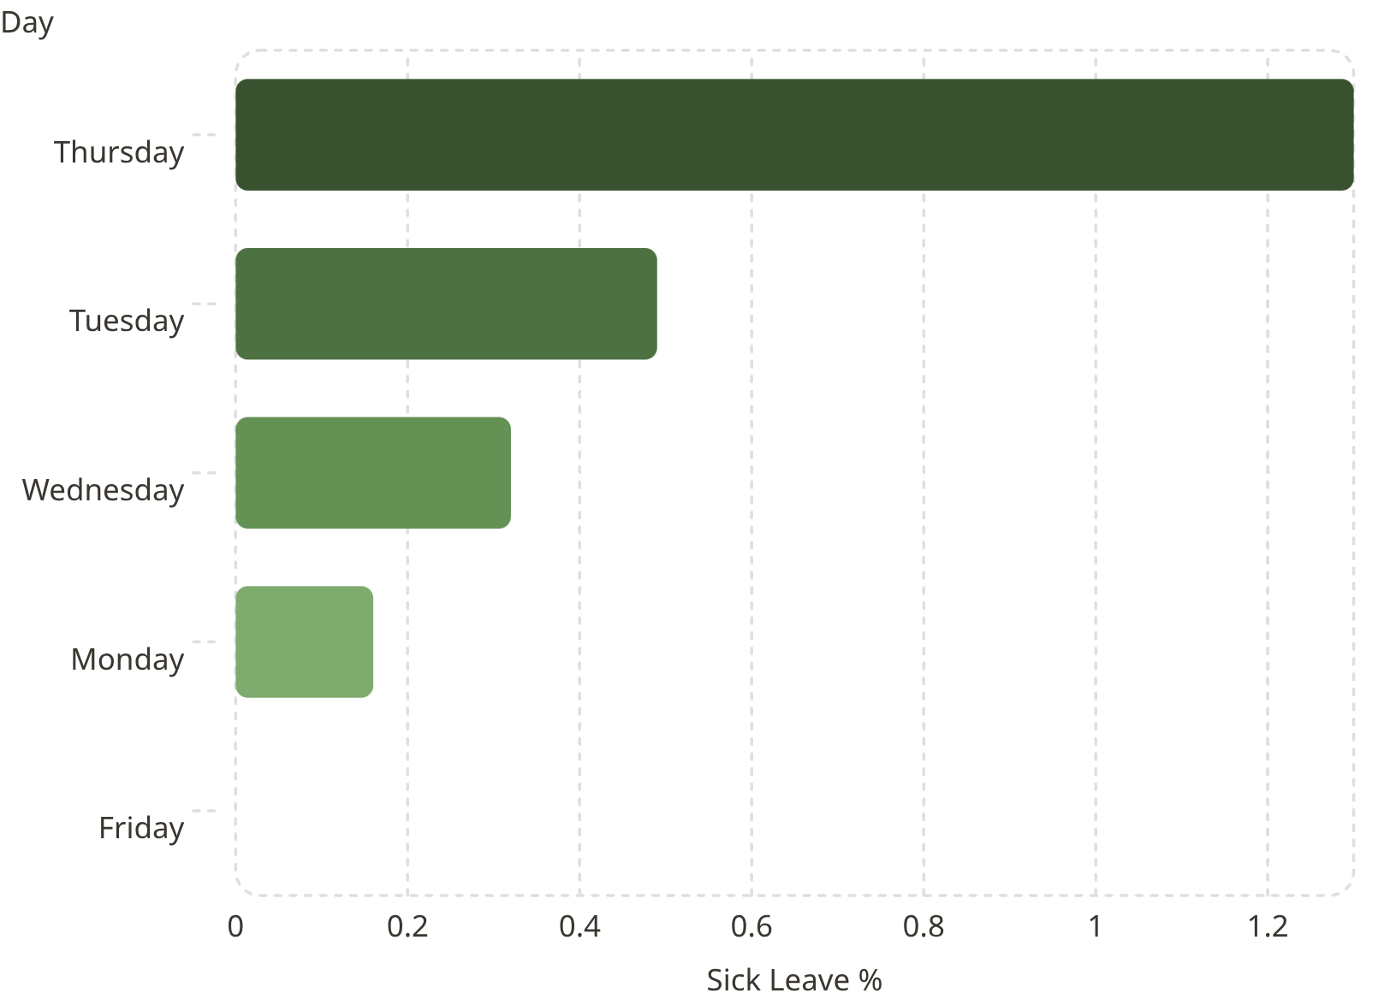

Sick Leave by Day of Week
Thursday Bottleneck
Thursday holds 1.30% SL — over 3x the overall average of 0.43%
Friday records 0.00% sick leave — cleanest day of the week
Mid-week burnout or logging anomalies may skew Thursday metrics

Slide 6
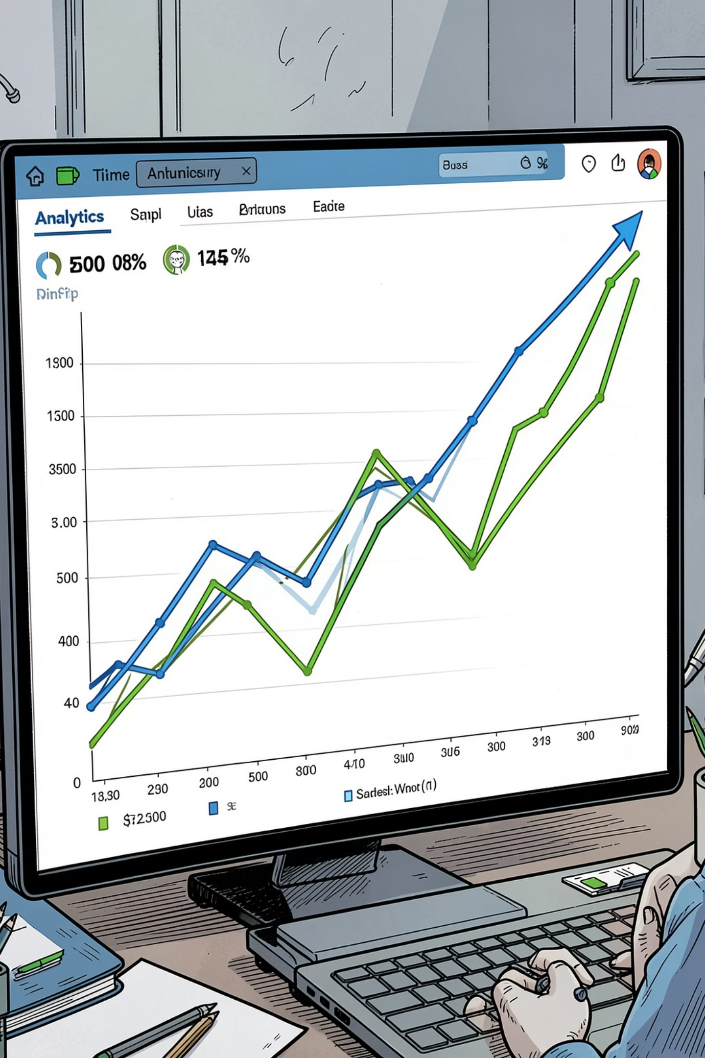

Timeline Trends: Apr – Jun 2022
Attendance
Stable 92.1–97.4% corridor; sharp dip to 87.2% pre-mid-month
Sick Leave
Near-zero baseline (0.00–0.64%); single-day surge to 2.56%
WFH Growth
Upward trendline: from 3.9% early month to peak of 16.4%

Slide 7
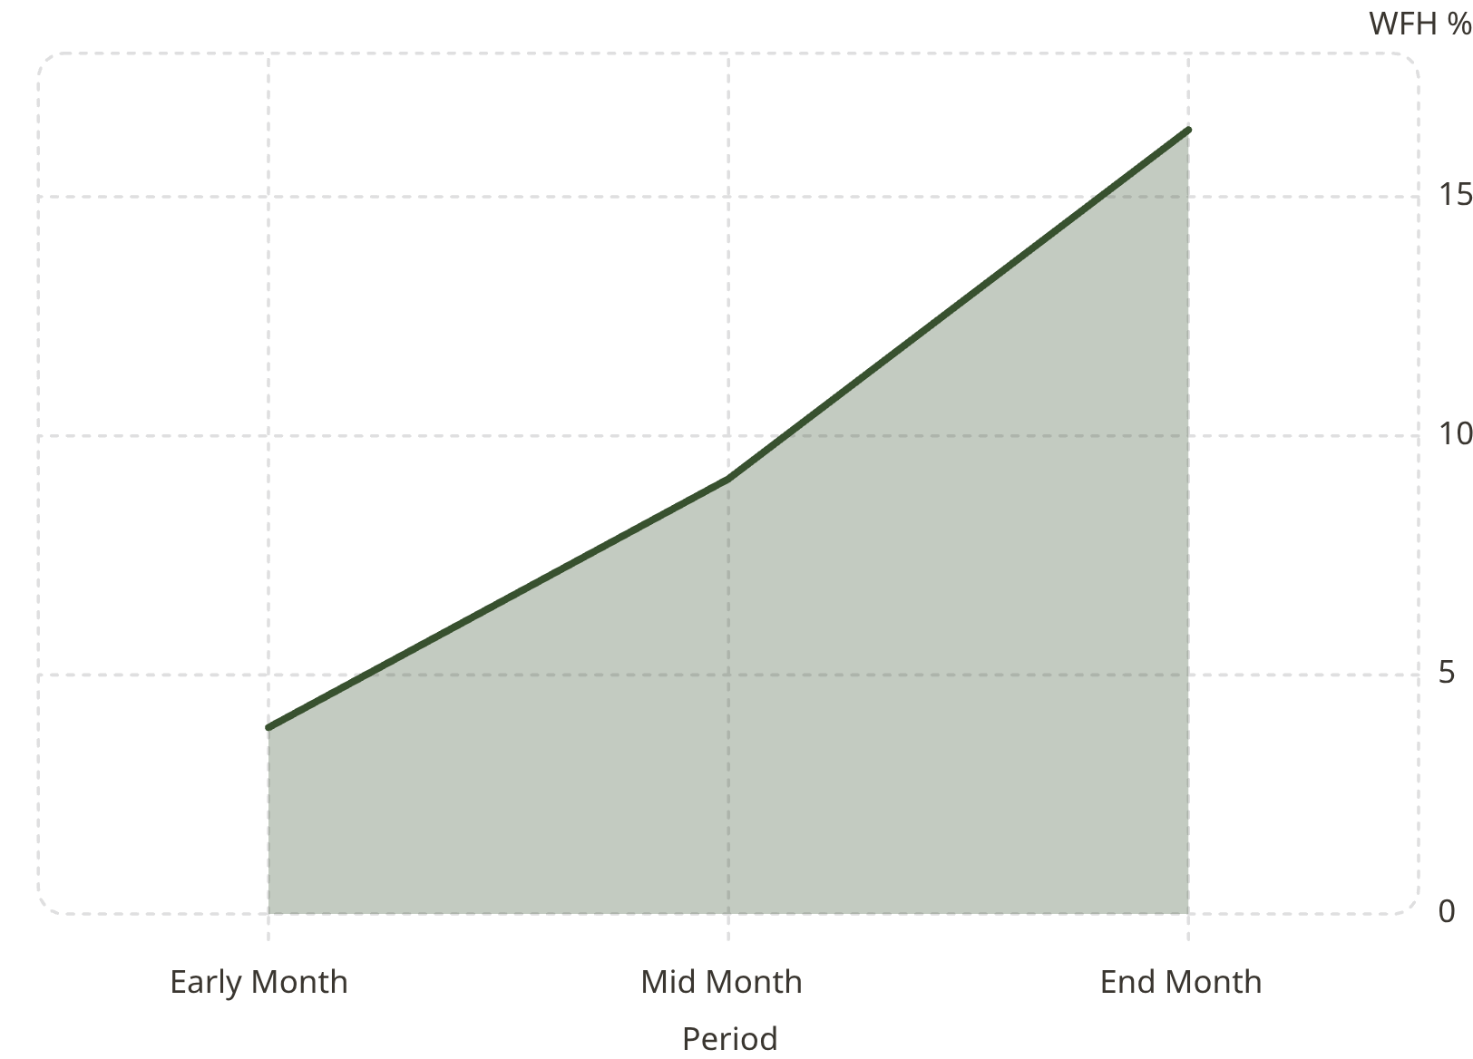

WFH Adoption Trend
Remote Work is Scaling
WFH rate grew 4x over the tracked period
From 3.9% baseline to 16.4% peak — an active, sustained upward trajectory
IT must scale VPN bandwidth and remote security protocols to match demand

Slide 8




Strategic Recommendations
Reschedule Fridays
Audit Thursdays
Move client workshops to Monday (96.5% in-office)
Investigate 90.3% presence & 1.30% SL — check for burnout
Scale Remote Infra
Expand VPN & security for rising hybrid demand

