Slide 1
01 / THE CONTEXT & PROBLEM
YUVA YODHA ENERGY TECH 2026 ◆ SCHNEIDER ELECTRIC
THE GRID IS BECOMING LESS PREDICTABLE.
Renewables fluctuate. Demand moves. Flexibility is uncertain. Every intervention has consequences.
THE INTERACTION OF FORCES
Modern distribution networks operate under simultaneous non-stationary dynamics:
• Renewable Intermittency: Feeder solar & wind swing by MWs within minutes. Without weather forecasts, 24h PV prediction error spikes to 74.3 kW (R²=0.62).
• Variable Demand: 1,871 residential & commercial loads shift concurrently. Peak evening ramps concentrate 18.5x more prediction error than calm hours.
• Uncertain Flexibility: Operators balance grids using assumed flexibility, yet historical consumption variation carries zero physical control guarantees.
REALITY BENCHMARK: SMART-DS V1.0 FEEDER
5,196 Nodes | 1,871 Customer Loads | 1,216 PV Arrays | 93 Batteries
Evaluated on 35,040 native 15-minute intervals across real geographic distribution topology. No synthetic data, no artificial smoothing.
UNMODELLED PHYSICS: 3.22% TECHNICAL LOSSES
Real feeders lose 501.67 kW across lines at 15,090.72 kW load. Naive balance algorithms that ignore physics fail to close by >500 kW.
ENERGY SYSTEM VULNERABILITY COUPLING:
RENEWABLES (Intermittent)
GRID STATE & UNCERTAINTY
DEMAND (Volatile Shifts)
➔
THE IMPACT ON DISCOMS & RELIABILITY
When automated dispatch acts blindly on point forecasts, incorrect commands trigger line overloads, voltage collapse, and severe DSM deviation penalties.
GridSentinal Core Objective: Turn raw predictions into verified, risk-aware energy decisions.
DECISION & CONSEQUENCE
DISTRIBUTED ASSETS (DERs)
GRIDSENTINAL | Adaptive, Self-Verifying Energy Intelligence
Challenge: Grid Reliability | The Unsupervised Suspects
‹ 01 / 11 ›

Slide 2
02 / THE CRITICAL INDUSTRY GAP
YUVA YODHA ENERGY TECH 2026 ◆ SCHNEIDER ELECTRIC
PREDICTION IS ONLY THE FIRST PROBLEM.
Why naive automation fails: four interacting challenges that make unverified AI unsafe.
01 / VARIABLE DEMAND
Non-Stationary Consumer Loads
Customer demand profiles change by day of week, seasonal temperature, and lifestyle shifts.
• Peak error concentrates in high-demand & high-ramp periods (18.5x error ratio vs baseline).
• Standard regression models optimize average loss, collapsing exactly during critical stress hours.
02 / RENEWABLE INTERMITTENCY
Weather-Dependent Generation Volatility
Solar ramps occur with high frequency and zero advance notice from standard SCADA.
• At 24h horizon without local weather forecasts, PV forecasting MAE jumps from 8.57 kW to 74.3 kW.
• Percentage metrics (MAPE) fail completely (reading 126%) because 52.2% of solar data is zero.
03 / UNCERTAIN FLEXIBILITY
Consumption History != Controllable Capacity
Standard smart grid tools mistake past load variation for available demand response.
• Real feeder audit reveals 0 of 8 flexibility dimensions have physical control interfaces.
• Batteries often lack real-time state-of-charge telemetry; dispatching assumed flexibility causes blackout risk.
04 / UNCHECKED DECISION RISK
Execution Without Adversarial Verification
Point forecasts feed directly into optimization solvers without verifying failure modes.
• Naive automation acts on confidence without knowing if the forecast is in an uncalibrated regime.
• No red-teaming exists to ask: 'What happens if this dispatch command coincides with a solar drop?'
THE VULNERABILITY FORMULA:
[ Forecast Error ] + [ Hidden Uncertainty ] + [ Unknown Capability ] + [ Physical Consequences ] = Naive Automation is Unsafe
GRIDSENTINAL | Adaptive, Self-Verifying Energy Intelligence
Challenge: Grid Reliability | The Unsupervised Suspects
‹ 02 / 11 ›

Slide 3
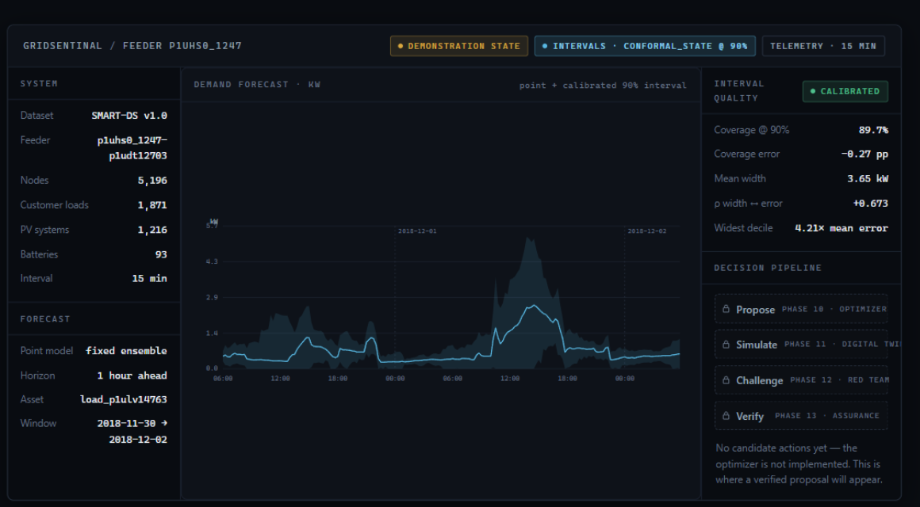
03 / PROPOSED SOLUTION
YUVA YODHA ENERGY TECH 2026 ◆ SCHNEIDER ELECTRIC
MEET GRIDSENTINAL.
An adaptive, self-verifying energy intelligence system for renewable-integrated distributed networks.
THE CORE PHILOSOPHY
Don't just predict the grid.
Verify what happens next.
GridSentinal connects predictive intelligence directly to verified action. Instead of treating forecasting as the end product, it wraps every prediction in calibrated uncertainty, audits available flexibility, and challenges candidate decisions before they touch physical hardware.
THE 11-STAGE INTELLIGENCE LIFECYCLE:
• 01-04 OBSERVE & PREDICT:
Ingest telemetry, normalize power flows, run multi-expert ensemble, calibrate prediction intervals [OPERATIONAL]
• 05-07 CHALLENGE & SIMULATE:
Formulate candidate dispatch, subject to adversarial red-teaming, run digital twin power-flow [DESIGNED]
• 08-11 ASSURE, ACT & LEARN:
Decision assurance gate, verified execution, outcome tracking, energy-aware MLOps loop [ROADMAP]
LIVE OPERATOR CONSOLE: Feeder p1uhs0_1247 (5,196 nodes).
Shaded 90% conformal interval bounding 1h demand forecast with operational verification pipeline.
GRIDSENTINAL | Adaptive, Self-Verifying Energy Intelligence
Challenge: Grid Reliability | The Unsupervised Suspects
‹ 03 / 11 ›

Slide 4
04 / SYSTEM ARCHITECTURE
YUVA YODHA ENERGY TECH 2026 ◆ SCHNEIDER ELECTRIC
FROM TELEMETRY TO TRUSTED DECISION.
A layered, evidence-based pipeline with explicit operational boundaries and zero fake mocks.
LAYER 1: DATA & TELEMETRY
LAYER 2: PREDICTION & ERROR
LAYER 3: FLEXIBILITY & PROXY
LAYER 4: DECISION & ASSURANCE
SMART-DS v1.0 Feeder
[OPERATIONAL]
AUS/P1U 2018 base timeseries; 359 files SHA-256 verified; 35,040 native 15-min points.
Heterogeneous Ensemble
[OPERATIONAL]
Fixed ensemble (Persistence, Hist-GBM, Temporal TCN) beats learned router across all horizons (0.398 kW at h=1).
Flexibility Capability Audit
[OPERATIONAL]
0/8 dimensions physically supported in SMART-DS; battery dispatch unavailable (G-01); all gaps documented.
Optimization & Red Team
[DESIGNED]
Multi-objective candidate actions attacked under stress scenarios (solar ramp, EV spike, telemetry delay).
➔
➔
➔
Data Quality & Contract
[OPERATIONAL]
Strict Pydantic domain models; 3.22% physical line loss detected and accounted for; no synthetic filling.
Calibrated Uncertainty
[OPERATIONAL]
Split-conformal intervals on CAL_CONF; empirical coverage within ±0.01 at h=1, h=4, h=96 on sealed test.
Behavioural Envelope
[STATISTICAL PROXY]
Empirical variation bounds (±2.73 kW at h=1 to ±14.12 kW at h=96); scheduler control strictly forbidden.
Digital Twin & Assurance
[ROADMAP]
OpenDSS power flow validation; assurance gate approves/rejects before physical execution touches hardware.
ARCHITECTURAL INTEGRITY COMMITMENT: Learned models (Forecaster, Uncertainty) are separated from orchestrating agents (Red Team, Drift). Subpackages are created only when implemented — no empty stubs or simulated mocks.
GRIDSENTINAL | Adaptive, Self-Verifying Energy Intelligence
Challenge: Grid Reliability | The Unsupervised Suspects
‹ 04 / 11 ›

Slide 5
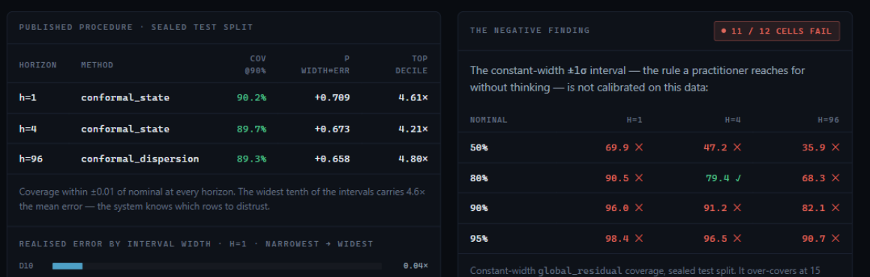
05 / PROBABILISTIC INTELLIGENCE
YUVA YODHA ENERGY TECH 2026 ◆ SCHNEIDER ELECTRIC
A FORECAST WITHOUT UNCERTAINTY IS HALF A FORECAST.
Point predictions fail silently; calibrated intervals identify exactly which rows must not be trusted.
PHASE 8 EMPIRICAL EVIDENCE (SEALED TEST, 179,520 ROWS)
Evaluated on sealed chronological test split without data leakage:
METHODOLOGICAL HONESTY: THE ±1σ NEGATIVE RESULT
A constant-width ±1σ interval (the default rule most practitioners use) fails 11 of 12 coverage cells on this dataset.
• At h=1 it over-covers (0.984 vs nominal 0.95); at h=96 it under-covers (0.907).
• The root cause: Point forecast error differs by +8.6% (h=1) and -11.0% (h=96) across the year. A static width calibrated on one half does not transfer to another.
• Conformal calibration guarantees are NOT claimed: time series residuals violate exchangeability. We report empirical held-out coverage, not marketing fiction.
Horizon | Published Method | Cov @90% | Corr ρ | Top Decile
h = 1 (15m) | conformal_state | 90.20% | +0.709 | 4.61× err
h = 4 (1h) | conformal_state | 89.73% | +0.673 | 4.21× err
h = 96 (24h) | conformal_dispersion | 89.34% | +0.658 | 4.80× err
KEY QUANTITATIVE TAKEAWAYS:
• Error-Width Coupling: Spearman correlation between interval width and realized error is +0.66 to +0.71. The interval reliably expands when the grid is unpredictable.
• Risk Containment: The widest 10% of prediction intervals carries 4.2x to 4.8x the mean error — enabling automated decision suppression during volatile periods.
GRIDSENTINAL | Adaptive, Self-Verifying Energy Intelligence
Challenge: Grid Reliability | The Unsupervised Suspects
‹ 05 / 11 ›

Slide 6
06 / FLEXIBILITY CAPABILITY AUDIT
YUVA YODHA ENERGY TECH 2026 ◆ SCHNEIDER ELECTRIC
FLEXIBILITY WITHOUT FICTION.
Historical consumption behavior does not automatically imply dispatchable capacity.
PHYSICAL FLEXIBILITY
[UNKNOWN ON RAW DATA]
STATISTICAL PROXY
[PARTIALLY ESTIMABLE]
ASSUMED FLEXIBILITY
[SCENARIO ONLY]
◆ 0 of 8 Dimensions Supported
SMART-DS carries no physical limits or control interfaces for customer loads.
◆ Battery Telemetry Blindspot
93/93 storage units report State=IDLING with nameplate scalar only; no SOC series (G-01).
◆ Missing DER Programs
Zero demand-response enrolment, HVAC setpoint, or EV departure series exist (G-07 through G-10).
◆ Rigorous Verdict: NO
Refusing to invent controllable capacity is a core safety feature, not an omission.
◆ Behavioural Envelope
Measures how far demand historically deviated from expected profile without intervention.
◆ Calibrated Widths
Bounded at ±2.73 kW (h=1), ±5.57 kW (h=4), ±14.12 kW (h=96).
◆ 6x Wider Than Point MAE
90% two-sided coverage requires wide bands due to heavy-tailed load variation.
◆ Strict Interpretation
'We were surprised outside this band 10% of the time' — NOT 'We can move 6 kW.'
◆ Advisory Authority Only
Assumed values are allowed strictly for offline scenario stress-testing and simulation.
◆ Enforced Domain Contract
Code constructor raises DomainValidationError if a statistical proxy claims scheduleable control.
◆ Zero Unverified Commands
The decision engine is architecturally barred from commanding unverified capacity.
◆ DISCOM Value
Protects distribution utilities from severe under-delivery imbalance penalties.
SCIENTIFIC INTEGRITY: UNCERTAINTY PREDICTS FLEXIBILITY, YET DISCOUNT WAS WITHHELD
Phase 8 uncertainty correlated with realized flexibility deviations (+0.393 / +0.246 / +0.312 at h=1/4/96). Because this was observed post-hoc on the sealed split, GridSentinal deliberately refused to apply an uncertainty discount to avoid test-leakage contamination.
GRIDSENTINAL | Adaptive, Self-Verifying Energy Intelligence
Challenge: Grid Reliability | The Unsupervised Suspects
‹ 06 / 11 ›

Slide 7
07 / DECISION ASSURANCE ENGINE
YUVA YODHA ENERGY TECH 2026 ◆ SCHNEIDER ELECTRIC
BEFORE IT ACTS, IT TRIES TO BREAK THE DECISION.
Instead of asking only 'What should the system do?', GridSentinal asks 'What could go wrong if it does?'
01 / PROPOSE
Optimizer Engine
[DESIGNED (Phase 10)]
02 / RED TEAM
Adversarial Engine
[DESIGNED (Phase 12)]
03 / SIMULATE
Digital Twin
[DESIGNED (Phase 11)]
04 / ASSURE
Assurance Gate
[DESIGNED (Phase 13)]
05 / EXECUTE
Adaptive Autonomy
[ROADMAP (Phase 16)]
Converts forecasts, calibrated uncertainty envelopes, and contractual flexibility into candidate dispatch actions.
Formulates multi-objective cost vs reliability trade-offs under operational constraints.
Subjects candidate action to deliberate extreme stress scenarios:
• Sudden 80% solar collapse
• Correlated EV cluster spike
• Communication latency & dropped telemetry
• Unmodelled 3.22% line losses
Independent power-flow simulation (OpenDSS integration) computes actual physical outcomes:
• Feeder voltage deviations
• Line thermal overload limits
• Substation back-feed risks
Decision Assurance evaluates candidate against physics & policy:
• Does action survive Red Team?
• Is uncertainty within safe bounds?
• Action: Approve, Reject, or Re-optimize
Closed-loop actuation:
• Autonomous execution for verified high-confidence actions
• Fallback to Human Supervisor for edge-case alerts
• Real-world outcome telemetry loops into MLOps
➔
➔
➔
➔
THE CORE DIFFERENTIATOR:
Trust is not earned by high model confidence. Trust is earned when candidate actions survive deliberate attempts to break them before touching physical grid hardware.
GRIDSENTINAL | Adaptive, Self-Verifying Energy Intelligence
Challenge: Grid Reliability | The Unsupervised Suspects
‹ 07 / 11 ›

Slide 8
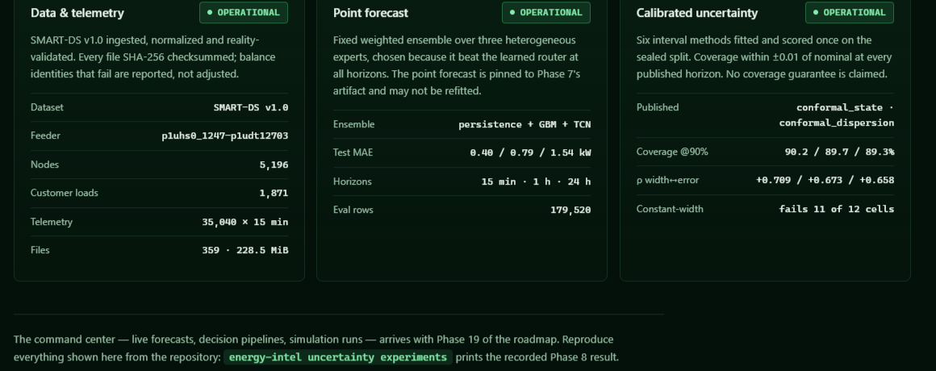
08 / RESEARCH & EXPERIMENTAL EVIDENCE
YUVA YODHA ENERGY TECH 2026 ◆ SCHNEIDER ELECTRIC
WE TESTED THE IDEA. WE DIDN'T JUST DEMO IT.
1,235 tests passing, 29 registered experiments, and rigorous negative result reporting.
TECHNICAL STACK & PROTOCOL DISCIPLINE
◆ Runtime & Tooling: Python 3.12, PyTorch CPU-deterministic, scikit-learn, OpenDSS parser. pandas was deliberately rejected across the entire core pipeline.
◆ Leakage Protection: Chronological train/validation/test partitions. Validation split into CAL_FIT (50%) and CAL_CONF (50%). Sealed test split read exactly once.
◆ Pre-Registered Bars: Success thresholds registered before execution (e.g. Qwen required to beat 1.5648 kW at 24h). Misses recorded rather than tuned around.
◆ Verification Integrity: 1,235 automated tests passing; 29 committed experiment runs in registry.jsonl; D-001 through D-109 architectural decision records.
FIVE COMPLETED RESEARCH FINDINGS
Phase 6: Language-Model Specialization [NEGATIVE RESULT]
A frozen Qwen3-1.7B LLM trunk lost to classical GBM at every horizon (2.74 vs 1.56 kW at 24h). Readout representations collapsed to participation ratio 2.1 vs 10.0 for random controls.
Phase 7: Learned Expert Router (MoE) [NEGATIVE RESULT]
While oracle routing proved 30-38% theoretical headroom existed, a learned neural router lost to the fixed weighted ensemble at 0 of 3 horizons (0.398 vs 0.407 kW at h=1). The fixed ensemble shipped.
Phase 8: Calibrated Prediction Intervals [VERIFIED YES]
Conformal state intervals achieved nominal 90% coverage (89.3%-90.2%) across all horizons. Disproved static ±1σ assumption (failed 11/12 cells).
Phase 9: Flexibility Capability Audit [MEASURED VERDICT: NO]
Disproved the industry myth of free demand response. 0 of 8 dimensions possessed physical control interfaces; statistical proxy bounded at ±2.73 to ±14.12 kW.
Phase 10: Controlled Feature Ablation [COMPLETE EVIDENCE]
Feature contribution is target-dependent. PV improved -27.40% under autoregressive lag features (A->B), while customer load preferred simple calendar features (Set A).
GRIDSENTINAL | Adaptive, Self-Verifying Energy Intelligence
Challenge: Grid Reliability | The Unsupervised Suspects
‹ 08 / 11 ›

Slide 9
09 / INNOVATION & CHALLENGE ALIGNMENT
YUVA YODHA ENERGY TECH 2026 ◆ SCHNEIDER ELECTRIC
WHAT ACTUALLY MAKES GRIDSENTINAL DIFFERENT?
Yuva Yodha Energy Tech Hackathon: Direct causal mapping to Grid Reliability challenge needs.
CHALLENGE NEED: RENEWABLE INTERMITTENCY
Feeder solar ramps cause voltage spikes, reverse power flows, and sudden generation deficits.
GRIDSENTINAL CAPABILITY
15-minute multi-expert nowcasting + calibrated 24h day-ahead horizon with conformal error envelopes.
EXPECTED VALUE
DISCOMs gain quantified ramp foresight, preventing blind generation shortfalls.
➔
➔
CHALLENGE NEED: DER & STORAGE COORDINATION
Uncoordinated distributed solar and batteries can destabilize local distribution networks.
GRIDSENTINAL CAPABILITY
Rigorous Flexibility Capability Audit + Behavioural Envelopes; refuses unverified dispatch commands.
EXPECTED VALUE
Prevents over-commitment penalties; commands only verified, physically supported assets.
➔
➔
CHALLENGE NEED: TECHNICAL LOSSES & PHYSICS
Distribution lines exhibit 3.22% technical losses (501.7 kW on feeder), causing power balance failure.
GRIDSENTINAL CAPABILITY
Formal Energy Contract with loss modeling; OpenDSS digital twin physical power-flow validation.
EXPECTED VALUE
Ensures dispatch actions close physically and prevent transformer thermal stress.
➔
➔
CHALLENGE NEED: AUTONOMOUS GRID SAFETY
Direct execution of unverified AI decisions risks catastrophic grid events and utility liability.
GRIDSENTINAL CAPABILITY
Adversarial Red Team stress-testing + Decision Assurance Gate with human-in-the-loop fallback.
EXPECTED VALUE
Zero unchecked automated decisions; verifiable operational safety for industrial deployment.
➔
➔
THE SYSTEM-LEVEL INNOVATION:
GridSentinal treats uncertainty, capability limits, and decision verification as first-class citizens of energy intelligence, rather than cosmetic reporting dashboards.
GRIDSENTINAL | Adaptive, Self-Verifying Energy Intelligence
Challenge: Grid Reliability | The Unsupervised Suspects
‹ 09 / 11 ›

Slide 10
10 / VALUE CREATION & ROADMAP
YUVA YODHA ENERGY TECH 2026 ◆ SCHNEIDER ELECTRIC
FROM LAB EVIDENCE TO INDUSTRIAL DEPLOYMENT.
Clear distinction between completed research foundation and future industrial scaling.
EXPECTED SYSTEM IMPACT (SCIENTIFICALLY FRAMED)
◆ Enhanced Grid Reliability
Pre-emptive mitigation of solar ramps & evening demand peaks through calibrated forecast bounds; eliminates blind tripping.
◆ DISCOM Financial Integrity
Separating statistical proxies from physical flexibility prevents costly DSM deviation penalties and battery degradation.
◆ Operational Safety & Assurance
Adversarial stress-testing ensures zero unverified autonomous dispatch commands reach critical distribution assets.
◆ Physics-Grounded Optimization
Incorporating explicit 3.22% technical losses guarantees power balance closure across feeder nodes.
◆ Outcome-Aware MLOps
Model degradation is evaluated by physical consequence (voltage violations, line stress) rather than offline validation loss.
PHASED IMPLEMENTATION ROADMAP
PHASE I: PROVEN FOUNDATION [NOW (COMPLETE)]
• SMART-DS v1.0 data ingestion & reality validation (5,196 nodes)
• Heterogeneous multi-expert forecasting ensemble
• Calibrated split-conformal uncertainty intervals (89.7% cov)
• Flexibility capability audit & Phase 10 feature ablation
PHASE II: DECISION & VERIFICATION [Q1-Q2 2026 (NEXT)]
• Pyomo/MPC constrained candidate action optimizer (Phase 10)
• OpenDSS digital twin power-flow integration (Phase 11)
• Adversarial Red-Team scenario attack engine (Phase 12)
• Decision assurance scoring gate with operator console (Phase 13)
PHASE III: INDUSTRIAL SCALING [Q3-Q4 2026 (ROADMAP)]
• Schneider Electric EcoStruxure ADMS / DERMS API bridge
• Hardware-in-the-loop (HIL) microgrid testbed integration
• Real-world DISCOM pilot deployment with adaptive autonomy
• Outcome-aware MLOps agent orchestration with automated drift recovery
GRIDSENTINAL | Adaptive, Self-Verifying Energy Intelligence
Challenge: Grid Reliability | The Unsupervised Suspects
‹ 10 / 11 ›

Slide 11

11 / TEAM & CONCLUSION
YUVA YODHA ENERGY TECH 2026 ◆ SCHNEIDER ELECTRIC
BUILDING THE GRID'S INTELLIGENCE LAYER.
Yuva Yodha Energy Tech Hackathon 2026 — Schneider Electric.
THE UNSUPERVISED SUSPECTS
Team Lead & Developer: Pratham Kapoor
Email: prathamkapoor027@gmail.com
ENGINEERING REFERENCES & STANDARDS
• NREL SMART-DS v1.0: Synthetic Models for Advanced, Realistic, Reliable Grid Scenarios
• IEEE 1547-2018: Standard for Interconnection and Interoperability of Distributed Energy Resources
• Conformal Prediction: Algorithmic Learning in a Random World (Vovk, Gammerman, Shafer)
• EPRI OpenDSS: Electric Power Research Institute Open Distribution System Simulator
OPEN SOURCE REPOSITORY & PROVENANCE:
GitHub: https://github.com/PrathamKapoor/GridSentinal
DON'T JUST AUTOMATE THE GRID.
MAKE IT THINK BEFORE IT ACTS.
CORE EXPERTISE & RESEARCH FOCUS:
◆ Probabilistic Energy AI: Split-conformal prediction, quantile regression, heterogeneous ensemble modeling.
◆ Energy Systems Modeling: OpenDSS distribution power-flow, SMART-DS v1.0 architecture, feeder loss accounting.
◆ Adversarial Verification: Red-teaming decision pipelines, digital twin safety constraints, adaptive autonomy gates.
◆ Enterprise MLOps: Zero-leakage data pipelines, verifiable experiment registries, automated audit traces.
GRIDSENTINAL | Adaptive, Self-Verifying Energy Intelligence
Challenge: Grid Reliability | The Unsupervised Suspects
‹ 11 / 11 ›

