Slide 1

identification and analysis of factors leading to mobile addiction in engineering students
Division C: Team 3

Slide 2
Team #3
Roll No. | Name | USN
313 | Ayush Yaligar | 070
315 | V Chandrasivanarayana Reddy | 208
317 | Pratham Kathare | 085
318 | Zaid Momin | 121

Slide 3
Problem statement
Identification and analysis of factors leading to mobile addiction in engineering students.

Slide 4

Introduction
Mobile phones have become essential — but for engineering students, overuse can lead to serious addiction, impacting focus, mental health, and academic life. This study aims to identify key factors behind mobile addiction and analyze them through data-driven insights, helping promote healthier digital habits.

Slide 5
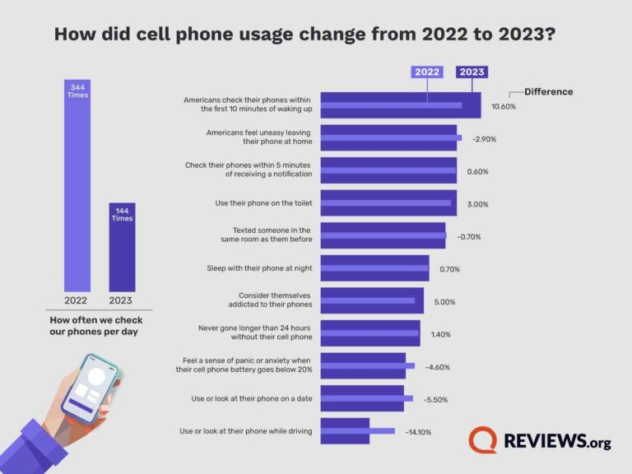
Introduction

Slide 6



Relevant sdgS
1. SDG 3: Good Health and Well-Being
Mobile addiction negatively impacts mental health, sleep quality, stress levels, and social relationships.
By analyzing factors, your project promotes awareness and healthier digital behavior, improving overall well-being.
2. SDG 4: Quality Education
Addiction affects academic performance (distraction, procrastination, reduced productivity).
Your project supports better focus, academic excellence, and learning outcomes through healthier mobile usage.
3. SDG 9: Industry, Innovation, and Infrastructure (indirect connection)
Engineering students are future innovators. Protecting their mental health and productivity today ensures a stronger, more innovative workforce tomorrow.

Slide 7
SDG 3
Mobile addiction directly threatens several parts of SDG 3’s mission. For engineering students — who are often under academic pressure — excessive smartphone use leads to:
Increased stress and anxiety (due to social media overuse, FOMO, constant notifications)
Poor sleep hygiene (because of late-night screen time and blue light exposure)
Reduced physical activity (more time spent indoors, sitting, scrolling instead of moving)
Impaired mental focus and emotional stability (leading to lower academic performance and burnout)
Target 3.4: Reduce by one-third premature mortality from non-communicable diseases through prevention and mental health care. → Mobile addiction is a behavioral risk factor contributing to poor mental health.
Target 3.5: Strengthen the prevention and treatment of substance abuse, including harmful use of alcohol and narcotic drugs. → While not a substance, behavioral addictions (like mobile addiction) are similarly harmful and need attention.

Slide 8
SDG 4
Our project also supports SDG 4: Quality Education by recognizing how mobile addiction compromises academic success among engineering students.
Excessive phone usage leads to lower attention spans, reduced deep learning, and a decline in student performance. By uncovering addiction patterns through data analysis, we aim to promote healthier digital habits that can strengthen learning capabilities, improve academic engagement, and support better educational outcomes.
Thus, we contribute to building a future workforce that is not only technologically skilled but also mentally focused and academically empowered.
Target 4.1: Ensure that all girls and boys complete free, equitable and quality primary and secondary education leading to relevant and effective learning outcomes.
→ Effective learning outcomes are hurt by mobile addiction even in higher education.
Target 4.4: Increase the number of youth and adults who have relevant skills, including technical and vocational skills, for employment, decent jobs, and entrepreneurship.
→ Engineering students with better focus and learning habits are more likely to acquire deeper technical skills

Slide 9
SDG 9
Ensure healthy lives and promote well-being for all at all ages.
Our project supports SDG 3 by addressing the growing mental and emotional challenges caused by mobile addiction among engineering students. Excessive smartphone usage is linked to increased stress, anxiety, sleep disturbances, and reduced physical activity, all of which negatively impact mental and physical health. By identifying key addiction patterns through data-driven analysis, we aim to promote healthier technology habits, improve sleep quality, reduce emotional stress, and foster better overall well-being among students. Ultimately, our work contributes to building a generation of students who are healthier, more resilient, and mentally prepared for academic and professional success.
Target 3.4: Reduce premature mortality through prevention and treatment of mental health conditions.
Target 3.5: Strengthen prevention of behavioral addictions.

Slide 10
Data description
Student_ID
Age
Gender
Year_of_Study
Average_Screen_Time_per_Day
Main_Purpose_of_Us
Number_of_Social_Media_Apps
Daily_Social_Media_Usage_Hours
Mobile_Usage_Before_Sleep
Sleep_Hours_Per_Night
Academic_Performance_CGPA
Anxiety_Level
Stress_Level
Participation_in_Physical_Activities
Feelings_of_Loneliness
Family_Background
Hostel_or_Day_Scholar
Has_Smartphone_Since
Expenditure_on_Mobile_Per_Month
Attempts_to_Reduce_Usage
Self_Reported_Addiction_Level
Favorite_App
Average_YouTube_Watch_Time_Per_Day
Gaming_Hours_Per_Week
TikTok_Reels_Usage_Hours_Per_Day

Slide 11
Data description
Daily_Number_of_Mobile_Unlocks
Notifications_Received_Per_Day
FOMO_Level
Self_Control_Rating_Out_of_10
Parental_Restrictions
Previous_Attempts_to_Quit_Social_Media
Mindfulness_Practice
Physical_Exercise_Hours_Per_Week
Relationship_Status
Part_Time_Job
Average_Data_Consumption_Per_Day_GB
Preferred_Screen_Brightness_Percentage
Preferred_Device_Brand
Peer_Pressure_Experience
Depression_Symptoms
Hrs_Spent_on_Online_Shopping_Per_Week
Involvement_in_Student_Organizations
Daily_Whatsapp_Messages_Sent
Screen_Time_on_Weekends
Screen_Time_on_Weekdays
Usage_of_Productivity_Apps
Time_Spent_on_Educational_Content_Per_Week
Average_Battery_Consumption_Per_Day_Percentage
Participates_in_Digital_Detox_Camps
Uses_Screen_Time_Management_Apps

Slide 12
Data preprocessing techniques
Data Preprocessing and Feature Selection
1. Filling Missing Values
- Missing values were handled separately for numerical and categorical columns.
- For numerical features (like screen time, number of unlocks), missing values were filled with the mean of the respective column.
- For categorical features (like favorite app, gender), missing values were filled with the most frequent value (mode).
- This ensured that no information was lost and the dataset remained complete for further analysis.
2. Normalization
Two types of normalization techniques were applied:
- Min-Max Normalization: Scaled all numerical features to a range between 0 and 1. Useful for models that are sensitive to the scale of data.
- Z-Score Normalization (Standardization): Transformed numerical features so that they have a mean of 0 and a standard deviation of 1. Helpful when features are on very different scales.
- Normalization made sure that all numerical features contributed equally during model training and comparison.

Slide 13
Data preprocessing techniques
3. Feature Selection using Linear Regression
- Linear Regression was used to determine which features have the strongest relationship with the target variable: Average Screen Time per Day.
- The model was trained, and feature importances were ranked based on the absolute values of their coefficients.
- The top 10 most influential features were identified.
- This step helped in focusing the analysis on the most critical factors affecting mobile addiction among students.
4.Handling Outliers:
Outliers in the numerical features were detected and handled using the IQR (Interquartile Range) method. For each numerical column, the first quartile (Q1) and third quartile (Q3) were calculated, and the IQR was found as (Q3 - Q1). Values lower than (Q1 - 1.5 * IQR) or higher than (Q3 + 1.5 * IQR) were considered outliers. Instead of removing the data points (which could lead to information loss), outlier values were capped to the nearest acceptable boundary (Winsorization). This approach preserves the dataset size while minimizing the distortion caused by extreme values.
Summary:
Proper preprocessing improves model accuracy and interpretation. Feature selection narrows down the focus to what's truly important, avoiding noise and overfitting.

Slide 14
Suitable data visualization techniques
Screen Time vs. Academic Performance
Visualization Type: Scatter Plot
Columns to Visualize: Average_Screen_Time_per_Day, Academic_Performance_CGPA
Purpose: This will help identify any correlation between mobile screen time and academic performance, allowing you to see if higher screen time is associated with lower CGPA, which is a significant point in mobile addiction studies.
Gender vs. Self-Reported Addiction Level
Visualization Type: Bar Chart
Columns to Visualize: Gender, Self_Reported_Addiction_Level
Purpose: This will show whether there is a gender difference in perceived addiction levels, giving insight into how addiction is experienced differently across genders.
Mobile Usage Before Sleep vs. Sleep Hours
Visualization Type: Scatter Plot
Columns to Visualize: Mobile_Usage_Before_Sleep, Sleep_Hours_Per_Night
Purpose: This is key to understanding whether using mobile devices before sleep is linked to poorer sleep quality or fewer sleep hours, a central issue in mobile addiction.

Slide 15
Suitable data visualization techniques
Self-Control Rating vs. Self-Reported Addiction Level
Visualization Type: Scatter Plot
Columns to Visualize: Self_Control_Rating_out_of_10, Self_Reported_Addiction_Level
Purpose: This will explore whether students with higher self-control tend to report lower levels of mobile addiction, which could be an important behavioral insight.
Social Media Usage by Year of Study
Visualization Type: Bar Chart
Columns to Visualize: Year_of_Study, Daily_Social_Media_Usage_Hours
Purpose: This will show if social media usage increases or decreases as students progress through their academic journey, helping to identify patterns in mobile addiction across different stages of university life.

Slide 16
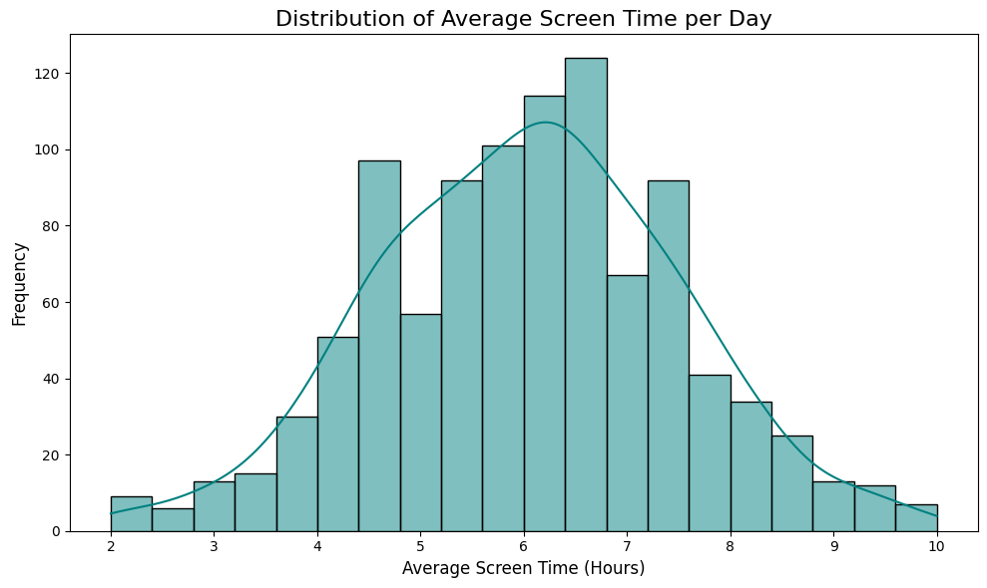
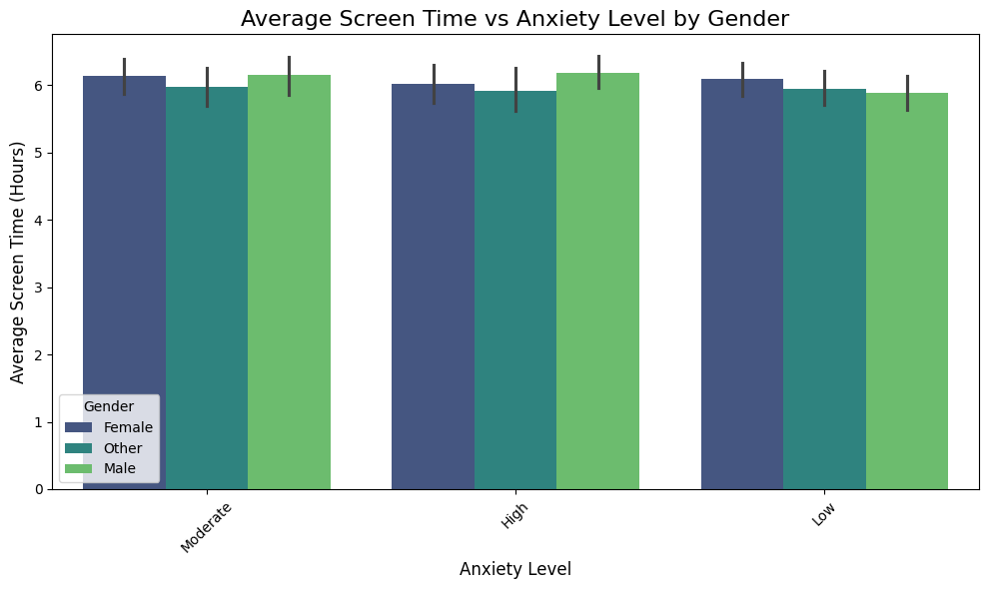
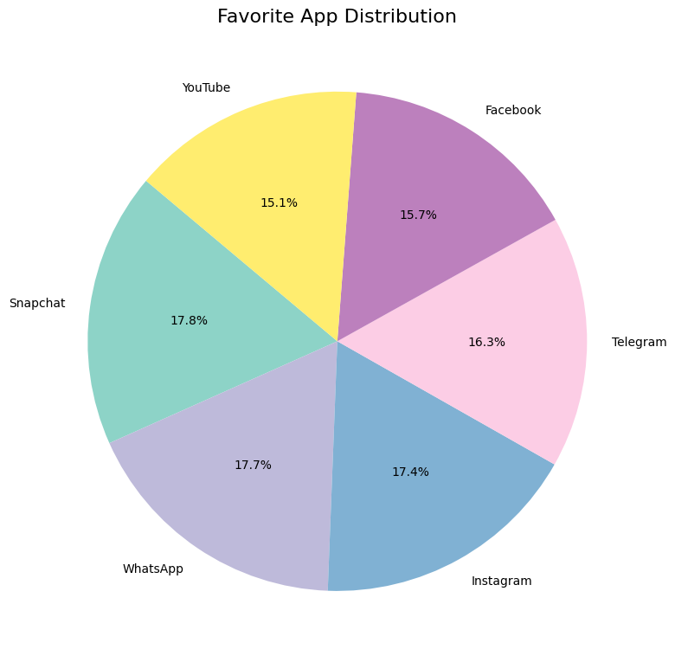
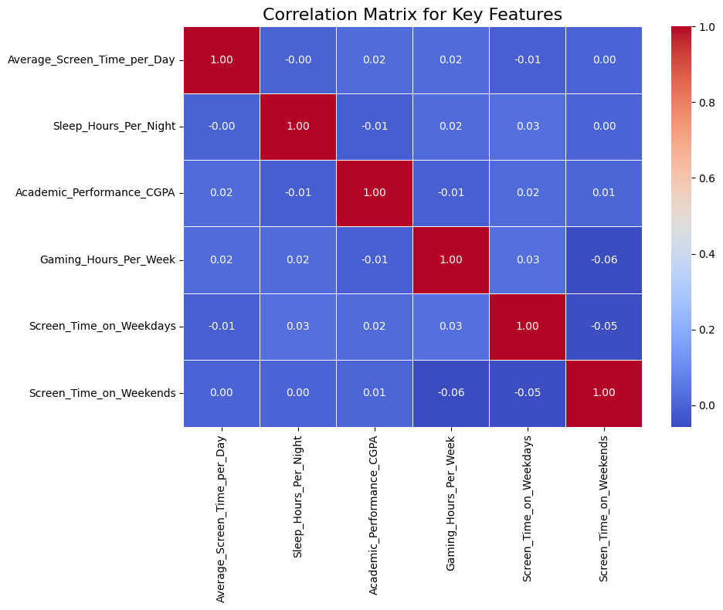
Suitable data Visualizations

Slide 17
Sources
www.kaggle.com

