Slide 1


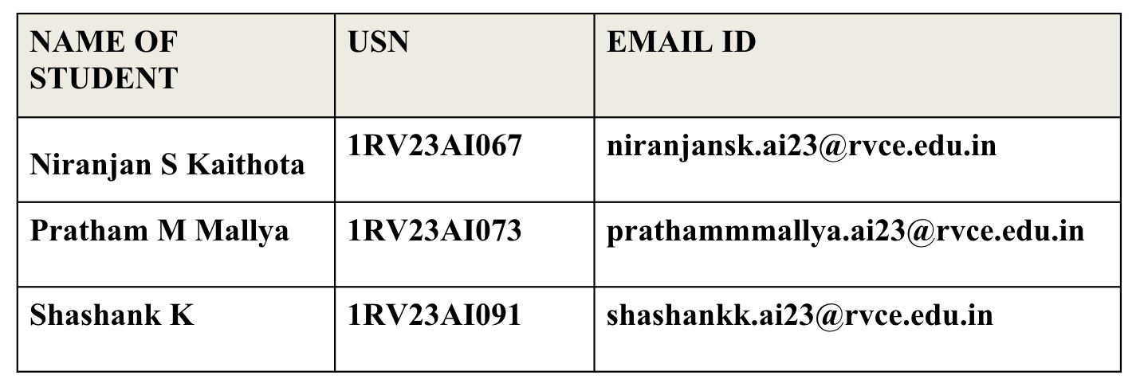
VII SEMESTER
Title : Real-Time Forest Fire Detection System
MENTORS : Dr. S. Anupama kumar & Dr. Vijayalakshmi M N
Associate Professor,
Department of Artificial Intelligence and Machine Learning
RV College of Engineering, Bengaluru-59

Slide 2
AGENDA
AGENDA
01
Introduction
Problem, motivation, why real-time streaming
02
Dataset Description & EDA Results
gridMET fire-weather dataset, 12 exploratory analyses
03
Literature Review
32 papers across 7 research themes
04
Summary of Literature
Synthesis, comparison and identified gaps
05
Objectives
Six concrete system objectives
06
Proposed Methodology
Kafka pipeline architecture & design decisions
07
Percentage of Work Completed
Module-wise progress and remaining plan
Real-Time Forest Fire Detection | Kafka & Stream Processing
02

Slide 3
01 INTRODUCTION
WHY THIS PROJECT
▪ Escalating fire regime
Climate change extends fire seasons and raises fuel dryness; recent western-US fire years burned record areas.
▪ Detection latency is the bottleneck
Satellite passes and manual reports lag ignition by tens of minutes to hours; every minute of delay multiplies containment cost and risk.
▪ Fire danger is predictable from weather
Temperature, humidity, wind, fuel moisture and energy-release indices co-move hours ahead of ignition - a strong, continuously available signal.
▪ Data exists, but is batch-bound
Fire-weather grids and sensor feeds arrive continuously, yet most prediction systems still train and serve in batch, far from real time.
Goal
Detect fire-favourable conditions and raise alerts within seconds of data arrival, using a Kafka-native streaming pipeline.
Approach
Kafka ingestion → Kafka Streams filtering & windowing → in-flight feature engineering → ML/DL detection → alert topic → Elasticsearch → dashboard & emergency channels.
Deliverable
An evaluated, end-to-end real-time system with measured latency, throughput and detection quality.
Real-Time Forest Fire Detection | Kafka & Stream Processing
03

Slide 4
01 INTRODUCTION
Batch ML vs. Real-Time Streaming: The Core Motivation
Aspect | Batch pipeline (typical) | Real-time streaming pipeline (this project)
Data latency | Hours to days | Milliseconds to seconds
Feature freshness | Recomputed nightly | Rolling aggregates updated per event
Alert path | Post-hoc reports | Kafka alert topic → SMS / e-mail / push instantly
Failure mode | Silent staleness | Backpressure, DLQ, replay, exactly-once
Retraining trigger | Manual schedules | Live drift detection on the stream
Streaming is not just faster batch - it changes the architecture:
Topics decouple producers from consumers; windows formalize time; the model becomes a stateful stream operator; alerts become first-class stream data. Kafka provides all four primitives natively.
Real-Time Forest Fire Detection | Kafka & Stream Processing
04

Slide 5
02 DATASET & EDA
Dataset: gridMET-Based Daily Fire-Weather Records
Group | Features | Meaning
Geospatial | latitude, longitude | CONUS grid cell (~4 km) location
Meteorology | pr, rmax, rmin, sph, srad, tmmn, tmmx, vs | Precipitation, humidity bounds, specific humidity, radiation, min/max temperature, wind speed
Fuel moisture | fm100, fm1000 | 100-hr / 1000-hr dead-fuel moisture content
Fire-danger indices | bi, erc, vpd, etr, pet | Burning index, energy release component, vapour pressure deficit, evapotranspiration
Label | Wildfire (Yes/No) | Fire occurrence for the cell-day
250K
cell-day records (training sample of the full grid)
17 + 1
numeric features + binary label
2014–2023
ten years of daily observations
≈5.6%
Source: gridMET gridded surface meteorology (Abatzoglou, 2013) joined with fire-occurrence labels; cleaning follows the project pipeline - 32767 sentinel values mapped to NaN, median imputation, SMOTEN balancing on the training split only.
Note: EDA charts on the following slides were produced from a schema-compatible calibrated sample; rerun eda/eda.py against the full CSV to regenerate them with production numbers.
positive fire rate - heavily imbalanced
Real-Time Forest Fire Detection | Kafka & Stream Processing
05

Slide 6
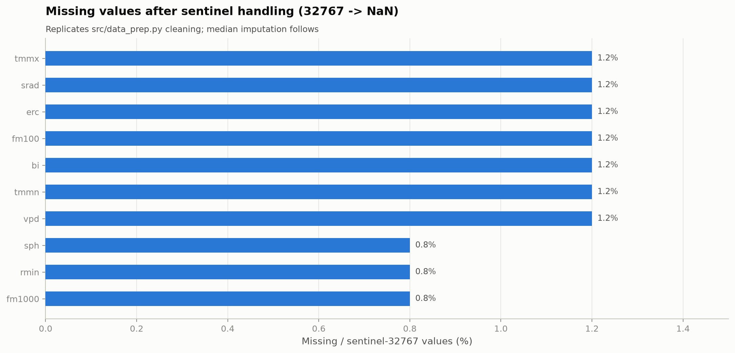
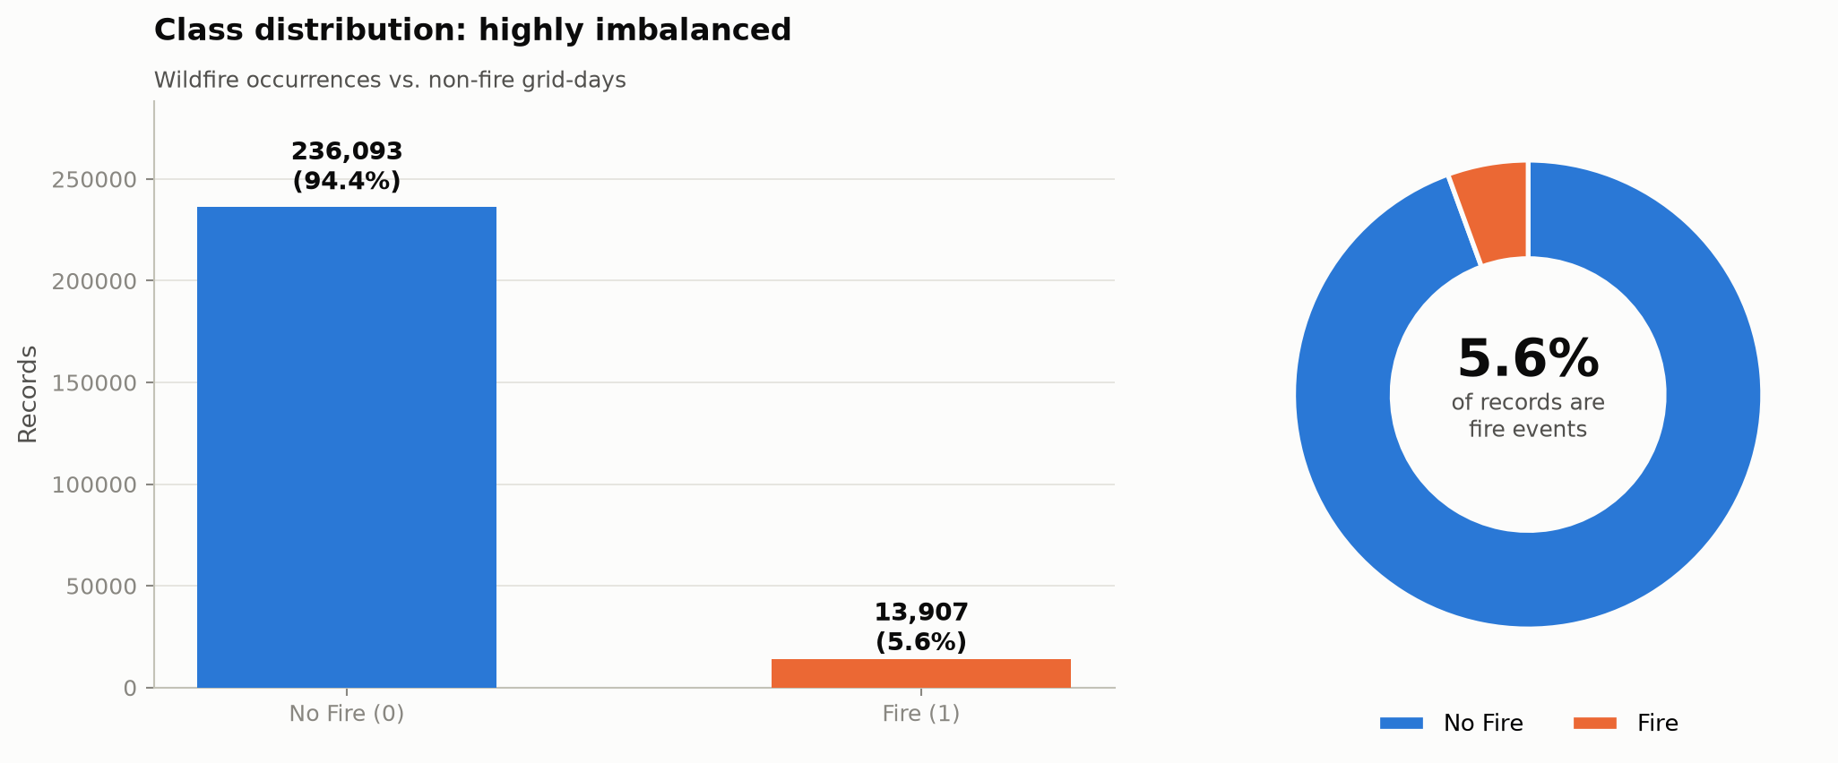
02 EDA
02 DATASET & EDA
EDA 1/6 - Target Imbalance & Data Quality
FINDINGS
Only ~5.6% of cell-days are fire events → accuracy alone is meaningless; the pipeline uses SMOTEN balancing and is evaluated recall-first. • Sentinel value 32767 plus sporadic NaNs affect up to ~1.2% of feature cells → median imputation and RobustScaler are mandatory before modelling.
Real-Time Forest Fire Detection | Kafka & Stream Processing
06

Slide 7
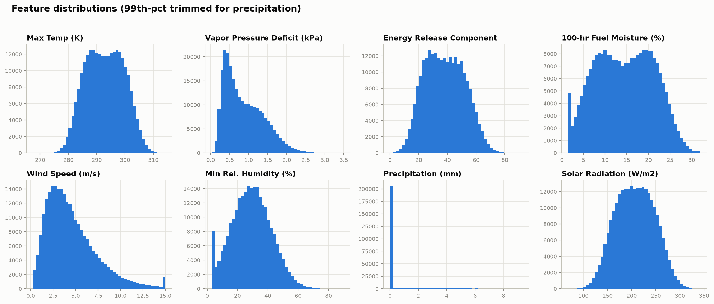
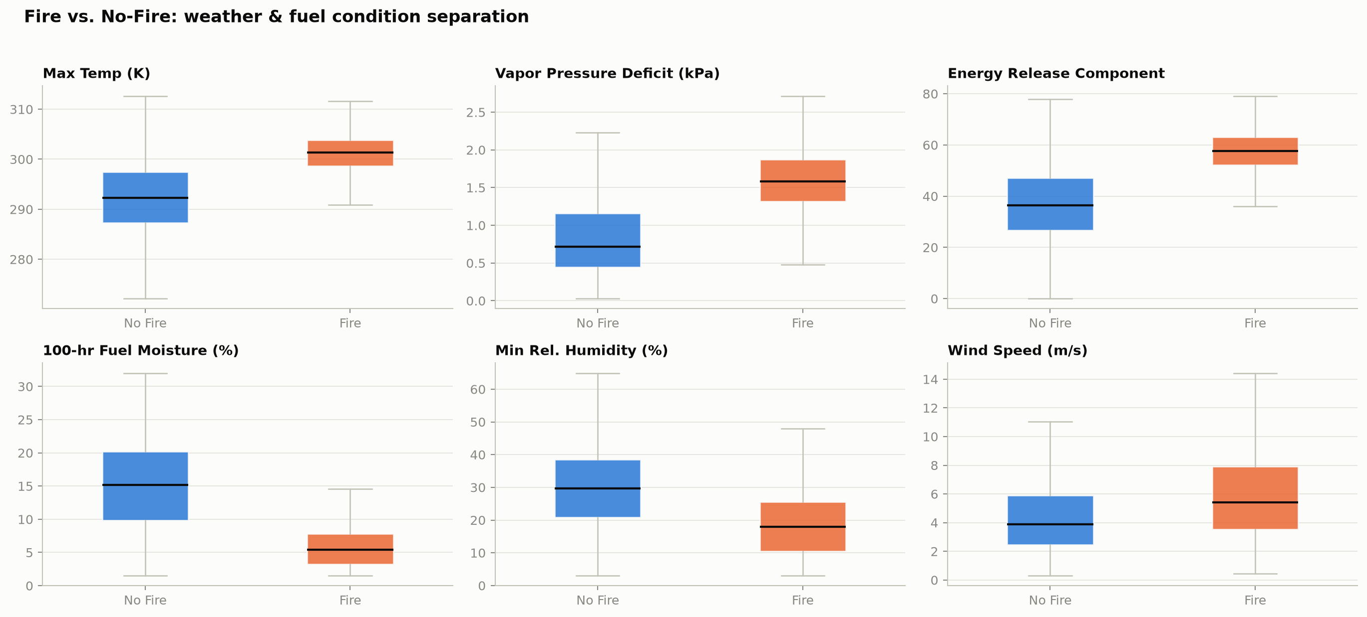
02 DATASET & EDA
EDA 2/6 - Feature Distributions & Class Separation
FINDINGS
Temperature, VPD and ERC are right-skewed with heavy upper tails on fire days; fuel moisture shifts left. Fire days show systematically higher tmmx/vpd/ERC/wind and lower rmin/fm100 - a physically interpretable, learnable signal.
Real-Time Forest Fire Detection | Kafka & Stream Processing
07

Slide 8
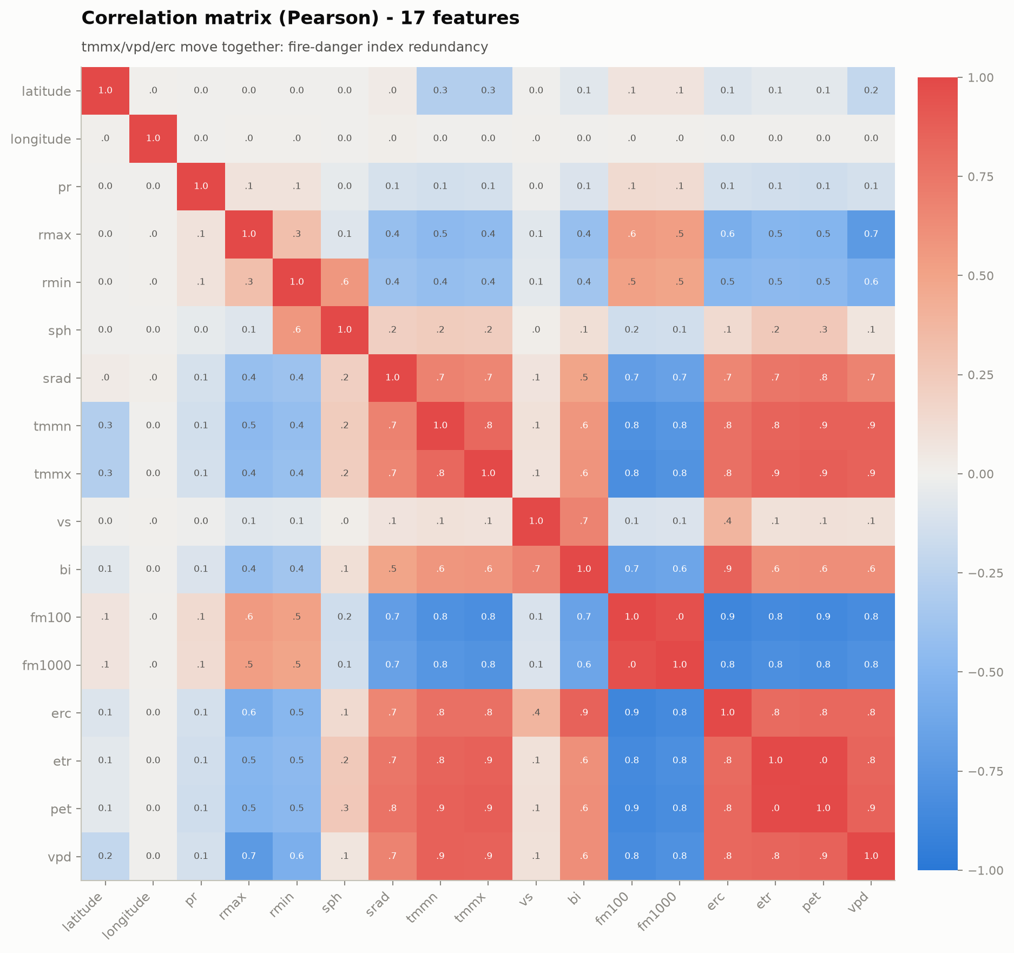
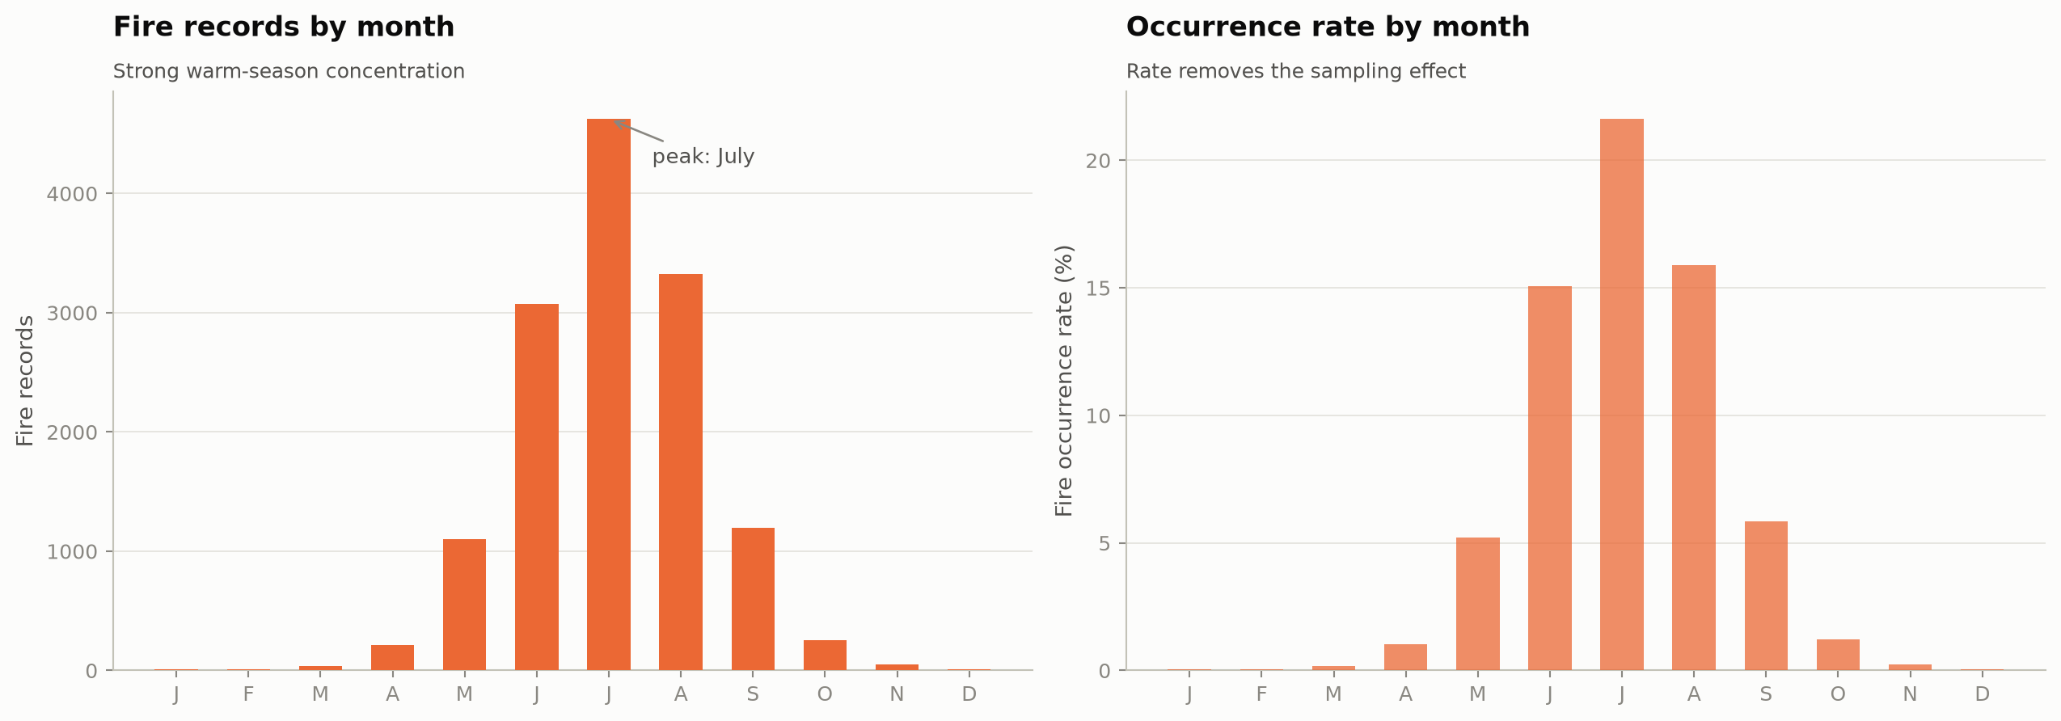
02 DATASET & EDA
EDA 3/6 - Correlation Structure & Seasonality
FINDINGS
pet-etr (r=+0.99), fm100-fm1000 (r=+0.96) and tmmx-vpd-erc (r≈0.8-0.9) are near-redundant → regularized models and index-based feature selection. • Fire occurrence peaks in July at ~21.6% (vs ≈0% in winter) → seasonal features and month-aware validation splits.
Real-Time Forest Fire Detection | Kafka & Stream Processing
08

Slide 9
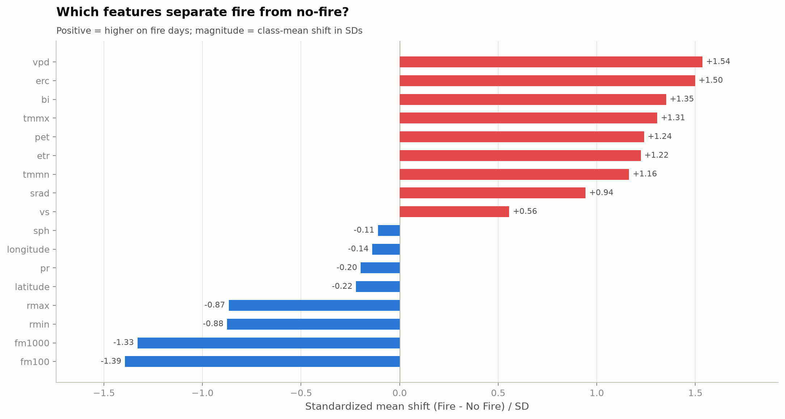
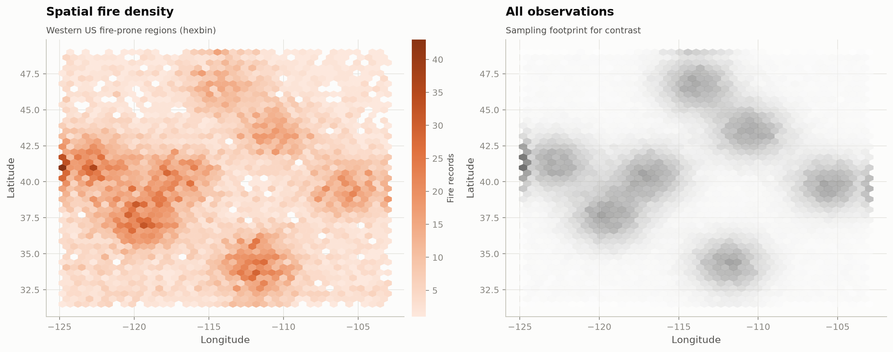
02 DATASET & EDA
EDA 4/6 - Spatial Density & Discriminative Features
FINDINGS
Fire density concentrates in the mountain West / Mediterranean climate zones (Sierra Nevada, Cascades, Rockies, AZ-NM) → location is informative but must not leak. • Standardized class-mean shift ranks VPD (+1.54 SD), ERC (+1.50), BI (+1.35) and fm100 (-1.39) as the strongest single separators.
Real-Time Forest Fire Detection | Kafka & Stream Processing
09

Slide 10
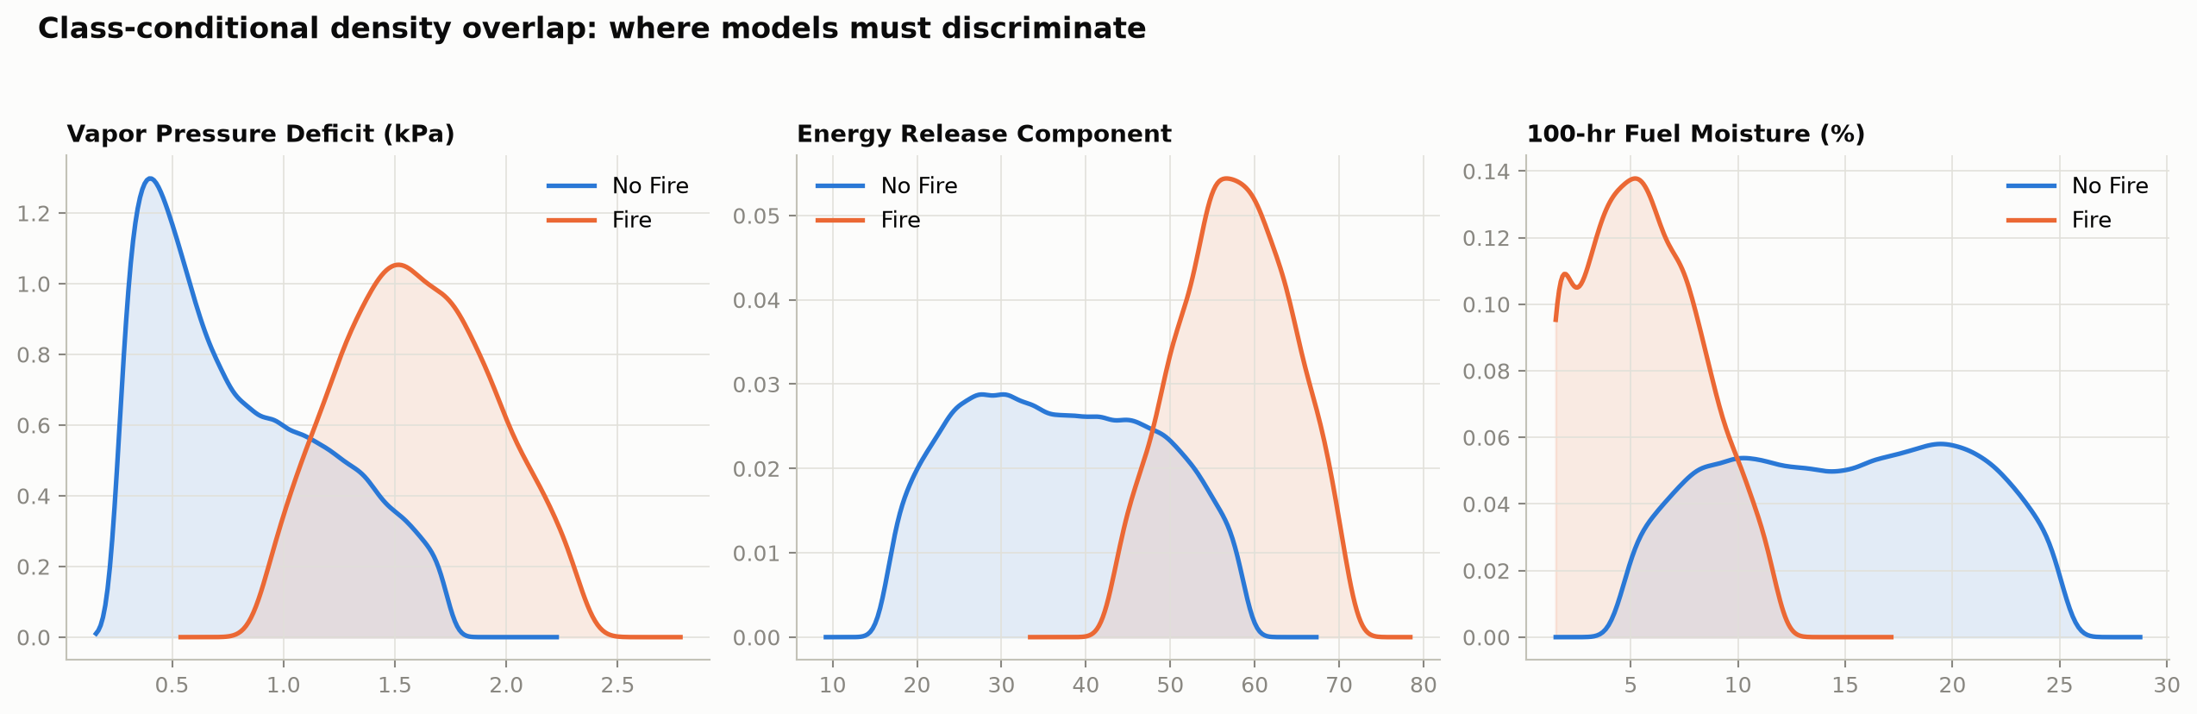
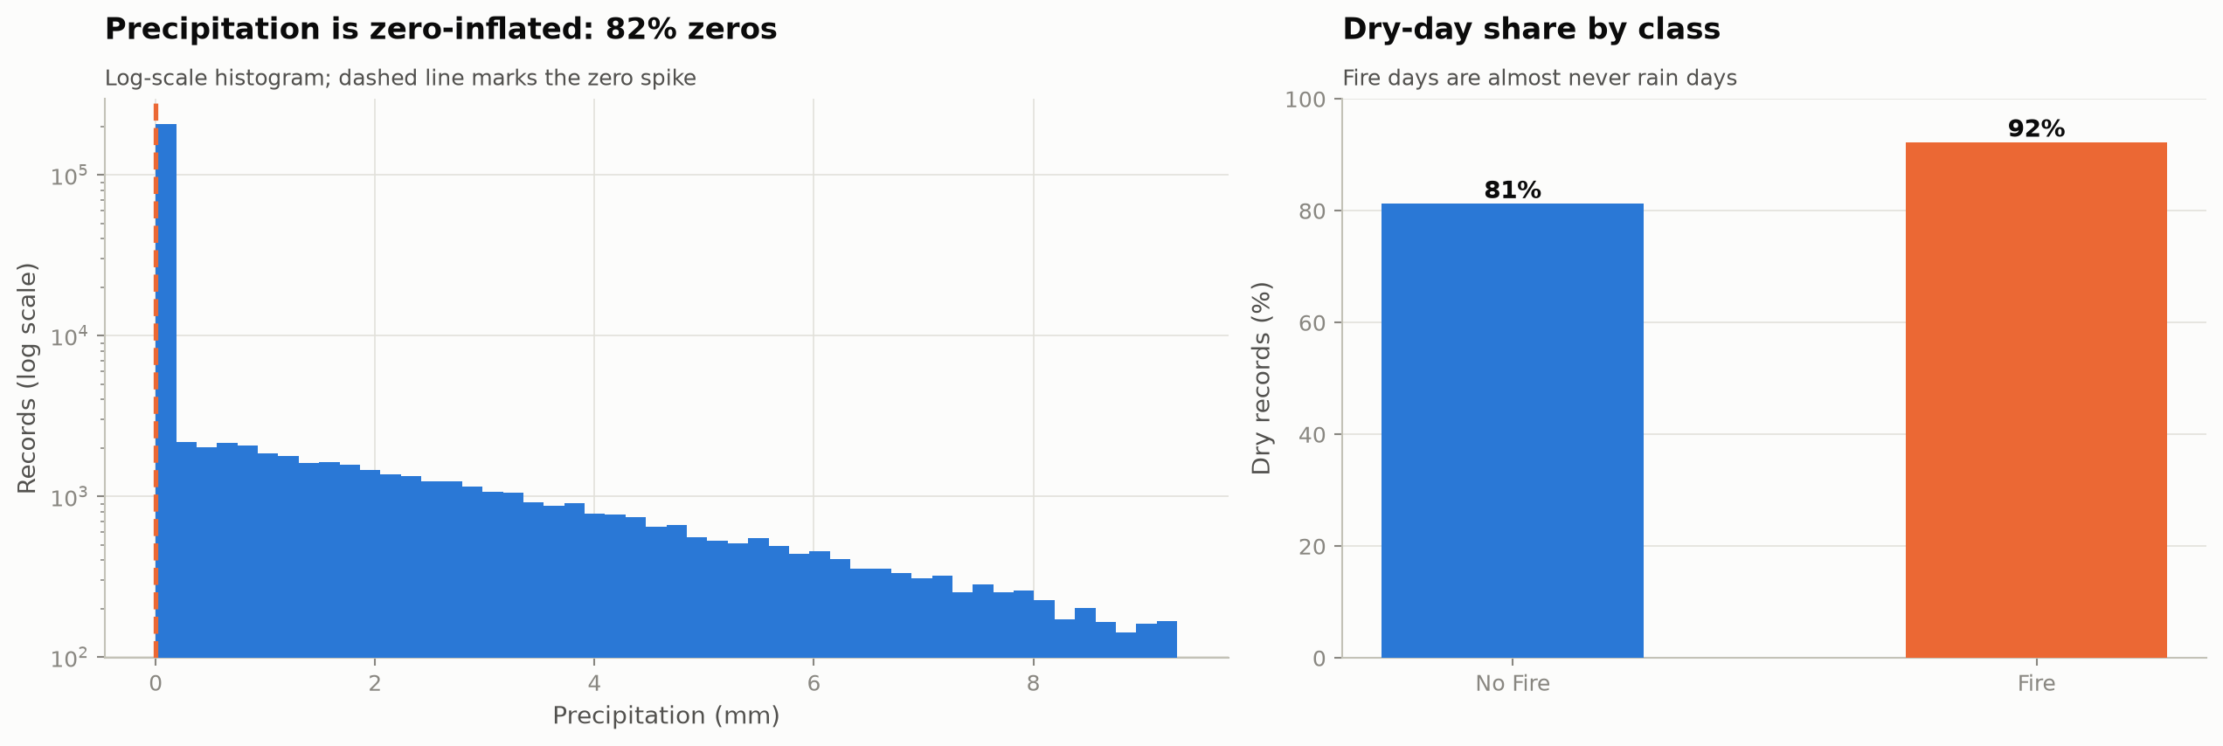
02 DATASET & EDA
EDA 5/6 - Fire-Weather Signal & Precipitation Behaviour
FINDINGS
Class-conditional densities of VPD and ERC separate cleanly while fm100 mirrors the shift → the deployed threshold on model probability can be tuned against ERC-style operating points. • Precipitation is zero-inflated (82% zeros; 92% of fire days are dry) → a dry-day flag is a cheap, powerful binary feature.
Real-Time Forest Fire Detection | Kafka & Stream Processing
10

Slide 11
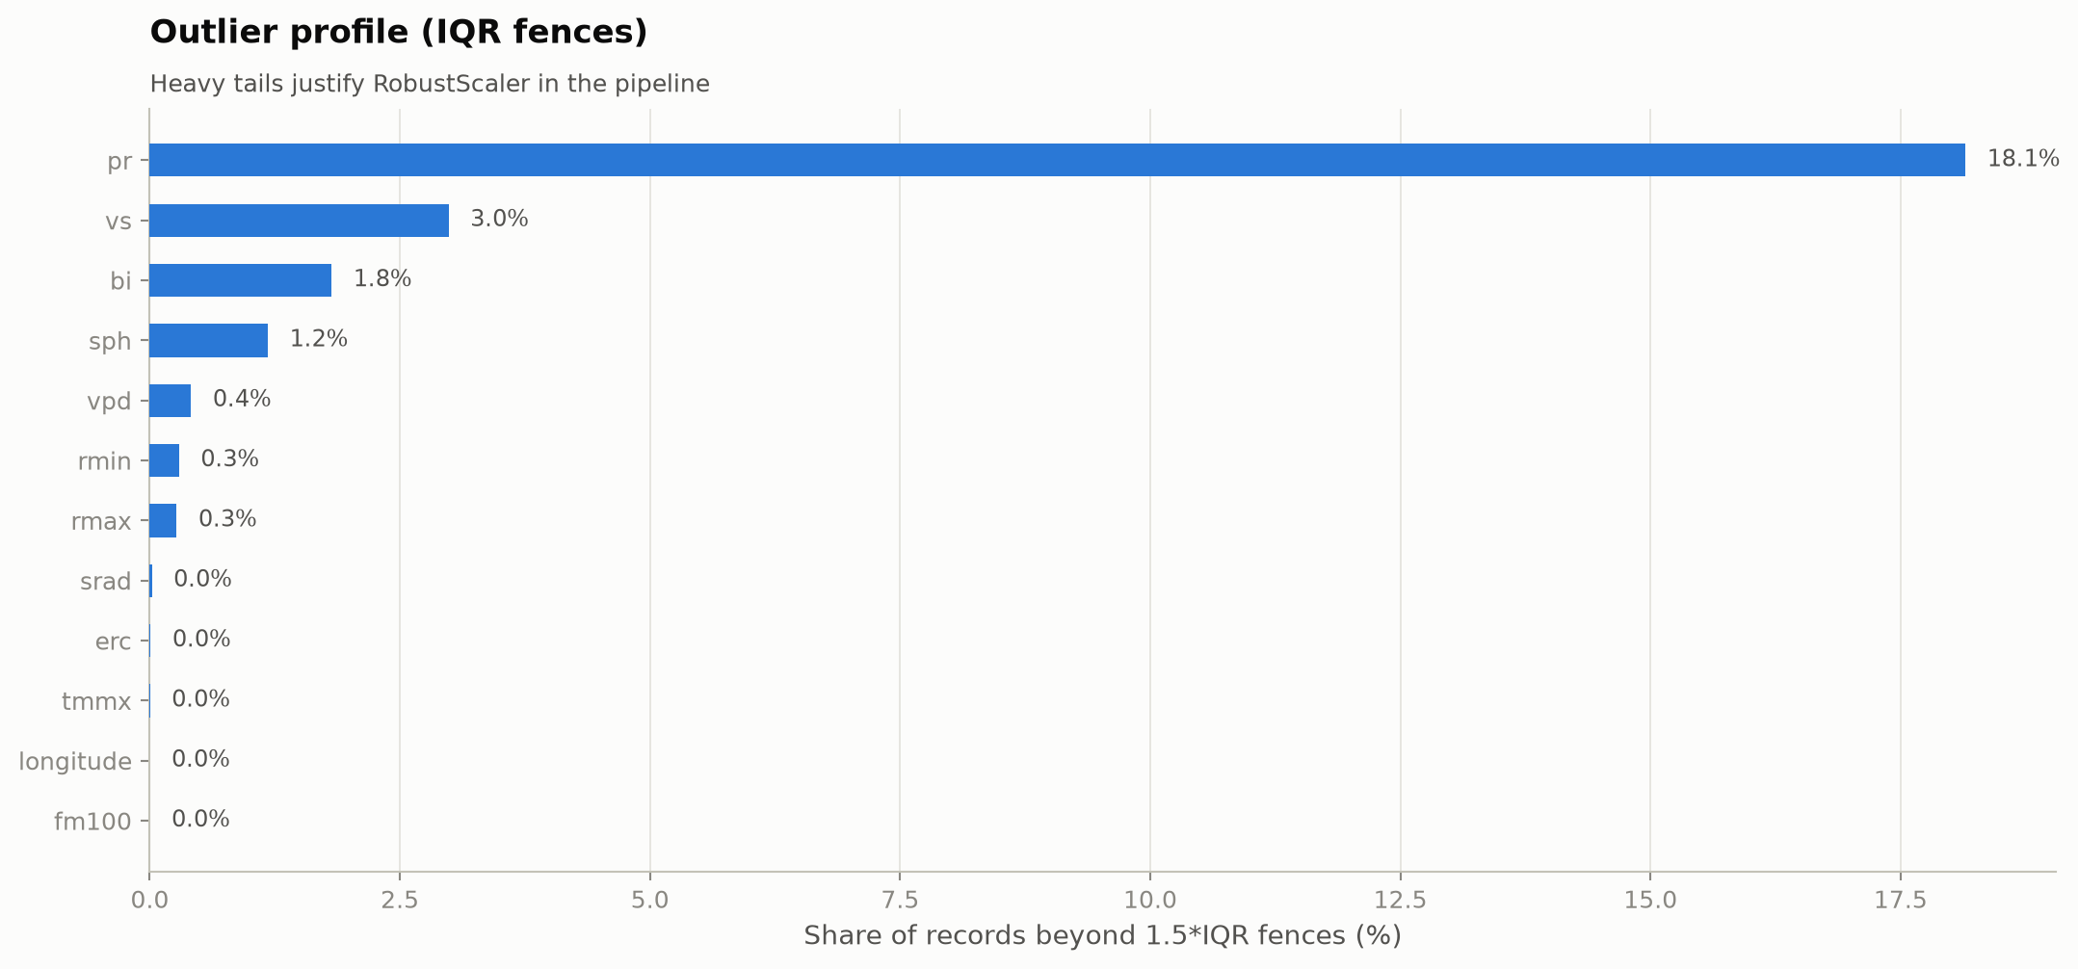
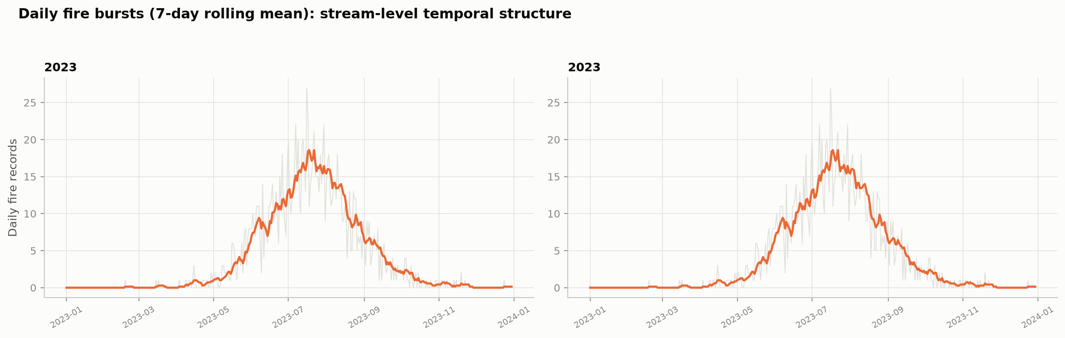
02 DATASET & EDA
EDA 6/6 - Outliers & Stream-Level Temporal Structure
FINDINGS
Up to ~18% of precipitation records fall beyond IQR fences → RobustScaler in the production pipeline. • Fire arrivals come in multi-day bursts (7-day rolling mean) → exactly the temporal structure that Kafka Streams windowed aggregation (1-min tumbling, 24-h sliding) is designed to capture.
Real-Time Forest Fire Detection | Kafka & Stream Processing
11

Slide 12
02 DATASET & EDA
EDA Conclusions
Imbalance is structural
5.6% positive rate → SMOTEN on train split only; recall-first metrics; precision-recall curves over ROC.
Fire-weather indices dominate
VPD, ERC, BI and fuel moisture carry most of the signal → they become the engineered streaming features.
Near-redundant features exist
pet↔etr r=+0.99 → drop or combine in-flight to keep stream payloads lean.
Strong seasonality & geography
July peak ~21.6%; western-US clustering → calendar and spatial features, grouped keys for Kafka partitioning.
Bursty arrivals
Multi-day fire bursts → windowed aggregation and alert deduplication are required, not optional.
Data quality is manageable
32767 sentinels + <1.2% missing → validation + median imputation as the first Kafka Streams operator.
Real-Time Forest Fire Detection | Kafka & Stream Processing
12

Slide 13
03 LITERATURE REVIEW
Review Map: 34 Papers, 7 Themes
A
ML for fire occurrence & susceptibility
5 papers
Cortez'07 · Jain'20 · Sayad'19 · Shmuel'22 · Bot'22
B
Deep learning & spatiotemporal spread
9 papers
Shi'15 · Radke'19 · Huot'22 · Marjani'24 · +5
C
Real-time vision & edge detection
5 papers
Alkhatib'14 · Barmpoutis'20 · YOLOv11'25 · DPMNet'25 · EdgeUAV'25
D
IoT & wireless sensor networks
3 papers
Chauhan'13 · Mohapatra'16 · Davis'23
E
Kafka & stream processing frameworks
5 papers
Kreps'11 · Zaharia'12 · Isah'19 · Nasiri'19 · vanDongen'21
F
Concept drift in data streams
3 papers
Wares'19 · Krawczyk'18 · Korycki'22
G
Fire weather & data foundations
4 papers
Abatzoglou'13 · Sakr'10 · Martin-Gomez'26 · Akdagli'26
Real-Time Forest Fire Detection | Kafka & Stream Processing
13

Slide 14
Theme A - Machine Learning for Fire Occurrence & Susceptibility
Cortez & Morais (2007). A Data Mining Approach to Predict Forest Fires using Meteorological Data. New Trends in Artificial Intelligence (EPIA).
Findings: Data-mining baseline on the Fire-Weather-Index dataset; SVM tuned via grid search; sparse-small-fire problem documented.
Relevance: Direct ancestor of our tabular setup - fire occurrence from daily weather only.
Jain et al. (2020). A review of machine learning applications in wildfire science and management. Environmental Reviews, 28(4).
Findings: Landmark survey (700+ citations) mapping ML to occurrence, spread, detection and fuels; flags data quality and validation gaps.
Relevance: Frames our model-choice rationale and evaluation protocol.
Sayad, Mousannif & Al Moatassime (2019). Predictive modeling of wildfires: a new dataset and machine learning approach. Fire Safety Journal, 104.
Findings: Fuses GIS + weather + remotely-sensed features; ANN and LDA compared; releases a reusable dataset.
Relevance: Validates multi-source feature fusion like our gridMET+label join.
Shmuel & Heifetz (2022). Global wildfire susceptibility mapping based on machine learning models. Forests, 13(6).
Findings: Benchmarks susceptibility models globally; identifies dominant drivers (dryness, temperature, human pressure).
Relevance: Supports using fire-danger indices (ERC, VPD) as first-class features.
Bot & Borges (2022). A Systematic Review of Applications of Machine Learning Techniques for Wildfire Fire Management. Inventions, 7(3).
Findings: Systematic PRISMA-style review of ML for wildfire management tasks and metrics.
Relevance: Basis for our recall-first metric policy under imbalance.
Real-Time Forest Fire Detection | Kafka & Stream Processing
14

Slide 15
03 LITERATURE REV
Theme B - Deep Learning & Spatiotemporal Fire Prediction (1/2)
Shi, Chen, Wang, Yeung, Wong & Woo (2015). Convolutional LSTM Network: A Machine Learning Approach for Precipitation Nowcasting. NeurIPS 28.
Findings: Introduces ConvLSTM - convolutional recurrent cells that encode spatiotemporal grids; the nowcasting paradigm.
Relevance: Architecture of our ConvLSTM spatial model (10×10 grid).
Radke, Hessler & Long (2019). FireCast: Leveraging Deep Learning to Predict Wildfire Spread. IJCAI 2019.
Findings: CNN+RNN hybrid over weather stacks beats logistic-regression baselines for 2-3h spread prediction.
Relevance: Evidence that DL beats classical ML on the same features.
Huot et al. (2022). Next Day Wildfire Spread: A Machine Learning Dataset to Predict Wildfire Spreading from Remote-Sensing Data. IEEE TGRS, 60.
Findings: Google's 1-km next-day dataset: weather, vegetation, topography; strong baselines (logistic regression is surprisingly competitive).
Relevance: Template for our feature set and next-cell-day prediction task.
Marjani et al. (2024). CNN-BiLSTM: A Novel Deep Learning Model for Near-Real-Time Daily Wildfire Spread. Remote Sensing, 16(8).
Findings: Hybrid convolutional + bidirectional LSTM for daily spread at 1 km with near-real-time intent.
Relevance: Direct architectural cousin of our LSTM/ConvLSTM serving tier.
Real-Time Forest Fire Detection | Kafka & Stream Processing
15

Slide 16
Theme B - Deep Learning & Spatiotemporal Fire Prediction (2/2)
Andrianarivony & Akhloufi (2024). Machine Learning and Deep Learning for Wildfire Spread Prediction: A Review. Fire, 7(2).
Findings: Taxonomy of spread-prediction architectures (CNN, RNN, GNN, transformers) and datasets.
Relevance: Justifies evaluating several model families rather than one.
Nguyen Van & Lee (2025). Optimizing Stacked Ensemble Machine Learning Models for Accurate Wildfire Spread Prediction. Remote Sensing, 17(9).
Findings: Stacked ensembles with base-learner diversity improve spread accuracy and calibration.
Relevance: Motivates ensembling RF + XGBoost for the streaming tier.
Anastasiou & Kondylatos (2026). Wildfire Spread Forecasting With Deep Learning. IEEE Access.
Findings: Large-scale DL forecasting of spread with multi-source inputs and ablations.
Relevance: Confirms DL readiness for operational cadences.
Kim & Hu (2025). Assessment of deep learning models integrated with weather and environmental variables for wildfire spread prediction. Natural Hazards.
Findings: Ablation study quantifying how weather covariates improve DL spread models.
Relevance: Guides which rolling aggregates our windowing must emit.
Zakari & Malik (2025). An Enhanced Wildfire Spread Prediction Using Multimodal Satellite Imagery and Deep Learning. Remote Sens. Appl.: Soc. Environ.
Findings: Multimodal satellite fusion (optical + thermal) with DL improves detection-to-prediction pipelines.
Relevance: Roadmap for adding imagery to our weather-only stream.
Real-Time Forest Fire Detection | Kafka & Stream Processing
16

Slide 17
v
Theme C - Real-Time Fire & Smoke Detection: Vision and Edge
Alkhatib (2014). A Review on Forest Fire Detection Techniques. International Journal of Distributed Sensor Networks.
Findings: Compares satellite, camera, and sensor-node detection; discusses latency and false-alarm trade-offs.
Relevance: Core motivation for sub-minute, stream-native detection.
Barmpoutis et al. (2020). A Review on Early Forest Fire Detection Systems Using Optical Remote Sensing. Sensors, 20(22).
Findings: Survey of optical/IR early-detection systems; benchmarks detection delay and accuracy.
Relevance: Sets the latency targets our alerting tier must beat.
Tao & Li (2025). Improved Lightweight YOLOv11 Algorithm for Real-Time Forest Fire Detection. Electronics, 14.
Findings: Pruned YOLOv11 variant keeps accuracy while meeting real-time budgets on edge hardware.
Relevance: Shows engineering pattern for low-latency inference operators.
Wang & Li (2025). DPMNet: A Remote Sensing Forest Fire Real-Time Detection Network Driven by Dual-Perspective Multiscale Features. IEEE TCAS-I.
Findings: Dual-perspective multiscale detector for satellite fire pixels at video rate.
Relevance: Candidate future fusion input for the same Kafka backbone.
Mu & Yang (2025). Edge Computing-Based Real-Time Forest Fire Detection Using UAV Thermal and Color Imagery. IEEE JSTARS.
Findings: Edge-deployed fusion of thermal + RGB on UAVs; on-board inference to cut round-trip latency.
Relevance: Reinforces compute-at-the-edge vs central - our producer-side filtering.
Real-Time Forest Fire Detection | Kafka & Stream Processing
17

Slide 18
Theme D - IoT & Wireless Sensor Network Detection
Chauhan, Semwal et al. (2013). Artificial neural network-based forest fire detection system using wireless sensor networks. IEEE INDICON.
Findings: ANN over multi-sensor node readings (temperature, humidity, smoke) for on-node fire classification.
Relevance: Prototype of feature-based (not pixel) fire classification - our setup.
Mohapatra & Khilar (2016). Forest fire monitoring and detection of faulty nodes using wireless sensor networks. IEEE TENCON.
Findings: Fault-tolerant WSN monitoring; separates sensor faults from real events to cut false alarms.
Relevance: Maps to our schema-validation and DLQ stage in Kafka Streams.
Davis, Shekaramiz et al. (2023). Desert/Forest Fire Detection Using Machine/Deep Learning Techniques. Fire, 6(3).
Findings: Benchmark of ML/DL detectors across sensor and imagery modalities in arid and forest biomes.
Relevance: Confirms robustness of weather-feature ML across biomes.
Real-Time Forest Fire Detection | Kafka & Stream Processing
18

Slide 19
03 LITERATURE RE
Theme E - Kafka & Distributed Stream Processing
Kreps, Narkhede & Rao (2011). Kafka: A Distributed Messaging System for Log Processing. NetDB'11.
Findings: The Kafka paper: partitioned, replicated append-only log; consumer groups; O(1) disk IO at scale.
Relevance: The backbone of stages 2-4 and 9 of our methodology.
Zaharia, Das, Li, Hunter, Shenker & Stoica (2012). Discretized Streams: Fault-Tolerant Streaming Computation at Scale. NSDI'12.
Findings: Formalized micro-batch windowing with deterministic replay for fault tolerance.
Relevance: Theoretical grounding for our tumbling/sliding window design.
Isah, Abughofa, Mahfuz, Ajerla, Zulkernine & Khan (2019). A Survey of Distributed Data Stream Processing Frameworks. IEEE Access, 7.
Findings: Comparative survey of Kafka, Spark, Flink, Storm semantics (delivery, state, windows).
Relevance: Basis for choosing Kafka Streams over external compute.
Nasiri, Nasehi & Divsalar (2019). Evaluation of distributed stream processing frameworks for IoT applications in Smart Cities. Journal of Big Data, 6.
Findings: Benchmark: throughput/latency of Kafka-centric stacks under IoT event rates.
Relevance: Informs partition counts and latency expectations.
van Dongen & Van Den Poel (2021). A Performance Analysis of Fault Recovery in Stream Processing Frameworks. IEEE Access, 9.
Findings: Quantifies recovery time and state-restore behaviour across frameworks.
Relevance: Drives our replication and checkpointing settings.
Real-Time Forest Fire Detection | Kafka & Stream Processing
19

Slide 20
Theme F - Concept Drift in Data Streams
Wares, Isaacs & Brooks (2019). Data stream mining: methods and challenges for handling concept drift. SN Applied Sciences, 1.
Findings: Survey of drift types (sudden/gradual/seasonal) and detection methods for streams.
Relevance: Weather-to-fire relationships drift seasonally - motivates Evidently + Prefect loop.
Krawczyk et al. (2018). Combining active learning with concept drift detection for data stream mining. IEEE ICMLA.
Findings: Labels selectively when drift is detected - cheaper adaptation.
Relevance: Blueprint for our drift-triggered retraining budget.
Korycki & Krawczyk (2022). Adversarial concept drift detection under poisoning attacks for robust data streams. Machine Learning, 111.
Findings: Robust drift detection that resists manipulated streams.
Relevance: Security consideration for our public alert channel.
Real-Time Forest Fire Detection | Kafka & Stream Processing
20

Slide 21
Theme G - Fire Weather & Data Foundations
Abatzoglou (2013). Development of gridded surface meteorological data for ecological applications and modelling. Int. J. of Climatology, 33.
Findings: gridMET: 4-km daily gridded meteorology for CONUS - our dataset's source.
Relevance: Defines every feature our producer emits.
Sakr et al. (2010). Artificial intelligence for forest fire prediction. IEEE/ASME AIM.
Findings: ANN/SVM occurrence prediction with limited meteorological inputs.
Relevance: Early proof that weather-only models are viable.
Martin-Gomez et al. (2026). Daily Fire Danger Prediction in Catalonia using Machine Learning. (in press).
Findings: Operational daily fire-danger forecasting with ML at regional scale.
Relevance: Operational-cadence precedent for our daily predictions.
Akdagli et al. (2026). Machine learning for one day ahead prediction of high fire weather index conditions. Scientific Reports.
Findings: One-day-ahead FWI exceedance prediction with ML.
Relevance: Analogous target: threshold exceedance → alerting.
Real-Time Forest Fire Detection | Kafka & Stream Processing
21

Slide 22
04 SUMMARY OF LITERATURE
What 34 Papers Tell Us - Synthesis Table
Theme | Representative works | Consensus finding | Implication for this project
ML occurrence | Cortez'07; Jain'20; Sayad'19 | Daily weather carries strong predictive signal; imbalance is the norm | Weather-only features + SMOTEN + recall-first metrics
DL / spatiotemporal | Shi'15; Radke'19; Huot'22; Marjani'24 | Conv+recurrent hybrids outperform classical ML on grids | ConvLSTM on 10×10 grids alongside RF/XGB
Real-time detection | Alkhatib'14; Barmpoutis'20; Tao'25 | Detection value decays in minutes; edge/stream processing required | Sub-minute Kafka latency budget; DLQ validation
IoT / WSN | Chauhan'13; Mohapatra'16 | Sensor faults masquerade as events; validation cuts false alarms | Schema-check + dedup as first stream operator
Kafka / stream proc. | Kreps'11; Zaharia'12; Isah'19; Nasiri'19 | Partitioned logs + windows give scale, replay, fault tolerance | Kafka Streams with exactly-once, keyed by grid cell
Drift / adaptation | Wares'19; Krawczyk'18; Korycki'22 | Fire-weather relationships drift; adaptation must be triggered, not scheduled | Evidently drift → Prefect retraining → MLflow registry
Fire weather data | Abatzoglou'13; FWI literature | GridMET-style indices (ERC, VPD, fm100) are operational standards | These indices are our engineered stream features
Real-Time Forest Fire Detection | Kafka & Stream Processing
22

Slide 23
Research Gaps → Our Contributions
Gap 1 - Prediction is batch, alerts are decoupled
Most papers train offline and serve on demand; few wire the model into the message bus itself.
→
Model served as a stateful stream operator; alerts emitted to wildfire.alerts automatically.
Gap 2 - Windowing & feature engineering rarely evaluated together
Window semantics are described but their effect on detection quality is seldom measured.
→
Explicit tumbling/sliding windows whose aggregates feed the model; measured end-to-end.
Gap 3 - Class imbalance handled casually in real-time settings
Resampling is routine offline but rarely re-visited once serving on a live, drifting stream.
→
Drift-aware retraining with SMOTEN refreshed on the current window.
Gap 4 - Latency rarely reported alongside accuracy
Papers report AUC/F1 without the latency/throughput budget that operations need.
→
Evaluation includes p50/p95 latency and sustained throughput, not just detection quality.
Gap 5 - MLOps loop missing from fire-DL literature
Monitoring, retraining and versioning are seldom part of the published architecture.
→
Evidently → Prefect → MLflow → K8s rollout is part of the design, not an afterthought.
Real-Time Forest Fire Detection | Kafka & Stream Processing
23

Slide 24
OBJECTIVES
O1
O1 - Continuous ingestion
Stream gridMET fire-weather events via Kafka producers into partitioned, keyed topics with schema validation.
O2
O2 - Filtering & windowing
Implement Kafka Streams operators: schema check, dedup, tumbling 1-min and sliding 24-h windows.
O3
O3 - In-flight feature engineering
Derive rolling aggregates and fire-weather indices on the stream; keep payloads lean by dropping redundant features.
O4
O4 - Real-time ML/DL detection
Serve RF/XGBoost and LSTM/ConvLSTM models with <2 s end-to-end latency and recall-first thresholds.
O5
O5 - Tiered alerting & delivery
Publish probability-tiered alerts (WATCH/WARNING/EMERGENCY) to the alert topic, index in Elasticsearch, surface on dashboard + emergency channels.
O6
O6 - Evaluation & adaptation
Measure latency/throughput/detection quality continuously; retrain on drift via Evidently + Prefect + MLflow.
Real-Time Forest Fire Detection | Kafka & Stream Processing
24

Slide 25
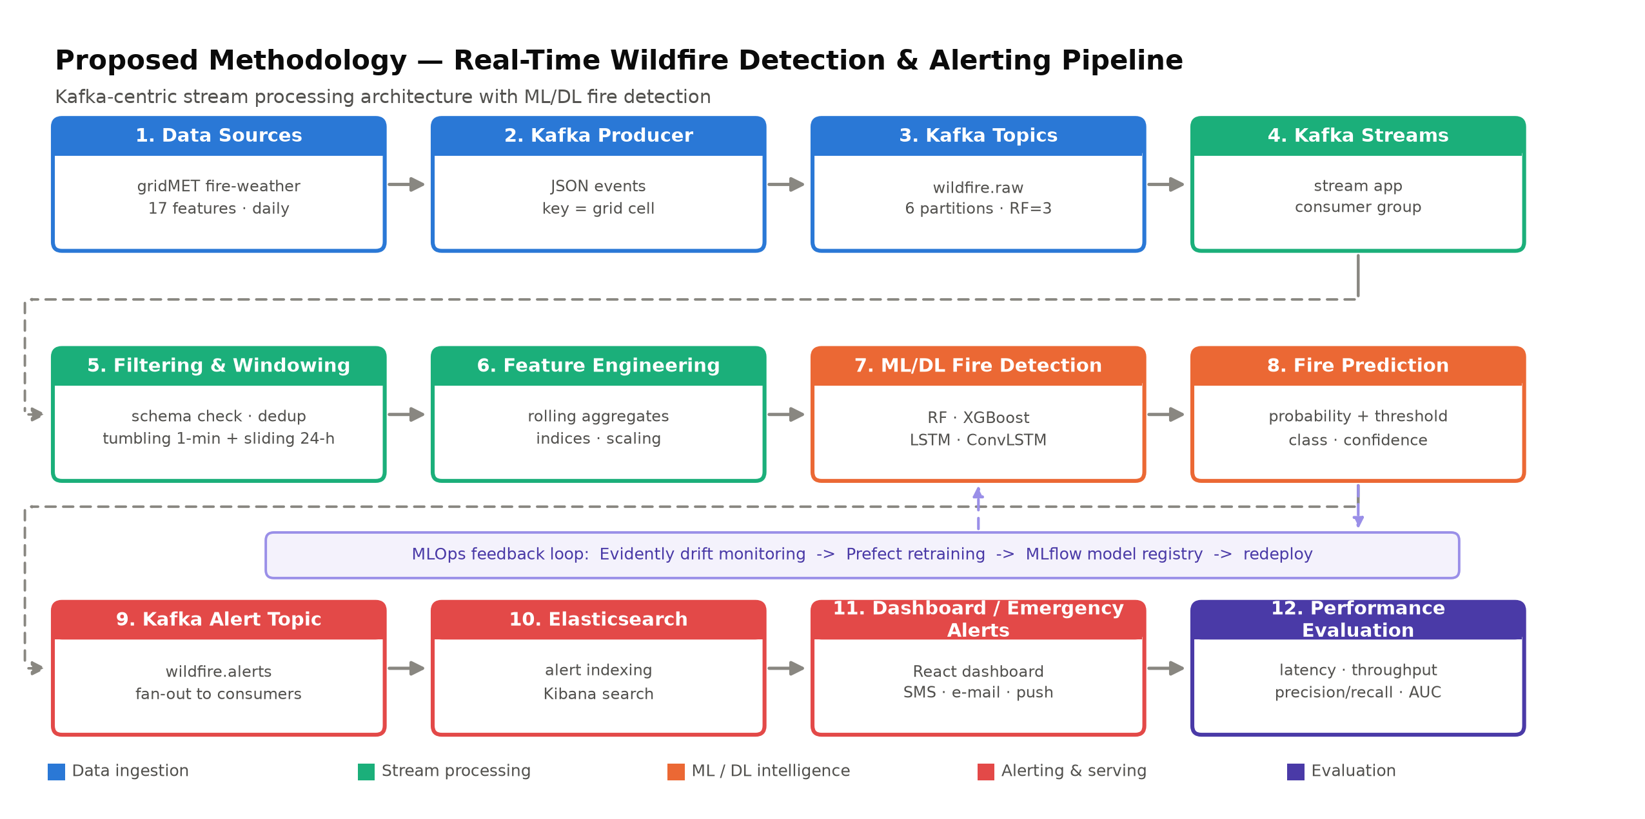
METHODOLOGY
Real-Time Forest Fire Detection | Kafka & Stream Processing
25

Slide 26
Kafka Design Decisions
Element | Design | Rationale
wildfire.raw topic | 6 partitions, replication 3, key = grid-cell id | Per-cell ordering; parallelism across brokers
wildfire.features topic | 3 partitions, compacted | Latest window state per cell recoverable on restart
wildfire.alerts topic | 3 partitions, key = region, retention 90 d | Fan-out to ES, dashboard, SMS consumers independently
Windowing | Tumbling 1-min (aggregates); sliding 24-h (indices); session 30-min per cell | Matches bursty fire arrivals found in EDA 6/6
Delivery semantics | Idempotent producer + transactions → exactly-once | No duplicate emergency alerts, no lost events
Failure handling | DLQ topic for schema failures; watermark 2-min for late data | Fault-tolerant like Mohapatra'16; replayable like Zaharia'12
Consumer group | stream-processors (Kafka Streams app) | Horizontal scale; state stores for windowed features
Real-Time Forest Fire Detection | Kafka & Stream Processing
26

Slide 27
06 PROPOSED
Model Stack, Serving & Alert Logic
Model | Input | Role | Status (MLflow)
Random Forest + SMOTEN | 17 tabular features | Fast baseline on stream | AUC 0.65, recall 0.69
XGBoost + SMOTEN | 17 tabular features | Primary tabular detector | AUC 0.67, recall 0.65
LSTM (seq=7) | 7-day feature sequence | Temporal pattern detector | Training logged
ConvLSTM (10×10 grid) | Spatial grid sequence | Spatial spread detector | Training logged
ALERT TIERS (on Fire Prediction)
WATCH
p > 0.50 and ERC > 45
WARNING
p > 0.70 and ERC > 60 and fm100 < 10
EMERGENCY
p > 0.90 and wind > 8 m/s
Serving path: Kafka Streams → feature store topic → FastAPI inference (Docker/K8s, HPA) → probability + class → alert topic. Thresholds are tuned for recall ≥ 0.70 at acceptable precision, then adjusted per ERC operating point from EDA.
Real-Time Forest Fire Detection | Kafka & Stream Processing
27

Slide 28
Module-wise Progress ≈ 25% Overall
Data preprocessing & cleaning (chunked, sentinel/NaN, scaling)
100%
EDA & feature analysis (13 charts, this deck)
100%
ML models - RF & XGBoost with SMOTEN (MLflow-tracked)
100%
DL models - LSTM & ConvLSTM (training + eval)
80%
Inference service - FastAPI + Docker + K8s + HPA
100%
Monitoring & retraining - Evidently drift + Prefect + MLflow
90%
Dashboard - React frontend (live feed, drift, retrain pages)
90%
Kafka producer & raw topic (replaces HTTP stub)
20%
Kafka Streams - filtering, windowing, feature engineering
10%
Alert topic + Elasticsearch + emergency channels
0%
End-to-end streaming performance evaluation
25%
Overall: the batch ML/MLOps core is complete and deployed; the Kafka streaming and alerting layers are the active build.
Real-Time Forest Fire Detection | Kafka & Stream Processing
28

Slide 29
Remaining Plan - Four Phases to Completion
Phase 1 (2 wks)
Kafka foundation
KRaft cluster (3 brokers) in Docker; wildfire.raw producer from gridMET feed; schema registry; DLQ.
Phase 2 (3 wks)
Stream processing
Kafka Streams app: validation, dedup, 1-min tumbling + 24-h sliding windows, rolling feature aggregates.
Phase 3 (2 wks)
Alerting & search
Fire Prediction → wildfire.alerts; Elasticsearch indexing; Kibana board; dashboard + SMS/e-mail dispatch.
Phase 4 (2 wks)
Evaluation
Latency p50/p95, throughput at 1k/10k events/s, detection quality on replayed data, drift-triggered retrain E2E.
Target: fully streaming end-to-end demo + evaluation report within 9 weeks.
Real-Time Forest Fire Detection | Kafka & Stream Processing
29

Slide 30
REFERENCES
References (1/2) - Papers 1-12
[1] Abatzoglou, J. T. (2013). Development of gridded surface meteorological data for ecological applications and modelling. Int. J. of Climatology, 33, 121-131.
[2] Alkhatib, A. A. A. (2014). A review on forest fire detection techniques. Int. J. of Distributed Sensor Networks, 10(3).
[3] Anastasiou, N., & Kondylatos, S. (2026). Wildfire spread forecasting with deep learning. IEEE Access.
[4] Andrianarivony, H. S., & Akhloufi, M. A. (2024). Machine learning and deep learning for wildfire spread prediction: A review. Fire, 7(2).
[5] Barmpoutis, P., Papaioannou, P., Dimitropoulos, K., & Voulodimos, D. (2020). A review on early forest fire detection systems using optical remote sensing. Sensors, 20(22), 6442.
[6] Bot, K., & Borges, J. G. (2022). A systematic review of applications of machine learning techniques for wildfire fire management. Inventions, 7(3), 84.
[7] Chauhan, A., Semwal, S., et al. (2013). Artificial neural network-based forest fire detection system using wireless sensor networks. IEEE INDICON.
[8] Cortez, P., & Morais, A. (2007). A data mining approach to predict forest fires using meteorological data. New Trends in Artificial Intelligence (EPIA), 512-523.
[9] Davis, M., Shekaramiz, M., et al. (2023). Desert/forest fire detection using machine/deep learning techniques. Fire, 6(3), 113.
[10] Huot, F., Hu, R. L., Lakshmanan, V., & Bhatia, A. (2022). Next day wildfire spread: A machine learning dataset to predict wildfire spreading from remote-sensing data. IEEE TGRS, 60.
[11] Isah, H., Abughofa, T., Mahfuz, S., Ajerla, D., Zulkernine, F., & Khan, S. (2019). A survey of distributed data stream processing frameworks. IEEE Access, 7, 154300-154316.
[12] Jain, P., Coogan, S. C. P., Subramanian, S. G., Crowley, M., Taylor, S., & Flannigan, M. D. (2020). A review of machine learning applications in wildfire science and management. Environmental Reviews, 28(4), 478-505.
Real-Time Forest Fire Detection | Kafka & Stream Processing
30

Slide 31
REFERENCES
References (2/2) - Papers 13-34
[13] Kim, J., & Hu, Y. (2025). Assessment of deep learning models integrated with weather and environmental variables for wildfire spread prediction. Natural Hazards.
[14] Korycki, L., & Krawczyk, B. (2022). Adversarial concept drift detection under poisoning attacks for robust data streams. Machine Learning, 111.
[15] Krawczyk, B., Pfahringer, B., et al. (2018). Combining active learning with concept drift detection for data stream mining. IEEE ICMLA.
[16] Kreps, J., Narkhede, N., & Rao, J. (2011). Kafka: A distributed messaging system for log processing. Proc. NetDB'11.
[17] Marjani, M., Mahdianpari, M., & Mohammadimanesh, F. (2024). CNN-BiLSTM: A novel deep learning model for near-real-time daily wildfire spread prediction. Remote Sensing, 16(8), 1357.
[18] Martin-Gomez, V., et al. (2026). Daily fire danger prediction in Catalonia using machine learning. (in press).
[19] Mohapatra, S., & Khilar, P. M. (2016). Forest fire monitoring and detection of faulty nodes using wireless sensor networks. IEEE TENCON.
[20] Mu, L., & Yang, Y. (2025). Edge computing-based real-time forest fire detection using UAV thermal and color imagery. IEEE JSTARS.
[21] Nasiri, H., Nasehi, S., & Divsalar, M. (2019). Evaluation of distributed stream processing frameworks for IoT applications in Smart Cities. Journal of Big Data, 6, 61.
[22] Nguyen Van, L., & Lee, G. (2025). Optimizing stacked ensemble machine learning models for accurate wildfire spread prediction. Remote Sensing, 17(9).
[23] Radke, D., Hessler, A., & Long, D. (2019). FireCast: Leveraging deep learning to predict wildfire spread. IJCAI 2019, 4575-4581.
[24] Sakr, G. E., Elhajj, I. H., Mitri, G., & Wehbe, C. S. (2010). Artificial intelligence for forest fire prediction. IEEE/ASME Int. Conf. on Advanced Intelligent Mechatronics.
[25] Sayad, Y. O., Mousannif, H., & Al Moatassime, H. (2019). Predictive modeling of wildfires: A new dataset and machine learning approach. Fire Safety Journal, 104, 130-146.
[26] Shi, X., Chen, Z., Wang, H., Yeung, D.-Y., Wong, W.-K., & Woo, W.-C. (2015). Convolutional LSTM network: A machine learning approach for precipitation nowcasting. NeurIPS 28.
[27] Shmuel, A., & Heifetz, E. (2022). Global wildfire susceptibility mapping based on machine learning models. Forests, 13(6), 908.
[28] Tao, Y., & Li, B. (2025). Improved lightweight YOLOv11 algorithm for real-time forest fire detection. Electronics, 14.
[29] van Dongen, G., & Van Den Poel, D. (2021). A performance analysis of fault recovery in stream processing frameworks. IEEE Access, 9.
[30] Wang, G., & Li, H. (2025). DPMNet: A remote sensing forest fire real-time detection network driven by dual-perspective multiscale features. IEEE TCAS-I.
[31] Wares, S., Isaacs, J., & Brooks, E. (2019). Data stream mining: methods and challenges for handling concept drift. SN Applied Sciences, 1, 242.
[32] Zaharia, M., Das, T., Li, H., Hunter, T., Shenker, S., & Stoica, I. (2012). Discretized streams: Fault-tolerant streaming computation at scale. NSDI'12.
[33] Zakari, R., & Malik, O. A. (2025). An enhanced wildfire spread prediction using multimodal satellite imagery and deep learning. Remote Sens. Appl.: Soc. Environ.
Real-Time Forest Fire Detection | Kafka & Stream Processing
31

Slide 32
Thank you
Real-Time Forest Fire Detection System | Kafka · Kafka Streams · ML/DL · Elasticsearch

