Slide 1

Skin Cancer Detection
Made By:
Karan Lodha: 371028
Mahesh Malbhage: 371032
Saiprasad Mane: 371033
Pratham Raka: 371046
Under the Guidance:
Prof. Swapnil Shinde

Slide 2
Introduction
According to the WHO's statistics, the number of people will be affected by skin cancer will rise up to almost 13.1 million by 2030. Skin cancer is a condition in which there is an abnormal growth of melanocytic cells in the skin. Skin cancer is the most common human malignancy, is primarily diagnosed visually, beginning with an initial clinical screening and followed potentially by dermoscopic analysis, a biopsy and histopathological examination. A image processing based Neural Network algorithm is utilized to detect the benign and malignant. This framework is based on learning the images that are captured with the dermoscopic device to find out whether it is benign or malignant.

Slide 3
Objectives
To implement skin cancer detection which first detects and then identifies the skin cancer type by comparing it with the large dataset.
Other Objectives Are:
To help the healthcare community to diagnose skin cancer which causes more deaths compared to most of cancer.
Developed a secure and ridged database and system for the healthcare-practitioners to enable them to work more efficiently and swiftly in battle against cancer.

Slide 4
Dataset Taken
The dataset is taken from the ISIC (International Skin Image Collaboration) Archive. We have taken 3 very large US based datasets here : test, validation, test directly from the website.
Each dataset has 2 different classes of skin cancer which are listed below:
1.Benign 2. Malignant
The task of the project is to create a model, which can classify a mole visually into benign and malignant. As the dataset is pretty balanced, the model will be tested on the accuracy score.

Slide 5
train_url = https://s3-us-west-1.amazonaws.com/udacity-dlnfd/datasets/skin- cancer/train.zip
valid_url = https://s3-us-west-1.amazonaws.com/udacity- dlnfd/datasets/skin-cancer/valid.zip
test_url = https://s3-us-west-1.amazonaws.com/udacity-dlnfd/datasets/skin- cancer/test.zip

Slide 6
Proposed Work
1) Initializing all the images and all the parameters that are needed for the system.
2) The system takes a training image as input and saves the images into the system. 3) The system uses image processing techniques and finds out the prediction.
4) Training with the model that is generated in step 3.
5) Save the model into the system for prediction of the test data.
6) Evaluate the result with the standard evaluation metrics like accuracy, precision, and recall.

Slide 7
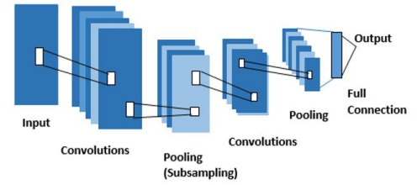
A Brief about CNN
Convolutional Neural Network(CNN or ConvNet)is a class of deep neural networks which is mostly used to do image recognition, image classification, object detection, etc.
The advancements in Computer Vision with Deep Learning has been constructed and perfected with time, primarily over one particular algorithm — a Convolutional Neural Network.

Slide 8
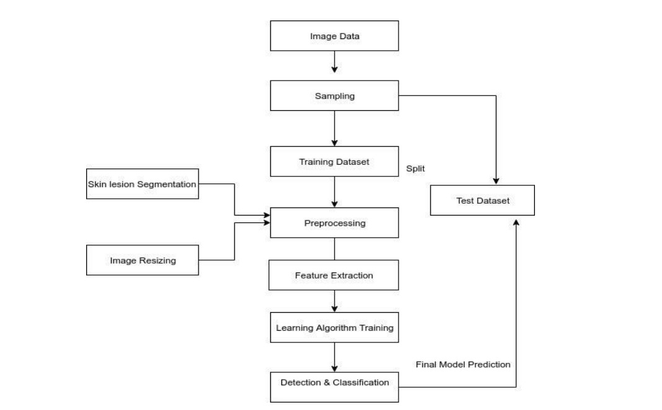
Flow chart of the system

Slide 9
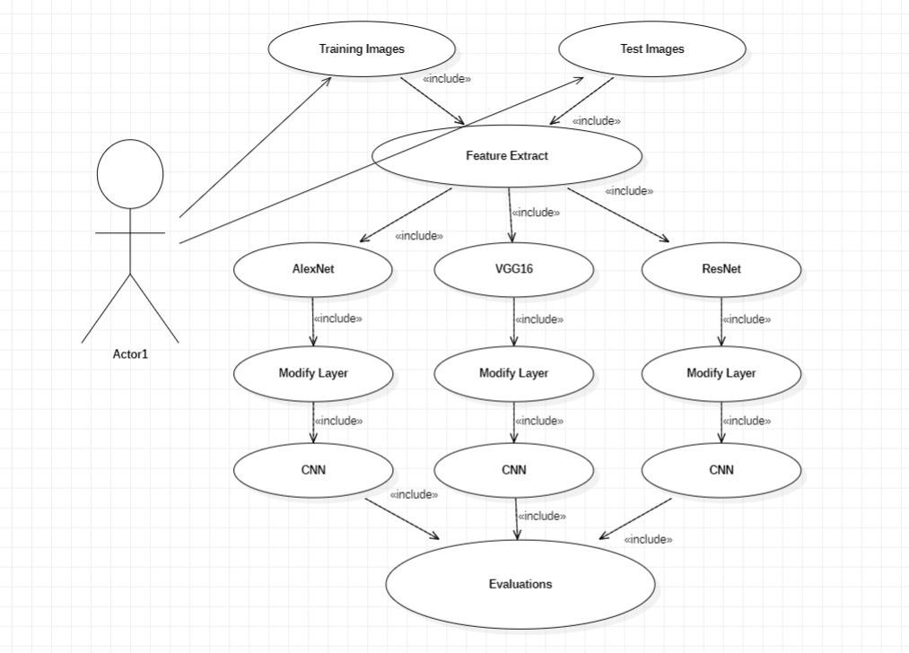
Use case Diagram

Slide 10
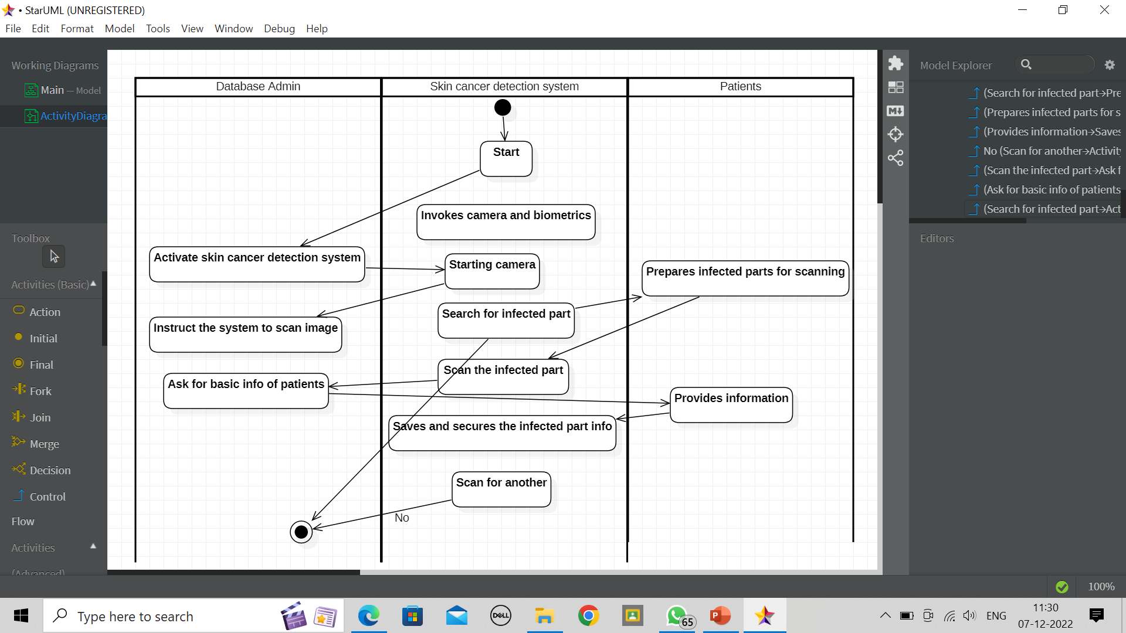
Activity Diagram

Slide 11
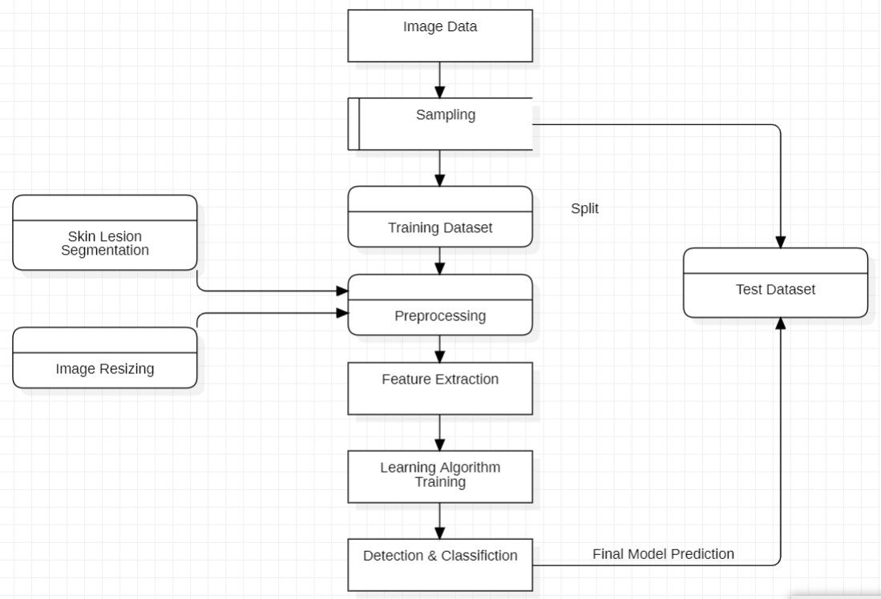
Dataflow Diagram

Slide 12
Literature Survey
Title: Skin Cancer Detection Using Convolutional Neural Network
Author: Mahamudul Hasan, Surajit Das Barman, Samia Islam, Ahmed Wasif Reza
Link: ResearchGate Survey
Points:
a) If the iterations are increased, the accuracy is also increased. But, after 80 iterations, the accuracy is decreased because the added neurons are contributed to the system negatively.

Slide 13
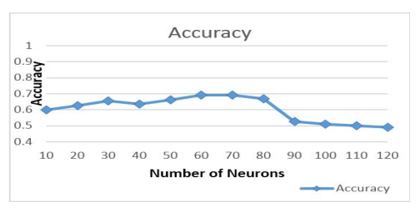
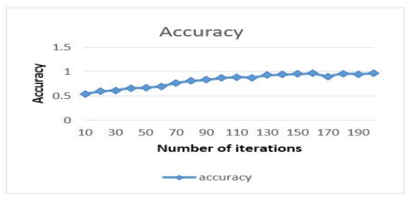
b) Loss vs iteration has been shown in figure 8. The loss is reduced with the increase of iteration

Slide 14
References
1. Geoffrey E. Hinton Alex Krizhevsky, Ilya Sutskever. 2012. ImageNet Classification with Deep Convolutional Neural Networks. Neural Information Processing Systems (2012).
2. Spencer Shawna Bram Hannah J, Frauendorfer Megan and Hartos Jessica L. 2017. Does the Prevalence of Skin Cancer Differ by Metropolitan Status for Males and Females in the United States? Journal of Preventive Medicine 3, 3:9 (2017), 1–6. https://doi.org/10.21767/2572-5483.100019.
3. Koby Crammer and Yoram Singer. 2005. Online ranking by projecting. Neural Computation 17, 1 (2005), 145–175.

Slide 15
Thank You!

