Slide 1

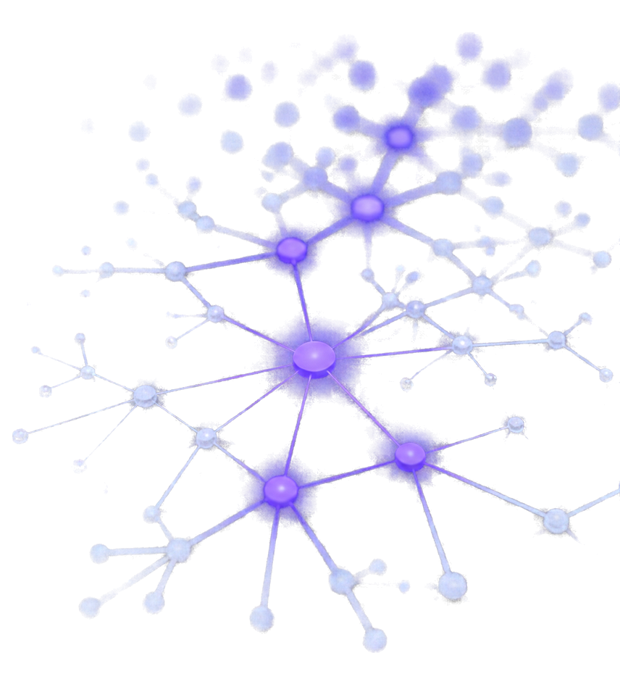
MORPHE
Memory-Oriented Reconfigurable Plasticity and Hierarchical Evolution
Memory that adapts its structure as retrieval needs evolve.
MORPHE is an adaptive memory system that organizes AI agent memories into a graph and experimentally evaluates structural changes to retrieval.
Team AlphaQ
Nitesh Tanawade | Pranav Tanawade | Pratham Shid
PS
3

Slide 2











Storing information is not enough
As memory grows, fixed structures struggle to deliver what exists.
AI systems accumulate knowledge across projects, preferences, conversations, and documentation. When memory structures stay fixed, retrieval becomes inefficient and valuable information is missed.
1
2
3
Missed relevant memories
4
Growing memory
Overloaded modules
Inefficient retrieval
Knowledge accumulates across sources and topics.
Fixed structures become crowded and inefficient.
The right information exists but isn't retrieved.
Queries are routed poorly, wasting time and resources.
WHO IS AFFECTED
EVIDENCE FROM MORPHE EXPERIMENTS*
AI assistants with long-term memory
1
2
3
Agentic applications with growing knowledge bases
Fixed graph routing lowered nDCG@10 versus global dense retrieval by 0.094 on SciFact, 0.039 on NFCorpus and 0.010 on ArguAna (internal partition).
Graph routing cut the candidate pool by 77 to 89 percent, but this gave no quality or latency advantage.
On SciFact the fixed graph left 66 relevant documents in modules it never searched, across 64 test queries.
Retrieval-enhanced generation systems
Applications that repeatedly access information spread across topics
* Results of MORPHE's own BEIR experiments, not industry-wide statistics.
MORPHE | 2
PS 3

Slide 3

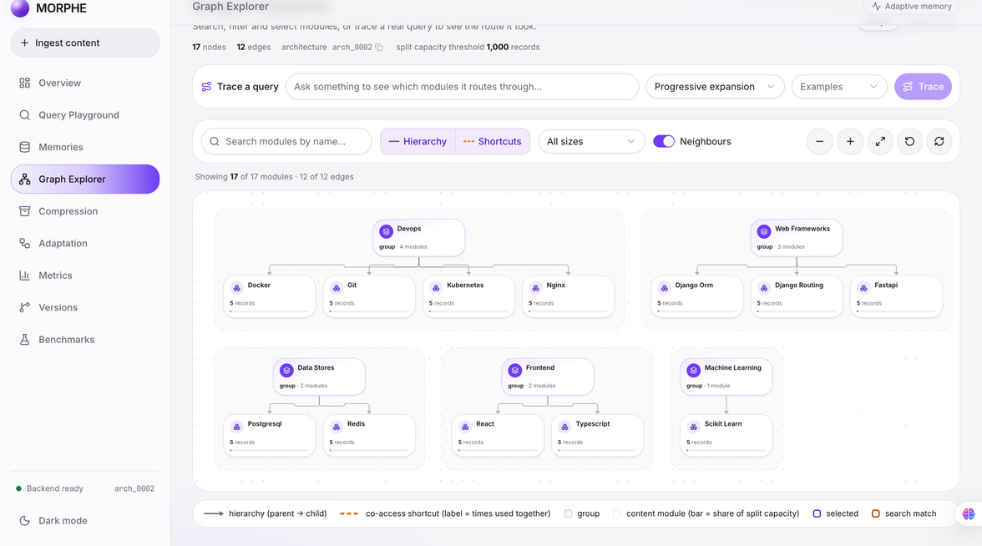
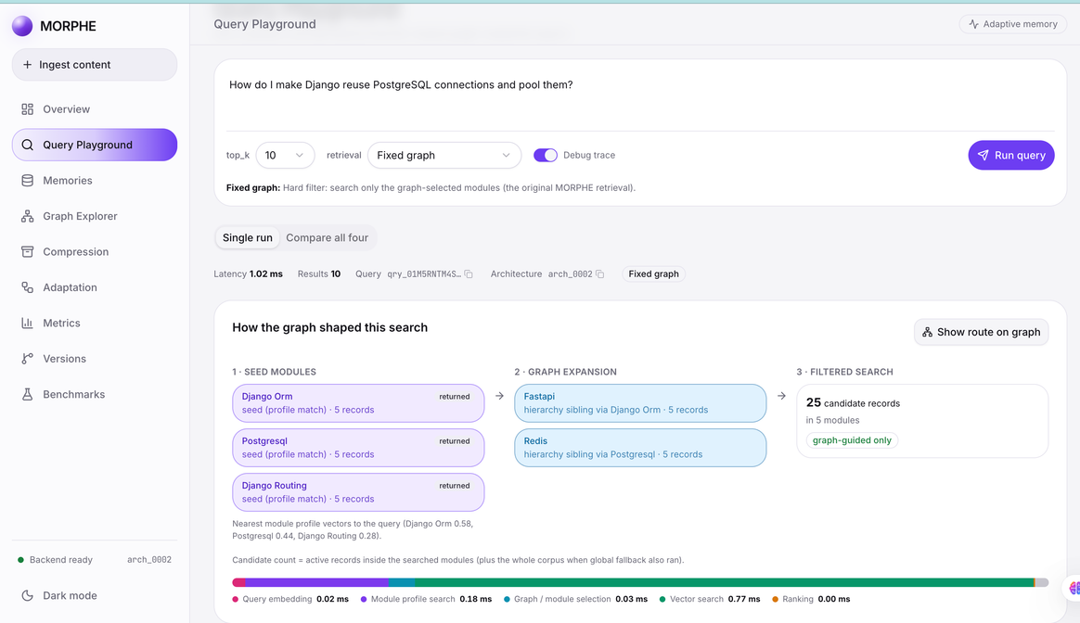
PROPOSED SOLUTION
Memory organization as a testable design decision
Graph-structured memory
Memories live in modules linked by a hierarchy and co-access edges.
Graph-guided retrieval
Four strategies compared: global, fixed graph, progressive, soft routing.
Adaptive restructuring
Graph Explorer: module graph laid out from the real hierarchy
Split, merge and shortcut changes are proposed from real usage.
Benchmark-validated changes
Candidates are evaluated in a sandbox before any commit.
Versioning and rollback
Checksummed architecture versions; any version can be restored.
Observable dashboard
Graph Explorer, Query Playground, Benchmarks and Versions pages.
Reproducible benchmarking
BEIR harness with paired statistics and frozen baselines.
Query Playground: fixed-graph retrieval trace on one query
MORPHE | 3
PS 3

Slide 4

Technical approach and system architecture
Four data flows across React, FastAPI, Qdrant, NetworkX and MongoDB
Ingestion
Upload memory
Embed text
Assign to module
Store vectors
Record metadata
React dashboard to FastAPI
all-MiniLM-L6-v2
NetworkX module hierarchy
Qdrant: memories + module profiles
MongoDB
Query
Ask a question
Embed query
Choose strategy
Route over graph
Search and rank
Query Playground
Same encoder
Global, fixed graph, progressive, soft
NetworkX picks candidate modules
Qdrant filtered or global search
Adaptation
Usage signals
Detect change
Validate
Commit or reject
Rollback ready
Query events and co-access in MongoDB
Split, merge or shortcut
Benchmark in a sandbox first
Checksummed architecture version
Restore any earlier version
Benchmarking
BEIR datasets
Run strategies
Paired statistics
Benchmarks page
Validation gate
SciFact, NFCorpus, ArguAna
BM25 + four dense strategies
Bootstrap CIs, frozen baselines
Results shown in the dashboard
Same harness checks adaptation
React
TypeScript
Vite
Tailwind CSS
shadcn/ui
React Flow
FastAPI
Pydantic
all-MiniLM-L6-v2
Qdrant
NetworkX
MongoDB
BEIR
MORPHE | 4
PS 3

Slide 5

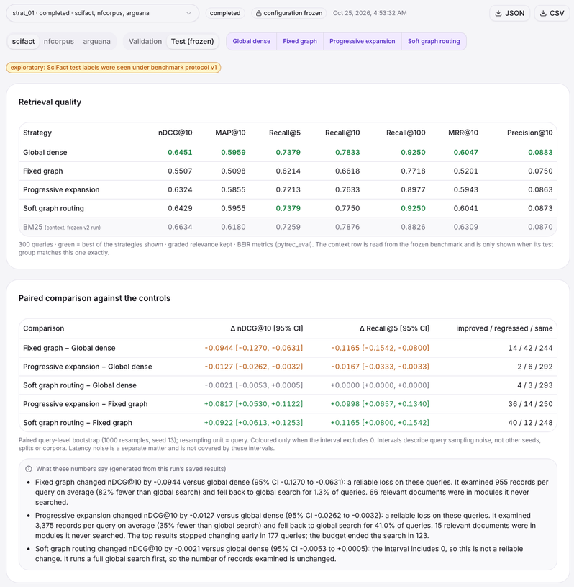
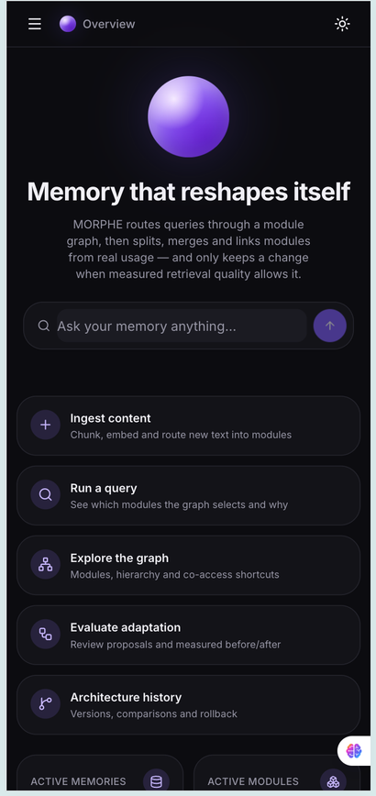







Prototype status, results and risks
nDCG@10 comparison (test split)
Global dense
Fixed graph
Progressive
Soft routing
SciFact
0.6451
0.5507
0.6324
0.6429
(exploratory)
NFCorpus
0.3159
0.2771
0.3143
0.3151
(confirmatory)
ArguAna
0.5088
0.4989
0.5081
0.5093
(internal partition, not an official score)
Key conclusion
Graph structure makes memory inspectable and safe to change, but graph-restricted retrieval did not beat global dense search. Fixed graph lowered nDCG@10 on all three datasets (-0.094 / -0.039 / -0.010); progressive and soft routing recover most of it, not more.
Risks and mitigations
Benchmarks > Retrieval strategies, saved run strat_01 (crop of the live app)
Overview, mobile layout
Routing misses (progressive expansion and soft routing evaluated)
Retrieval latency (graph and vector-store costs measured separately)
186
70
60
0
Uncertain adaptation gains (benchmark validation before any structural commit)
Data consistency (versioned state, integrity checks, recovery)
Backend
Frontend
End-to-end (Playwright)
Frozen baseline check
Limited evaluation scale (more datasets, seeds and hardware in future work)
passing tests
passing tests
passing tests
problems
MORPHE | 5
PS 3

Slide 6









Impact, future scope and references
EXPECTED IMPACT
SCALABILITY DIRECTIONS
ROADMAP
More adaptable memory organization for long-running agents
Better inspection of how memory relationships influence retrieval
Evidence-based decisions
about graph structure
Recoverable architecture changes
A reproducible framework for
comparing retrieval strategies
Larger datasets and longer
agent memory workloads
Multiple embedding models
Global dense versus hybrid versus
graph-guided retrieval on larger corpora
Better routing calibration
Find when graph relationships
really beat dense search
1
2
3
WORKING
PROTOTYPE
(DONE)
RESEARCH
VALIDATION
(NEXT)
FUTURE
SYSTEM
(EXPLORE)
Ingestion and retrieval
Interactive graph
Benchmark harness
Versioning and recovery
Improve routing policies
Evaluate merges and
shortcut edges on
controlled workloads
Repeated-seed experiments
Larger corpora
Workload-aware
memory organization
Efficient retrieval
at scale
Operational safeguards
if justified
REFERENCES
BEIR
Sentence Transformers
Qdrant
NetworkX
FastAPI
MORPHE Technical
github.com/beir-cellar/beir
sbert.net
qdrant.tech/documentation
networkx.org/documentation
fastapi.tiangolo.com
Project Specification v1.0
Thank You
MORPHE | 6
PS 3

