Slide 1
Local Business Review Analyzer
Ahmedabad & Bangalore: Sentiment & Rating Prediction
By: Pratham Sonpal
Github: https://github.com/PrathamSonpal/LocalBusinessReview
Streamlit: https://localbusinessreview.streamlit.app

Slide 2
1. Problem Statement
Context: Local businesses (Gyms, Salons, Restaurants) rely heavily on online reputation.
The Problem: Manual analysis of thousands of reviews is slow, biased, and inefficient.
The Gap: Businesses struggle to quantify 'sentiment' or predict ratings from text alone.
The Solution: An automated NLP pipeline to extract insights and predict scores instantly.

Slide 3
2. Dataset Overview
Target Cities: Ahmedabad & Bangalore
Total Volume: ~6,000 Reviews
Categories:
- Gyms (~2,000 rows)
- Salons (~2,000 rows)
- Restaurants (~2,000 rows)
Columns Collected: Business Name, Review Text, Rating (1-5), City, Category.

Slide 4
3. Data Cleaning Pipeline
Raw text data is noisy. We applied the following preprocessing steps:
1. Lowercasing: Standardization of text.
2. Noise Removal: Removing punctuation, URLs, and Emojis.
3. Stopword Removal: Removing common words (is, the, and).
4. Lemmatization: Converting words to root forms (e.g., 'running' -> 'run').
5. Normalization: ensuring ratings are on a standard 1-5 scale.

Slide 5
4. Sentiment Model (Classification)
Objective: Classify review as Positive, Neutral, or Negative.
Algorithm: Logistic Regression.
Feature Engineering: TF-IDF Vectorizer (20,000 features).
Performance: Achieved ~94% Accuracy on the test set.
Why Logistic Regression? It performs excellently on high-dimensional sparse text data.

Slide 6
5. Rating Model (Prediction)
Objective: Predict exact star rating (1 to 5) based on text.
Algorithm: Logistic Regression (One-vs-Rest for multi-class).
Feature Engineering: TF-IDF Vectorizer (25,000 features).
Performance: ~93-94% Accuracy.
Utility: Helps businesses spot discrepancy between what users say vs. what they rate.

Slide 7
6. Robustness & Fallback System
Challenge: Deployment environments (Streamlit Cloud) can sometimes mismatch library versions.
Solution: A Dual-Layer System.
Primary Layer: Custom Machine Learning Models (High Accuracy).
Secondary Layer (Fallback): VADER (Valence Aware Dictionary).
- If ML fails, VADER rules take over.
- Ensures the app NEVER crashes for the end-user.

Slide 8
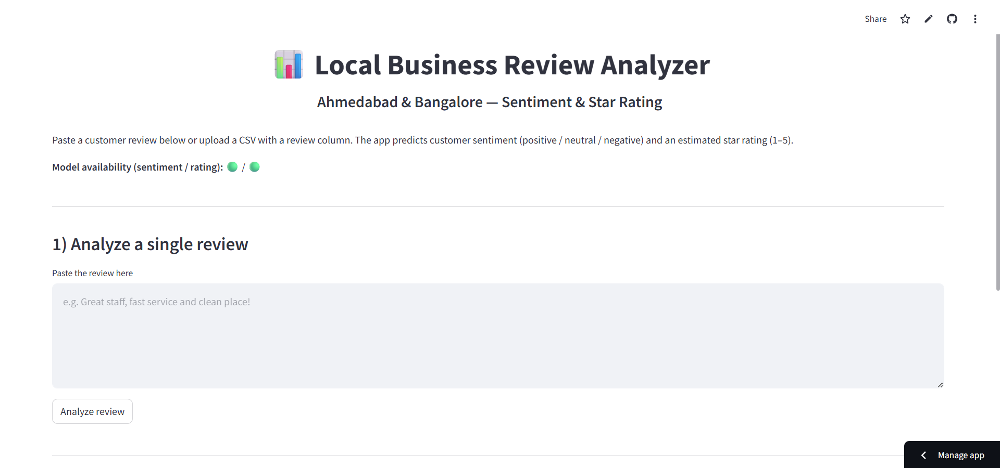
7. Streamlit App Interface

Slide 9
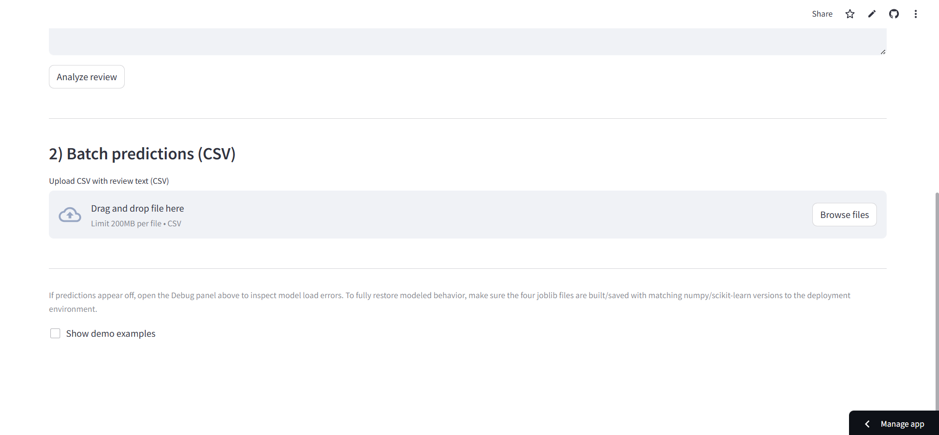
8. Batch CSV Processing

Slide 10
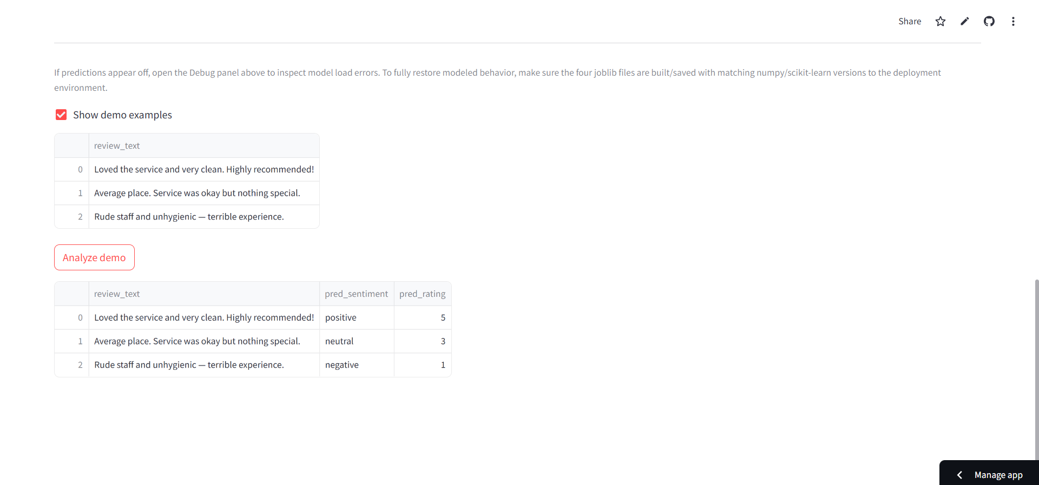
9. Live Prediction Results

Slide 11
10. Challenges & Future Scope
Challenges Faced:
- Handling code-mixed languages (Hindi-English mix).
- Detecting sarcasm in reviews.
Future Enhancements:
- Multilingual Support (Multilingual models).
- Aspect-Based Sentiment (grading 'Food' vs 'Service' separately).
- Deep Learning (BERT/Transformers) for higher nuance.

Slide 12
11. Conclusion
Summary:
- We successfully built an end-to-end NLP pipeline.
- Scraped 6k rows, cleaned data, and achieved 94% accuracy.
- Deployed a user-friendly Web App.
Deliverables:
- Full Source Code on GitHub.
- Live Dashboard for Stakeholders.
Github: https://github.com/PrathamSonpal/LocalBusinessReview
Streamlit: https://localbusinessreview.streamlit.app

Slide 13
Thank You

