Slide 1
LinkedIn Enrichment Extension
Team Members:
Pratham Thakkar
Abhinanda Chaudhury
Abhinav Bangar

Slide 2
Background & Problem Statement
Manual Data Entry is Inefficient Recruiters and HR teams currently spend hours manually copying candidate details (names, locations, experiences) from LinkedIn into their CRM systems. Platform Restrictions & Obfuscation LinkedIn actively discourages scraping by utilizing heavily obfuscated DOM structures (randomized class names) and strict rate limits, making traditional web scrapers obsolete. The Need for an Integrated Solution There is a pressing need for a tool that lives inside the browser to extract data dynamically while respecting platform limits, paired with a central database to manage that data.

Slide 3
Proposed Solution & Architecture
Two-Part Architecture Our solution bridges the gap between the browser and a central candidate database. 1. Chrome Extension (Frontend Data Extractor)
Injects directly into LinkedIn pages to read the active DOM, bypassing traditional network blocks. It securely packages data and sends it to our custom API.
2. Express/Node.js API (Backend Server)
A RESTful API that receives the extracted candidate JSON data, normalizes it, and securely stores it in our database for future management and viewing.

Slide 4
Implementation Progress: Frontend Engine
Structural DOM Parsing Algorithms We successfully engineered a scraper that ignores randomized class names. Instead, it uses structural landmarks (like profile anchor tags) to extract correct data reliably. Auto-Pagination System Implemented an automated script that clicks through search result pages, waits for dynamic content to load, and extracts candidates in bulk. Popup Interface Developed a clean extension popup that gives users real-time feedback on extraction progress and allows one-click bulk saving to the database.

Slide 5
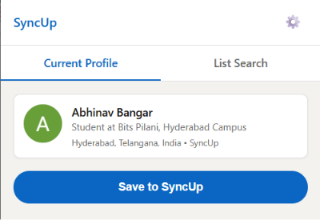
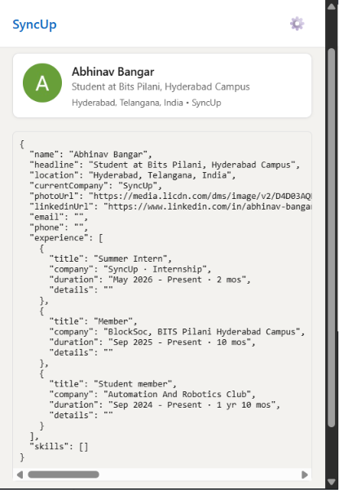
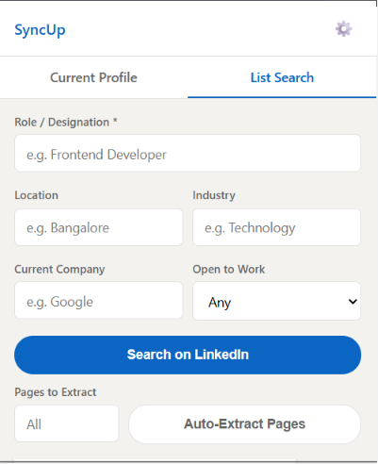
Extension UI

Slide 6
Implementation Progress: Backend API
REST API Infrastructure Built standard endpoints (GET, POST, DELETE) using Express.js to handle incoming candidate data securely with API Key authentication. Data Normalization & Storage Created logic to merge new extractions with existing database records to prevent duplicates and ensure data integrity. Web Dashboard Designed a responsive frontend dashboard connected to the API where users can view saved candidates in a table format and manage their pipeline.

Slide 7
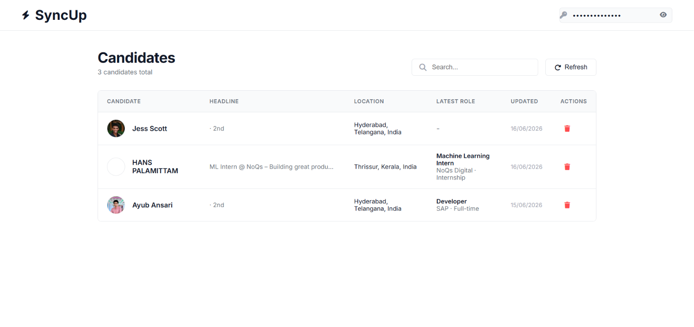
Dashboard UI

Slide 8
Next Steps & Future Scope
API-Based Data Enrichment Transitioning to a backend-driven model. Instead of relying purely on Chrome extraction (which risks bans at scale), the system will use third-party APIs (like Proxycurl) to fetch perfect data via URLs. Cloud Database Migration Moving the local JSON database to a scalable cloud solution such as MongoDB or PostgreSQL. Production Deployment Deploying the Node.js backend to a production environment (Vercel/AWS) so the extension can be distributed to end-users.

Slide 9
Thank You

