Slide 1
SOFTWARE ENGINEERING LAB · PROBLEM 16
SAC Hostel Management System
Group 16
Het(24JE0670) | Sireesha(24JE0671) | Prabir(24JE0672)
Pranjul(24JE0673) | Prathamesh(24JE0674)
Notes:
Introduce the team and the project. This is our SE lab project on Problem 16: we took the problem statement through requirements, UML design, implementation as a web app, and testing.

Slide 2
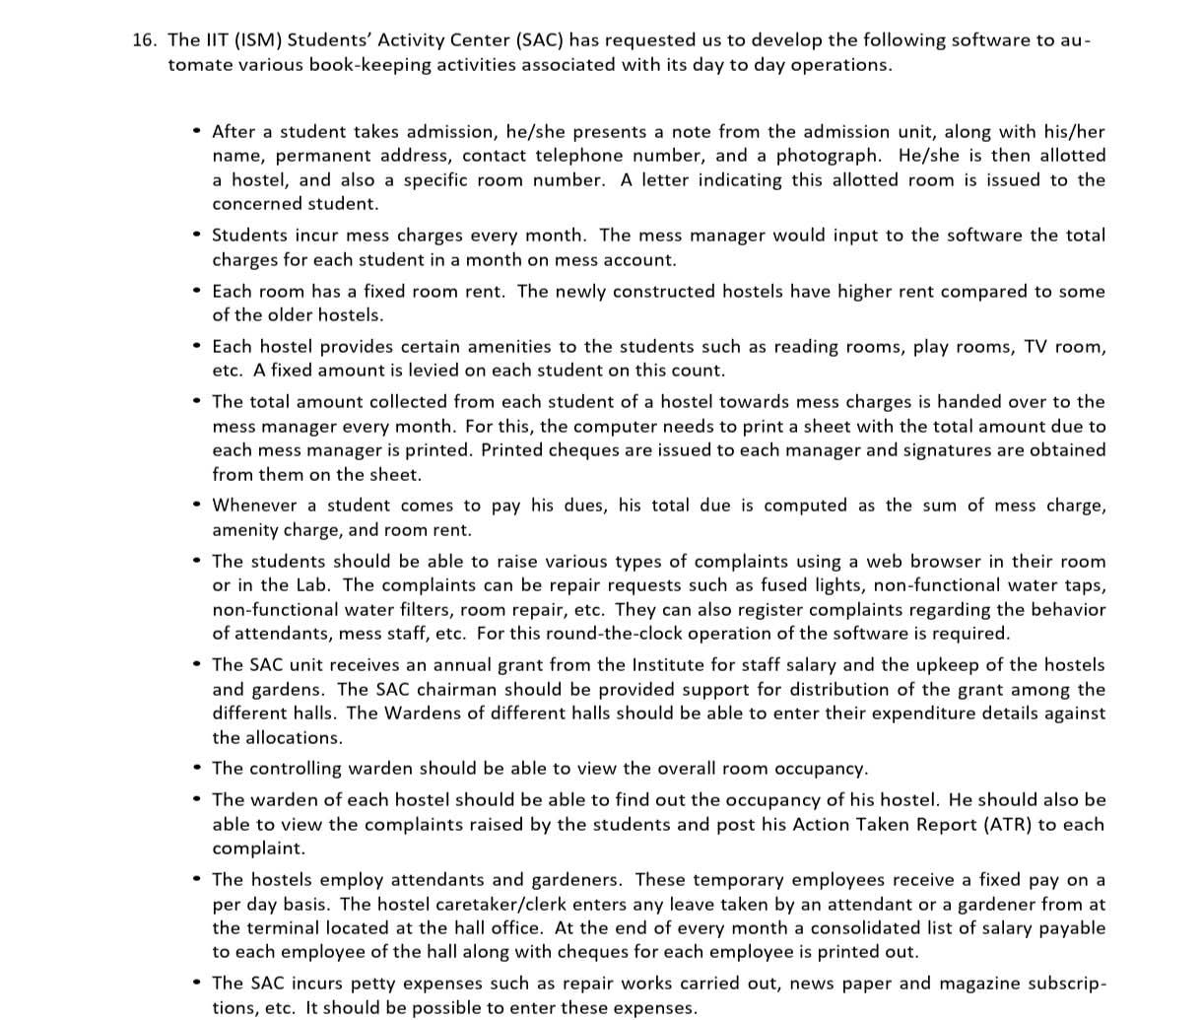
REQUIREMENTS
Problem statement: what the SAC asked for
In short, the software must handle
Admission: register the student, allot hostel and room, issue a letter
Monthly billing: mess charge + room rent + amenity charge
Mess managers: print a sheet of amounts due and issue cheques
Complaints: students raise them online; the warden posts an Action Taken Report (ATR)
Staff: attendants and gardeners paid per day, minus leave
Grants: chairman splits the annual grant among halls
Accounts: petty expenses and the annual statement for audit
Key constraint: "very secure to prevent frauds and financial irregularities"
2
Notes:
This is the problem statement we were given. Summarise it in plain words: the SAC does all hostel book-keeping by hand. We need software for admission, billing, complaints, staff salary, grants and accounts, and it must be secure against fraud.

Slide 3
APPROACH
How we built it: SDLC phases and tech stack
1
Requirements
Part | Technology | Why we used it
Backend | Python + FastAPI | Simple, fast; auto API docs at /docs
Database | PostgreSQL + SQLAlchemy | Reliable storage for money records; tables from the class diagram
Validation | Pydantic | Rejects bad input (wrong month, negative amount) automatically
Login | JWT + bcrypt | Secure login token; passwords stored hashed
Frontend | HTML + CSS + JavaScript (Jinja2) | No framework needed; printable pages
Testing | pytest | Easy to write and run API tests
Config | .env file | Passwords and secrets kept out of the code
Read the problem, list actors and features
2
Analysis
Use case, activity diagram, DFD
3
Design
Class, sequence, state diagrams; DB tables
4
Implementation
Backend API + web pages
5
Testing
Automated pytest cases + manual checks
6
Deployment
Run locally with PostgreSQL
3
Notes:
We followed the classic waterfall phases, going back a step when testing found a gap. The right side is the tech stack: FastAPI for the backend, PostgreSQL for data, JWT for login, plain HTML/JS for the website, and pytest for testing.

Slide 4
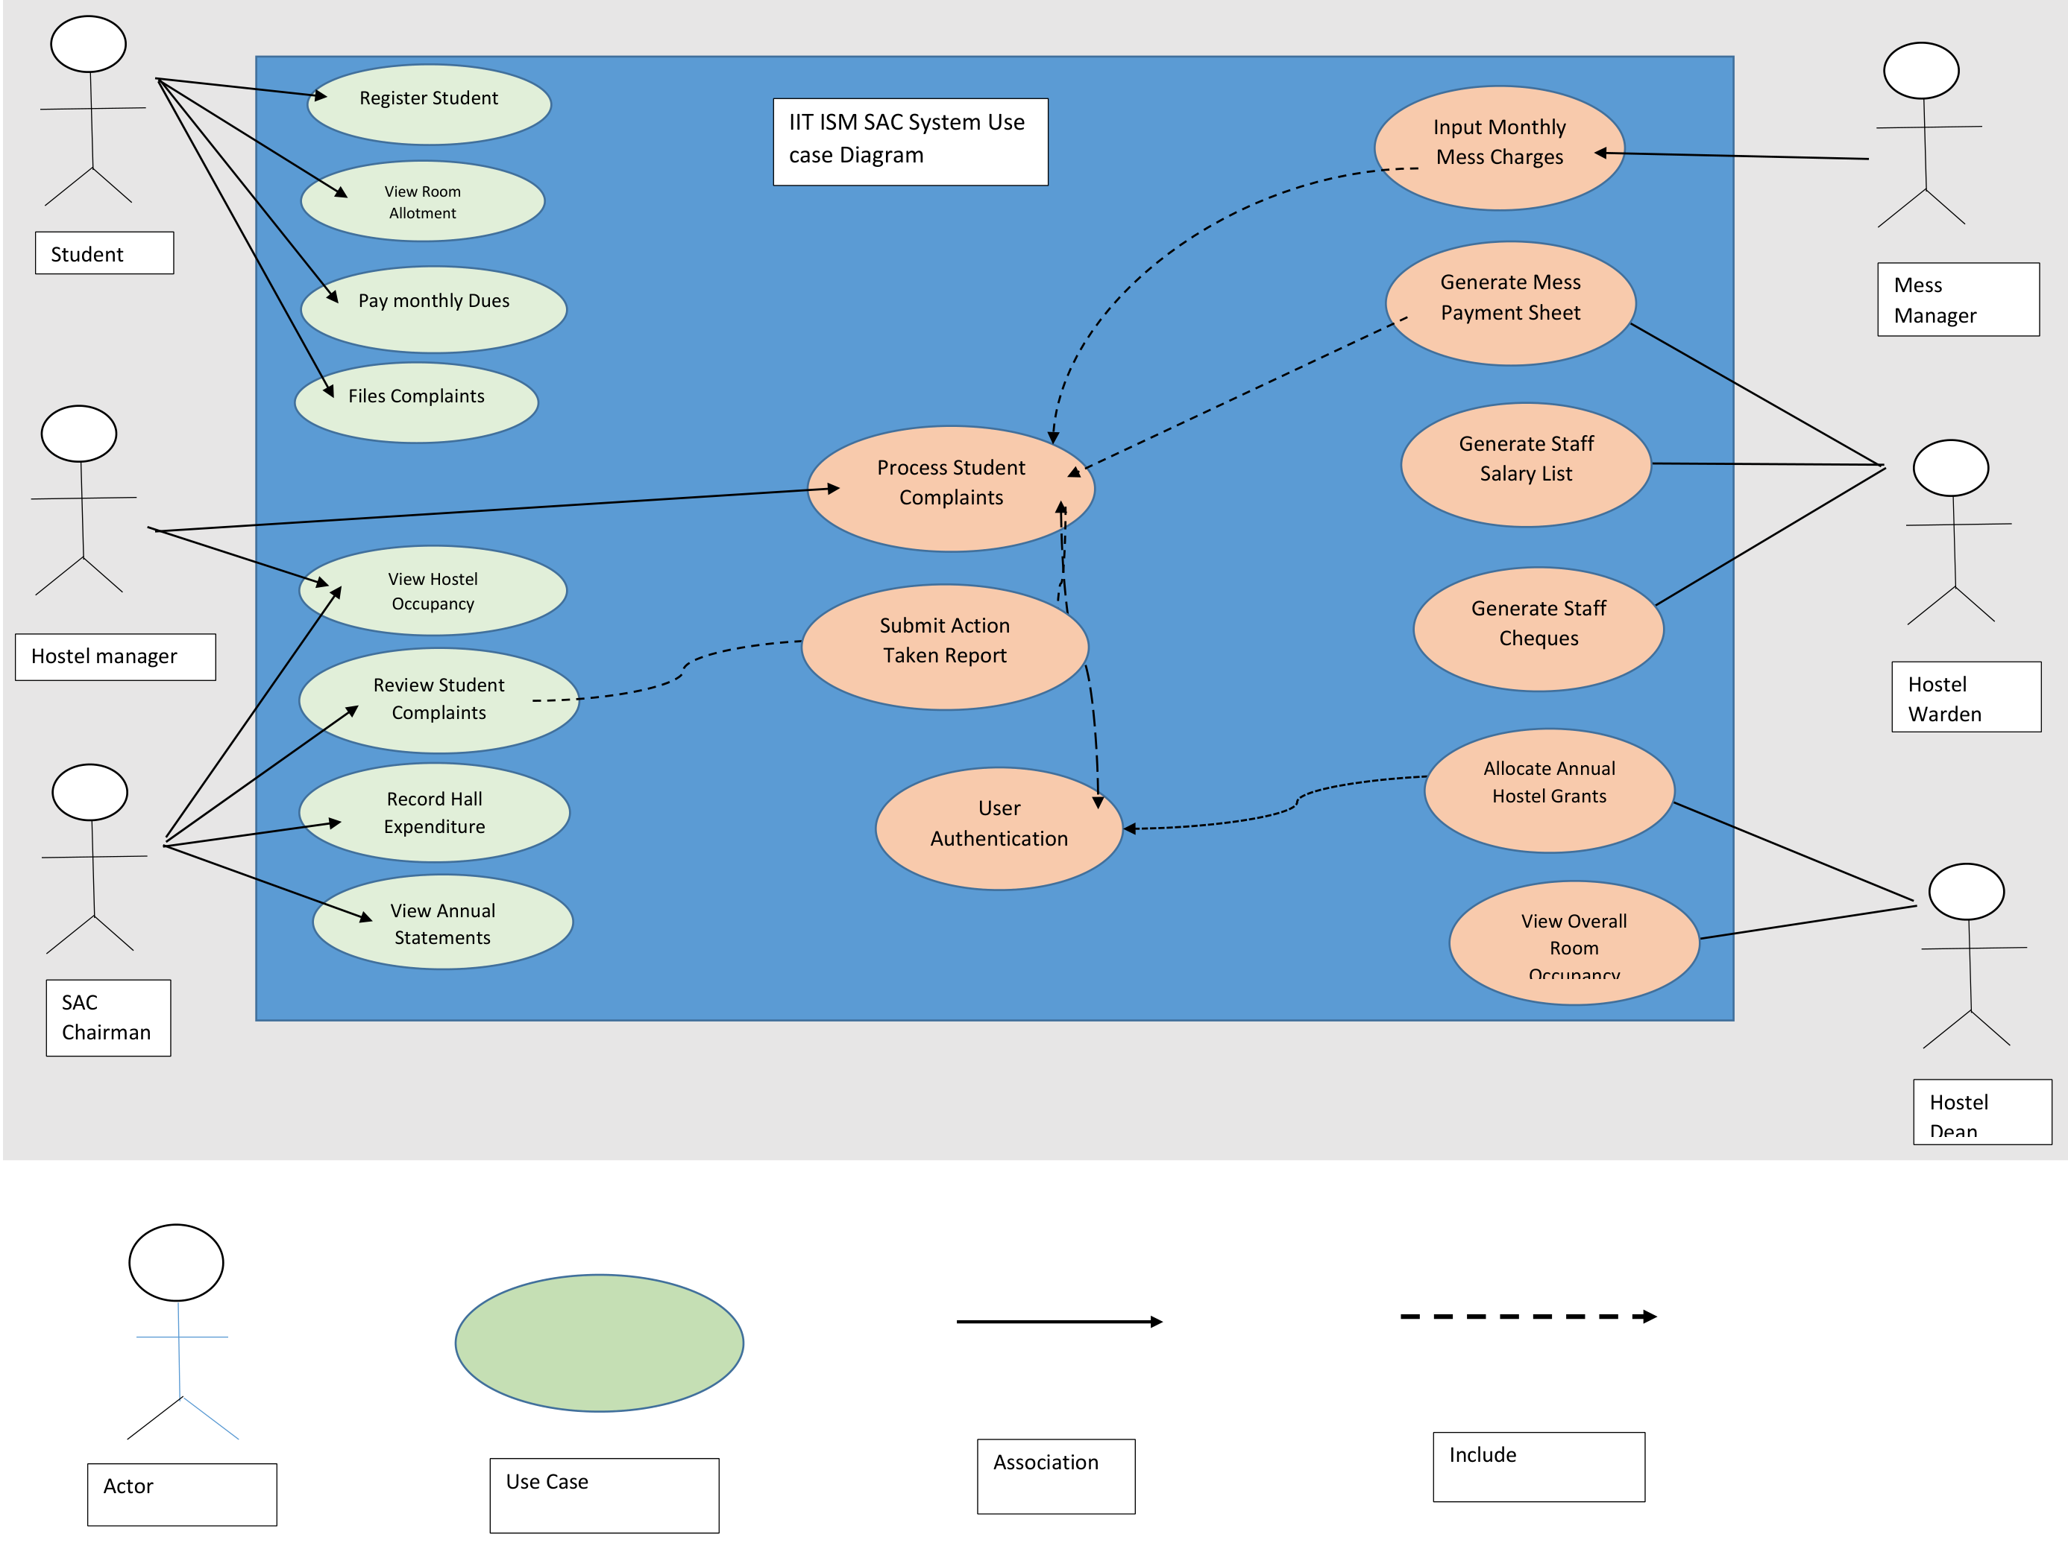
ANALYSIS · UML
Use case diagram
What it shows
Actors: Student, Hostel manager (clerk), SAC Chairman on the left; Mess Manager, Hostel Warden, Hostel Dean on the right
Student: register, view room allotment, pay monthly dues, file complaints
Mess Manager: input monthly mess charges
Warden: mess payment sheet, staff salary list and cheques
Dean / Chairman: allocate grants, overall occupancy, annual statements
<<include>>: every use case includes User Authentication
In the website, each actor became a login role, and each use case became a page or menu item.
4
Notes:
Explain actors first, then the use cases linked to each actor. Point out the dashed include arrows to User Authentication: that is why every page needs a login in our website.

Slide 5
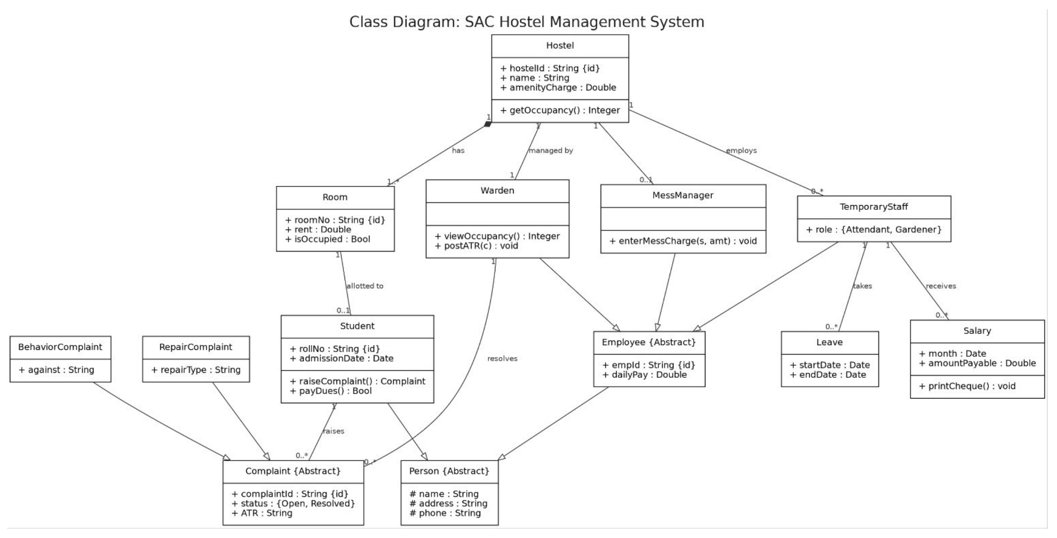
DESIGN · UML
Class diagram
Main classes and relations
Hostel has many Rooms (composition), is managed by a Warden, employs TemporaryStaff
Room is allotted to 0 or 1 Student
Student raises Complaints; Student, Warden and staff inherit from Person
Complaint is abstract, with two types: RepairComplaint and BehaviorComplaint
TemporaryStaff (attendant or gardener) takes Leave and receives Salary
Methods such as getOccupancy() and printCheque() became backend functions
Each class became a database table; extra tables were added for billing, grants and payments.
5
Notes:
Walk through the relationships. Each class became a database table in our code. Complaint subtypes are stored in one table with a type column.

Slide 6
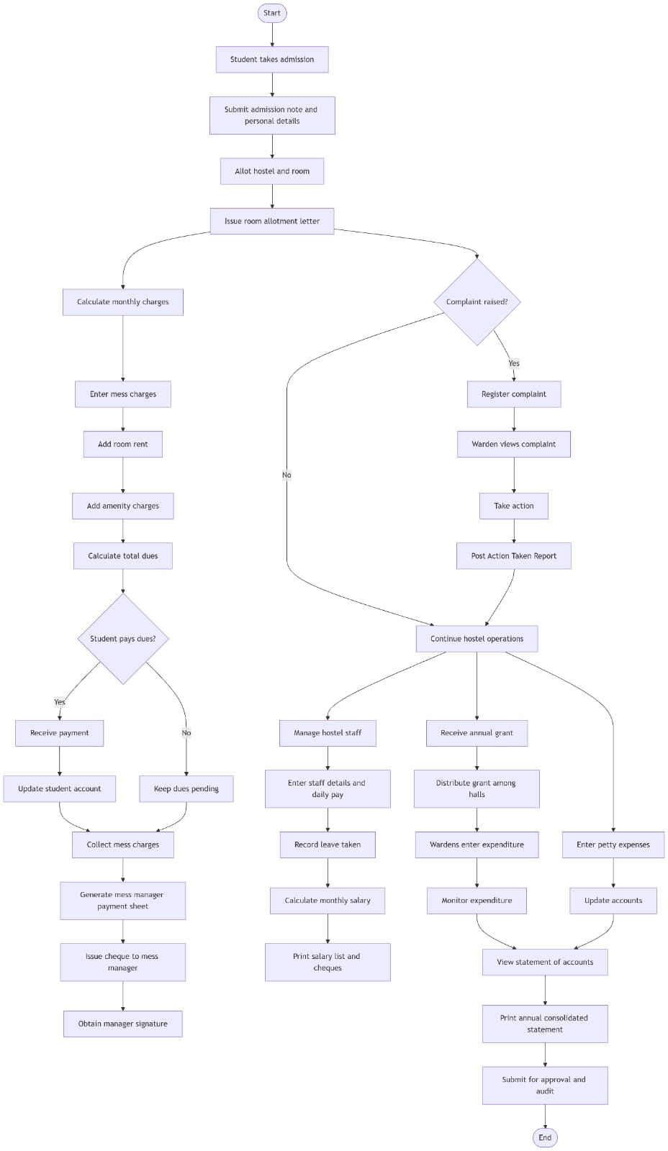
ANALYSIS · UML
Activity diagram
The flow of work through a year
1. Admission: student takes admission, submits details, gets a hostel and room, and receives the allotment letter
2. Monthly billing (left): enter mess charges, add rent and amenity, calculate total dues. Student pays? Yes: update account. No: keep dues pending. Then collect mess charges and issue a cheque to the mess manager
3. Complaints (decision): if a complaint is raised, it is registered, the warden views it, takes action and posts an ATR
4. Parallel work: manage staff and salary, receive and distribute the annual grant, enter petty expenses
5. End: view the statement of accounts, print the annual statement, submit for audit
Diamonds are decisions. Our website follows the same flow: each box is a form or button for the matching role.
6
Notes:
Read the diagram top to bottom. The two diamonds are decisions: complaint raised, and student pays dues. The branches join again at the statement of accounts.

Slide 7
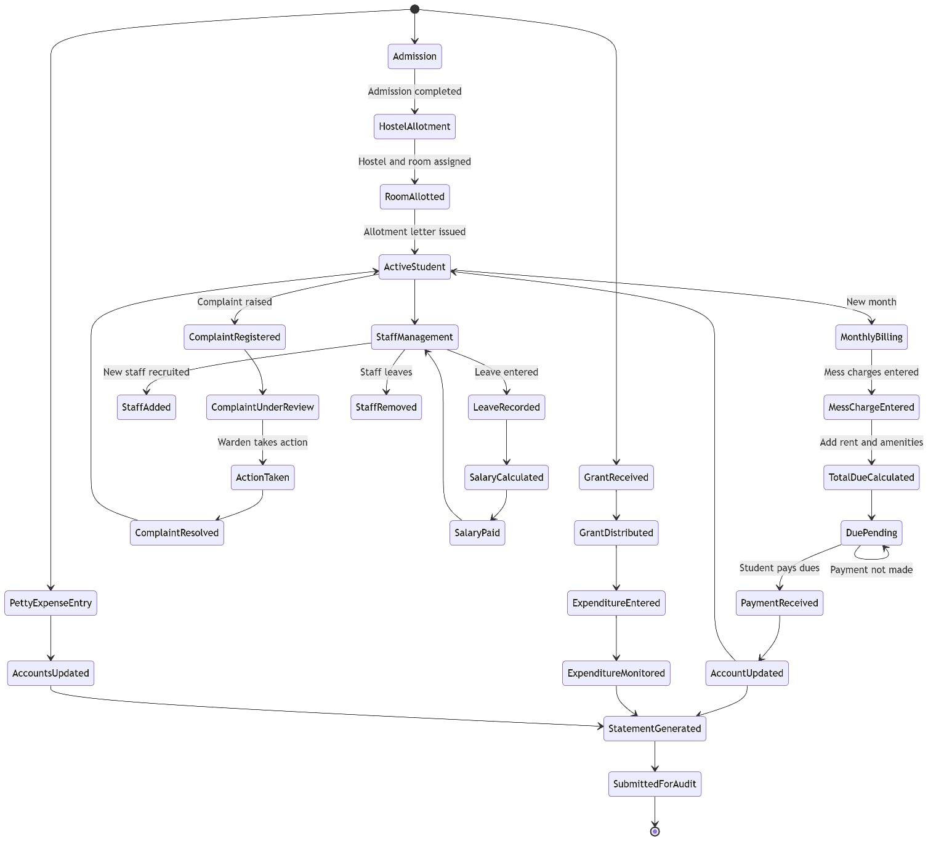
DESIGN · UML
State diagram
States of a student and the system
Admission → HostelAllotment → RoomAllotted → ActiveStudent
Complaint: Registered → UnderReview → ActionTaken → Resolved, then back to ActiveStudent
Billing: MonthlyBilling → MessChargeEntered → TotalDueCalculated → DuePending; loops on "payment not made" until PaymentReceived
Staff: StaffAdded / StaffRemoved / LeaveRecorded → SalaryCalculated → SalaryPaid
Accounts: Grant, expenditure and petty-expense states lead to StatementGenerated → SubmittedForAudit
Our code enforces these: paying twice is rejected, and a complaint is resolved only through the warden's ATR.
7
Notes:
Explain that each state change is enforced by the server. For example, dues cannot go from pending to paid twice, and a complaint only becomes resolved when the warden posts an ATR.

Slide 8
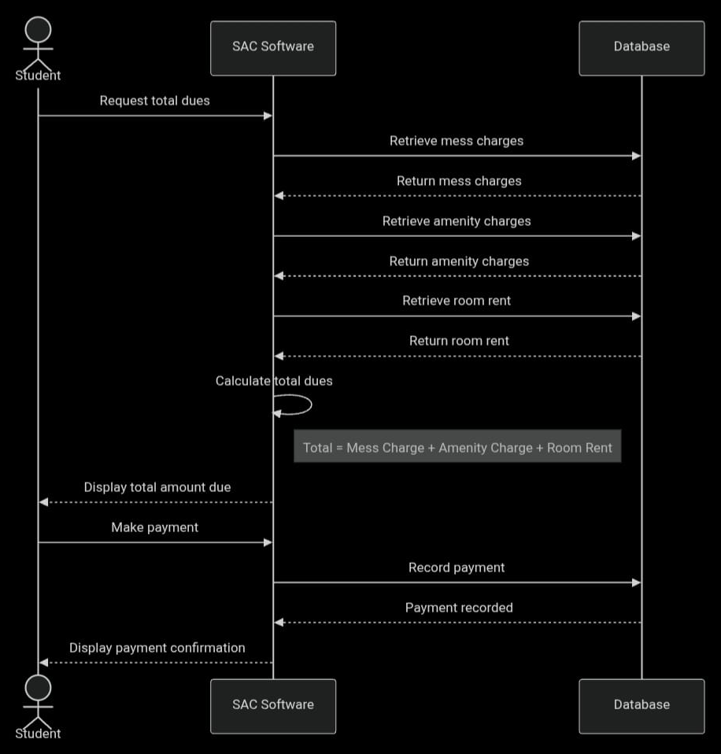
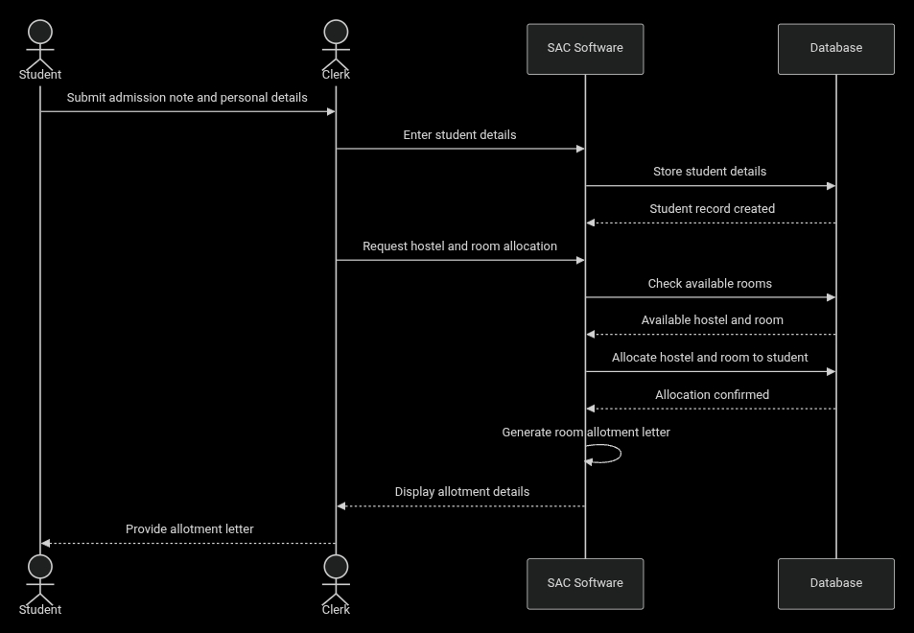
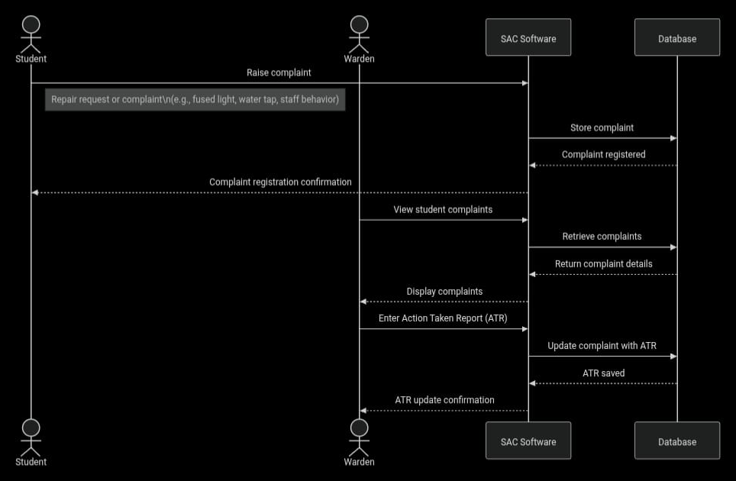
DESIGN · UML
Sequence diagrams: three key interactions
1. Student admission
2. Complaint and ATR
3. Dues payment
Student gives details to the clerk → clerk enters them → software stores the student, checks free rooms, allocates one → generates the allotment letter
Student raises a complaint → stored, confirmation sent → warden views complaints → enters an ATR → complaint updated
Student requests dues → software fetches mess, amenity and rent → calculates the total → student pays → payment recorded
8
Notes:
Each sequence diagram shows the order of messages between the user, our software and the database. They directly shaped our API: for example, in the dues diagram the software calculates the total itself, so the payment API never accepts an amount from the user.

Slide 9
ANALYSIS
Data flow diagram (level 0)
→ details, complaints, payment
Red arrows: data into the system · Teal arrows: information out of the system
→ ATR, expenditure
← letter, dues, ATR status
← complaints, statement
Student
Warden
SAC Hostel
Management
System
Clerk
Dean
→ admission, staff, leave
→ occupancy request
← rooms, salary list
← overall occupancy
→ monthly mess charges
→ grant, allocations
← mess cheque
← mess sheet, accounts
Mess Manager
SAC Chairman
9
Notes:
The context-level DFD shows the whole system as one process and the data that each user sends in and gets back. It helped us decide what each role's API endpoints must accept and return.

Slide 10
IMPLEMENTATION
How the website implements the features
Website
Feature | Who | API endpoint
Admission + room allotment | Clerk | POST /api/students
Allotment letter | Student, Clerk | GET /api/students/{roll}/allotment-letter
Enter mess charges | Mess Manager | POST /api/mess-charges
View and pay dues | Student | GET /api/dues, POST /api/payments
Mess manager sheet + cheque | Chairman | GET /api/mess-sheet
Raise complaint / post ATR | Student / Warden | POST /api/complaints, /{id}/atr
Staff, leave, salary | Clerk | /api/staff, /api/leaves, /api/salaries
Grant distribution | Chairman | POST /api/grants/allocations
Occupancy | Warden, Dean | GET /api/occupancy
Statement of accounts | Warden | GET /api/statement
HTML pages + app.js (one menu per role)
API routers
FastAPI: login, role check, validation
Services
Business rules: dues, salary, statement
Database
SQLAlchemy models → PostgreSQL
Entry point: main.py · run: fastapi dev main.py
10
Notes:
The code follows the design in layers: the website calls the API, the API checks the login and role, the services apply business rules, and SQLAlchemy stores data in PostgreSQL. The table shows which API each feature uses.

Slide 11
IMPLEMENTATION
Business rules and security
Business rules (checked on the server)
Security ("prevent fraud")
1
Total due = mess charge + amenity charge + room rent
Login: username + password gives a JWT token that expires after 60 minutes
Passwords: stored as bcrypt hashes, never as plain text
Roles: 6 roles (chairman, dean, warden, clerk, mess manager, student); each API allows only certain roles
Hostel scope: a warden, clerk or mess manager can only access their own hostel
No editing money records: payments, cheques and salaries cannot be deleted
Secrets (DB password, JWT key) live in the .env file, not in the code
2
The amount to pay is calculated by the server, never sent by the user
3
Dues for a month can be paid only once
4
One student per room; the first free room is allotted
5
Hall allocations cannot exceed the annual grant; spending cannot exceed the allocation
6
Salary = (days worked − leave days) × daily pay
11
Notes:
These are the rules from the problem statement that our server enforces. The most important is that the server calculates every amount, so a user cannot pay less by changing the request. Security uses JWT tokens and role checks: a warden can only see their own hostel.

Slide 12
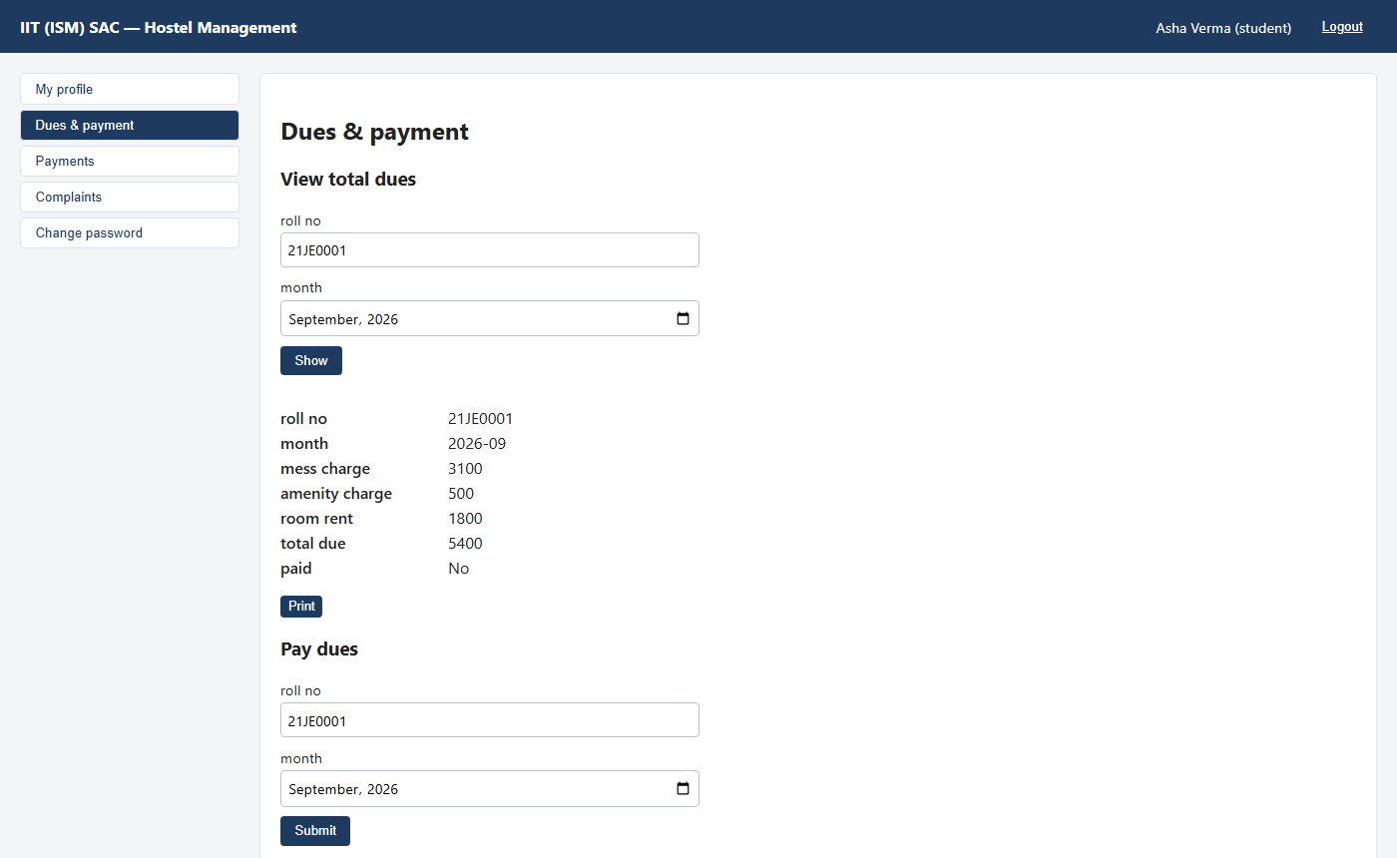
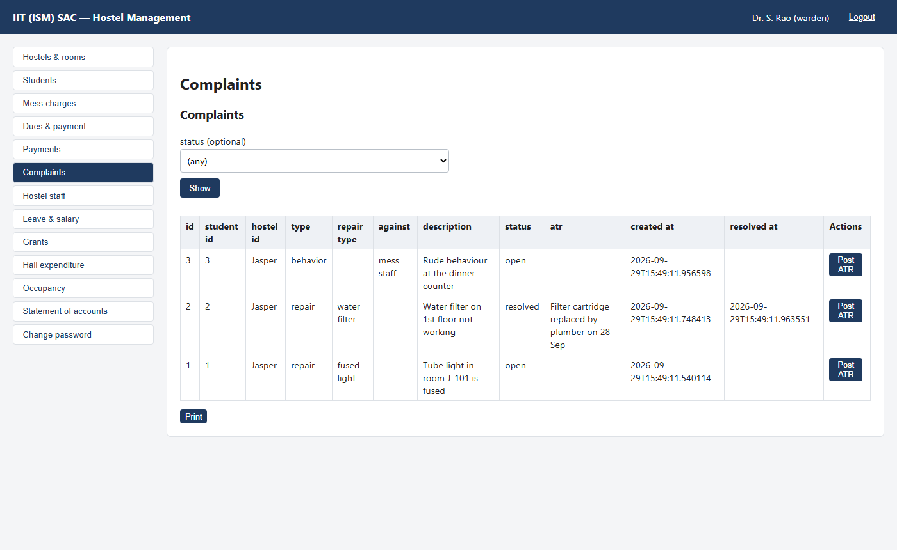
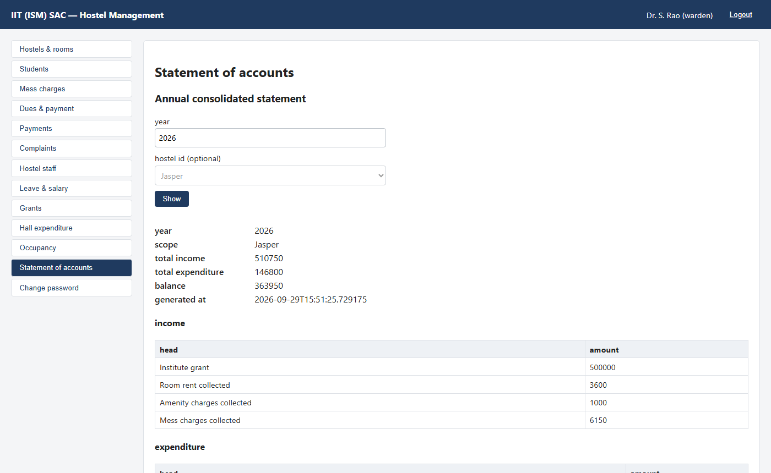
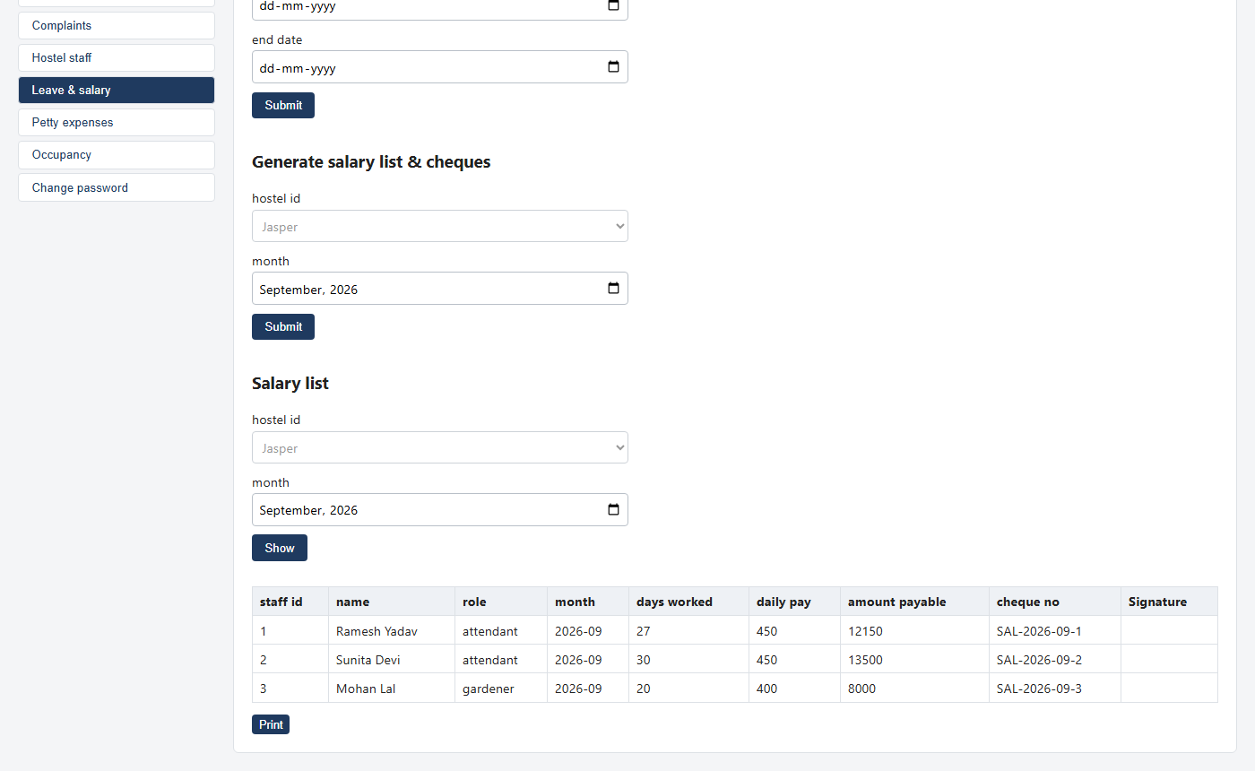
RESULT
Screenshots of the final website
Student: dues breakdown and payment
Warden: hostel complaints with the Post ATR button
Warden: annual statement of accounts (printable)
Clerk: salary list and cheques, leave deducted
12
Notes:
Screenshots of the running website with sample data. Top left: a student sees the dues breakdown. Top right: the warden sees complaints and can post an ATR. Bottom left: the annual statement of accounts. Bottom right: the salary list with leave deducted and a cheque number per employee. You can replace these with screenshots from your own run.

Slide 13
TESTING
Testing: approach and important test cases
pytest + TestClient
Fresh test database
No PostgreSQL needed
calls the real API like a browser would
sample hostels, users and a student for each test
tests use a temporary SQLite file
# | Test case | Input / action | Expected result
1 | Dues calculation | Mess 3000, amenity 500, rent 1500 | Total due = 5000
2 | Double payment | Student pays September twice | Second attempt rejected (409)
3 | Fake amount | Student sends total = 1 with the payment | Ignored; server charges 5000
4 | Room allotment | Admit a student when the hostel is full | Rejected: no vacant room (409)
5 | Salary with leave | Leave 30 Aug – 2 Sep, salary for September | Only 2 days deducted
6 | Complaint ATR | Warden of another hostel posts an ATR | Forbidden (403)
7 | Grant limit | Allocate more than the remaining grant | Rejected (400)
8 | Login security | Expired or fake JWT token | Unauthorised (401)
13
Notes:
We tested with pytest. Each test starts with a fresh sample database: two hostels, rooms, staff accounts and one student, so tests do not affect each other. These are the most important cases; each one checks a rule from the problem statement.

Slide 14
TESTING
How the tests are implemented and run
Test 3: the server ignores a fake amount (tests/test_billing.py)
Test 5: leave across two months (tests/test_staff.py)
def test_payment_ignores_client_supplied_amount(world):
ok(charge(world), 201) # mess manager enters 3000
res = world.client.post("/api/payments",
json={"roll_no": "21JE0001", "month": MONTH,
"total": 1}, # student tries to pay 1
headers=world.student)
# server ignores "total": 3000 + 500 + 1500
assert ok(res, 201)["total"] == 5000
def test_salary_deducts_leave_including_leave_spanning_months(world):
sid = ok(recruit(world), 201)["id"] # Rs 400 per day
ok(leave(world, sid, "2026-08-30", "2026-09-02"), 201)
ok(leave(world, sid, "2026-09-15", "2026-09-15"), 201)
row = ok(salaries(world))[0] # September
# 30 days - (2 + 1) leave days = 27 days
assert row["days_worked"] == 27
assert row["amount_payable"] == 27 * 400
Run the tests
Result
cd project
pip install -r requirements.txt
pytest -v
All tests pass (about 25 seconds). The full list of test cases is in docs/TESTING.md, and the complete API reference is in docs/API.md.
14
Notes:
Here are two real tests from our project. The first checks that the server ignores an amount sent by the client. The second checks the salary calculation when leave spans two months. At the bottom is the command to run them and our result.

Slide 15
CONCLUSION
What we built and learned
Analysed
Designed
Built
Tested
Problem statement → actors, use cases, activity and data flow
Class, sequence and state diagrams → database tables and APIs
FastAPI + PostgreSQL website with login and 6 user roles
pytest cases for the key business rules and security
Thank you.
Notes:
Recap the four phases. If time allows, give a live demo: log in as a student, view dues, try paying twice, then log in as the warden and post an ATR.

